Slide 1



Changing the Conversation about Climate Change
A Review of the Place-Based CCEP Phase I Research
Jessica Thompson, PhD
Colorado State University
Notes:
1
1

Slide 2
In the next 50 minutes…
Place Based Climate Change Engagement Theoretical Framework
Summary of Place-based Climate Change Engagement Audience Research
Preview of our Phase II Proposal Activities

Slide 3
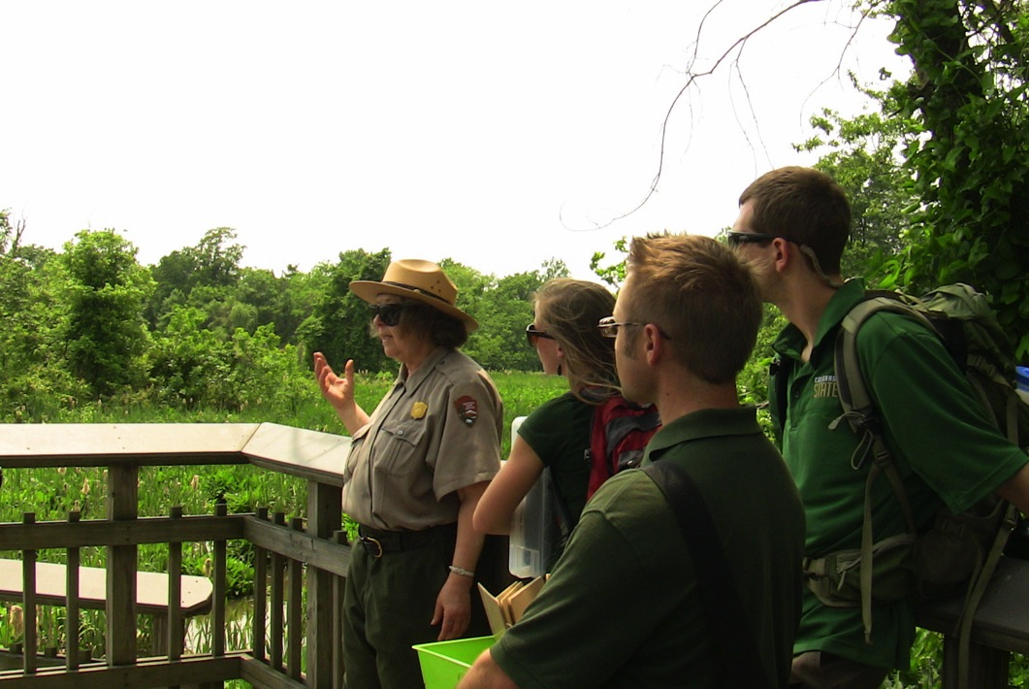
What is Place-based Engagement?
Meaningful dialogue situated in a specific location, where audiences interact with each other and the landscape to develop a deeper understanding about ecological and social interrelationships.
Notes:
3
3

Slide 4
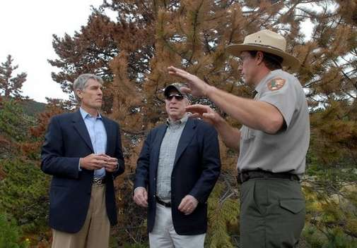
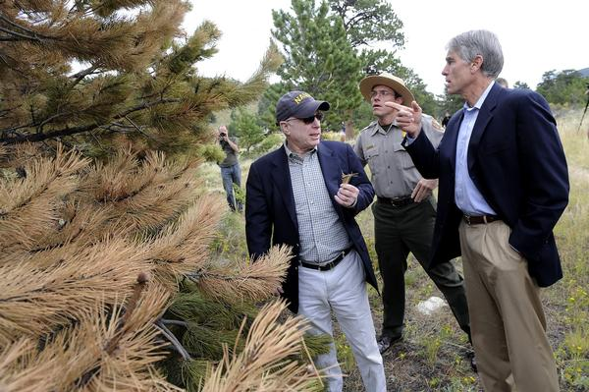
"Look, I believe climate change is real. Every visit we make, such as we are making here, argues that we need to take action... Every citizen in America should see what's happening here!”
Notes:
4
4

Slide 5
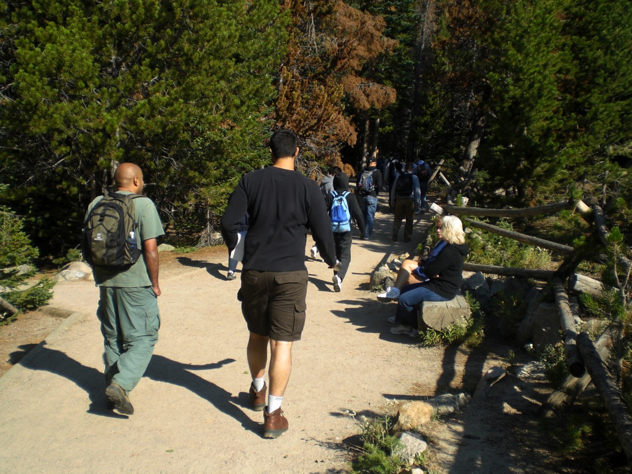

Slide 6
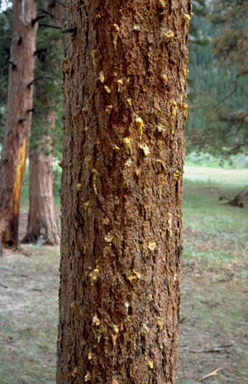
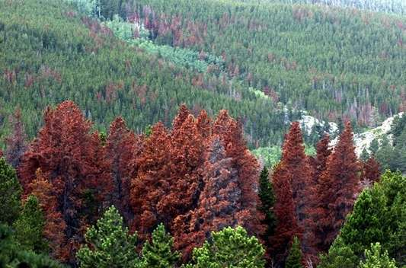

Slide 7
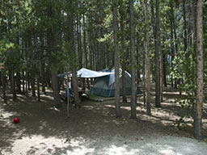
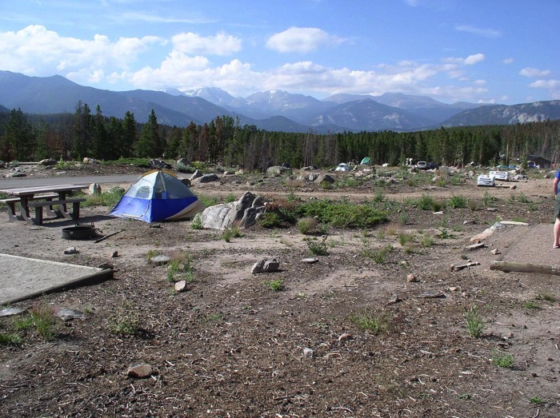
Glacier Basin Campground at
Rocky Mountain National Park

Slide 8
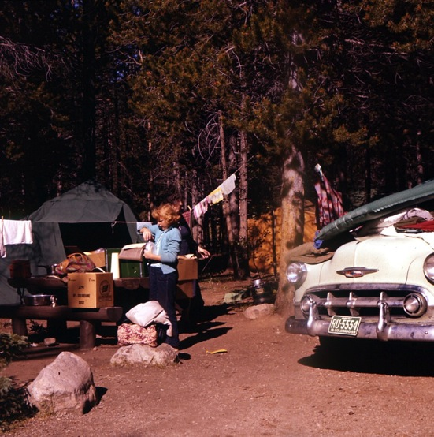
Glacier Basin Campground at
Rocky Mountain National Park

Slide 9
Place-based Climate Change Engagement
Theoretical Framework
Norm Activation Theory
Place Attachment
Place-based Learning
Free Choice Learning
Situated in
Place
Situated in Cultural Context
Empowers a Specific Action
So, how does this help the audience “get” climate change?

Slide 10
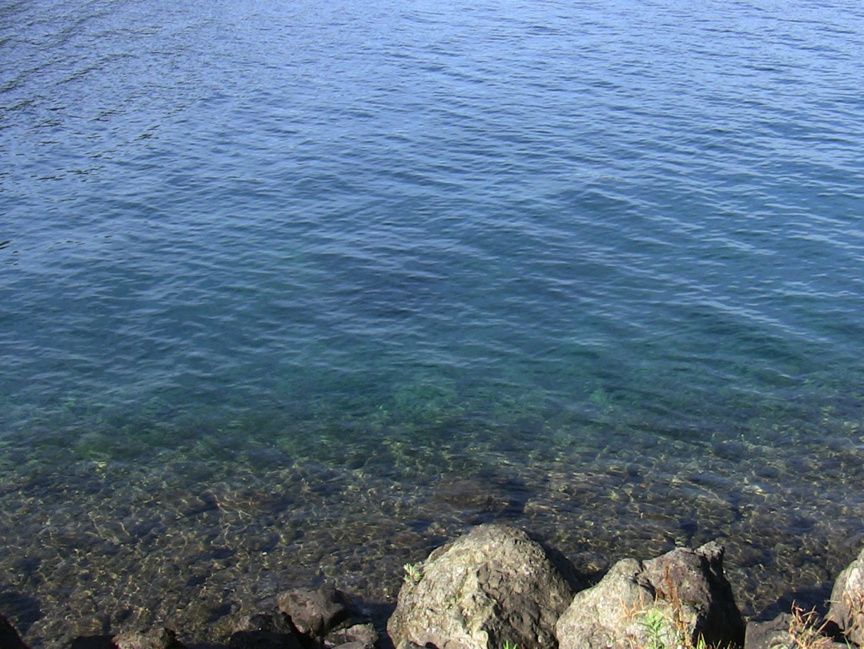
How does it help audiences understand climate change?
Audiences are connected to places; they have unique bonds with, and value specific landscapes/places.
Effectively learn through meaningful hands-on activities in that special place or on that landscape.
Remember lessons and adopt behaviors when they feel a sense of responsibility & have knowledge of consequences.
Thompson & Schweizer, 2009; Schweizer, Thompson & Davis, 2012
Notes:
10
10

Slide 11
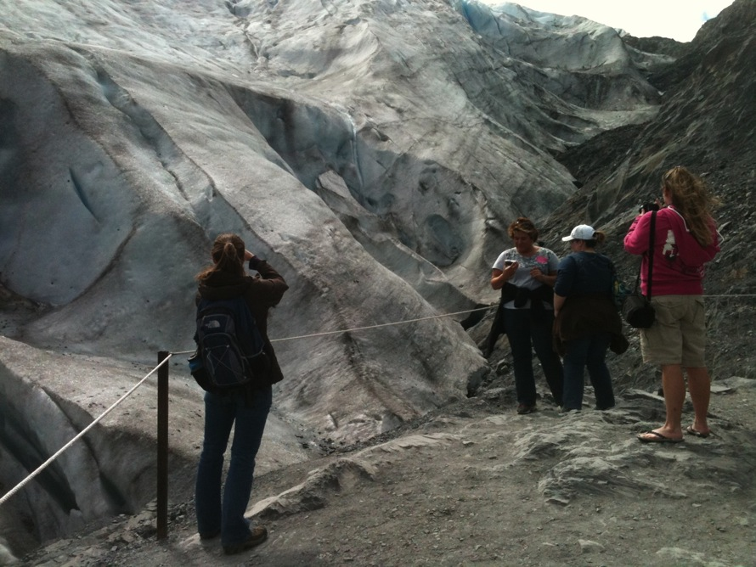
How can we change the climate change conversation through the lens of places we love?

Slide 12

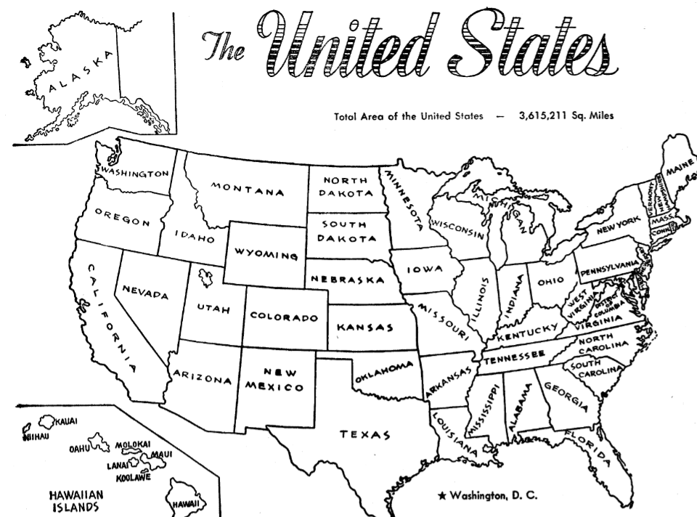















Pilot Sites/Areas
Partner Sites for Place-Based CCEP
Kenai Peninsula
Place-based Climate Change
Education Partnership
Puget Sound
Northern Colorado
D.C. Area
South
Florida & Keys

Slide 13
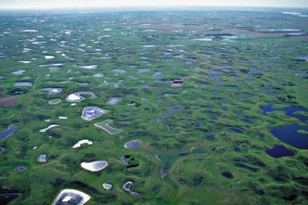
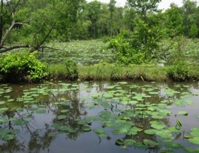
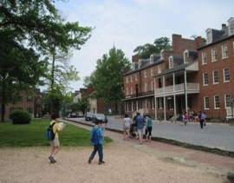
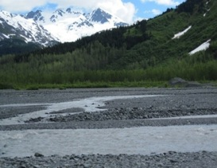
CCEP Sites
Project Objectives
  Identify issues & impacts to be communicated
  Discover current activities at each site
  Identify barriers & opportunities for collaborating and communicating about climate change
  Integrate ideas for place-based climate change education/engagement strategy

Slide 14
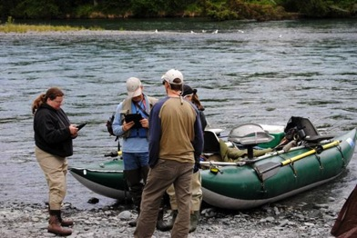
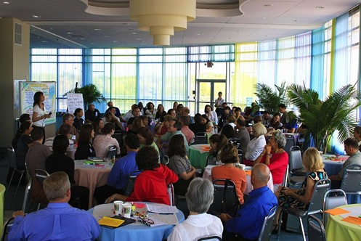
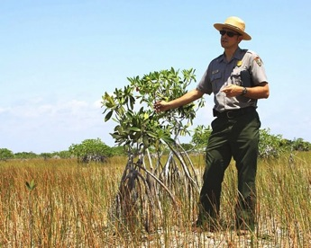
Project Activities
Survey of Agency Staff & Partners (n = 847)
16 Site Visits & Focus Groups with Site Partners (n = 80)
5 World Café Workshops & Questionnaires (394 participants)
Quantitative & Qualitative Visitor Data Collection (survey n = 4,181; interview n = 359)
Strategic Planning Workshop (46 participants)

Slide 15
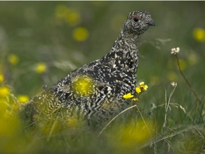
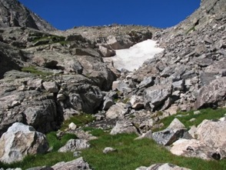
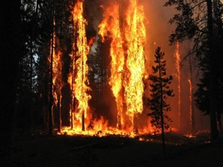
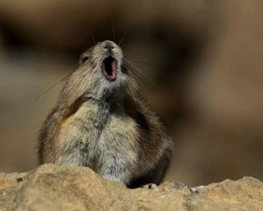
Preliminary Results
Issues & Impacts
272 of 303 workshop participants said effects can be seen now!
Northern Colorado (11% said 1-2 effects; 83% said several effects)
Changes in Precipitation & Temperature Patterns
Alpine & Subalpine species shifts (e.g., Pika, Ptarmigan)
Reduced Snowfields
Increase in Wildland Fires

Slide 16

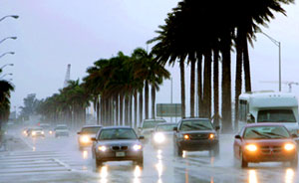
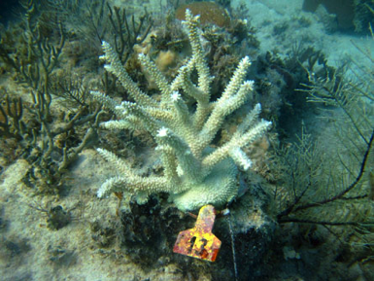
Preliminary Results
Issues & Impacts
272 of 303 workshop participants said effects can be seen now!
Southern Florida (23% said 1-2 effects; 68% said several effects)
Coral Bleaching
Sea Level Rise
Abnormal Weather Patterns & Storms
Increased Land & Water Temperatures

Slide 17
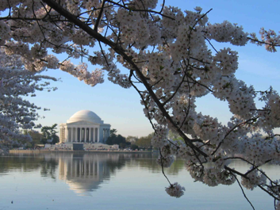
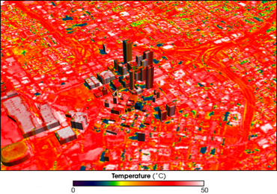
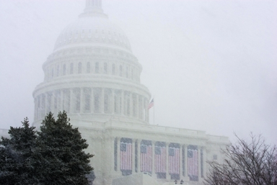
Preliminary Results
Issues & Impacts
272 of 303 workshop participants said effects can be seen now!
Washington DC (43% said 1-2 effects; 41% said several effects)
Sea Level Rise
Superheated Run-off
Changing Vegetation Patterns (e.g. cherry blossoms)
Urban Heat Island Effect
Erratic Weather & Storm Intensity

Slide 18
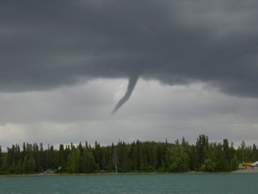
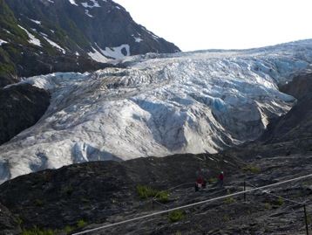
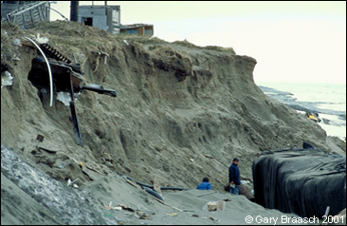
Preliminary Results
Issues & Impacts
272 of 303 workshop participants said effects can be seen now!
Kenai Peninsula (17% said 1-2 effects; 76% said several effects)
Sea Level Rise
Erosion
Erratic Weather & Storm Intensity (e.g. lightning)
Glacial Retreat

Slide 19
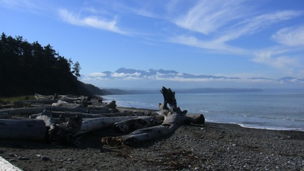
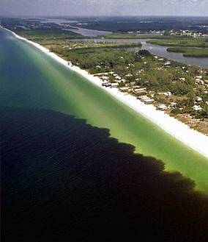
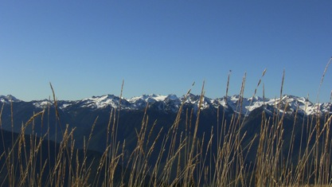
Preliminary Results
Issues & Impacts
272 of 303 workshop participants said effects can be seen now!
Puget Sound (25% said 1-2 effects; 63% said several effects)
Temperature & Precipitation Changes
Water Cycle Changes
Water Quality Changes – “the Dead Zone”
Glacial Melting/Recession

Slide 20
Partner Research Results
Objective 1: Current Activities
#1 – Formal Education Programs (18%)
#2 – Workshops & Meetings (16%)
#3 – Publications (15%)
#4 – Website, Webinars & Web-based Media
#5 – Interpretive Programming
#6 – Professional Development & Trainings
#7 – Presentations
#8 – Special Exhibits & Displays

Slide 21
Partner Research Results
Objective 2: Barriers & Opportunities
Barriers:
Lack of a connection to people’s “everyday” (16%)
Apathy, disbelief & disinterest (10%)
Lack of urgency/immediacy (9%)
Lack of climate/science literacy
Politicization of the issue
Lack of local evidence / data to illustrate effects
Opportunities:
Educate the youth – early and often! (26%)
Focus on the local effects / visible changes (24%)
The potential for collaboration, partnerships & support (18%)
Local action can make a difference!
Make the link to the economy & jobs

Slide 22
CCEP Sites
Project Objectives
✔
  Discover current activities at each site
  Identify barriers & opportunities for collaborating and communicating about climate change
  Identify issues & impacts to be communicated
  Integrate ideas for place-based climate change education/engagement strategy!
✔
✔

Slide 23
Audience Research Results
Staff & Visitor Surveys
Agency Staff Survey (courtesy of Bernuth & Williamson Consulting)
847 total
  402 National Park Service
  445 U.S. Fish & Wildlife Service
Visitor Survey
4,181 total
3, 233 National Parks
948 National Wildlife Refuges
  51% male / 49% female – average age 54
  86% Caucasian / 69% with a college degree+
  33% democrat / 18% republican / 17% independent

Slide 24
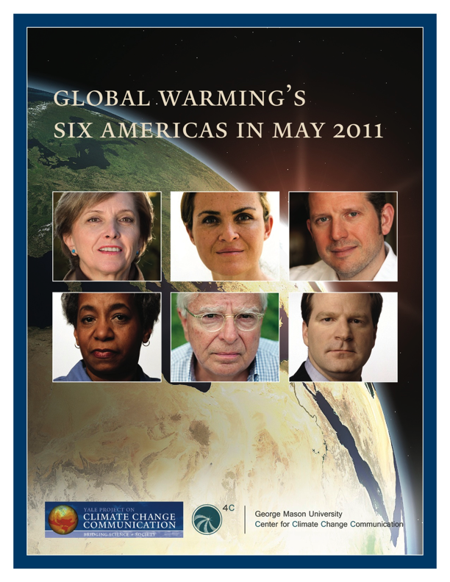

Slide 25
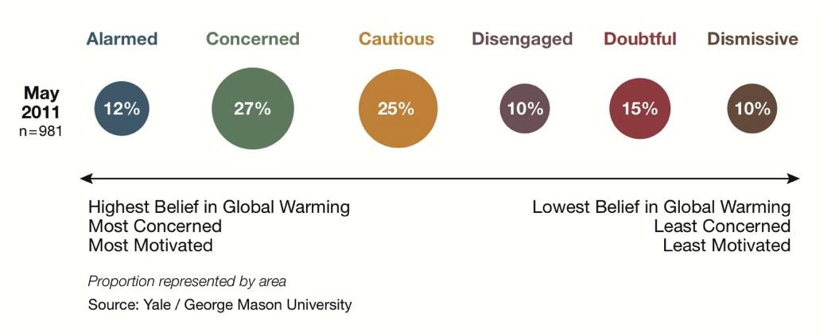
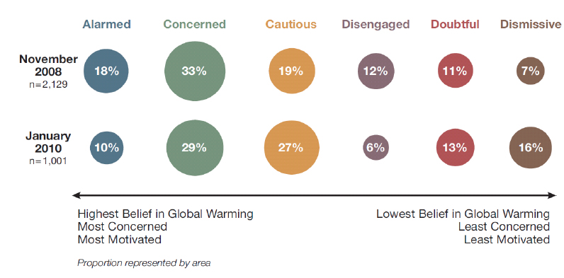
Audience Segmentation in Parks & Refuges
Jan - Dec
2011
n = 4,136
29%
21%
20%
15%
9%
7%

Slide 26
Audience Research Results
Staff & Visitor Surveys
Are the effects of climate change already seen at places managed by NPS & USFWS?

Slide 27
Audience Research Results
Staff & Visitor Surveys
We asked the Staff: Are Your Visitors
Concerned about Climate Change?

Slide 28
Audience Research Results
Staff & Visitor Surveys
Then we asked the Visitors: How
Concerned are You about Climate Change?

Slide 29
Audience Research Results
Staff & Visitor Surveys
Should the National Parks and National Wildlife Refuges be Communicating about Climate Change with Visitors?

Slide 30
Audience Research Results
Visitor Surveys
Are you willing to change your behavior during your visit to help reduce the impacts of climate change at this place?

Slide 31
Audience Research Results
Visitor Surveys
Top Ways Visitors Want to Learn about Climate
Change at National Parks & Wildlife Refuges
Ranking | Communication / Engagement Method
#1 | The Park or Refuge Website (46%)
#2 | Trailside Exhibits (42%)
#3 | Indoor Exhibits (38%)
#4 | Printed Materials (32%)
#5 | Films, Movies or Videos (31%)
#6 | Guided Walks / Talks (26%)
#7 | Roadside Exhibits (26%)

Slide 32
Partner Research Results
Ideas for Engagement Strategy
Who is our Target Audience(s)?
#1 – Children / Youth Audiences
#2 – Staff
#3 – Web Audience

Slide 33
Partner Research Results
Ideas for Engagement Strategy
Top Actions to Promote: “We Want The Audience To…”
#1 – Know that they can make a difference
#2 – Understand local examples and have a connection to place
#3 – Appreciate that they don’t need to know everything to start taking action!
#4 – Take responsibility for everything from understanding the science to lifestyle choices!

Slide 34
Partner Research Results
Ideas for Engagement Strategy
Top Themes for Effective Engagement
#1 – Tell local, personal stories about our changing landscape
#2 – Utilize new technology and social media
#3 – Create a citizen science program
#4 – Make connections to the economy, to our families, to patriotism; make it personally relevant
#5 – Create messages of hope!

Slide 35
Place-based Climate Change Engagement
Theoretical Framework
Norm Activation Theory
Place Attachment
Place-based Learning
Free Choice Learning
Situated in
Place
Situated in Cultural Context
Empowers a Specific Action
Audience Research
4,181 surveys
349 interviews
16 focus groups
6 workshops
Climate Change
Communication Literature
Regional Community of Practices
Youth Camps
Regional Trail Signs
Mobile Apps
Staff Training
Web-based Training

Slide 36
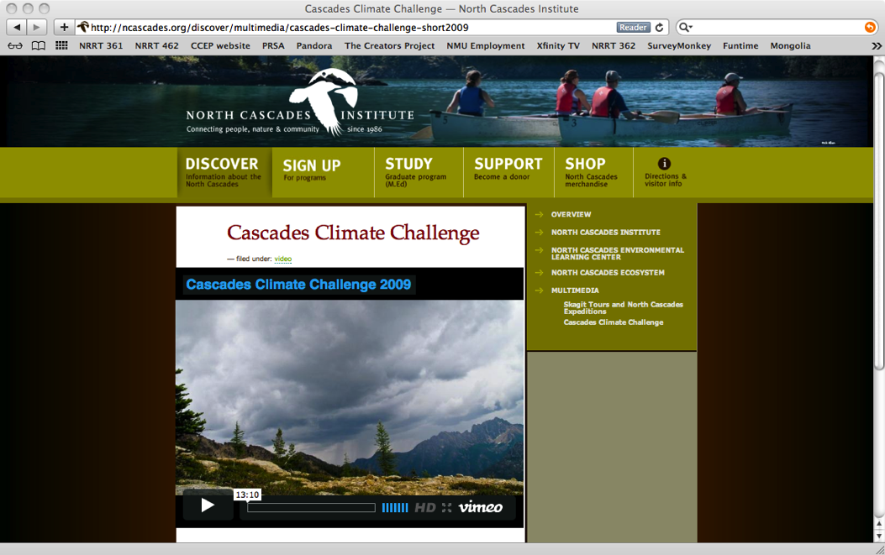
http://vimeo.com/15967782

Slide 37
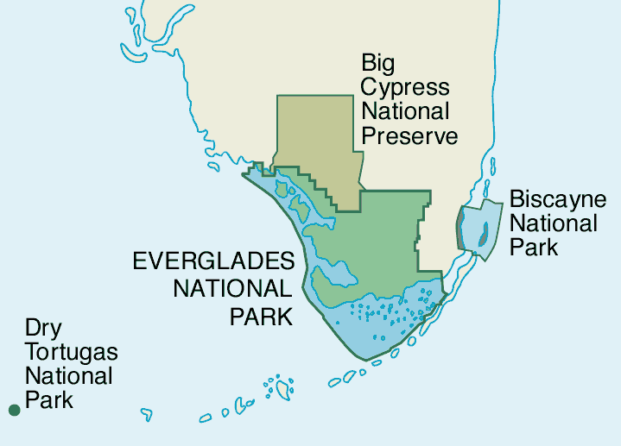
Ten Thousand
Islands National
Wildlife Refuge
Miami
Key Deer National
Wildlife Refuge

Slide 38
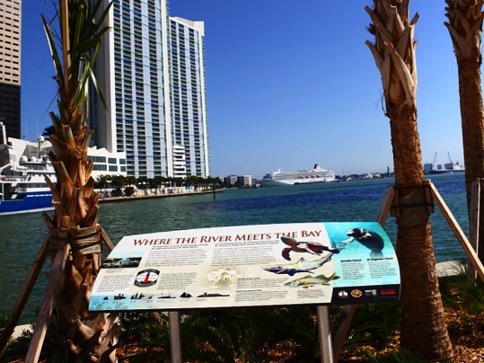
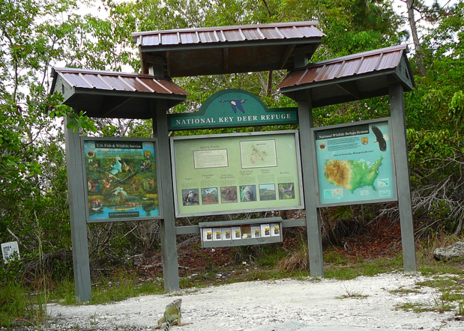

Slide 39
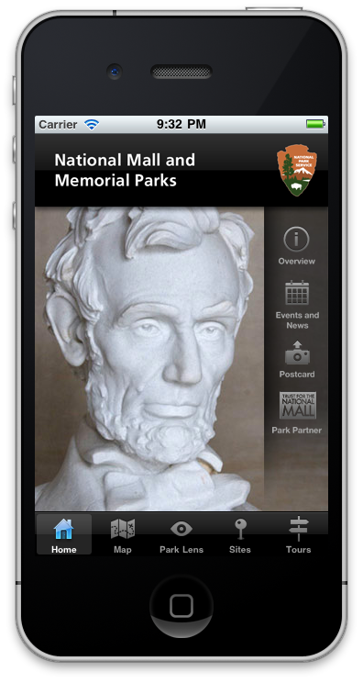

Slide 40
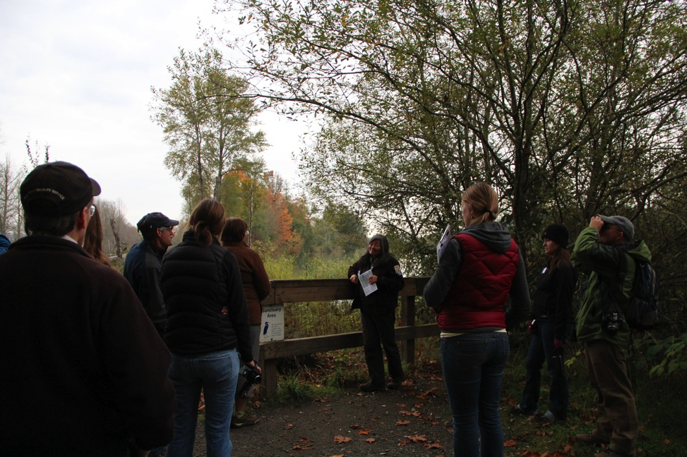

Slide 41
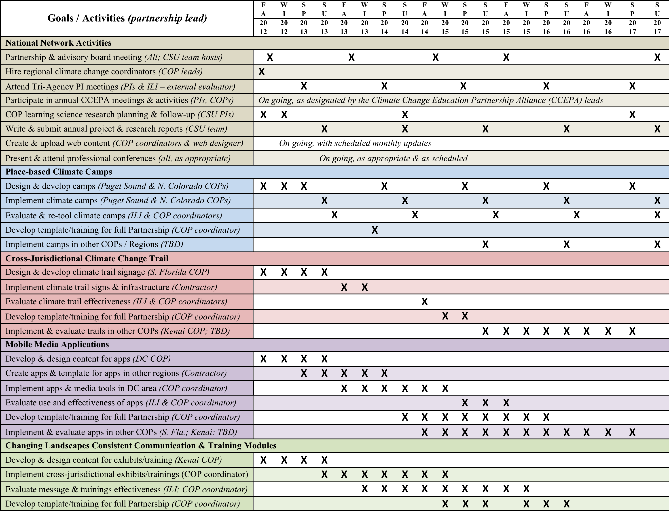

Slide 42
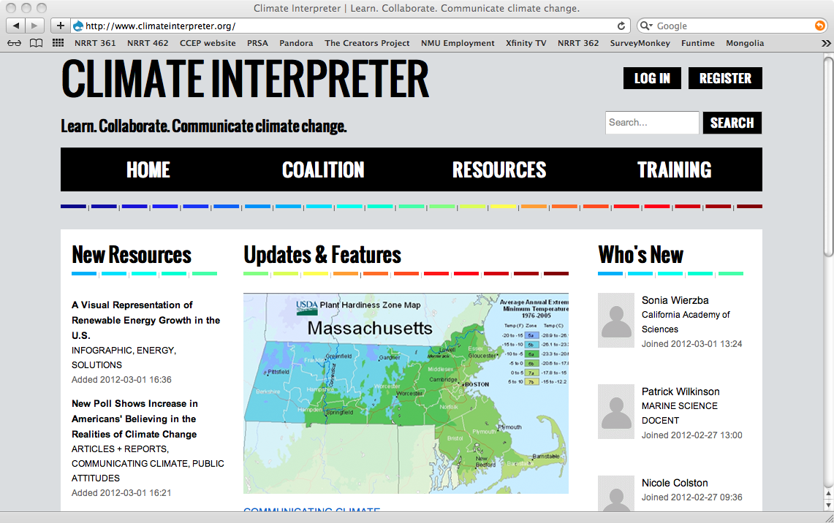

Slide 43
THE IMPORTANT MESSAGE ABOUT COMMUNICATING CLIMATE CHANGE:
There is no template or “ready-made” solution! We need to experiment with – and – test different strategies.
Making progress means that we link our understanding of ecological changes with our understanding of our audience(s) and develop meaningful messages to engage them in climate dialogue and action.
Notes:
43
43

Slide 44
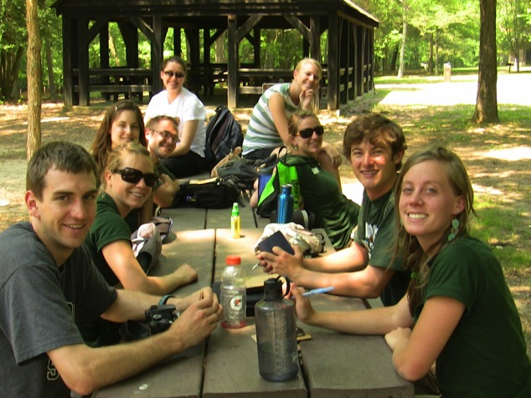

Special Thanks to the CCEP Research Team!
This project is funded by a grant from the National Science Foundation, award number DBI-1059654

