Slide 1


TV Meteorologists as Climate Educators
Presentation to the Climate Literacy Network
February 28, 2012
Edward Maibach, MPH, PhD

Slide 2
Abstract
Surveys indicate that TV weathercasters are among America’s the most trusted sources of climate change information – second only to scientists and government climate science agencies. Unlike most scientists, TV weathercasters have unparalleled educational access to American adults: a large majority of adults watch local TV news, especially the local weather, and TV is cited by most adults as their #1 source of weather information. Moreover, TV weathercasters’ educational access is both timely (it can occur precisely when people are open to learning – e.g., when extreme weather events such as heat waves, heavy downpours and snowstorms, floods and droughts create an educational opportunity), and it is likely to be seen as relevant by viewers (it can focus on concrete local and regional manifestations of climatic conditions, rather than on more distant manifestations). Furthermore, TV weathercasters often have the opportunity to repeat their educational content in a variety of media channels (TV, radio, newspapers, station websites, and personal blogs), and through face-to-face education (at school and community events), thereby greatly increasing the odds of audience learning. In this talk, I will present what we have learned through two NSF-funded grants in which we have had the opportunity to work with America's weathercasters and explore their interests in educating their viewers about climate and climate change.

Slide 3
TRUST
Public trust in most institutions is at an all-time low
(although trust in scientists remains high).
Education can only occur when there is trust.

Slide 4
Confidence in People Running Various Institutions
(“A great deal of confidence”)
Source: General Social Science Survey, NORC, University of Chicago.

Slide 5
Trust in Sources of Information about Climate Change: General Public
Source: Leiserowitz, A., Maibach, E., & Roser-Renouf, C. (2010) Climate change in the American Mind: Americans’ global warming beliefs and attitudes in January & June 2010. Yale University and George Mason University. New Haven, CT: Yale Project on Climate Change.

Slide 6
Trust in Sources of Information about Climate Change: General Public
Source: Leiserowitz A, Maibach E, Roser-Renouf, C & Smith N. (2011) Climate change in the American Mind: Americans’ global warming beliefs and attitudes in May 2011.

Slide 7
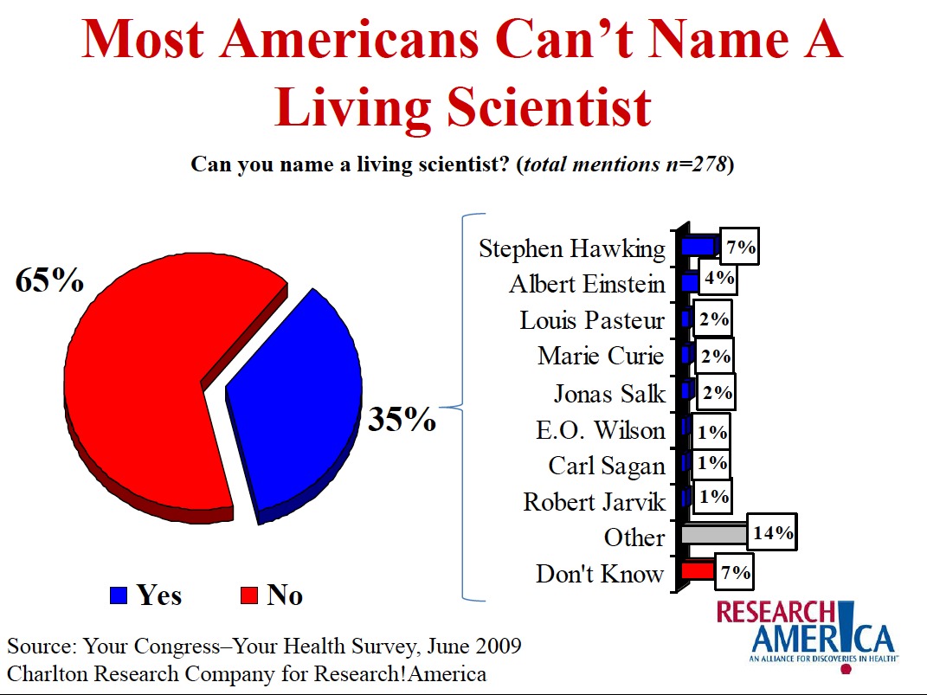

Slide 8
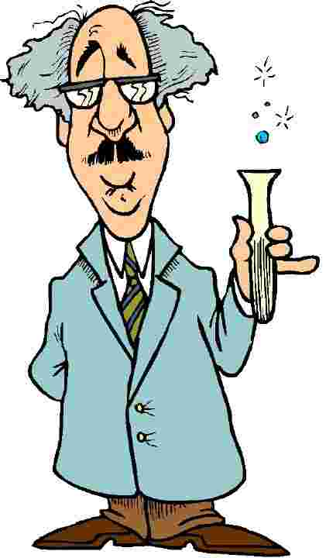

Slide 9
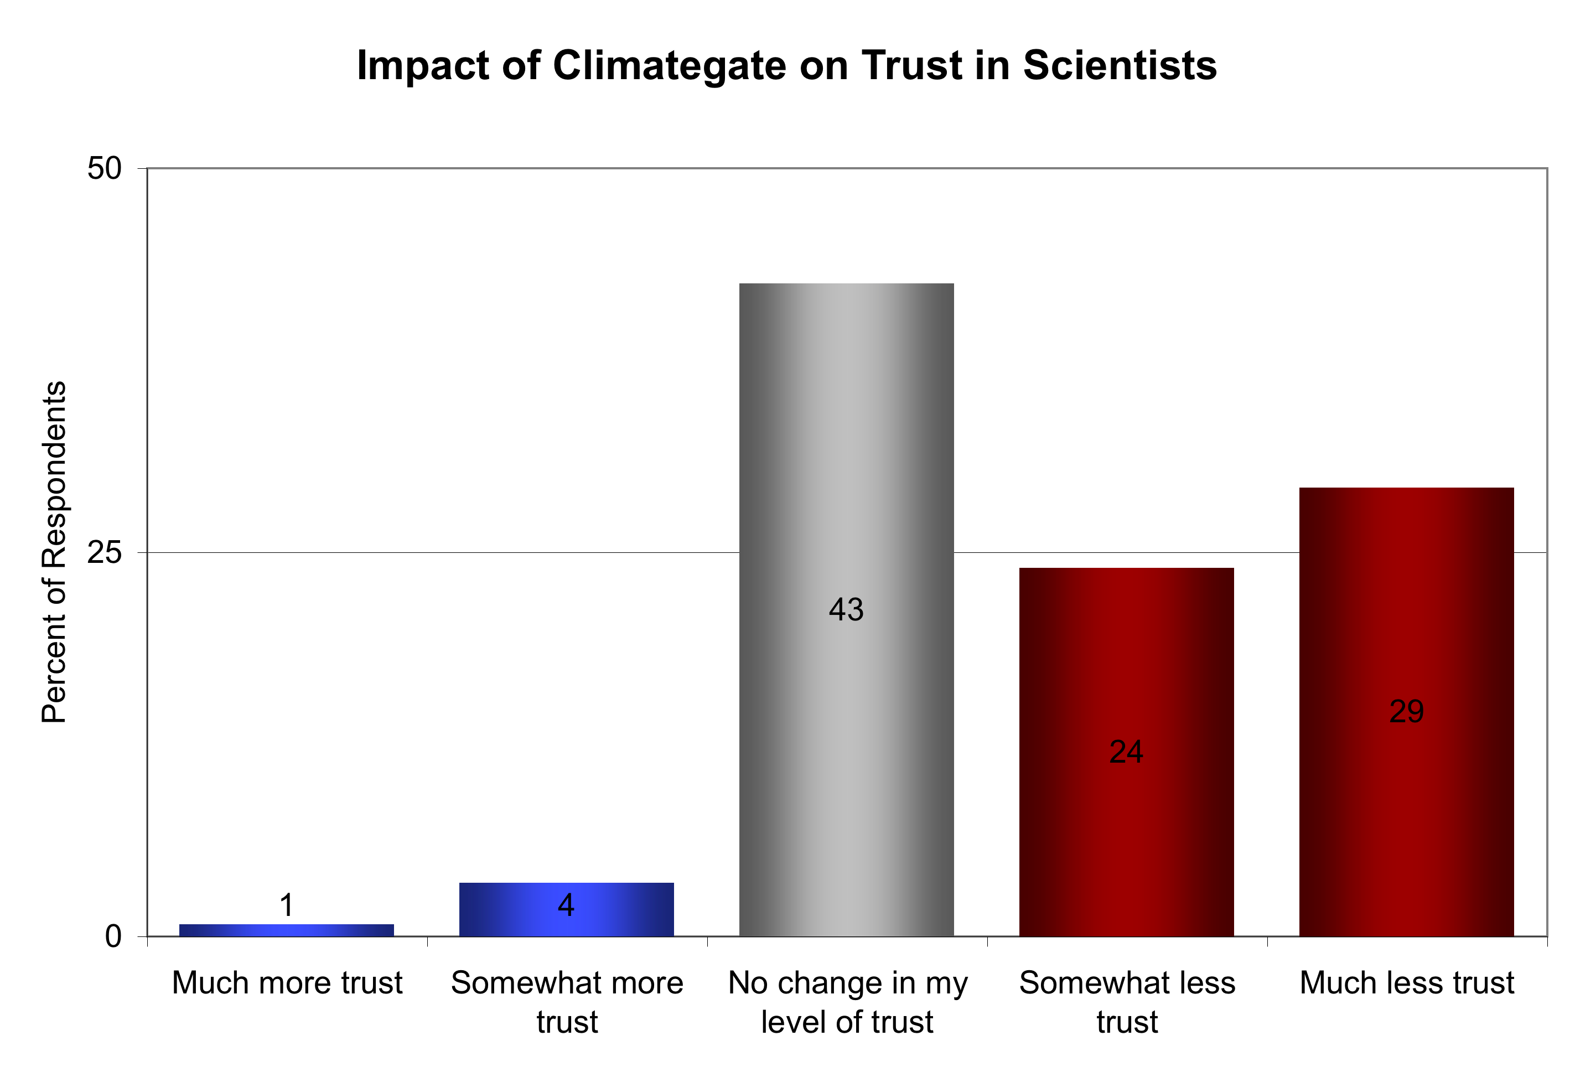
Source: Leiserowitz et al (in press) Climategate, public opinion & the loss of trust. Amer. Behavioral Scientist.

Slide 10
Who is Canada’s most trusted person?
Hint: He’s a scientist
(not a hockey player)

Slide 11
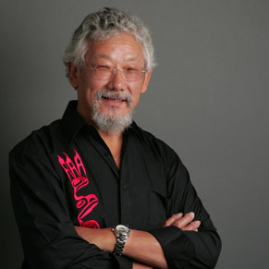
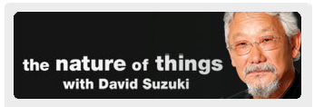
The long-time host of "The Nature of Things" and Chair of the David Suzuki Foundation, this eco champion has reached out to millions all across the globe, telling people about the danger the environment faces and we can make a differences with small changes.
Honest, compassionate, and communicating a clear message, it's easy to see why Canadians voted him the Most Trusted for the third year in a row.
“He knows how to reach out and explain things so the common man understands,” says 59-year-old respondent Jacqueline Fitzpatrick of Thunder Bay, summarizing the general take on her No. 1 pick.

Slide 12
Only one of these scientists suffered a loss of trust as a result of “Climategate.”

Slide 13
What’s going on here?
Familiarity ➔ Liking
Liking ➔ Trust
QED: Familiarity ➔ Trust
David is familiar, liked and trusted.

Slide 14
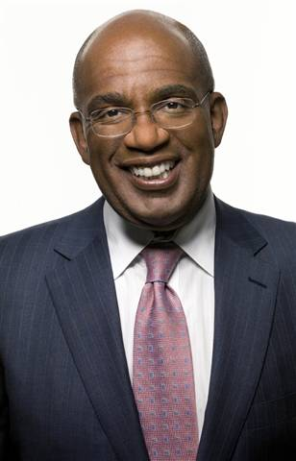
Proximity ➔ Familiarity
Familiarity ➔ Liking
Liking ➔ Trust
TV weathercasters are seen as being close, familiar, likable and trusted. Moreover, American adults listen to them with remarkable frequency.

Slide 15
How often do you watch or listen to the following shows?
Source: Yale & George Mason, 2009

Slide 16
How closely do you follow news about each of the following?
Source: Yale & George Mason, 2009

Slide 17
Most Americans Rely on Local TV News for Weather Reports
A December 2010 national telephone survey found that 54% of Americans watch local TV news for most of their weather information, while 19% tune in to cable TV. Twenty percent (20%) rely on the Internet for most of their weather news. Five percent (5%) listen to the radio, and two percent (2%) get the bulk of their weather news from newspapers.
The Rasmussen Reports survey of 1,000 Adults was conducted on December 30, 2010. The margin of sampling error is +/- 3 percentage points with a 95% level of confidence.

Slide 18
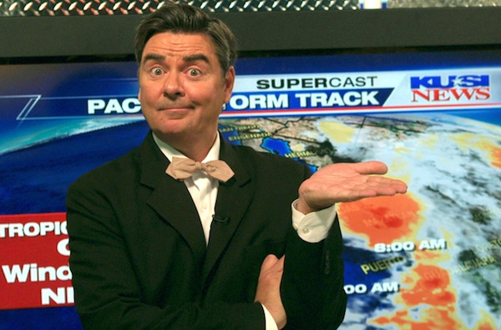
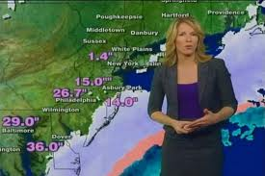
Premise #1: Because of their trust and access,
TV weathercasters have an unrivaled opportunity to educate the public about climate change

Slide 19
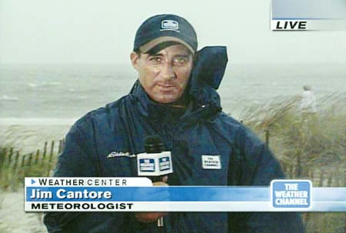
Premise #2. Weathercasters can use extreme weather events to help viewers understand the abstraction of climate change in a concrete and personally experienced manner.

Slide 20

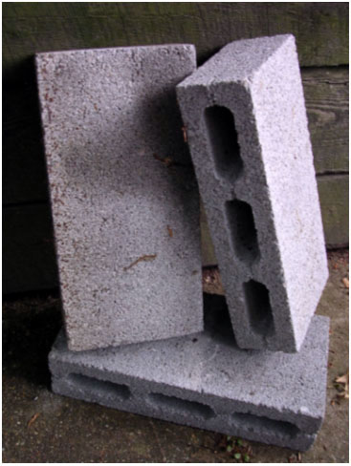
Abstract vs. Concrete

Slide 21
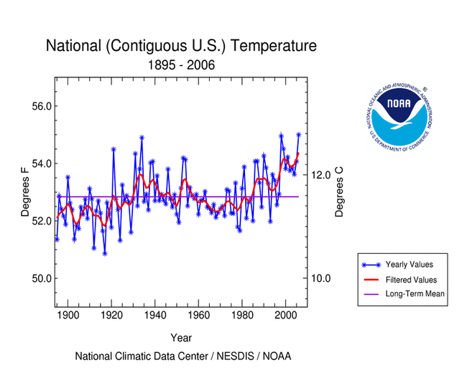
Abstract

Slide 22
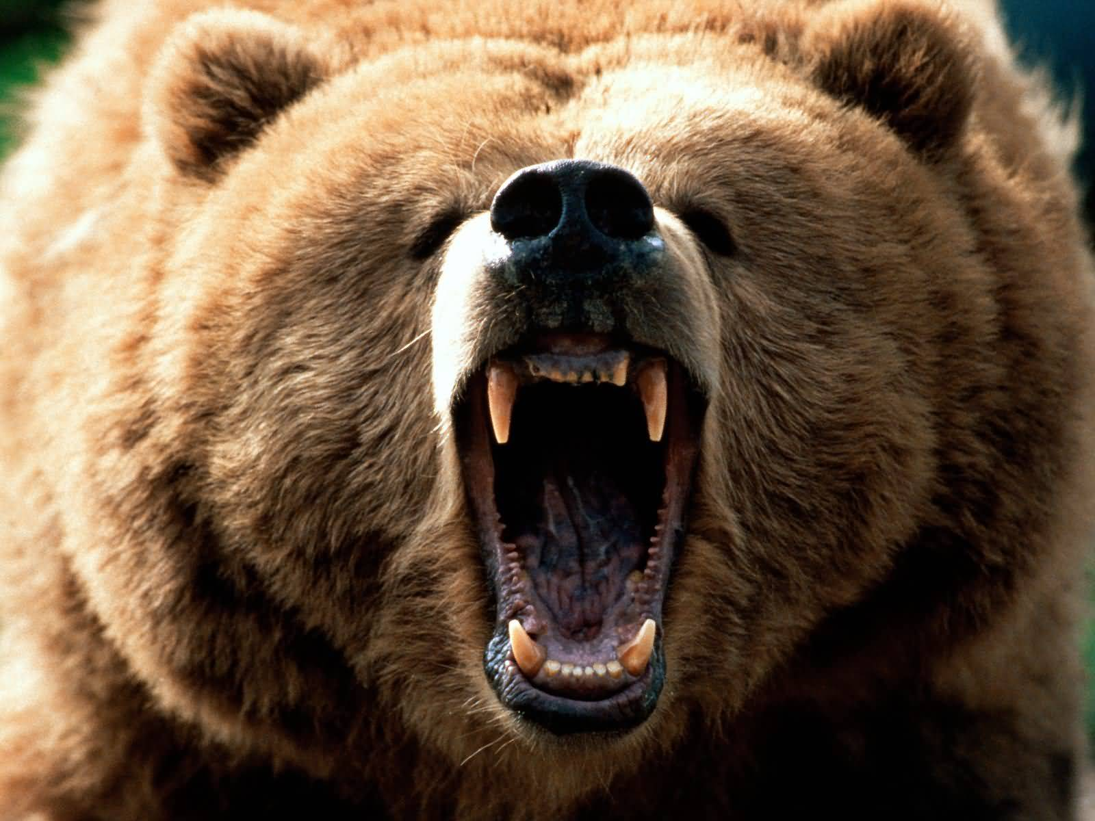
Concrete

Slide 23
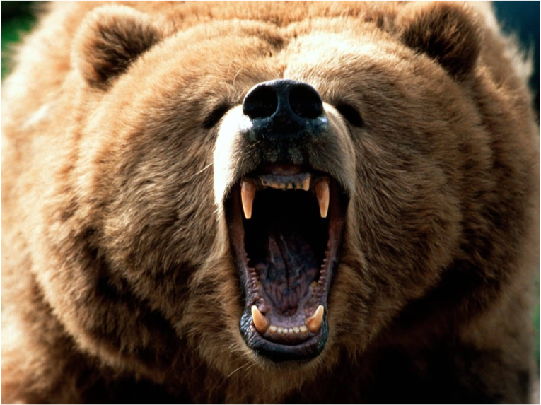
Our brains process risk information in two ways
percents%
words
<= logic
Experiential
system
Analytic
system
“experiencing is believing”
requires logic and evidence
Processing of risk
Source: Slovic, Finucane, Peters, & McGregor, 2004

Slide 24
percents%
words
Analytic system
<= logic
requires logic and evidence
Experiential
system
“experiencing is believing”
Processing of risk
Source: Slovic, Finucane, Peters, & McGregor, 2004

Slide 25

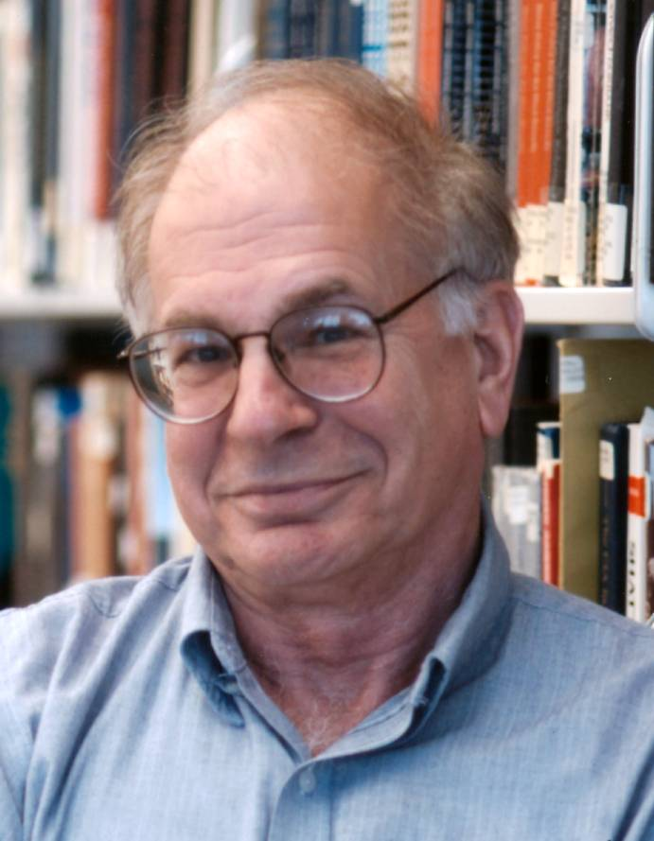

Slide 26
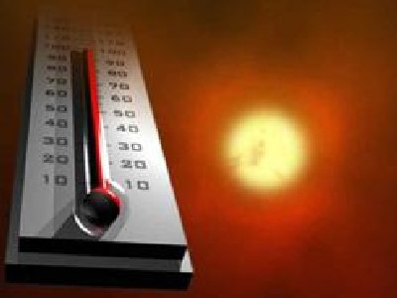
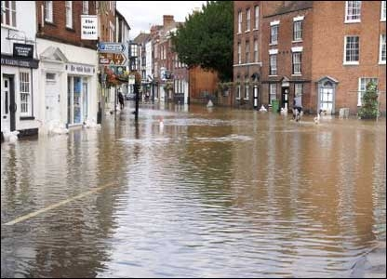
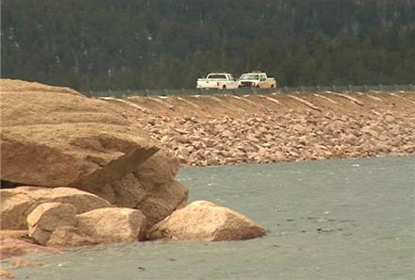
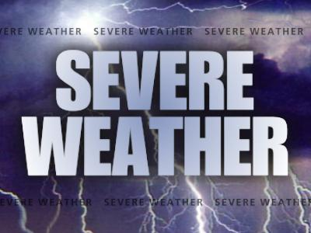

Slide 27
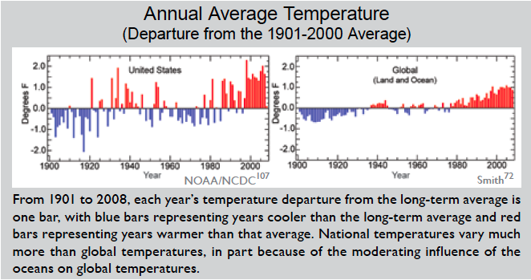
Weathercasters can provide context to extreme weather events, by explaining them as a manifestation of an observed trend

Slide 28
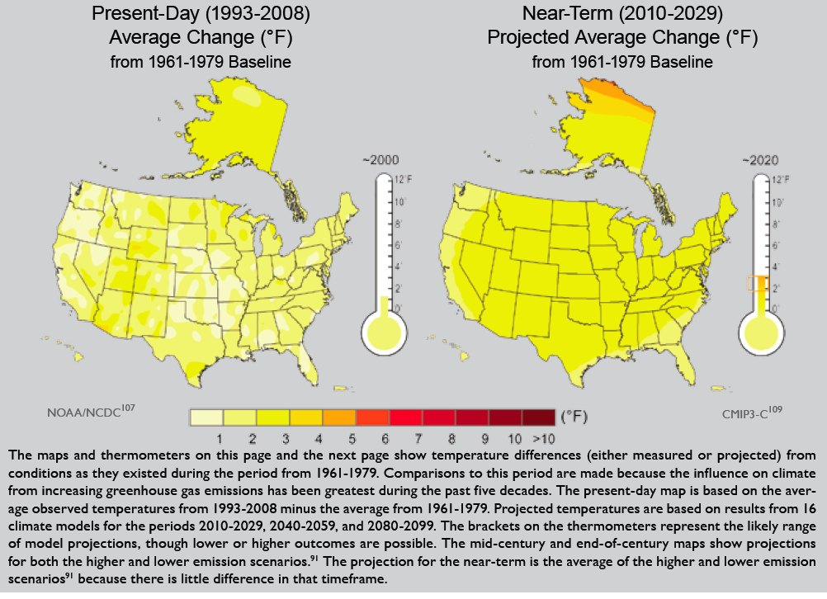
Weathercasters can also provide context to extreme weather by explaining it as a harbinger of conditions projected to become more frequent

Slide 29
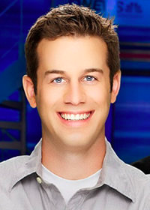
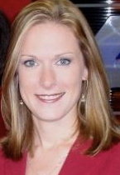
Premise #3. There are large numbers of weathercasters across America who welcome the opportunity to educate their viewers about climate change, but they require some assistance

Slide 30
NSF grant (DRL-0917566):
Enabling TV meteorologists to provide viewers with climate change-related science education based on ISE “best practices.”
In-depth interviews with “early adopters” (n=17)
National survey of TV weathercasters (and news directors) – January & February, 2010
Pilot-test of broadcast-ready climate change educational materials at WLTX, Columbia, SC

Slide 31
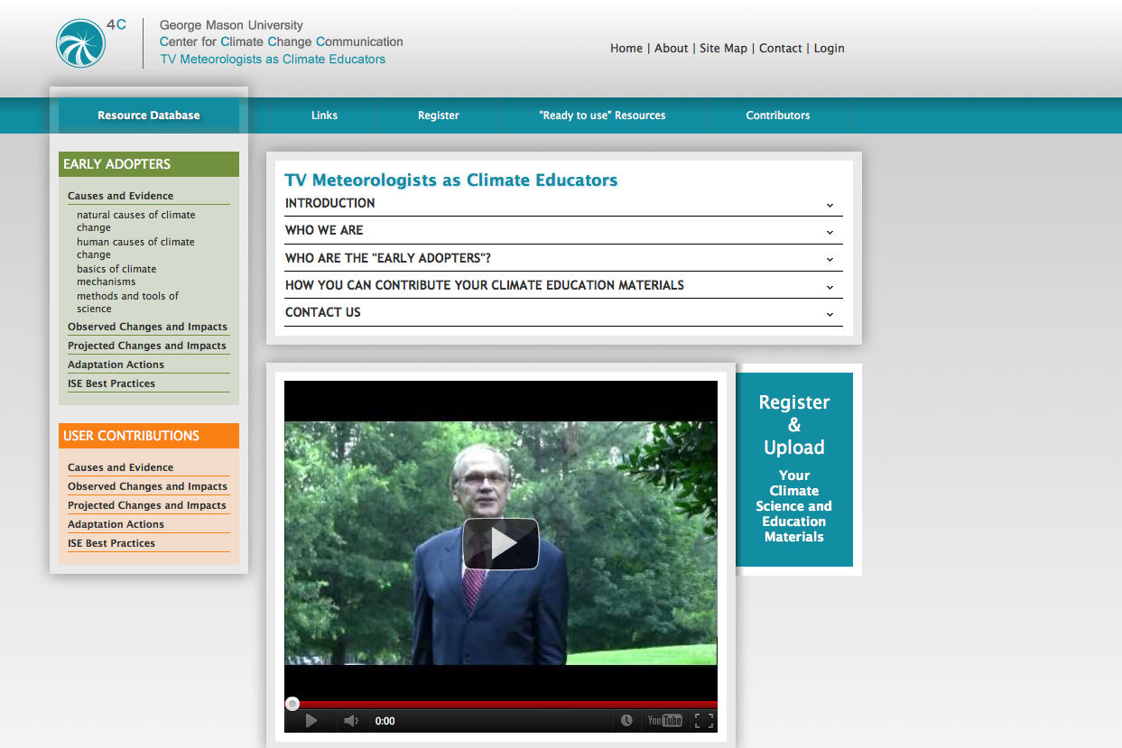

Slide 32
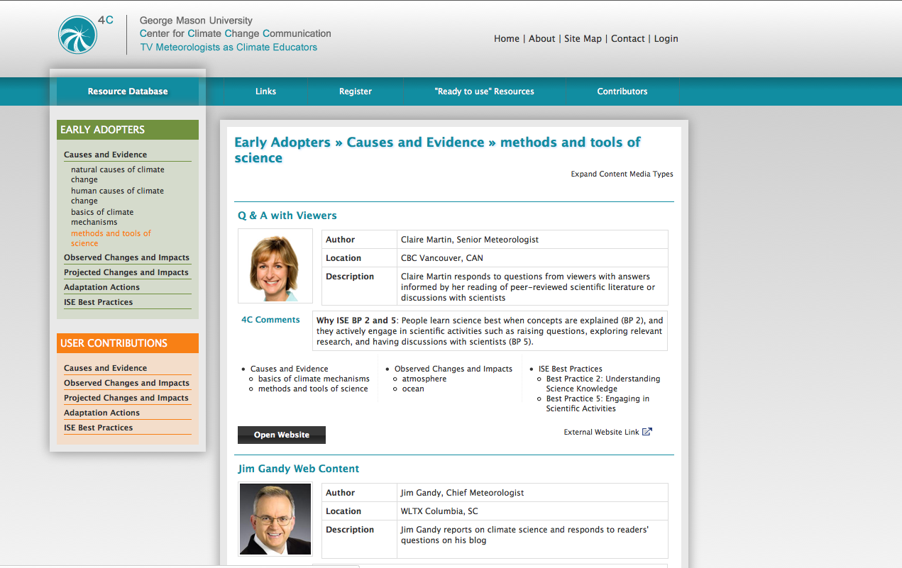

Slide 33
Are you interested in reporting on climate change?
34%

Slide 34
It is appropriate for me to discuss the science of climate change…

Slide 35
What local climate change stories would you like to report?

Slide 36
How helpful would the following be in increasing your ability to report on climate change?

Slide 37
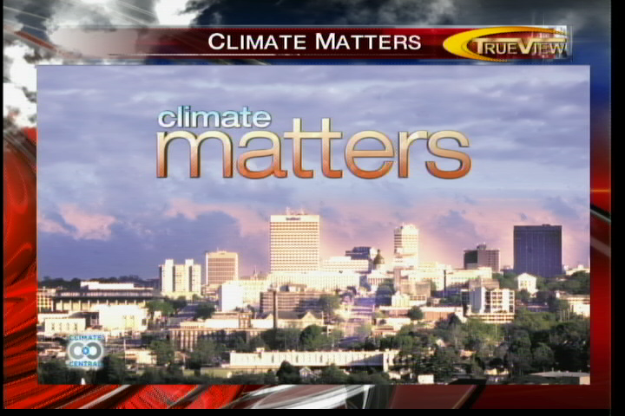
WLTX, Columbia, SC

Slide 38
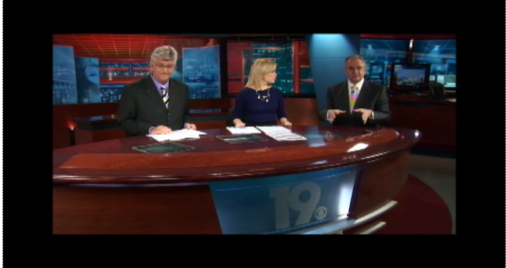
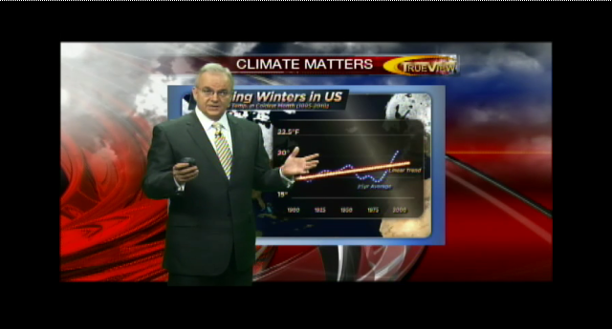
Jim Gandy, Senior Meteorologist, WLTX, Columbia, SC

Slide 39
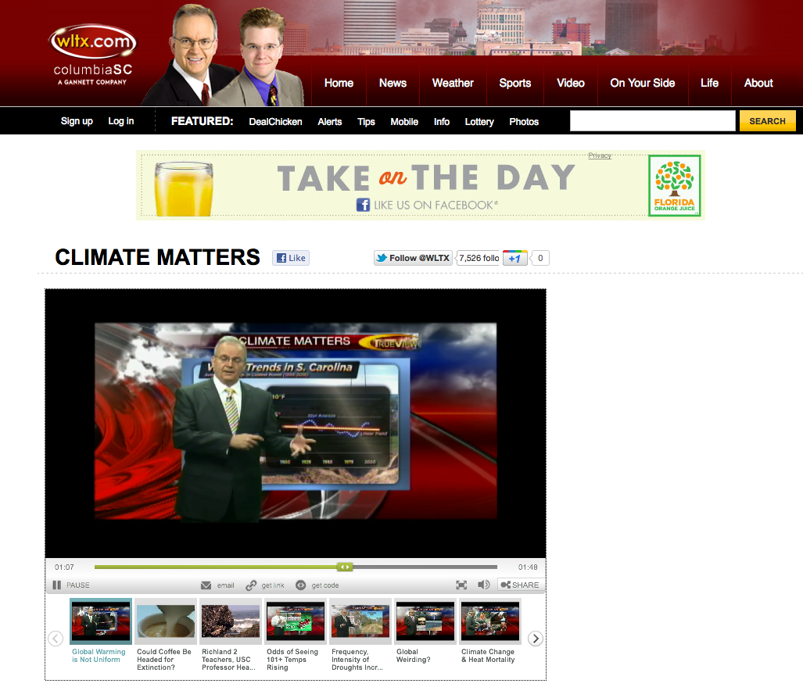

Slide 40

Climate Change Education Partnership (CCEP) Program, Phase I (CCEP-I)
Program Solicitation
NSF 10-542
National Science Foundation
Directorate for Education & Human Resources
Directorate for Geosciences
Directorate for Biological Sciences
Office of Polar Programs

Slide 41
Trust in Sources of Information about Climate Change:
Local TV Weathercasters
Source: Maibach, E., Wilson, K & Witte, J. (2010) A National Survey of Television Meteorologists about Climate Change: Preliminary Findings. George Mason University. Fairfax, VA: Center for Climate Change Communication.

Slide 42












Slide 43
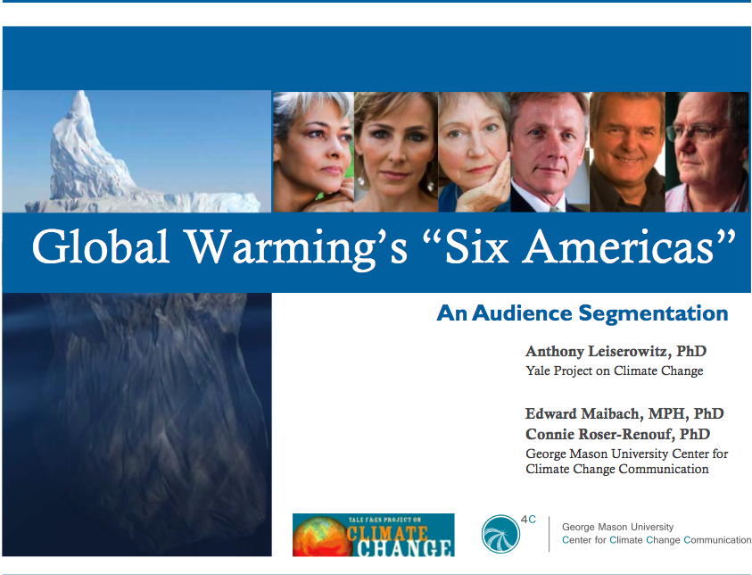
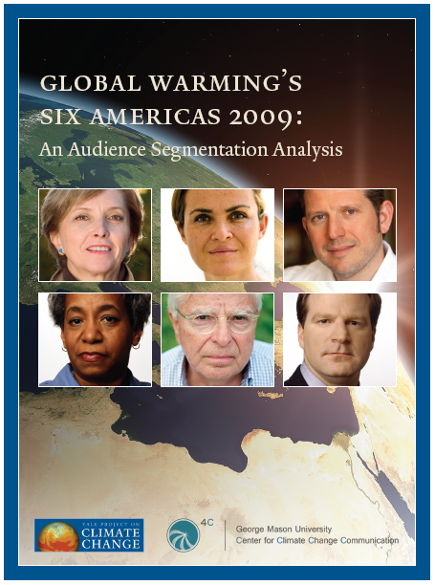
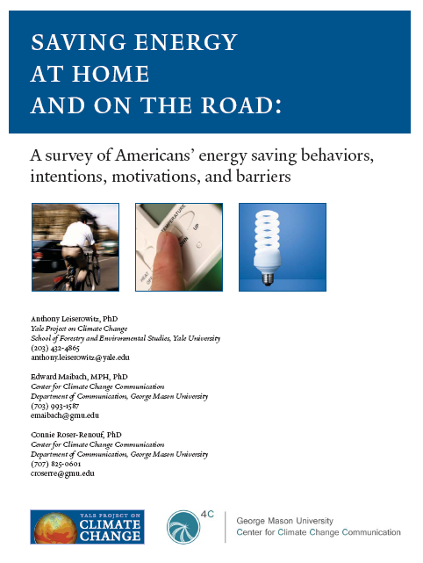
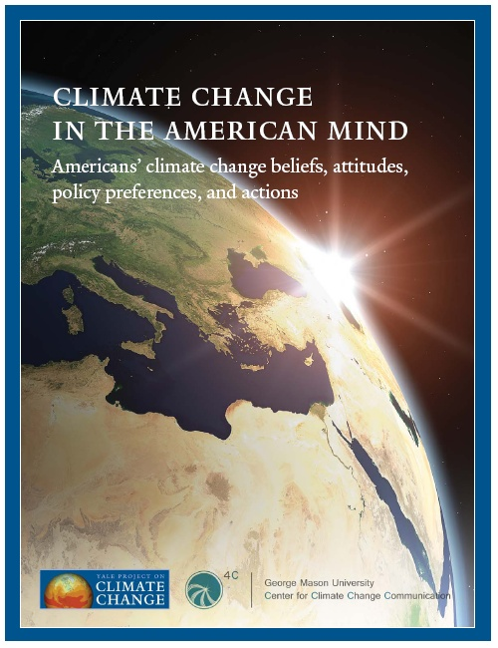

Slide 44
All 4C reports can be downloaded at: climatechange.gmu.edu

