Slide 1
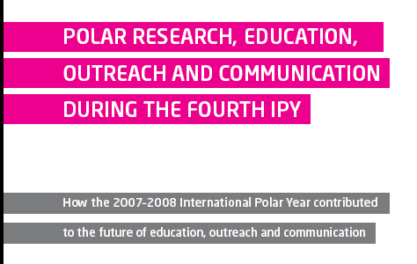
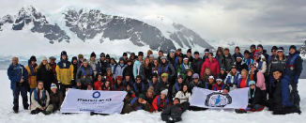
APECS activities and some communication lessons from IPY
Jennifer Provencher
APECS ExCom and PhD student Carleton University
Ottawa, Canada

Slide 2


Slide 3


Slide 4


Slide 5
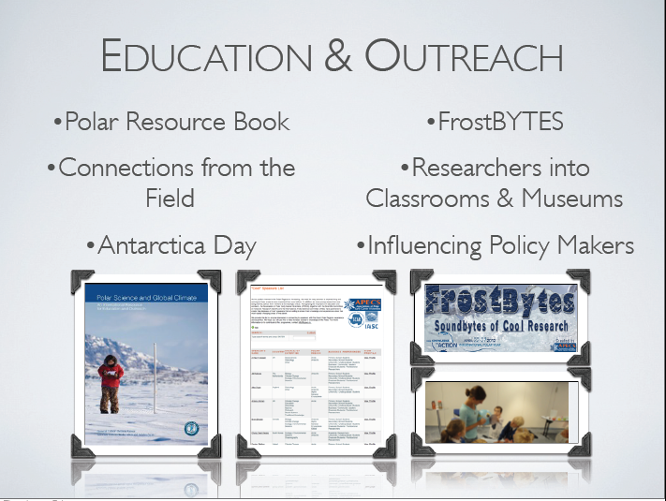

Slide 6
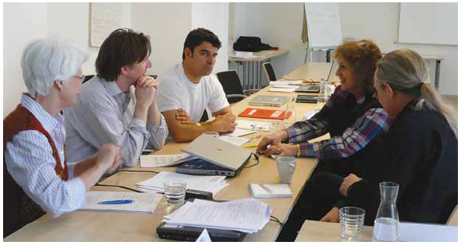

Outreach during the
International Polar Year
The IPY Planning Group set out to have IPY EOC to have an impact on a global scale that would target key audiences with important messages and themes.
Zicus et al. 2011
Notes:
EOC was prioritized with its own committee that was tasked with ensuring EOC was a large part of IPY.

Slide 7
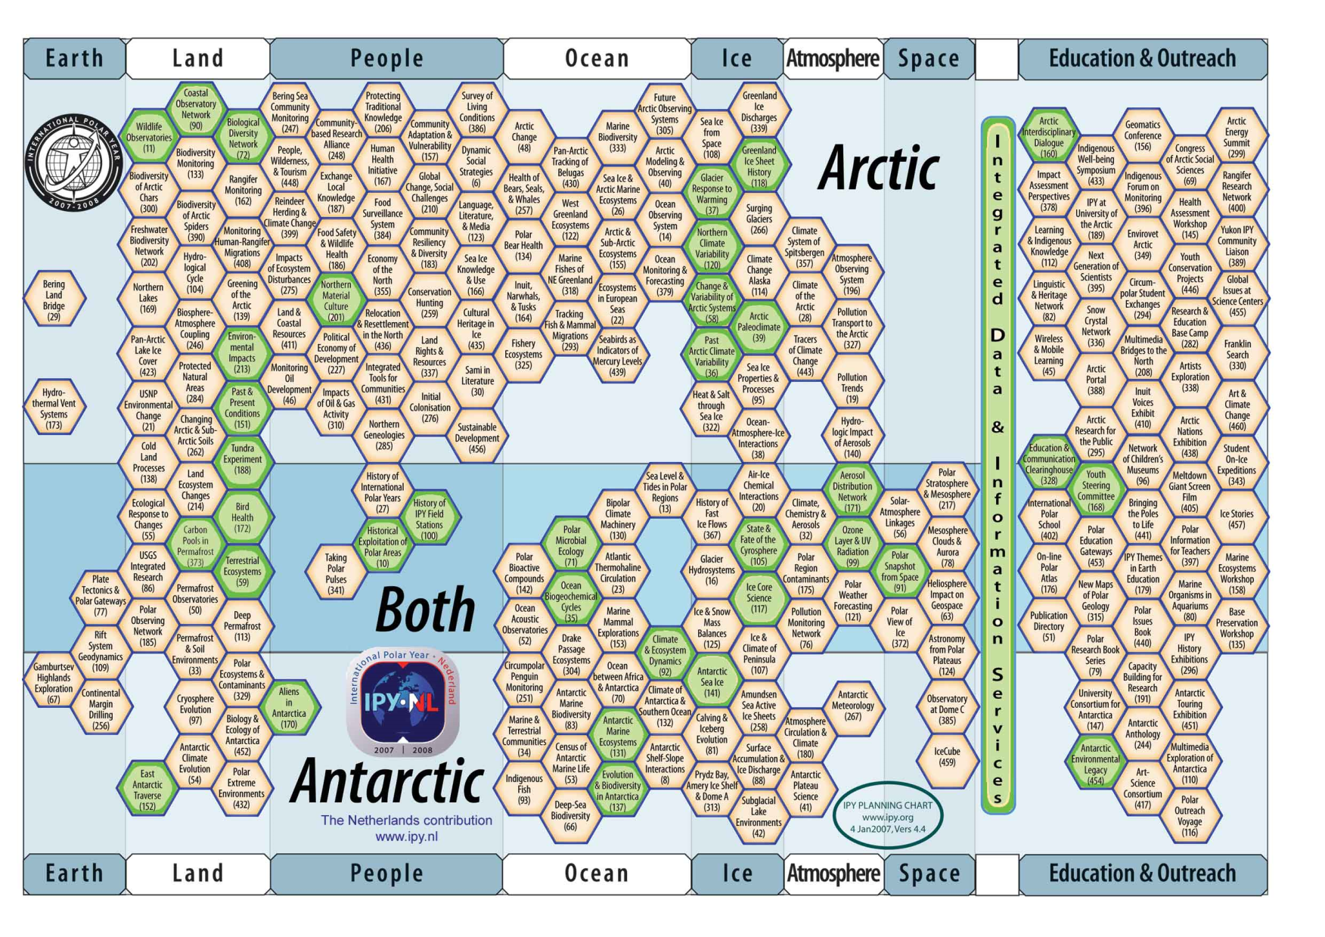
IPY 2007-2008
Notes:
Overall, IPY had a full range of disciplines involved around the world, with EOC projects spanning a similar range of topics, locations and themes.

Slide 8


What can be learned about EOC from IPY?
IPY microcosm of science outreach information
Jenny Baeseman (APECS) and Dave Carlson (formerly of IPY IPO) supported by ICSU, the IPY IPO and AWI put together a team of IPY educators, communicators and researchers to form the IPY EOC Assessment Committee.
rb.com, theblacksheepagency.com/blog
Notes:
So IPY brought together over a record number of nations and tens of thousands of people, making it a very valuable microcosm of science EOC info. This was recognized by Jenny and Dave, who worked to put together a group of people to assess the lessons that could be learned from IPY EOC.

Slide 9

Was IPY EOC successful?
Going back to the objectives of the IPY Planning Group....
global scale
target key audiences
important messages and themes
Notes:
To measure success we went back to the original goals of the IPY planning group.

Slide 10

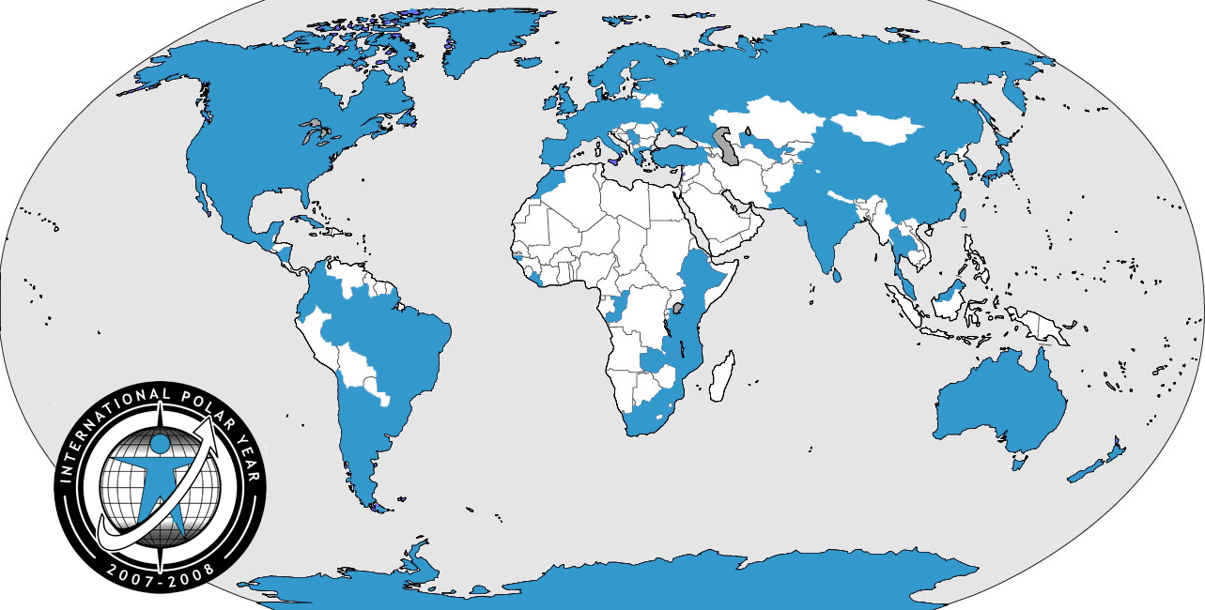
1. Global Scale
IPY EOC projects reports indicate that more than 70 countries were involved

Slide 11
2. Wide Audiences
IPY EOC projects reached more than 14 million people
Notes:
The variety of audiences shows that IPY EOC reached many. Number estimates of the projects reported suggest a minimum of 14 million reached, though a better estimate is more likely to be 20 million.

Slide 12

3. Important messages and themes
Notes:
This is a word cloud of all of the 522 project titles currently in the IPY outreach catalogue. The larger the word, the more it appeared in IPY outreach project names.
Of course IPY, Polar, Arctic and Antarctica are all common, but the range of other words such as education, school sea, perspectives, earth and health and the lack of specialty terms such as glaciology, meteorology show the diversity of programs.

Slide 13
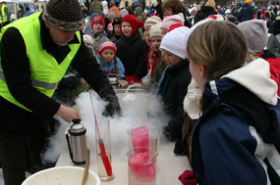
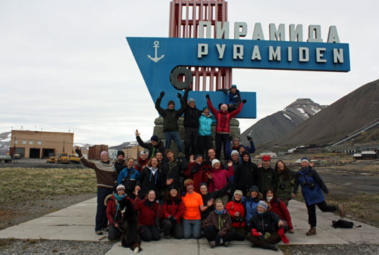
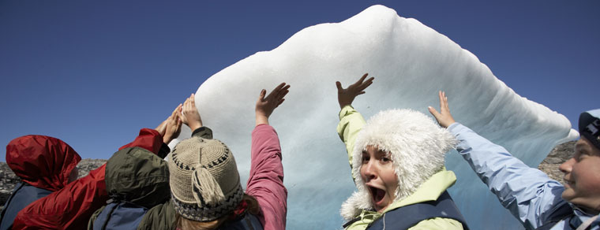
So IPY EOC was successful by its own goals.....but why?
You don’t have to look far for the signs of success, but what about the IPY EOC efforts made it so great?
ipy-osc.no, apecs.is, studentsonice.com
Notes:
Knowing that IPY EOC was successful on a global scale at reaching millions of people with key messages, what are the lessons that we can take from it.

Slide 14

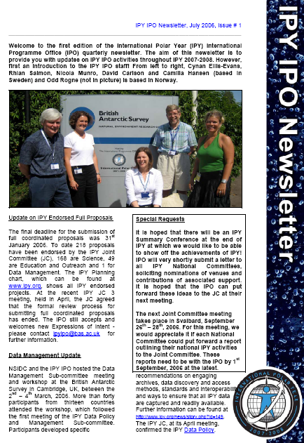
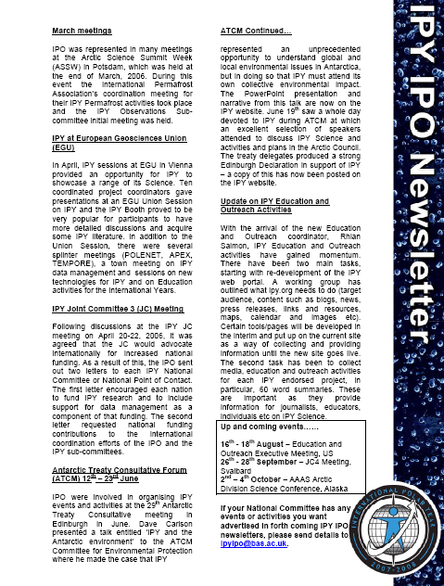
Why IPY EOC was successful - 1
EOC was integrated into the larger science IPY programme from the beginning.
Notes:
Going to back to 2003, the IPY Planning Group identified EOC as important. Here we can see in the very first newsletter from the IPY IPO that EOC was integrated along the way.

Slide 15
Why IPY EOC was successful - 2
The EOC efforts engaged and involved experts in both science and communication.
Researchers
Graduate students
Educators
Teachers
Communication experts
Media personnel
Writers
Artists
Musicians
.....were all involved in IPY EOC projects
Notes:
Another primary reason for the success was the integration of communication experts. Many projects employed people that had experience in EOC. What made it successful was researchers and communication people working together to make relevant programmes.

Slide 16
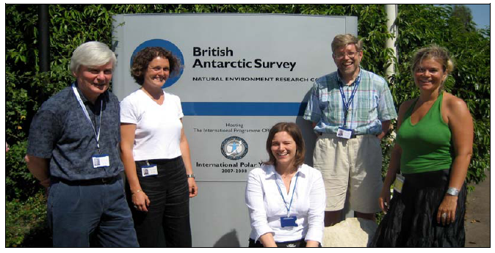

Why IPY EOC was successful - 3
EOC was encouraged and coordinated from a central office throughout the IPY.
We had a lot of help from the IPY IPO and we used all the materials available online. - Miriam Hebling Almeida , Colégio Puríssimo Coração de Maria, Brazil
Notes:
The IPY IPO was not only the main organizing body for several international programmes; it was also the central hub for many volunteers and networks. Many IPY EOC activities were organized and carried out by a large number of volunteers worldwide who donated time and resources. It was these volunteers who felt welcomed and connected to IPY, combined with the coordination from the IPY IPO, which allowed many outreach efforts to have such a wide audience.

Slide 17
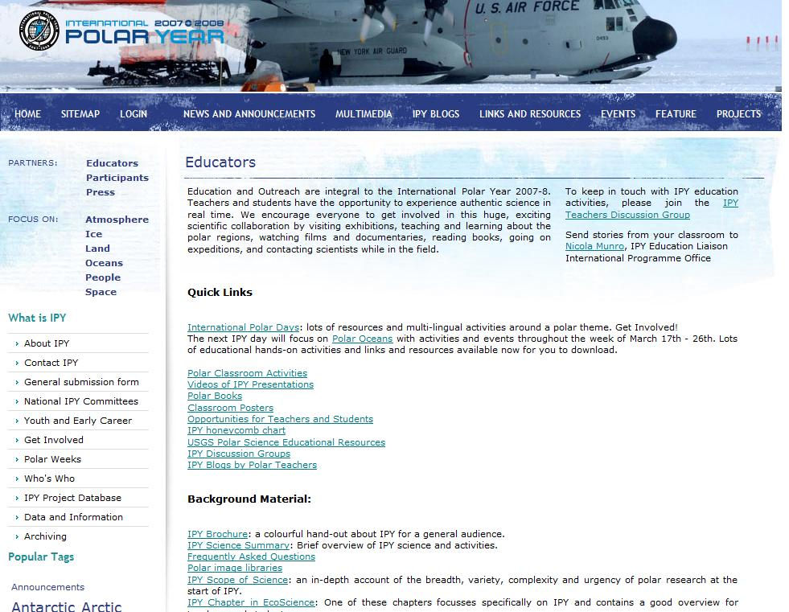
Why IPY EOC was successful - 4
The EOC programme was branded and inclusive.
Consistent branding
Inclusive
Teachers Discussion Group
Classroom posters
Opportunities
Activities
Blogs by teachers
Image library
Lesson plans sorted by level of preparation needed
And more.....
Notes:
Through open invitations to participate, use of accessible technology, innovative outreach methods and flexible timing, IPY EOC encouraged and energized many individuals and activities to take part in IPY, and to become important partners in the global IPY outreach efforts.

Slide 18
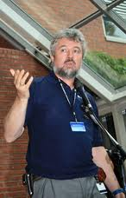
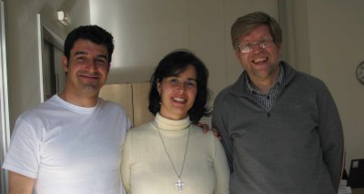
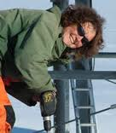
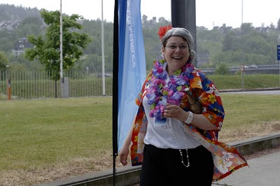

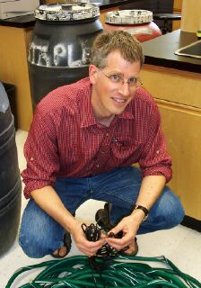
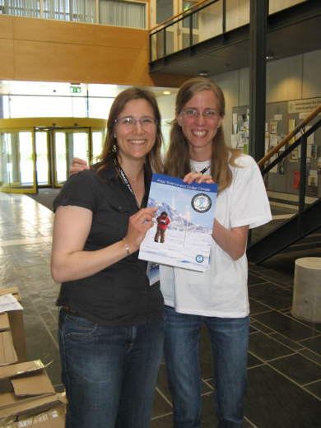
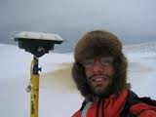
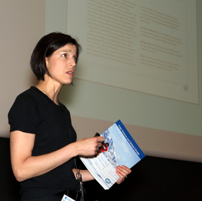
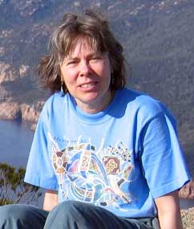
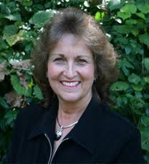


Why IPY EOC was successful - 5
Advocacy maintained EOC momentum throughout the IPY period.
Notes:
IPY EOC success required continued advocacy to promote and support EOC at all levels throughout the IPY. And there are a number of people who were key in keeping it at the forefront of IPY. Many you can see here, but there are countless people who worked to make IPY EOC successful throughout IPY.

Slide 19
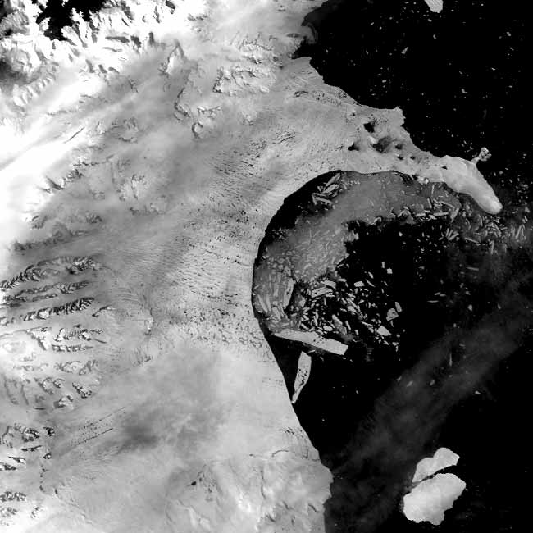
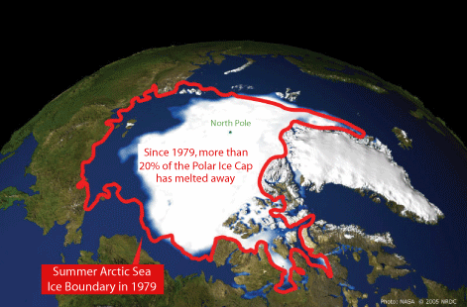
Why IPY EOC was successful - 6
Polar issues were timely and topical.
2003
2007, 2010
Rapid decline in Arctic summer sea ice
nsidc.org
Collapse of the Larsen B Shelf
Notes:
Beyond control and planning, we do need to recognize that polar issues were timely in 2007-2008. Several events such as these two made the global press, drawing people into wanting to know about polar issues.

Slide 20
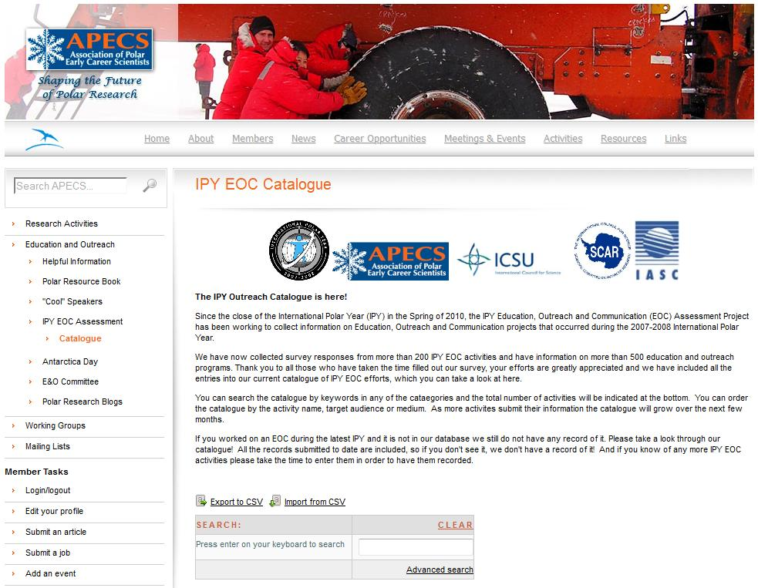
The IPY Outreach Catalogue
Search the catalogue by Key words
Notes:
In hopes of providing a central place where everyone can find information on IPY outreach efforts we have created the IPY Outreach Catalogue. It is currently housed on the APECS website.
You can search over 522 entries, making it a very useful tool.

Slide 21

What we have learned about EOC through IPY - 1
The public, students, teachers, media, artists and musicians want to be actively engaged in science.
http://innovationcanada.ca/en/articles/science-strategies-for-a-smart-canada
Notes:
By working through hundreds of projects and talking to dozens of people there are several lesson learned that we can take away from IPY EOC. And here is number 1.
Regardless of the pockets of mistrust and bad press about science, in general people what to be actively engaged.

Slide 22
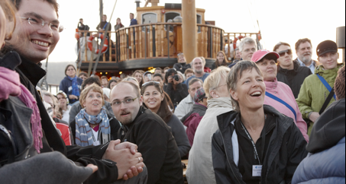

What we have learned about EOC through IPY - 2
Professionals in science and communication, at junior and senior levels, expressed frustration at the lack of professional recognition for outreach activities.
One of the main obstacles that many scientists and communicators, early career and established, have voiced concern over is the lack of professional recognition, and in some cases support, for science EOC activities.
We need to support and reward EOC efforts now to ensure future polar outreach

Slide 23
What we have learned about EOC through IPY - 3
Small scale outreach projects benefit greatly by being linked to larger outreach initiatives.
Polar Days
Seven 1 day events
2007 to 2008
Polar Weeks
Four Week long events
2009 to 2010
Grew to involve hundreds of people in 49 countries, with participants on all 7 continents.
Many smaller programs and projects joined these larger events until the last one in 2010.

Slide 24
What we have learned about EOC through IPY - 4
Formal outreach assessment is still lacking in most programmes and needs to be prioritized in order to gauge the effectiveness of such programmes and to adapt accordingly.
We expect review and assessment of science, why not of science education to ensure goals are being met?

Slide 25

What we have learned about EOC through IPY - 5
Science EOC has moved beyond the traditional poster or pamphlet, but more needs to be done to ensure that outreach efforts are reaching target audiences.
But posters and presentations at conferences are still being listed by many as science outreach

Slide 26



What we have learned about EOC through IPY - 6
Institutions and organizations with long-term programmes should house and maintain networks that link scientists and communicators, creating a legacy of the science programme and sustaining outreach efforts past short lived projects.
Notes:
In order to really capitalize on the energy and momentum of short-lived science initiatives, longer lived organisations should house and maintain communication networks so that researchers, educators, media personnel and educators can continue to build on the relationships post special event.

Slide 27















What we have learned about EOC through IPY - 7
Science outreach efforts should involve partners that already have EOC capacity and an audience such as teachers, media and science centers.
Notes:
Science EOC needs to take advantage of existing skills, infrastructure and audiences. Many parners have these built in such as museums, science centres and galleries. Some of the biggest and widest reaching IPY EOC activities utilized such relationships to spread the word about polar issues.
These are just some of thee museums, science centers and galleries that partnered with IPY projects to create IPY EOC events. We could going, but we just don’t have enough time to list all the partners.

Slide 28
In Summary.....
IPY EOC was successful
And it was successful because of all those people who worked hard to make it happen!
The public in general wants active science involvement
Most scientists want to do EOC, but need support and resources
Educators and communicators need to be involved to help develop relevant, effective material

Slide 29

APECS in the next year
New Director
Polar Week coming up in march with numerous activities
IPY Montreal Meeting, many events
APECS Website is getting a facelift

Slide 30

Many Thanks
Thanks to all those who undertook outreach projects during IPY!
Jenny Baeseman, Dave Carlson and Allen Pope
ICSU, SCAR, IASC, AWI for support and funding
IPY EOC Assessment Committee – Renuka Badhe, Jennifer Bellman, David Hik, Louise Huffman, Jacinta Legg, Margarete Pauls, Mare Pit, Sandy Shan, Kristin Timm, Kristen Ulstein and Sandy Zicus

