Slide 1
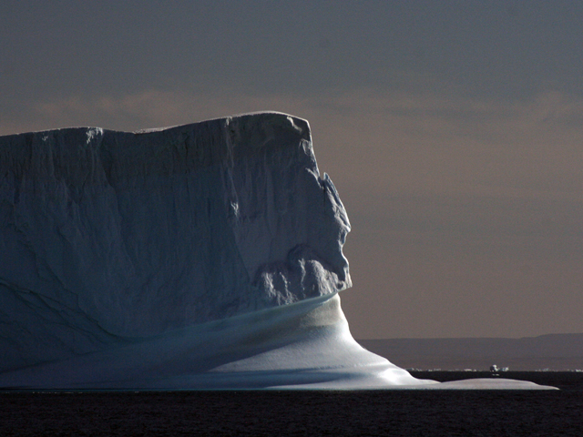





Earth: The Operators’ Manual
Good news in unexpected places
1
Richard B. Alley
Climate Literacy Network (CLN)
March 27, 2012
Please note: I work for
Penn State University,
And help UN IPCC, NRC, etc., But I am not representing them, just me.
G. Comer Foundation

Slide 2

2
First hour shown nationwide on PBS last spring
Full three-hour version in April
Stay tuned…
NSF Funded, TV, web, museum tour, book
**Accessible, apolitical, authoritative, and a lot of fun
**Streaming at www.earththeoperatorsmanual.com and PBS
Geoff Haines-Stiles & Erna Akuginow, Passport to Knowledge

Slide 3
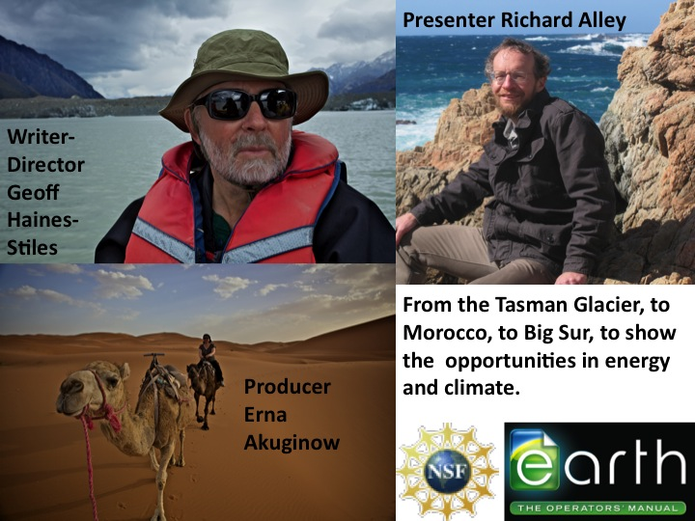
3

Slide 4
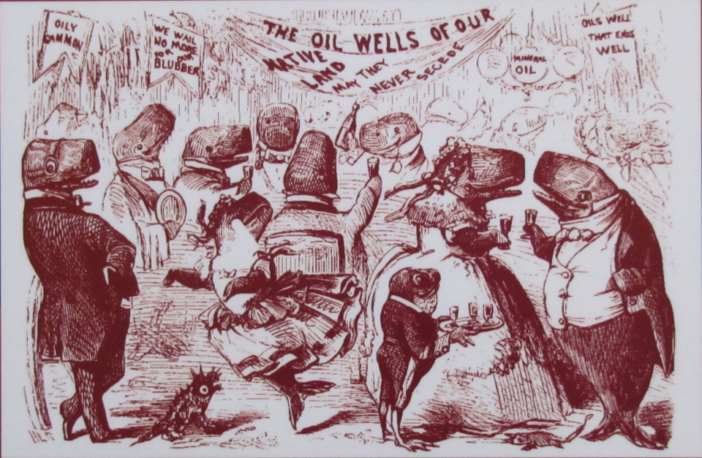
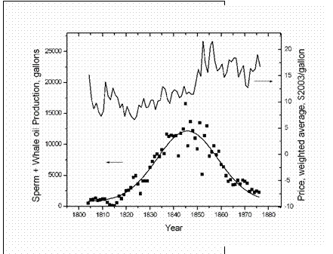
We get much good from energy use, but tend to use so much we cause problems as we run out, and suffer damaging price shocks before finding new sources
4
Drake Well, 1859
Cost
“GRAND BALL GIVEN BY THE WHALES IN HONOR OF THE DISCOVERY OF THE OIL WELLS IN PENNSYLVANIA”, VANITY FAIR, 1861
Whale-oil production, gallons
“…suggests that central banks cannot fully insulate
their economies from the consequences of oil-price shocks…”
Production
S Leduc, K Sill, 2004, J. Monetary Econ. 51, 781
Prices & Production over a complete Hubbert Cycle.. 2004, Ugo Bardi, http://www.aspoitalia.net/aspoenglish/documents/bardi/whaleoil/whaleoil.html Data from A. Starbuck, History of the American whale fishery, Seacaucus, N.J. 1878

Slide 5
5
We’re heading toward repeating history…
~85% of energy use is from fossil fuels
We’re using them ~1 million times faster than nature saved them for us
Published estimates I’ve found: entire frackable gas reserve <5 to ≈25 years of total US energy use (gas ~1/4 of use now)
Big energy-system change in <30 years very difficult…gas has much energy, many $$, NOT sustainable.

Slide 6
6
High scientific confidence:
If we burn, then learn, we will have changed climate in ways that make our grandchildren’s lives much harder
And risked really big price shocks
If we learn while we burn, we can sustainably have a better economy with more jobs and greater national security
Barriers are not in science or engineering (the wisdom of Pogo comes to mind…)

Slide 7
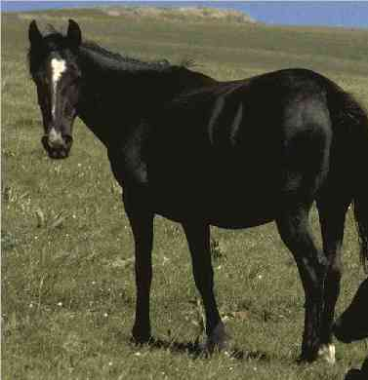
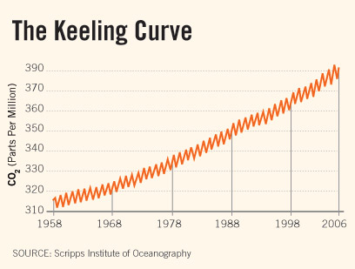
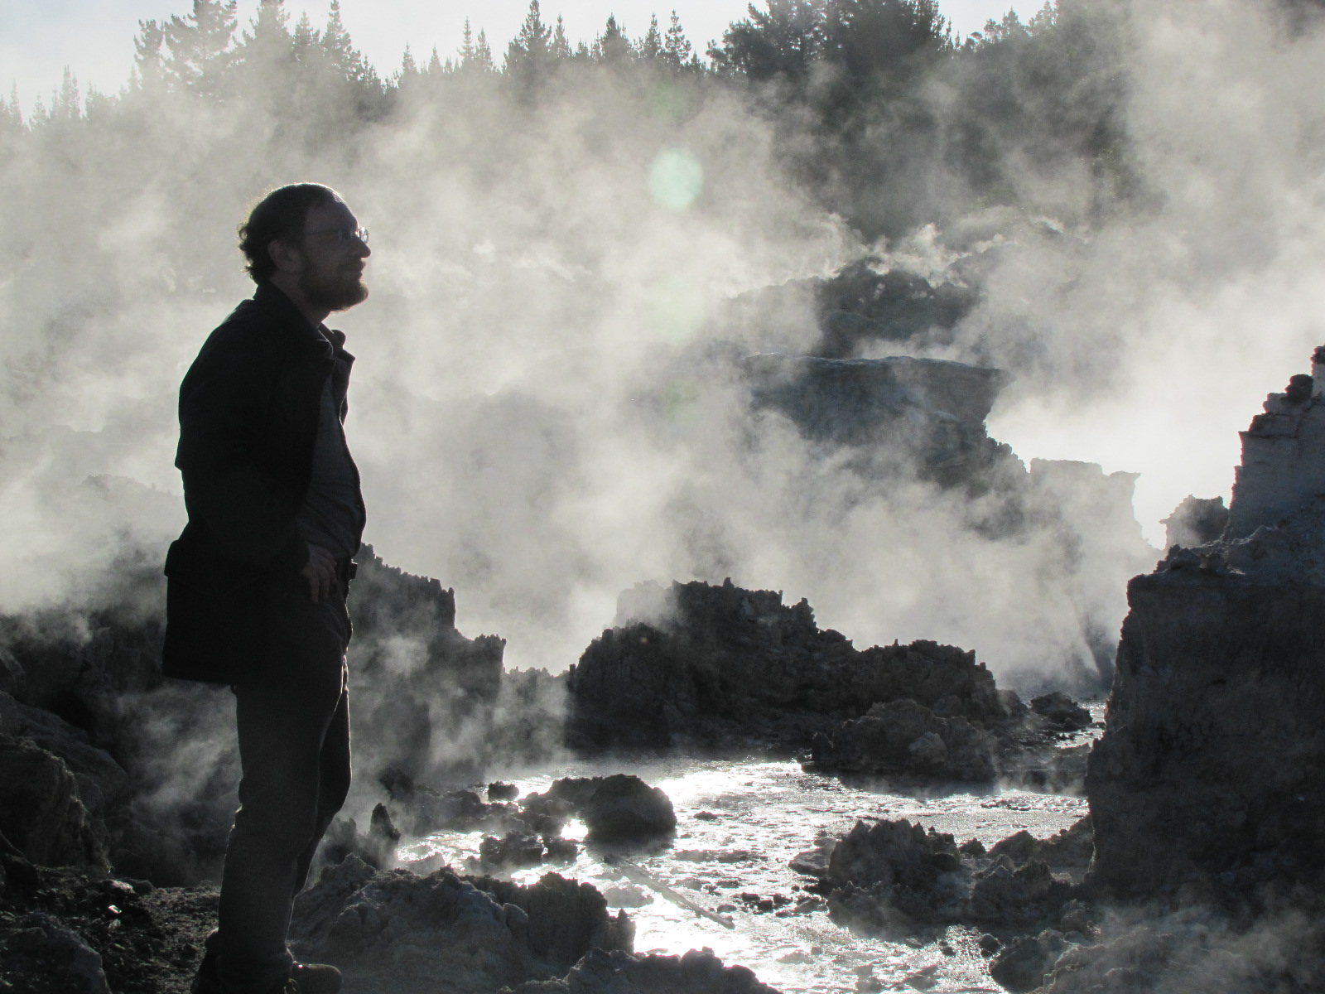
CO₂ is rising, fossil fuels main cause:
→Bookkeeping (we see CO₂ we emit in air and moving into ocean)
→No other source big enough (volcanoes 1-2% of human source)
→Fingerprints—dropping oxygen, ¹³C and ¹⁴C show CO₂ from burning of something that was alive but has been dead a long time—fossil fuels.
7
If CO₂ came out of tailpipes as horse ploppies:
→ 1 pound/mile for a typical car
→ Would cover every road in US an inch deep in 1 year
(See “It’s us” in first hour of ETOM)
http://www.npr.org/templates/story/story.php?storyId=9885767

Slide 8
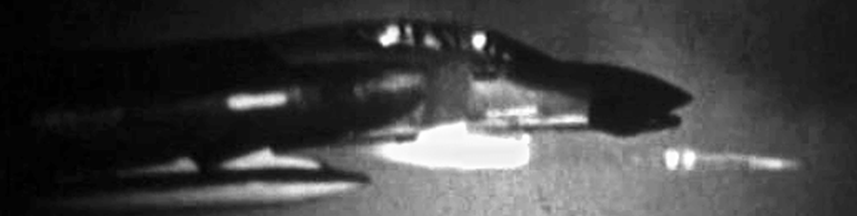
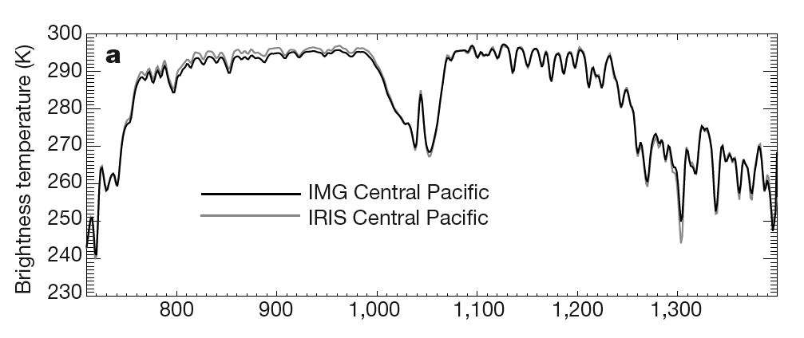
8
Basis for expecting global warming:
Is PHYSICS
**Known for over a century
**Refined by Air Force after WWII (operations, communications, and heat-seeking missiles)
**Confirmed by history
**Observed today (satellites, etc.)
Earth glowing to cool off
CO₂ blocking, warms
“Color” in infrared (wavenumber cm⁻¹)
Harries et al., 2001, Nature

Slide 9
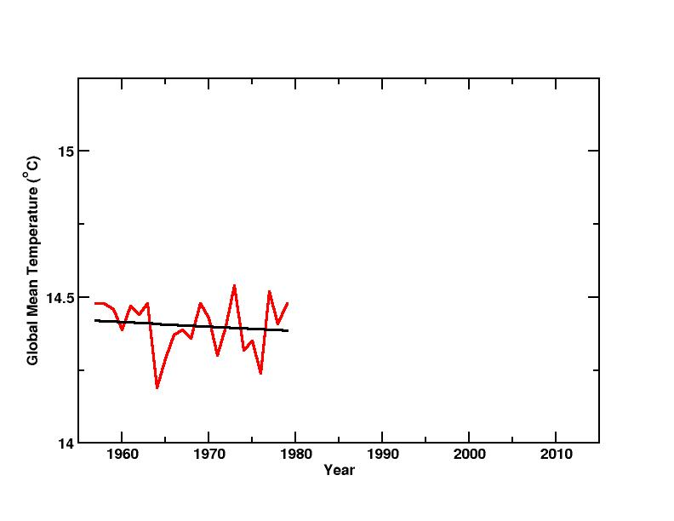
So is it warming?
9
I was born in 1957,
at the start of cooling?

Slide 10
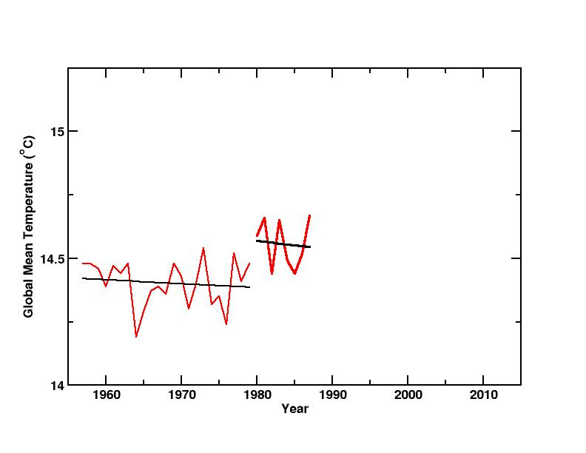
10
I got married in 1980, at the start of cooling?

Slide 11
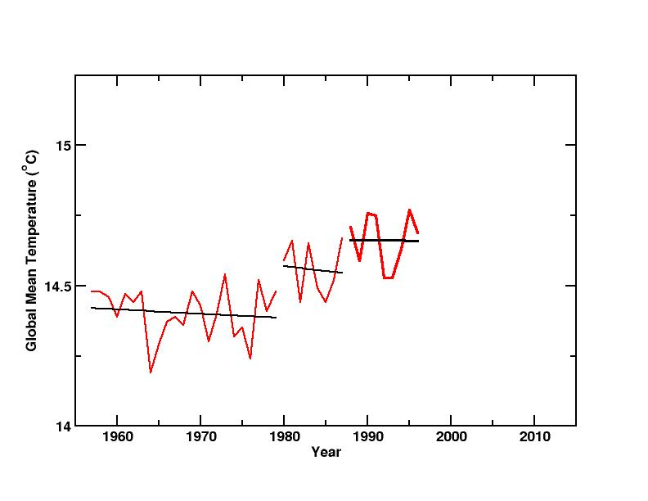
11
We moved to Penn State in 1988, at the start of cooling?

Slide 12
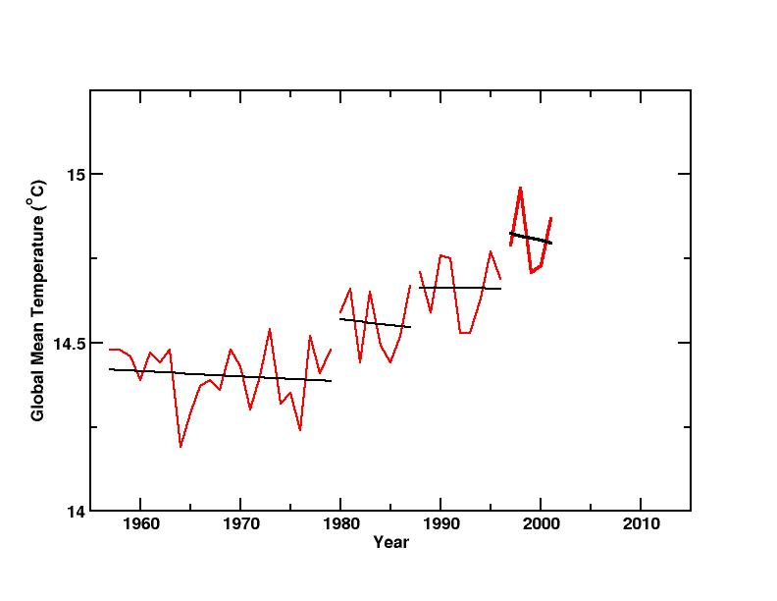
12
We toured the west in 1997, at the start of cooling?

Slide 13
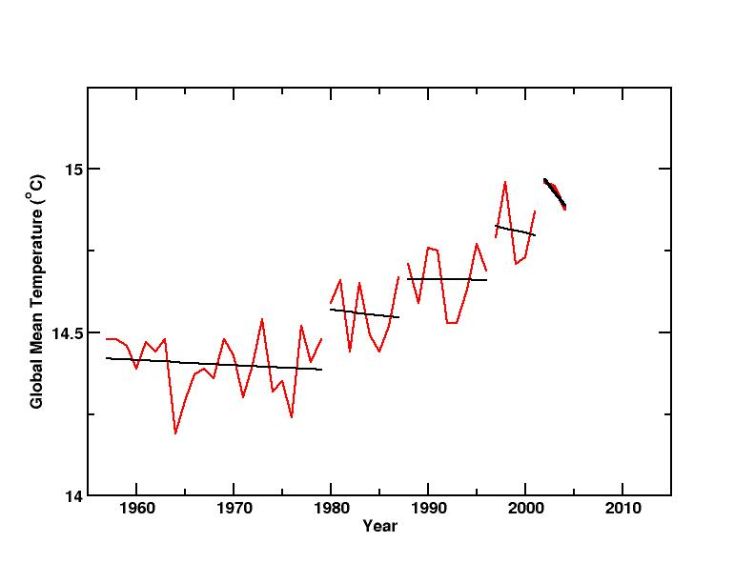
13
A glacier was named after me in 2002, at the start of cooling?

Slide 14
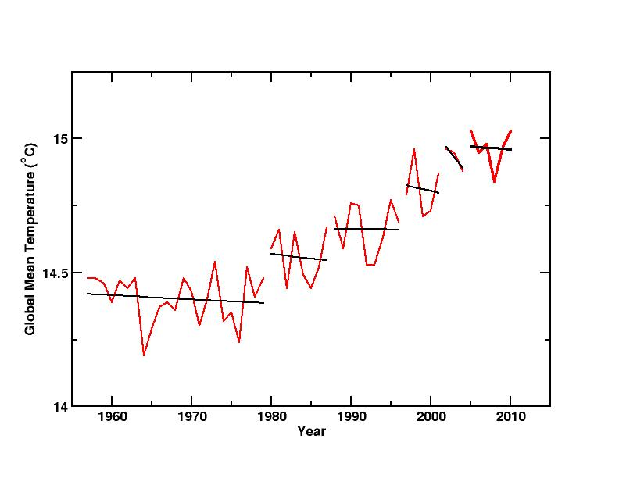
14
Daughter Janet to PSU in 2005, at the start of cooling?

Slide 15
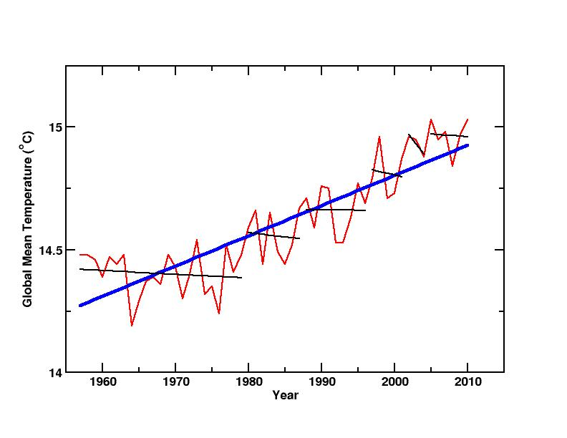
15
So has the climate been cooling my whole life? NO!
None of those shorter trends is significant, but longer trend is.

Slide 16
It is getting warmer (e.g., IPCC, 2007):
Thermometers (including outside cities, and analyzed by NOAA, and NASA, and British, and Berkeley, and…)
Thermometers in oceans, in ground, on balloons, and on satellites, analyzed in different ways by different groups
Snow and ice (temperature-sensitive times and places)—seasonal snow, lake and river ice, seasonally frozen ground and permafrost, glaciers, etc.—and where creatures live and when they do things
16
Many people are fooled by short wiggles (the black lines) in the temperature history (GISTEMP, red), but the significant trend is WARMING (blue)—people lose money in Vegas and on Wall Street based on the same confusion!

Slide 17
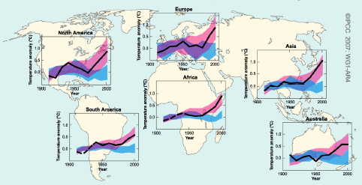
17
How much of recent warming is from CO₂ and other greenhouse gases? Most likely answer is: more than all of it. We have cooled with sun-blocking particles, sun has dimmed a bit, yet we see warming…
Blue=Nature Only Pink=Humans+Nature Black=Data
The warming occurring is not explained by nature. Changes are occurring as expected from early climate-science projections, including patterns such as upper-stratospheric cooling with surface warming, and even changes in hydrologic cycle—climate science is successfully predictive as well as explanatory.

Slide 18
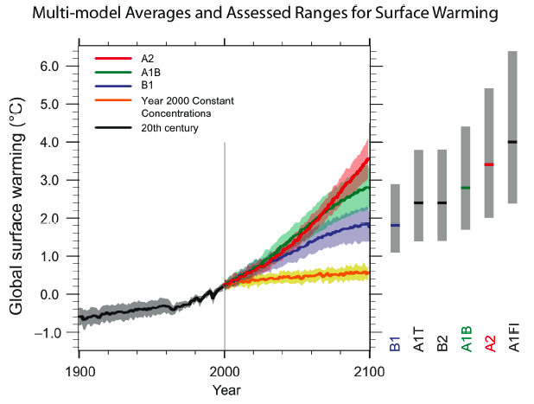
18
Warming to come (world continues past 2100…)
Future warming could be large
Changes to date confirm our scientific understanding, which shows future changes if we keep burning will be much larger than past changes.

Slide 19
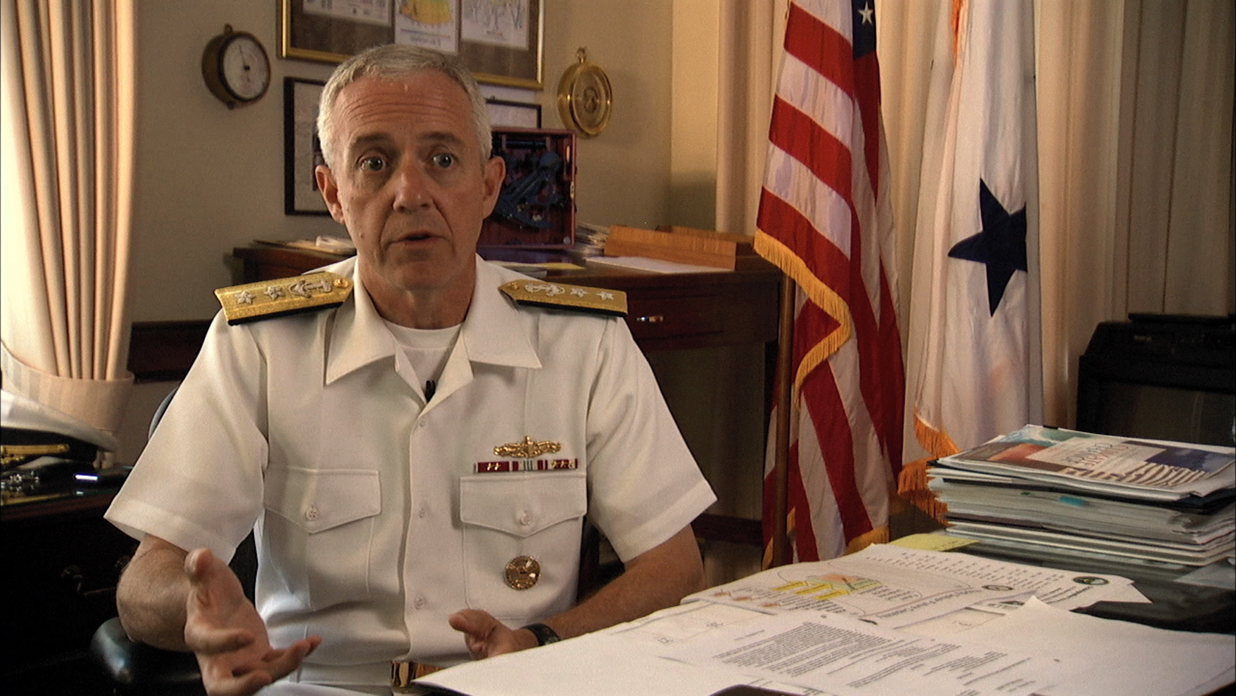
19
Rear Admiral David Titley, Oceanographer of the Navy and Navigator of the Navy
“. . . climate change, energy security, and economic stability are
inextricably linked. Climate change will contribute to food and water scarcity, will increase the spread of disease, and may spur or exacerbate mass migration.” US Pentagon QDR

Slide 20
20
Some traffic,
blah tunes
No traffic,
great
tunes
Lots of traffic,
test of emergency
broadcast system
Probability
Run over by
drunk driver
Problems
Suppose you have to drive somewhere. What are you likely to encounter, and what do you plan for?

Slide 21
Air bags, crumple zones, seat belts, kid seats, insurance, Mothers Against Drunk Driving, more—real investment.
21
Some traffic,
blah tunes
No traffic,
great
tunes
Lots of traffic,
test of emergency
broadcast system
Probability
Run over by
drunk driver
Problems
Suppose you have to drive somewhere. What are you likely to encounter, and what do you plan for?

Slide 22
22
Abrupt climate change; ice-sheet collapse; so hot that humans would need air conditioning to persist on large parts of Earth (Sherwood & Huber, PNAS, 2010)
UN-IPCC
(best estimate)
Smaller
or slower
changes
Larger
or faster
changes
Probability
Problems
My interpretation of probability of various levels of future problems.

Slide 23
Maximum Available Energy:
23
Sun 173,000 TW
Wind 1220 TW
Plants 166 TW
Waves & currents 65 TW
Geothermal 44 TW
Human use today 15 TW
Tides 4 TW
Hydroelectric 1.9 TW

Slide 24
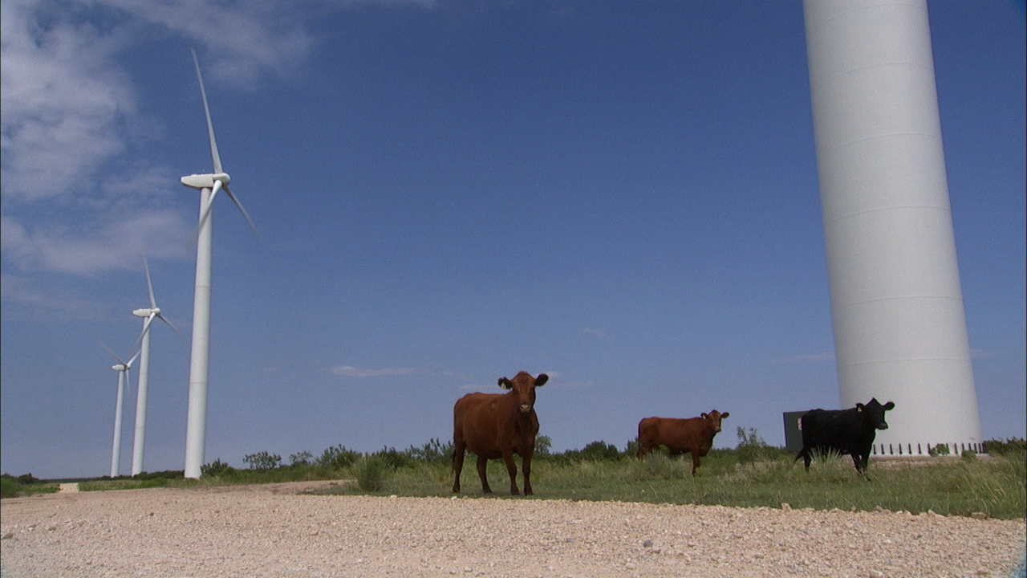
24
Take any given space of the Earth’s surface—for instance, Illinois; and all the power exerted by all the men, and beasts, and running-water, and steam, over and upon it, shall not equal the one hundredth part of what is exerted by the blowing of the wind over and upon the same space… As yet, the wind is an untamed, and unharnessed force; and quite possibly one of the greatest discoveries hereafter to be made, will be the taming and harnessing of it. Discoveries and Inventions: A Lecture by Abraham Lincoln Delivered in 1860 (John Howell, San Francisco, 1915).

Slide 25
For Energy :
25
Building a wind farm on windy parts of deserts and plains would generate ~5x more energy than world use (On land that is not city, forest or ice, with enough wind to run at >20% capacity; Lu, McElroy and Kiviluoma, 2009, Global potential for wind-generated electricity, Proceedings of the National Academy of Sciences of the USA 106, 10,933-10,938)
Some issues with batteries if a lot of wind is used, but wind is generally competitive now
Modern price ~$1 trillion/year for 30 years to install windmills to power world—U.S. alone spends over $1 trillion/year on energy
HUGE challenge, surely NOT impossible

Slide 26
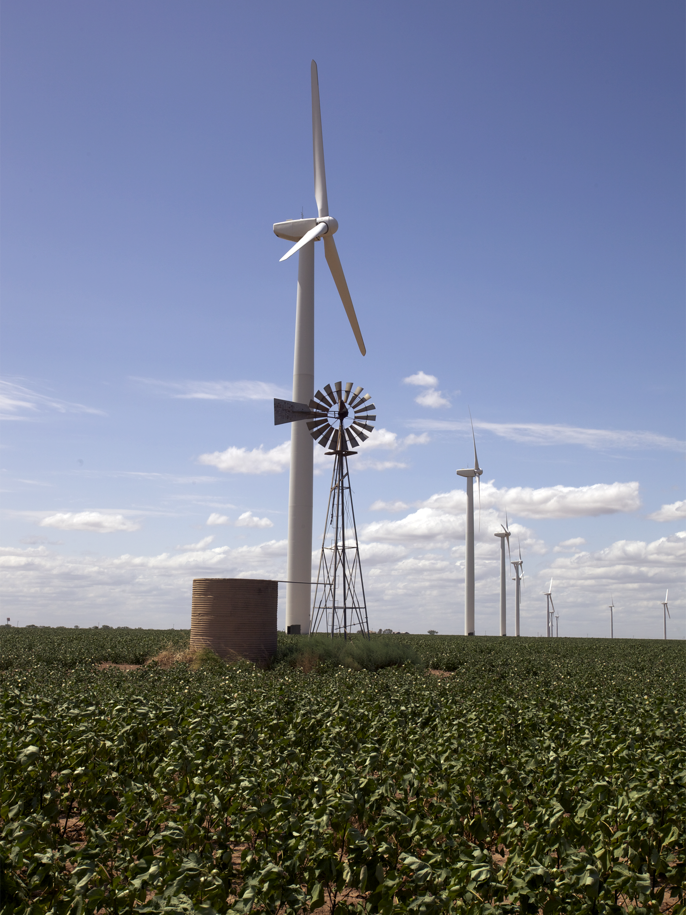
26
The US rate of windmill installation a century ago, if repeated today with modern wind turbines, would supply 1/3 of WORLD energy use from wind in 30 years.
Photo by Geoffrey Haines-Stiles for Earth: The Operators’ Manual, Texas

Slide 27
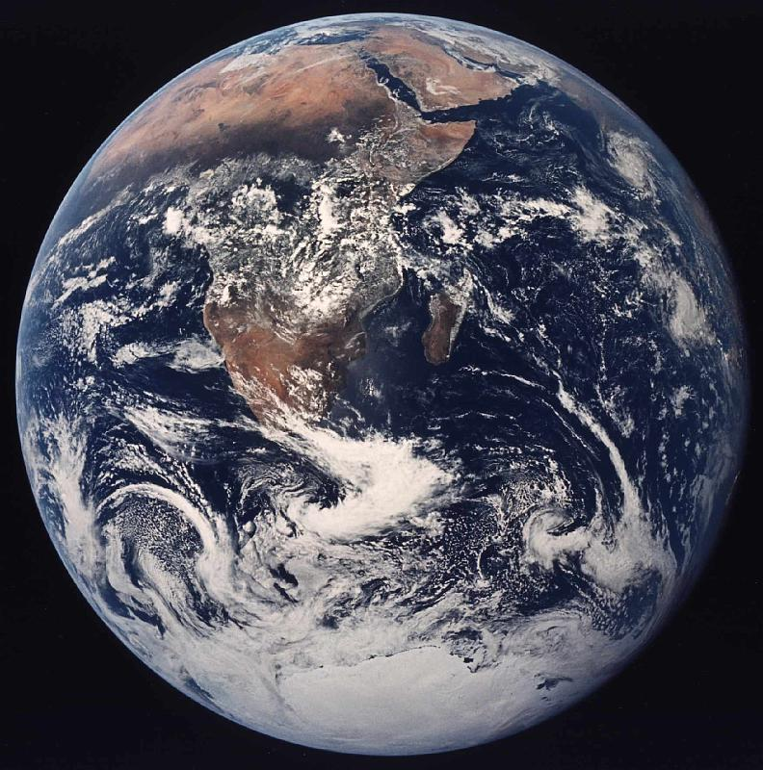
27
Global human energy use could be supplied by covering approximately this area of a tropical desert with solar cells converting 10% of sunlight to electricity.

Slide 28
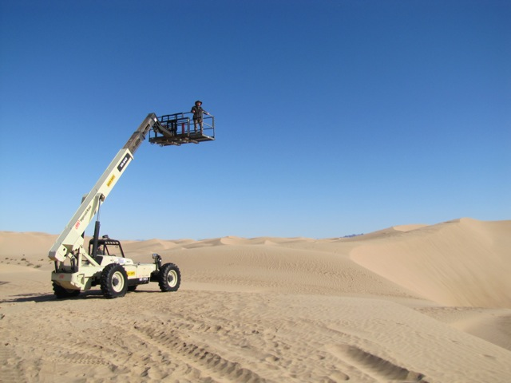
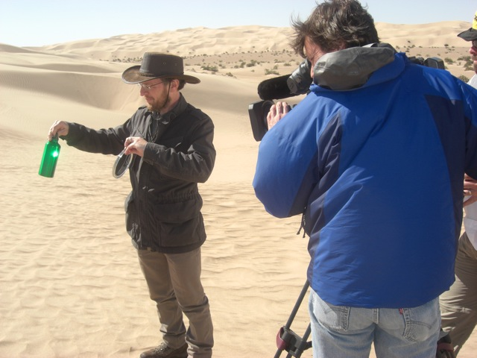
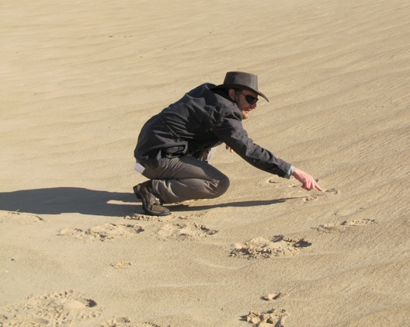
28
Cinematographer Art Howard films basic physics of concentrated solar thermal power—it worked a century ago. And 0.01% of sun’s energy would power humanity.

Slide 29
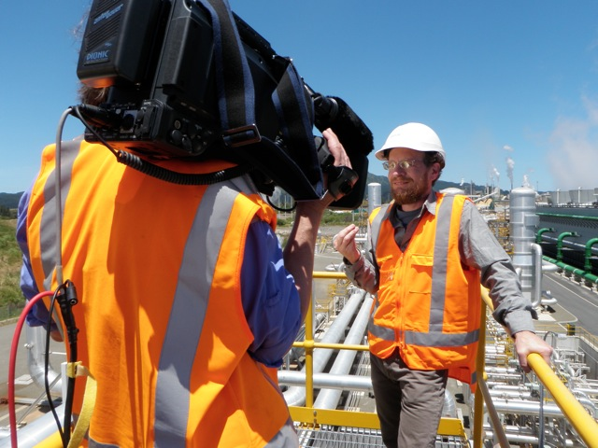
29
We aim to show how much good really is available…
here relating human-tapped to natural geothermal power in New Zealand.

Slide 30
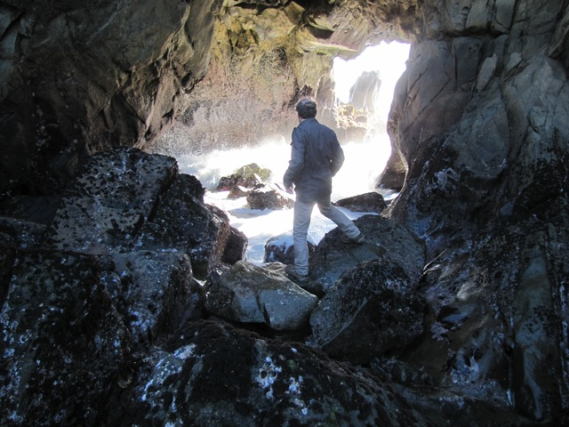
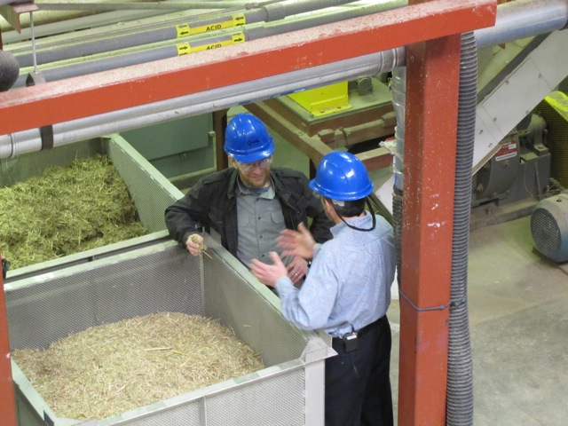
30
From waves, currents, tides and ocean thermal energy…
to cellulosic ethanol and other biofuels, including accounting for the tradeoffs (here with Jim McMillan, National Renewable Energy Lab).

Slide 31
31
Economics consistently gives same answer:
If you believe in traditional economics, with traditional discount rate, and an economy that can grow a few percent per year forever
Then you still respond to climate change
Not with panic, but over 30 years or so (Nordhaus, etc.)
This is really important, I believe—hard-nosed economics says respond!

Slide 32
32
If you care about national security, the Pentagon says that you respond to this
How about jobs? Work ongoing, but papers I found indicate response gives more jobs, or at least similar numbers. (Paying “rent” to people whose ancestors settled atop fossil fuels may not be job-optimal.)
Golden rule: losers are especially poor people in hot places, and future people, who are not causing the changes
Failure to respond is unsustainable; response can be sustainable!

Slide 33
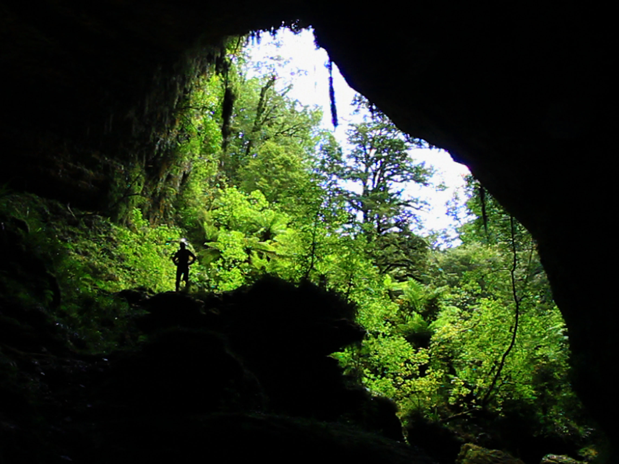
So, we can have a sustainable future, with a better economy providing more jobs and greater security while following the golden rule… If we decide we want it.

