Slide 1
Climate Feedbacks
Brian Soden
Rosenstiel School of Marine and Atmospheric Science
University of Miami
Notes:
Consider 3 quantities: temp, precip, large-scale circulation

Slide 2
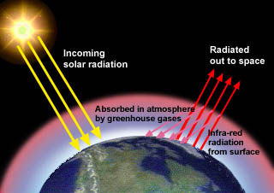
Physics of Climate Change
In Equilibrium
Absorbed Solar = Outgoing IR
240 W/m2
240 W/m2
236 W/m2
Instantly double CO2
Absorbed Solar > Outgoing IR
Surface Temperature Warms
Outgoing IR increases until
Absorbed Solar = Outgoing IR
Ts = 287 K
Ts = ??? K
Notes:
Now compare the wv rate to that of precip.

Slide 3
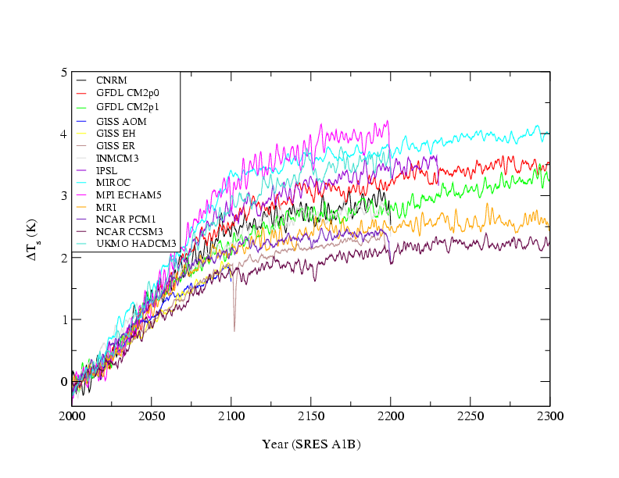
Key Climate Feedbacks
IPCC AR4 GCMs
+ clouds
Global Mean Surface Temperature
+ snow/ice
+ water
vapor
Consistent across
models
Direct
Forcing
of CO2

Slide 4
Climate Feedback
A sequence of interactions that may amplify (positive) or dampen (negative) the response of the climate to an initial perturbation.
Example: Snow/Ice Feedback
+
Surface T
Absorbed
Sunlight
-
-
Ice/Snow Cover

Slide 5
Water Vapor Feedbacks
+
Surface T
Greenhouse
Effect
+
+
H₂O Vapor
All models predict a strong positive feedback
from water vapor.
Notes:
Water vapor feedback provides a fairly simple picture to get started with.

Slide 6
IPCC Assessments: Water Vapor Feedback
1990: “The best understood feedback mechanism is water vapor feedback,
and this is intuitively easy to understand”

Slide 7
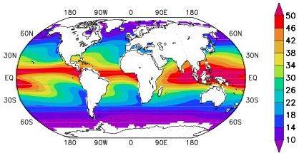
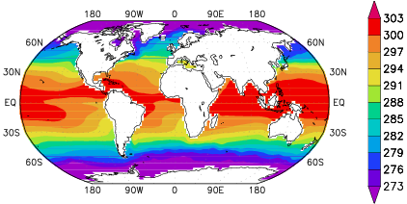
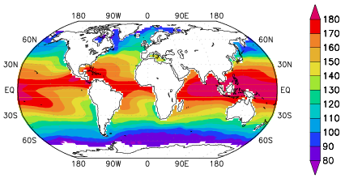
Water Vapor Feedback
Satellite observations illustrate how water vapor enhances regional differences in ocean temperature.
Atmospheric Water Vapor (kg/m²)
1.
Ocean Surface Temperature (K)
2.
Greenhouse Effect (W/m²)
3.
1. Warmer oceans → more water vapor.
2. More water vapor → larger Greenhouse Effect.
3. Larger GHE → warmer oceans.
Notes:
WV is important for GHE. But what makes water vapor so important for GW is that its concentrations depend strongly on the temperature of the air. Warmer air can hold more wv before reaching saturation.
Will wv increase in response to global warming? If so, how much will this increase further exacerbate the warming?

Slide 8
IPCC Assessments: Water Vapor Feedback
1990: “The best understood feedback mechanism is water vapor feedback,
and this is intuitively easy to understand”
1992: “There is no compelling evidence that water vapor feedback is
anything other than positive—although there may be difficulties with upper tropospheric water vapor”
1995: “Feedback from the redistribution of water vapor remains a substantial
source of uncertainty in climate models”
2001: “The balance of evidence favours a positive clear-sky water vapour feedback of magnitude comparable to that found in (model) simulations“
2007: “Observational and modelling evidence provide strong support for a combined water vapour/lapse rate feedback of around the strength found in GCMs”

Slide 9
Testing Model Predictions of Water Vapor
Models capture:
Moistening of tropical atmosphere during warm (El Nino) events.
Drying of tropical atmosphere during cold (La Nina) events.
Pinatubo
El Nino
(warm)
La Nina
(cold)
El Nino
La Nina
Notes:
Clearly WVFB is important. Consistency across models may be reassuring. Consistency across models is not enough. To develop confidence in models we must have some way of testing them against observations.
In this example, the model is given the ocean surface temperature

Slide 10
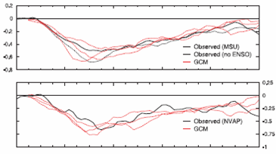
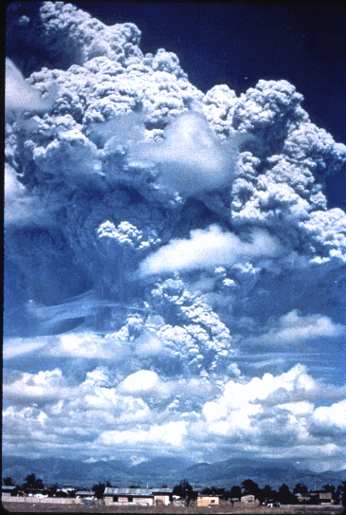
Global Cooling and Drying after Mt. Pinatubo
Temperature (C)
Water Vapor (mm)
Atmosphere cools and dries following eruption.
Climate models successfully reproduce observed
cooling and drying.
Eruption of
Mt. Pinatubo
June 1991
Notes:
When Pinatubo erupted it injected a cloud of dust high into the atmosphere which lasted for ~4 years. Blocked sun and provided a temporary cooling of the climate. In a sense, the volcanic eruption provides a mini-global cooling experiment which we can use to test models.
Different models – predict the temperature

Slide 11
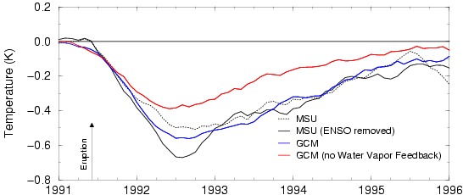
Testing Water Vapor Feedback
Observed
Model without water vapor feedback significantly underestimates cooling.
Water vapor amplifies pre-existing temperature change (either warming or cooling).
Notes:
How much did this drying actually amplify the cooling?

Slide 12
Cloud Feedback
-
Surface T
+
Reflected
Sunlight
?
Greenhouse
Effect
+
Cloud Cover
+
Cloud feedback is uncertain in both magnitude and sign.
Notes:
Cloud feedback is both more complicated and more uncertain (than water vapor). Cloud feedbacks are uncertain because the response of clouds to surface T is unknown and the balance between solar and infrared feedbacks is also uncertain. May also depend on type of cloud.

Slide 13
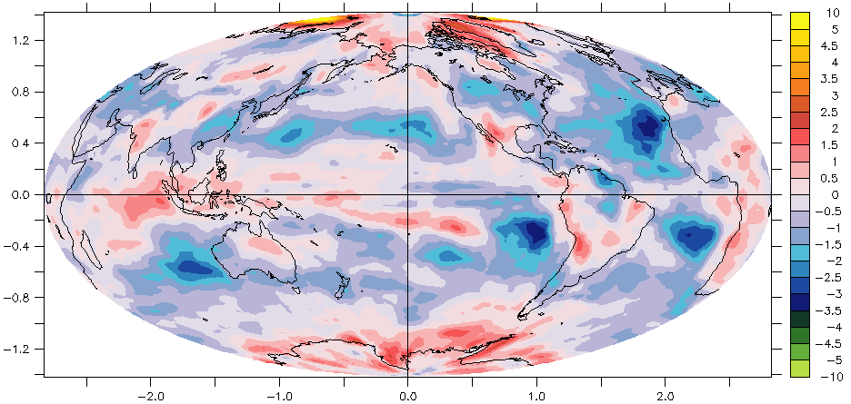
The Problem Clouds
Regional contribution to intermodel spread in cloud feedback
Subtropical marine stratocumulus clouds are responsible for most (~2/3) of the uncertainty in cloud feedback in current models.

Slide 14
Thank You!
Questions?

Slide 15
EXTRA SLIDES

