Slide 1
Field Guide to Climate Misconceptions
As you come in, type into the chat:
What do you want to know about climate misconceptions?

Slide 2
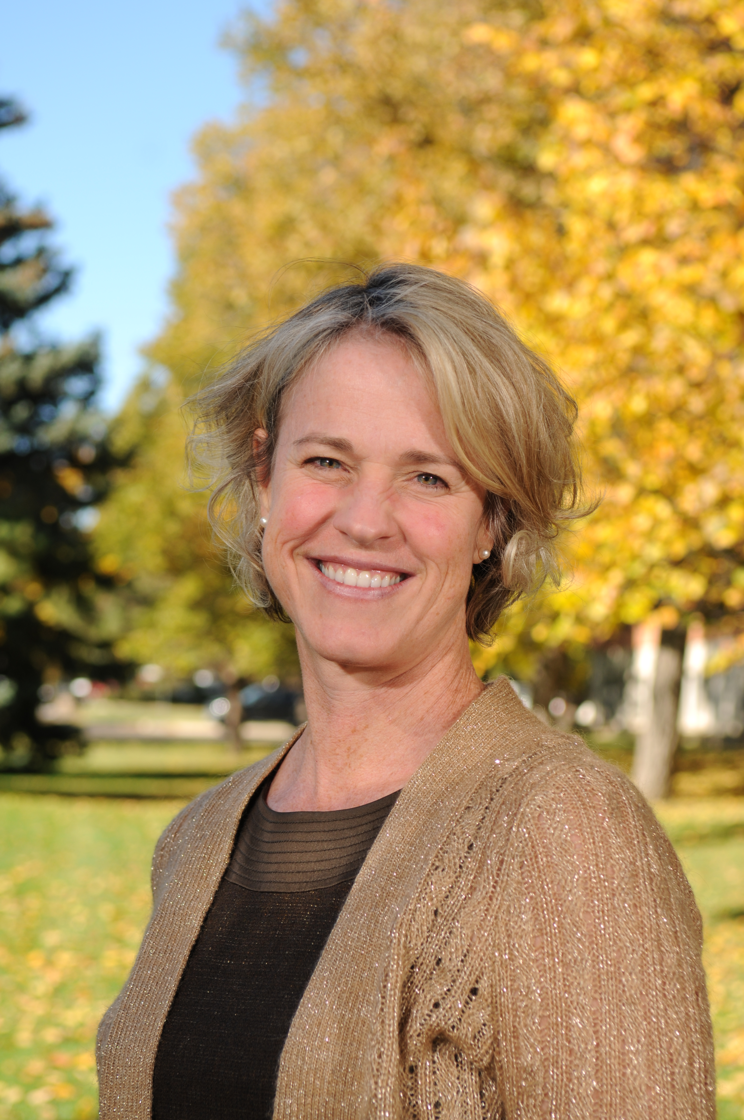
Field Guide to Climate Misconceptions
Susan Buhr
Notes:
Susan Buhr is director of the education and outreach group at the Cooperative Institute for Research in Environmental Sciences. Dr. Buhr holds a PhD in atmospheric chemistry and has provided professional development for teachers on environmental and climate topics since 1996.

Slide 3
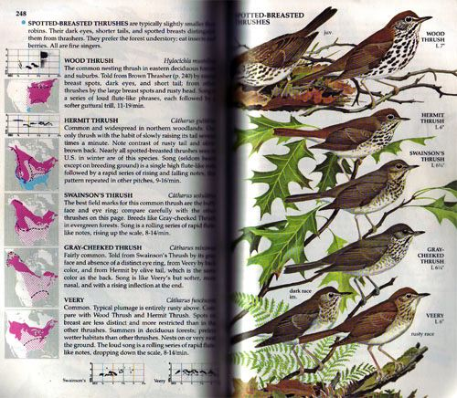
Field Guide to Climate Misconceptions
Strategies to spot misconceptions?
What types of misconceptions exist?
Variations on themes
Addressing misconceptions
Notes:
We can use strategies to uncover misconceptions and to know under what circumstances we are likely to encounter particular misconceptions. With practice misconceptions can evolve into more scientifically accurate concepts. It takes lots of cognitive dissonance, dialogue, data and experience to make meaningful change.

Slide 4
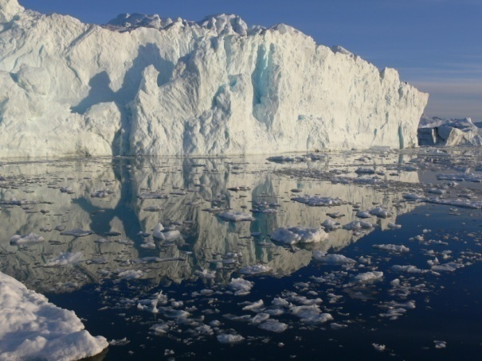
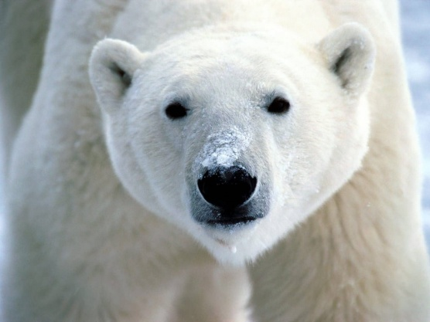
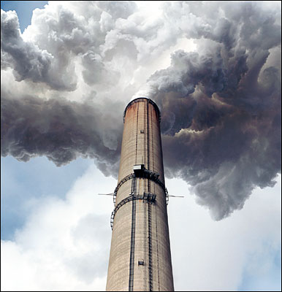
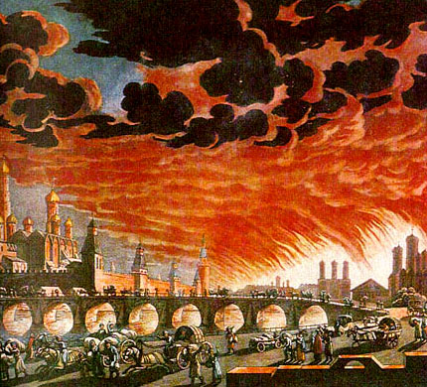
Do misconceptions matter?
happening far away (it’s not urgent)
happening to non-humans (it’s low priority)
it’s pollution (don’t use spray bottles)
it’s weather (can’t affect it)
it’s an apocalypse (it’s too late!)
appropriate mental
models involve a
global systems
perspective
Notes:
We can try to address each climate misconception individually, or we can listen closely to what our audience knows, and try to frame our response in a way that will help them build a more inclusive mental model.
Misconceptions lead to lack of concern and wrong ideas about what can be done to address the climate change issue.

Slide 5
Try this
Which answer below best represents carbon dioxide levels in the atmosphere today?
450 ppmv
390 ppmv
280 ppmv
180 ppmv
Write on whiteboard or chat: How do you know what you know about your answer? Please be specific.

Slide 6
How confident are you?
Which answer below best represents your confidence in your answer?
Very confident
Confident
Somewhat confident
Not at all confident
Notes:
How do you know what you know? On what basis?

Slide 7

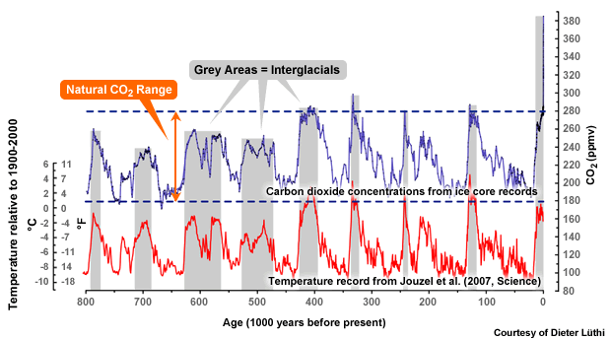
What is today’s CO2 level?
450
Stabilize 2C
Today=393 ppm
390
Pre-Industrial
Last ice age
Graphic from COMET
Graphic: COMET

Slide 8
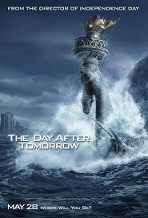
Sources of climate concepts (good, bad and ugly)
“The greatest obstacle to new learning often is not the student’s lack of prior knowledge but, rather, the existence of prior knowledge” Angelo and Cross, Classroom Assessment Techniques, 1993
Everyday experience
Parents, friends
Vicarious experience- movies
Internet-blogs, websites
School, textbook graphics
Help or hindrance?
Notes:
This prior knowledge can be problematic for instruction. Movies can lead to emotional responses that are not helpful-raising concern but also raising the tendency to turn away or shut down. School helps if it is done well. Textbook graphics lead to misconceptions a lot.

Slide 9
How do you spot misconceptions?
Type in the chat: What is your favorite way to uncover misconceptions?

Slide 10
A Novice Learner Probe
Seven students argued about what they thought were major human causes of global warming. This is what they thought were causes that cold be attributed to humans:
Maria: acid rain
Natalia: burning coal
Tessa: the fuel we use in our cars
Blaine: using leaded gasoline instead of unleaded
Raul: the thinning of the Earth’s ozone layer
Circle the name(s) of the student(s) you agree with. Explain why you agree.
Keeley and Tugel, Uncovering Student Ideas in Science Vol 4, 2009
Notes:
Keeley and Tugel, Uncovering Student Ideas in Science Vol 4, 2009
What are some ways probes may backfire? There is a concern that multiple choice quizzes may introduce or confirm misconceptions.

Slide 11
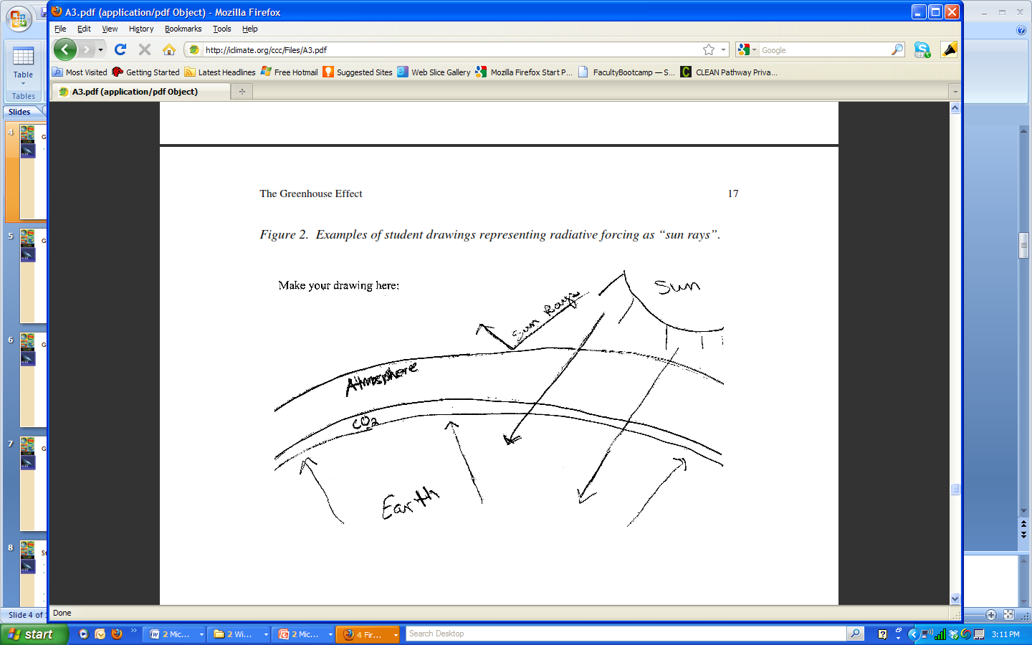
Draw the greenhouse effect2
Shepardson, et. al., 2010
Notes:
This is a great way to see misconceptions. In this drawing see how the CO2 exists in a layer. I once taught a class where the students who were in fields such as dance and film all conceived of a concept in the same way in the drawing, different than the science majors. Super interesting. I wouldn’t have seen that with a multiple choice.

Slide 12
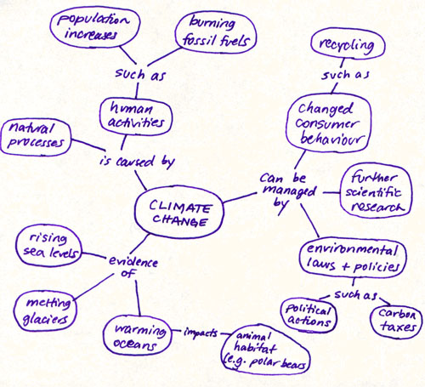
How does climate change impact polar bear habitat?
Example from U. of Victoria
Notes:
What is the probe question? I think this must be a pre-assessment.

Slide 13
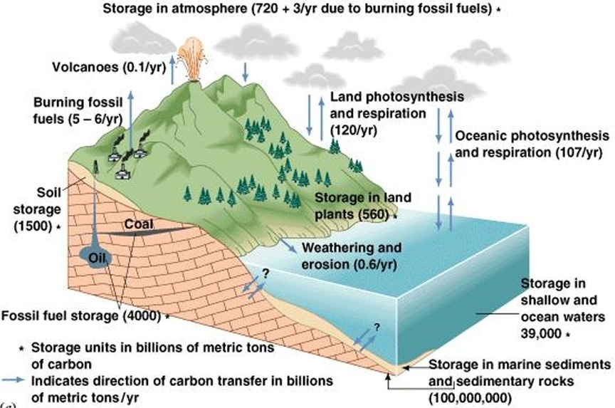
Undergraduate level probe
Q: How might human activities affect the carbon cycle?
Source of Diagram: The Blue Planet, Skinner et al., 1999
courtesy of Dr. John Madsen, U. of Delaware
Notes:
Used with an introductory undergraduate class. Students held a variety of misconceptions about the carbon cycle as will be discussed later.

Slide 14
Uncovering misconceptions
Multiple choice quizzes-caveat
Prior conception probes
Concept maps-shows fragmentation
Class discussion
What else?
Resources:
Angelo and Cross (1993) Classroom Assessment Techniques,
Keeley, Uncovering Student Ideas in Science series
CLEAN Teaching About pages
Notes:
Just some of the ways you can uncover misconceptions. If you have more ideas, write them in the chat. One minute papers, muddiest point papers, all kinds of ways to learn what students think and get them talking (and thinking) about their ideas.

Slide 15
Which misconceptions are most common?
In chat, list the most common misconceptions you have encountered.

Slide 16
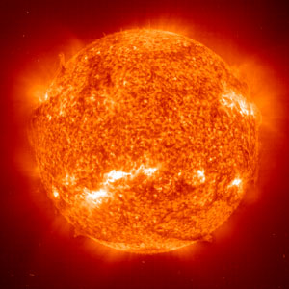
Solar activity

Slide 17
It’s the Sun, stupid!
Increased radiation causes recent climate change
Increased sun spots cause recent climate change
Changes in Earth’s orbit causes recent climate change
Warming is due directly to sunlight.

Slide 18
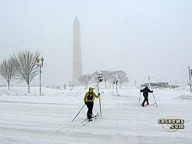
Variability

Slide 19
Misunderstanding variability
Seasonal: The Equator is warmer because it is closer to the Sun
Seasonal: Summer is warmer because the Earth is closer to the Sun.
Weather is the same as climate-if we have a blizzard, so much for global warming
Sea ice is recovering so climate change isn’t happening
Last few years are cooler so warming has stopped

Slide 20
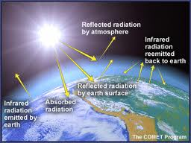
Greenhouse effect

Slide 21
Greenhouse effect
Greenhouse effect is the same as albedo or reflectivity
If other greenhouse gases exist, CO2 is not responsible for recent climate change
Greenhouse effect is same mechanism as a physical greenhouse
Greenhouse effect is bad
Greenhouse effect is due to humans
Greenhouse effect is not proven (less of this one)

Slide 22
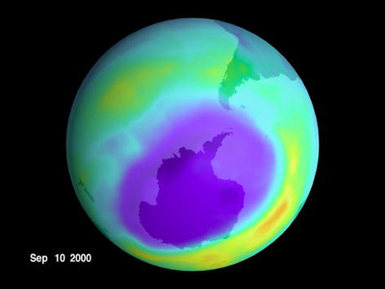
Ozone layer

Slide 23
Ozone and climate change
The ozone hole is causing climate change
Global warming is causing the ozone hole
The ozone hole lets in more heat/radiation
Not using aerosol bottles (or polluting) leads to less climate change
Fossil fuel use leads to ozone destruction.
Global warming causes skin cancer
Constructs are fuzzy

Slide 24
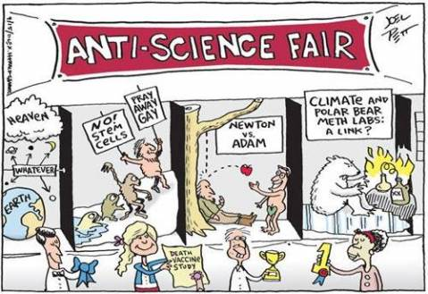
Non/Anti-Science

Slide 25
Non-/Anti-Science
Peer-reviewed science is the kool-aid of the liberal conspiracy
The climate system is too complex to understand
Scientists are over-stating the issue to get funding
It’s hubris to think we can change anything

Slide 26
Undergraduate level probe
Q: How might human activities affect the carbon cycle?
Source of Diagram: The Blue Planet, Skinner et al., 1999
courtesy of Dr. John Madsen, U. of Delaware

Slide 27
carbon concepts study
39% of undergrads held some misconception(s)
misconceptions fell into 4 categories:
  carbon equated with all pollutants
  total carbon is increasing, decreasing, or rate of movement is changing
  carbon thins atmosphere or destroys ozone
  carbon creates a catastrophe

Slide 28
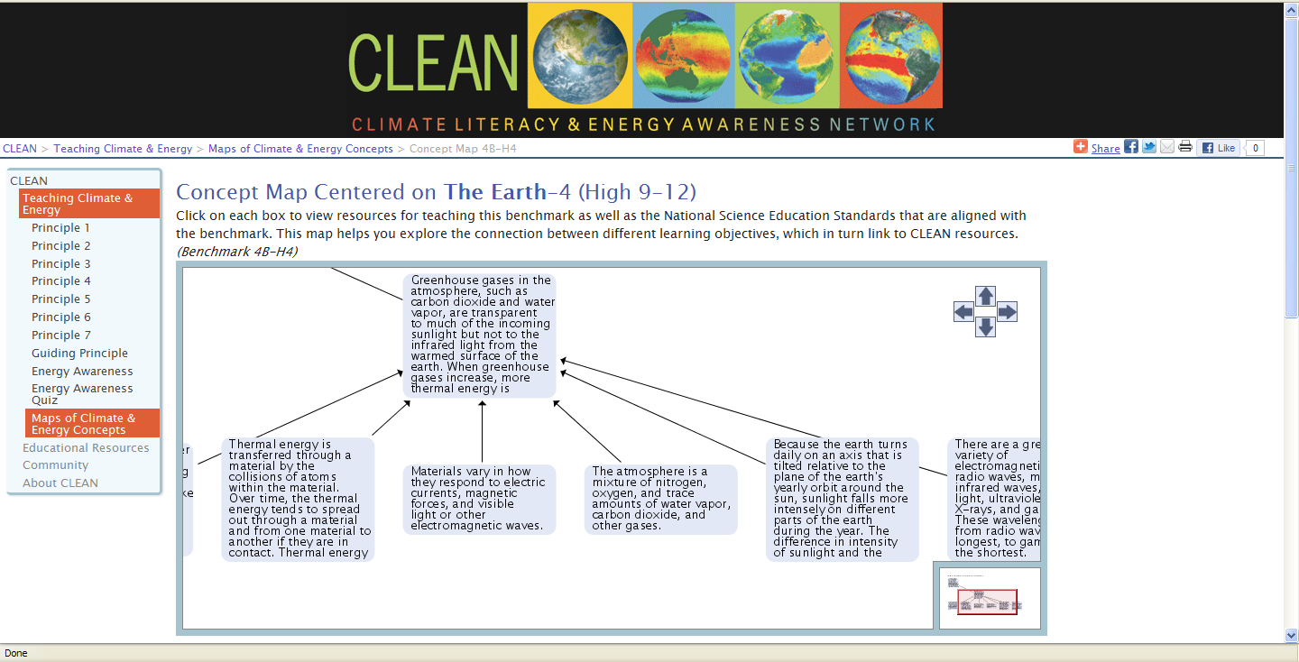
Sources for target concepts

Slide 29
Which of these do you use to address misconceptions?
A Help students become aware of their own thinking
B. Students interact with data
C. Emphasize the nature of science and practices of science
D. Students practice scientific dialogue

Slide 30
Strategies that lead to change
Raise student metacognition
Cause cognitive conflict
Understand nature of science, quality of research
Help student “self-repair” misconceptions
Engage students in argumentation to strengthen new knowledge
Joan Lucariello CUNY
Apa.org/education/k12/misconceptions.aspx

Slide 31
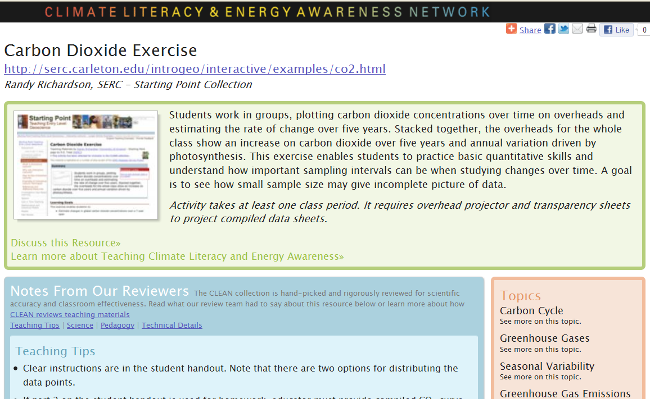
Examples from the CLEAN collection
http://cleanet.org/resources/41805.html

Slide 32
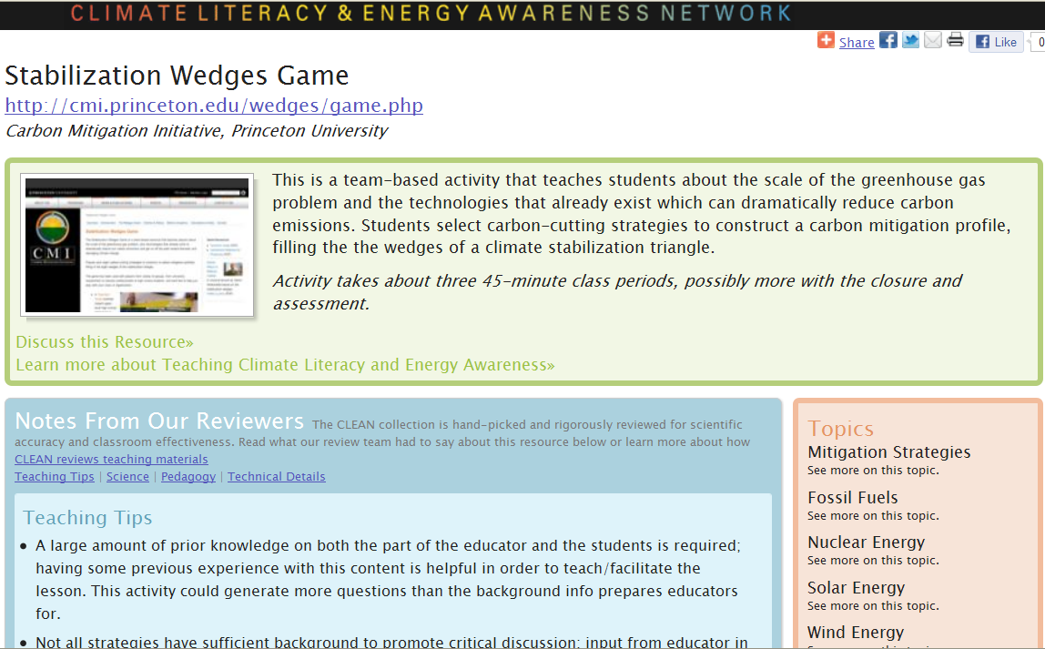
Examples from the CLEAN collection
http://cleanet.org/resources/41709.html

Slide 33
Conclusions
Major misconceptions are knowable
Repairing” takes time and thought
Being a positive, reliable source is important.

Slide 34

Not-So-Serious Climate and Energy Book Club
The Climate Diaries 2015 by Saci Lloyd.
Email me susan.buhr@colorado.edu

Slide 35
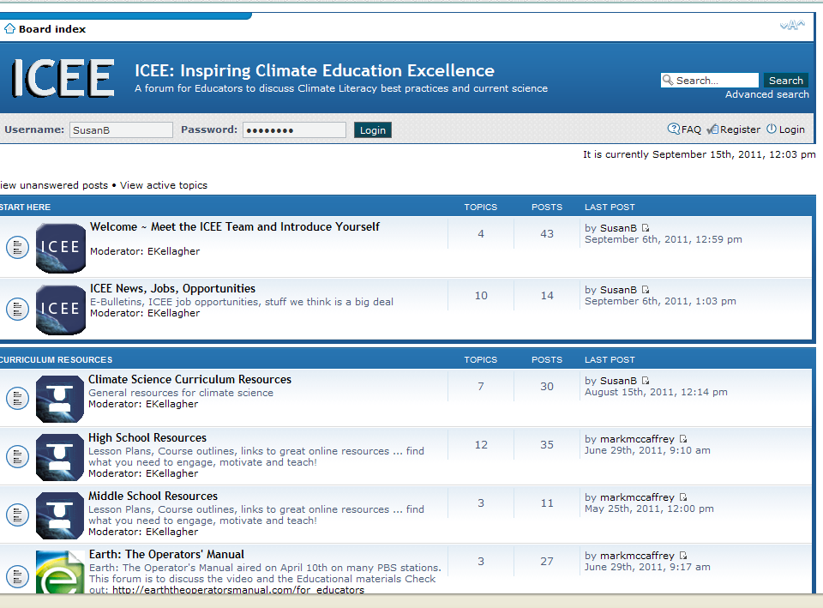

Contact
Susan Buhr susan.buhr@colorado.edu
Iceeonline.org/forum
Not-So-Serious Book Club starting now!
Online course Fall 2012
Sign for email list at outreach@cires.colorado.edu
Questions?

