Slide 1



Communication & Debunking with
Sticky Science
John Cook
Climate Literacy and Environmental Awareness Network
^{Date: 17 May 2012}

Slide 2
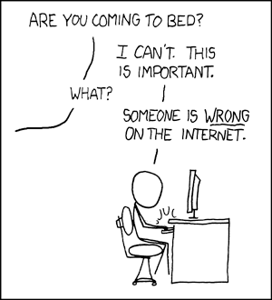

Slide 3

One Model of the Human Brain

Slide 4
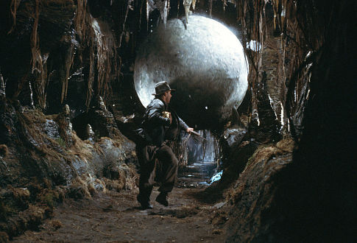
A More Accurate Model
of the Human Brain

Slide 5


Familiarity
Backfire Effect
Debunking a myth can reinforce the myth in people’s minds
(Schwarz et al 2007)

Slide 6
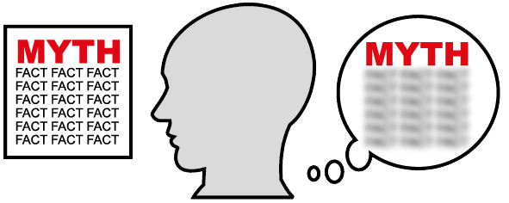
Familiarity Backfire Effect

Slide 7
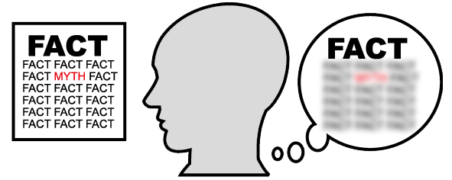
Familiarity Backfire Effect

Slide 8
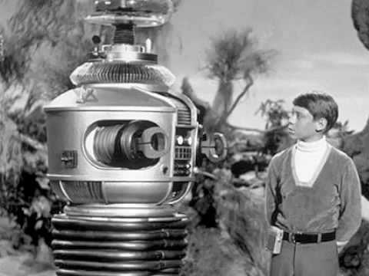
Danger,
Will Robinson!
Approaching
myth!

Slide 9
The Overkill Backfire Effect
A simple myth is more cognitively attractive than an over-complicated correction
(Schwarz et al 2007)

Slide 10
The Overkill Backfire Effect
A simple myth is more cognitively attractive than an over-complicated correction
(Schwarz et al 2007)

Slide 11
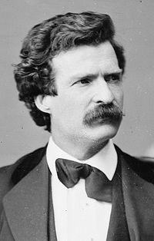
“I didn’t have time
to write a short letter,
so I wrote a long one instead.”
MARK TWAIN

Slide 12
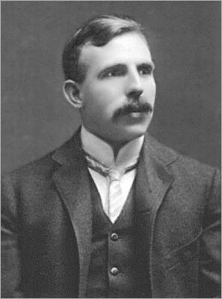
“If you can’t explain your physics to a barmaid, it is probably not very good physics.”
ERNST RUTHERFORD

Slide 13
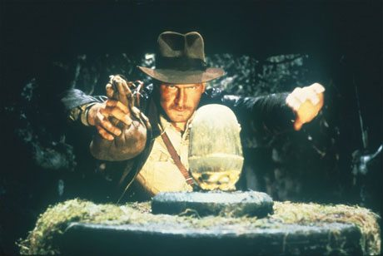
Another psychological pitfall

Slide 14
Create a Gap

Slide 15
Fill the Gap

Slide 16
Anatomy of an Effective Debunking

Slide 17
Anatomy of an Effective Debunking
97 out of 100 climate experts agree humans are causing global warming
Several independent surveys find 97% of climate scientists who are actively publishing peer-reviewed climate research agree that humans are causing global warming.
Core fact

Slide 18
Anatomy of an Effective Debunking
97 out of 100 climate experts agree humans are causing global warming
Several independent surveys find 97% of climate scientists who are actively publishing peer-reviewed climate research agree that humans are causing global warming.
Core fact
However, movements that deny a scientific consensus have always sought to cast doubt on the fact that a consensus exists. One technique is the use of fake experts, citing scientists who have little to no expertise in the particular field of science.
Warning

Slide 19
Anatomy of an Effective Debunking
97 out of 100 climate experts agree humans are causing global warming
Several independent surveys find 97% of climate scientists who are actively publishing peer-reviewed climate research agree that humans are causing global warming.
Core fact
However, movements that deny a scientific consensus have always sought to cast doubt on the fact that a consensus exists. One technique is the use of fake experts, citing scientists who have little to no expertise in the particular field of science.
Warning
For example, the OISM Petition Project claims 31,000 scientists disagree with the scientific consensus on global warming.
Myth

Slide 20
Anatomy of an Effective Debunking
97 out of 100 climate experts agree humans are causing global warming
Several independent surveys find 97% of climate scientists who are actively publishing peer-reviewed climate research agree that humans are causing global warming.
Core fact
However, movements that deny a scientific consensus have always sought to cast doubt on the fact that a consensus exists. One technique is the use of fake experts, citing scientists who have little to no expertise in the particular field of science.
Warning
For example, the OISM Petition Project claims 31,000 scientists disagree with the scientific consensus on global warming.
Myth
However, around 99.9% of the scientists listed in the Petition Project are not climate scientists. The petition is open to anyone with a Bachelor of Science or higher and includes medical doctors, mechanical engineers and computer scientists.
Alternative
Explanation

Slide 21
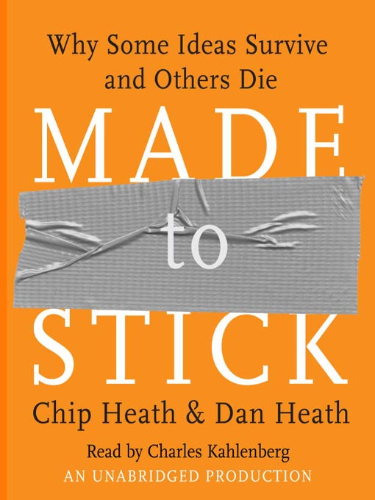

Slide 22
“Fight sticky ideas with stickier ideas.”

Slide 23
What makes an idea sticky?
SUCCES

Slide 24
What makes an idea sticky?
SUCCES
Simple

Slide 25
What makes an idea sticky?
SUCCES
Simple
Unexpected

Slide 26
What makes an idea sticky?
SUCCES
Simple
Unexpected
Concrete

Slide 27
What makes an idea sticky?
SUCCES
Simple
Unexpected
Concrete
Credible

Slide 28
What makes an idea sticky?
SUCCES
Simple
Unexpected
Concrete
Credible
Emotional

Slide 29
What makes an idea sticky?
SUCCES
Simple
Unexpected
Concrete
Credible
Emotional
Stories

Slide 30
The Curiosity Gap

Slide 31
The Curiosity Gap
Generate curiosity by opening gaps in their knowledge then filling those gaps

Slide 32
Debunking Method
Fill the gap with an alternative explanation
Create a gap with the facts

Slide 33
Debunking Method
Fill the gap with an alternative explanation
Create a gap with the facts
Generating Curiosity
Create a gap to generate curiosity
Fill the gap with answers to questions

Slide 34
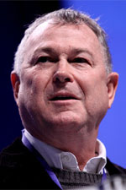
Example of a Debunking
“…the earth quit warming and now we may be in a cooling cycle.”
DANA ROHRABACHER

Slide 35
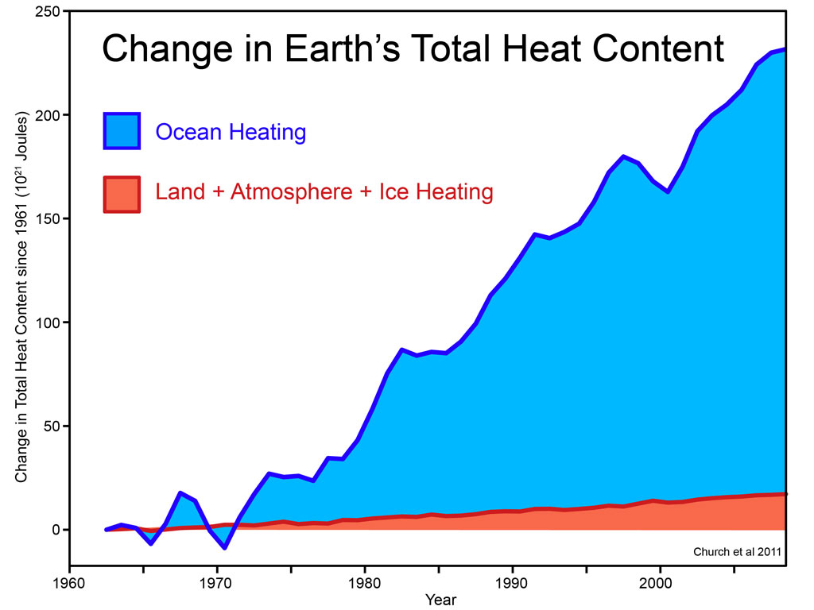
Notes:
35

Slide 36
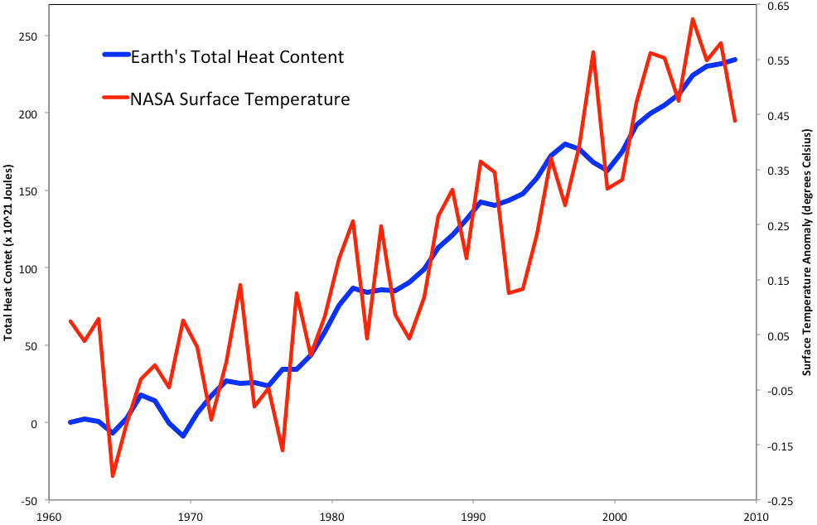
Notes:
36

Slide 37
Simple
Notes:
37

Slide 38
Simple
Unexpected
Notes:
38

Slide 39
Simple
Unexpected
Concrete
Notes:
39

Slide 40
Simple
Unexpected
Concrete
Story
Notes:
40

Slide 41
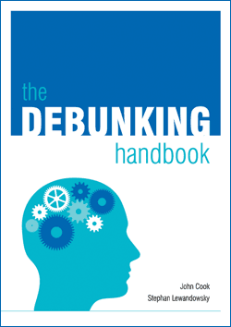
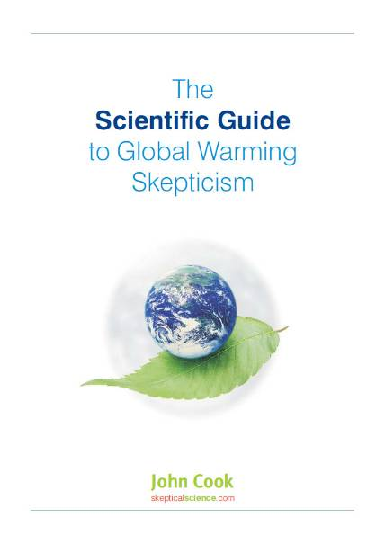
http://sks.to/debunk
http://sks.to/guide

Slide 42


John Cook
Global Change Institute, University of Queensland
Web: http://www.skepticalscience.com

