Slide 1
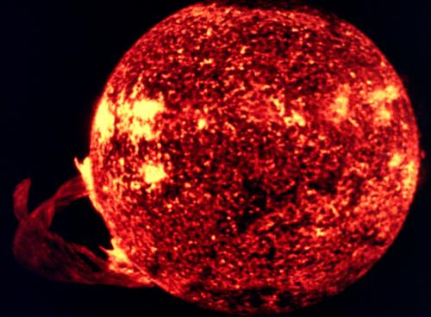
Energy Sustainability, The Challenge for Future Generations
John A. Turner
National Renewable Energy Laboratory
15013 Denver West Pkwy, Golden CO 80401
(303) 275-4270
John.Turner@nrel.gov

Slide 2


Slide 3
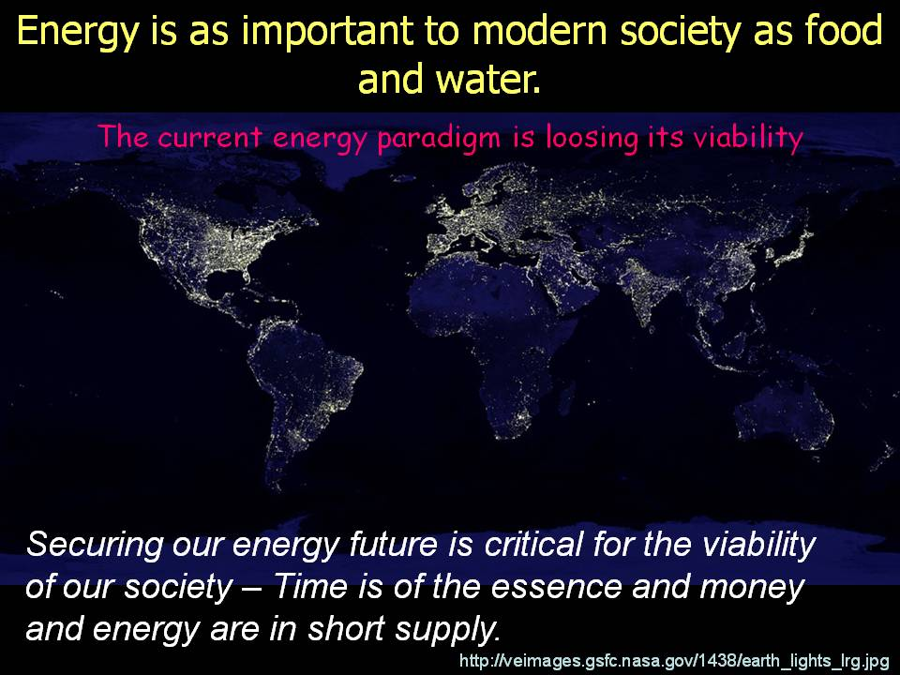

Slide 4
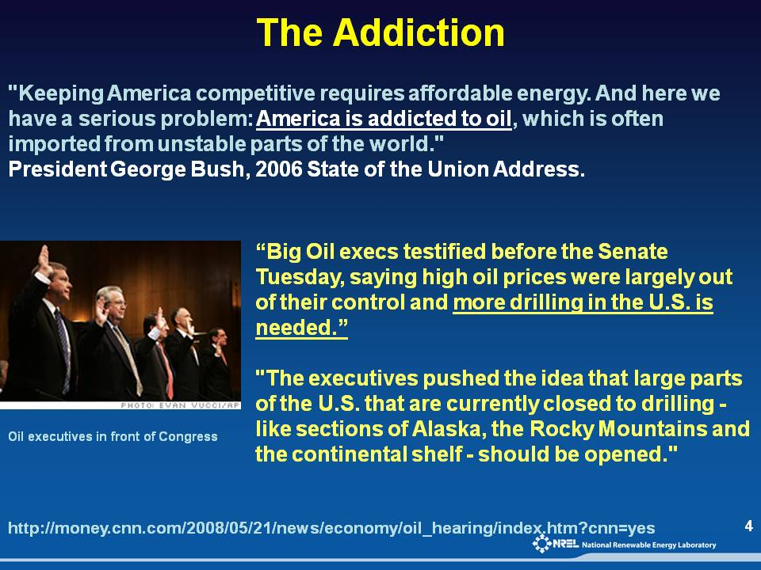

Slide 5
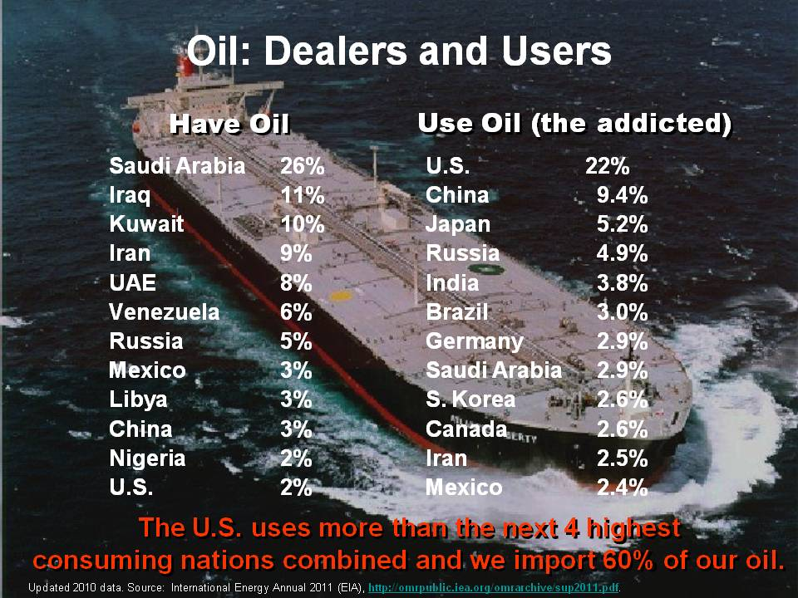

Slide 6
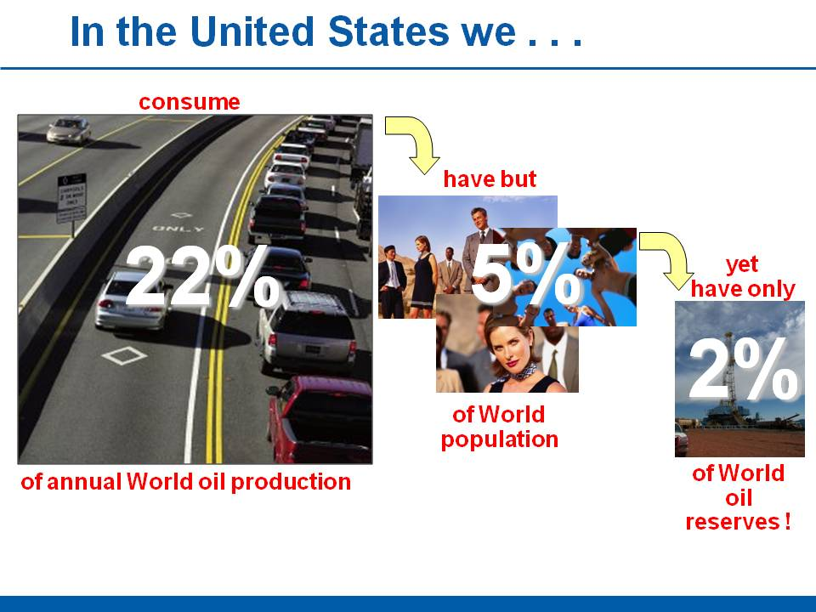

Slide 7


Slide 8
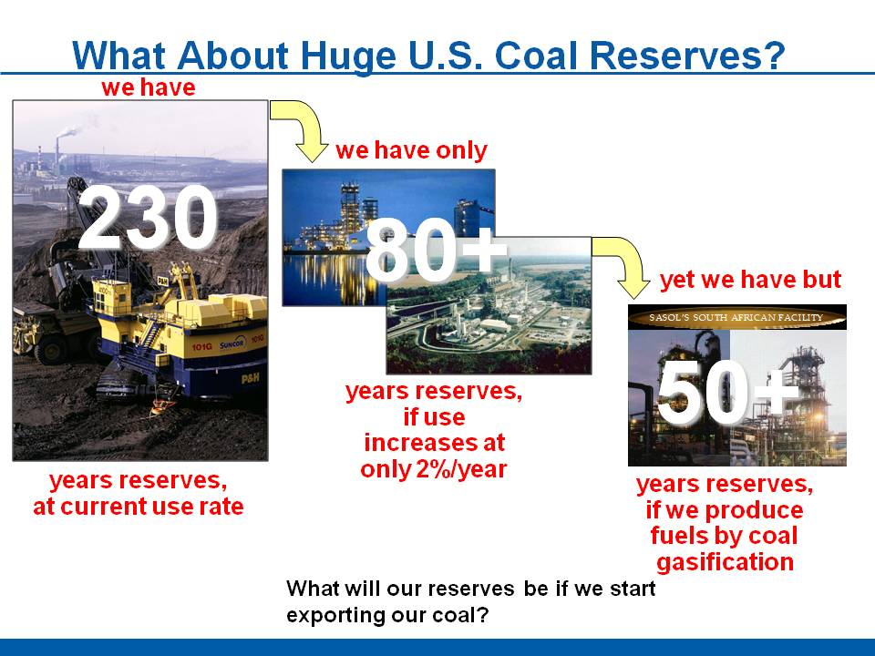

Slide 9
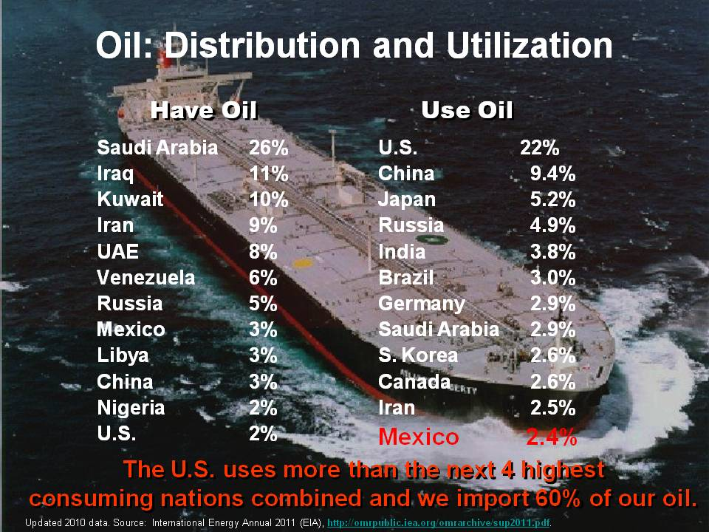

Slide 10
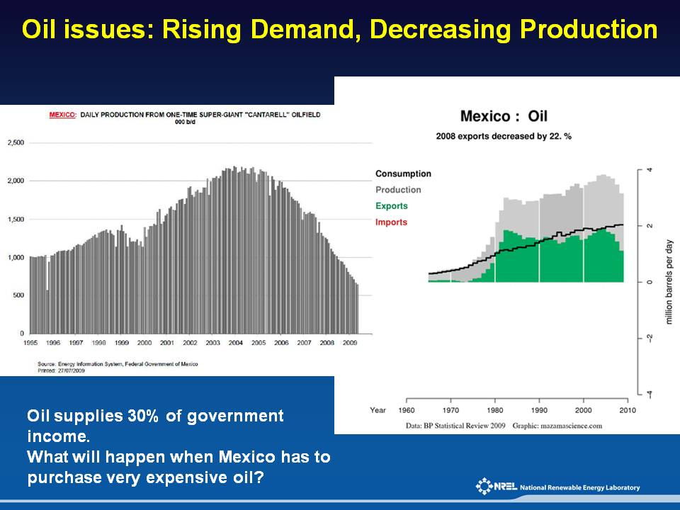

Slide 11
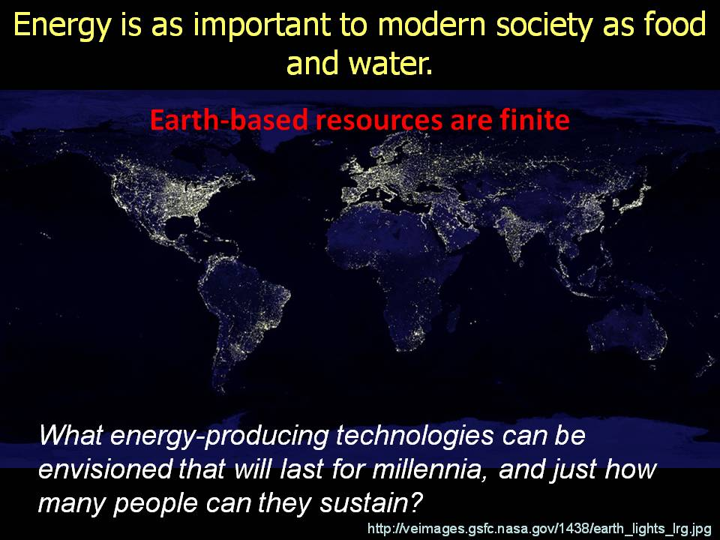

Slide 12
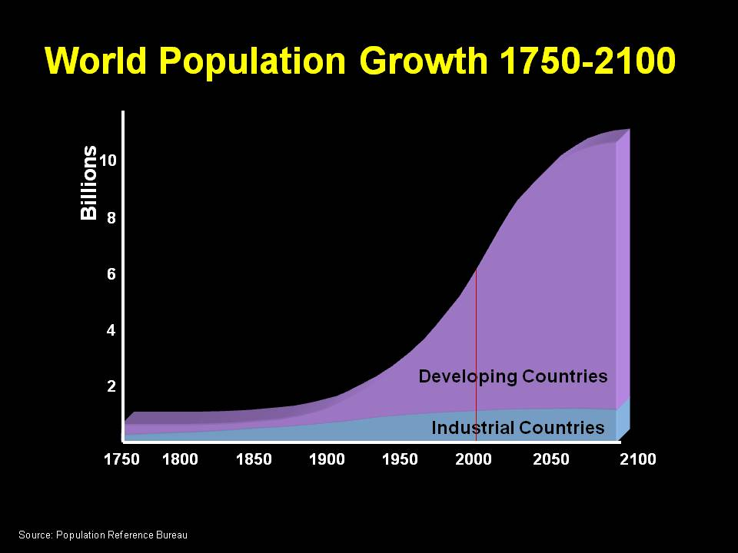

Slide 13
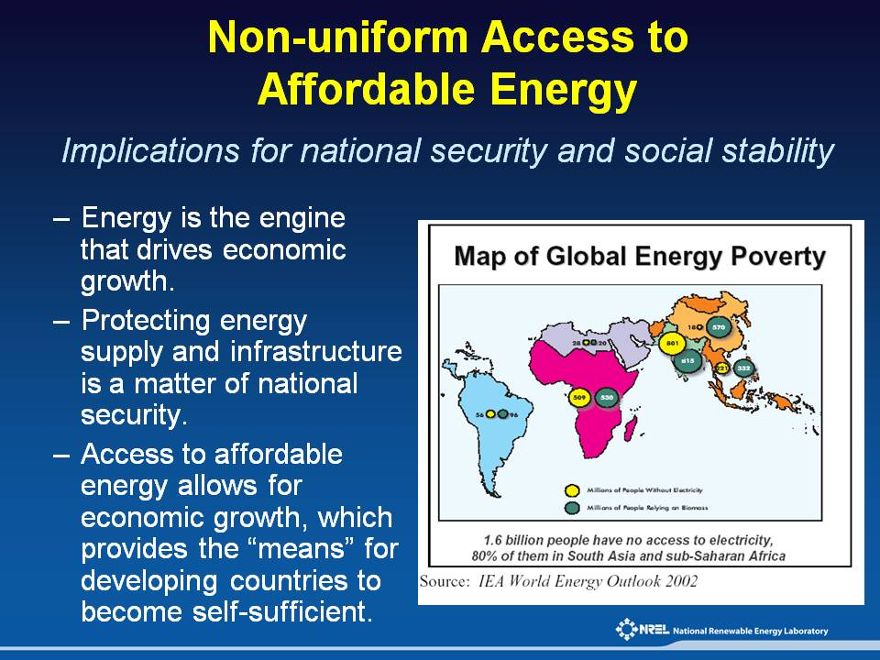

Slide 14
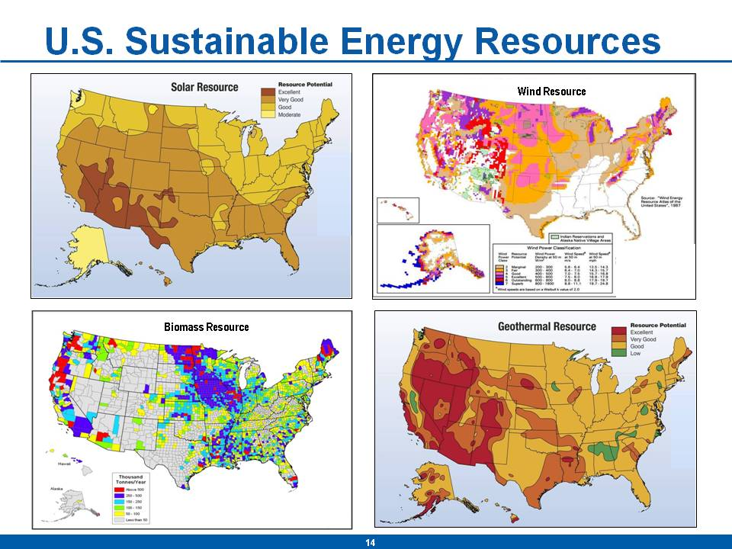

Slide 15
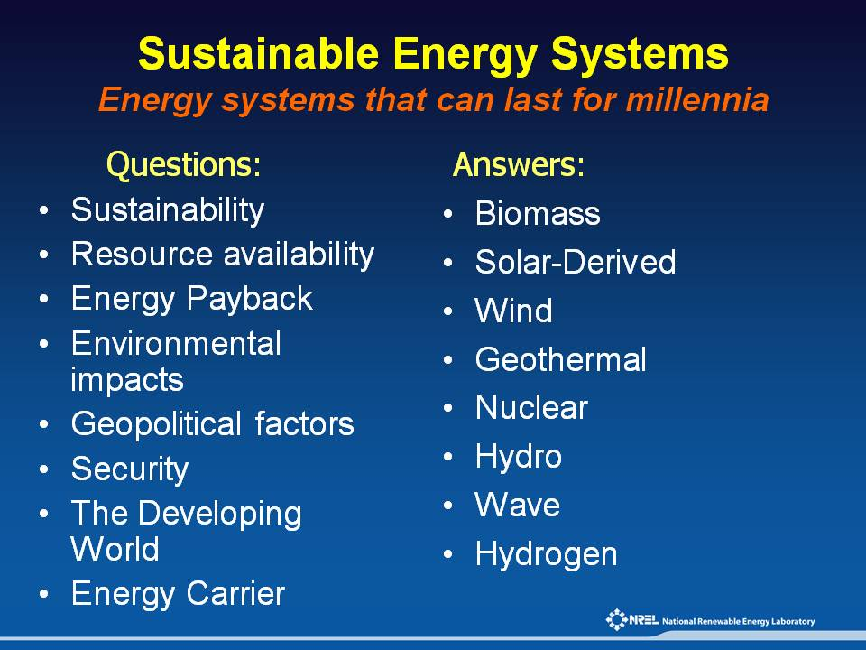

Slide 16
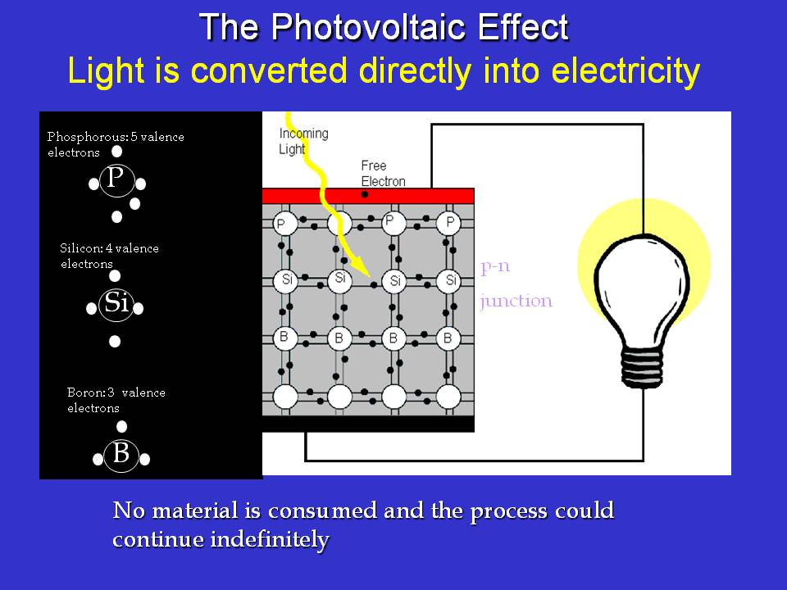

Slide 17
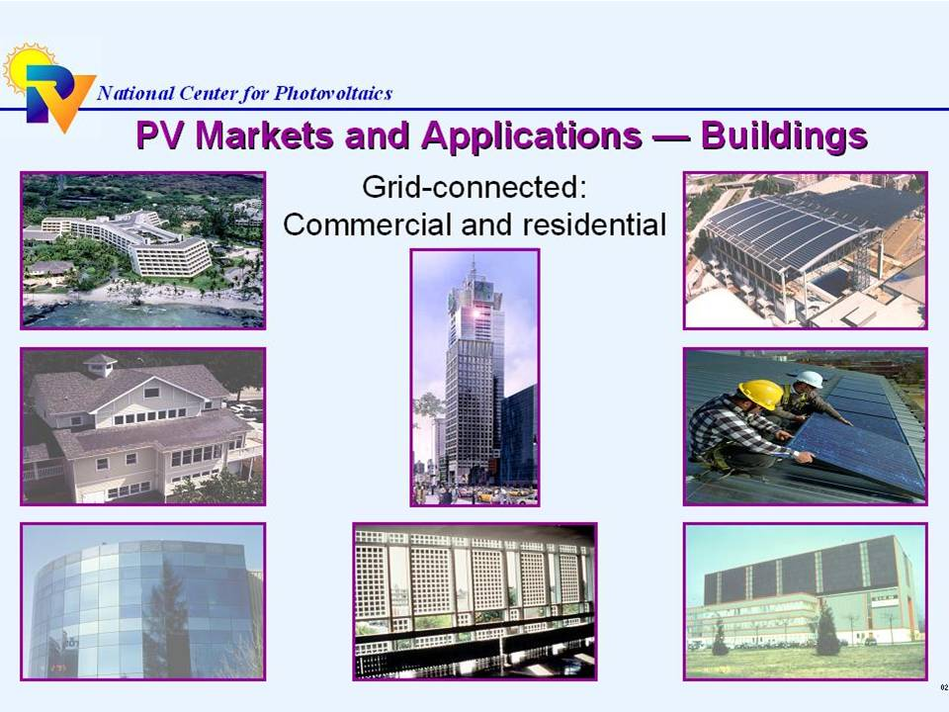

Slide 18
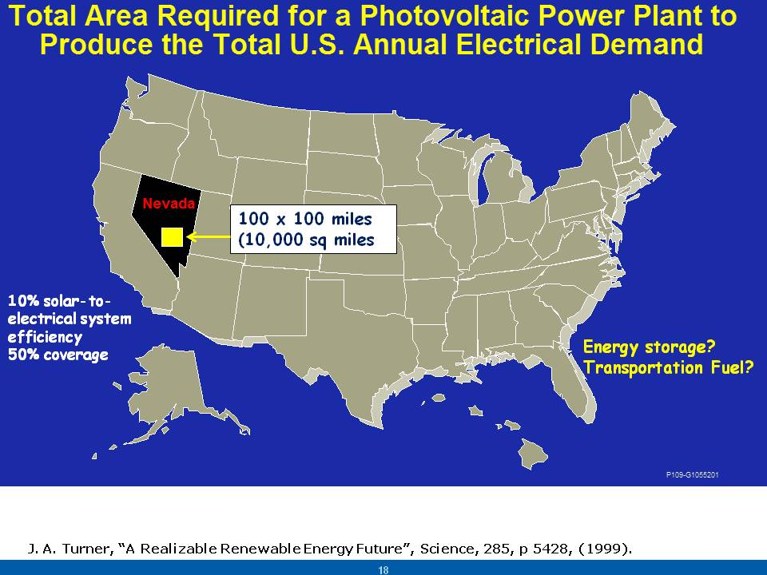

Slide 19
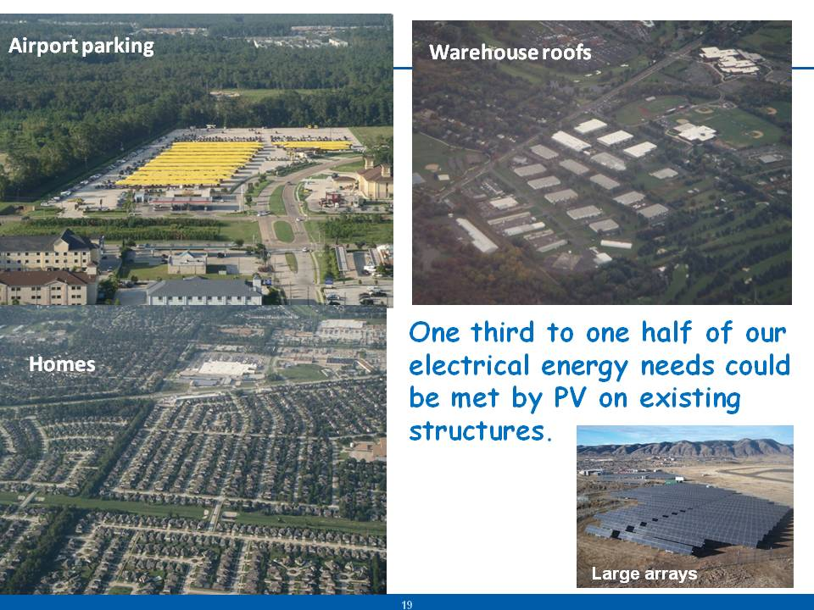

Slide 20
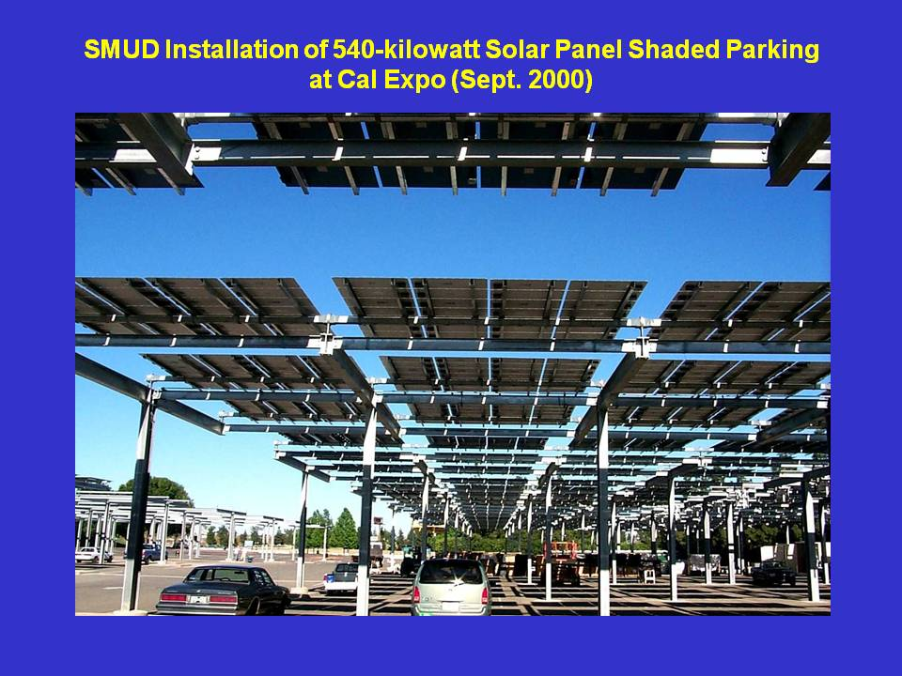

Slide 21
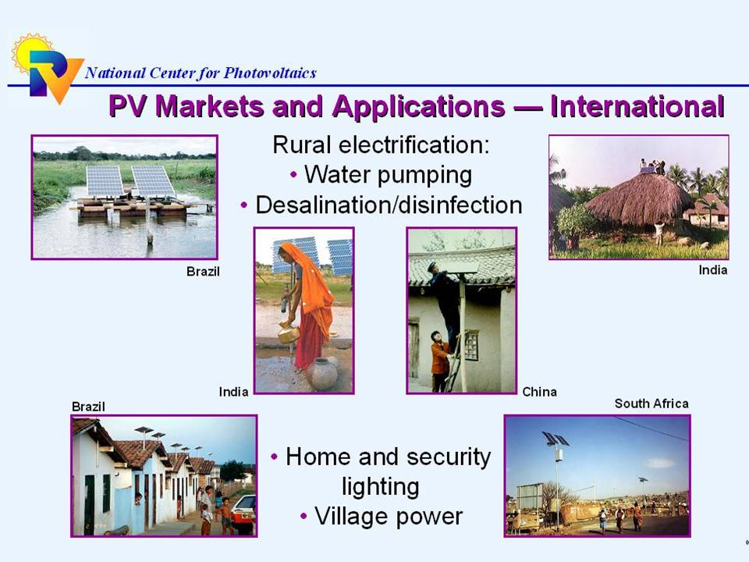

Slide 22
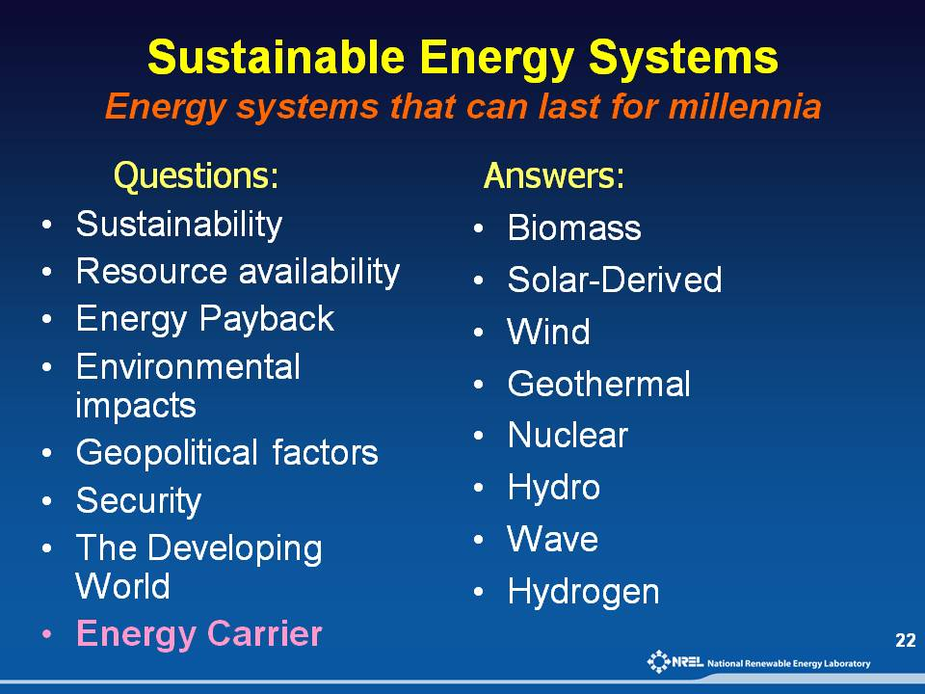

Slide 23
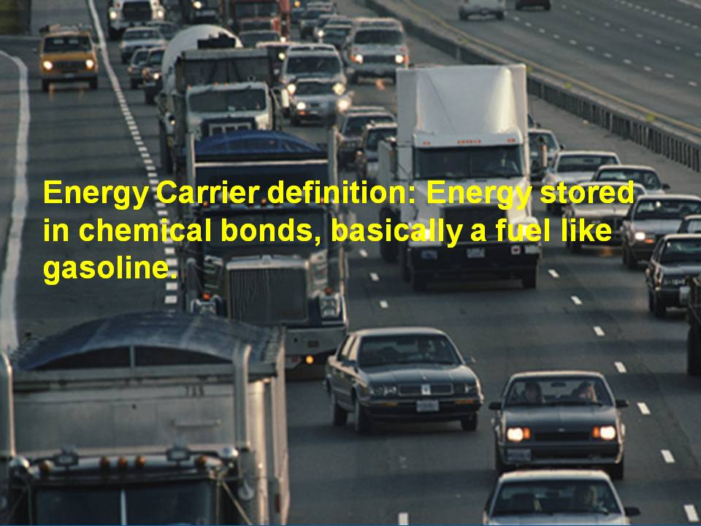

Slide 24
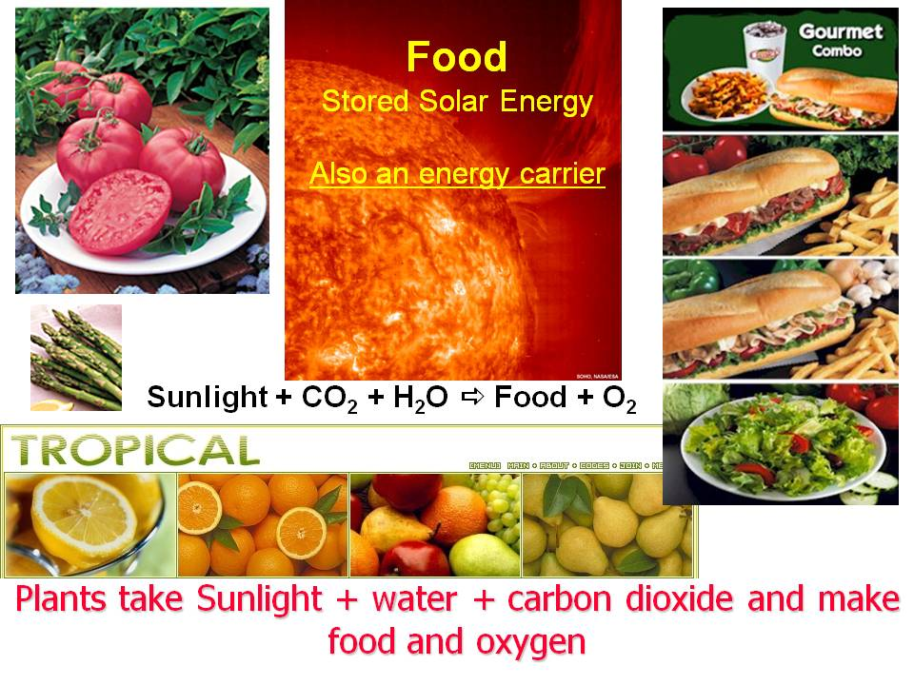

Slide 25
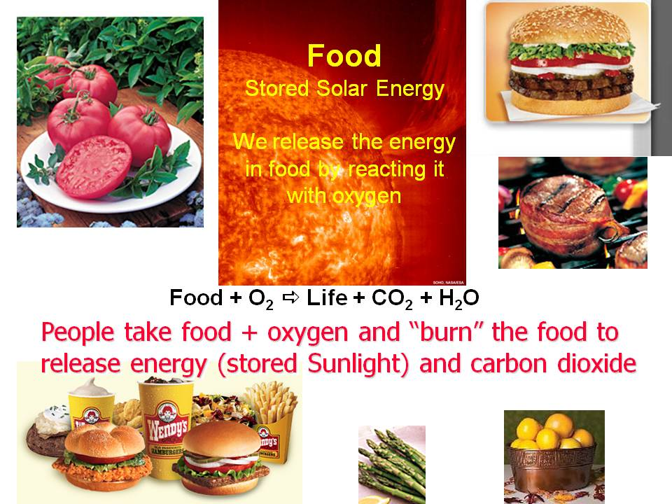

Slide 26


Slide 27
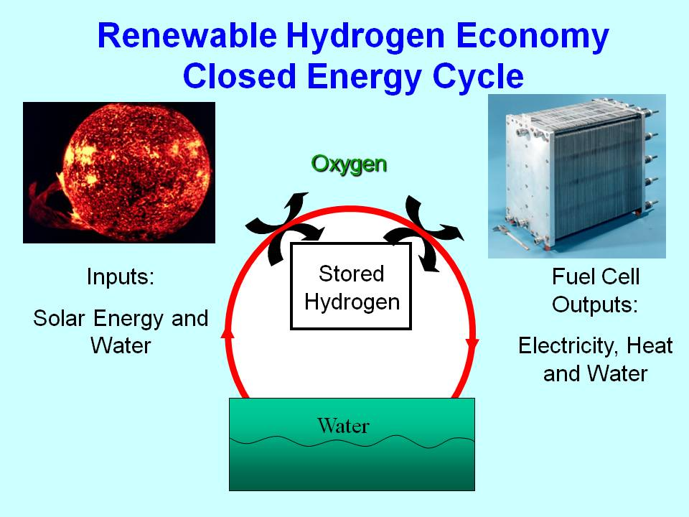

Slide 28
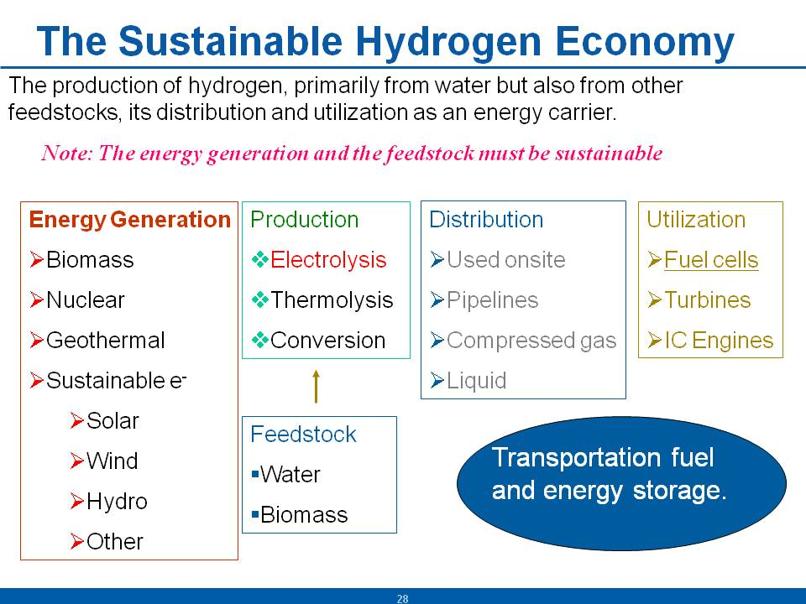

Slide 29
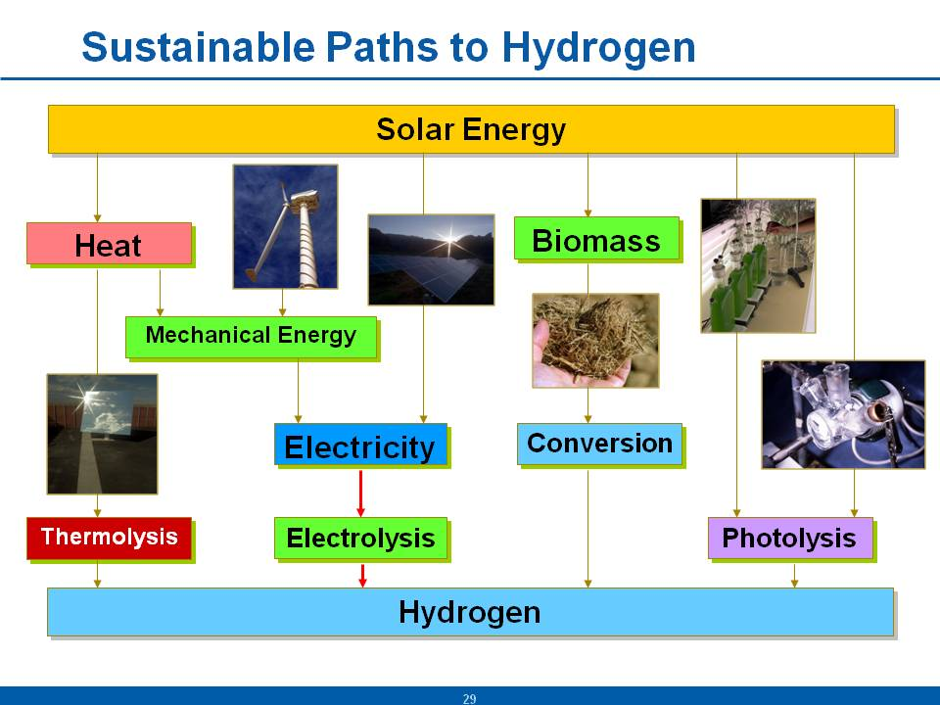

Slide 30
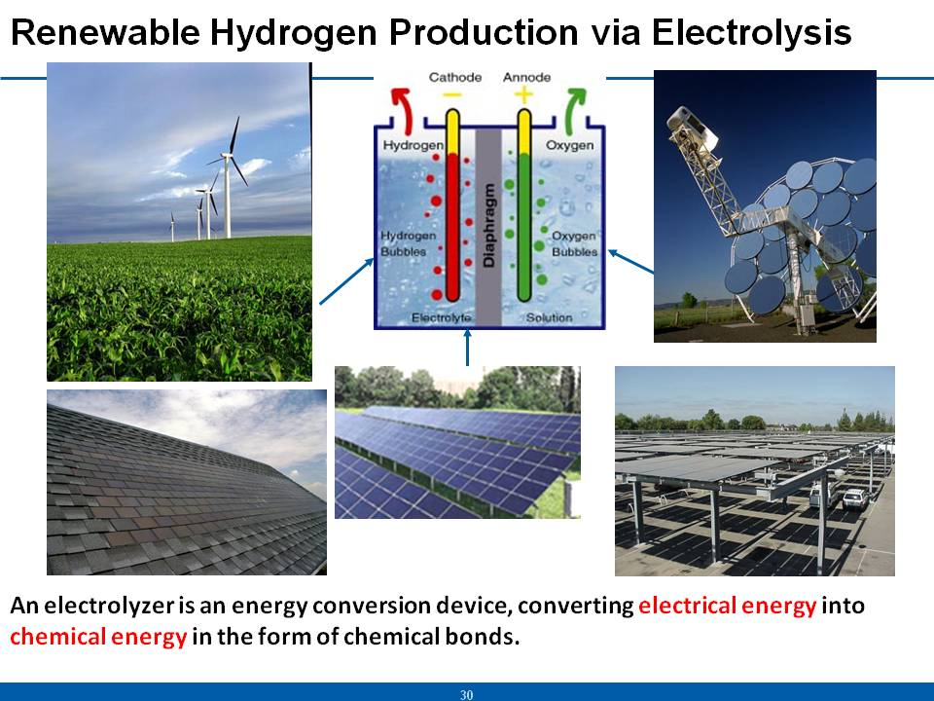

Slide 31
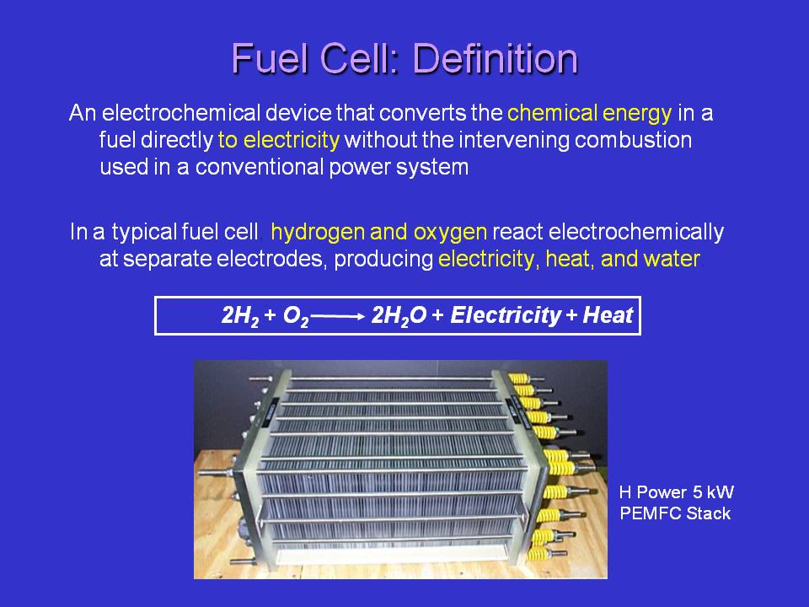

Slide 33
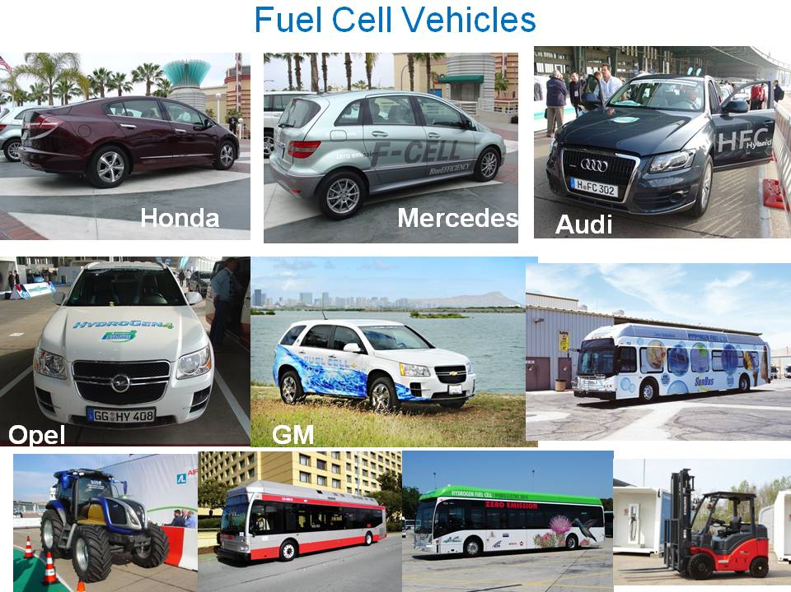

Slide 34
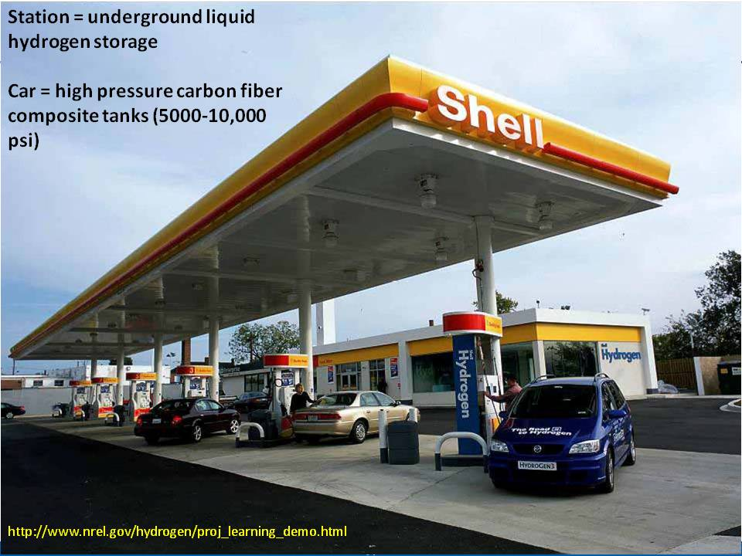

Slide 35
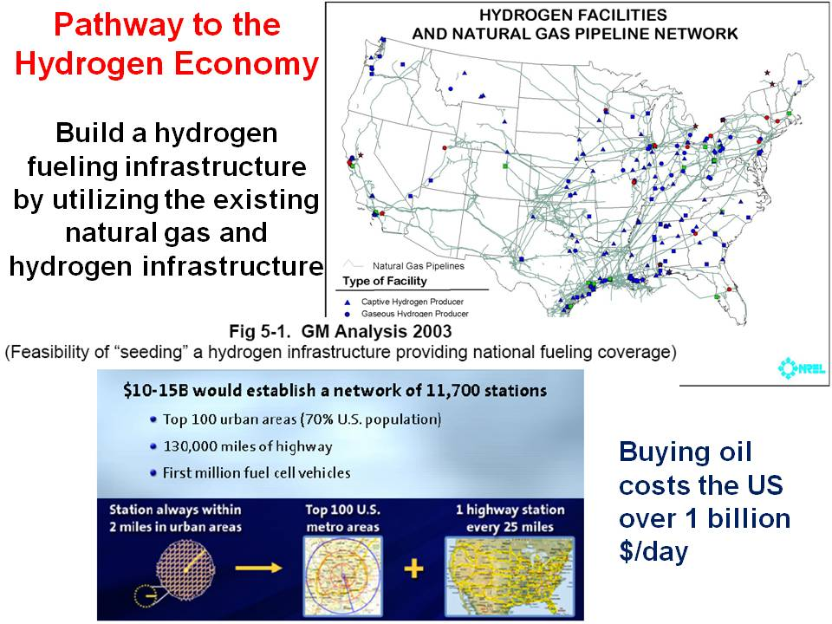

Slide 36


Slide 37
PV/electrolysis area for 250 million fuel cell vehicles.
J. A. Turner, “A Realizable Renewable Energy Future”, Science, 285, p 5428, (1999).
Notes:
This slide shows the Feasability of Renewables
We will first address the question “Can we really supply all our energy needs from renewable energy”. The power of renewable energy can easily be shown using the United States as an example. The US is the world largest energy consumer, total US annual electrical demand for 1997 was about 3.2 x 10¹² kWh (representing 25% of the World’s consumption). If we assume flat fixed-plate collectors covering only half of the available land area with a system efficiency of 10% (current commercial technology), a PV array 104 miles (166 km) on a side (~10,900 sq. miles, 27600 km²), placed in southwest Nevada, would over one year supply all this energy. This area represent less than 0.4% of the available land area of the United States. A system efficiency of 15%, which should be available in the next 3-5 years, would drop the area to 7200 sq. miles. If we add wind to the energy mix, this area for PV grows smaller, if we add geothermal, smaller still, if we add hydro smaller still, …the point is clear, we can gather more than enough renewable energy to power our society and yet have an abundance of renewable resources available for future growth. Also one should note that wind alone or solar thermal alone could also provide all our electrical energy needs.
The area of the Nevada test site is approximately 5000 sq mi.

Slide 38
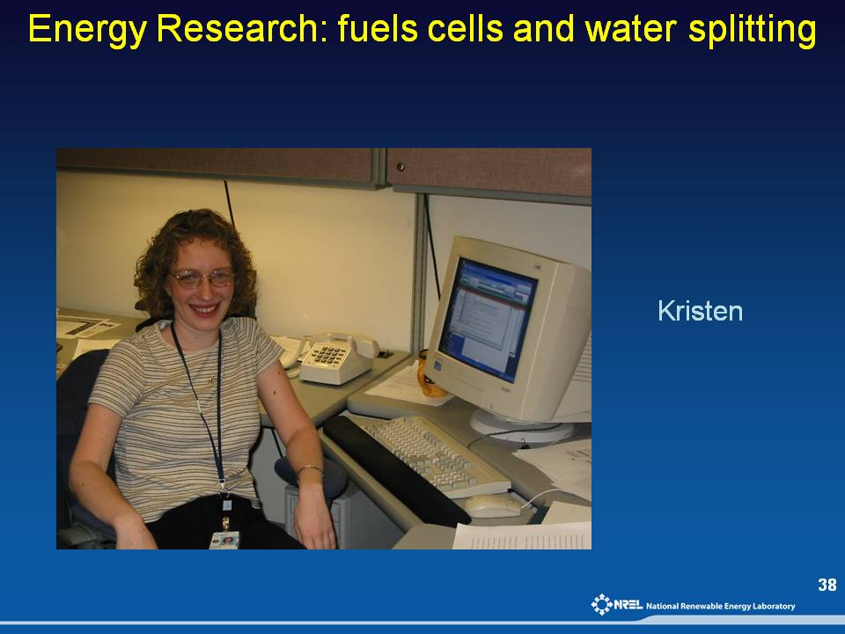

Slide 39
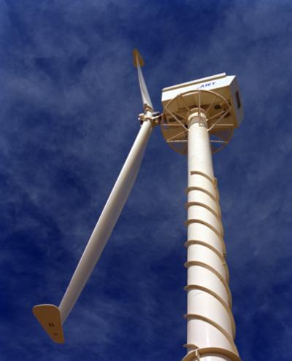
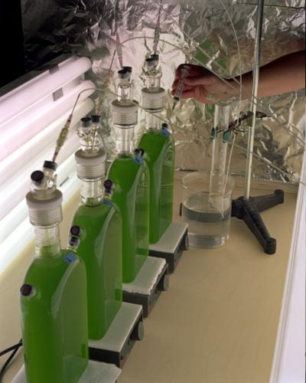
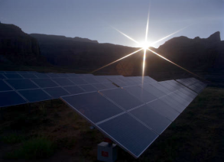
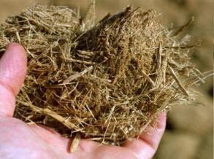
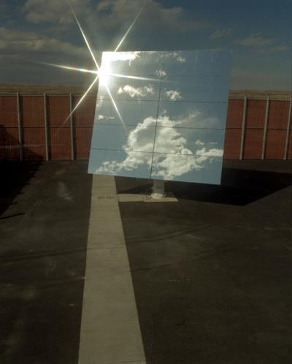
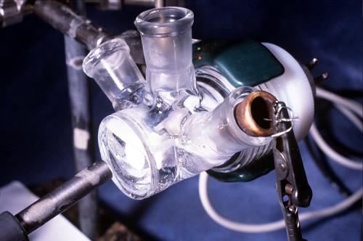
Sustainable Paths to Hydrogen
Solar Energy
Heat
Biomass
Mechanical Energy
Electricity
Conversion
Thermolysis
Electrolysis
Photolysis
Hydrogen

Slide 40
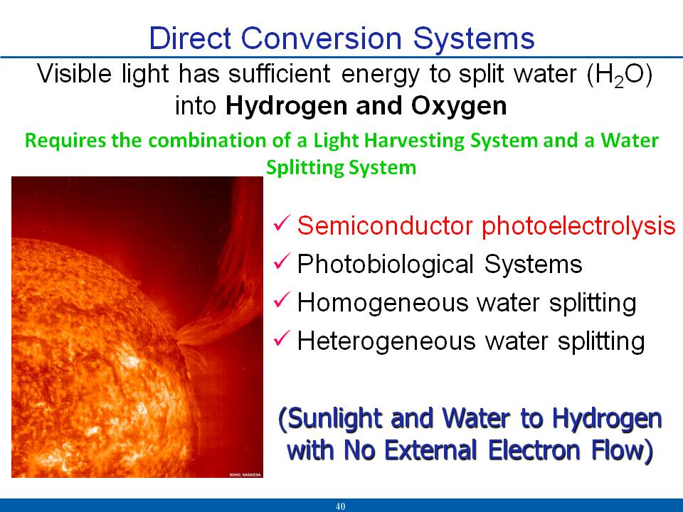

Slide 41
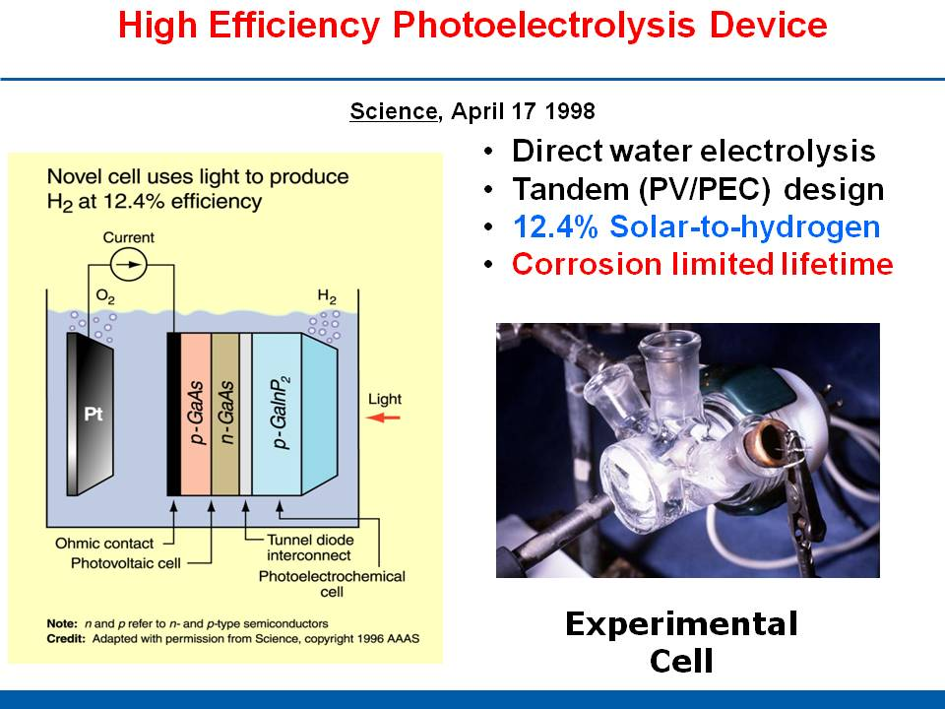

Slide 42
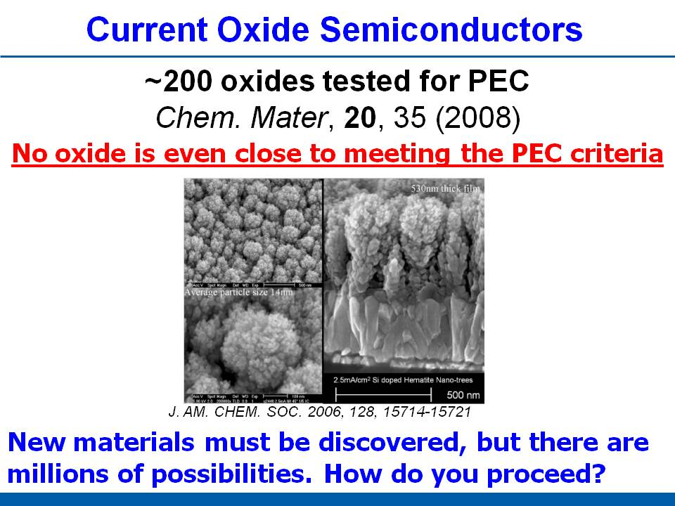

Slide 43
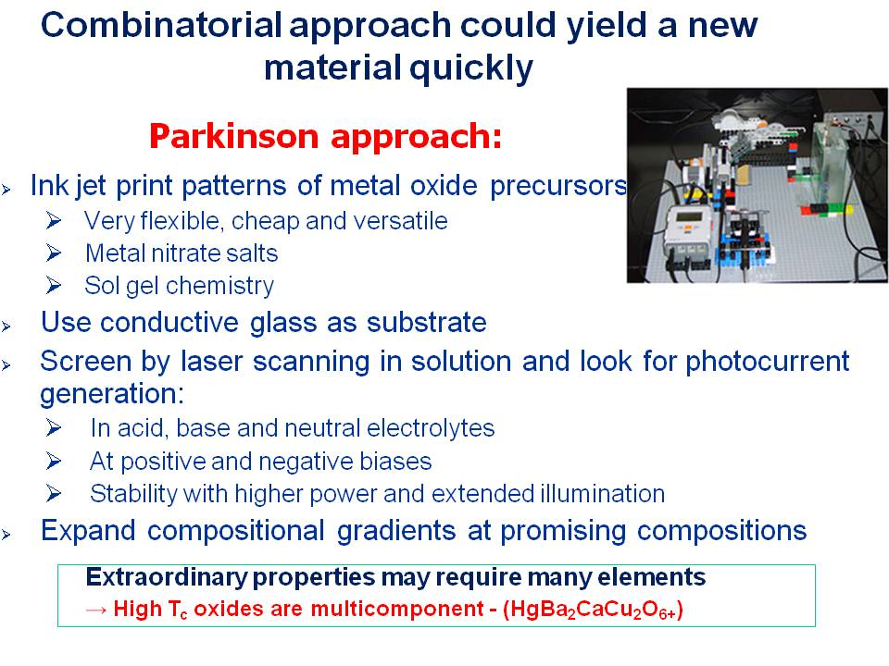

Slide 44
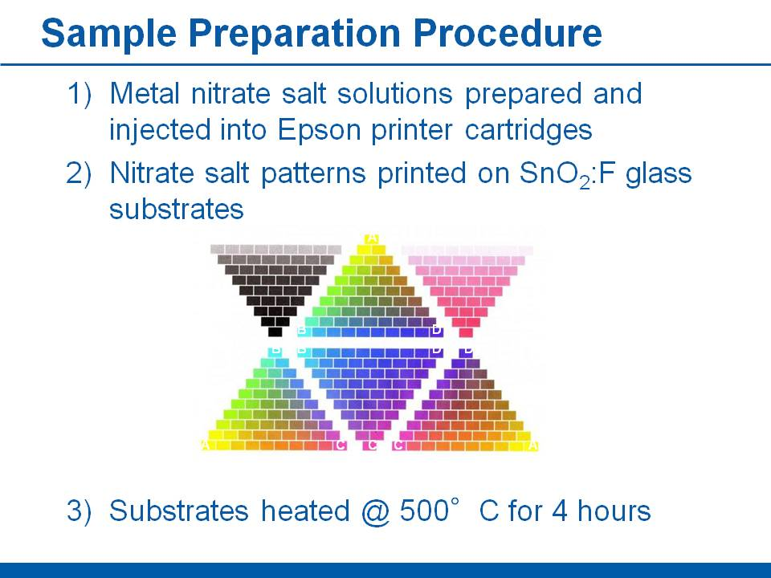

Slide 45
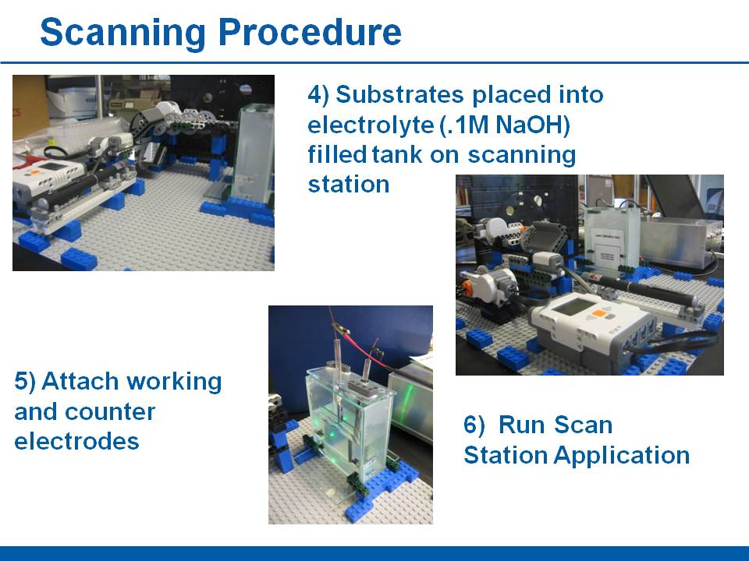

Slide 46
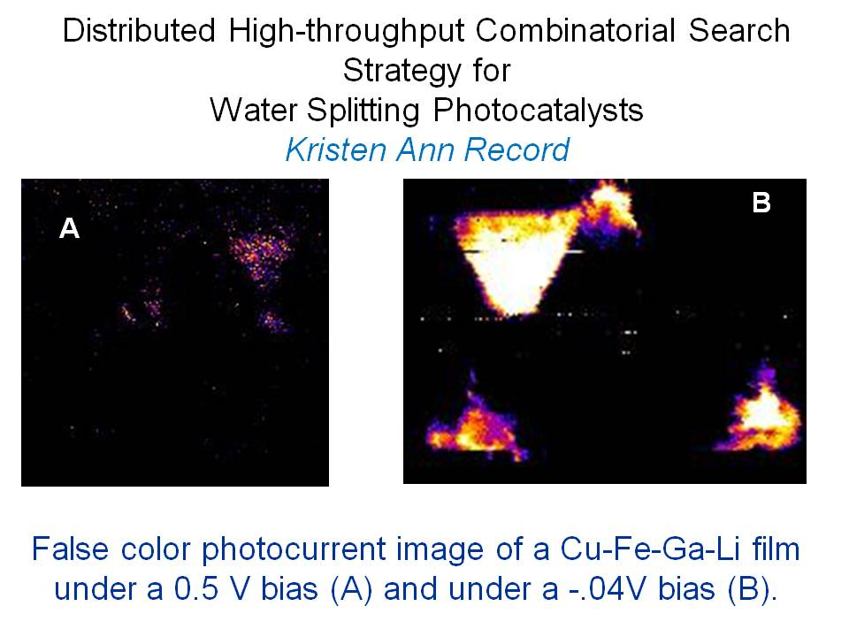

Slide 47
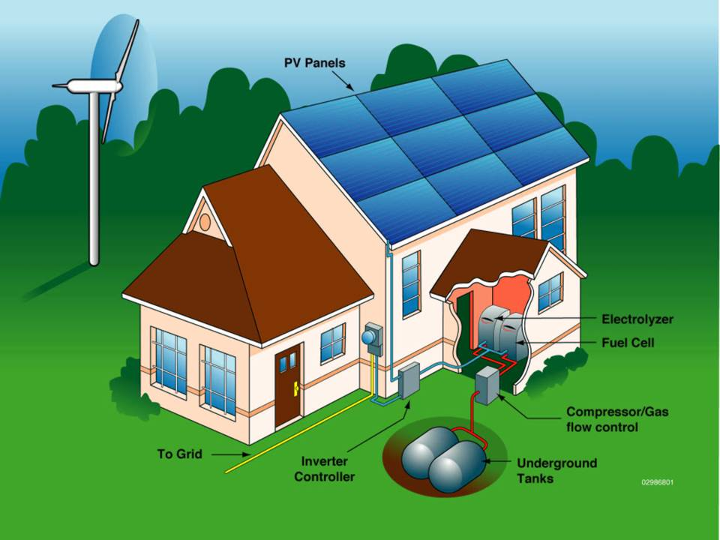

Slide 48
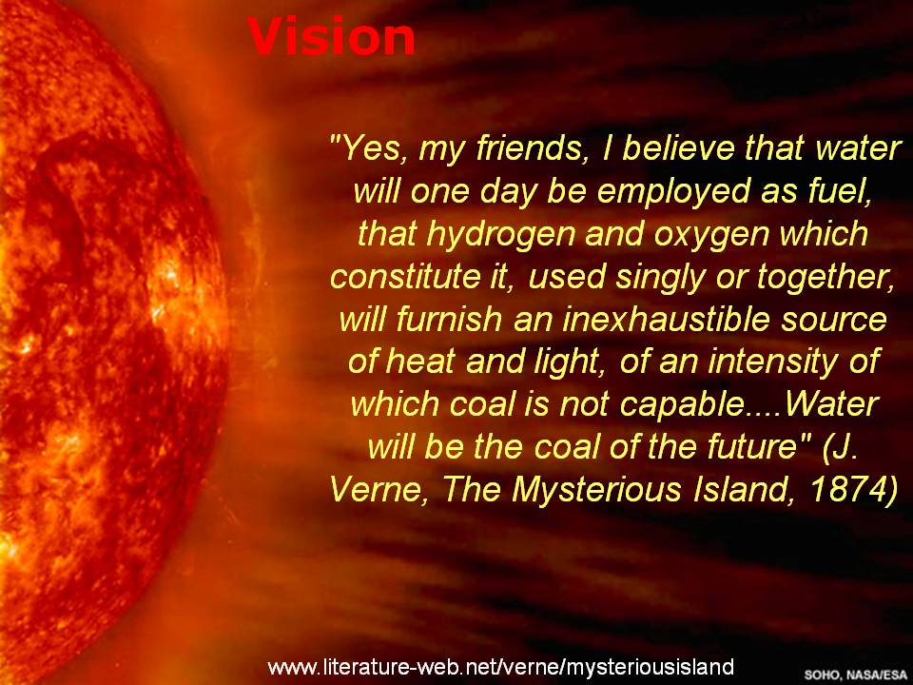

Slide 49
