Slide 1

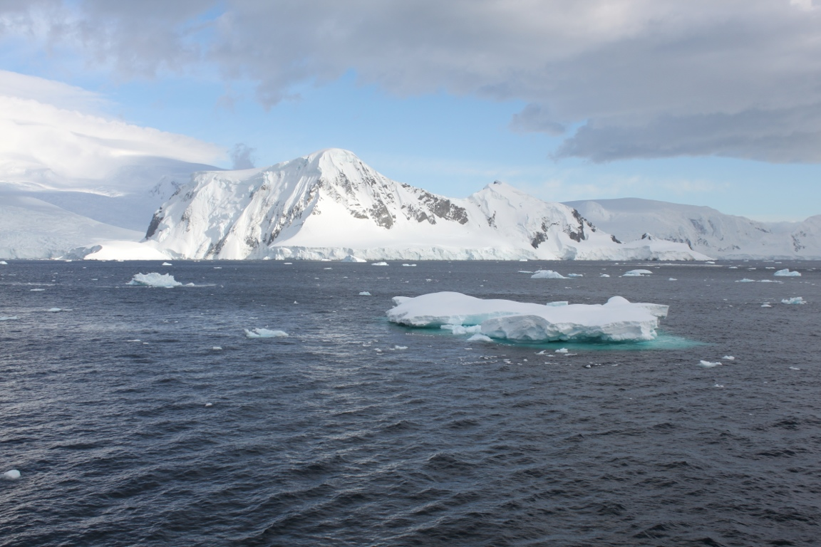
Neumayer Channel, Palmer Station, Antarctica (Photo B.Simmons, 2012)
Climate Literacy Principle #7
Beth E. Simmons TERC Education Consultant
March 15th, 2012
Notes:
Introduction: Hi, I’m Beth Simmons, the E/O coordinator for Palmer LTER and a TERC Education consultant. At the heart of teaching science are interactions with the scientific community, so thank you Dr. Hoffman for reviewing some of the core concepts behind climate literacy principle #7 . In this second portion of the webinar, I’m here to briefly assist educators by highlighting a few resources based on this principle - specifically on some concepts that Dr. Hoffman discussed: ocean acidification and also on ecosystems changed by climate.

Slide 2


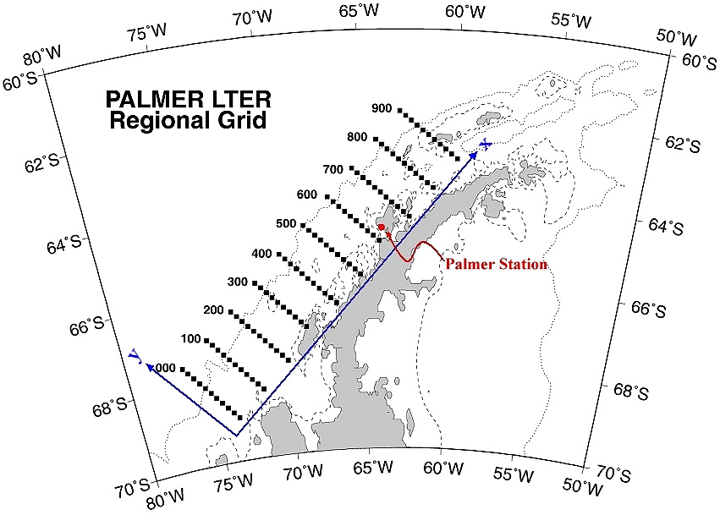
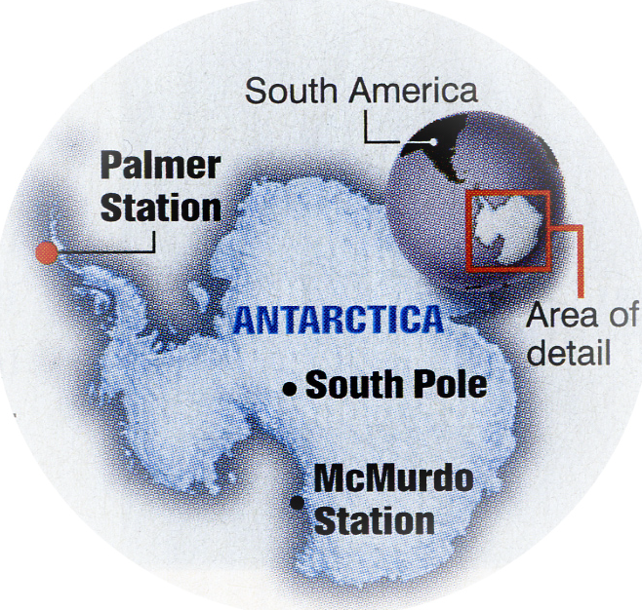
PalmerLTER
-64.77417 (south) -64.05450 (west)
Notes:
My field experience is also tied to the Antarctic, with Palmer Station which is located on the Western Antarctic peninsula. Our field sampling grid extends south.

Slide 3

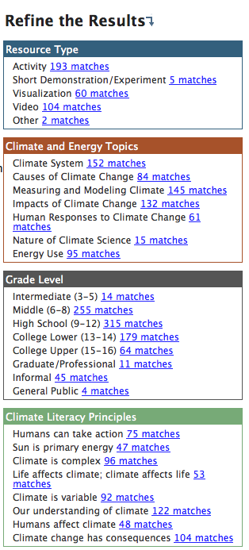
Climate Literacy Principle #7 states: Climate Change will have consequences for the Earth system and human lives.
A
Educational Resources: Search the CLEAN Collection Scientifically and pedagogically reviewed digital resources for teaching about climate science, climate change and energy awareness.
Collection includes :
Resource Type:
Topics:
Grade Level
Climate Literacy Principle:
B
C
D
Notes:
My role here is to serve as a liaison to demonstrate a few good examples of the resource available in the CLEAN website. Prior to the webinar, we suggested you preview the CLEAN website and familiarize yourself with the search engine. It provides a variety of options/categories to conduct searches such as: resource type, topics, grade level or principle. I used Climate Literacy Principle # 7 to narrow down my search specifically to find resources for Climate Literacy Principle #7. However, try conducting a search using various methods … supporting materials may be better categorized under a different principle (ex. Carbon cycle is under Climate Literacy Principle #2).

Slide 4
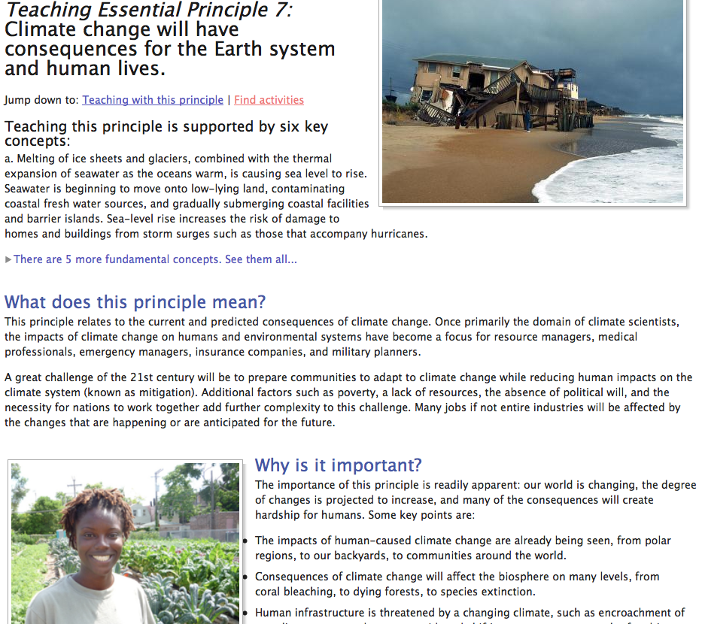
Six Key Fundamental
Concepts
Meaning
Importance
Challenges
Teaching
Resource Types
Activity
Demos
Visualizations
Videos
Other
Notes:
For example, today I chose searching by CLP. This option is so useful in that it outlines the process of implementing this principle by highlighting : 6 key concepts... see flow chart.

Slide 5

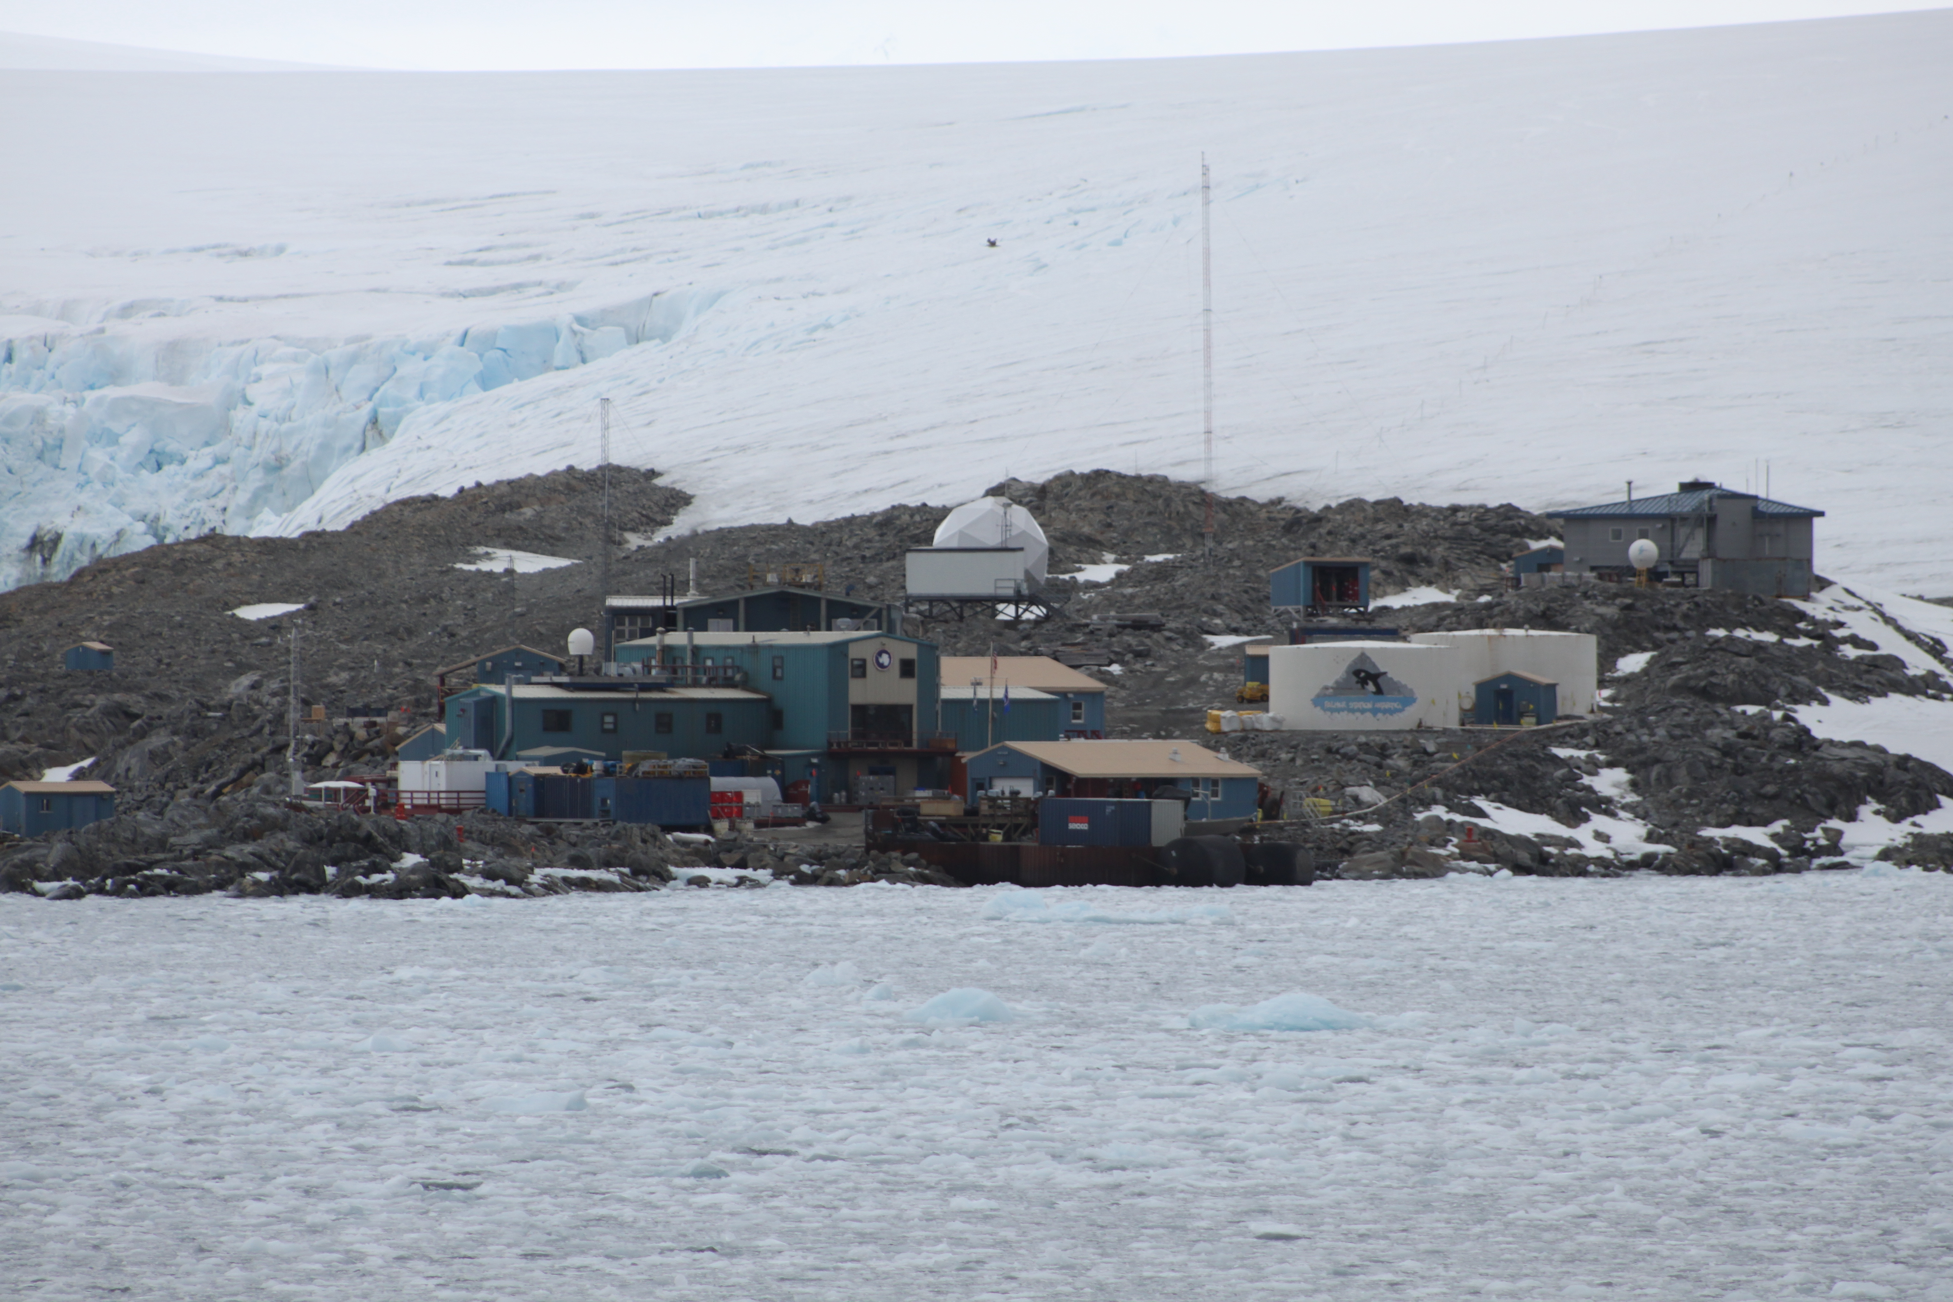
POLL QUESTIONS: Which discipline do you represent today ? A. Chemistry
Physical Earth/Space
Biology
Environmental Science / Ecology
Marine Science/Oceanography
Palmer Station (B.Simmons, 2012)
Notes:
Now, because teaching climate change in classrooms knows no boundaries, and it is truly interdisciplinary, it might be interesting to see the range of disciplines from our participants? Can those participating please select their most predominant core content area that they are looking to teach concepts of climate change?

Slide 6
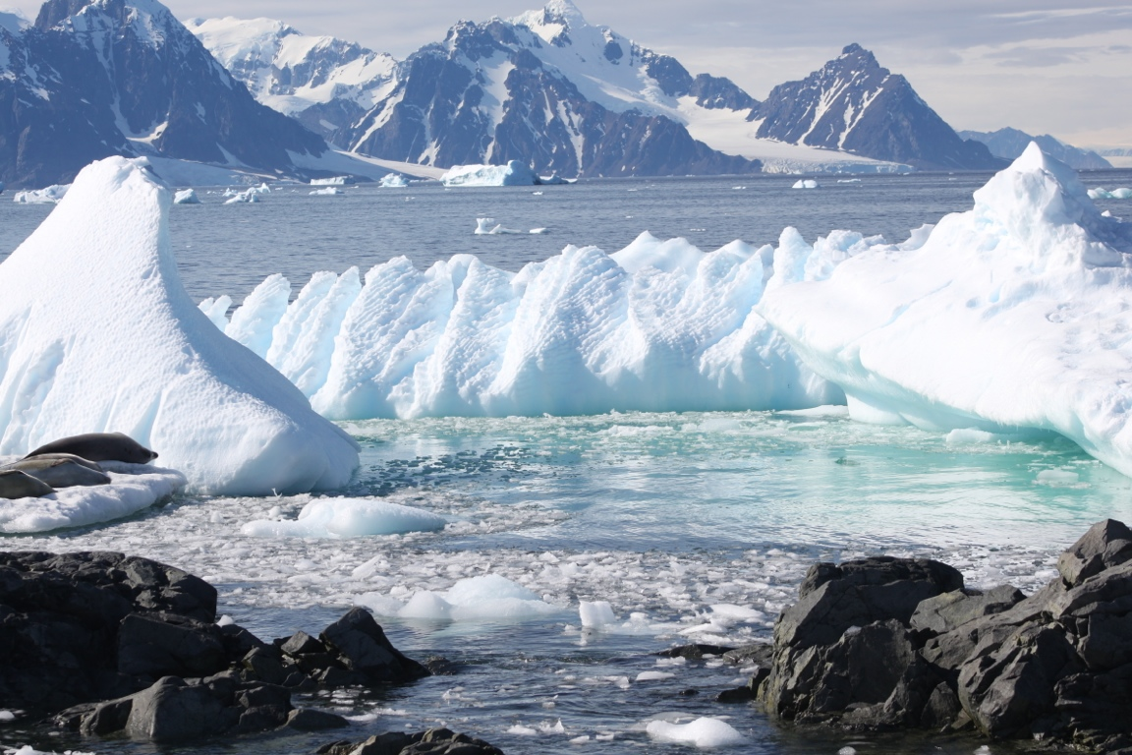
NaiveUnderstandingsMisconceptionsChallenges:
CLP #7: Climate Change will have consequences for the Earth System and human lives
7d. Increased acidity of oceans and negative impacts on food chain due to increasing carbon dioxide levels.
7e. Ecosystems on land and in the ocean have been and will continue to be disturbed by climate change.
What kinds of hands-on
experiences are there on this topic?
1. What is ocean acidity and is it real?
2. The lack of time to sift through conflicting literature on climate change.
6. Heavy data sets - how do I make it interesting?
5. It is difficult to quantify (An increase from 8.1 - 8.2 on the pH scale is a 30% increase in acidity).
Rothera Bay, Simmons 2011
3. This appears distant to individuals, & it isn’t something they worry about that directly impacts their daily lives. How do I make it real and relevant?
4. “The science is complex and confusing and I’m not sure I even understand it.”
Notes:
While you’re answering the poll question, I gathered some of the most common conversation pieces that many teachers voiced are their concerns @ teaching climate change in their classrooms. Walk with me through these and identify which you may relate to the most in your current situation. I will address these challenges throughout the presentation demonstrating CLEAN resources that may assist you in finding answers to these.

Slide 7
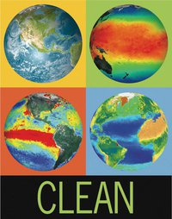
CrossCuttingScienceConcepts
utilize an interdisciplinary approach
one that fosters a global change position in which takes a stakeholders approach to building mutual understanding to develop solutions to address changes in our climate
integrates a progression of cross-cutting science
PATTERNS
CAUSE and EFFECT
SCALE,
PROPORTION,
QUANTITY
SYSTEMS and MODELS
ENERGY/FLOW CYCLES
STABILITY and CHANGE
Perspectives of the ecological consequences
Notes:
One of the major challenges of teaching climate change regardless of being in a formal/informal learning environment, lies in the ability to present it and to connect knowledge from various disciplines. The resources that will be showcased this evening, emphasize these cross-cutting concepts and may offer you a broader perspective in approaching the topic while also addressing some of those concerns we identified in the previous slide.

Slide 8
Addressing Climate Literacy Principle: 7d: Increased acidity of oceans and negative impacts on food chain due to increasing carbon dioxide levels

Slide 9
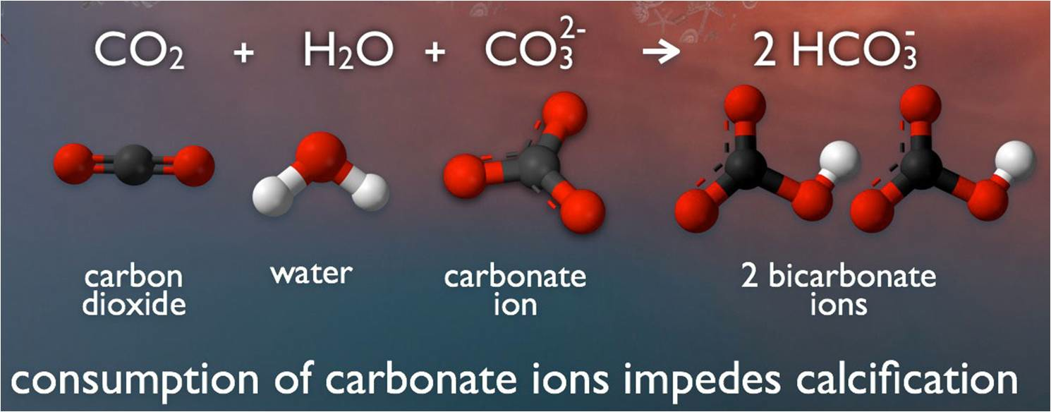
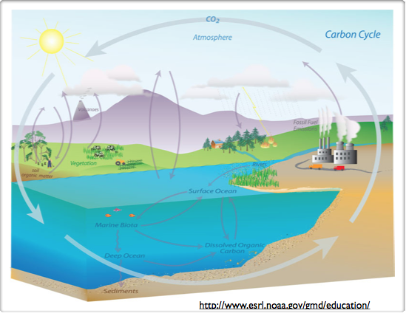
STATIC VISUALIZATIONS:
a. The Chemistry of Acidification: http://cleanet.org/resources/42857.html)
Static image from NOAA’s Pacific Marine Environmental Laboratory Carbon Program offers a visually compelling and scientifically sound image of the sea water carbonate chemistry process that leads to ocean acidification and impeded calcification.
b. The Carbon Cycle:
http://cleanet.org/resources/42680.html
understanding the inputs and outputs within a system to identify a systems’ possibilities and limitations.
Notes:
Static Visualizations: can be used to evaluate what prior knowledge student have on ocean acidification or act as a review.
a. The sea water carbonate chemistry involved in the ocean acidification: the process impeding shell calcification
b. While carbon is exchanged in both directions between the terrestrial biosphere and the atmosphere and between the ocean and the atmosphere, there is only a one-way movement of carbon from fossil fuels to the atmosphere.

Slide 10
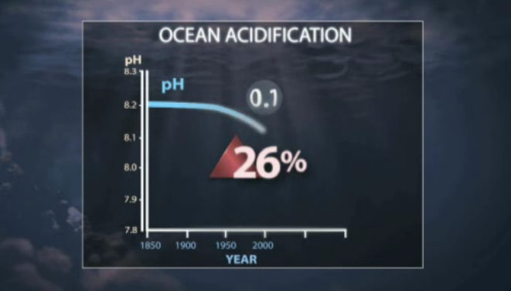
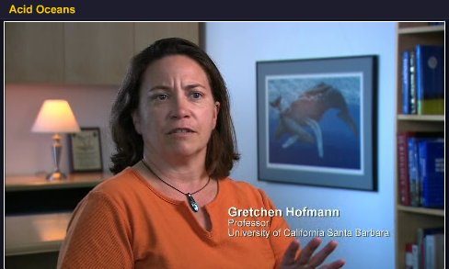
1. What is ocean acidity and is it real?
VIDEOS: a. Changing Planet : Ocean Acidification (Antarctica): http://cleanet.org/resources/42955.html
In Antarctica, in the southern ocean the water is so cold just above the freezing point are being tested by a new threat - ocean acidification. As the ocean is absorbing the CO2 its changing the ocean composition with a 0.2 - 0.3 drop in years ahead.
b. Acid Oceans (6:38) http://cleanet.org/resources/42796.html
The other CO2 problem featuring Gretchen Hofmann and her team discussing ocean acidification experiments using sea urchins. Since the beginning of the industrial age, 1/3 of the CO2 has been absorbed by the ocean and the pH of the ocean could change rapidly. Can the ocean organisms adapt to this chemistry?
Beth E. Simmons TERC Education Consultant March 15th, 2012
Notes:
Two videos in the CLEAN collection featuring Dr. Hofmanns research in which she validates what core content is important on the topic and gives specific examples relating to her research.

Slide 11
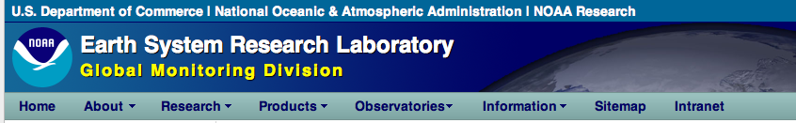
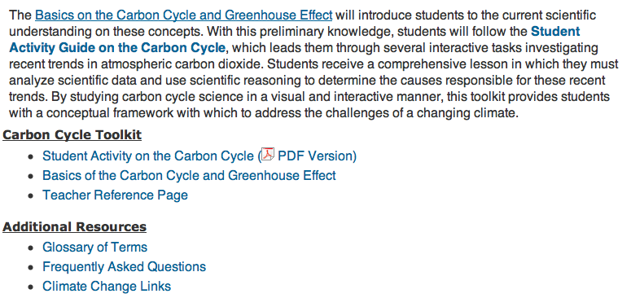
LESSON:
a. Carbon Cycle: NOAA /Earth System Research Laboratory http://cleanet.org/resources/42680.html
4. “The science is complex and confusing and I’m not sure I even understand it.”
Beth E. Simmons TERC Education Consultant March 15th, 2012
Notes:
Our first example is from NOAA’s Earth Systems Research Laboratory. It addresses 7d. of CLP #7 by discussing ocean acidification. one may need/want to approach the topic by reviewing and understanding the carbon cycle. You can spend as little or as much in this review because this interactive analyzes data and then reviews the reasoning behind the trends. Let’s look at it a little more closely. 4. “The science is complex and confusing and I’m not sure I even understand it.”
This lesson is for those more tech savvy
It has relevant and meaningful examples
It is interactive
It demonstrates to students variability over time

Slide 12
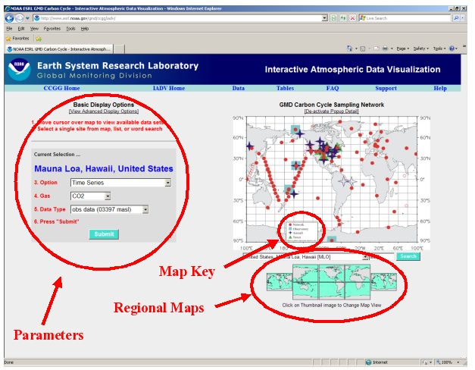
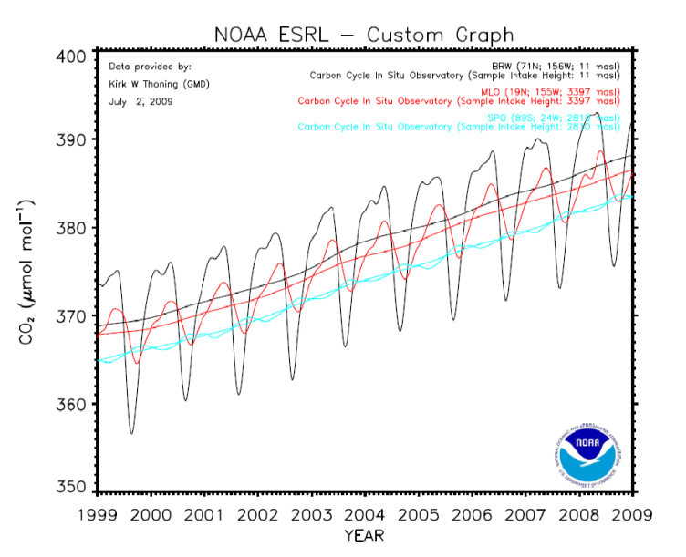
6. Heavy data sets - how do I make it interesting?
Task 1: Familiarize yourself with the different measurements = longest ongoing record of CO₂
Task 2: Start with Mauna Loa (default) and obtain graph of the trends of CO₂ at this site.
Task 3: Describe the short/long term trends in the graph
Task 4: Compare the Mauna Loa trends with another location .
Task 5: Identify trends, discuss possible causes, and differences in concentrations, local maximums.

Slide 13
Addressing Climate Literacy Principle: 7e Ecosystems on land and in the ocean have been and will continue to be disturbed by climate change

Slide 14
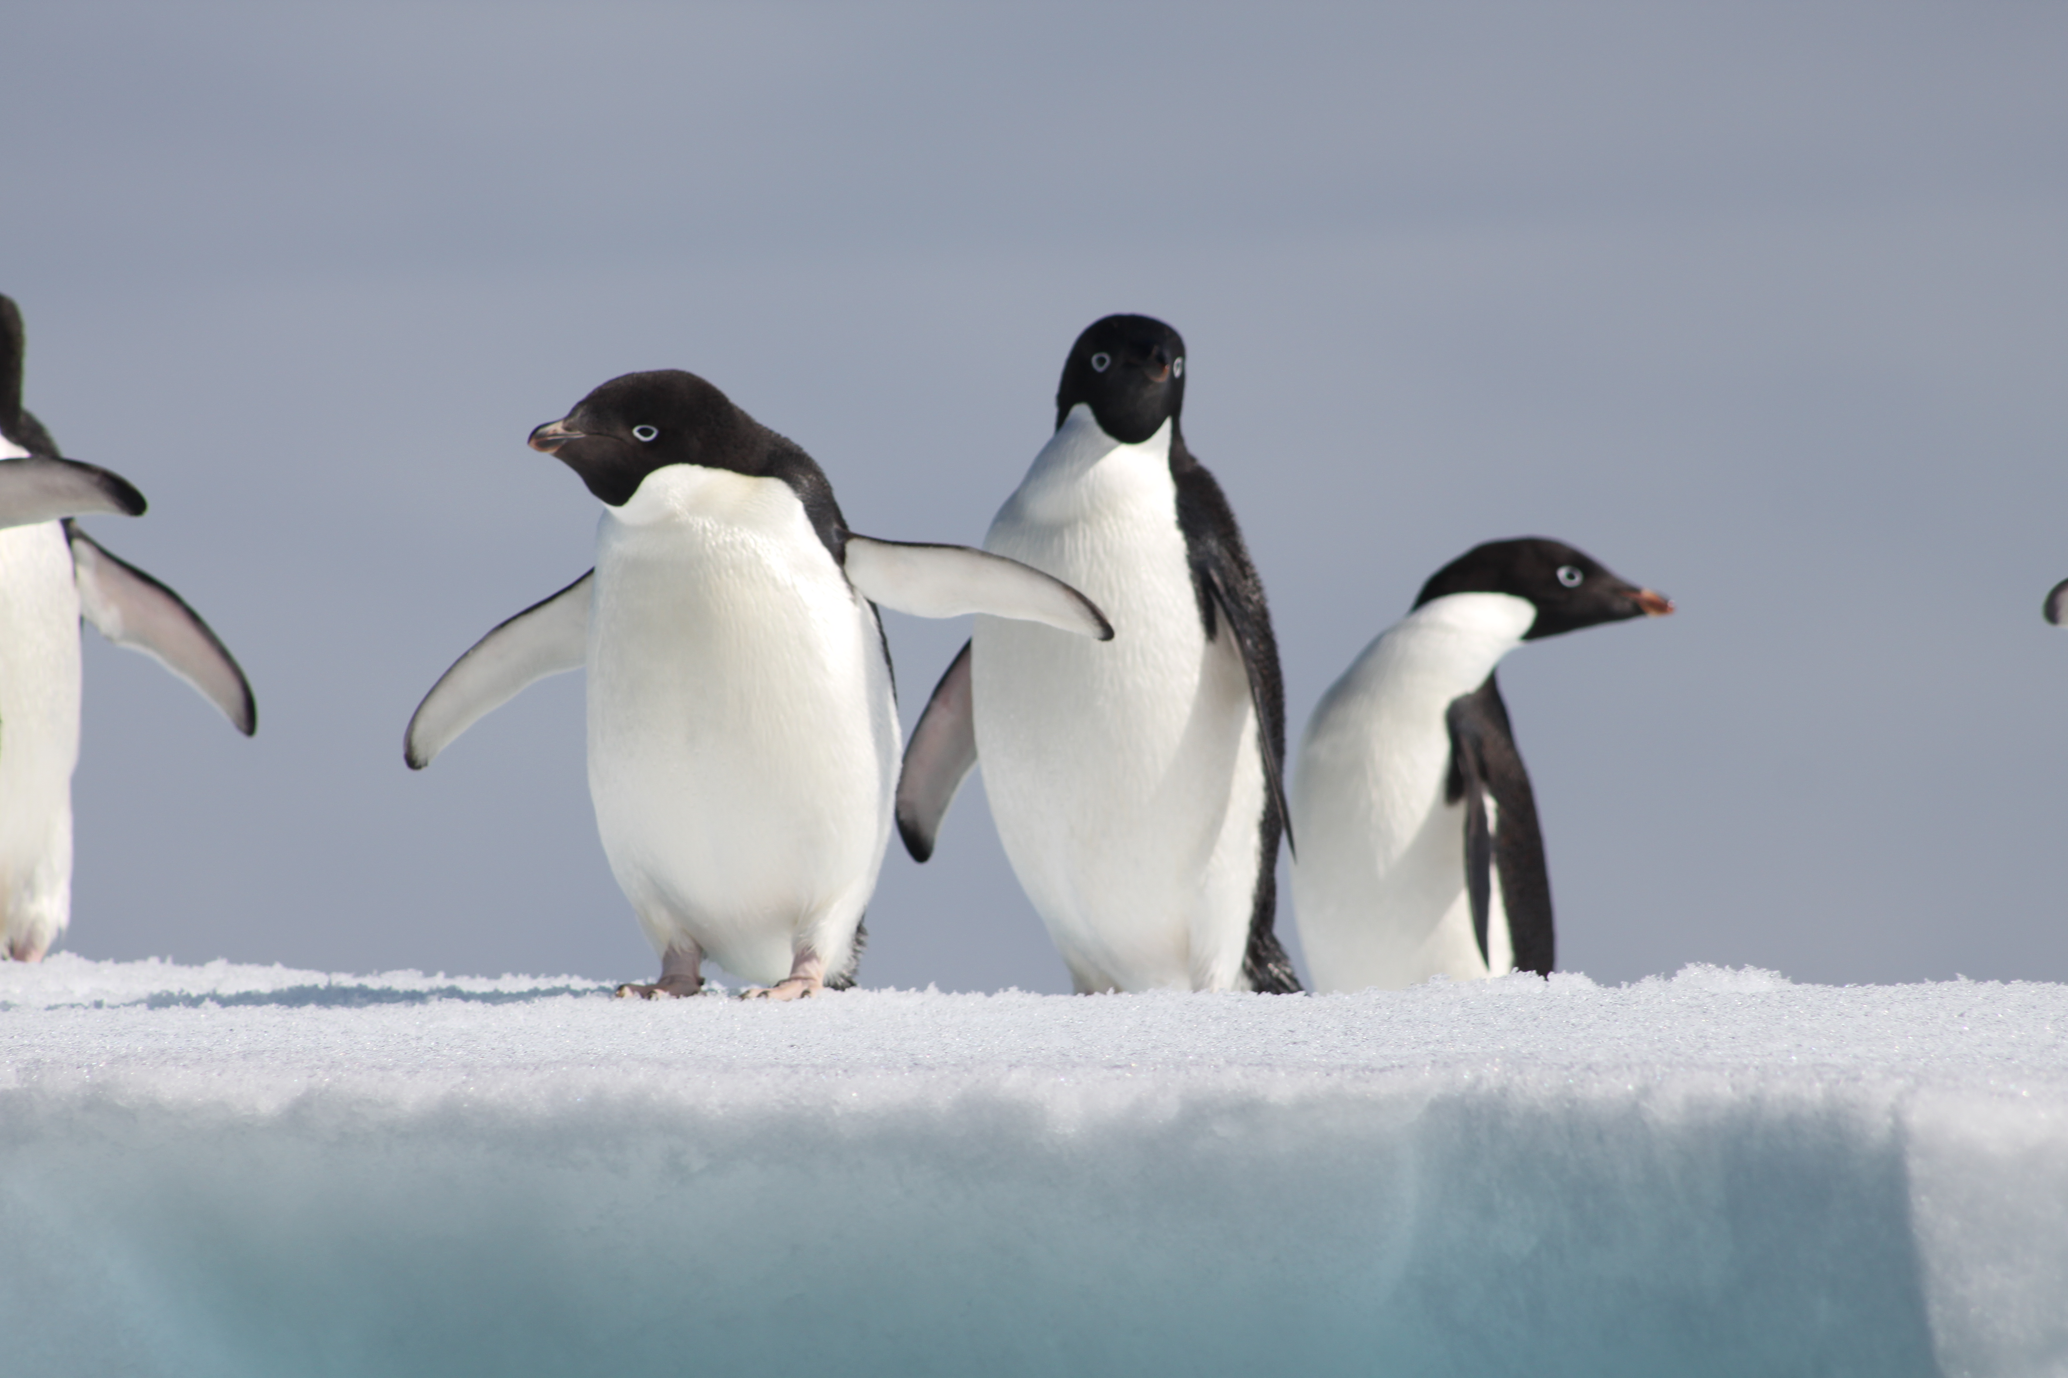
VIDEO:
A. Global Implications Adelie Penguins (Pygoscelis antarctica) (2:17) http://cleanet.org/resources/42817.html : Evidence of Change: Adelie Penguins
Adelie penguins on iceberg, Simmons 2011
Avian Island, Antarctica (Simmons, 2011)
Beth E. Simmons TERC Education Consultant March 15th, 2012
Notes:
Adapted to the rhythm of the sea ice, Adelies are intimately connected to a life that includes sea ice and krill, As climate changes the marine ecosystem around them, life on land and in the sea for these Adelies is shifting. This video complements the lesson and could be used as either at the beginning or at the end of this lesson.

Slide 15
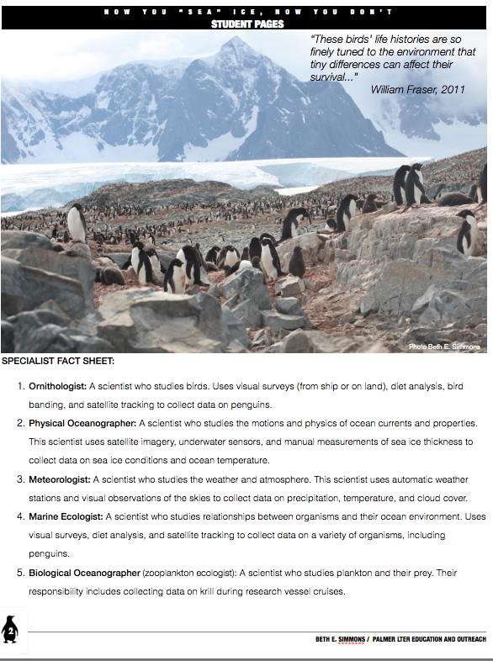
LESSON:
b. Now you Sea Ice Now you Don’t: Ecosystems approach depicting the fluctuations of climate change. http://cleanet.org/resources/43010.html
Ornithologist:
Physical Oceanographer
Meteorologist
Marine Ecologist
Biological Oceanographer
Notes:
In this lesson, a jigsaw approach is used where students approach climate change in the WAP through the eyes of 5 different perspectives:

Slide 16
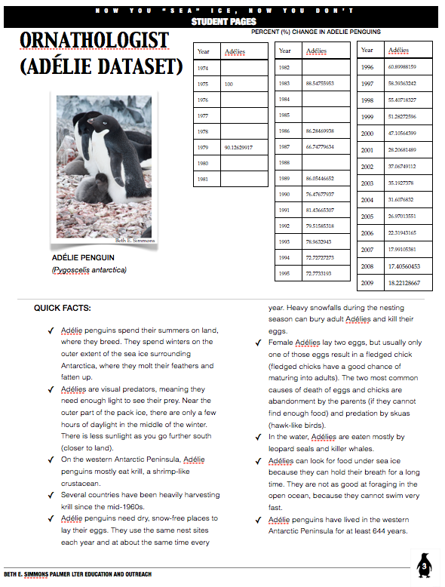
Updated Data set
Quick Facts
Notes:
Each specialist is given an updated data set and quick facts to learn about the environment along the WAP from their specific point of view.

Slide 17
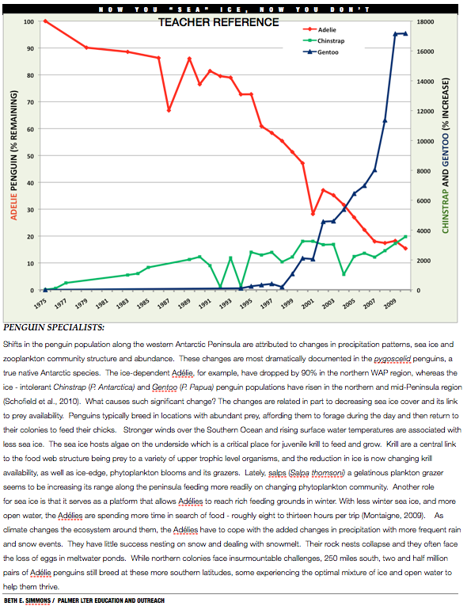
Teacher data reference
Scientific explanation of trends & patterns (cross-cutting concept)
Notes:
Each group is asked to graphically represent their data and share their findings within their groups and then with the entire class.

Slide 18
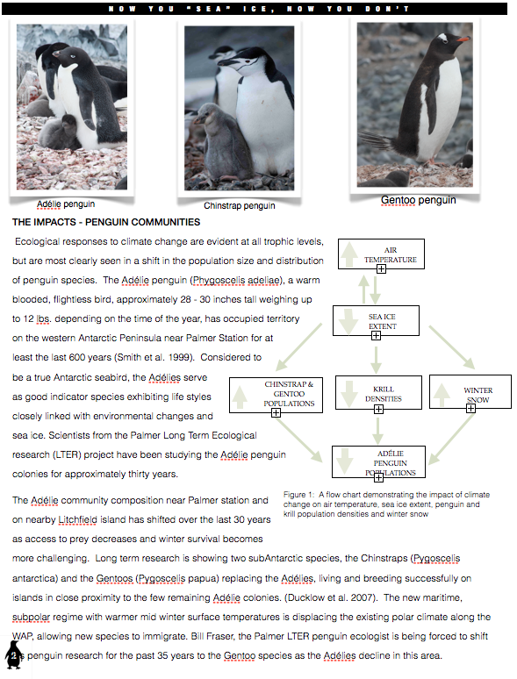
Scientific context
Flow chart
Notes:
Once the students hear all the points-of-view they must then build a flow chart that identifies all the feedback mechanisms that influence change/triggering the system over time. How do all these variables impact the Adelie’s current situation?

Slide 19
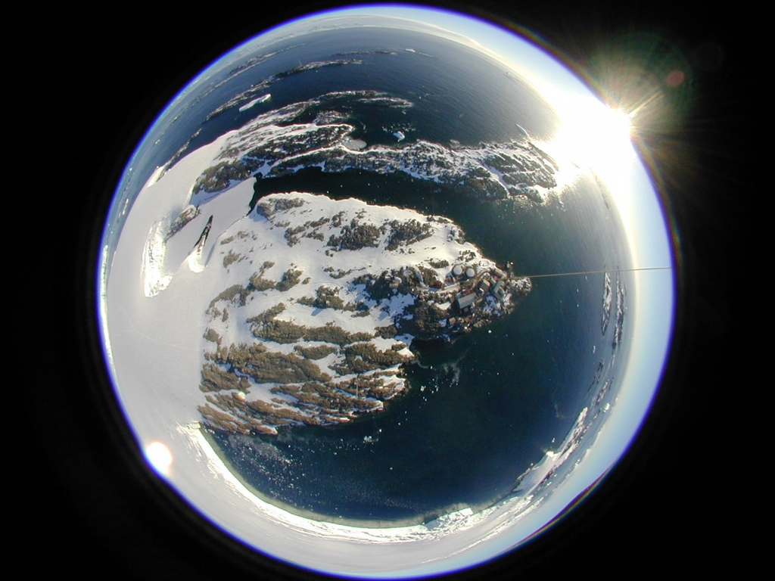
References
Ocean Acidification Reference User Group (2009) Ocean
Acidification: The Facts. A special introductory guide for
policy advisers and decision makers. Laffoley,D.D’A., and
Baster, J.M. (eds). European Project on Ocean
Acidification (EPOCA). 12pp.
http://www.epoca-project.eu/index.php/Outreach/RUG/
Ocean Acidification Reference User Group (2010). Ocean Acidification: Questions Answered. Laffoley, D. d’A., and Baxter, J.M. (eds). European Project on Ocean Acidification (EPOCA). 24pp. http://www.epoca-project.eu/index.php/Outreach/RUG/
Frequently Asked Questions about Ocean Acidification (2010) http://www.whoi.edu/OCB-OA/FAQs/
Ocean Acidification: Starting with the Science http://dels.nas.edu/resources/static-assets/materials-based-on-reports/booklets/OA1.pdf. National Research Council. 18pp.
K - 12 Cross Cutting Concepts: (http://www.nap.edu/openbook.php?record_id=13165&page=83 EPA.
Palmer LTER: http://pal.lternet.edu/outreach/
Ariel photograph of Palmer Station,
Antarctica (Palmer LTER)
Notes:
Resources/references used for your information and background on the topic.

