Slide 1
CLEAN Education Resources
Kristen Ann Record
Bunnell High School; Stratford, CT.
CLEAN Resource Collector and Evaluator

Slide 2
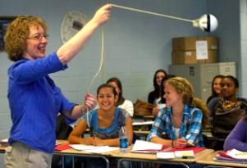
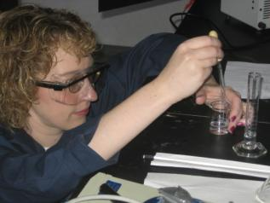
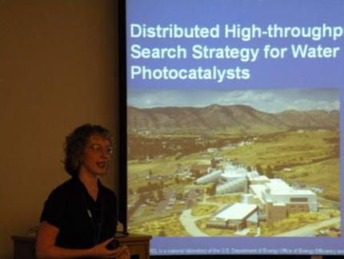
Physics Teacher
Meets Electrochemistry Lab

Slide 3
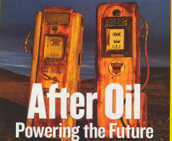

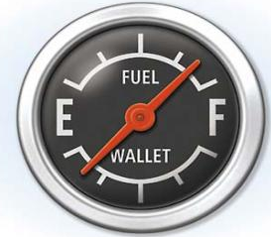
Why are we worried about Energy?

Slide 4
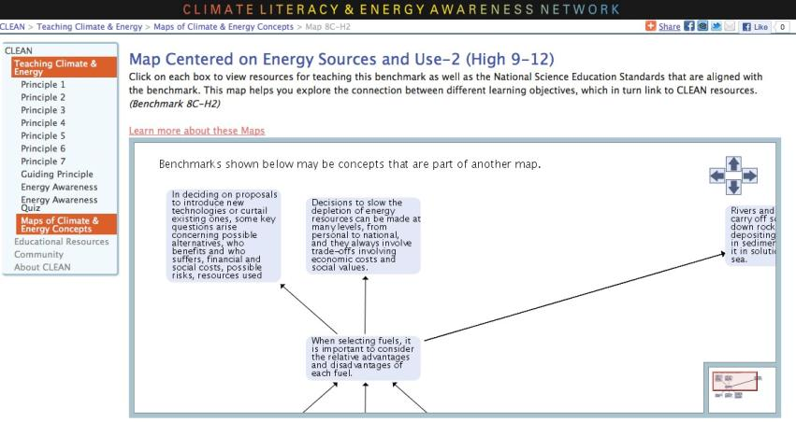

CLEAN and the AAAS Project 2061 Benchmarks for Science Literacy

Slide 5
CLEAN’s Energy Use Resources
55 Activities
27 Videos
13 Visualizations (Diagrams, Animations, etc)
1 Short Demo

Slide 6
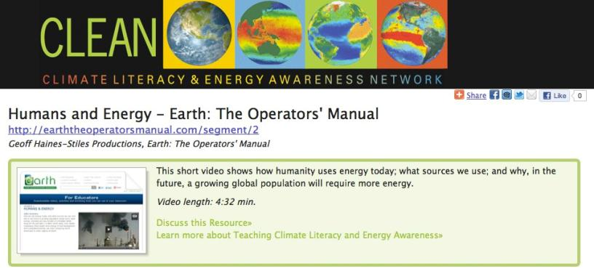

Slide 7
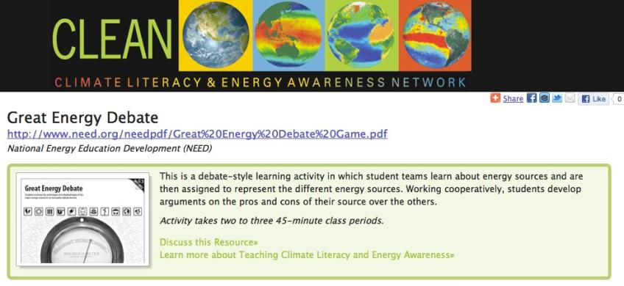

Slide 8
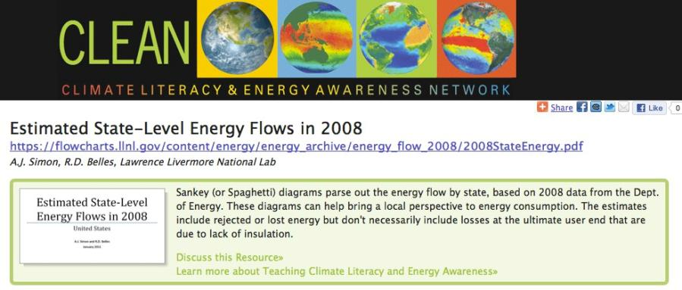

Slide 9
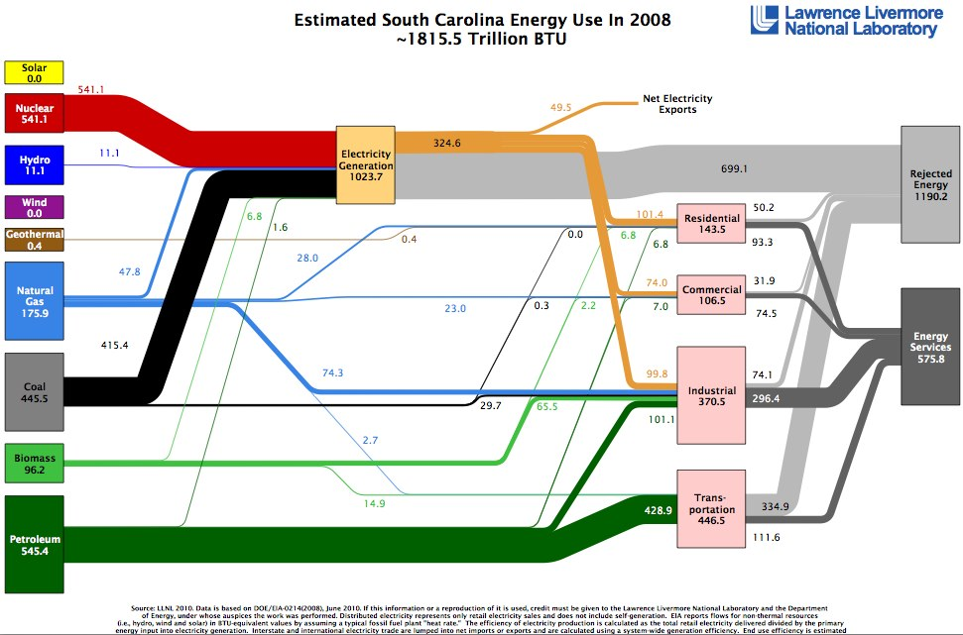
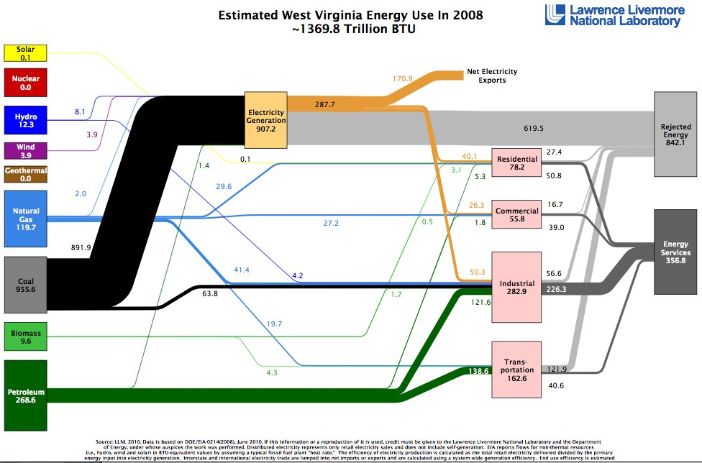
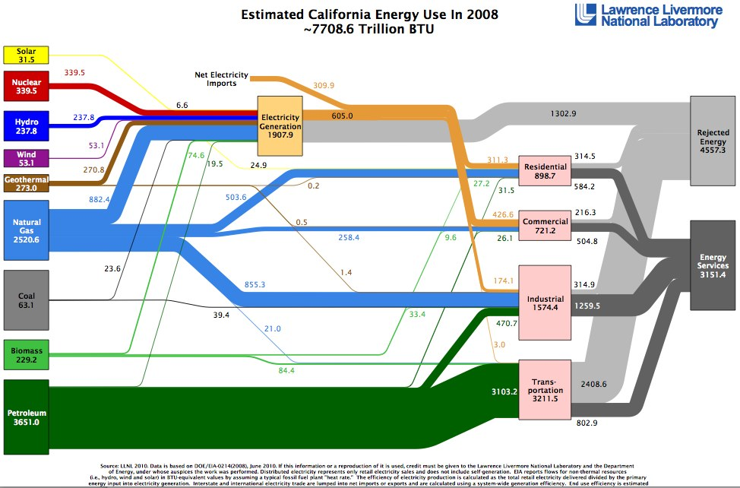
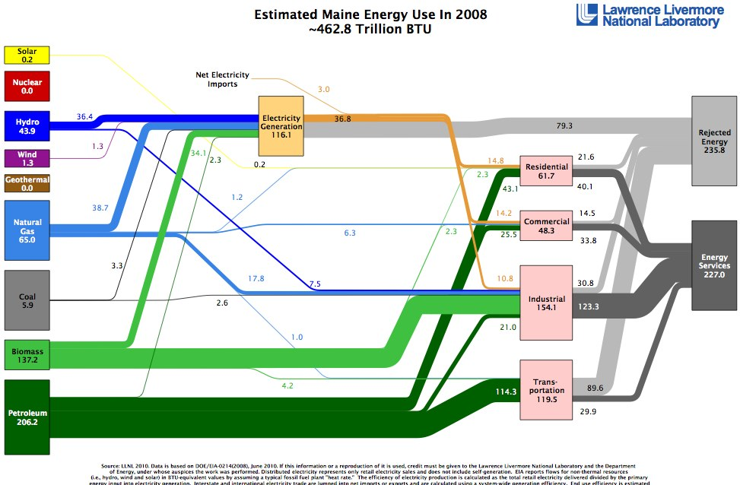

Slide 10
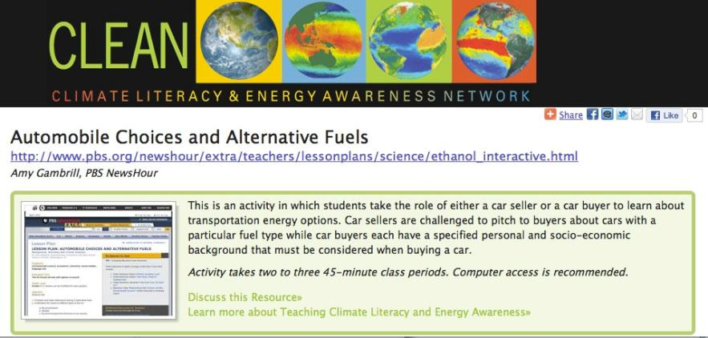

Slide 11
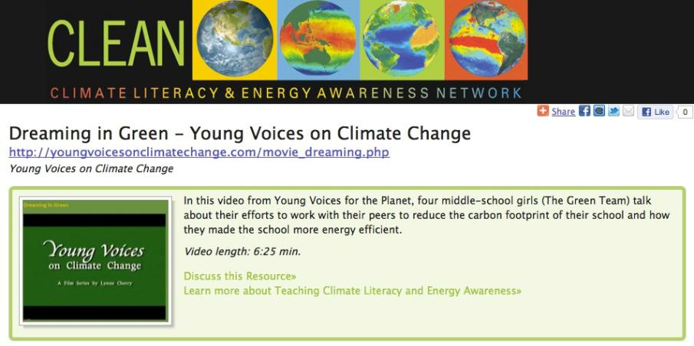

Slide 12
