Slide 1
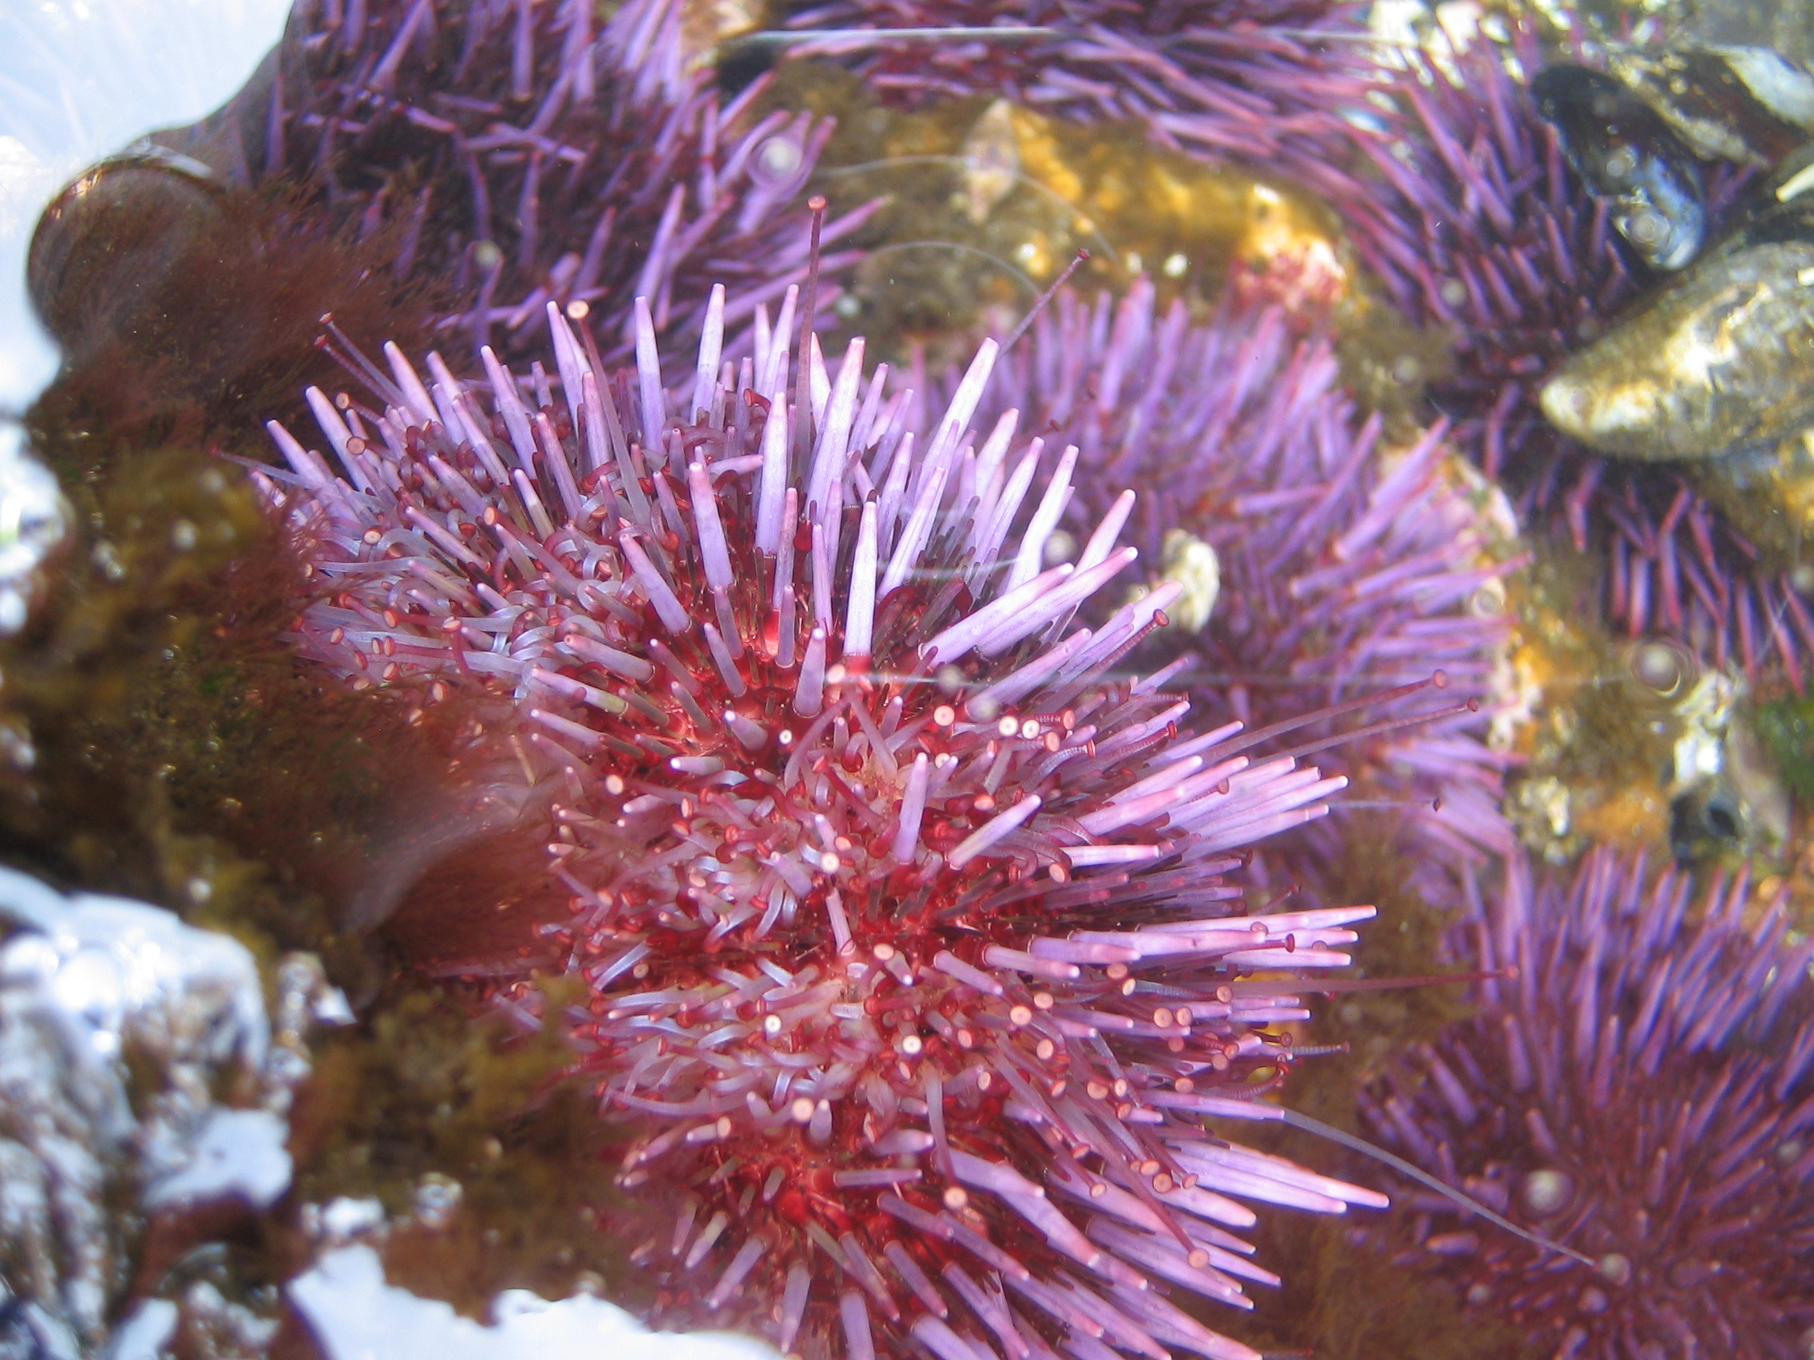
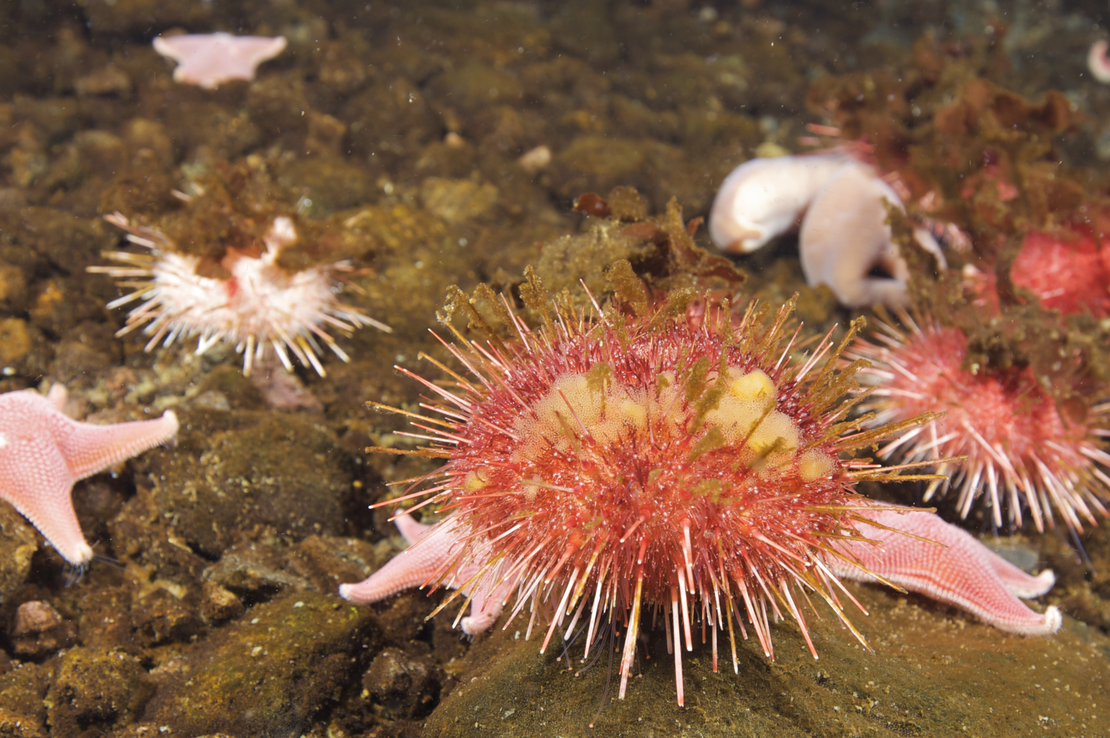
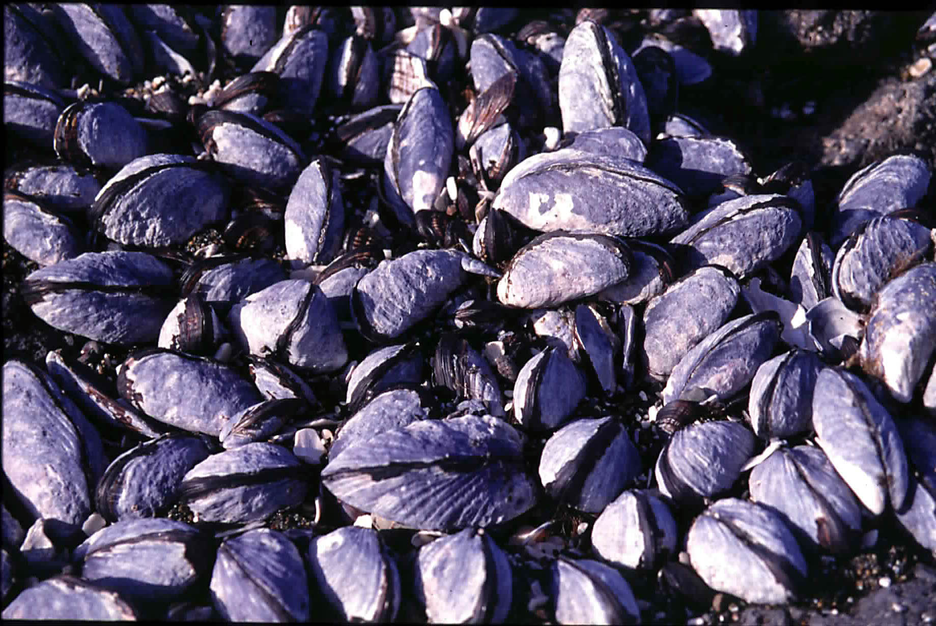
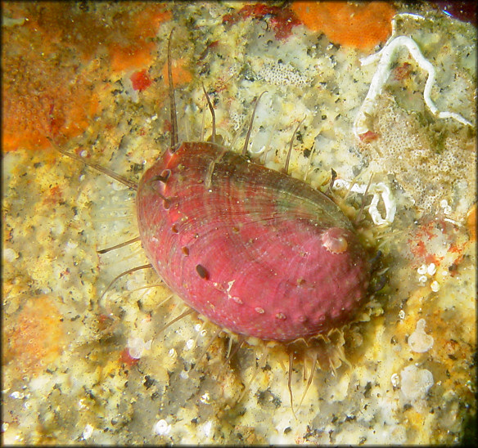
Global Change Biology &
Ocean Acidification
An organism to ecosystem approach
Gretchen Hofmann
UC Santa Barbara
March 15, 2012
Notes:
1
1

Slide 2
Global Change Biology
Physical
Organism
Ecosystem
GCB
GCB = Global Change Biology

Slide 3
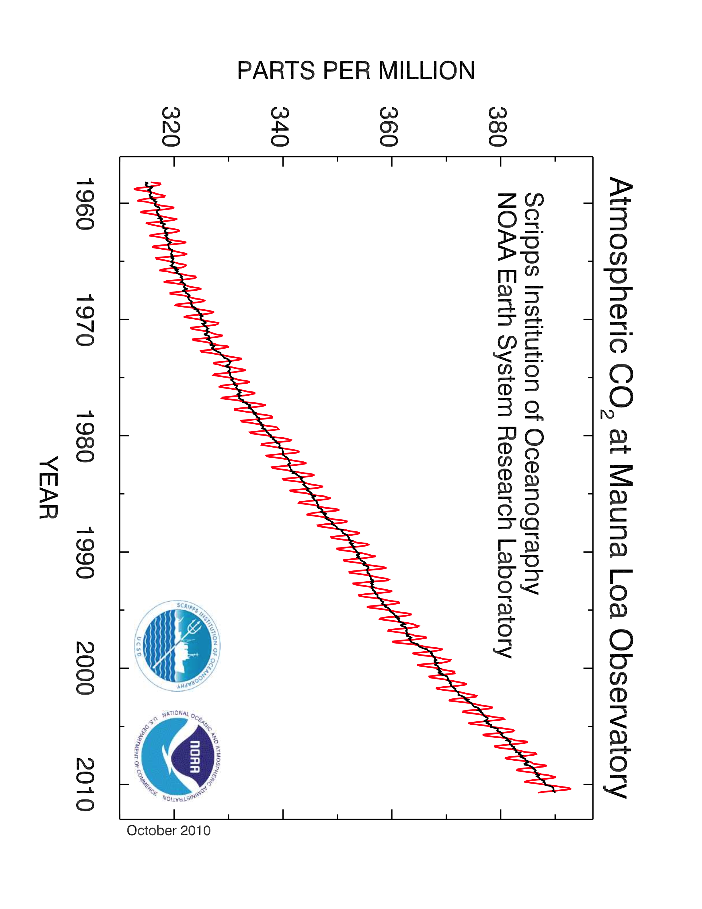
Keeling Curve
390 reported for 12/10

Slide 4
Global Change Biology
Physical
Organism
Ecosystem
I do: Physiology &
organismal biology
GCB

Slide 5
Migration
In global change biology, we predict
the following responses of organisms
to environmental change:
Acclimation
Migration
Acclimation
Adaptation
Extinction
Adaptation

Slide 6
Migration
Is it possible for a particular species?
What are the consequences?
Acclimation
Case Study: Pteropods, the sea butterfly
Adaptation

Slide 7
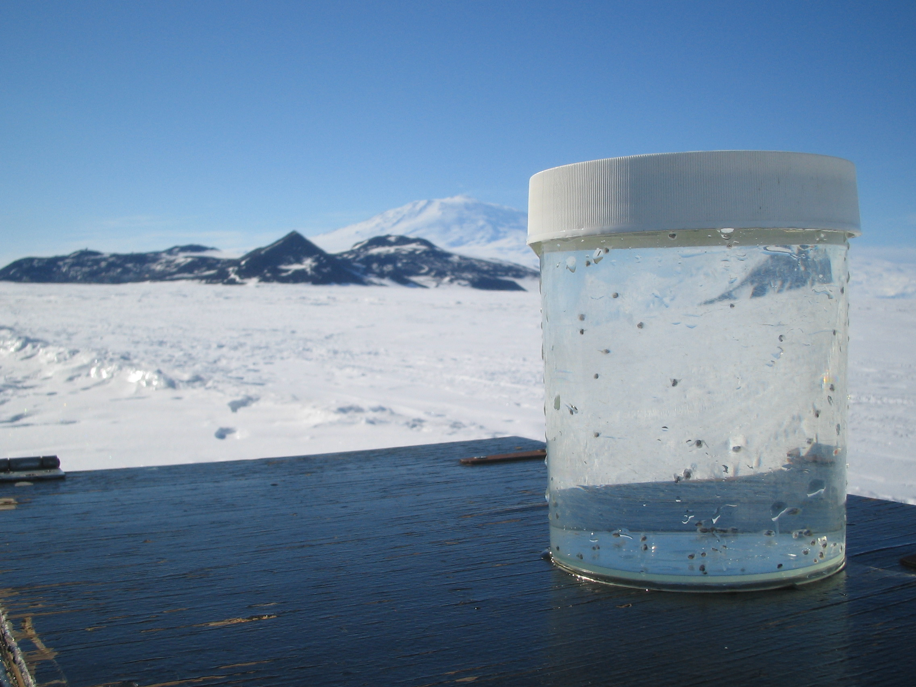
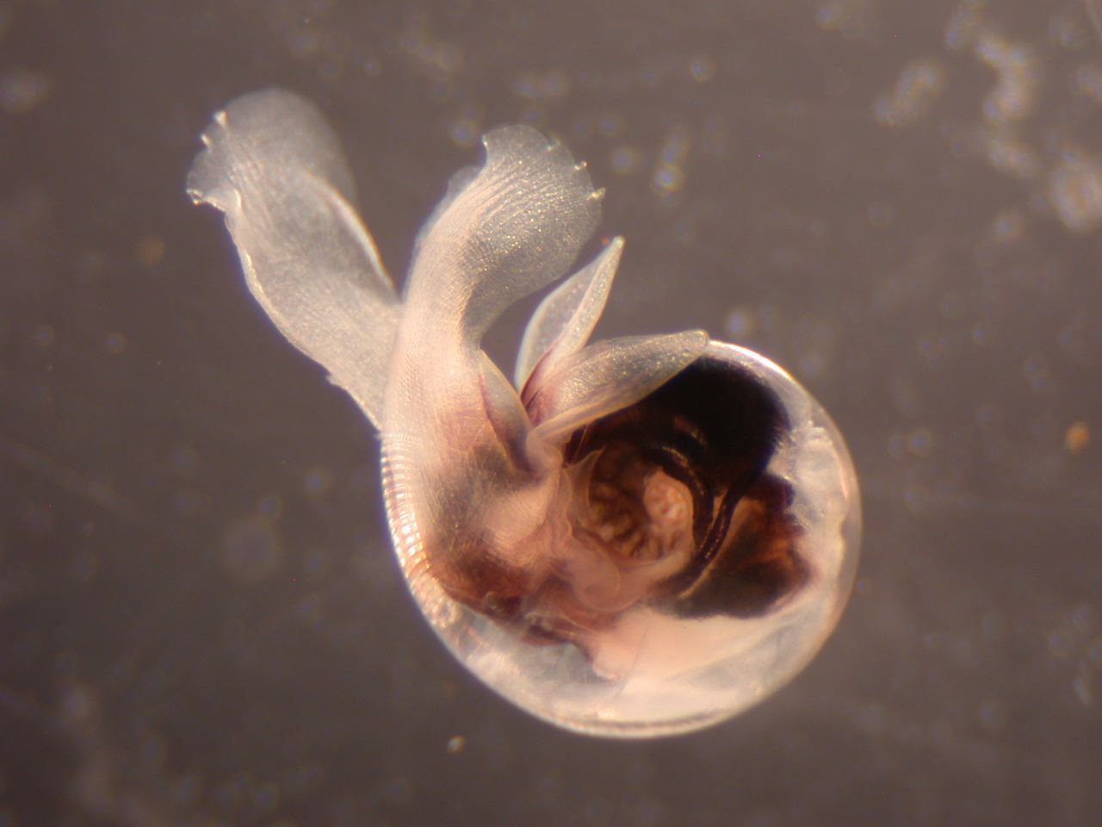
Limacina helicina: Bipolar species
Abundant (> 50% of zooplankton)
Significant food source
Pteropods from McMurdo Sound
Ross Sea, Antarctica
© G. Hofmann
Pteropod
Limacina helicina antarctica
1 mm

Slide 8
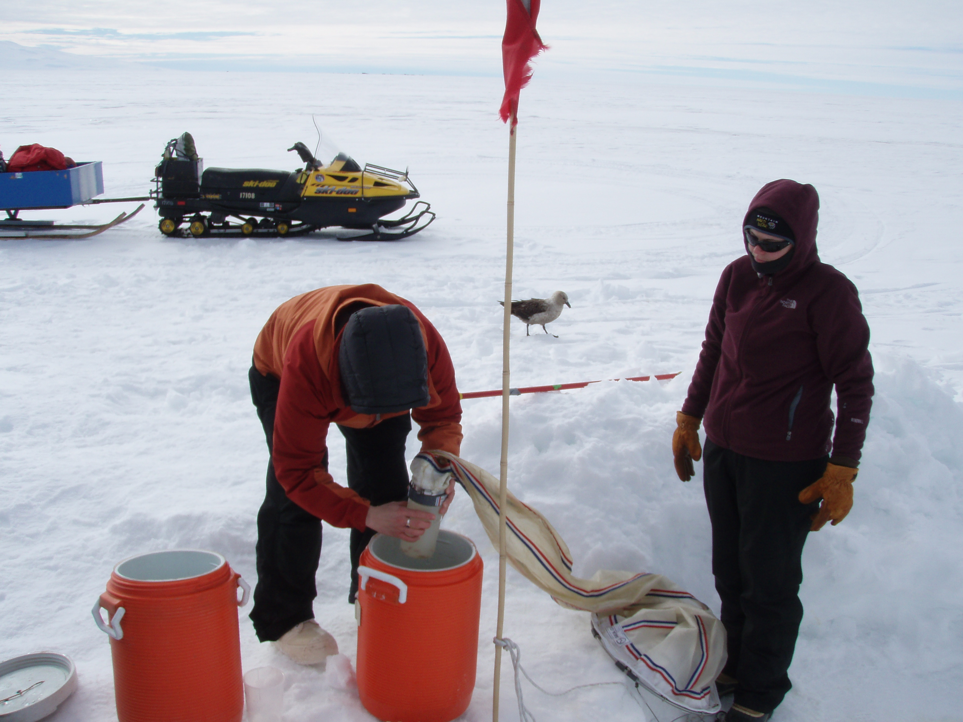

Slide 9
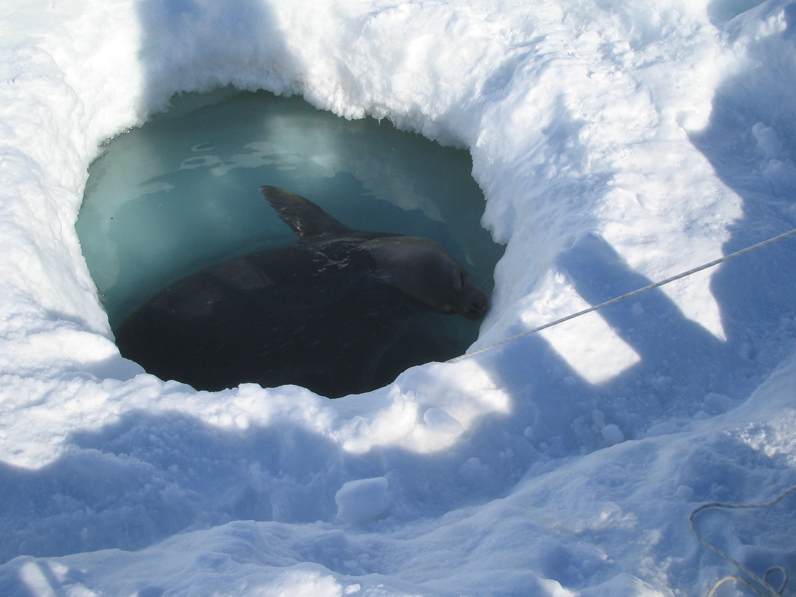

Slide 10
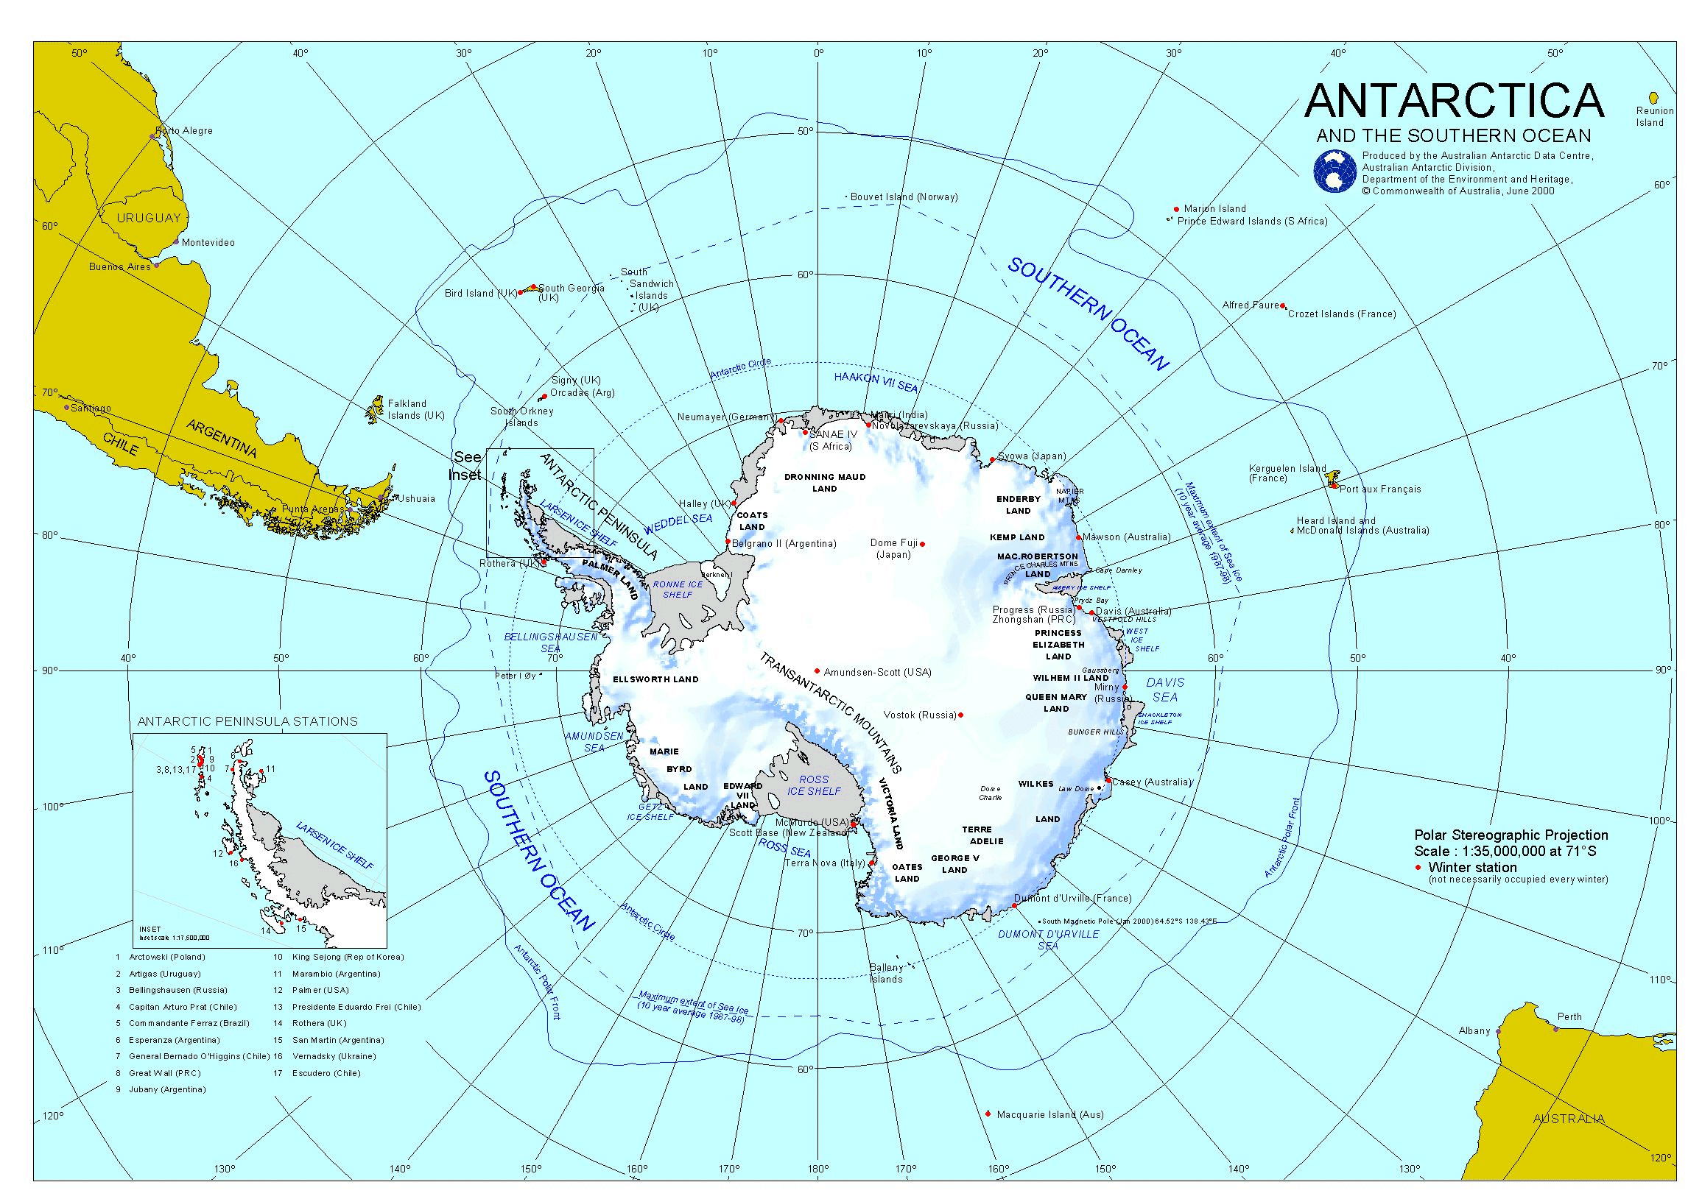
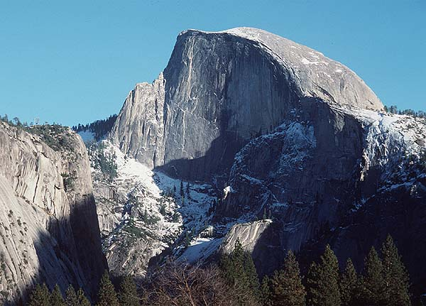
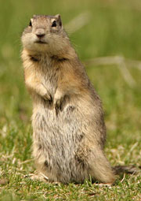
Migration may be limited:
Species with no where to go…
1 mm

Slide 11
Migration
Acclimation
Do species have the physiological tolerance
to withstand future acidification?
When do species ‘pop’ out of their tolerance windows?
Adaptation
Case Study: Pteropods

Slide 12
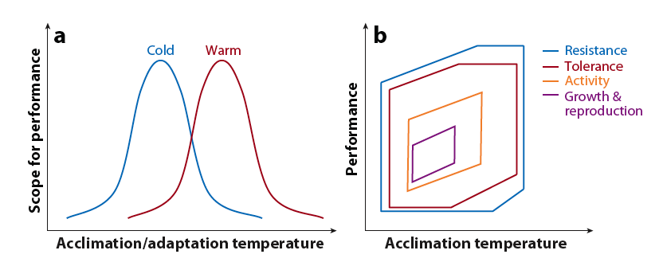
What we are asking:
Can organisms adjust…?
Phenotypic plasticity
Physiological plasticity
Capacity of current populations to tolerate upcoming, new conditions
Hofmann & Todgham (2010) Annu. Rev. Physiol. 72: 127-145

Slide 13
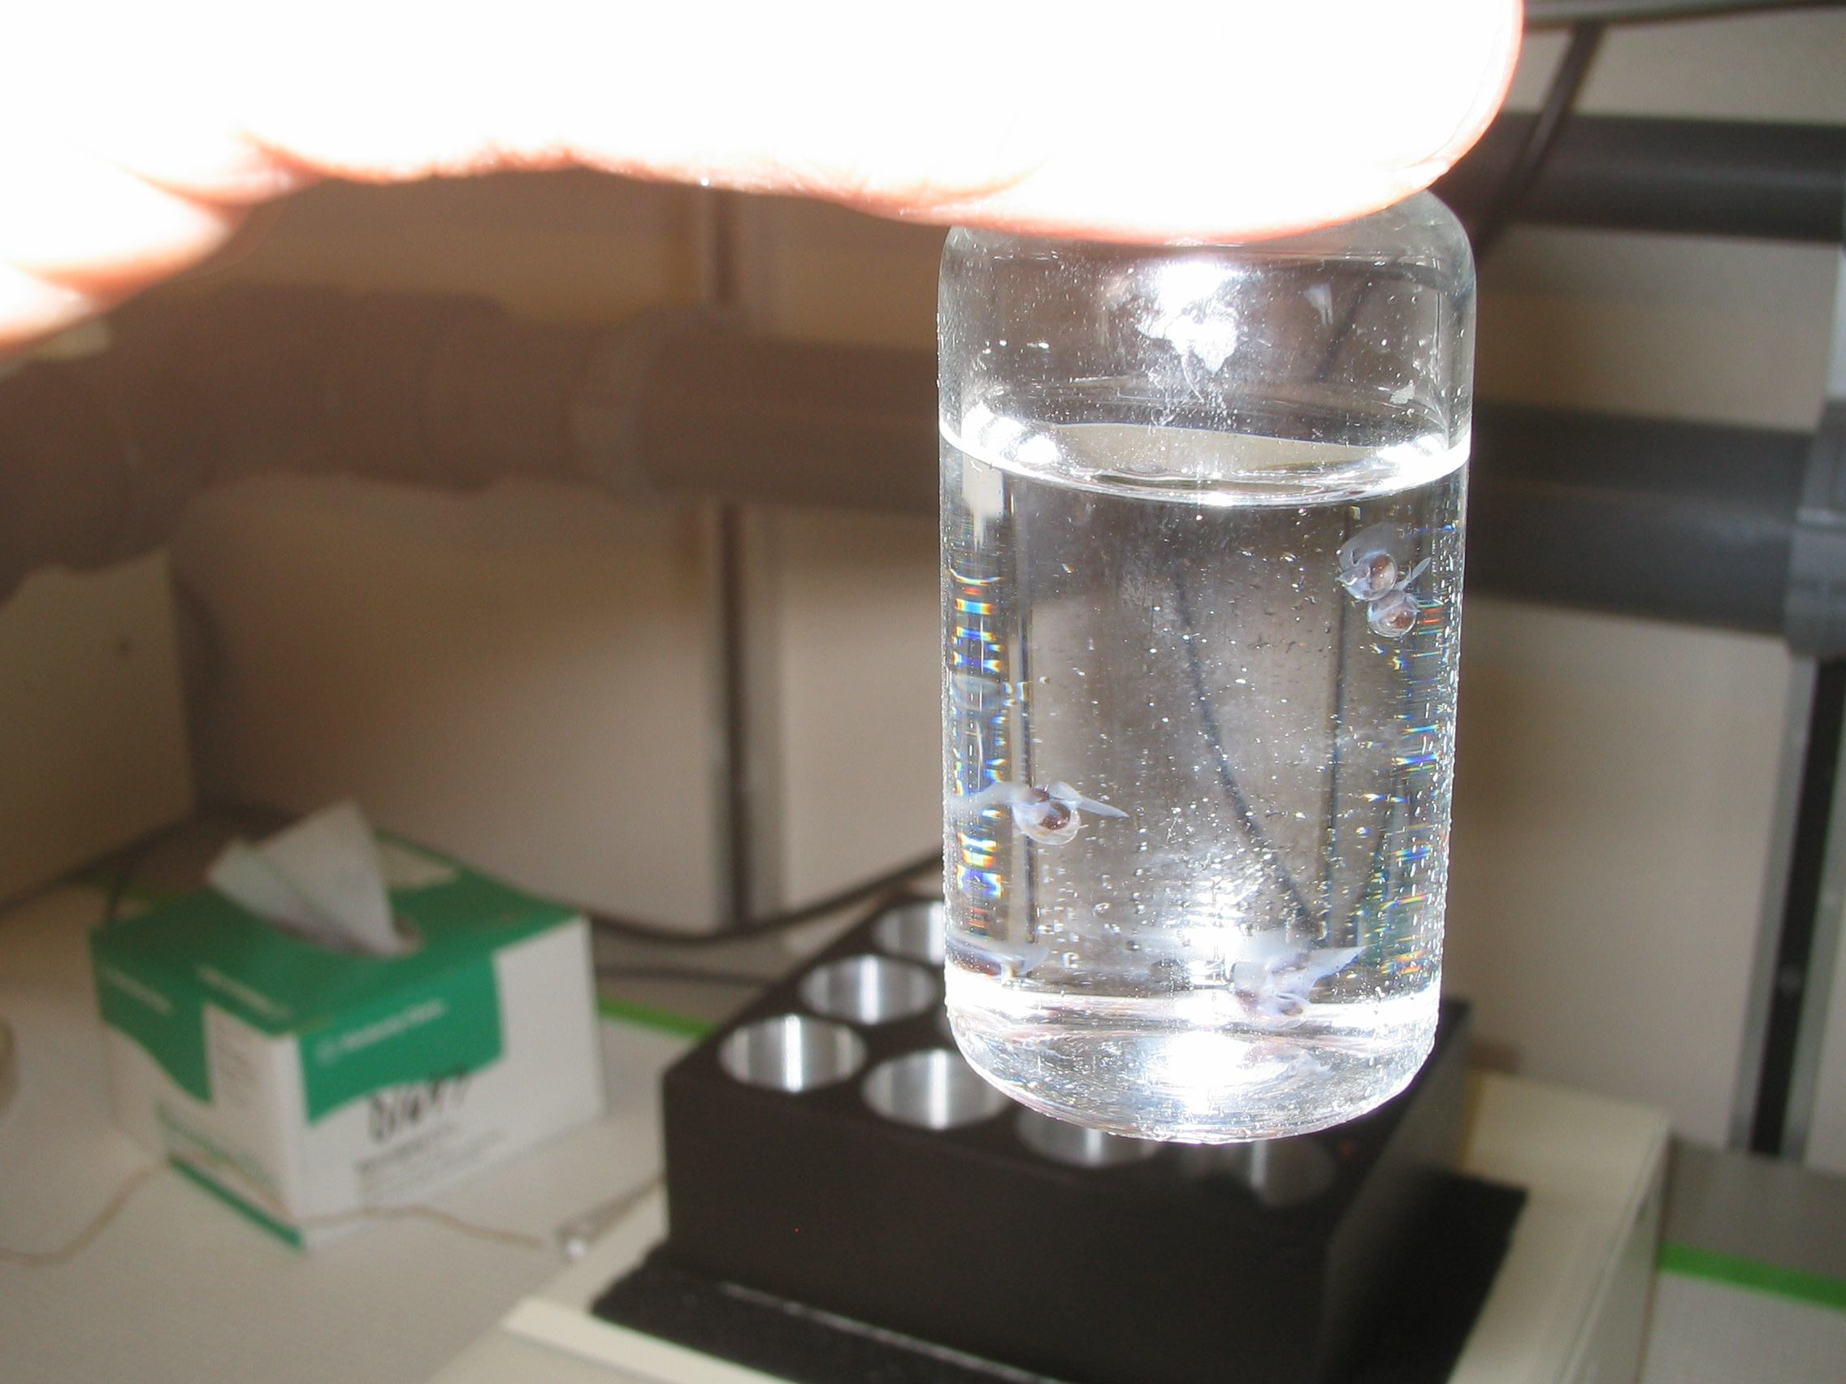

Slide 14
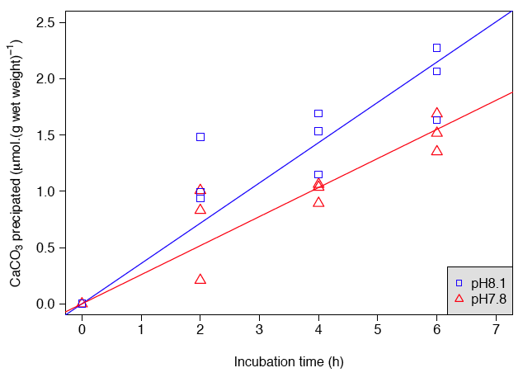
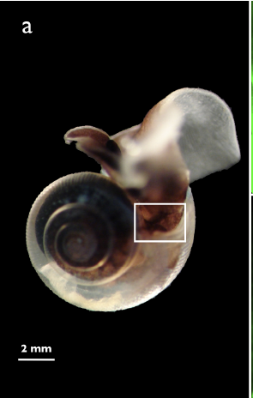
Calcification in pteropods
28% decrease
350 vs. 760 ppm
Limacina helicina helicina
Comeau et al (2009) Biogeosciences 6: 1877-1882

Slide 15
Migration
Acclimation
Case Study: Algae
Adaptation
Will species have time to adapt to rapidly changing
environmental conditions?

Slide 16
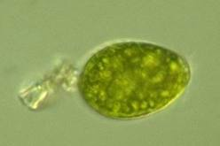
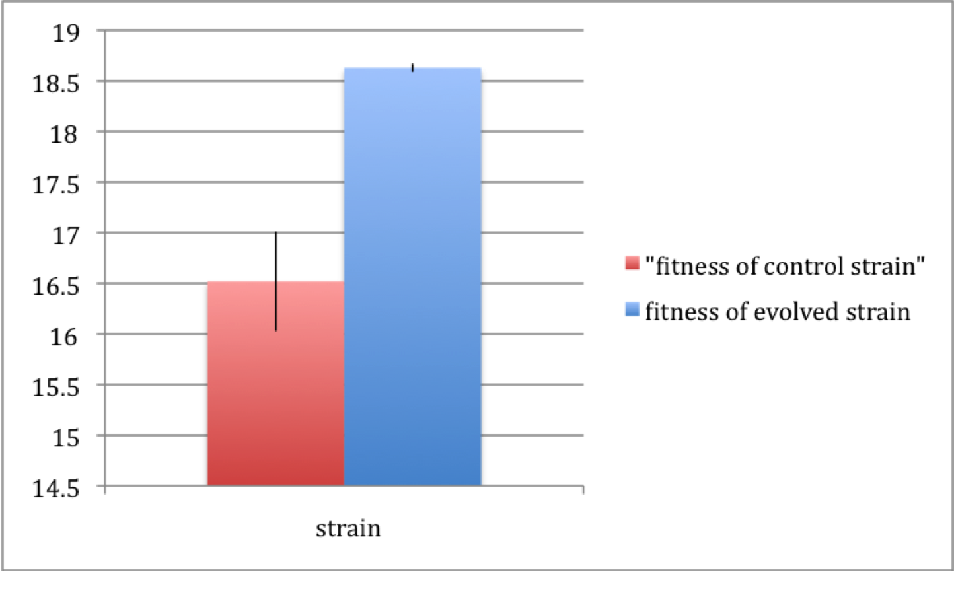
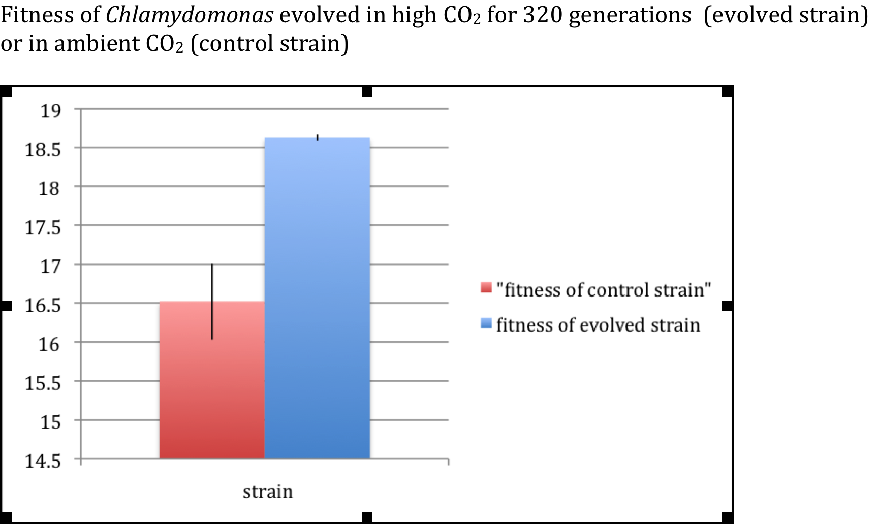
Research of Sinéad Collins, University of Edinburgh
Experimental Evolution: How much variation can be expected?

Slide 17
Migration
Acclimation
Migration
*Acclimation
Adaptation
Extinction
Adaptation

Slide 18
Ocean Acidification
Examining phenotypic and physiological plasticity
Notes:
18
18

Slide 19
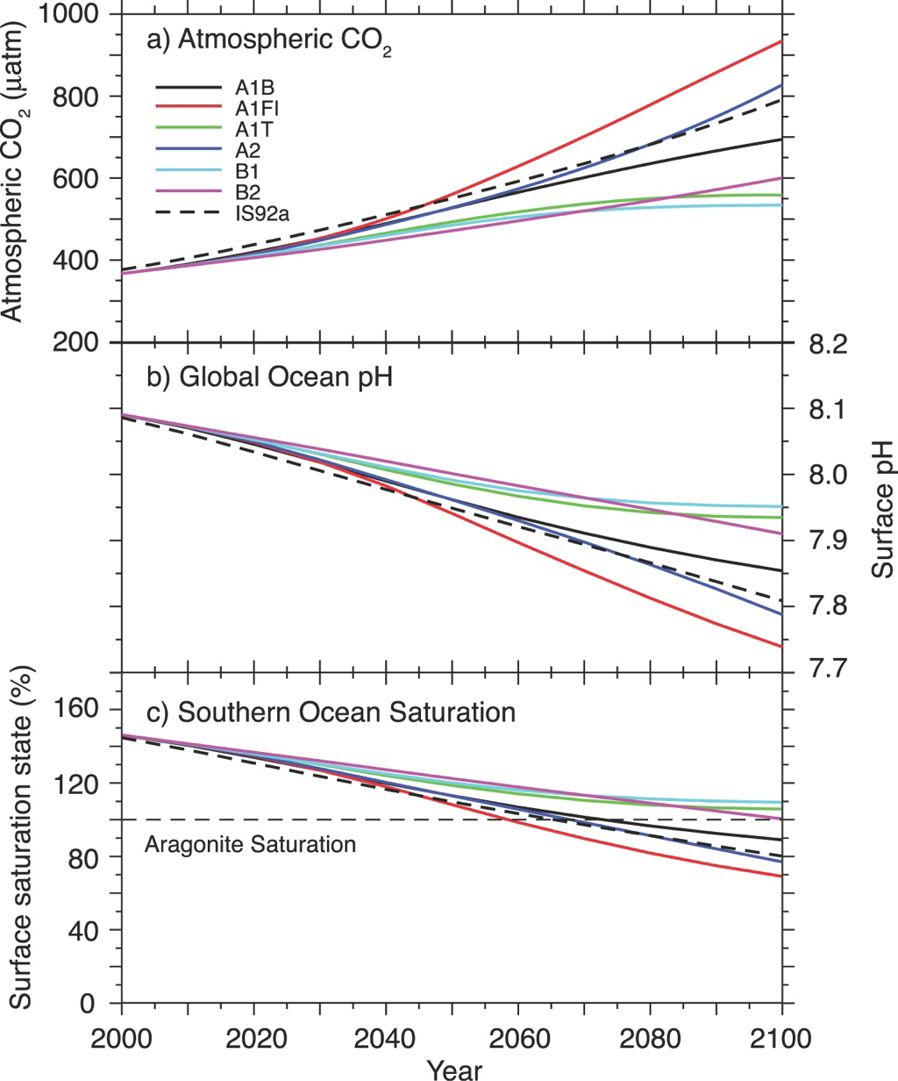
IPCC Emission Scenarios
Today:
386 ppm CO₂
pH = ~ 8.1
Future:
500-1000 ppm CO₂
pH drops to 7.9-7.7

Slide 20
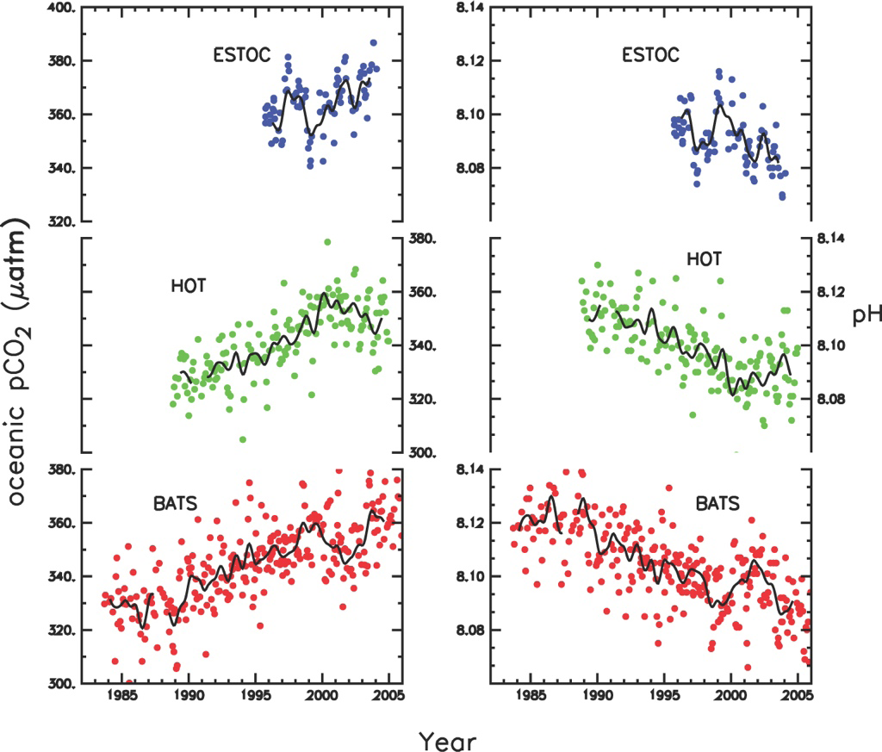
Canary Islands
Hawaii
Bermuda

Slide 21
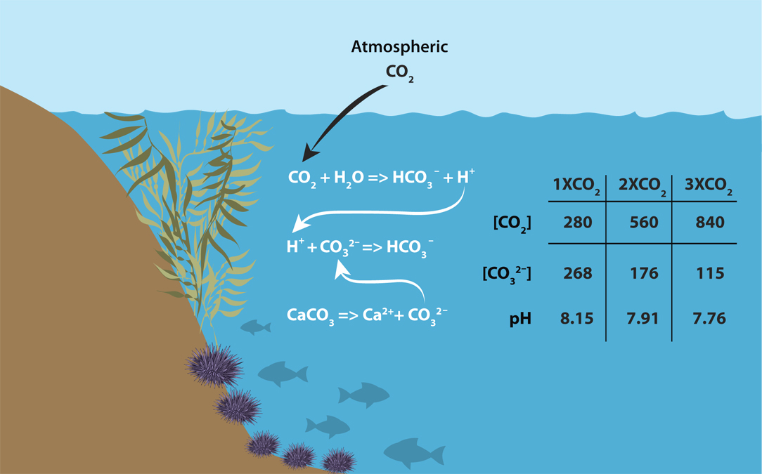
The Chemistry: How it works
Pre-Industrial [CO₂] = 280 ppm Present [CO₂] = 384 ppm
Notes:
This reduction of carbonate ions may have deleterious effects on organisms that produce CaCO3 shells and skeletons. The extent to which they will be affected depends on the CaCO3 saturation state. The continual increase in CO2 in the atmosphere will decrease carbonate ions and continue to decrease the Calcium carbonate saturation levels.
The two types of calcium carbonate secreted by marine organisms are calcite and aragonite, and the saturation state of both of these is projected to decrease significantly by 2100. The big question then is how will organisms that rely on carbonate ions to build their skeletons fare under conditions of calcite and aragonite saturations which are roughly half of what they were before the industrial revolution?

Slide 22
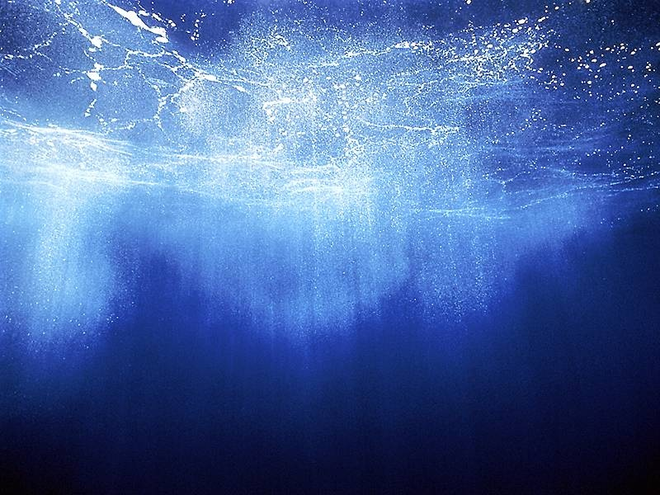
pH scale
0
1
2
3
4
5
6
7
8
9
10
11
12
13
14
Acidic
Alkaline
Stomach acid
Coca cola
Coffee
Surface seawater
Household bleach
Distilled water
0.3 decrease in pH = doubling of H+ concentration

Slide 23
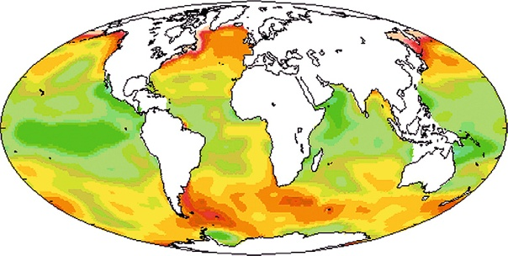
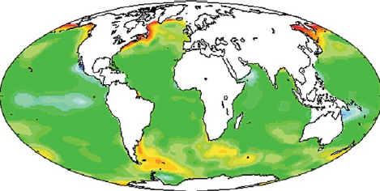
pH scale
0
1
2
3
4
5
6
7
8
9
10
11
12
13
14
Acidic
Alkaline
Surface seawater
Pre-industrial
Present day
pH scale for maps

Slide 24
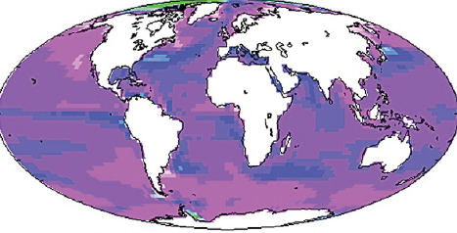
pH scale
0
1
2
3
4
5
6
7
8
9
10
11
12
13
14
Acidic
Alkaline
Surface seawater
Predicted for 2100 under ‘business as usual’
Pre-industrial
From Turley & Findlay (2009)
Present day
pH scale for maps

Slide 25
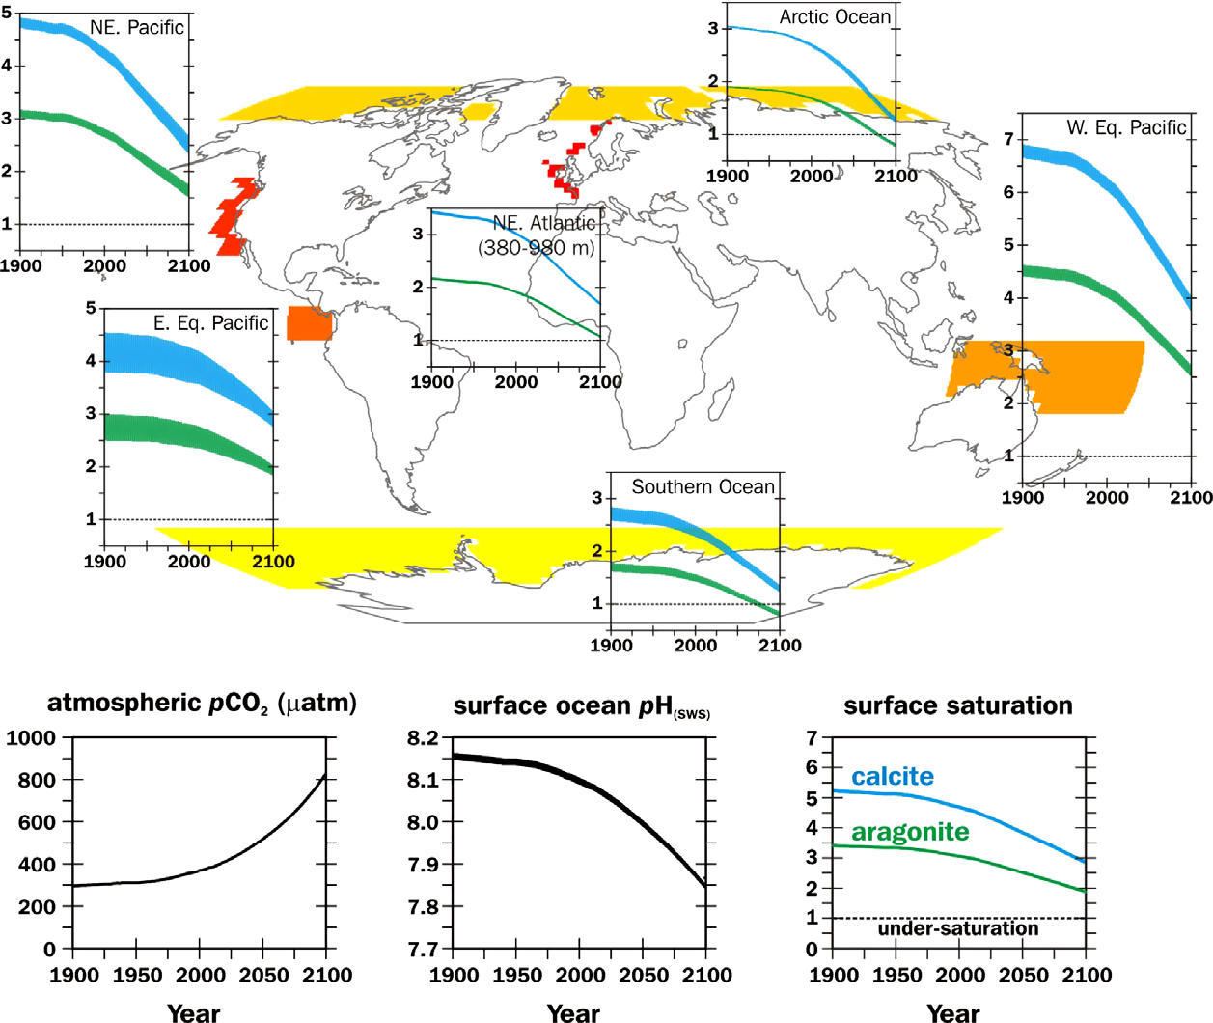
Saturation state of minerals
Organisms operating at increasingly lower saturation states
Turley et al. (2010) Marine Pollution Bulletin 60: 787-792

Slide 26
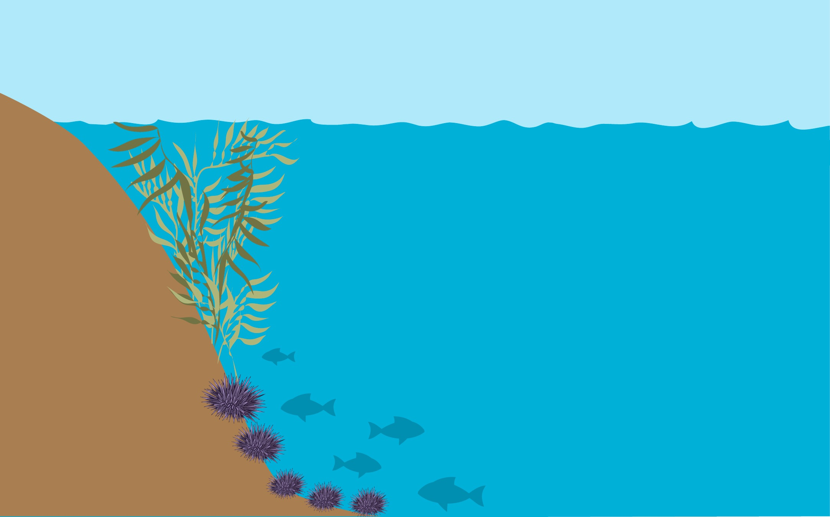
The Biological Consequences of Ocean Acidification
Carbon Dioxide (CO₂)
Results in carbonic acid formation
Lowers pH
Lowers carbonate ion
Less material to build
calcium carbonate shells &
other ‘hard parts’ & dissolution too

Slide 27
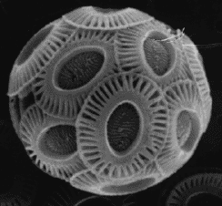
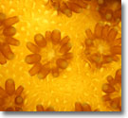
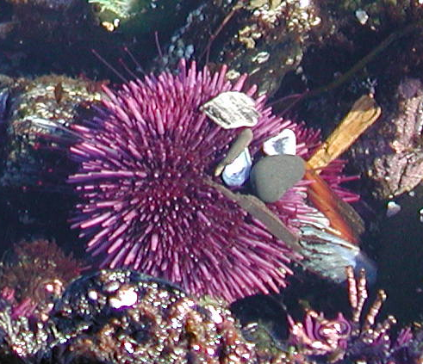
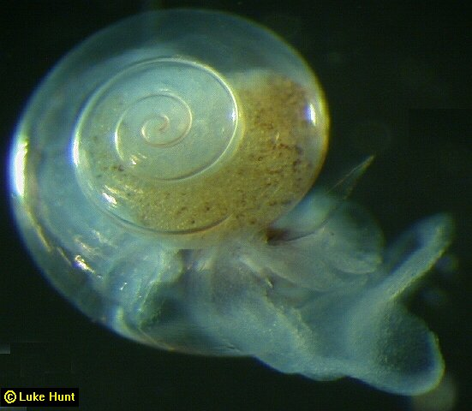
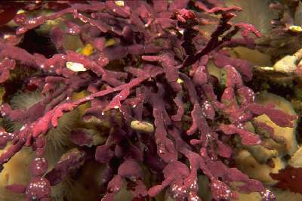
Calcium carbonate part
Coccolithophores
Plates (coccoliths)
Stony coral
Coral skeleton
Sea urchins
Skeleton & test
Pteropods
Shell
Coralline algae
Component of fronds

Slide 28
What are the problems?
Calcium carbonate (CaCO₃) shells and skeletons are vulnerable.
In experimental studies, reduced carbonate ion [CO₃²⁻] has been shown to:
  Decrease calcification rates
  Cause dissolution of existing shells & skeletons
  Alter the crystal form of biominerals
  Impact growth and development

Slide 29
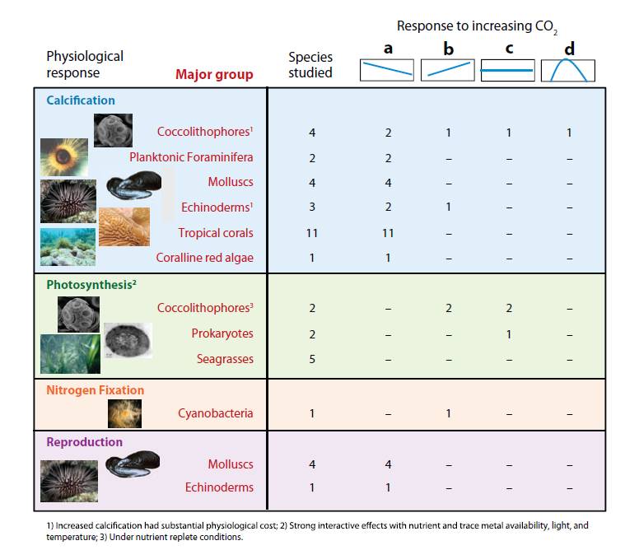
The OA Scorecard
Doney et al., ARMS 2009
Notes:
Very nice review by scott doney summarizing all that we know about OA responses in organims.
29

Slide 30
How my brand of science fits in:
Tipping points & organismal tolerances
X pCO₂?
Biological
ability to:
Resist
Tolerate
Compensate
pCO₂

Slide 31
Biological Responses &
Natural Variability of pH in the Environment
Two elements of Global Change Biology & Ocean Acidification

Slide 32
“Skin in, Skin out”
Predicting Ecological Consequences of OA
Molecular
Cellular
Organism
Population
Community
Proteomics
Gene
Expression
pH_{e}/ph_{i}
Calcification
Biochemical
Enzymes
Oxidative stress
Metabolic rate
Energetics
Acid/base phys.
Growth
Reproduction
Development
Respiration
Biomaterials
‘Hard parts’
Disease
Reef-wide
calcification
Recruitment
Species
Interactions
(trophic)
Local
Adaptation
Demographics
Symbiosis
Notes:
Ocean Acidification = multidisciplinary

Slide 33
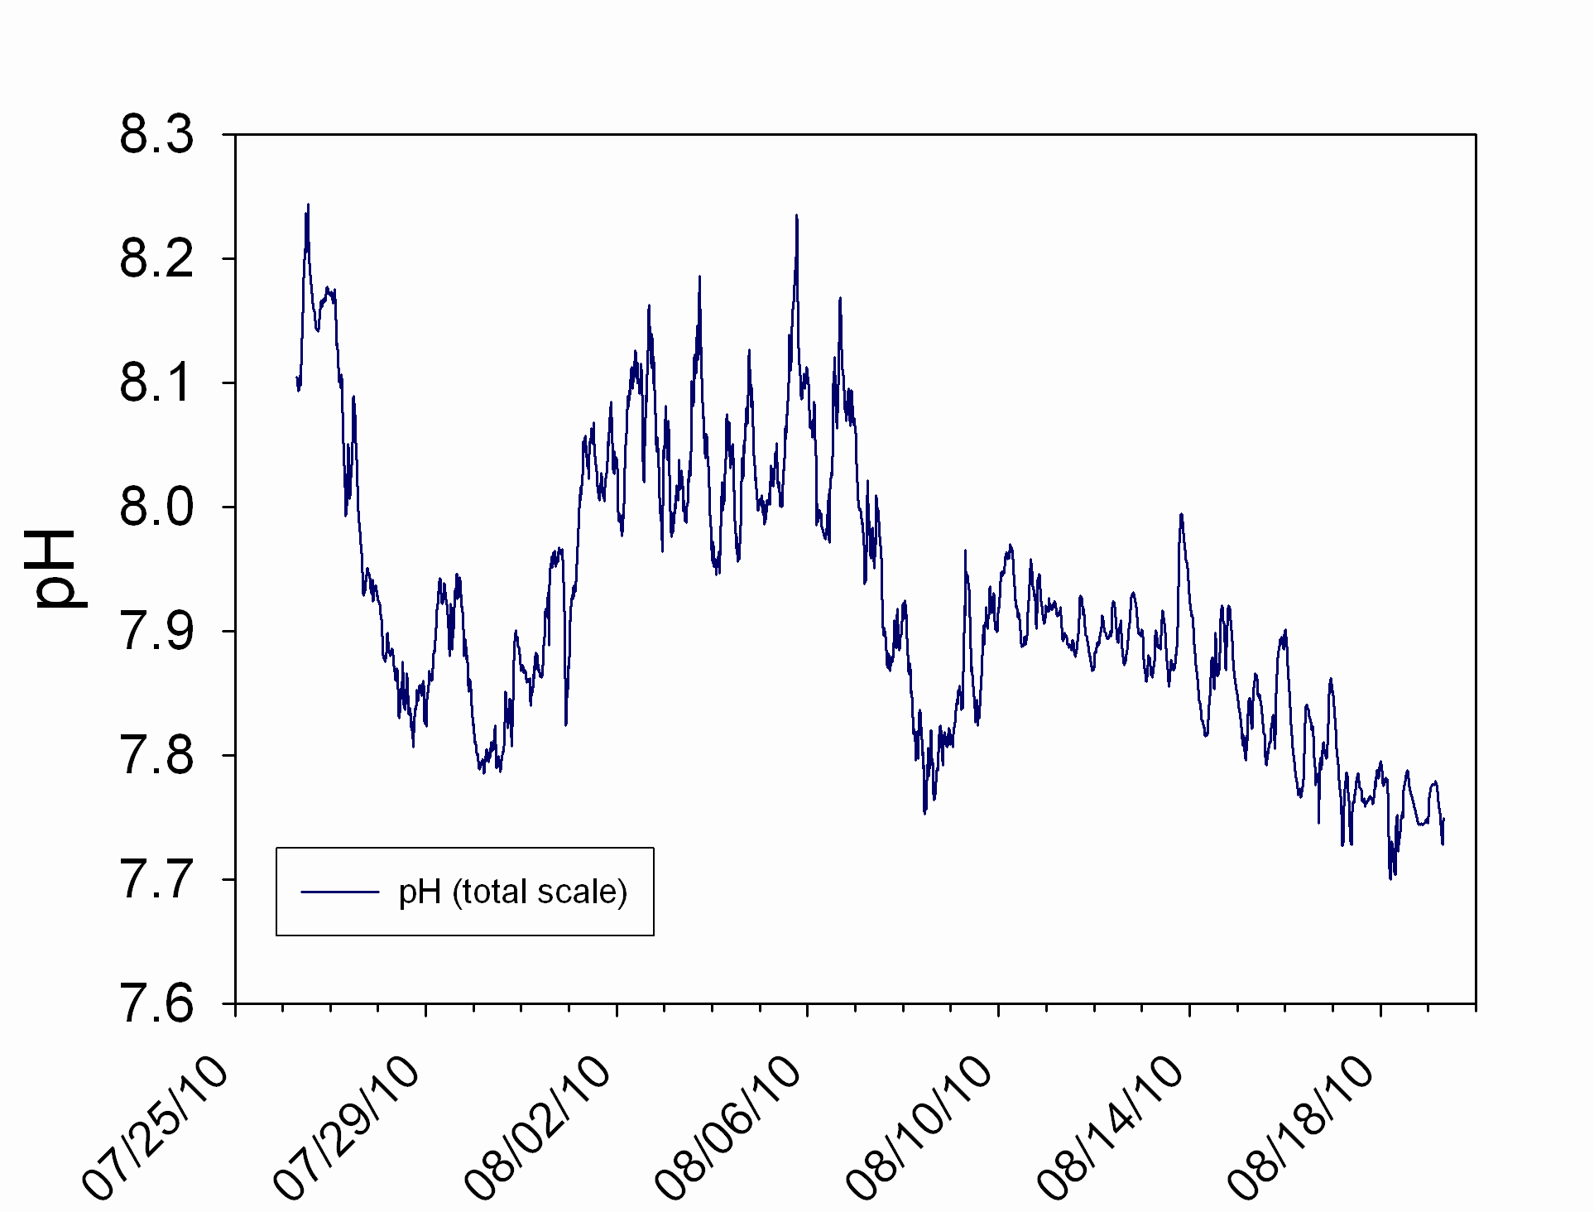
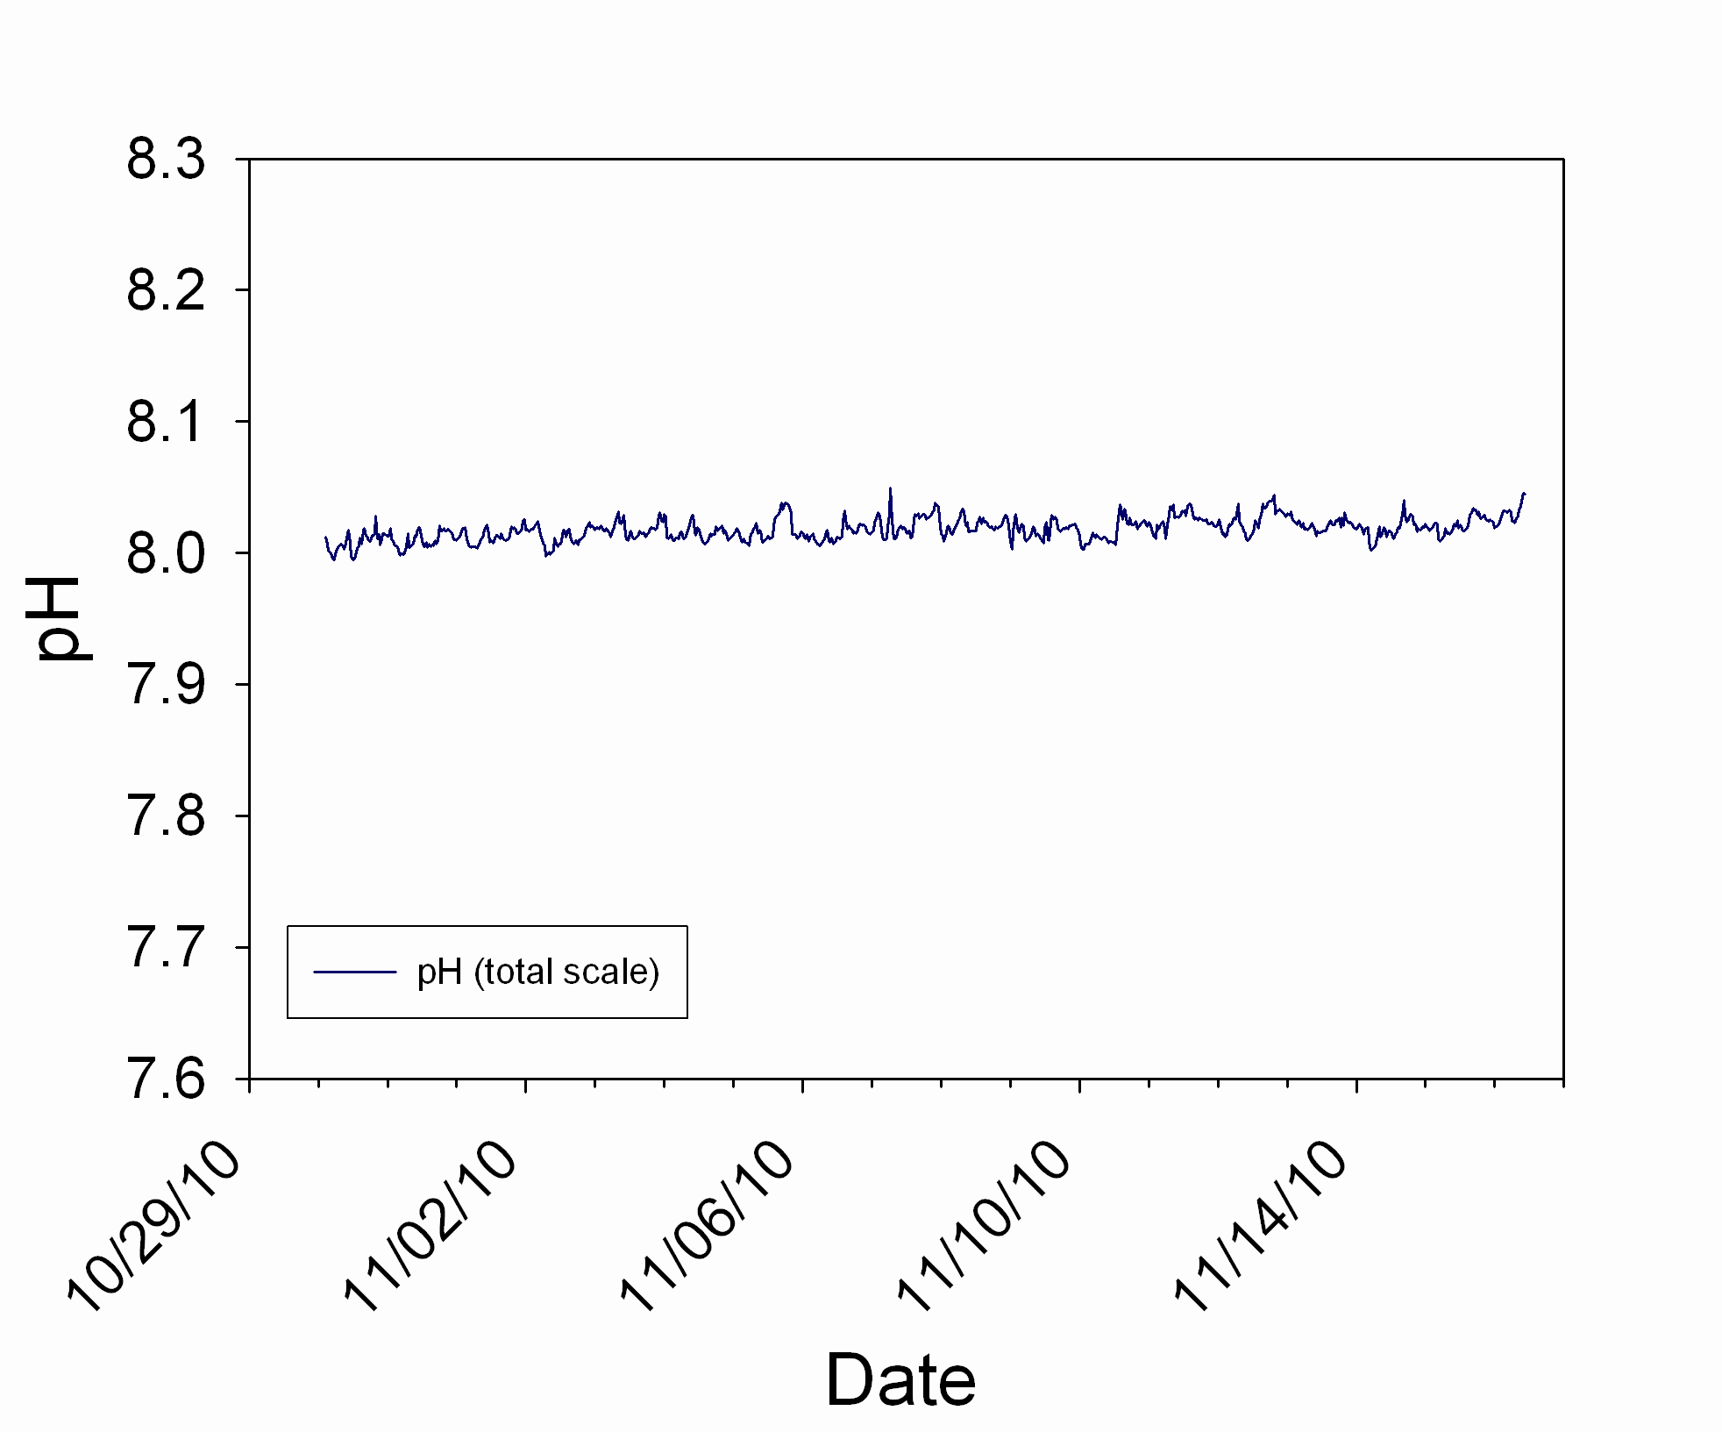
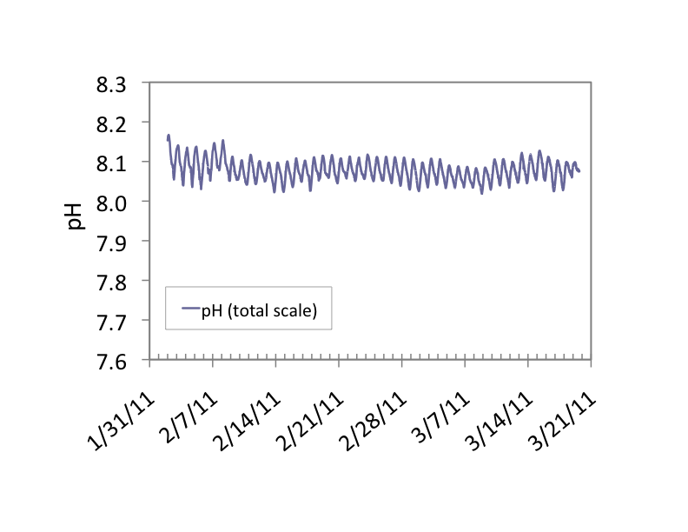
Natural variability:
How does it interface with plasticity?
Santa Barbara Channel
McMurdo Sound, Antarctica
Moorea, French Polynesia
Yu, Matson, Martz, Hofmann (2011)
JEMBE 400: 288-295
Matson, Martz, Hofmann (2011)
Antarctic Science 23: 607-613
Hofmann, et al, Martz (2011)
PLoS ONE 6(12): E28983
Notes:
As a result of SeaFET deployments, we realize there is a great deal of natural variation.

Slide 34
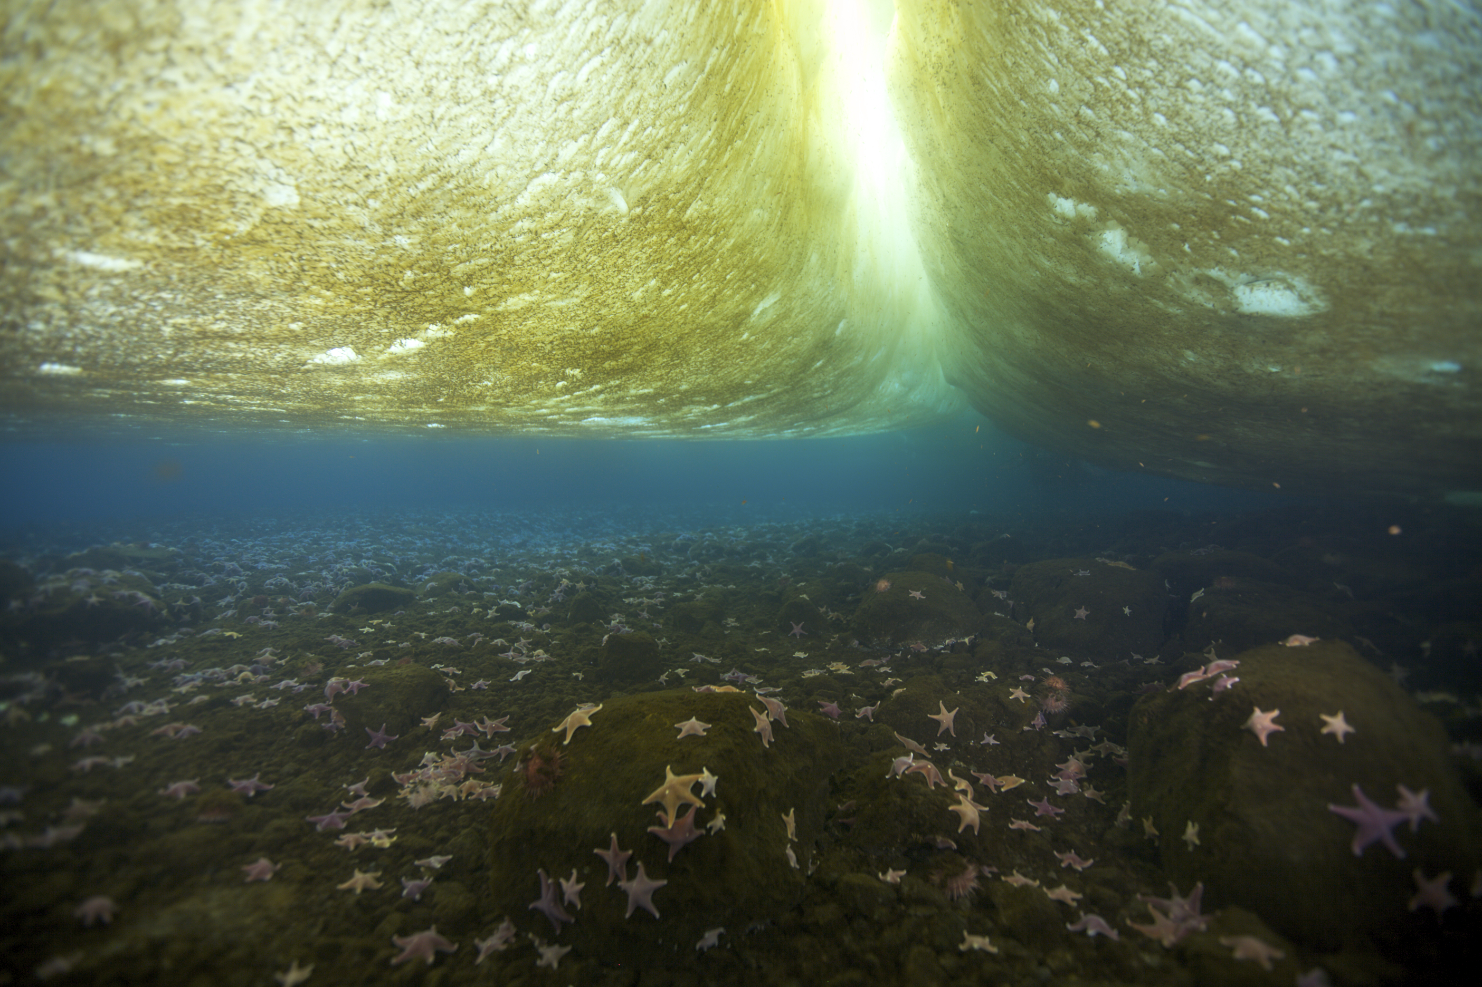
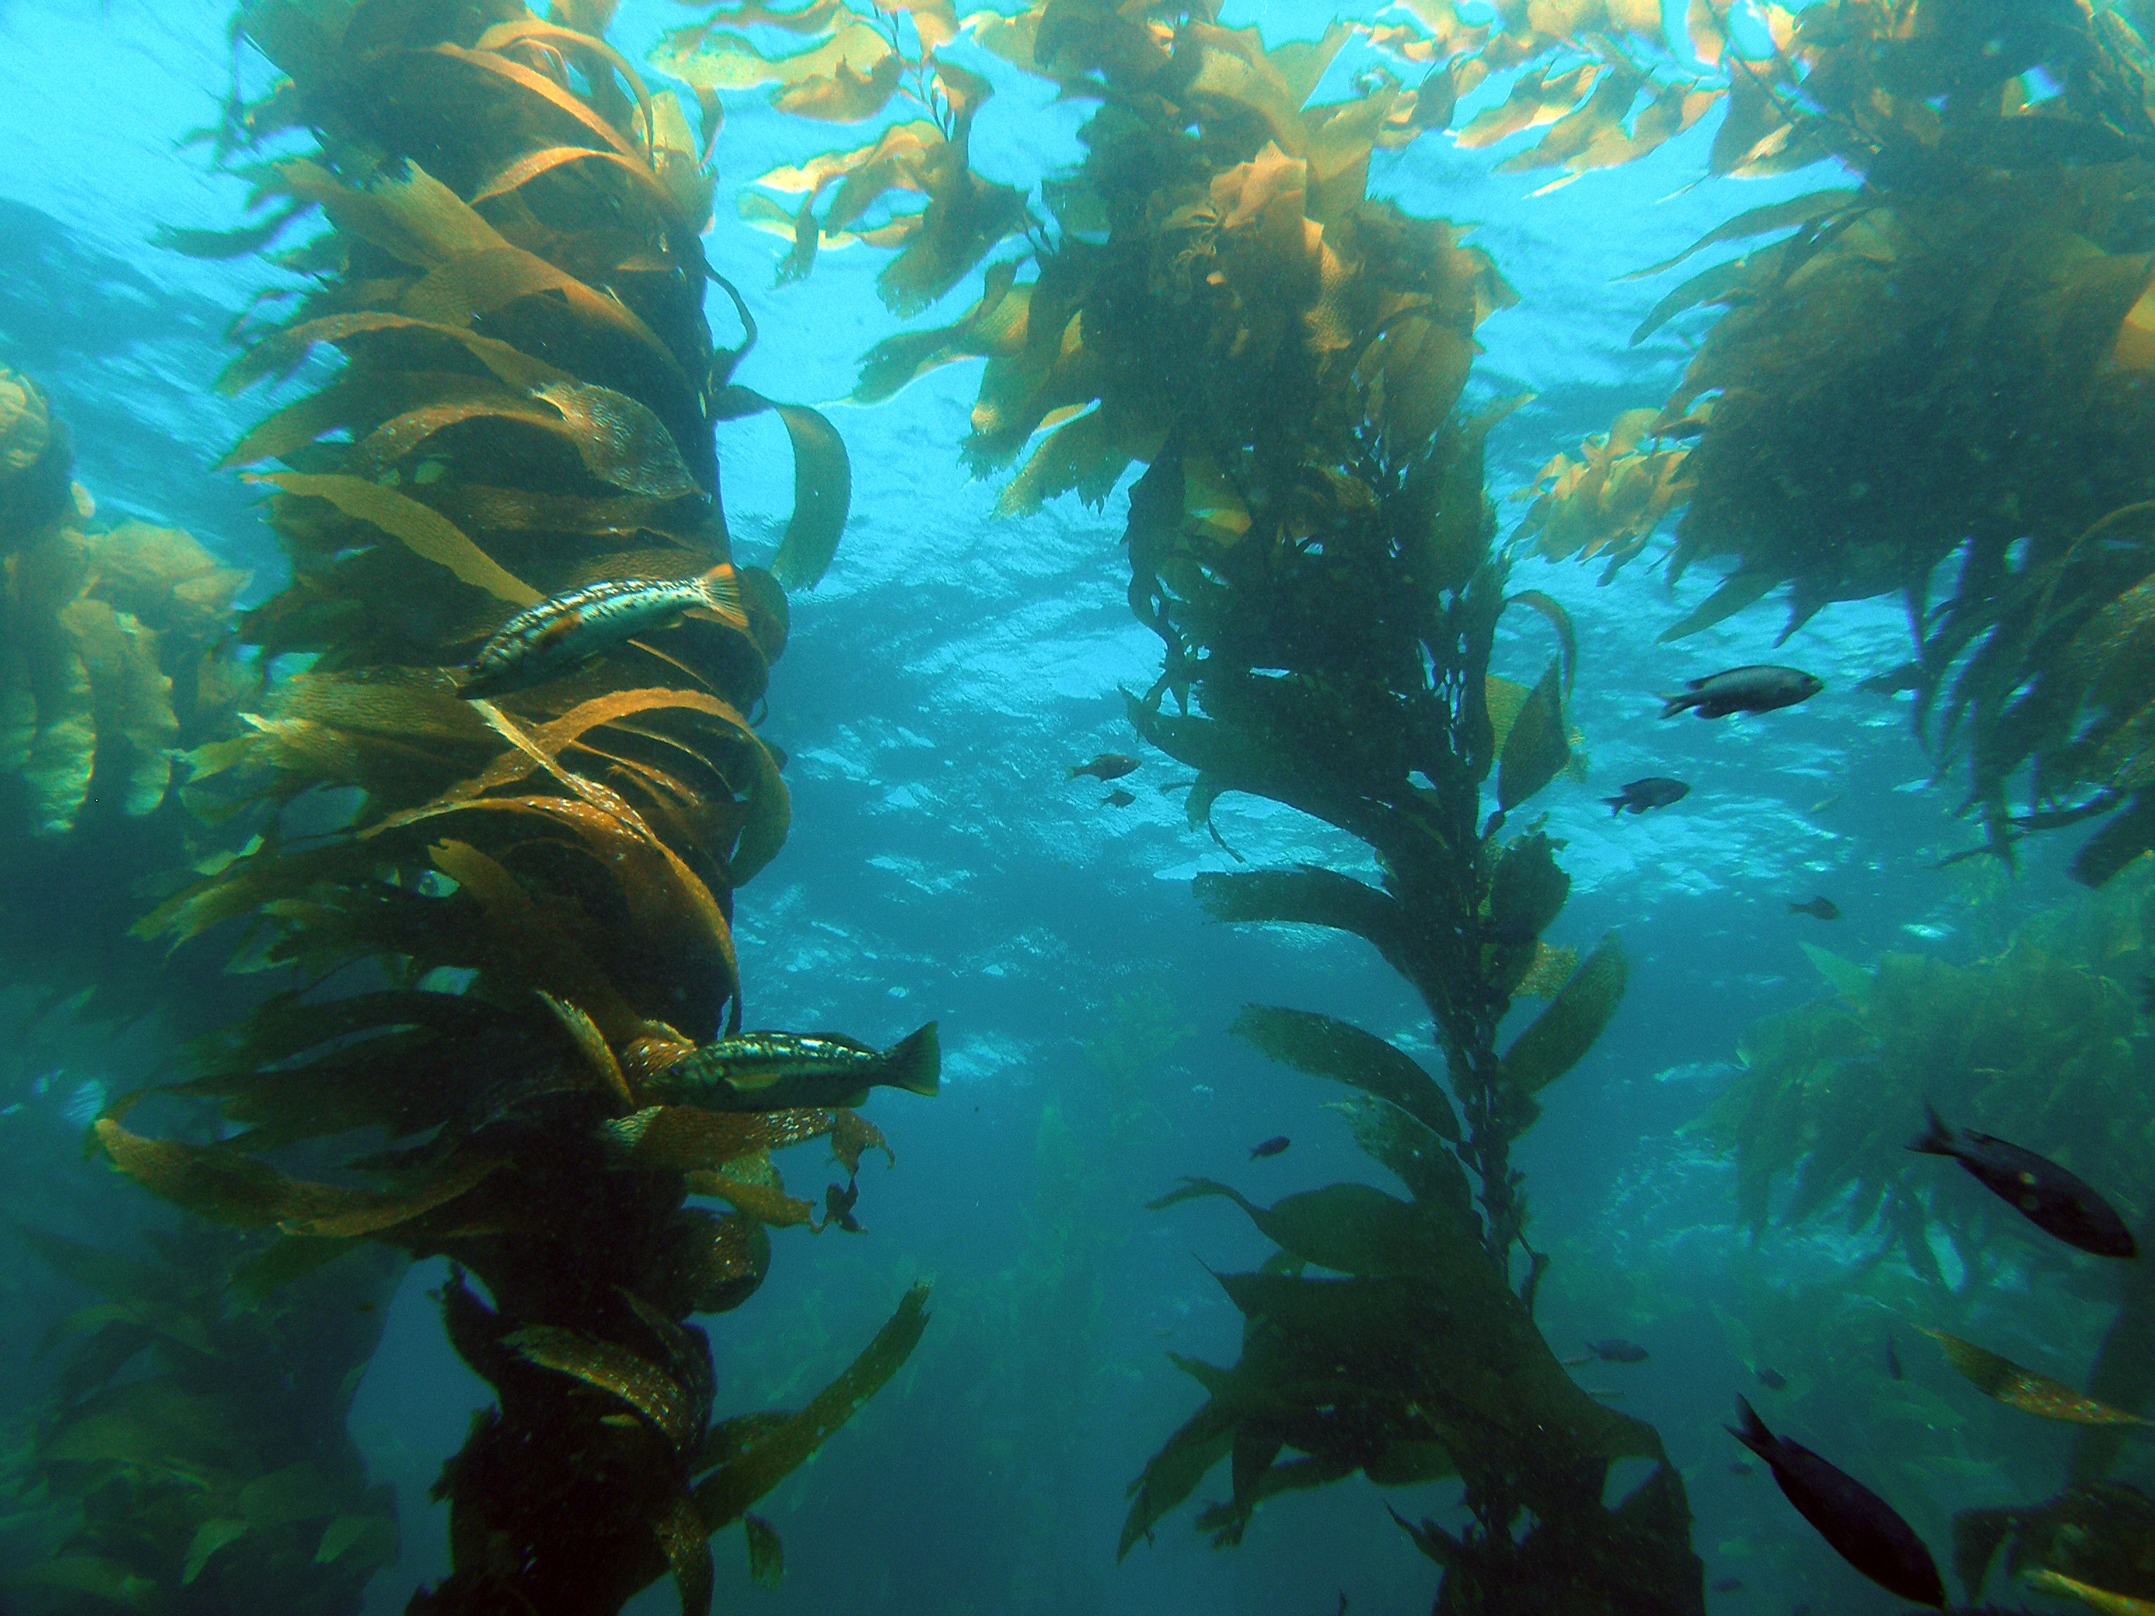
Road Map
Recording present-day pH at the coastal sites
Exposing animals to varying pCO₂ in the lab
© Shawn Harper
© UCSB SBC LTER
Notes:
This leads me to my Road Map…

Slide 35
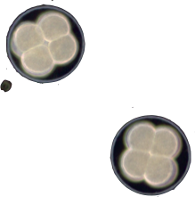


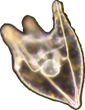
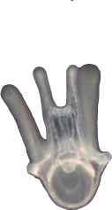
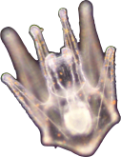
A tale of two urchins
Shawn Harper
Sterechinus neumayeri
Strongylocentrotus purpuratus
Both species have similar developmental morphology and ecological roles
images not to scale

Slide 36
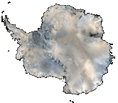
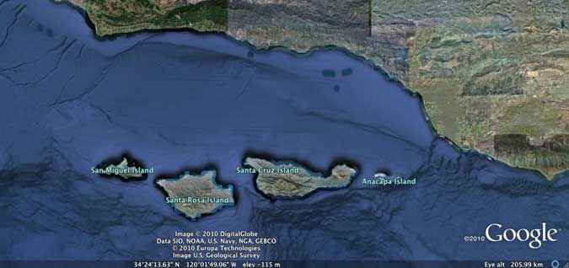
Physiological response during development at higher pCO₂
 | Temperate urchin | Antarctic urchin
Calcification | TBD
Morphology
Oxygen consumption | TBD
Lipid use
Gene expression

Slide 37
Road Map
Recording present-day pH in the field
Exposing animals to varying pCO₂ in the lab
© Shawn Harper
© UCSB SBC LTER
Notes:
This leads me to my Road Map…

Slide 38
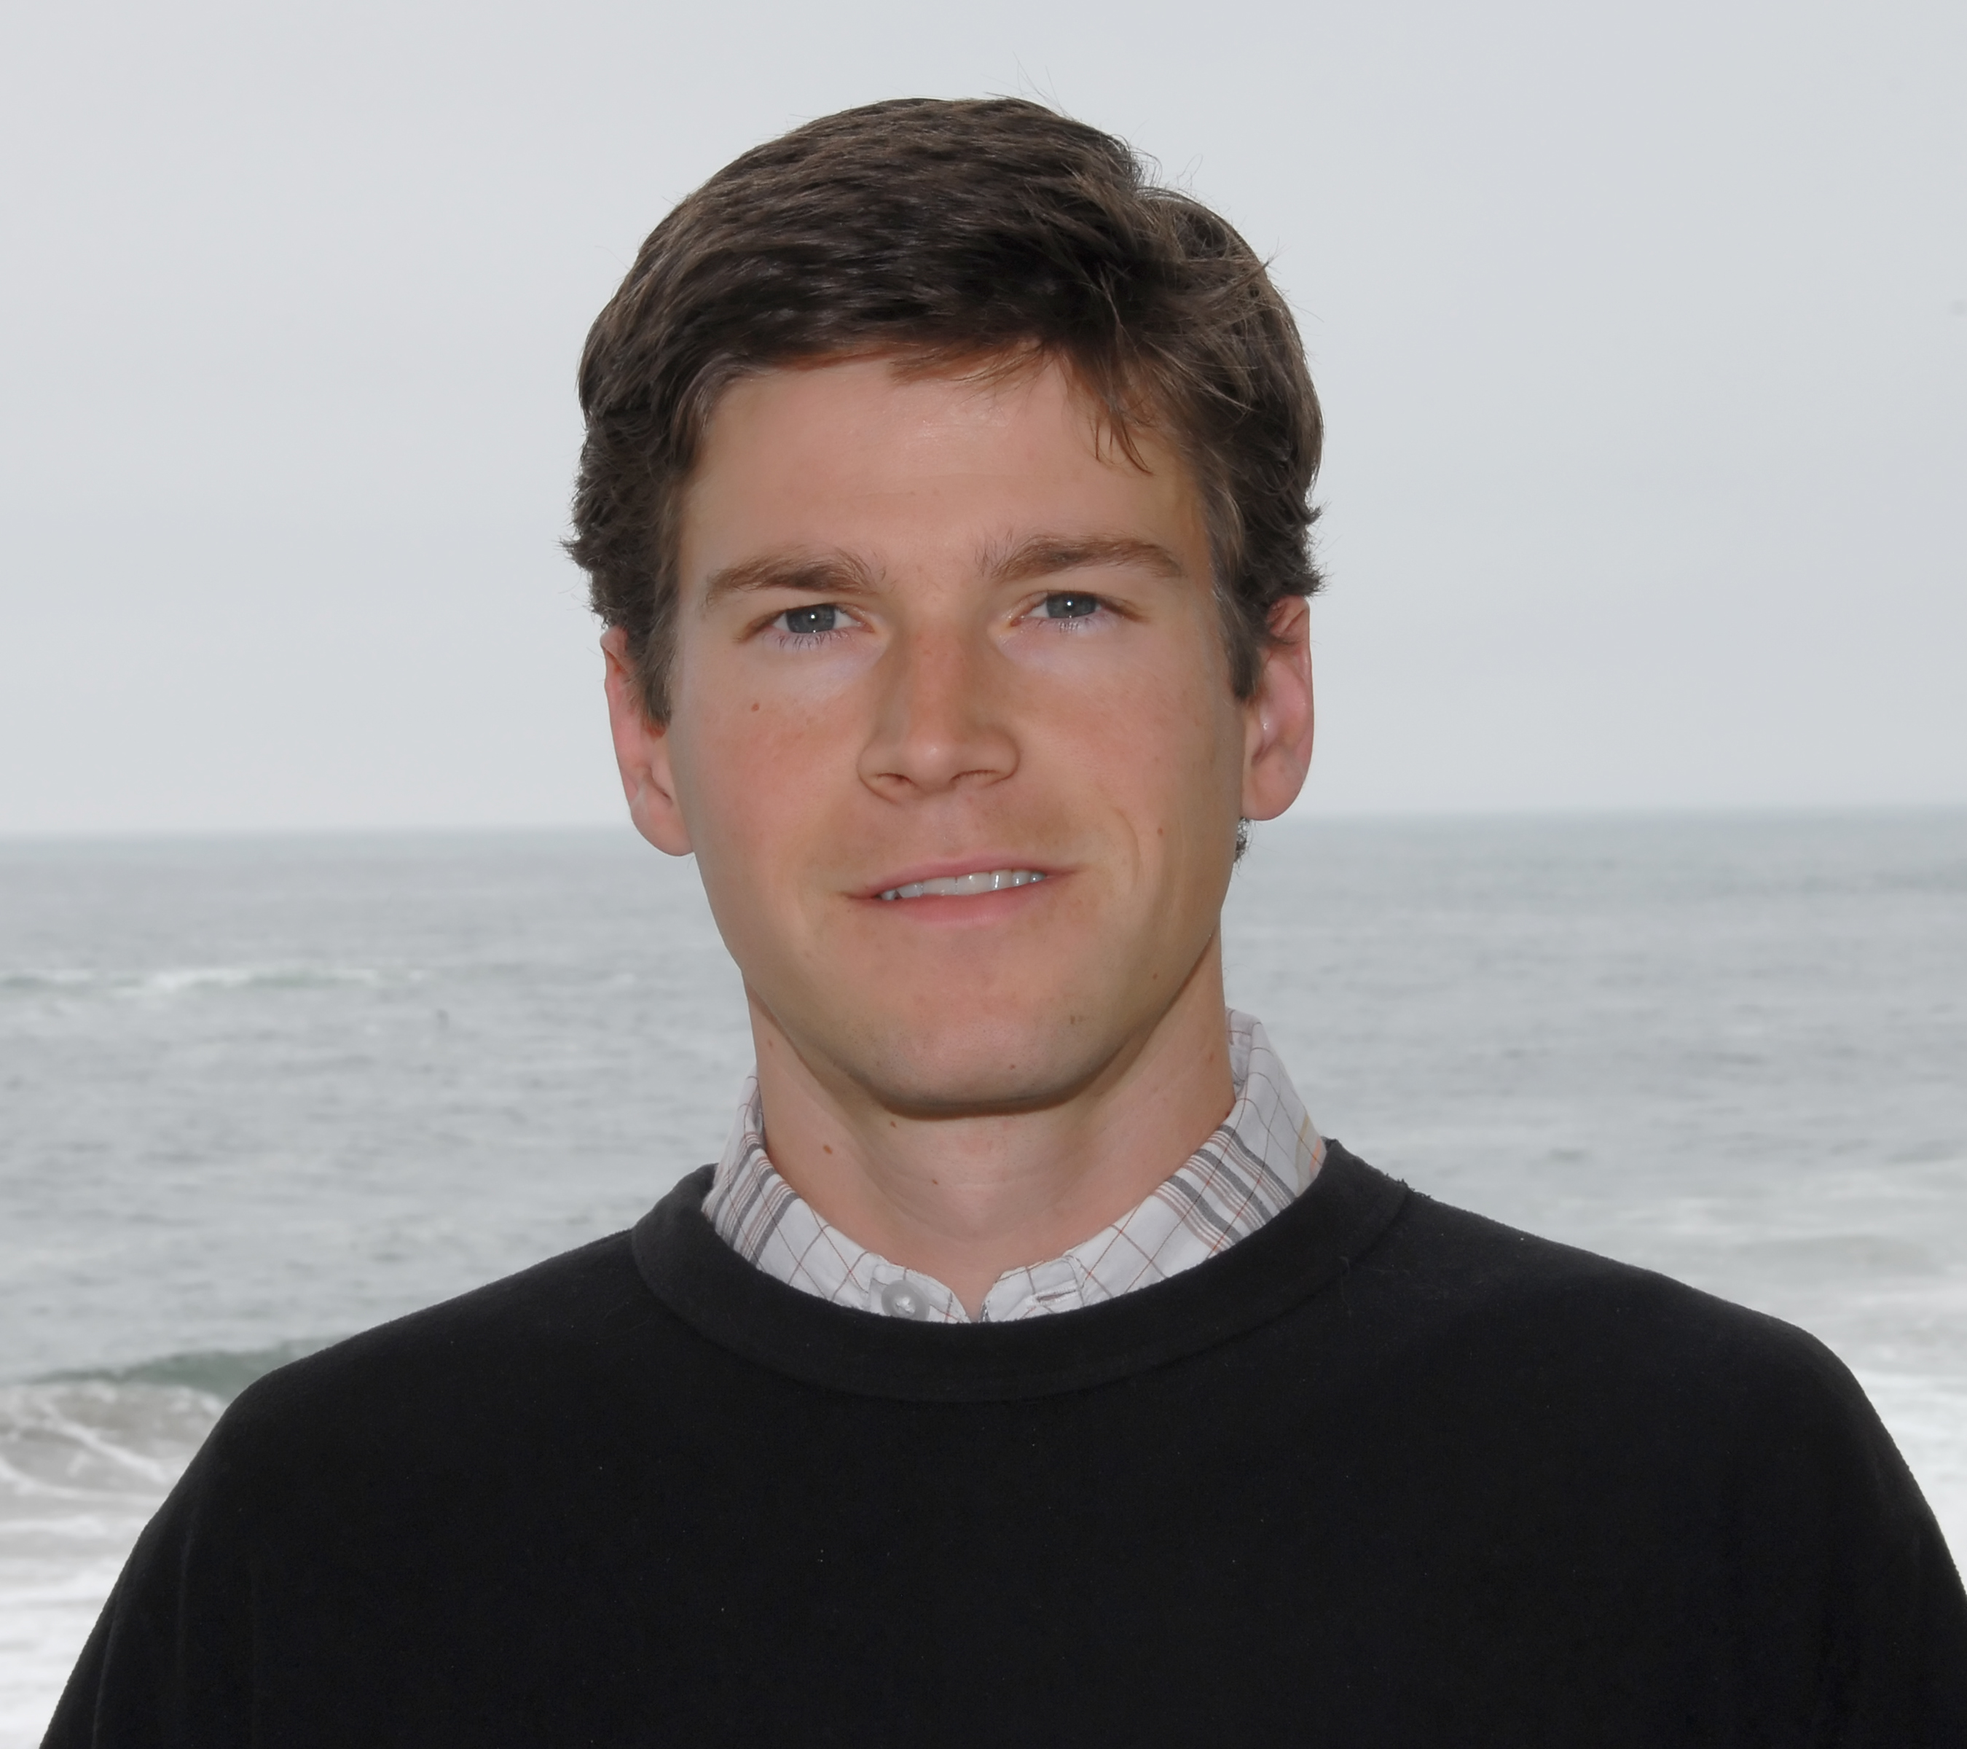
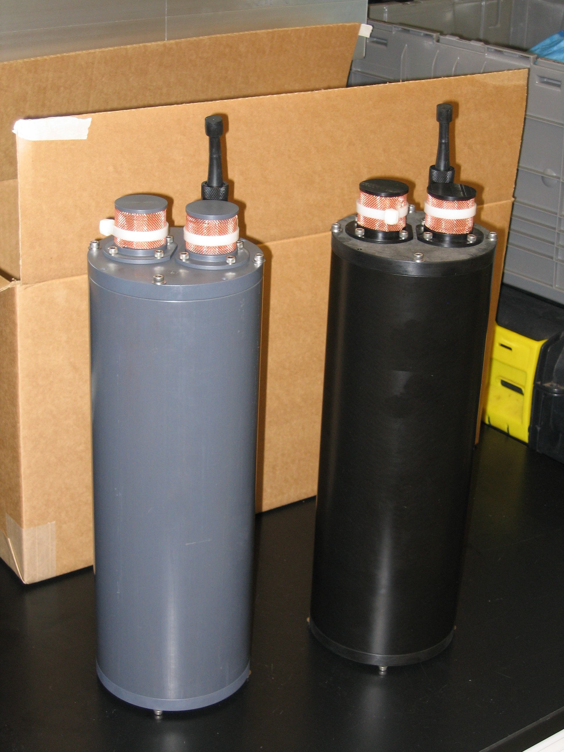
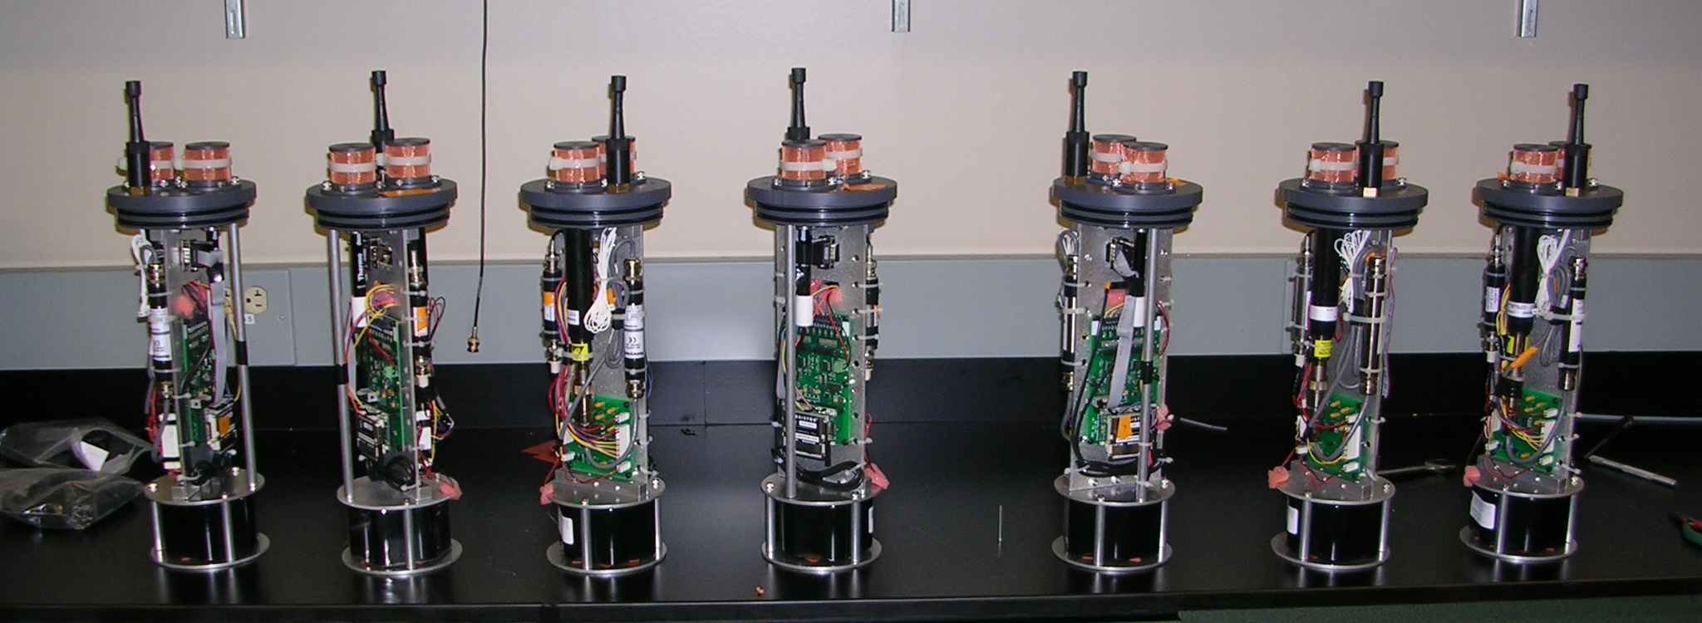
Continuous pH data collected using
SeaFET sensors
Professor Todd Martz
Scripps Institution of Oceanography (UC San Diego)
Martz et al. 2010. L & O: Methods.

Slide 39
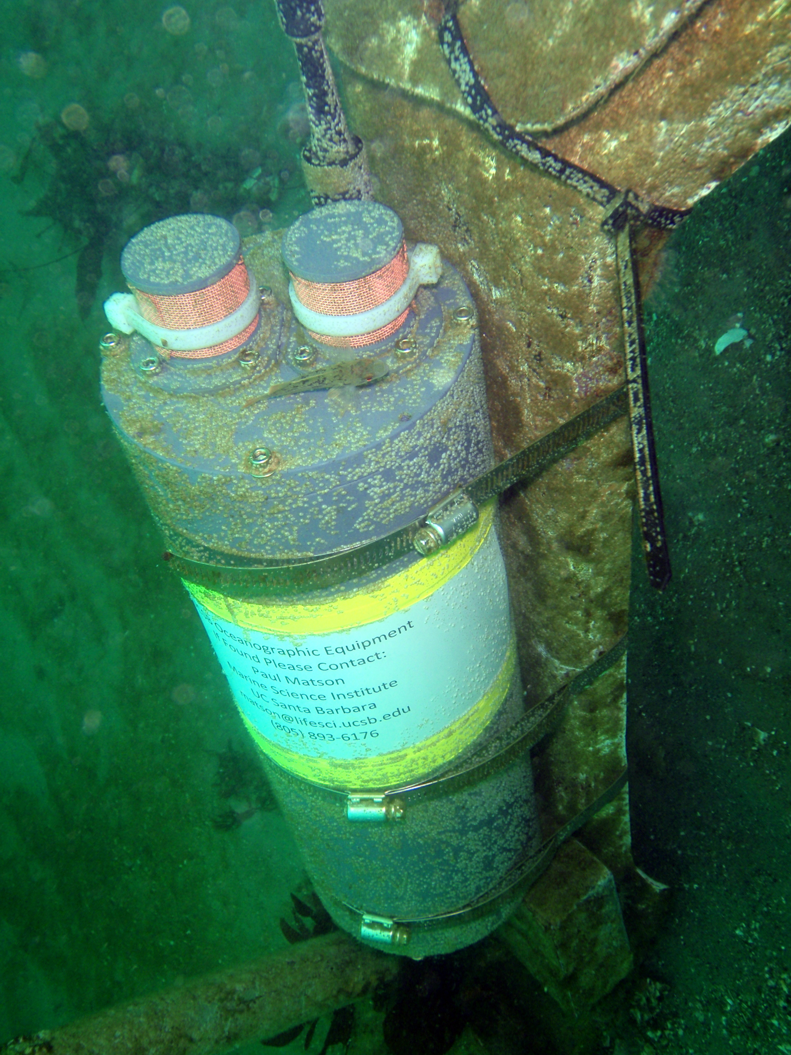
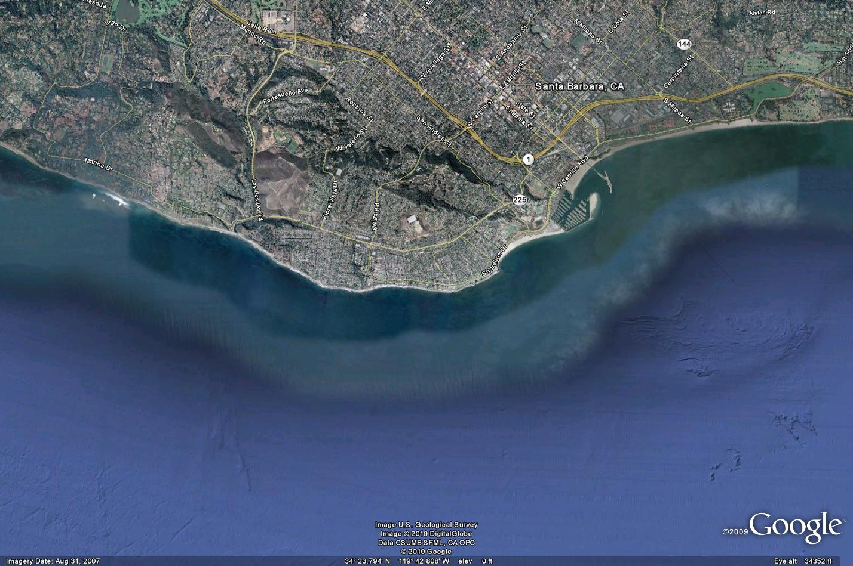
SeaFET pH Sensor
Deployed at an SBC LTER site
Measures in situ pH using two reference electrodes
Can store ~ 11,000 data points
Deployed 7/23/10 – 8/17/10
Recorded temperature and pH every 10 min
Stearns Wharf
Mohawk Reef
(SBC LTER Site)
~ 8 m depth
C. Nelson

Slide 40

Two study sites
in McMurdo
Sound

Slide 41

SeaFET pH data from the two study sites:
Cape Evans & Erebus Basin
Paul Matson
UCSB Graduate student

Slide 42
Data from Antarctica and Santa Barbara together
Paul Matson
UCSB Graduate student

Slide 43
Road Map
Recording present-day pH in the field
Exposing animals to varying pCO₂ in the lab
© Shawn Harper
© UCSB SBC LTER
Notes:
This leads me to my Road Map…

Slide 44
A tale of two urchins
Shawn Harper
Strongylocentrotus purpuratus
Sequenced genome
  Model organism routinely used in studies of early development
Sterechinus neumayeri
Slow development
images not to scale

Slide 45

Larval culturing system in Crary Labs
pCO² (μatm) | pH
410 | 8.03
510 | 7.94
730 | 7.79
Dr. Mary Sewell and Lydia Kapsenberg
Crary Labs, McMurdo Station, Antarctica
Notes:
For these experiments, larvae were raised from fertilization….

Slide 46

Sea urchin development:
When do the ‘hard parts’ form?
6 days
Echinopluteus
Larvae
Fertilized egg
Development at 15 °C takes about 6 days

Slide 47
Sea urchin development:
When do the ‘hard parts’ form?
Development at -1.9 °C takes about 30 days
30 days
Echinopluteus
Larvae
Fertilized egg

Slide 48


Sea urchin development:
When do the ‘hard parts’ form?
Gastrulation
Calcification starts here
250 µm
early gastrula

Slide 49


Sea urchin development:
When do the ‘hard parts’ form?
Pluteus larvae
Skeleton is extended
advanced 4-arm pluteus

Slide 50


Physiological responses
Calcification
of larval skeleton
Metabolism &
growth
Gene expression
as indicator of
metabolic activity

Slide 51

Calcification of the larval skeleton was reduced at low pH
pCO2 ➔ pH
410 = 8.03
510 = 7.94
730 = 7.80
G. Hofmann, unpubl. results

Slide 52
Physiological responses
Calcification
of larval skeleton
Metabolism &
Growth
Gene expression
as indicator of
metabolic activity

Slide 53


Body form changes -
Shorter arms at low pH/high pCO₂
***
Scale bar = 100 μm
Larval arms - Significant for feeding and swimming
Yu et al., unpublished

Slide 54

Elevated CO₂ @ 1450 ppm reduced size of larvae, but they still develop
Yu et al. (2011) JEMBE

Slide 55

No major changes in oxygen consumption
(an indirect measure of metabolism)
gastrula
prism
4-arm pluteus
Yu et al., unpublished

Slide 56

Lipid content:
No large changes in “fuel usage”
gastrula
prism
4-arm pluteus
Yu et al., unpublished

Slide 57
Physiological responses
Calcification
of larval skeleton
Metabolism &
Growth
Gene expression
as indicator of
metabolic activity

Slide 58








Quintessential response to ocean acidification
(…at least temporarily)
pH homeostasis
osmotic homeostasis
calcification
carbonic anhydrase
Na⁺,K⁺-ATPase
collagen XVII
aquaporin 8
calcium channel
Evans and Hofmann, unpublished

Slide 59







Other problems: Protein Loss
Cell’s Garbage Disposal
Damaged
protein
Dr. Tyler Evans
Postdoctoral Fellow
Evans and Hofmann,
unpublished

Slide 60
Physiological response during development at higher pCO₂
 | Temperate urchin | Antarctic urchin
Calcification | TBD | Reduced
Morphology | Smaller | Smaller
Oxygen consumption | TBD | Unchanged
Lipid use | No change | No change
Gene expression | Gastrulae more sensitive | Signs of more damage to proteins

Slide 61

Performance and plasticity as a trait: acclimation to the carbonate environment
Considerable natural environmental variation
Both species display plasticity in response to OA (i.e. they develop successfully)
Species has tolerance differs? Responses are related to Ω, less to pCO₂
© Shawn Harper
© UCSB SBC LTER

