Slide 1
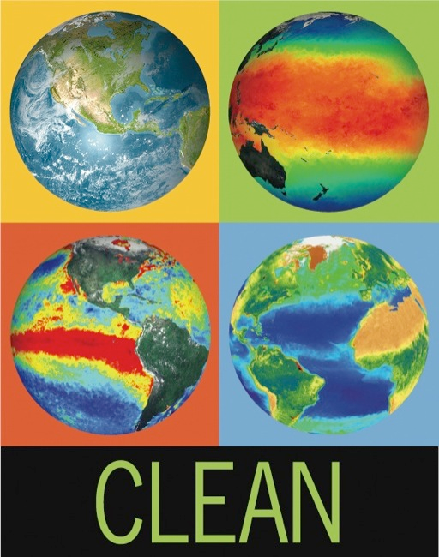
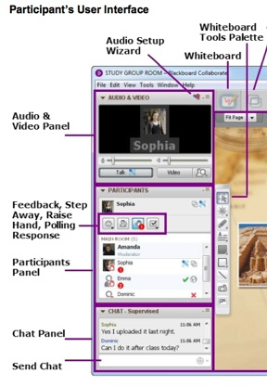
WELCOME CLEAN Interactive Webinar
Climate Literacy Essential Principle 4:
Focus: Mechanisms of long-term climate change
Please take some time to familiarize yourself with the webinar interface:
Mouse over icons and find:
How to raise your hand
How to respond to a poll
Respond w/smiley face – that is fun!
Introduce yourself in the chat panel!
→If you haven’t had a chance to do the homework – please take a look now.
We will begin at
7:00 pm Eastern
6:00 pm Central
5:00 pm Mountain
4:00 pm Pacific
Tech Support 617-873-9651
Toll free call in 1-866-910-4857 passcode 251399
Notes:
Put the call in number on this slide, so that people will see it when they log into blackboard. Remind them to mute their phones once they have called in and just us the chat box until the questions and discussion.

Slide 2
Agenda
Welcome and introductions (~10 min)
Climate Literacy Essential Principle #4: Looking at natural long term climate variability and how recent changes are different (~30 min)
Using the CLEAN collection to teach about climate variability (~30 min)
Discussion of resources from the CLEAN collection
(~30 min)
Wrap up and evaluation (~20 min)

Slide 3


CLEAN Interactive Webinar Presenters
Dr. Tamara Shapiro Ledley, TERC (scientist)
Elizabeth Youngman, Sun Valley, ID (educator)
  Marian Grogan, TERC, Moderator
  Sarah Hill, TERC, Technical Support
Technical Support 617-873-9651
Toll free call in 1-866-910-4857 passcode 251399

Slide 4
Climate Literacy Essential Principle #4
Climate varies over space and time through both natural and man-made processes
4a - Climate is determined by the long-term pattern of temperature and precipitation averages and extremes at a location…
4b - Climate is not the same thing as weather…
4c - Climate change is a significant and persistent change in an area's average climate conditions or their extremes…
4d - Scientific observations indicate that global climate has changed in the past, is changing now, and will change in the future…
4e - Based on evidence from tree rings, other natural records, and scientific observations made around the world, Earth's average temperature is now warmer than it has been for at least the past 1,300 years…
4f - Natural processes driving Earth's long-term climate variability do not explain the rapid climate change observed in recent decades…
4g - Natural processes that remove carbon dioxide from the atmosphere operate slowly when compared to the processes that are now adding it to the atmosphere…

Slide 5
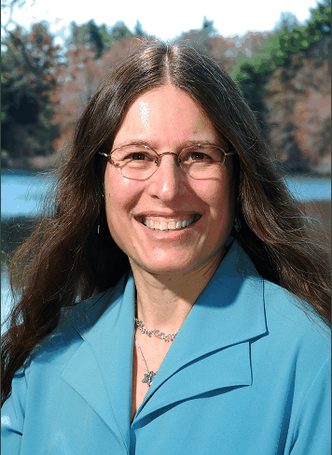
Climate Literacy Essential Principle #4
Climate varies over space and time through both natural and man-made processes
Dr. Tamara Shapiro Ledley, TERC (scientist)
Focus of this Interactive Webinar
  Example of natural long-term climate variability – Ice Age Cycles, Milankovitch variations & CO2
  How is now different?

Slide 6
Poll Question
Have you heard of Milankovitch cycles before?
  Yes
  No

Slide 7
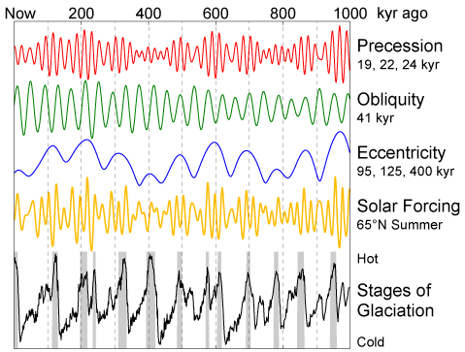
Ice Ages and Milankovitch
http://www.globalwarmingart.com/wiki/Image:Milankovitch_Variations.png

Slide 8
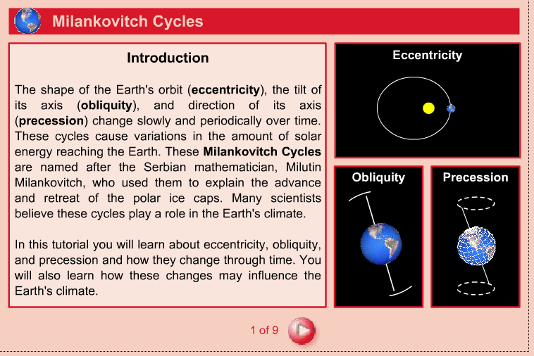
Milankovitch Cycles – The Orbital Elements
http://cleanet.org/resources/42799.html
http://www.sciencecourseware.org/eec/GlobalWarming/Tutorials/Milankovitch/

Slide 9
Impact of Milankovitch Variations on Energy Reaching the Earth
          Poll Question
Changes in which of the following affect the total amount of solar radiation the Earth receives?
  A Eccentricity (shape of Earth’s orbit around Sun)
  B Obliquity (tilt of Earth axis with respect to Sun)
  C Precession (time of year closest to Sun)
  D None of the above

Slide 10
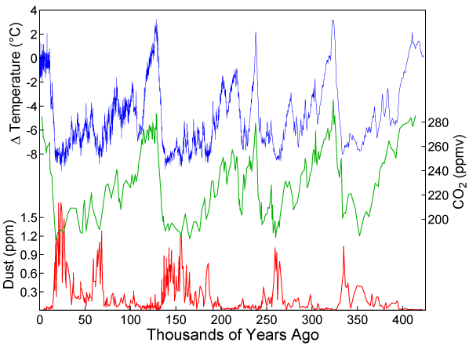
Ice Ages and Carbon Dioxide
http://cleanet.org/resources/42720.html
http://serc.carleton.edu/earthlabs/cryosphere/7.html
Graph of CO₂(Green graph), temperature (Blue graph), and dust concentration (Red graph) measured from the Vostok, Antarctica ice core as reported by Petit et al., 1999. Data source: Petit J.R., Jouzel J., Raynaud D.,Barkov N.I.,Barnola J.M., Basile I., Bender M., Chappellaz J., DavisJ., Delaygue G., Delmotte M., Kotlyakov V.M., Legrand M., Lipenkov V.,Lorius C., Pépin L., Ritz C., Saltzman E., Stievenard M. (1999). , Nature, 399: 429-436.

Slide 11
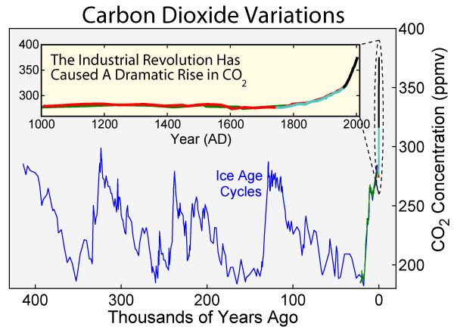
Carbon Dioxide Concentration Variations on ice age time scales
http://cleanet.org/resources/42761.html
http://www.globalwarmingart.com/wiki/File:Carbon_Dioxide_400kyr_Rev_png

Slide 12
Ice Ages and Milankovitch
http://www.globalwarmingart.com/wiki/Image:Milankovitch_Variations.png

Slide 13
Questions?

Slide 14

Using the CLEAN collection to teach about climate variability
Betsy Youngman, TERC consultant
Notes:
Name:
Teaching experience:
Other research experience with climate change:
How the CLEAN collection could have helped me in my teaching.

Slide 15
Some Naïve Understandings and Misconceptions
Recent global warming is caused by the sun.
Climate has changed many times in the distant past, before humans began burning coal and oil, so the current warming cannot be caused by humans burning coal, oil, and natural gas.
Notes:
Several examples of misconceptions; there are others that teachers may have observed. As Tamara just demonstrated, having solid resources such as the ones in the CLEAN collection can aid teachers in correcting these misconceptions.
Sources:
PEW center on climate change. http://www.pewclimate.org/science-impacts/realities-vs-misconceptions
Another resource of answers to FAQ: http://www.pewclimate.org/global-warming-basics/faq_s/glance_faq_science.cfm
References:
Common Misconceptions about Climate and Climate Change
http://cires.colorado.edu/education/outreach/climateCommunication/CC%20Misconceptions%20Handout.pdf
Common Misconceptions about Polar Weather and Climate
http://beyondpenguins.nsdl.org/issue/column.php?date=June2008&departmentid=professional&columnid=professional!misconceptions
Climate Misconceptions: A Top 10 List
http://beyondpenguins.nsdl.org/issue/column.php?date=June2010&departmentid=professional&columnid=professional!misconceptions
Greenhouse Gas Overview
http://www.epa.gov/climatechange/emissions/index.html

Slide 16

Exceptional resources for teachers of science – lessons and activities, videos, interactives, animations and more!
Collected and vetted by scientists and educators
Easy to search database – by topic, grade level and climate literacy essential principle
Offers resources for all disciplines – geosciences, biology, environmental science, chemistry, physics
Notes:
Grades 6 – lower college.
Time to find quality climate change science lessons and visuals important to teachers. Non-stop shopping.
CLEAN Review Team:
The CLEAN review team consists of experienced middle school and high school teachers and college-level instructors as well as PhD-level scientists of relevant fields (climate and energy science, social sciences etc.) and a few other climate literacy practitioners.
CLEAN Review Process:
The CLEAN review process was informed by review guidelines and criteria from other collections, such as the National Science Digital Library (NSDL) (more info) , the Science Education Research Center (SERC) Guidelines, the Merlot criteria and the Climate Change Collection. Our review criteria were tested and refined in multiple test review rounds and through review comparisons among different reviewers.
The CLEAN collection is aligned with the Essential Principles of Climate Science (CCSP 2009) at the concept level as well as with the Energy Awareness Principles.
The CLEAN collection is also aligned with the Benchmarks for Science Literacy (AAAS Project 2026). The alignment effort was done manually, based on a suggestion by a AAAS Project 2026 specialist on the alignment of the Climate Literacy Essential Principles with the Benchmarks. Alignment with the National Science Education Standards and the NAAEE Excellence in Environmental Education Guidelines for Learning will be completed by the summer of 2011.

Slide 17
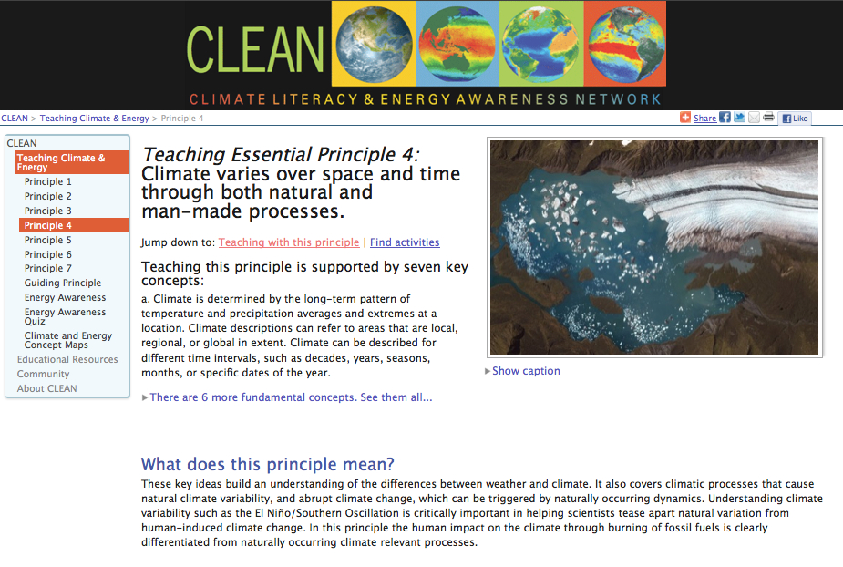
Teaching Essential Principle #4
Notes:
So, in order to locate teaching resources it is worthwhile to spend some time on the teacher’s page to see all that it offers in terms of background science, guidance for teaching. We will take a brief tour of the CLEAN site teaching page.
http://cleanet.org/clean/literacy/principle_4.html

Slide 18
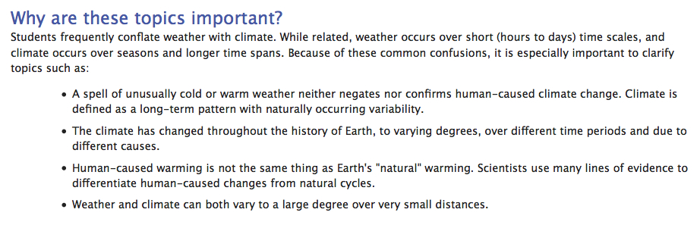
Notes:
This section can serve a variety or purposes for the teacher. Ex. Incorporating them into discussions, introductions to a lab, check for prior knowledge etc.

Slide 19
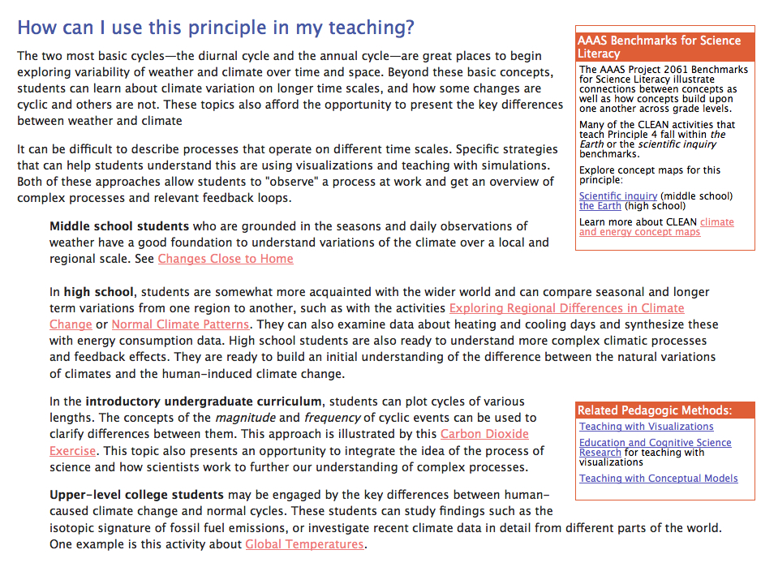
How Can I Use This Principle in My Teaching?
Notes:
Some suggestions for using Essential Principle 4 – again – clarifying some ways that EP4 can be taught and at the appropriate level.
Related Pedagogy in the small box upper right. There are ideas here that some of you might find valuable in creating curriculum units and/or lesson.
…. is on an up coming slide

Slide 20
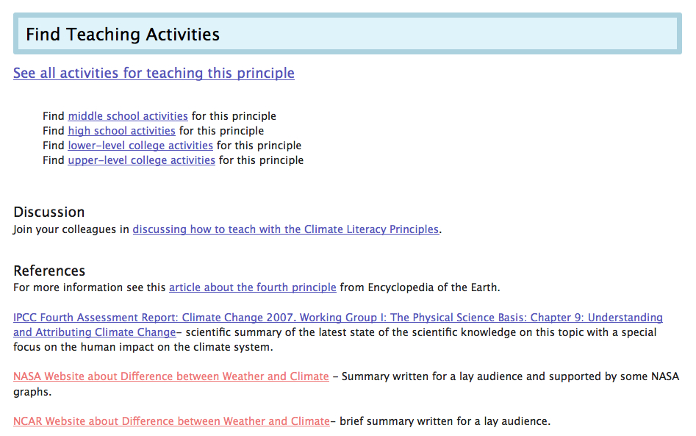
Notes:
Discussions section: This section has the potential to be a very powerful tool for educators, scientists and curriculum developers to support and learn from each other.
Can also click on “See all activities for teaching this principle”

Slide 21
What types of resources are on CLEAN?
Lessons and hands-on activities – varying in length
Videos (most < 10 min)
Static visualizations – images or graphics
Animations and interactives
Demos and short experiments
Notes:
A reminder what’s available: there is a large Diversity of lessons and additional supplemental resources that together give teachers the opportunity to create units and lessons for their students.
Versatility – Use a lesson and supplemental resource together or create a lesson around a additional resource.
Most IMPORTANT – the resource collection allows teachers to create texture within lessons. In other words it is easier to build lessons that tell a story! The next two slides are an example of a search to create a multimedia lesson.

Slide 22
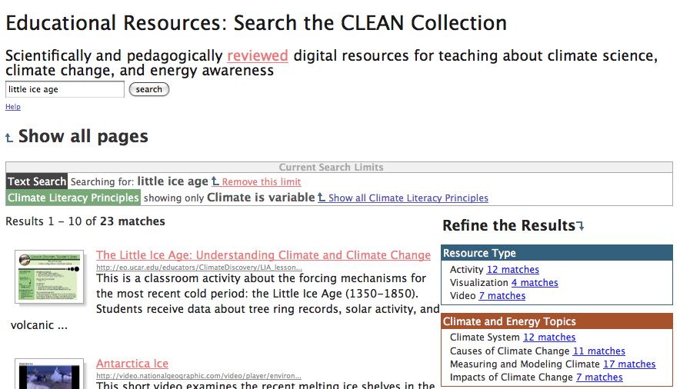
Example of a Search...
Notes:
Can search by topic, grade level, resource type
Once you have accessed the CLEAN site and selected a literacy principle you can narrow your search in several ways…
By using the refine the results tools or by doing a keyword search
Little Ice Age search
http://cleanet.org/clean/educational_resources/index.html?search_text=little+ice+age&Search=search&q1=sercvocabs__129%3A5
Ex. Search for tree rings, ten resources are found – one video and one complete lesson.
http://cleanet.org/clean/educational_resources/index.html?q1=sercvocabs__129%3A5

Slide 23
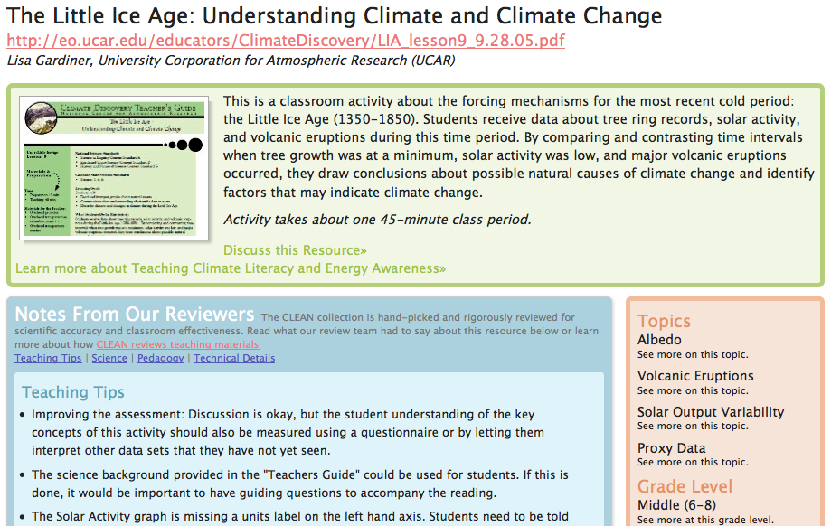
Notes:
Web tour from this page http://cleanet.org/resources/41810.html
Little Ice Age:
Clicking on the url takes directly to the lesson. http://eo.ucar.edu/educators/ClimateDiscovery/LIA_lesson9_9.28.05.pdf
TH points – you can quickly search a variety of quality lessons and useful bits, you can quickly review them to choose the ones you want and just print, download or link to. Couldn’t be easier.
Lets you review a summary, teaching tips, and important science information. There is also a section on pedagogy, technical details (computer usage etc) and related urls.
Elaborate on this lesson, how to use, why it is an excellent example.
Inquiry based
Hands on
Demonstrates natural variability
Integrates with other resources on CLEAN site.
Integrates with other subject areas. (history)

Slide 24
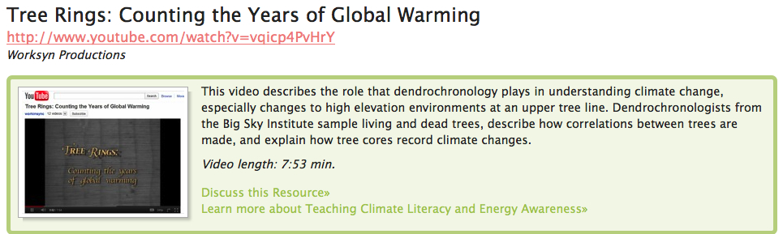
Tree Rings: Counting the Years of Global Warming – A CLEAN resource video
A CLEAN resource that will help students understand how tree rings are collected and analyzed. A good introduction to the subject.
Also shown on http://www.lifeonterra.com/episode.php?id=37
Notes:
Another useful supplement / introduction to activity.
http://cleanet.org/resources/42753.html
A third resource, that you could actually develop a lesson from this video by having students watch the video and then draw a concept map.
Take home point - Richness and diversity of the lessons and useful bits in the expanding CLEAN collection will allow you to create rich and complex lessons and units.

Slide 25
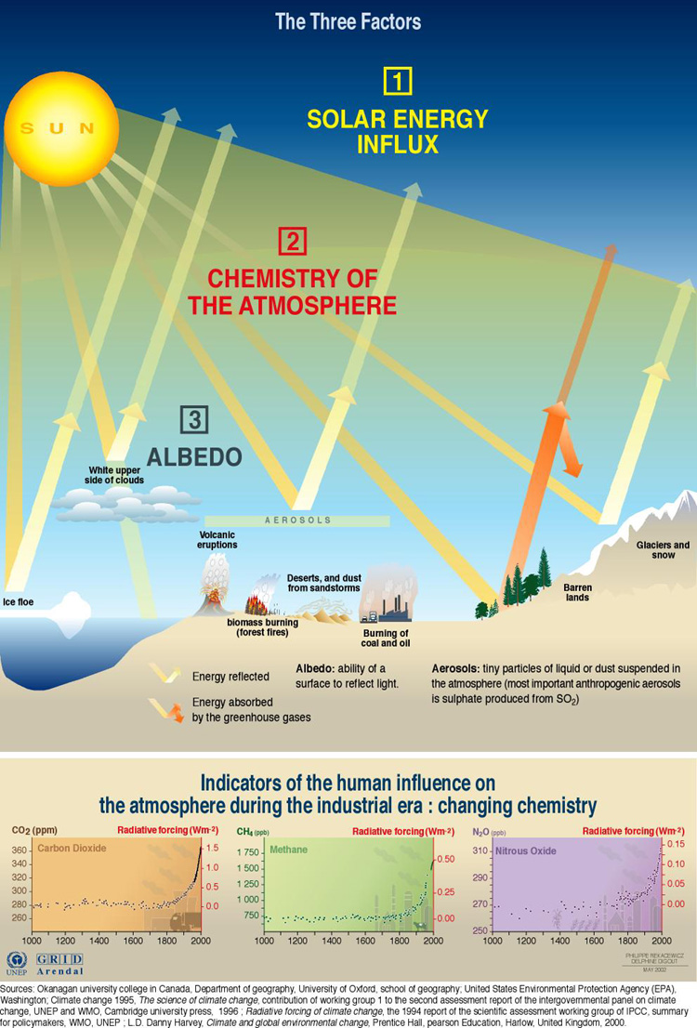
Climate Controls
Solar Energy Influx
Chemistry of Atmosphere
Albedo (reflectivity)
Notes:
Source : http://maps.grida.no/go/graphic/factors_influencing_the_greenhouse_effect
What has changed? Solar energy is cyclical and predictable
Albedo has essentially remained the same.
What has changed is the chemistry of the atmosphere. There are more heat-trapping gases such as NO2, CO2, and CH4 in the atmosphere.

Slide 26
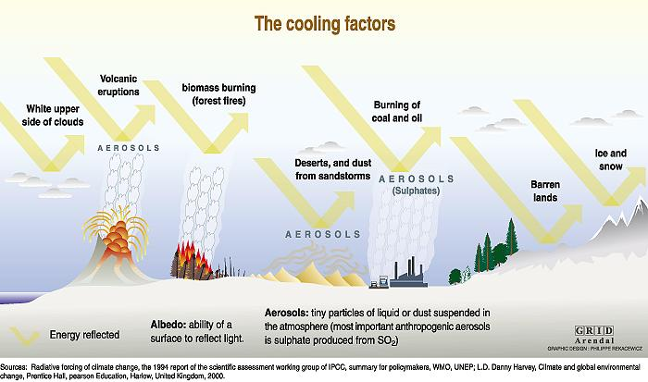
Cooling Factors
Notes:
Source: http://maps.grida.no/go/graphic/cooling-factors
What are some of the factors that can cool average global temperature?
Things that reflect incoming solar radiation including:
Volcanic Eruptions (aerosols)
White clouds
Barren lands (deserts) and Ice and Snow

Slide 27
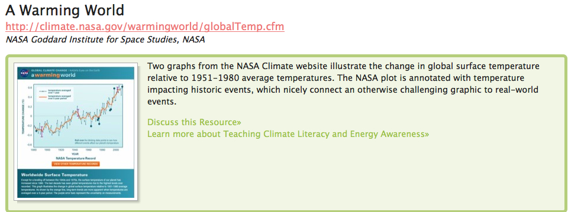
A flash interactive showing temperature and volcanic activity
http://climate.nasa.gov/warmingworld/globalTemp.cfm
Notes:
Other supplements that can be woven into the lesson. This interactive is over the same time period and shows the impact of volcanic activity.
http://cleanet.org/resources/42798.html
Note the other temperature / volcanism graph and animation from NCAR
http://www.vets.ucar.edu/vg/IPCC_CCSM3/index.shtml
Available as mpeg, QT, or You Tube

Slide 28
Comments?

Slide 29
Using CLEAN in Your Classroom- Discussion Session
Participants each chose one of the following topics:
  Ice Cores
  Paleoclimate Records
  Measuring and Modeling Climate
  Tree Ring Data
  Natural Variations
Share one activity and one supplemental resource. Discuss the following:
  What attracted you to these two resources?
  How might you use these two resources to enrich your teaching, learning and curriculum?
Notes:
Your assignment was to find one lesson and one supplemental resource within one of the topics above. I still get excited when I find a great resource that would be perfect in an environmental science unit. So hope you had searching as well. In your breakout rooms, you should share…………
Its time to go to breakout rooms. Just to let you know – you may get moved from one breakout room to another in the very beginning until rooms have equal amounts of people.
We will post the resources shown tonight and other supplemental resources on the CLEAN webinar site.

Slide 30
Evaluation
Please complete the Evaluation at this url:
https://www.surveymonkey.com/s/CLEANDecember2011
Thanks for joining us!

