Slide 1





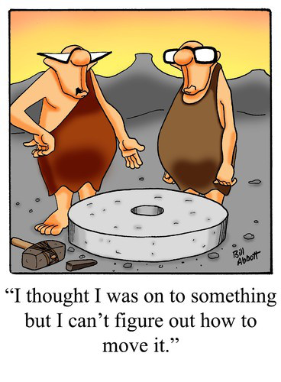
Social Media
Insights
Emily Kellagher

Slide 2

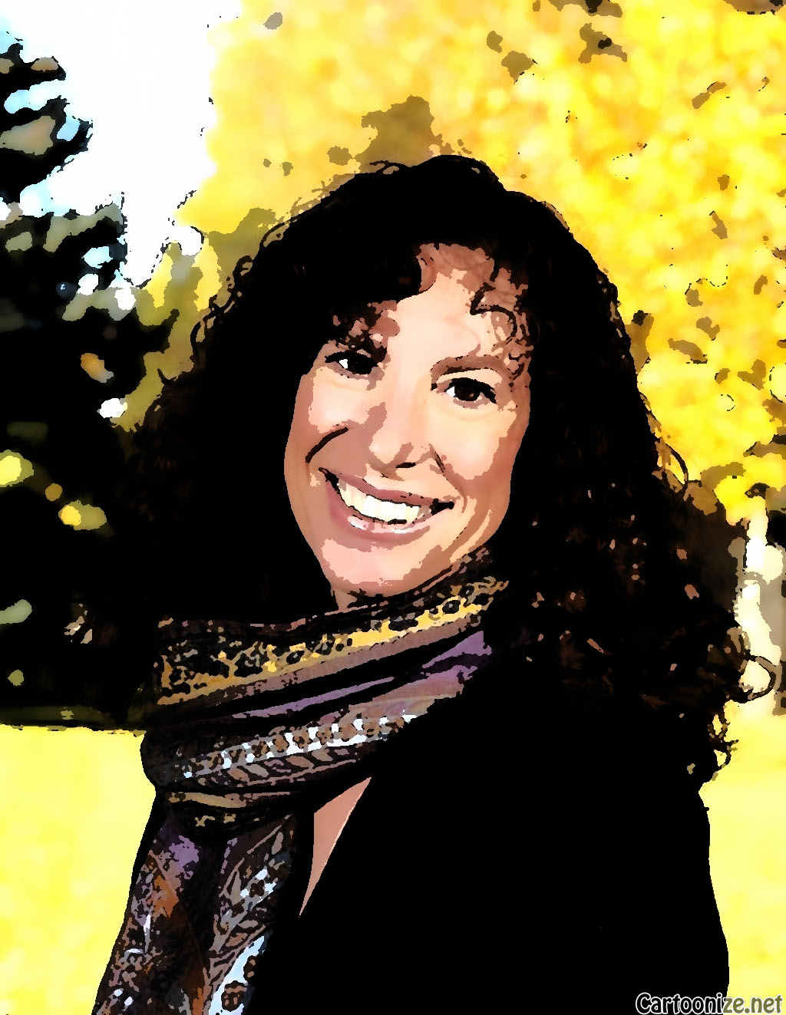
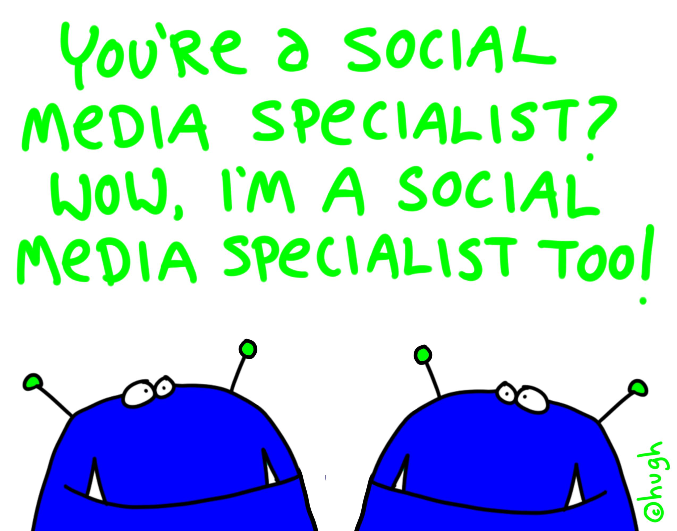
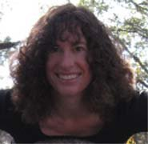
Social Media Expert?
Emily Kellagher
Notes:
Not an Expert – have researched about how to effectively use social media, it is a small part of my job

Slide 3

Social Media Opinions

Slide 4
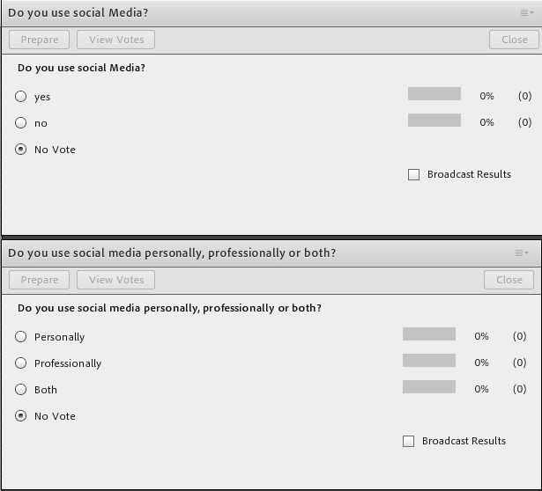
Tell me about Yourself!

Slide 5



Social Media Insights
Social Media Platforms Overview
How I use different platforms
Tips and Tools

Slide 6
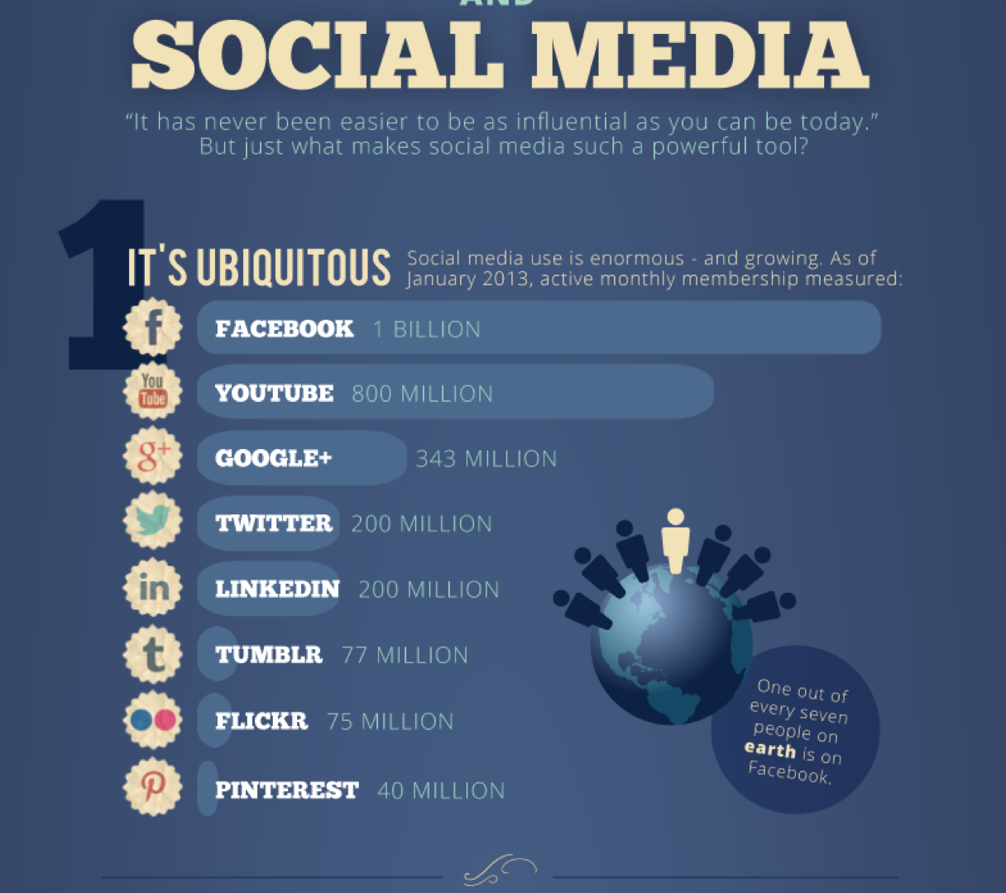
http://dashburst.com/social-media-influence-infographic/
Notes:
Photo Caption: asking a questions
???? Do your users know some of the CLEAN Team ????
Share a Link, link other links …

Slide 7
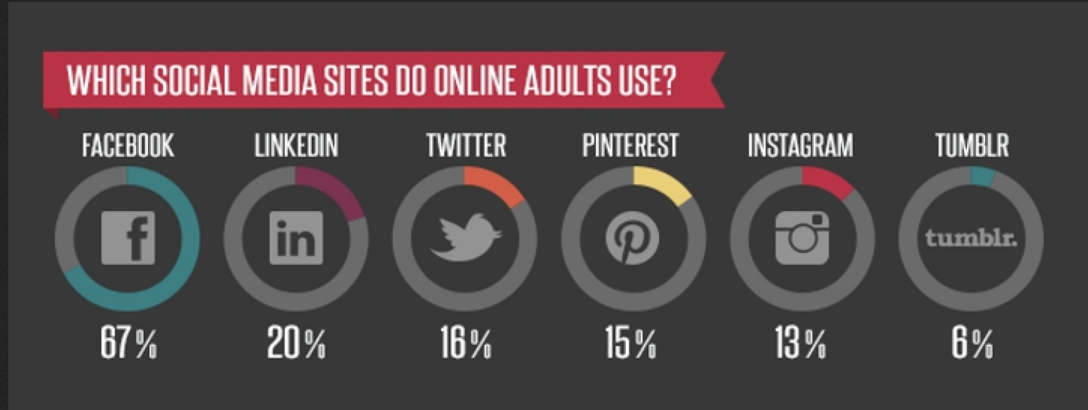
Social Media Data
http://premium.docstoc.com/article/151946864/INFOGRAPHIC-Survey-Reveals-Which-Demographics-Use-What-Social-Media

Slide 8

Social Media Data

Slide 9
Social Media Data
POLL: What social media platforms do you use? Make a mark next to the icon or type in chat!

Slide 10
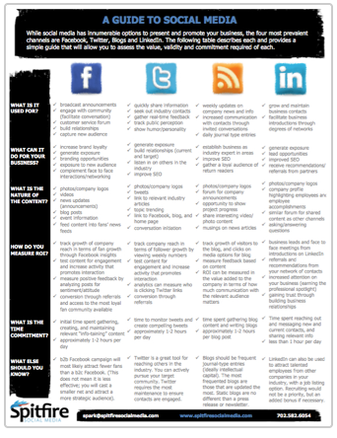
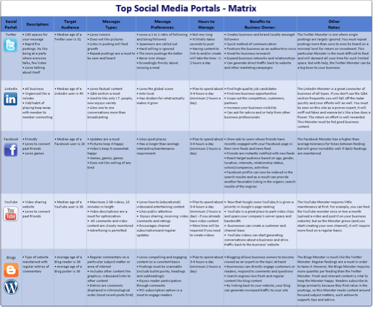
Social Media Platforms
Platform | How I use
Facebook | News aggregate, personal connections
Linked In | Business connections, prof. groups, ask questions, share info and tools
Twitter | News and Tweet Ups
Google + | Use ‘Hangout’, prof. groups
Pinterest | Web collection (sites, books, videos)
Refer to charts on website to download:
Notes:
One of the unwritten laws of using Social Media is that you should not spread yourself too thin

Slide 11
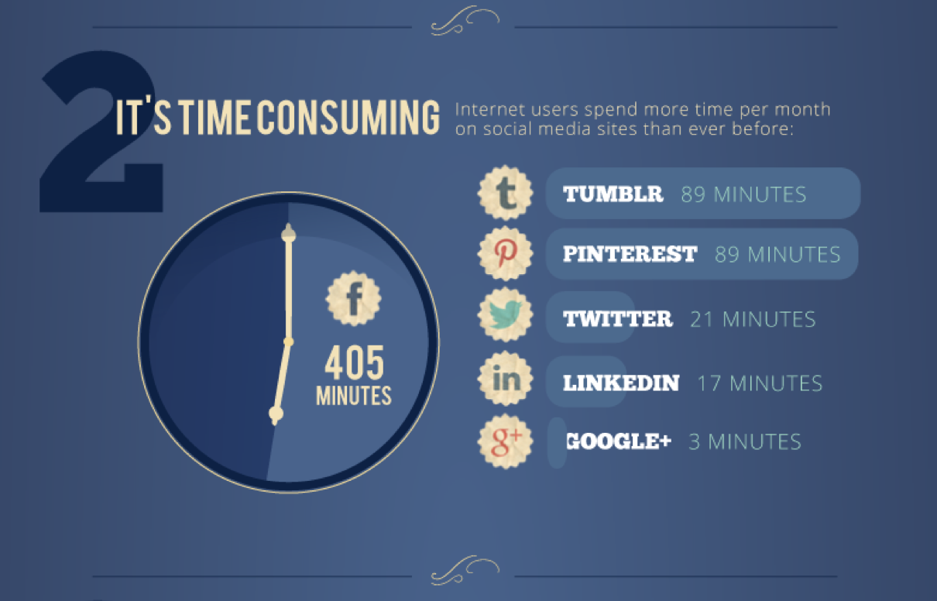
Initial Engagement
http://dashburst.com/social-media-influence-infographic/

Slide 12
Facebook Engagement
What’s in it for you?
Greet way to keep track of peers and colleagues
Easy access to thought leaders or information
Good way to share your events, work etc.
Easy access to learning and professional development
Also an easy way to get opinions
Notes:
Facebook, after all, has 250 million active users compared to about 44 million for LinkedIn, and even though the atmosphere is clearly not as focused on business, there are still a ton of opportunities for professional networking that business users would be remiss to pass up. Once you look beyond the obvious social features like sharing pictures and poking friends, there are plenty of ways to tap into the professional community on the world's largest social network. As with all networking, both online and offline, the best philosophy for engagement on social media is “givers gain.” If I am an active participant on my social media networks – like’ing, sharing, commenting on, re-tweeting or pinning other people’s posts – they will be more likely to do the same for me to, and it’s a great way to build credibility and even visibility for you. I recommend reading and sharing or commenting on at least 5 other posts, before you make one.

Slide 13


Using Facebook Professionally
Think of it like personalizing your desk. You can’t help it. When you walk by someone’s desk, your eye is drawn to the pictures and the way they have personalized and organized their space. You pick up on clues to their lives without realizing it.
Posts
Likes
Apps
Groups
Visibility

Slide 14

Be A FB power user

Slide 15

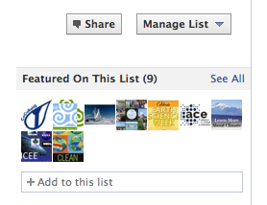
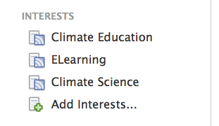
Be A FB power user
Put Friends in groups and create Interest Lists for the pages you like!

Slide 16
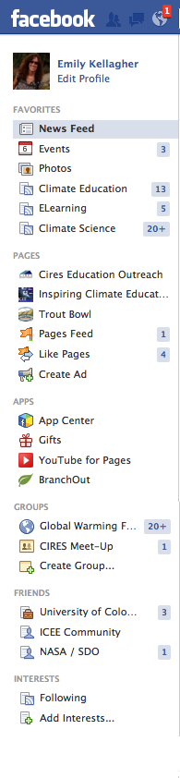
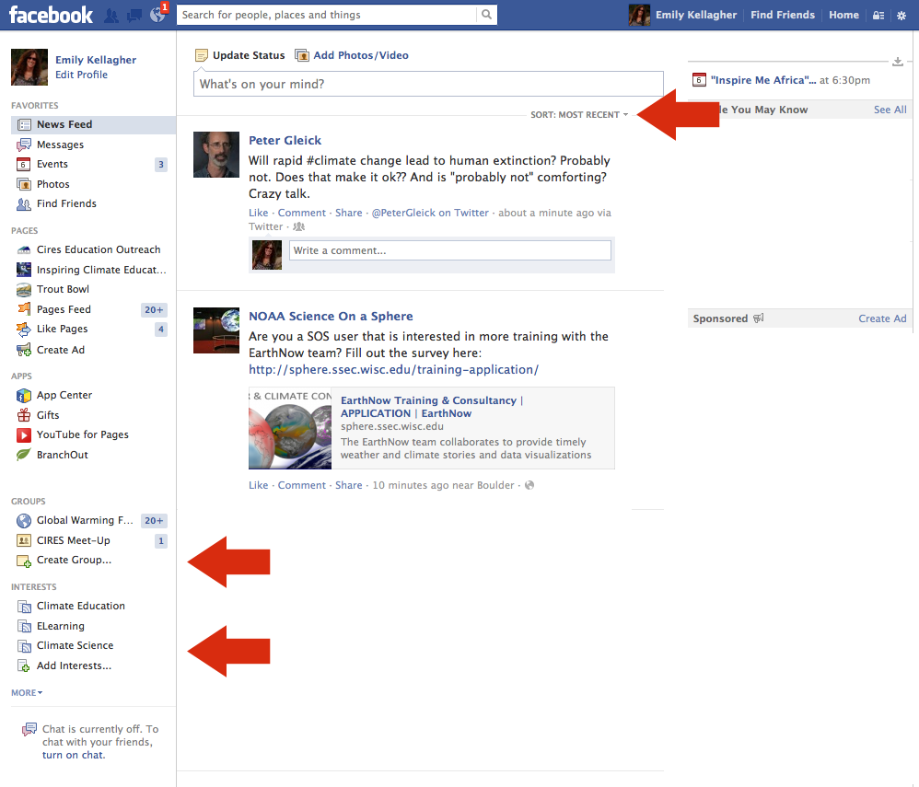
Be A FB power user
Navigation

Slide 17
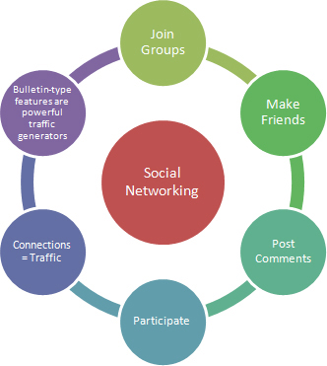
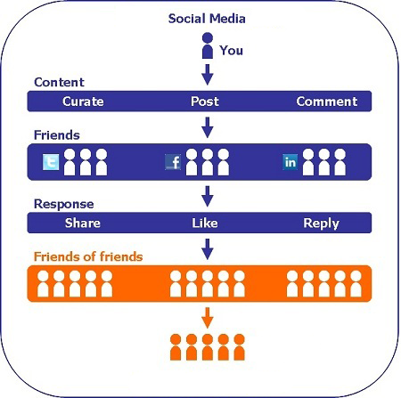
Getting in the flow

Slide 18
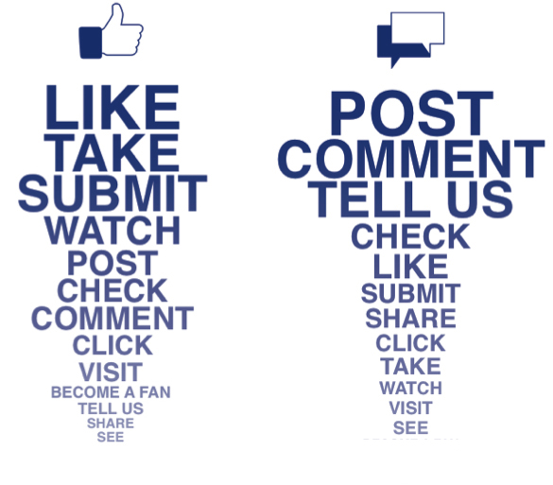
Effective Engagement

Slide 19
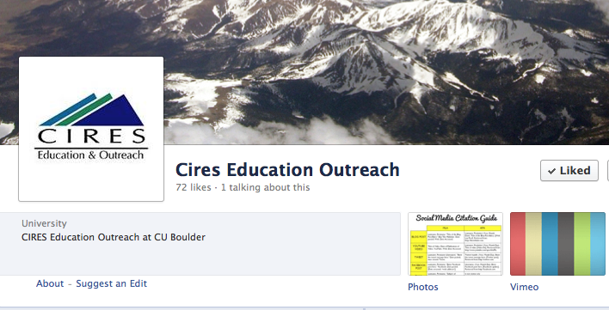

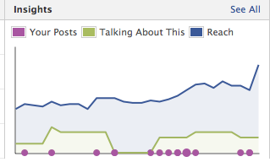
Creating a FB Page

Slide 20
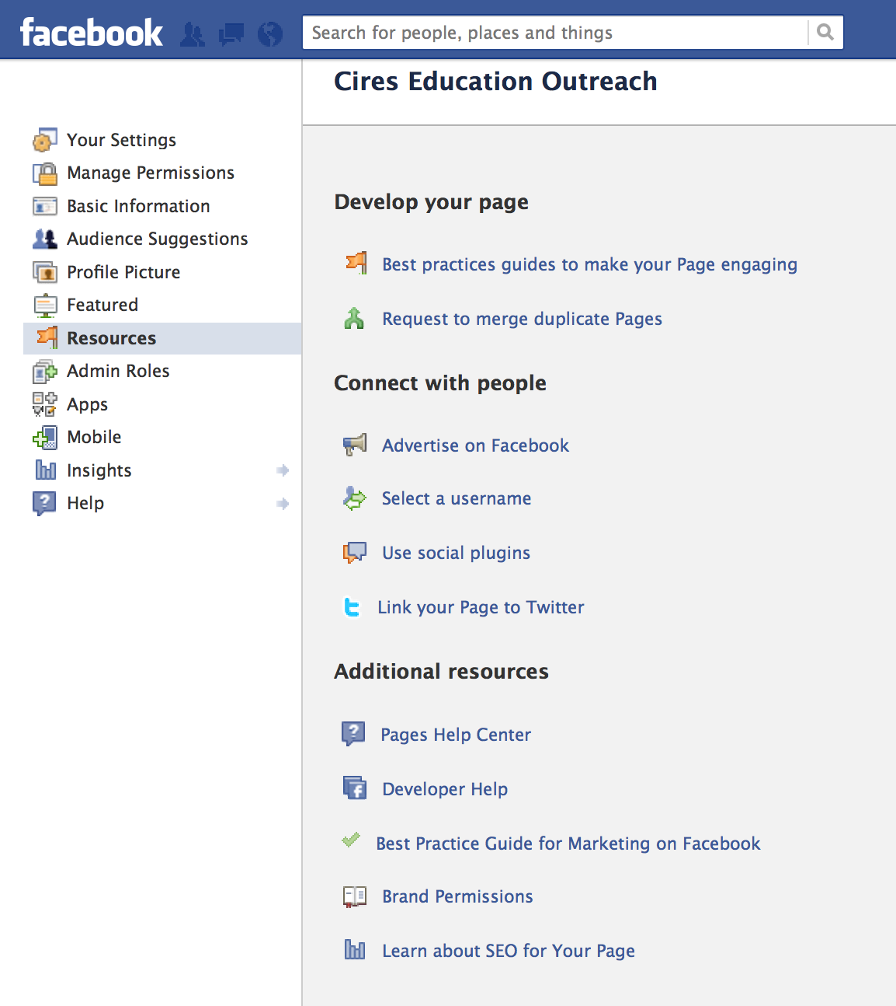

Be A FB power user
Link to Twitter Account and RSS feed
Notes:
Consider first how you use Twitter etc first - I am not a fan of double posting, I want each place to be unique and fresh – double post when you are really interested in broadcasting

Slide 21
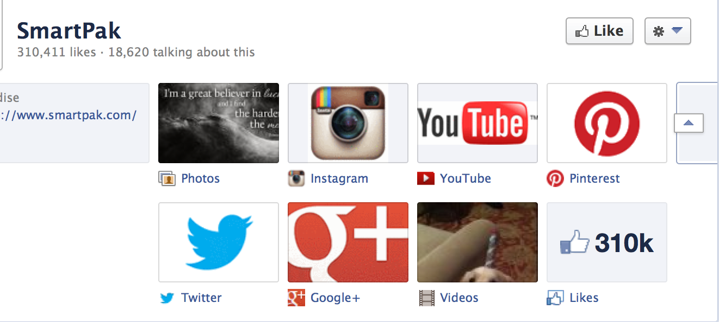
Facebook your Social Media Hub
Notes:
To make my life easier – learn something new, tips and advice (functional side of story building)
Build Relationships – feel raport (emotional side of story building)
To help others -
Craft Identity -

Slide 22




Ideas for Posts
Search.Twitter.com
Google Alerts
Google Search
Aggregators
_______________________________________
Tool bar folder
Content calendar

Slide 23
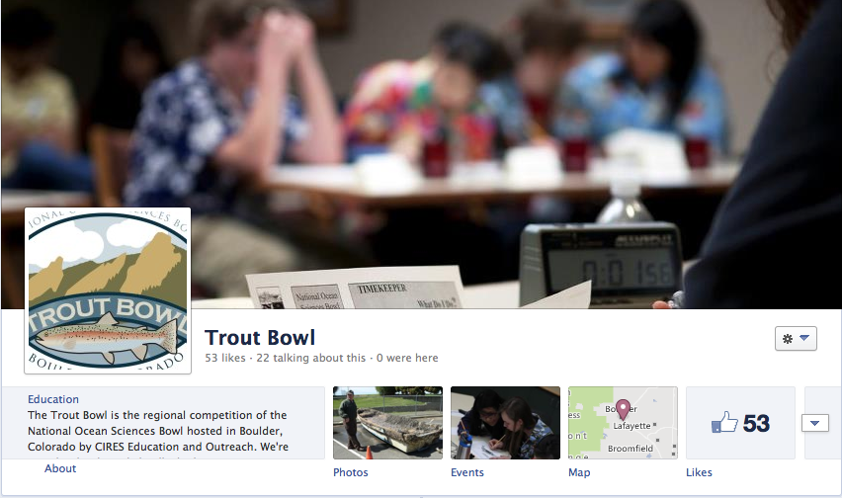
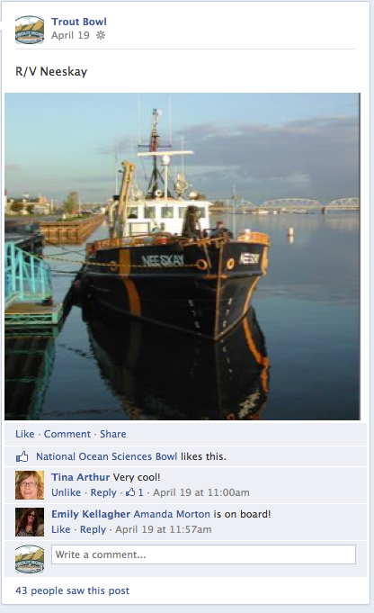
Example of Posts

Slide 24
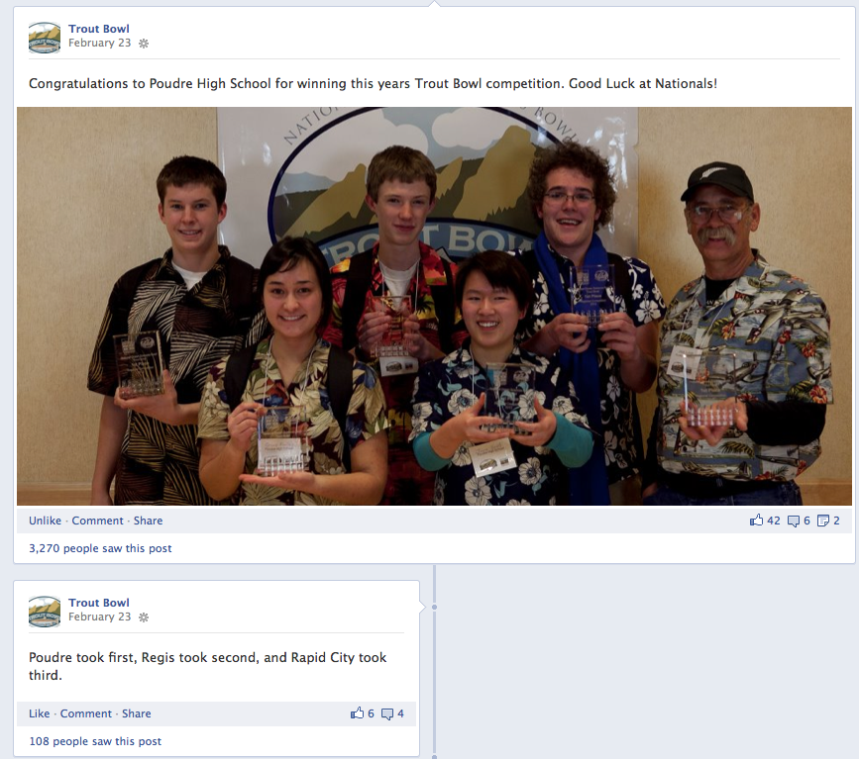
Examples

Slide 25
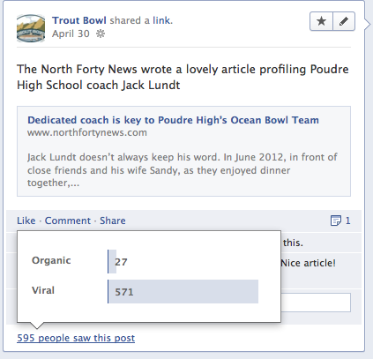
Examples

Slide 26

Choose an Action Step
New User: Check the settings of your FB account, create Friends list, LIKE Clean’s FB page, Share a post
Casual User: LIKE Clean’s FB Page, Share a post, comment on a post, Like similar pages, find colleagues
Advanced User: Create Interest Lists, Start using your side bar options to sort through your news feed, turn on or off notifications for people etc.

Slide 27

What concerns are left for you?
(Q&A Session)

Slide 28
Emily Kellagher
CIRES Education Outreach
Emily.Kellagher@colorado.edu
If you enjoyed my presentation, won’t you recommend me on LinkedIn?
www.linkedin.com/in/emilykellagher/
Connect with CIRES Education Outreach pages:
https://www.facebook.com/CIRESEducationOutreach
https://www.facebook.com/pages/Inspiring-Climate-Education-Excellence-ICEE/
https://www.facebook.com/NOSB.TroutBowl

Slide 29
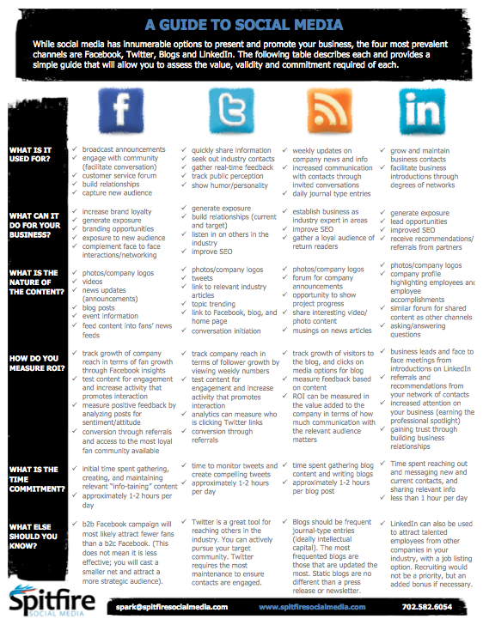

Slide 30
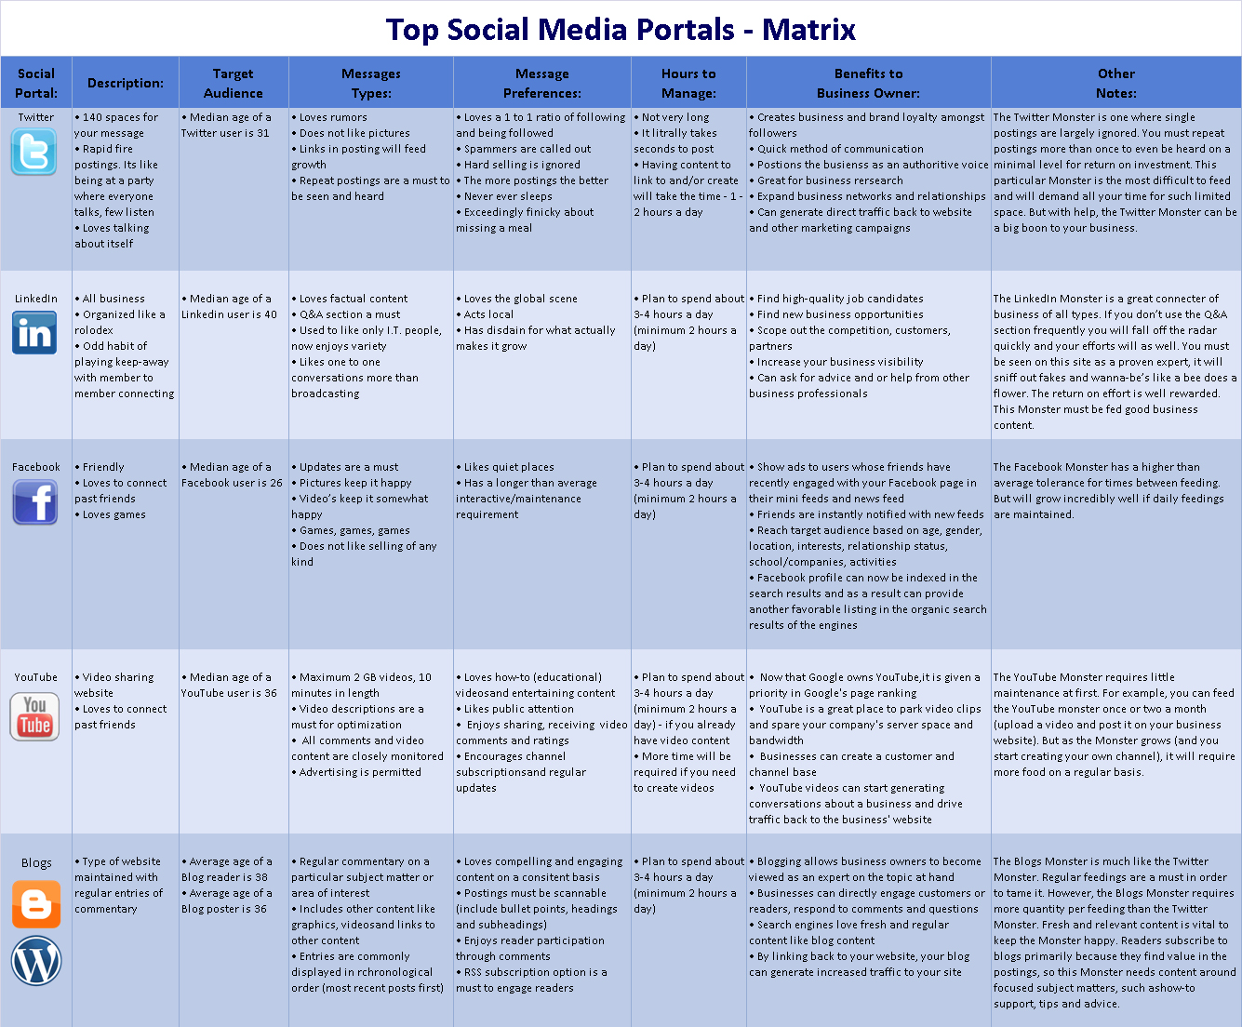

Slide 31






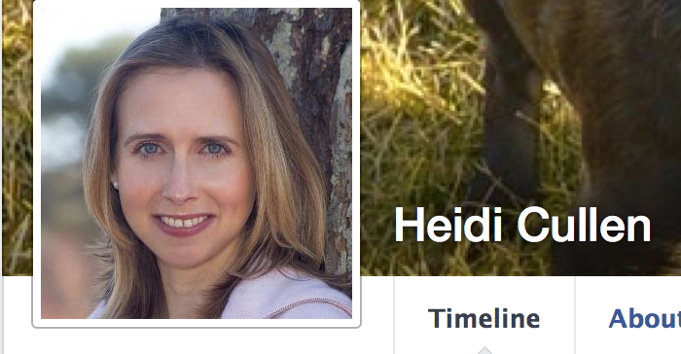
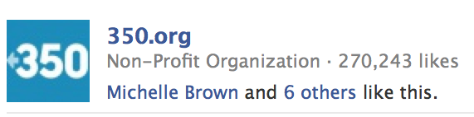

Who’s on Facebook?

