Slide 1



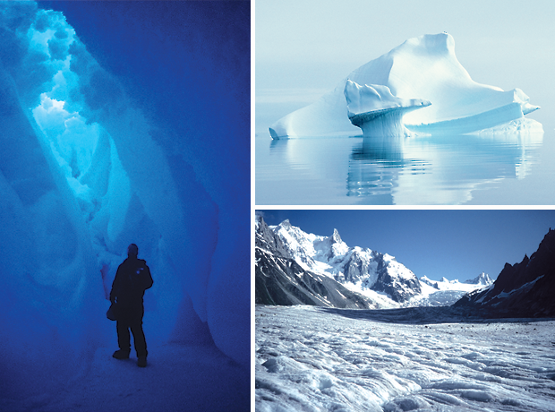
The Rapidly Changing Arctic Sea Ice:
New surprises in 2012
Cooperative Institute for Research
in Environmental Sciences
University of
Colorado
Walt Meier, National Snow and Ice Data Center
25 September 2012

Slide 2
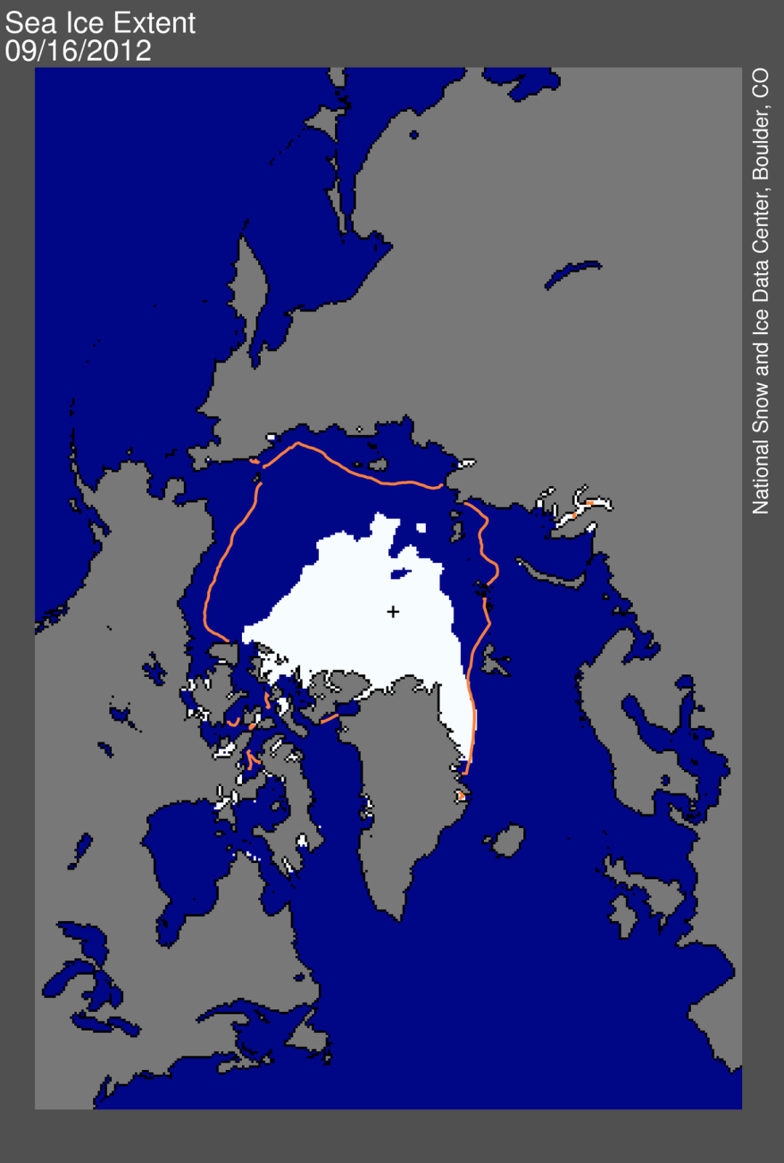
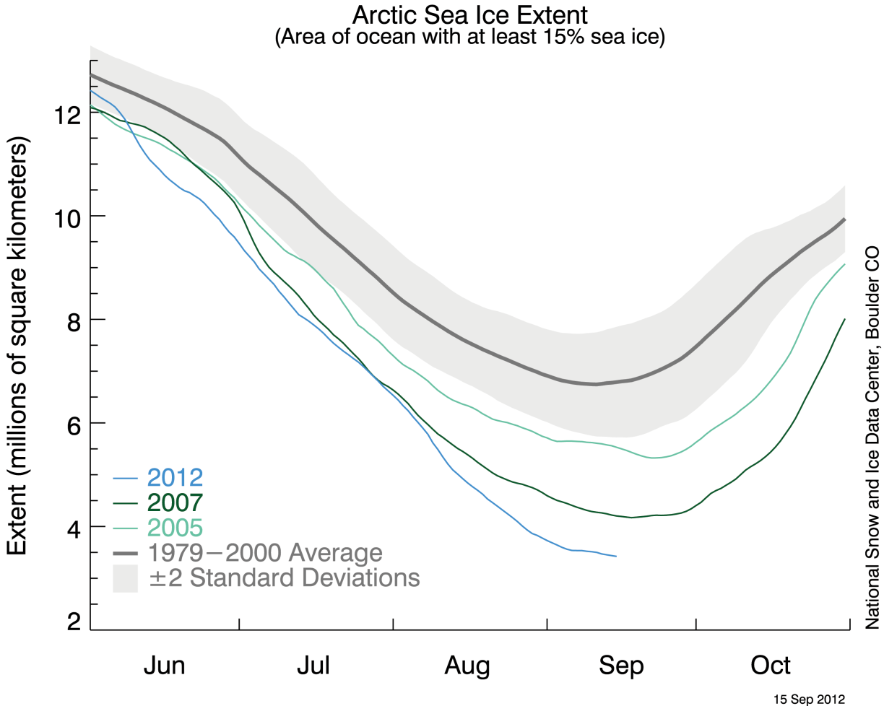
2012 Arctic sea ice minimum, 16 September
Previous low surpassed on Aug. 26
3.41 million km²
1.32 million mi²
1979-2000 average
Arctic Sea Ice News and Analysis: http://nsidc.org/arcticseaicenews/
Imagery from NSIDC Sea Ice Index: http://nsidc.org/data/seaice_index/

Slide 3
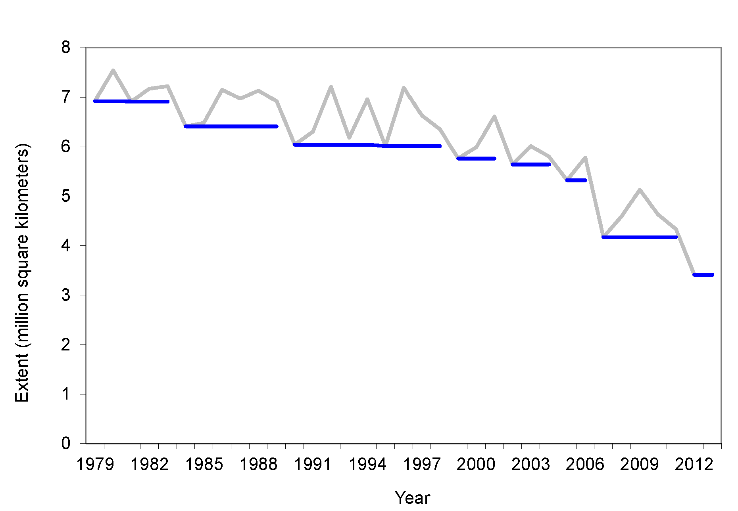
Change in record low extent since 1979
Annual minimum extent and standing record low extent
2005
-23%
2007
-22%
-51%
2012
-18%
% change from previous record low
% change from initial record low in 1979
Annual minimum extent

Slide 4
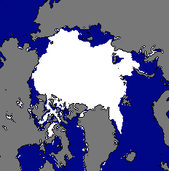
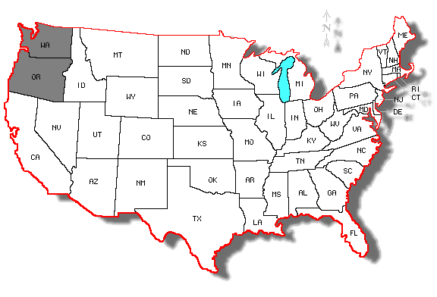
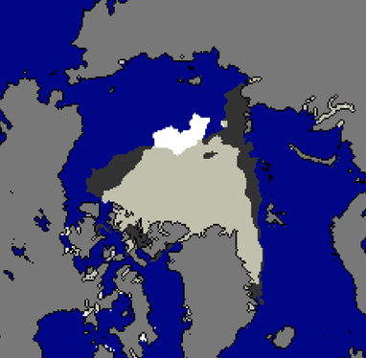
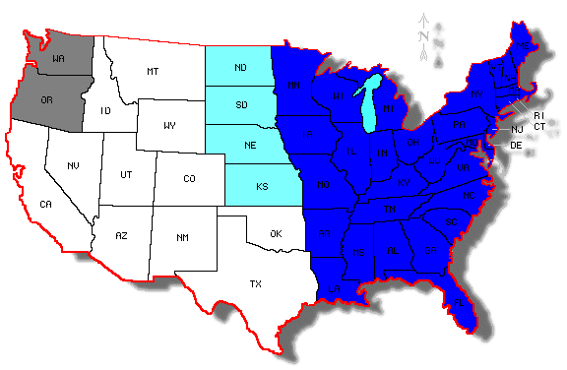
Change in minimum extent from 1980 to 2012
1980
Sea Ice
Ocean
2007
Ocean
2012
2007
2012
2007
2012
2012 &
2007
Not Incl.
Map courtesy: http://diymaps.net/us_12.htm
State area data from U.S. Census Bureau

Slide 5
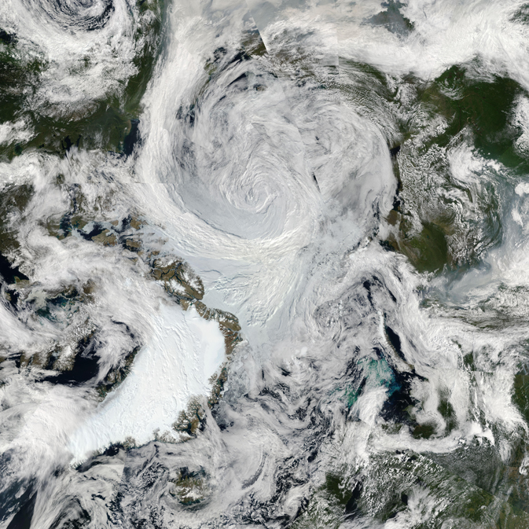
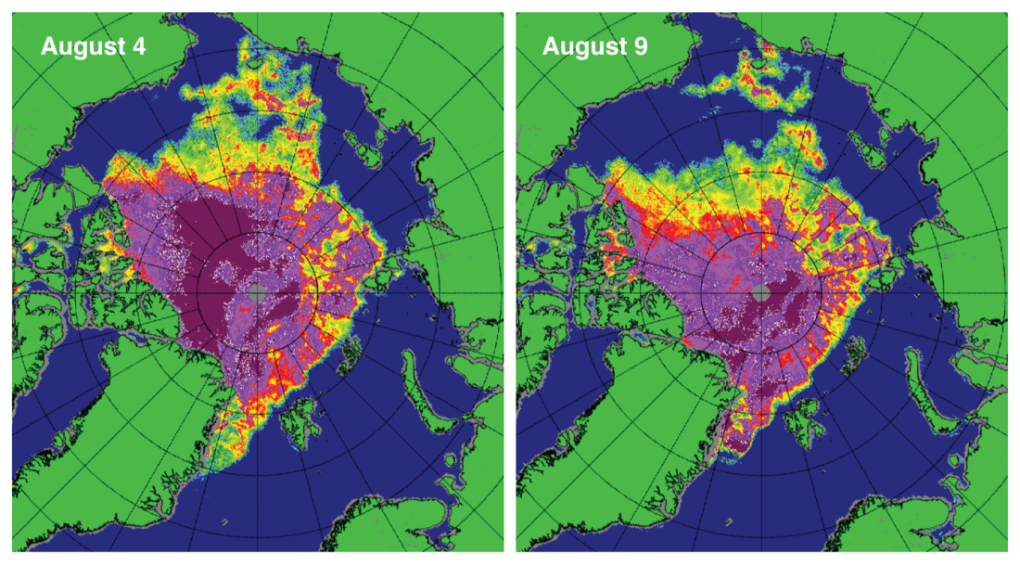
The “great” Arctic storm of August 2012
Strong storm broke up ice → rapid melt
Storm was strong but not unprecedented (8 similar storms in last 34 years)
Otherwise, 2012 weather was cooler and more moderate than in 2007
The primary reason for the record low was a thinner sea ice cover
Alaska
Siberia
L
Greenland
600,000 km² ice loss (~size of Texas) lost in 5 days
Norway
NASA MODIS imagery
University of Bremen
MODIS imagery: http://rapidfire.sci.gsfc.nasa.gov/subsets/?mosaic=Arctic
Univ. of Bremen data: http://www.iup.uni-bremen.de:8084/ssmis/

Slide 6
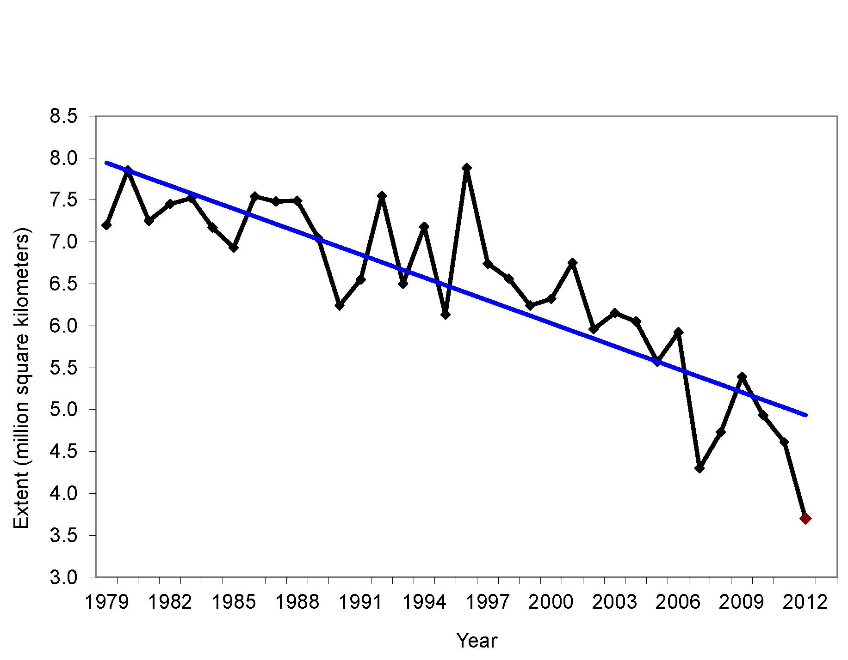
September extent trend is accelerating
Average Monthly Arctic Sea Ice Extent
September 1979 to 2012
Years | Trend (km² yr⁻¹) | % decade⁻¹ relative to 79-00 avg.
79-01 | -45900 | -6.5
79-02 | -51000 | -7.3
79-03 | -52800 | -7.5
79-04 | -54600 | -7.8
79-05 | -59400 | -8.4
79-06 | -60200 | -8.6
79-07 | -71600 | -10.2
79-08 | -78100 | -11.1
79-09 | -78700 | -11.2
79-10 | -81400 | -11.6
79-11 | -84700 | -12.0
79-12* | -91200 | -13.0
*2012 estimate
Overall, the Arctic has lost ~50% of its summer ice cover
The last six Septembers are the lowest in our satellite records (beginning in 1979)
State of Indiana = 92,900 km²

Slide 7
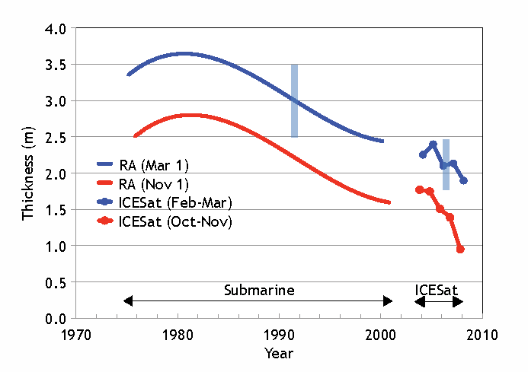
Sea ice thickness is decreasing
|-------------- Submarines -------------|
NASA
ICESat
Sea ice thickness estimated by submarine sonar and satellite laser altimeter
From Kwok and Rothrock, 2009

Slide 8
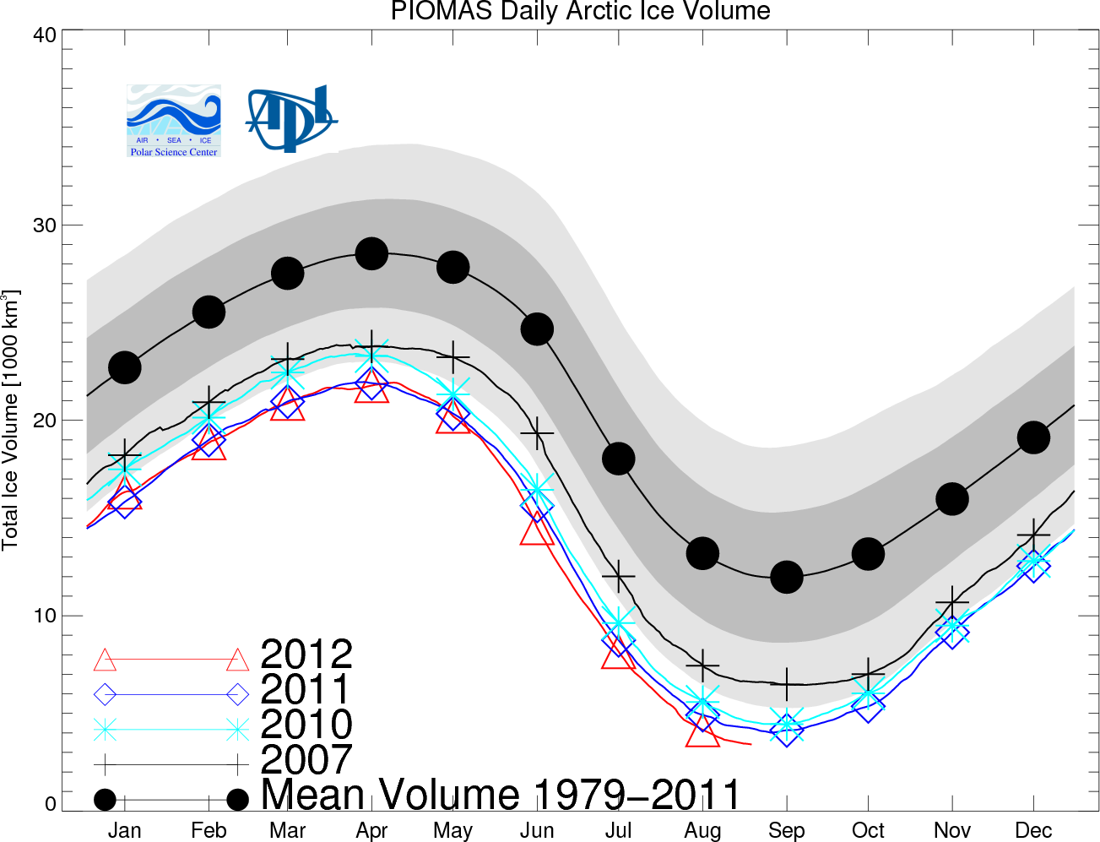
Sea ice volume decreasing
Estimated from
passive microwave data
model assimilation
University of Washington Polar Science Center
http://psc.apl.washington.edu/wordpress/research/projects/arctic-sea-ice-volume-anomaly/

Slide 9
Inferred thickness from sea ice age data
Age can be used as a proxy to estimate sea ice thickness
  Other things being equal:
  Older ice = Thicker ice
For an animation of ice age through October 2011 go to:
http://www.climatewatch.noaa.gov/video/2011/old-ice-becoming-rare-in-arctic

Slide 10
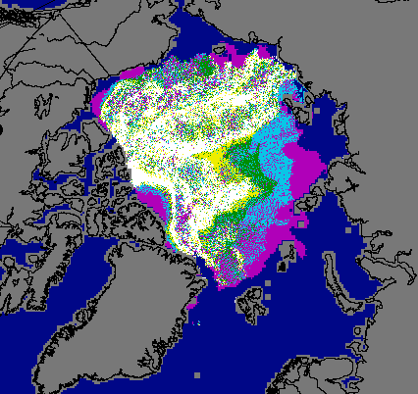
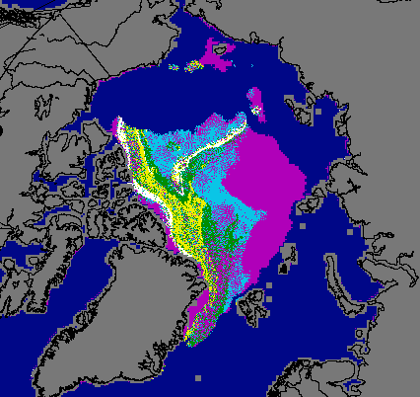
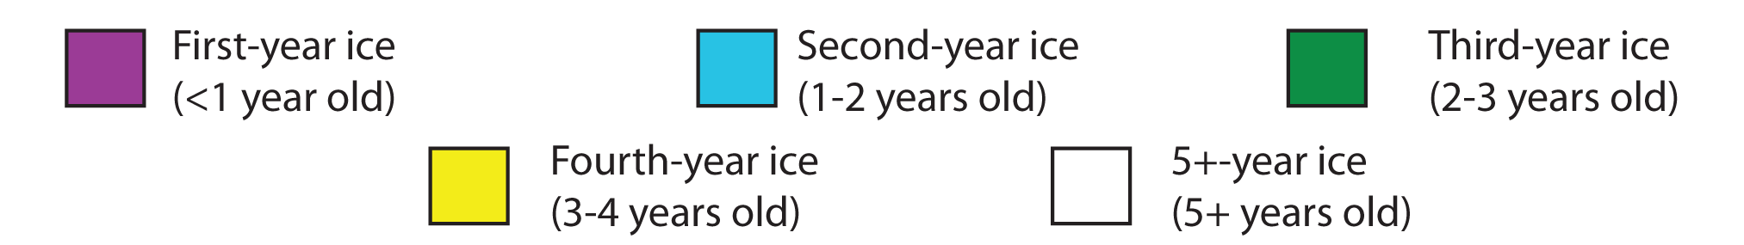
Older, thicker ice is being lost
August 1985
August 2012
Based on satellite observations; from J. Maslanik, M. Tschudi, Univ. Colorado

Slide 11
Projections of future sea ice changes
There is much interest to improve predictability of sea ice on century, decadal, and seasonal scales

Slide 12
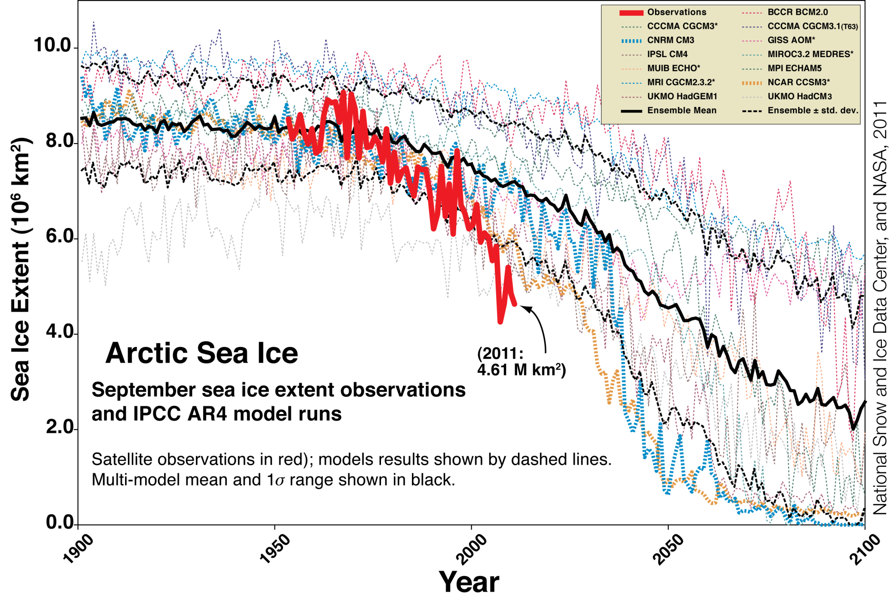
Decline is faster than forecast, old IPCC models
2012 (est.)
Updated from Stroeve et al., Geophysical Research Letters, 2007

Slide 13
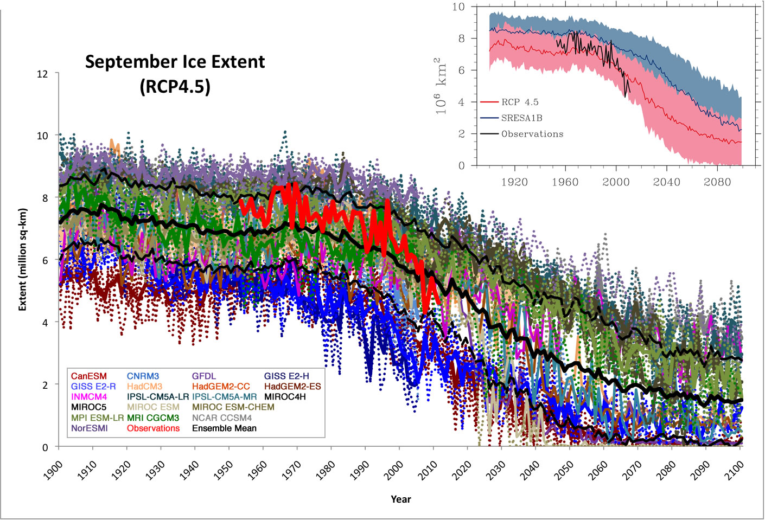
Decline is faster than forecast, new IPCC models
Stroeve et al., Geophysical Research Letters, 2012

Slide 14
Impacts of a changing Arctic sea ice cover
Sea ice plays a key role the Arctic environment, human activities in the Arctic, and in regional and global climate

Slide 15
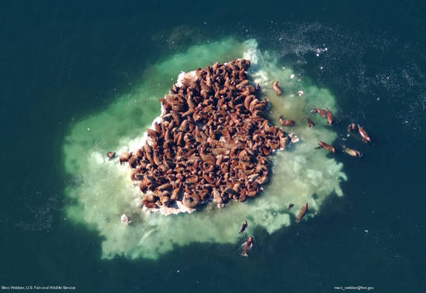
Photo by Mike Webber, U.S. Fish & Wildlife Service

Slide 16
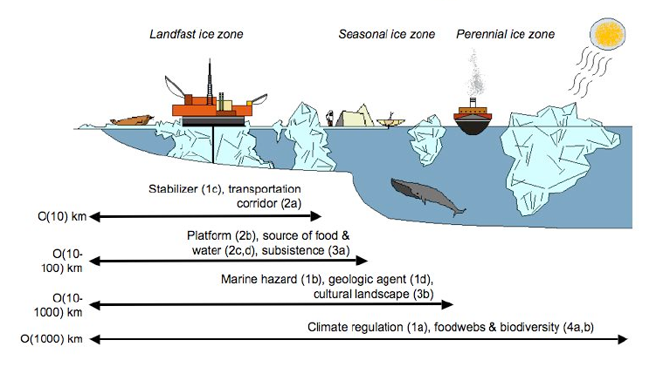
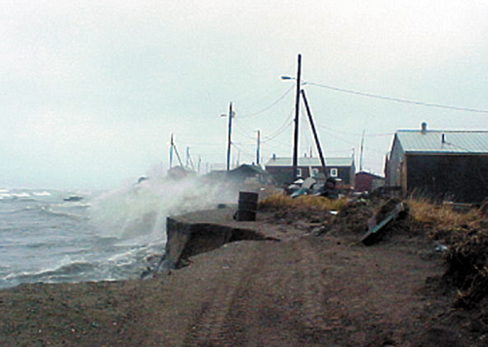
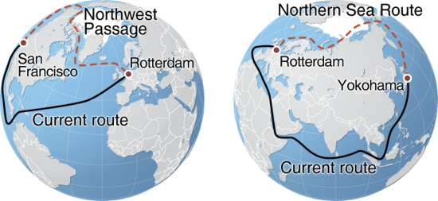
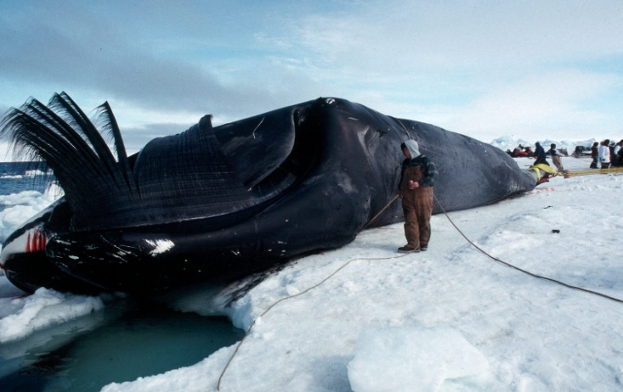
Human impacts
Local communities
Shipping and navigation
Resource extraction
Tourism
National sovereignty and defense issues
Global climate impacts
Photo by Tony Weyiouanna Sr.

Slide 17
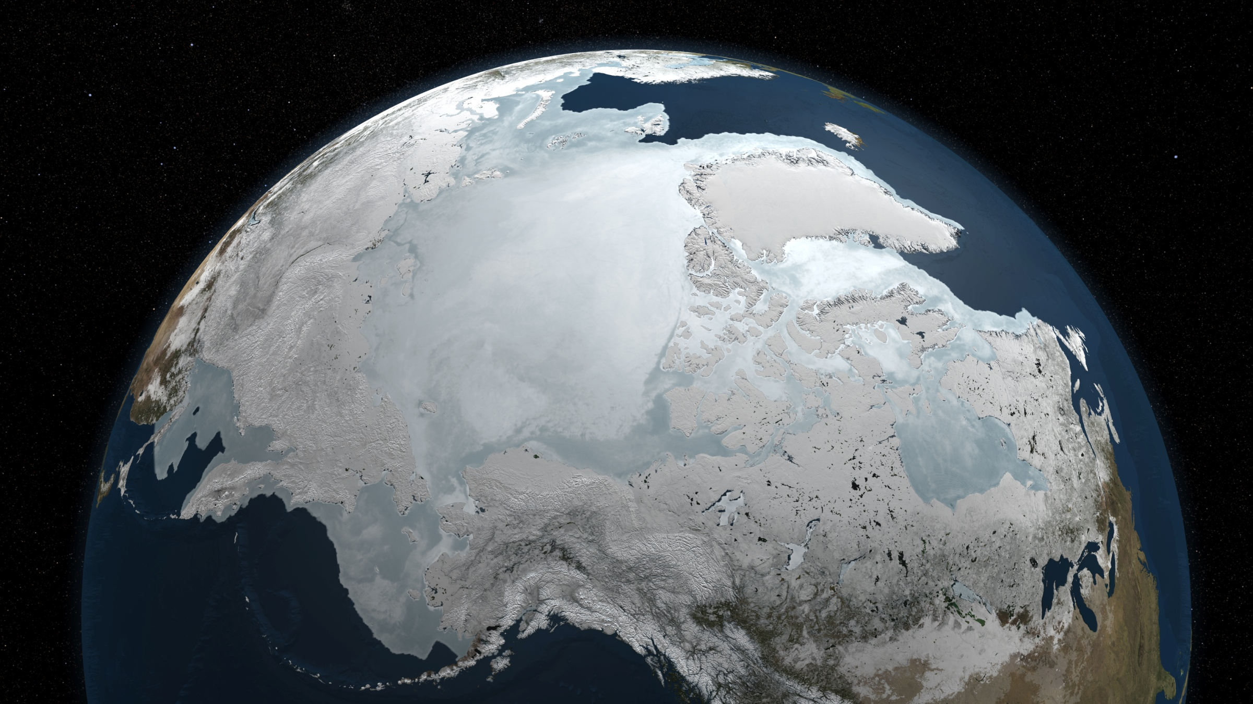
Effects of sea ice change on global climate
Winter sea ice; image from NASA

Slide 18
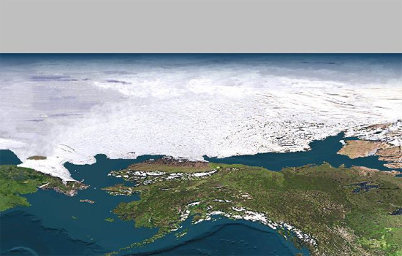
Loss of summer sea ice decreases albedo
With sea ice: α ≥ 60%
Without sea ice: α ≤ 10%
The change from sea ice to ice-free ocean is the largest surface contrast on earth as far as solar energy is concerned

Slide 19
Sea Ice – Albedo Feedback
Temperature ↑
Ice melt ↑
Heat ↑
Amplification of warming
Albedo ↓
Energy absorption ↑

Slide 20
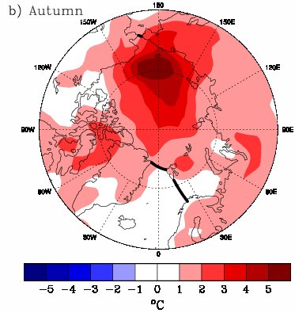
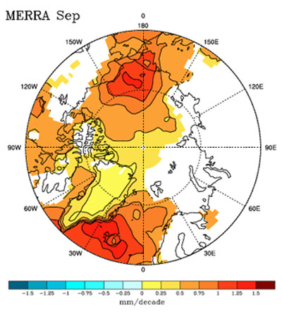
Arctic Amplification: a warmer, wetter Arctic
Temperatures:
  Ocean absorbs more of sun’s energy during summer than sea ice
  Ocean heat keeps atmosphere warm into the fall
  “Arctic Amplification”
Water vapor:
  Less sea ice means more transfer of moister to the atmosphere
  More water vapor during the autumn
Autumn air temperature anomalies,
(2003-2007) minus
(1979-2007)
September water vapor anomalies,
(2003-2007) minus
(1979-2007)
Serreze, et al., 2008 and Serreze et al., 2012
Data from NOAA NCEP (top) and NASA MERRA (bottom)

Slide 21
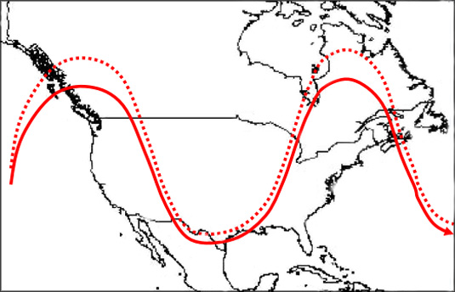
Changes in Arctic sea ice affecting global climate?
Less ice = “wavy-er” jet stream
Storm tracks change
Precipitation patterns change
More persistent weather patterns:
  Heat waves
  Cold snaps
  Drought
  Flooding
Changes expected in Europe and Asia as well
New
Old
Jet stream flow becoming more north-south and less west-east
J. Francis, Rutgers Univ. and S. Vavrus, Univ. Wisc., Geophys. Res. Letters, 2012

Slide 22
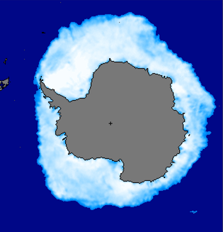
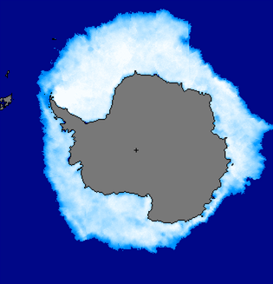
A word on Antarctic sea ice
Which is normal and which is record high?
September 22 Sea Ice
The Antarctic sea ice is at a record high maximum.
Is this significant?

Slide 23
A word on Antarctic sea ice
September 22 Sea Ice
Arctic | Antarctic
Minimum declining by 13% per decade | Maximum increasing by <1% per decade
Ocean surrounded by a continent | Continent surrounded by an ocean
Mostly multi-year ice | Mostly first-year ice
Avg. thickness, 3-4 m | Avg. thickness, 1-2 m
Less affected by winds | Dominated by winds
Change is primarily due to warming | Change is primarily due to circulation patterns
Volume changing dramatically | Volume changing minimally
Large climate impact | Small climate impact
2012
Record
Antarctic ice is ~750,000 km² from average, 25% of the current anomaly for the Arctic
1981
Normal

Slide 24
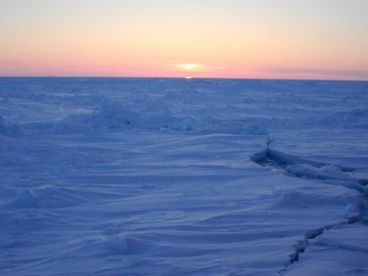
Summary
Arctic sea ice is changing faster than expected
  Extent is decreasing
  Ice is thinning
  Multiyear ice is being lost
Impacts in the Arctic are already being observed
  Native communities
  Coastal erosion
  Wildlife
  Resource exploitation
There are indications of impacts on global climate
Sea Ice News: http://nsidc.org/arcticseaicenews/
Sea Ice Data: http:/nsidc.org/data/seaice_index/
Education Resources: http:/nsidc.org/cryosphere/
Thank you!

