Slide 1
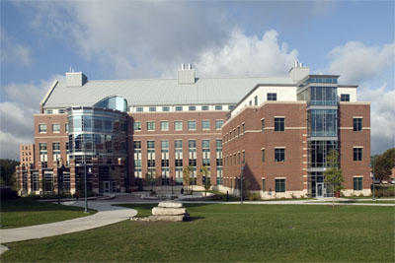
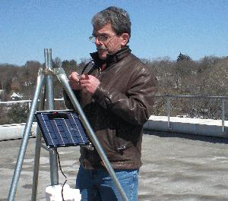
The Future of Energy
Fred Loxsom
Eastern Connecticut State University

Slide 2
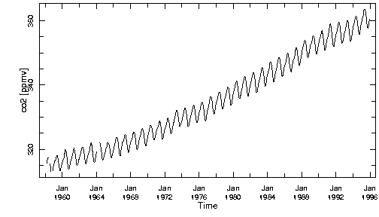
Atmospheric CO2 is rising.
GHG concentration is rising
Notes:
This figure shows the temperature record from the Vostock ice core (dark blue), together with CO2 (red) from the Vostock ice core, the Law Dome ice core, and from the Mauna Loa monitoring station in Hawaii. The dramatic increase in CO2 since the start of the industrial revolution is evident.

Slide 3
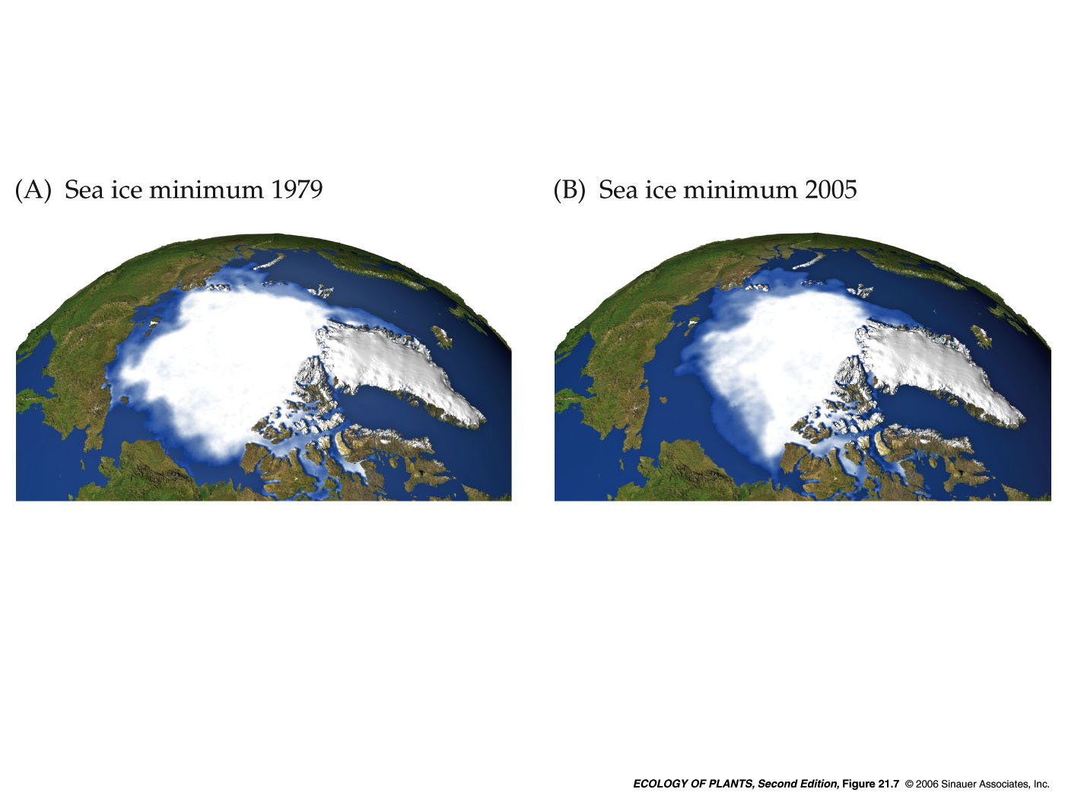
Environmental changes have been observed

Slide 4
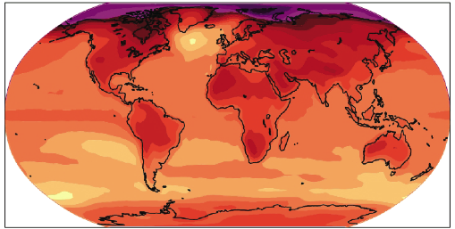

Global Climate is Changing

Slide 5
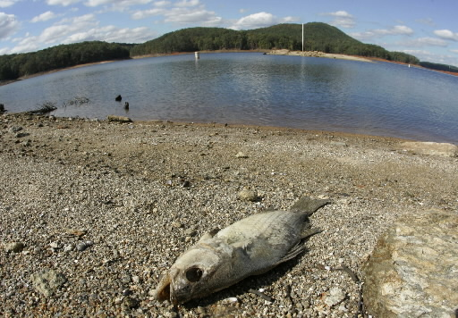

Impacts may be severe

Slide 6
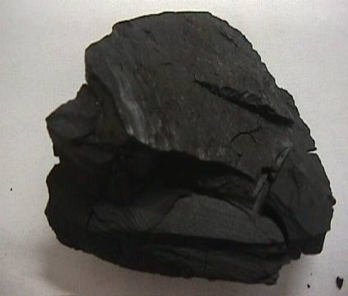
Fossil Fuels are the main cause
C + O₂ → CO₂

Slide 7
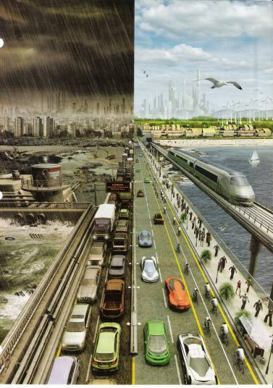
We have choices to make

Slide 8
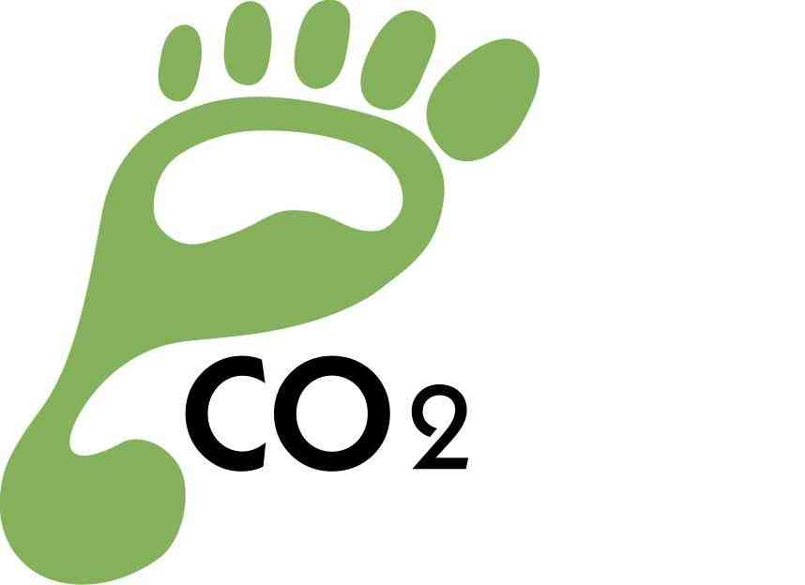
How do we reduce our carbon footprint?
Notes:
The pictures shows alternate futures. We are determining the future by our current actions. Take a careful look at this picture and describe how these alternate futures differ.

Slide 9
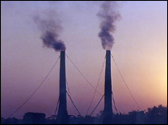
Current Situation
85% of US primary energy is from fossil fuel
Notes:
86% of global primary energy comes from burning fossil fuels – coal, oil, natural gas. This energy is called “primary” because it is used to produce secondary or tertiary energy sources such as electricity or hydrogen gas. Most of the other 14% comes from water power (hydroelectricity). So, our world runs mostly on coal, oil, and natural gas.

Slide 10
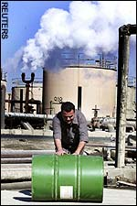
US Energy and CO2
Coal : 23% energy and 38% CO2
Oil: 38% energy and 41% CO2
NG: 23% energy and 21% CO2
Coal Consumption & Resources

Slide 11
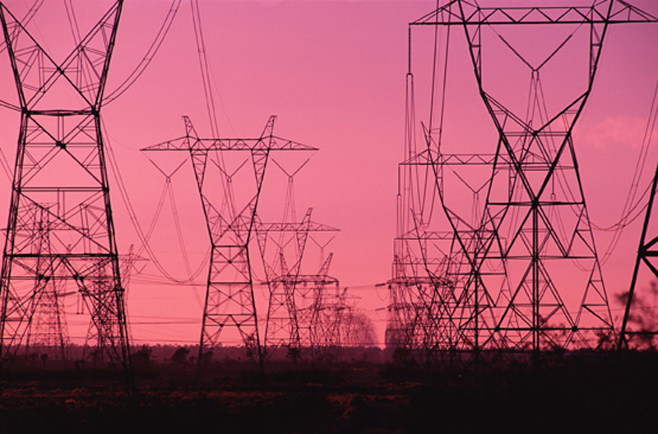
US Energy End Use
Coal Consumption & Resources
40% energy ➔ electricity
33% energy ➔ transportation
Remainder ➔ heating & industry

Slide 12
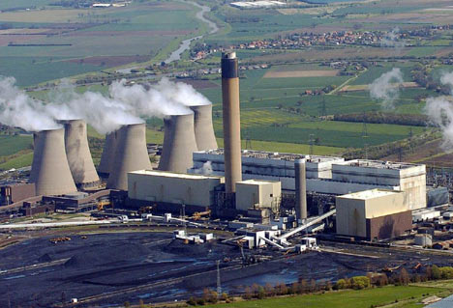
Coal
Coal Consumption & Resources
About 50% of US electricity is generated by coal-burning power plants.
Notes:
About 50% of US electricity is generated by coal burning power plants. Coal is also considered to be the dirtiest of the fossil fuels. In this section, we will look at how we use coal and how much coal remains in the ground.

Slide 13
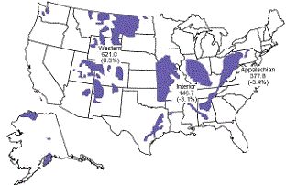
Future Coal Consumption
Because coal is cheap and plentiful, coal consumption is projected to increase rapidly.
Notes:
Because coal is relatively cheap and plentiful, coal consumption is projected to increase rapidly. China’s coal consumption will be a big factor in this growth.

Slide 14
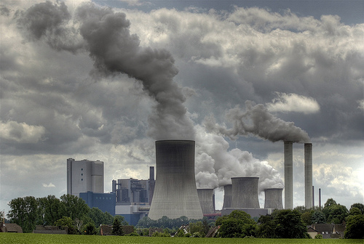
Coal-Burning Power Plant
600 plants
330 GW capacity
Baseline power
50% of US electricity
typical plant
500 MW capacity
3.4 billion kWh annually
3.4 MtCO2 annually
SOx, NOx, Hg, particulates
Mining and solid waste
Notes:
Because coal is relatively cheap and plentiful, coal consumption is projected to increase rapidly. China’s coal consumption will be a big factor in this growth.

Slide 15
Alternatives?
Nuclear
Shale gas
Energy Efficiency and Conservation
Sequestration
Distributed Solar
Central Solar
Wind
Geothermal
Other
Notes:
Because coal is relatively cheap and plentiful, coal consumption is projected to increase rapidly. China’s coal consumption will be a big factor in this growth.

Slide 16
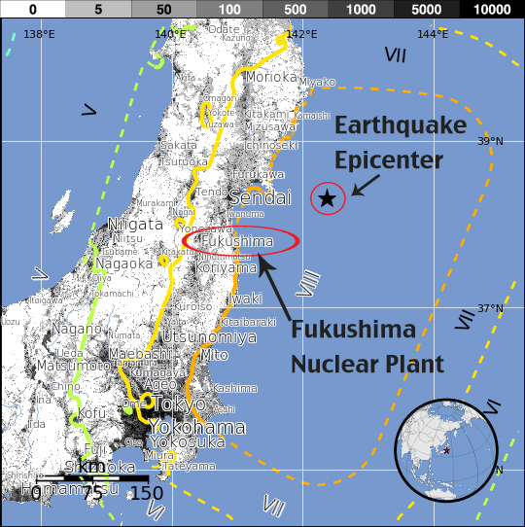
Nuclear Power after Fukushima
Notes:
Nuclear power’s chief advantages are inexpensive fuel and nearly zero greenhouse gas emissions. In this presentation we will describe nuclear science and technology and explore some of the advantages and disadvantages of using nuclear power to generate electricity.

Slide 17
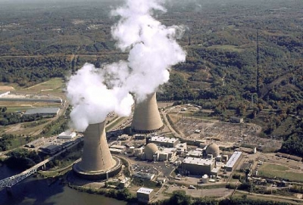
Nuclear Power
104 reactors
100 GW capacity
Baseline power
20% electricity
High capital cost
Minimal CO2
Notes:
A nuclear power plant uses nuclear fuel, usually uranium, to produce electric power for the power grid. In a nuclear power plant, the nuclear fuel is made to fission in a controlled manner. The thermal energy released in the fission is used to make steam to drive a steam turbine, just as in a coal-burning power plant, and, also just as in a coal-burning power plant, the steam turbine will turn the shaft of the electric generator to generate electricity.
This slide shows a photograph of the Beaver Valley Nuclear Power Plant at Shippingport PA. In this photo, we see the large cooling towers which cool the steam that is used to drive the steam turbine. After the steam has struck the turbine blades, causing the turbine axis to turn, the steam has to be condensed. In this context, “condensed” means “changed from a gas (steam) to a liquid (water)”. The cooling towers provide a source or cool water to cool and condense the steam used in the steam turbine. The white stuff coming out of the cooling towers is not steam, it is water vapor used to cool the water that is used to condense the steam used with the steam turbine. The two smaller domed structures to the right of the cooling towers are “containment” buildings that house the nuclear reactors. In the nuclear reactors, the nuclear fuel fissions and supplies the thermal energy for this power plant plant.

Slide 18
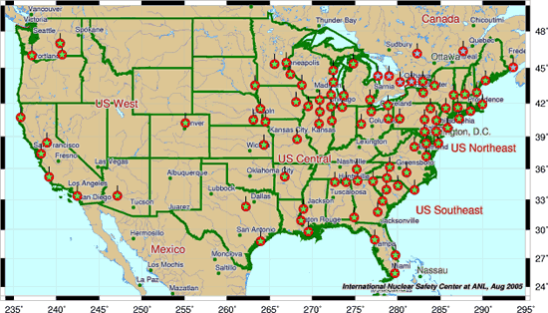
Nuclear Power in the US
Notes:
The US has 104 nuclear reactors. They produce 20% US Electricity. No new plants ordered since 1973. Later in this presentation, we will discuss reasons why nuclear power has not grown more rapidly. New plants are being planned now, but may not be built. Many people still distrust nuclear power because of the possibility of a nuclear accident that would spread dangerous nuclear radiation into the environment. Some people who do not oppose nuclear power in principle still do not want to live near a nuclear reactor. This is an example of NIMBY (not in my back yard) syndrome.

Slide 19
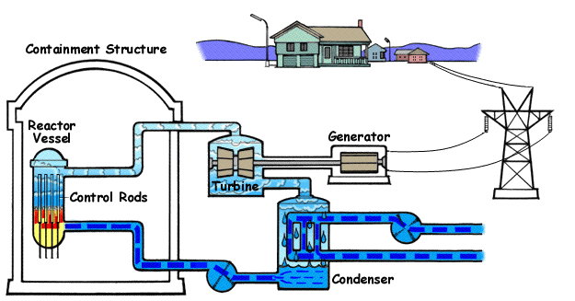
Nuclear Reactors:
Boiling Water Reactor (BWR)
Notes:
This diagram shows the big picture view of energy transformations in a boiling water nuclear reactor. The containment structure encloses the reactor vessel and limits the spread of radiation in case of an accident. In the reactor vessel, a controlled fission process releases thermal energy and heats water. The uranium fuel (in the form of fuel rods) and the control rods are in the reactor vessel; the vessel is full of water which keeps the fuel from overheating. The fuel and control rods are called the reactor core. The control rods control the speed of the reaction by absorbing some of the neutrons released by the fission reactions. The fission reaction converts the energy stored in the strong nuclear force into thermal energy. The thermal energy released in the reactor vessel boils the water in the vessel and converts the water into steam, the steam drives the steam turbine, and the steam turbine drives the electric generator. Except for the source of thermal energy used to heat the water to make steam, this plant is very similar to a coal-burning power plant. After the steam hits the turbine, it is cooled down and condenses as water in the condenser and goes back again to be heated up in the reactor vessel. The cooling loop going through the condenser is connected to the big cooling towers where the heat is dumped to the environment. Everything in the primary water loop is radioactive because it is in contact with the water (either as a liquid or as steam) that bathes the radioactive uranium fuel in the reactor vessel. The radioactive primary loop includes the reactor vessel, the turbine, and the condenser. The cooling loop that goes to the cooling tower is not radioactive and the electric generator is not radioactive. This type of reactor is a “Boiling Water Reactor” or BWR because it boils water in the reactor core to make steam.

Slide 20
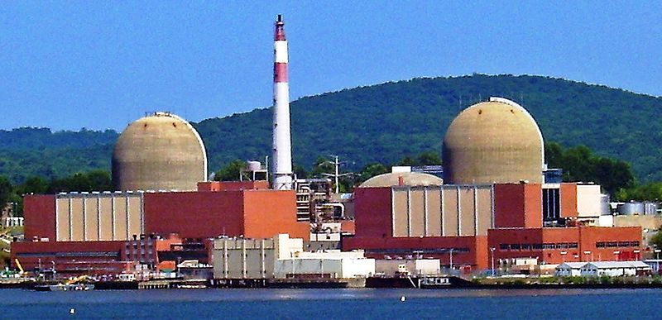
Indian Point
Unit 2 and Unit 3 were commissioned in 1974 and 1976.

Slide 21
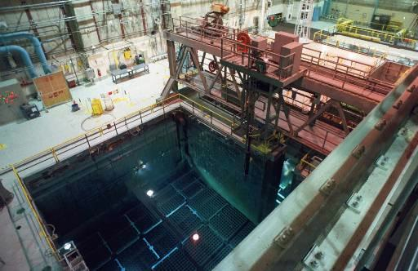
Onsite Pool Storage
The spent fuel rod pool inside the Clinton Nuclear Power Plant in Clinton, Ill., is shown on Tuesday, Nov. 19, 1996. The water in the pool acts as a shield against radiation from the used uranium rods. The reactor was shut down due to an equipment malfunction Sept. 5, 1996. (AP Photo/Mark Cowan)
Notes:
Spent fuel rods are full of radioactive fission products and are a form of high level wastes. They will stay thermally hot as well as radioactive for thousands of years. Currently they are mostly stored on site at the nuclear plant in pools adjacent to the reactor itself. Onsite storage of this material is a growing problem because the storage pools are become crowded. Onsite storage of these very dangerous materials is not considered to be a viable long-term solution.

Slide 22
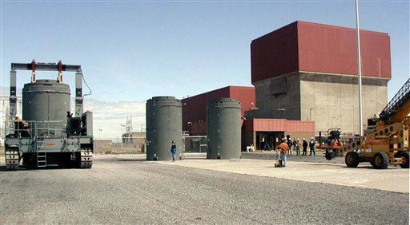
Dry Cask Storage
In this photo released by Holtec International, dry cask storage units are seen at the James A. Fitzpatrick nuclear power plant in Scriba, N.Y., in this undated photo. The Vermont Public Service Board approved "dry cask storage," of spent nuclear fuel at Vermont Yankee, lifting the threat that running out of room in its existing spent fuel storage pool would cause the plant to close by 2008.(AP Photo/Holtec International)
Notes:
Like storage pools, dry cask storage uses temporary storage containers on site near the nuclear reactor. Dry casks have been introduced because of pool storage crowding.

Slide 23
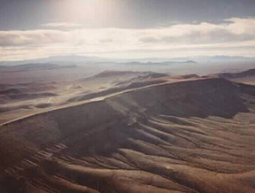
Long-Term Storage
Notes:
High level wastes include radioactive materials with long half-lives. They can be dangerous for more than 10,000 years. A long term storage site has been proposed and extensively studied by the department of energy (DOE) near Yucca Mountain, Nevada. The site was selected and studied because the site is geologically inactive and might be a safe site for long term storage of dangerous wastes. This site is still controversial and has not yet been approved. If it were approved, it would still not be adequate in size for all the reactor waste that is accumulating. No solution to the long-term problem of nuclear waste storage has been agreed upon the government, the nuclear industry, and the general public.

Slide 24
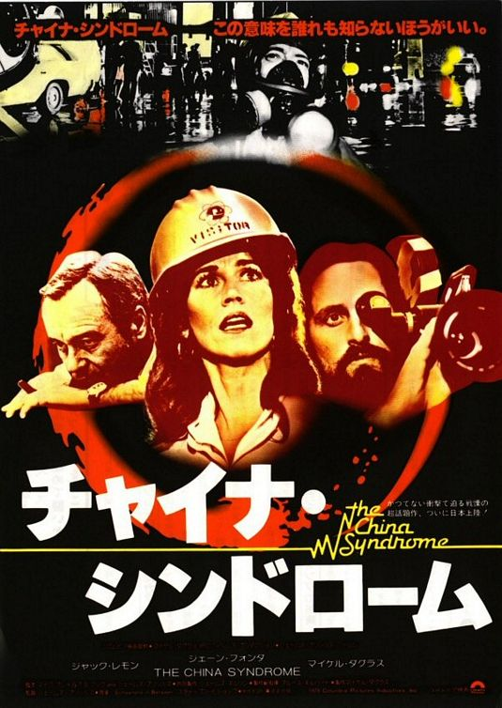
Nuclear Accidents
Notes:
We will take a brief look at some of the problems related to using nuclear power to generate electricity. This slide shows the Three Mile Island nuclear power plant in Pennsylvania. In 1979 there was a potentially serious accident at this plant. The water supply to the reactor vessel, the “core”, failed and the core overheated. The excess heat caused the core to partially melt. This could have been the beginning of a nuclear “meltdown” where the core would fully melt, resulting in an explosion, and a catastrophic release of deadly radiation along the highly populated eastern seaboard. This meltdown did not happen and no radiation was released to the environment, but many people saw this as a close call. This accident decreased public acceptance of nuclear power.

Slide 25
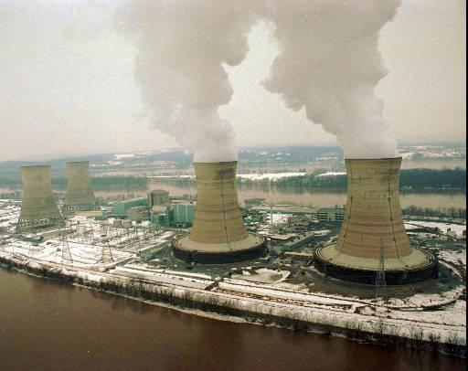
Three Mile Island (1979)
Three Mile Island nuclear power plant is pictured in Jan. 21, 1996. This is the site of the 1979 partial core melt. (AP Photo/Tim Shaffer, files)
Notes:
We will take a brief look at some of the problems related to using nuclear power to generate electricity. This slide shows the Three Mile Island nuclear power plant in Pennsylvania. In 1979 there was a potentially serious accident at this plant. The water supply to the reactor vessel, the “core”, failed and the core overheated. The excess heat caused the core to partially melt. This could have been the beginning of a nuclear “meltdown” where the core would fully melt, resulting in an explosion, and a catastrophic release of deadly radiation along the highly populated eastern seaboard. This meltdown did not happen and no radiation was released to the environment, but many people saw this as a close call. This accident decreased public acceptance of nuclear power.

Slide 26
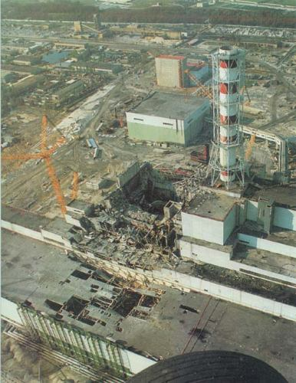
Chernobyl (1986)
Notes:
Although the 1979 partial core melt at Three Mile Island, Pa., frightened Americans, the 1986 explosion, fire, and radiation release at Chernobyl in the Ukraine was a much more serious accident. No radiation was released in the Three Mile Island accident, but the Chernobyl accident released a large amount of radiation into the atmosphere and caused contamination and very serious health effects across Europe. These accidents decreased public acceptance of nuclear power in the US.

Slide 27
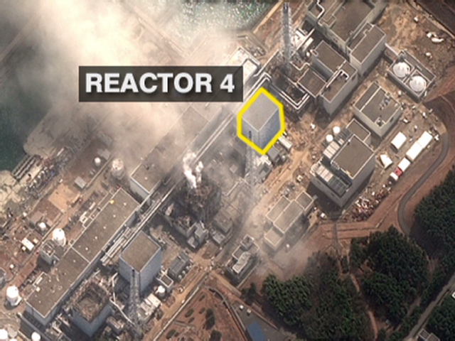
Japan (2011)
Notes:
Although the 1979 partial core melt at Three Mile Island, Pa., frightened Americans, the 1986 explosion, fire, and radiation release at Chernobyl in the Ukraine was a much more serious accident. No radiation was released in the Three Mile Island accident, but the Chernobyl accident released a large amount of radiation into the atmosphere and caused contamination and very serious health effects across Europe. These accidents decreased public acceptance of nuclear power in the US.

Slide 28
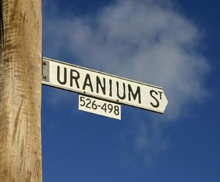
Nuclear Future?
Notes:
The future of nuclear power in the US and globally is uncertain. The nuclear power industry argues that nuclear power is more practical than solar and wind power and is environmentally benign. Environmentalists and others do not think nuclear is a practical and safe future option.

Slide 29
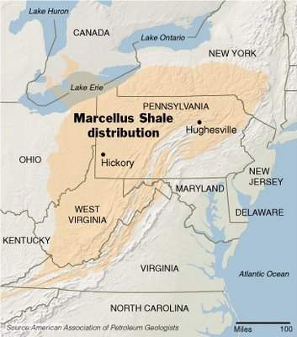
Shale Gas
Notes:
The future of nuclear power in the US and globally is uncertain. The nuclear power industry argues that nuclear power is more practical than solar and wind power and is environmentally benign. Environmentalists and others do not think nuclear is a practical and safe future option.

Slide 30
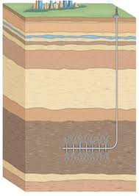
Horizontal Drilling
Notes:
The future of nuclear power in the US and globally is uncertain. The nuclear power industry argues that nuclear power is more practical than solar and wind power and is environmentally benign. Environmentalists and others do not think nuclear is a practical and safe future option.

Slide 31
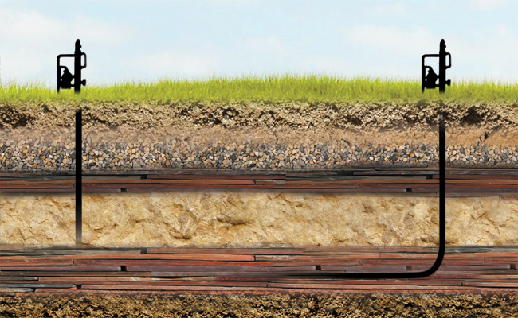
Hydrofracturing
Notes:
The future of nuclear power in the US and globally is uncertain. The nuclear power industry argues that nuclear power is more practical than solar and wind power and is environmentally benign. Environmentalists and others do not think nuclear is a practical and safe future option.

Slide 32
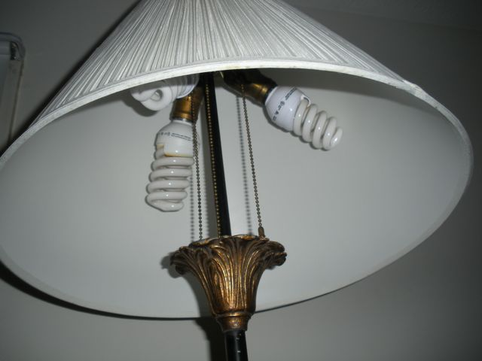
Efficiency and conservation

Slide 33
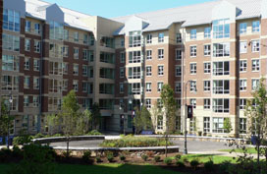
High Performance Buildings

Slide 34
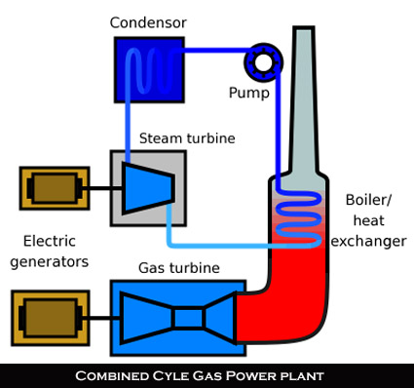
Efficient Power Plants

Slide 35
Economic Incentives
Cap and Trade
Carbon Tax
Tax Credits
Rebates

Slide 36
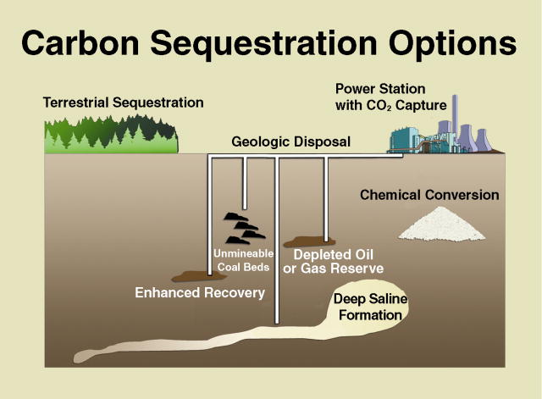
Carbon Sequestration

Slide 37
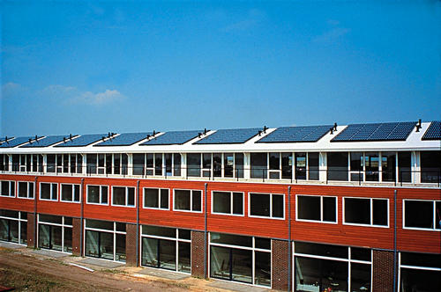
Rooftop PV
Notes:
The world's largest residential PV project. The system produces over 180 kW in this 500 home development -- 2.7 kW systems on 32 pitched roofed houses and 3.06 kW systems on 32 flat roofed houses in Amersfoort, Netherlands. The capacity of one of the systems is 2.7 kW. This is the power that system produces under peak conditions: 1000 W/square meter solar intensity.
NREL PIX number 08859

Slide 38
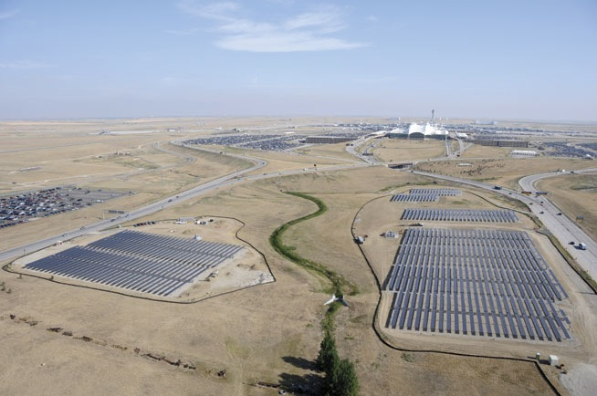
PV: Denver Airport 4 MW
Notes:
This array for a commercial building with a flat roof uses a rack to tilt the array up at a tilt angle equal to latitude to get maximum annual output power.

Slide 39
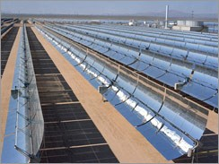
CSP: Parabolic Trough
Notes:
The parabolic through CSP is the most commonly used CSP design. These systems typically have capacity factor equal to 40%,

Slide 40
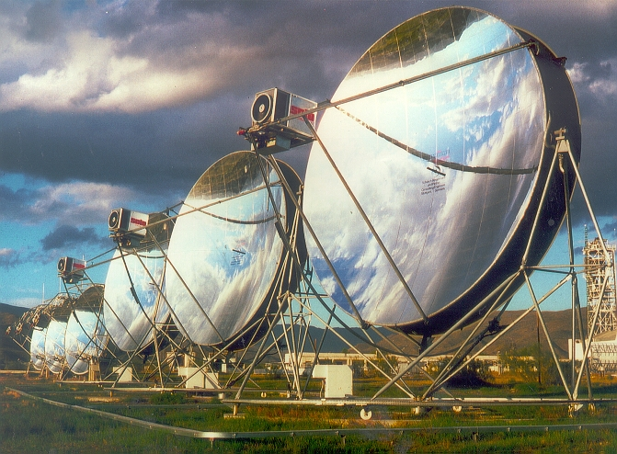
CSP: Dish Engines
Notes:
Dish engines use a parabolic dish to focus light onto a point. These systems must track the sun on two axes like a telescope. A heat engine ( a Stirling Engine) is located at the focal point of the the dish and produces electricity directly. These systems have higher concentration and produce higher temperatures than trough collectors. The Stirling engine uses a thermodynamic cycle, but does not use steam to produce electricity.

Slide 41
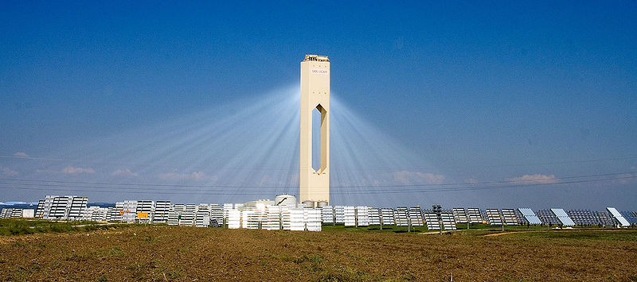
CSP: Power Tower
Notes:
A Power tower like this one in Spain uses flat mirrors called heliostats to concentrate sunlight onto a tower. Because it uses a central tower, the energy can be stored in the working fluid (e.g. molten salt) and used after sunset. Because this design allows energy to be saved for later in the day, this kind of system can have a capacity factor above 70%, These systems may provide the cheapest form of CSP electricty.

Slide 42
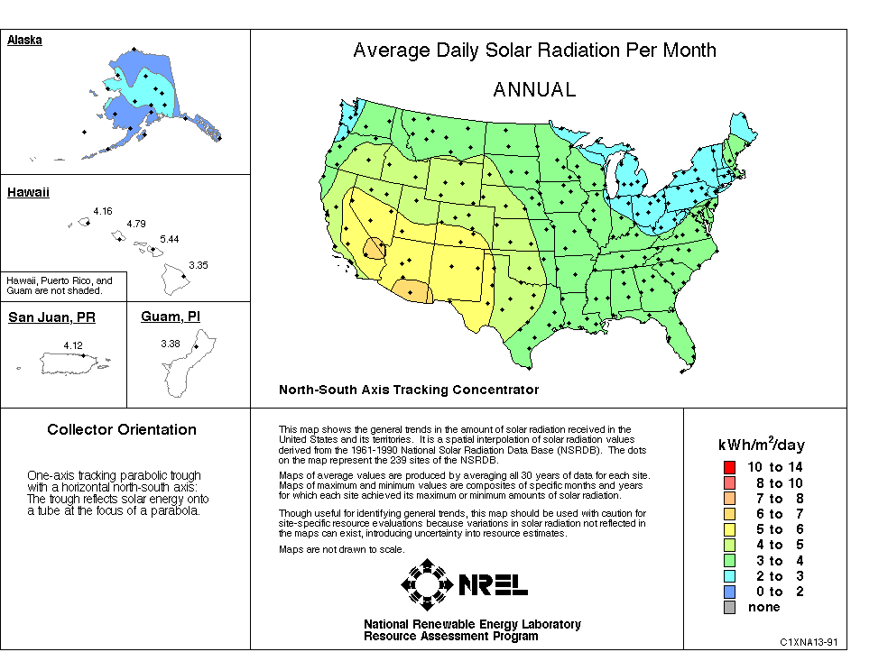
Notes:
Desert SW is best for this technology.

Slide 43
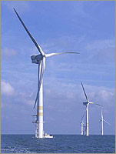
GE 3.6 MW Wind Turbines
Notes:
Blade Length is 175 feet, Hub height is 250 ft, tip of lower blade is 75 ft above surface, tip of top blade is 425 ft off surface, and the diameter of the tower base is 16 feet.

Slide 44
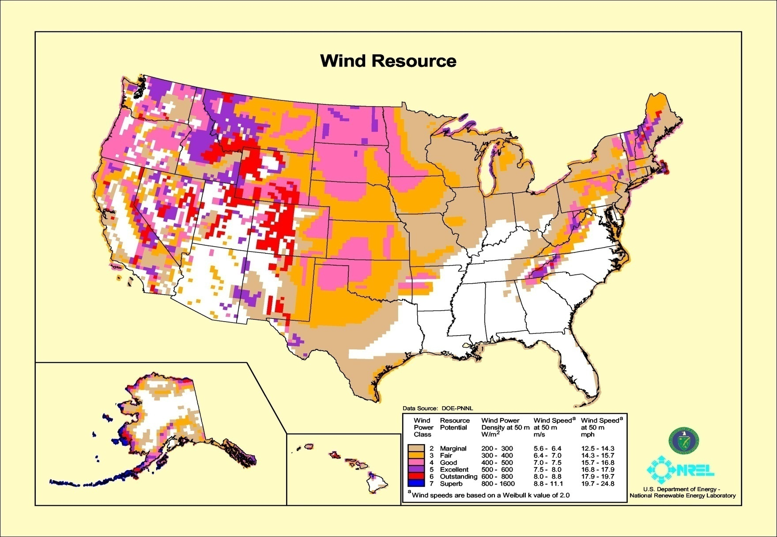
Wind Resources
http://attra.ncat.org/images/renewables/windResourceMap2.jpg,,Retrieved on 2/11/2009
Notes:
As indicated by the national map, good wind resources are not uniformly available in all parts of the US. Mountain and coastal regions are generally very good. The largest region of excellent wind resources are the great plains from Texas to North Dakota. The regions with the poorest wind resources are the southeast and the desert southwest.

Slide 45
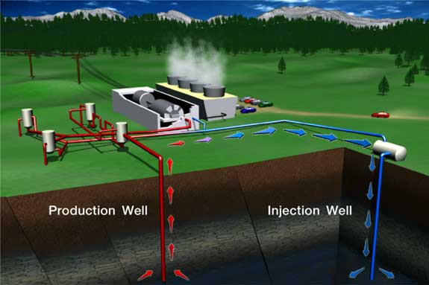
Geothermal Power Plant
Notes:
Natural steam from the production wells power the turbine generator. The steam is condensed by evaporation in the cooling tower and pumped down an injection well to sustain production.

Slide 46
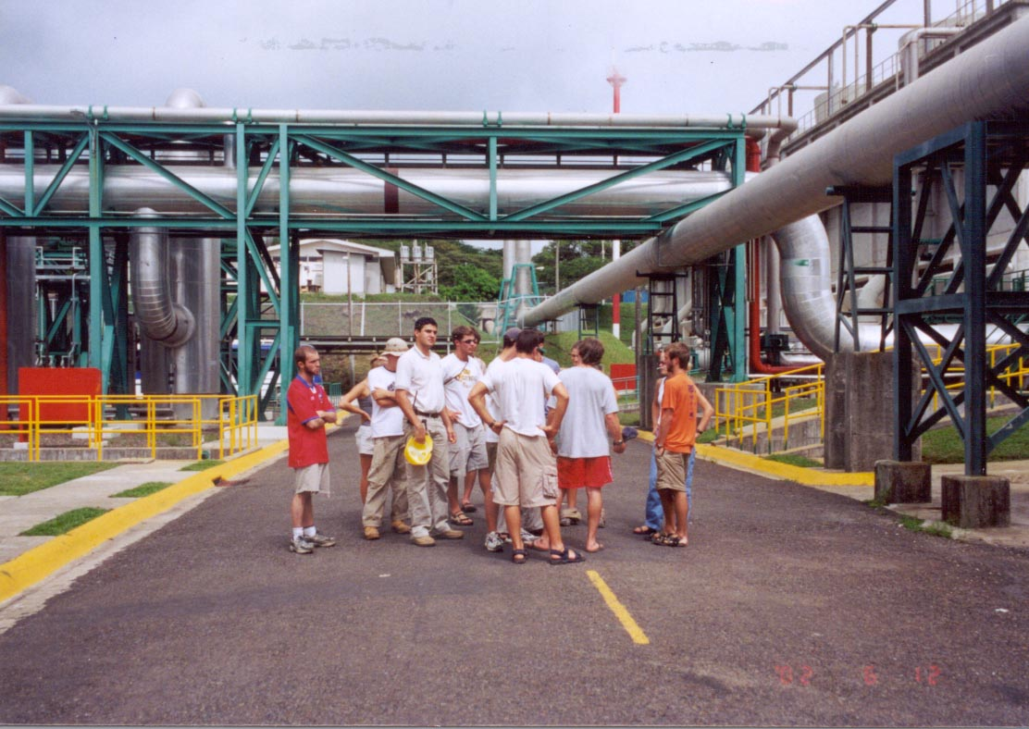
Electricity Generation
Notes:
Mile-or-more-deep wells can be drilled into underground reservoirs to tap steam and very hot water that drive turbines that drive electricity generators. An important resource for Costa Rica, Iceland and several other countries. This is a picture (taken by FL) of a geothermal power plant in Costa Rica.

Slide 47
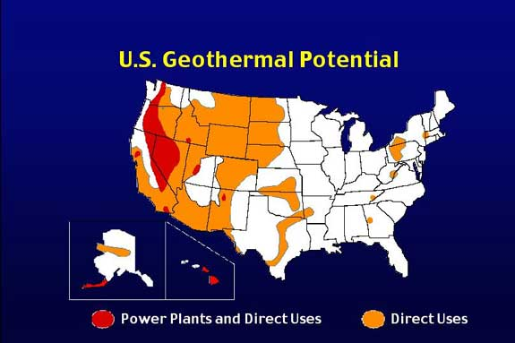
Geothermal Energy Distribution
Notes:
US geothermal resources are concentrated in the west, Hawaii, and Alaska.
Geothermal electric capacity in US is about 3.2 GW and 10 GW direct
Globally geothermal electric capacity is about 10 GW and 100 GW direct.

Slide 48
Selection Parameters
Environmental Impact
Cost
Safety
Footprint
Reliability
Acceptability
Notes:
US geothermal resources are concentrated in the west, Hawaii, and Alaska.
Geothermal electric capacity in US is about 3.2 GW and 10 GW direct
Globally geothermal electric capacity is about 10 GW and 100 GW direct.

Slide 49
Summary: Future of Energy
Must replace coal.
Natural gas, but not as clean as it seems.
Solar and Wind could supply 20%-50%, but better grid needed.
Efficiency has great potential.
Clean Coal & Geothermal -- ?
Tar sands & other fossil fuel – high environmental price
Notes:
US geothermal resources are concentrated in the west, Hawaii, and Alaska.
Geothermal electric capacity in US is about 3.2 GW and 10 GW direct
Globally geothermal electric capacity is about 10 GW and 100 GW direct.

