Slide 1
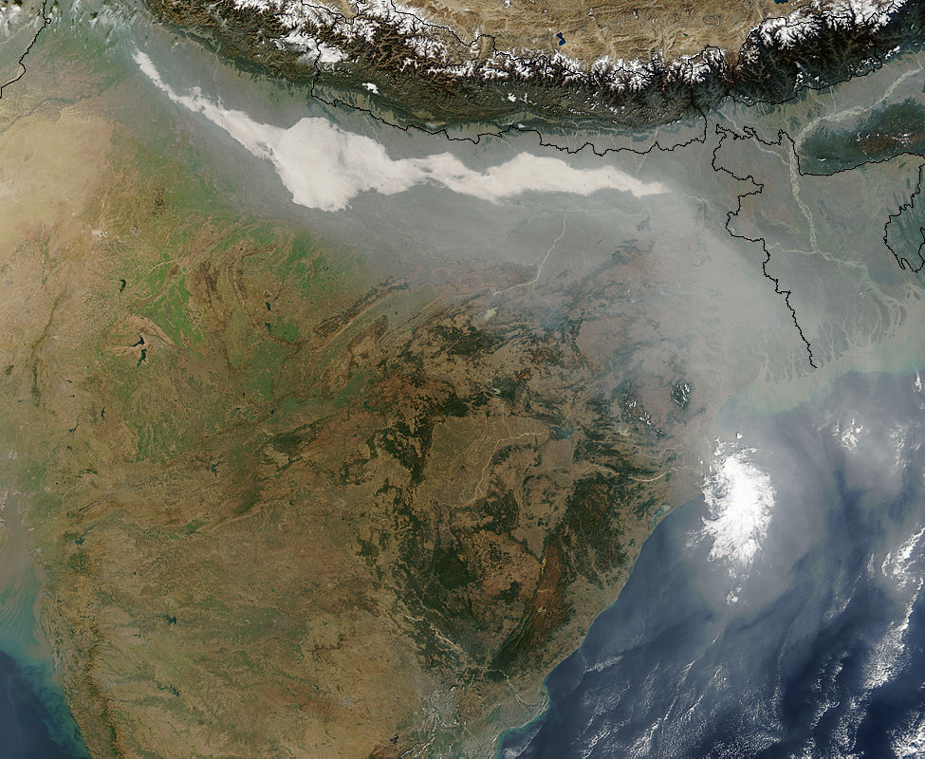
Energy and The Poor:
Black Carbon in
Developing Nations
Anne Larson Hall
Emory University
Department of Environmental Studies

Slide 2
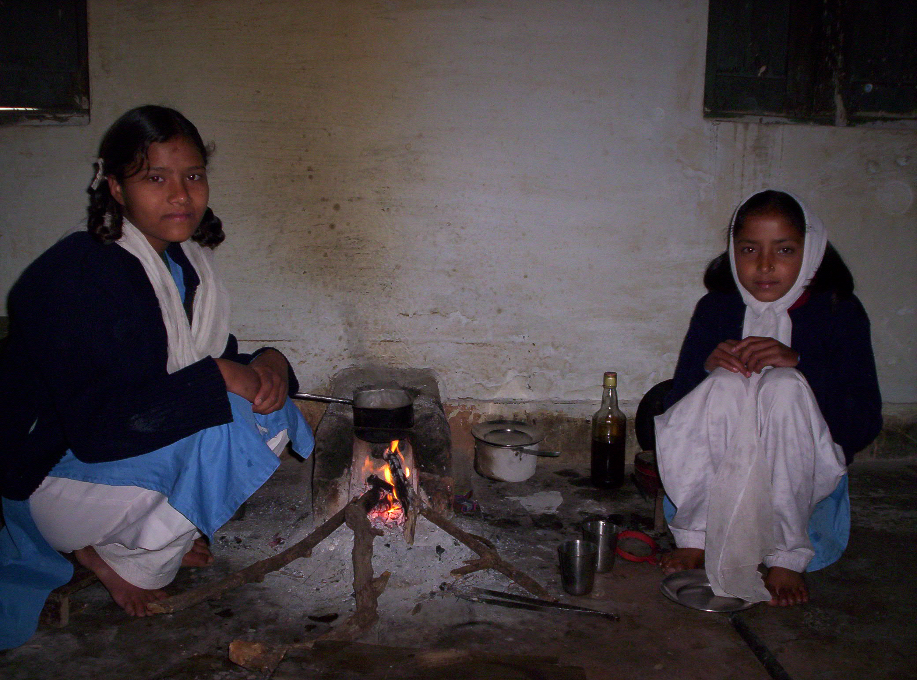
Energy and the Poor
Number of people without electricity in their homes: 1.6 billion (80% rural)
Number of people relying on traditional biomass fuels for cooking and heating: 2.4 billion
Number of people killed annually from health problems associated with open-fire cooking: nearly 2 million
Percent of total energy consumption used for domestic cooking in sub-Saharan Africa: 60%
From: Spreading the Water Wealth: Making Water Infrastructure Work for the Poor,” IRN Dams, Rivers and People Report 2006, International Rivers Network, Berkeley, CA.

Slide 3
A good introduction to the term Black Carbon is a short clip on the Earth Justice website, “Stop Soot.” Black carbon, or soot, is released when dung, charcoal, wood or diesel fuel is burned.

Slide 4
Black Carbon causes lung cancer and asthma, resulting in nearly 2 million premature deaths annually, mostly among the poor.

Slide 5
Black carbon is responsible for 25% of human-caused global warming. Soot travels thousands of miles and can settle on glaciers and on arctic snow and ice, decreasing albedo and accelerating melting. Since black carbon resides in the atmosphere for only a few weeks, its removal is the fastest way to slow global warming.

Slide 6
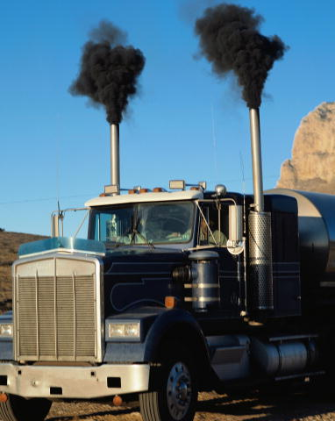
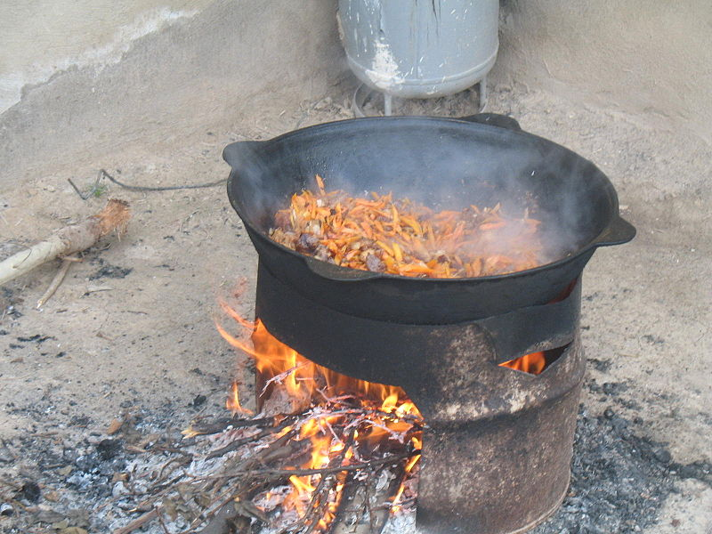
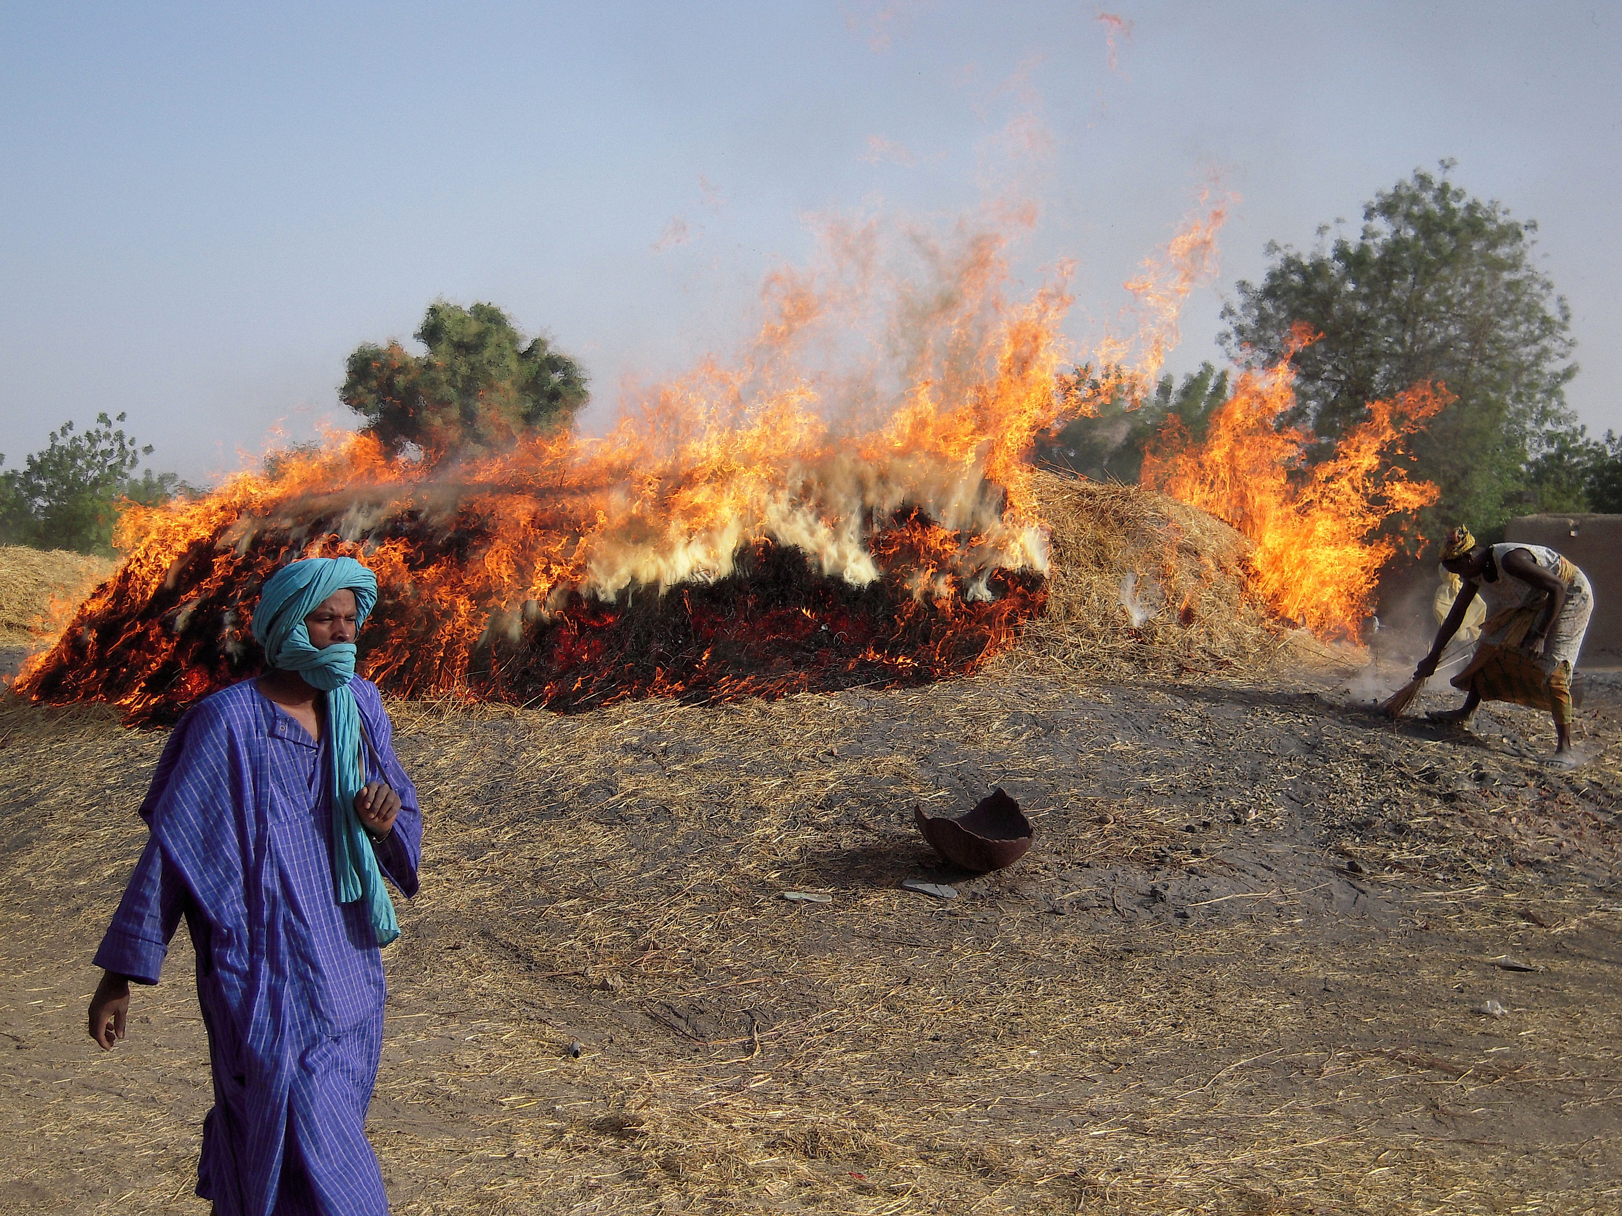
Which is the largest source of black carbon emissions globally?
A. Transportation
B. Residential
C. Open burning

Slide 7
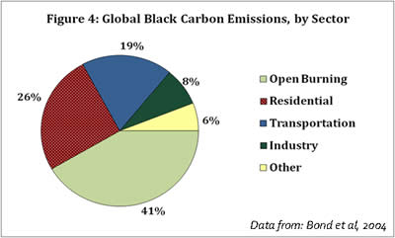

Slide 8
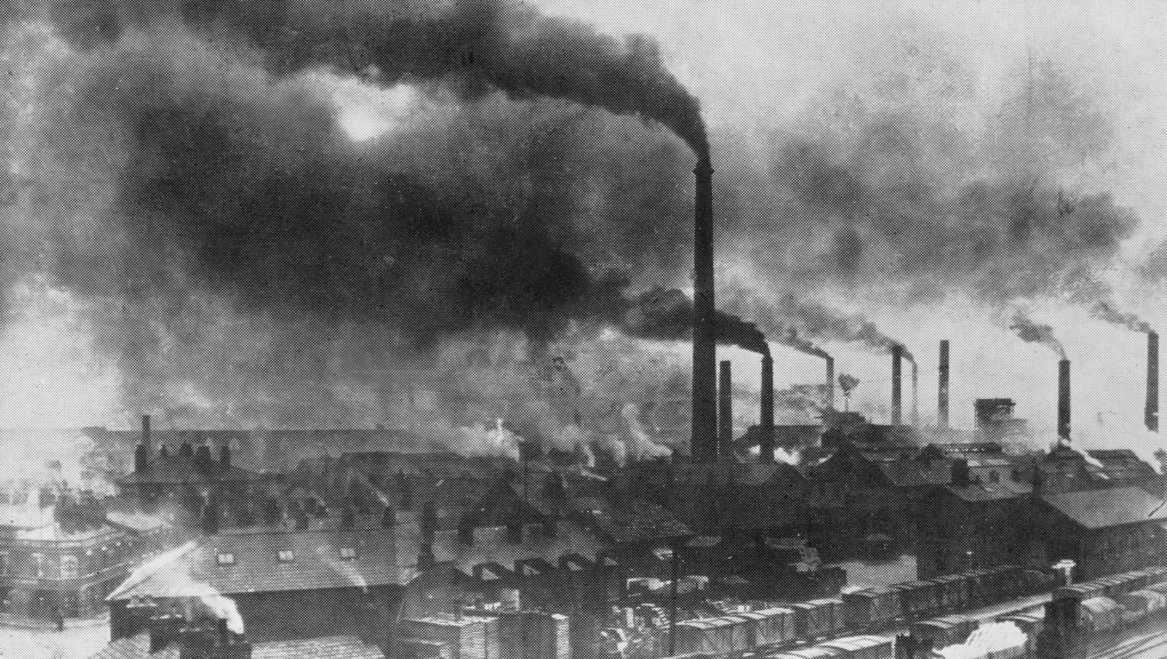
High-income nations have removed much of their black carbon through
air pollution regulations and abatement technologies.
Industrial pollution in England in the 1800s.

Slide 9
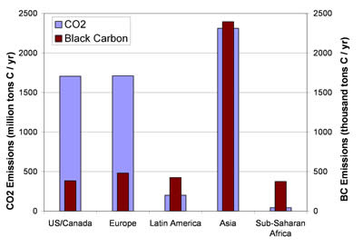
Climate Institute | www.climate.org
http://www.climate.org/publications/Climate%20Alerts/Autumn2009/ReassessingResponsibilities.html

Slide 10
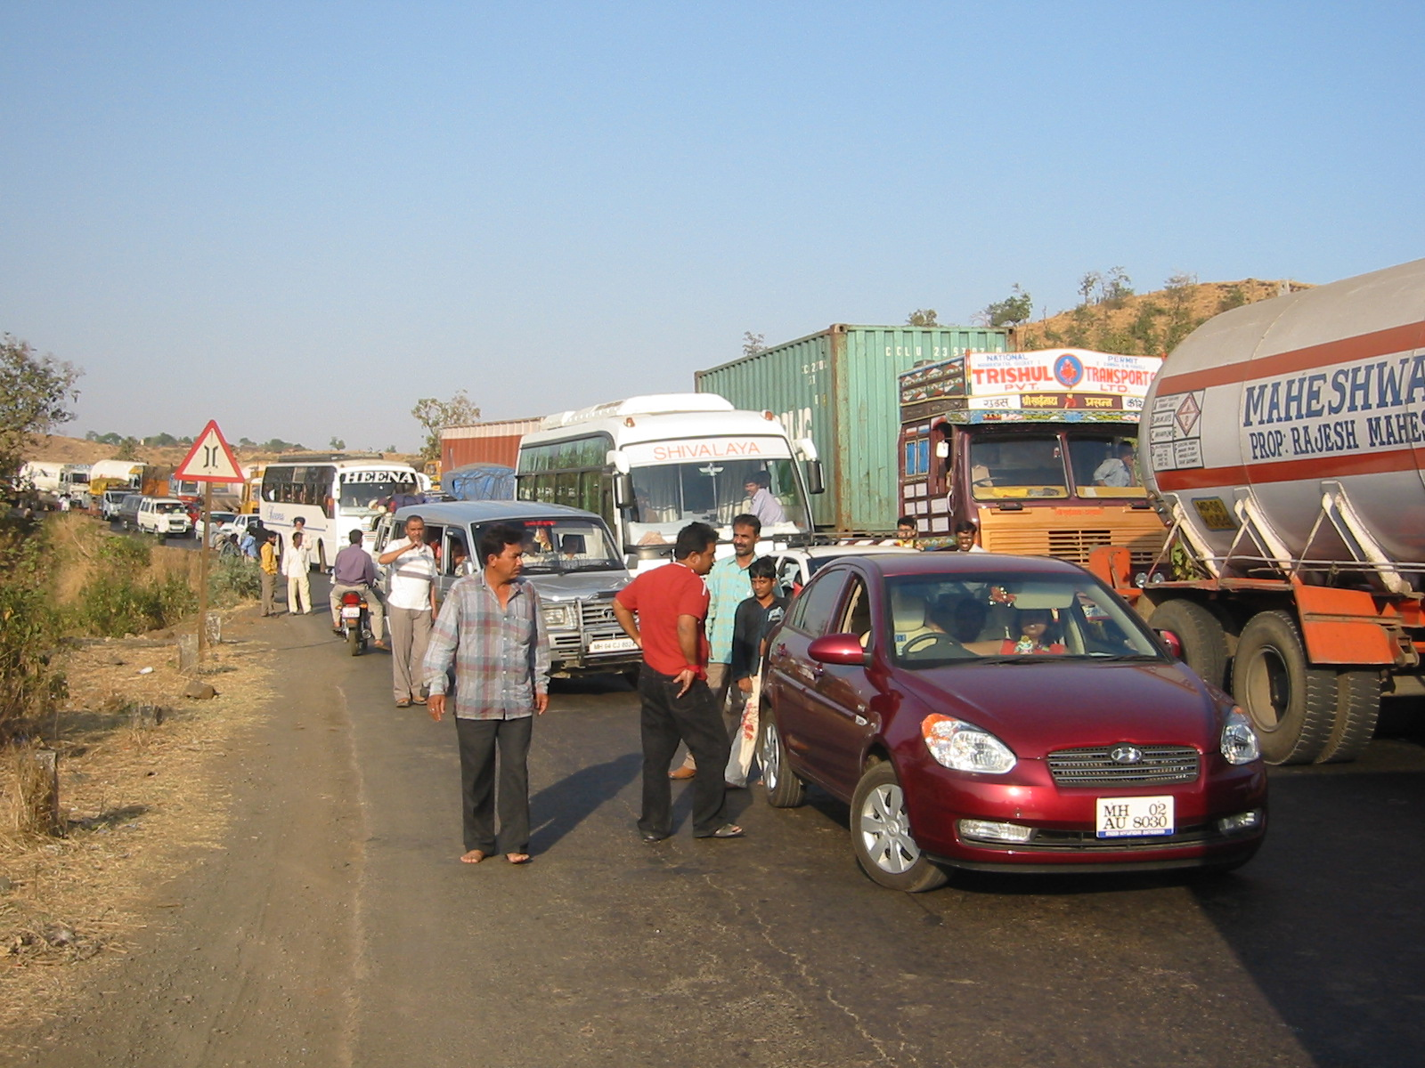
Developing nations still depend on older vehicles without pollution controls. Diesel Particulate Filters (DPFs) can reduce black carbon emission by 85-97%, but are expensive and do not work well on vehicles produced before 1994.
Climate Institute | www.climate.org
http://www.climate.org/publications/Climate%20Alerts/Autumn2009/ReassessingResponsibilities.html

Slide 11
It is difficult to make global progress on land use changes, deforestation and wild fires that contribute to the open burning source of black carbon, and it may be prohibitively expensive to address transportation-associated black carbon in developing nations. Decreasing residential black carbon may be achievable.
“About 26% of black carbon comes from the residential sector - essentially from incomplete combustion in cook stoves that burn fossil fuel and biomass. The health and climate benefits of transforming the world’s stove culture are enormous. Over 1.9 million people worldwide, roughly 85% women and children, die annually from indoor air pollution from stoves.
Technologies already exist that can make a difference at manageable costs even if applied to the roughly 780 million traditional cook- stoves across the planet: about $100 will buy a solar oven that achieves 100% black carbon reductions, and $25 buys a more efficient burner of biomass or fossil fuel that can achieve 80% reductions.
Besides saving millions of lives over the next decade and freeing women from much of the drudgery in biomass gathering, the potential climate benefits are startling. Eliminating all black carbon emissions from cook stoves over 20 years would be roughly equivalent to changing every car and light truck on Earth to a zero carbon dioxide emitter”.
Climate Institute | www.climate.org
http://www.climate.org/publications/Climate%20Alerts/Autumn2009/ReassessingResponsibilities.html

Slide 12
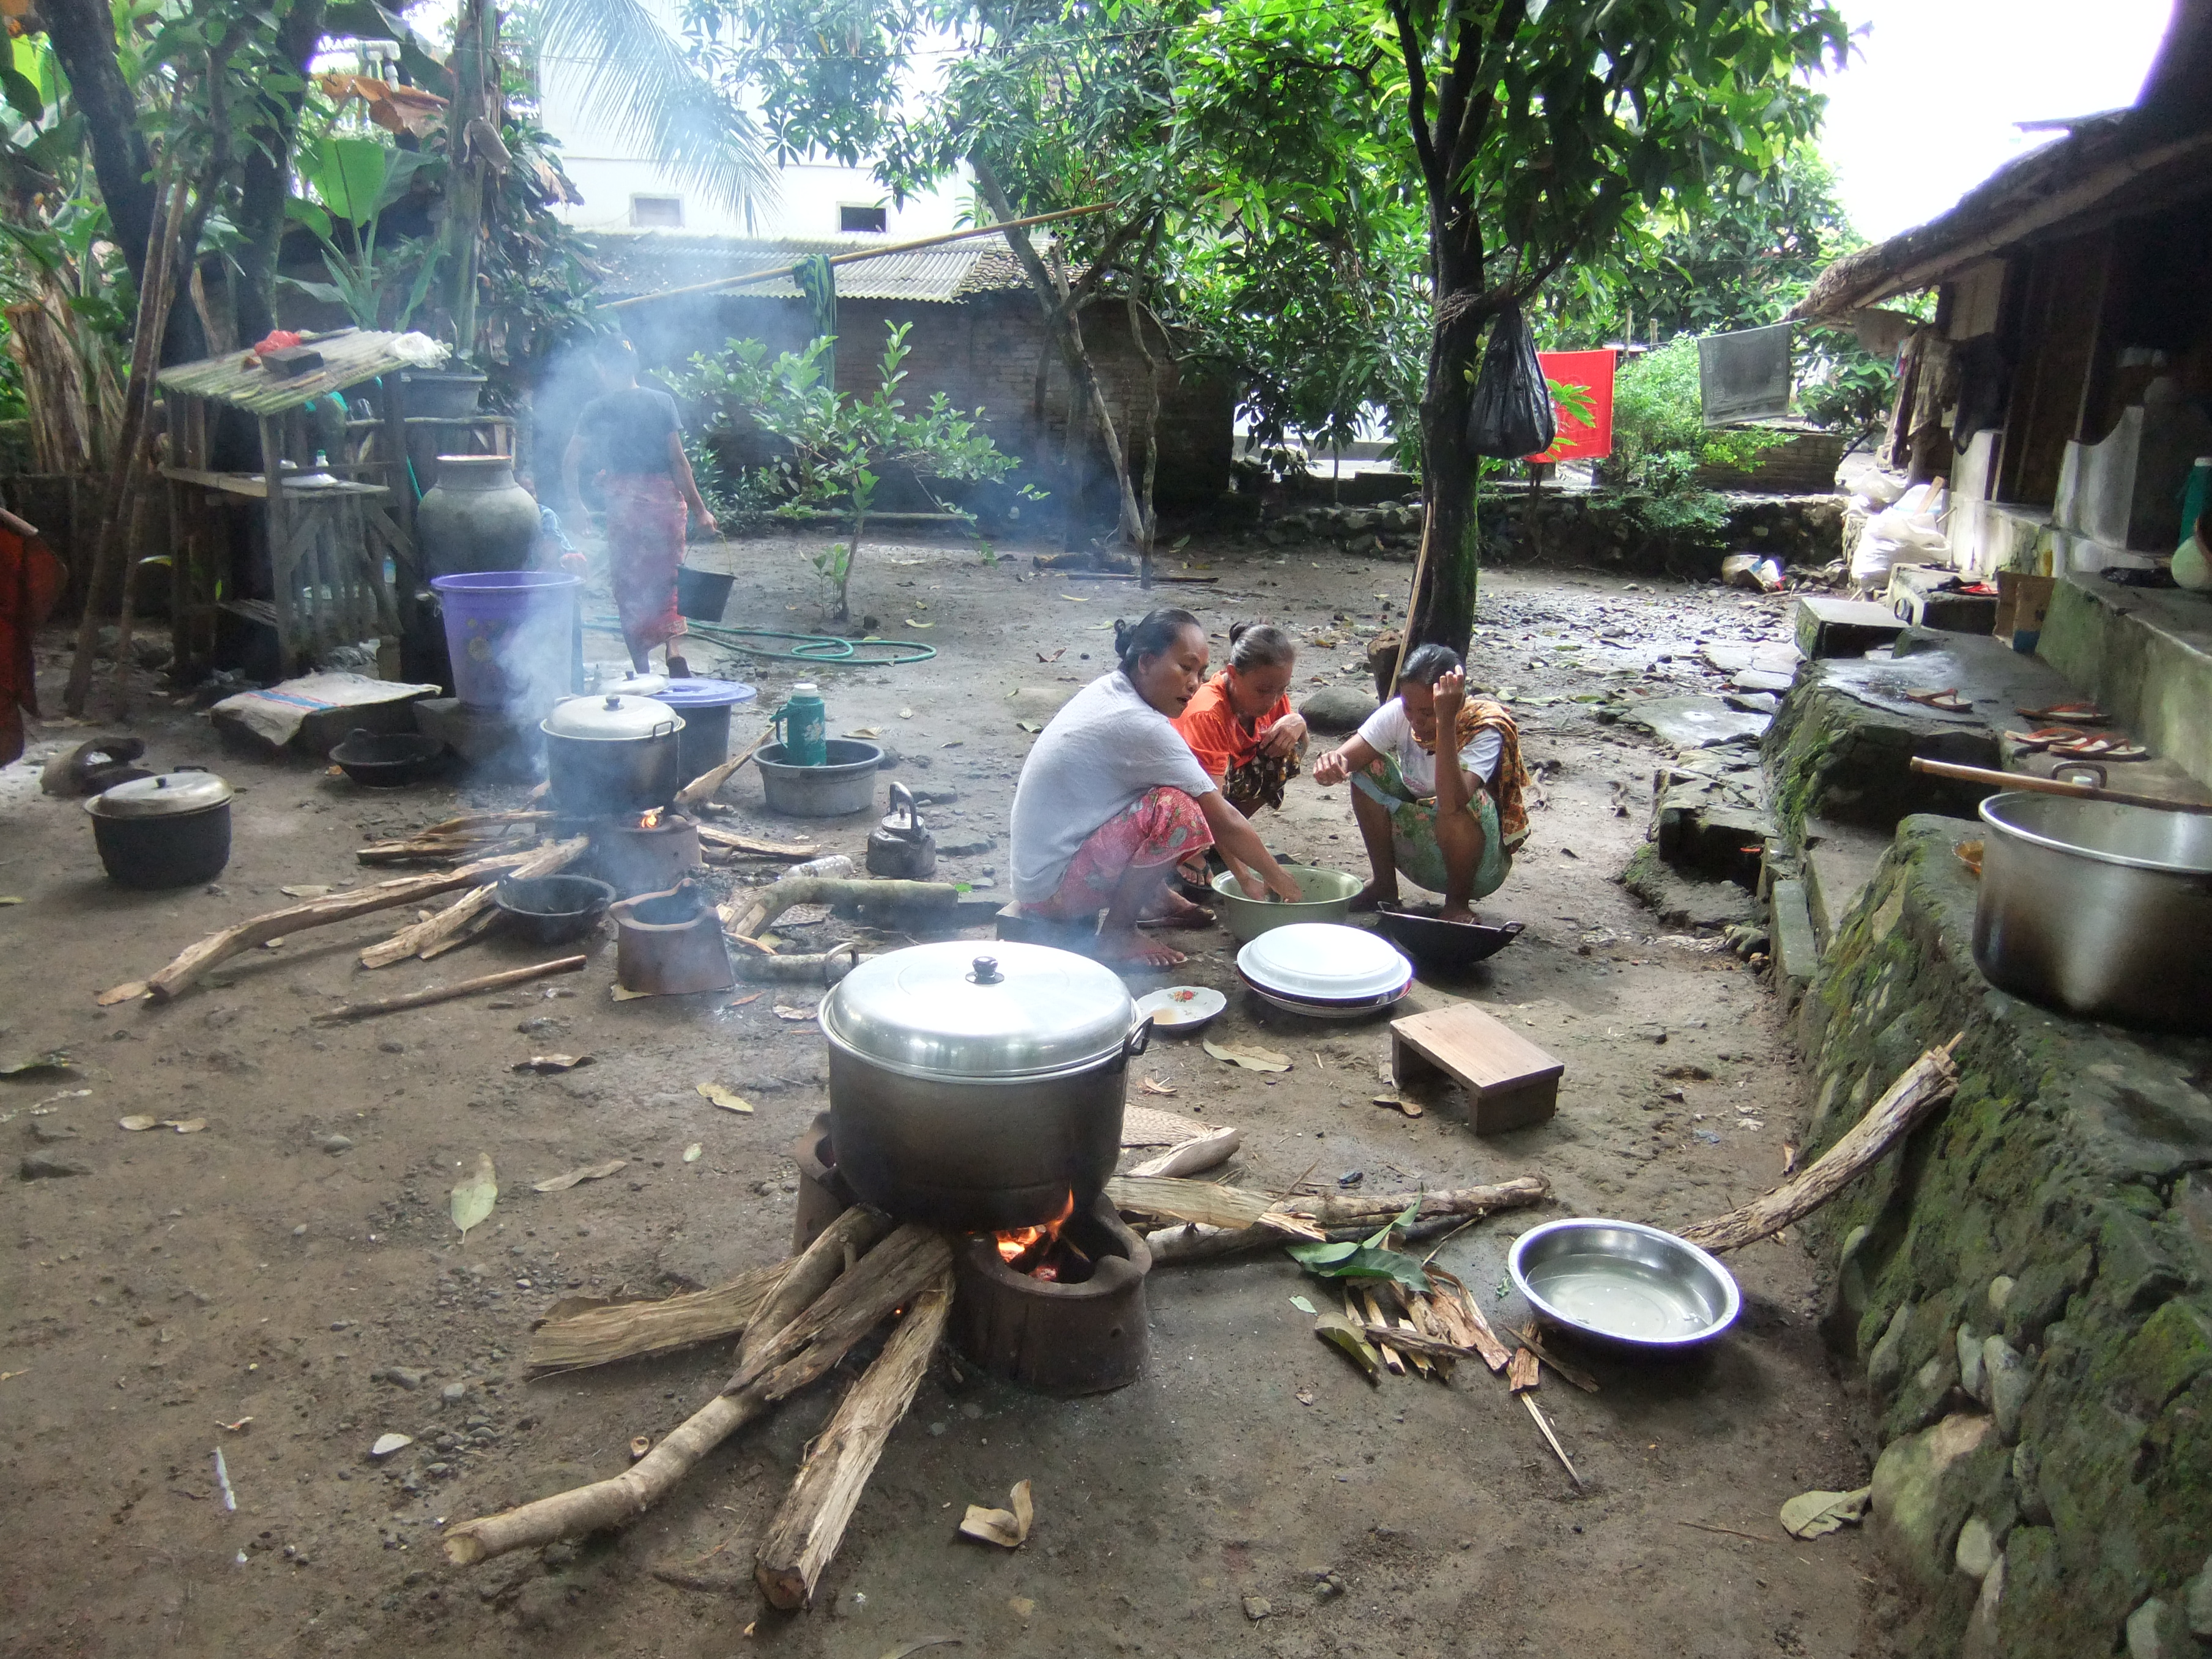
“There is a huge win-win potential
if we can
get this right”.

Slide 13
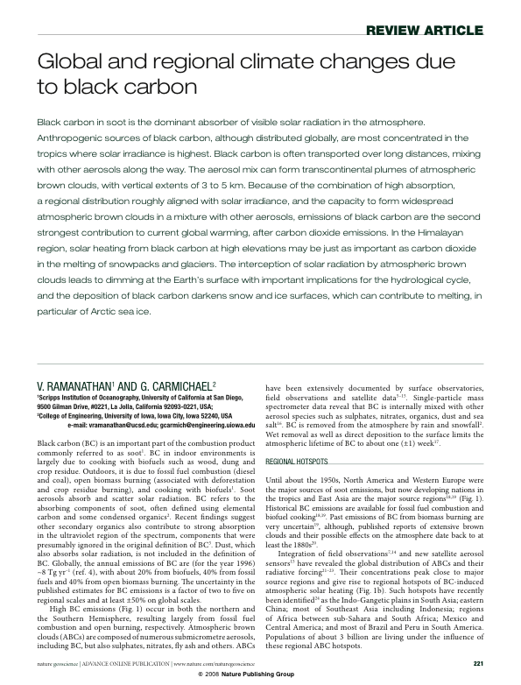

Slide 14
“In March 2008, Ramanathan and Carmichael published an article indicating that black carbon, a key component of
soot from incomplete combustion of fossil fuels and biomass, plays a very powerful role in the radiative forcing driving the climate change that we are now experiencing. Refining the calculations used by the IPCC in its Fourth Assessment Report published in early 2007, they estimated that the warming caused by atmospheric black carbon between 2000-2003 was equivalent to 55% of the warming caused by atmospheric CO₂ over the same period. Even 55% may underestimate black carbon’s total effect, as it does not allow for the changed albedo
from deposition of black carbon on Himalayan, Andean and other glaciers and on snow and ice across the planet”.
Climate Institute | www.climate.org
http://www.climate.org/publications/Climate%20Alerts/Autumn2009/ReassessingResponsibilities.html

Slide 15
Impact of California’s Air Pollution Laws on Black Carbon:
Implications for Mitigation of Global Warming ~ Veerabhadran Ramanathan
AGU Press Conference, Tuesday, December 14, 2010 http://www.youtube.com/watch?v=26hFtnpggSk&feature=related

Slide 16
Global Monitoring of Black Carbon Network Using Mobile Phones
Nithya Ramanathan
AGU Press Conference, Tuesday, December 14, 2010 http://www.youtube.com/watch?v=26hFtnpggSk&feature=related

Slide 19
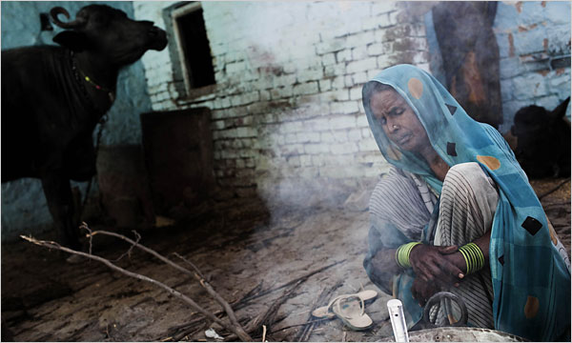
Black Carbon Assignment
1. Students will read through the New York Times article. As they read, students will note the many impacts of the use of wood, dung and charcoal as household fuel in developing countries, and will generate a list of references quoted in the article. These references will be a good starting point in learning more about their topics.
2. When the class comes back together, a list of topics and questions related to the impacts of black carbon is compiled.
“Third World Soot is Target in Climate Fight” by Elizabeth Rosenthal
http://www.nytimes.com/2009/04/16/science/earth/16degrees.html

Slide 20
Black Carbon Assignment
A list of some of the types of questions generated:
What is the role of black carbon in global climate change?
How does soot deposition affect snow and ice? Will it change the timing and amount of water available?
How will changing water availability affect agriculture and food production?
What is the impact of black carbon on freshwater ecosystems?
How does black carbon affect respiratory health?
What governmental policy and legislation can help reduce black carbon?
What new technologies are being developed for cook stoves?
What are the social and environmental impacts of wood gathering?
First single topic-group:
All of the students in the first group research the same black carbon-related topic, gathering and synthesizing information. Each student generates their own individual notes on this topic, in greater detail and depth than the original New York Times article.
This is a good opportunity to discuss search engines, reliable web resources and library resources at your university.

Slide 21
4. Second multi-topic group:
Students form new groups, with each new group having one member from each of the first single-topic groups. As a multi-topic group, the students generate a concept map illustrating the wide-ranging topics and questions related to black carbon generating fuels. A very broad example is given below.
A group-written paper is completed synthesizing the students’ findings, hopefully presenting some solutions. This paper should go beyond the bounds of the original New York Times article, not simply restate it.

Slide 22
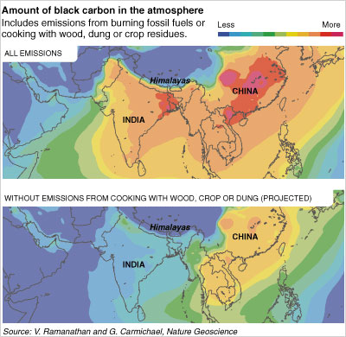
Posted with New York Times Article

Slide 23
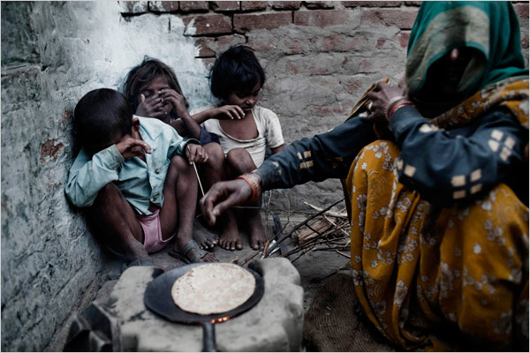
Family Cooking in Kohlua, India
Adam Ferguson for The New York Times

Slide 24
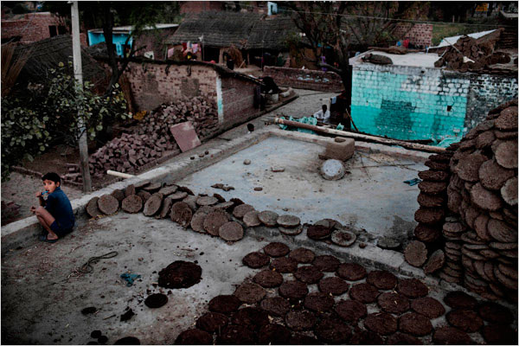
Stacks of Dung Cakes Used For Cooking Fuel in Kohlua, India Adam Ferguson for The New York Times

Slide 25
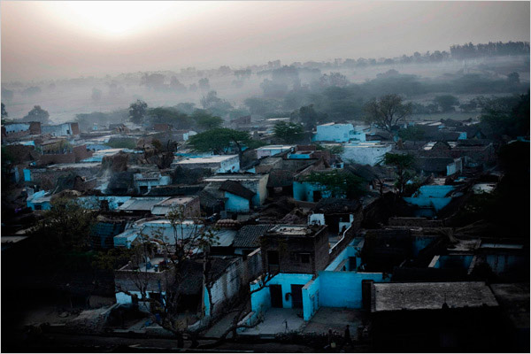
Early Morning Cooking Fires Across Pipal Kheda, India
Adam Ferguson for The New York Times

Slide 26
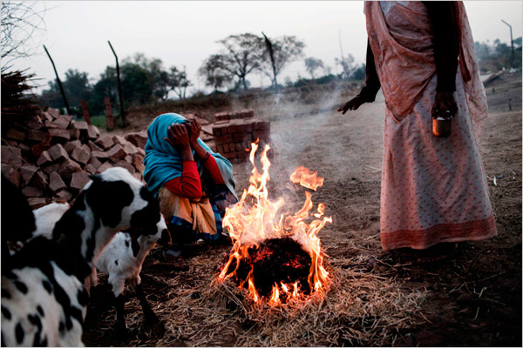
Burning Dung Cake in Kolhua, India
Adam Ferguson for The New York Times

Slide 27
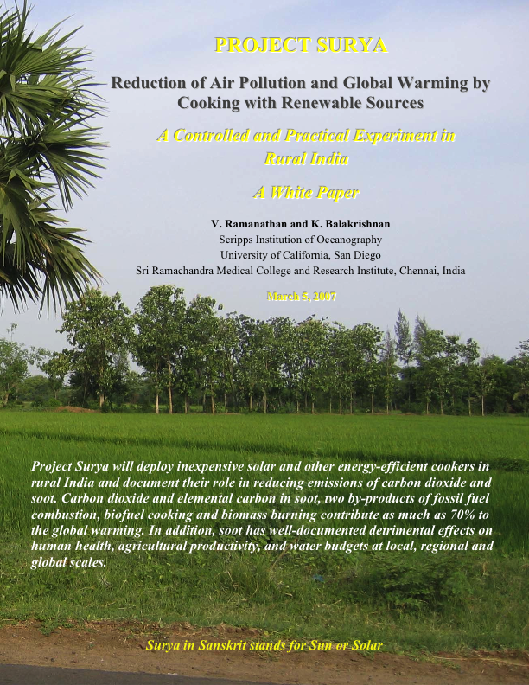

Slide 28
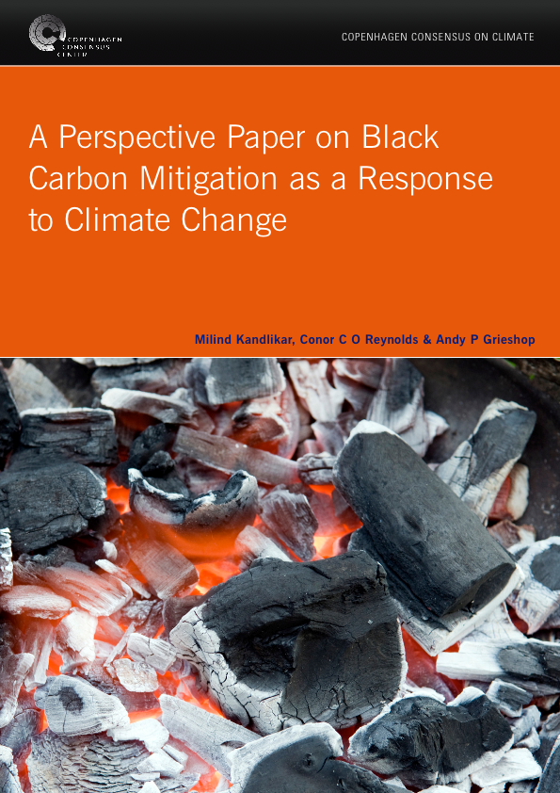

Slide 29
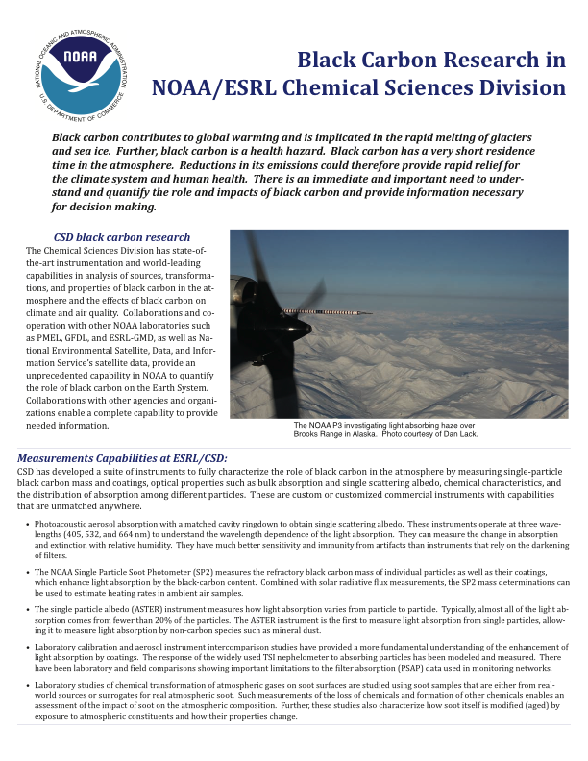

Slide 30


Slide 31
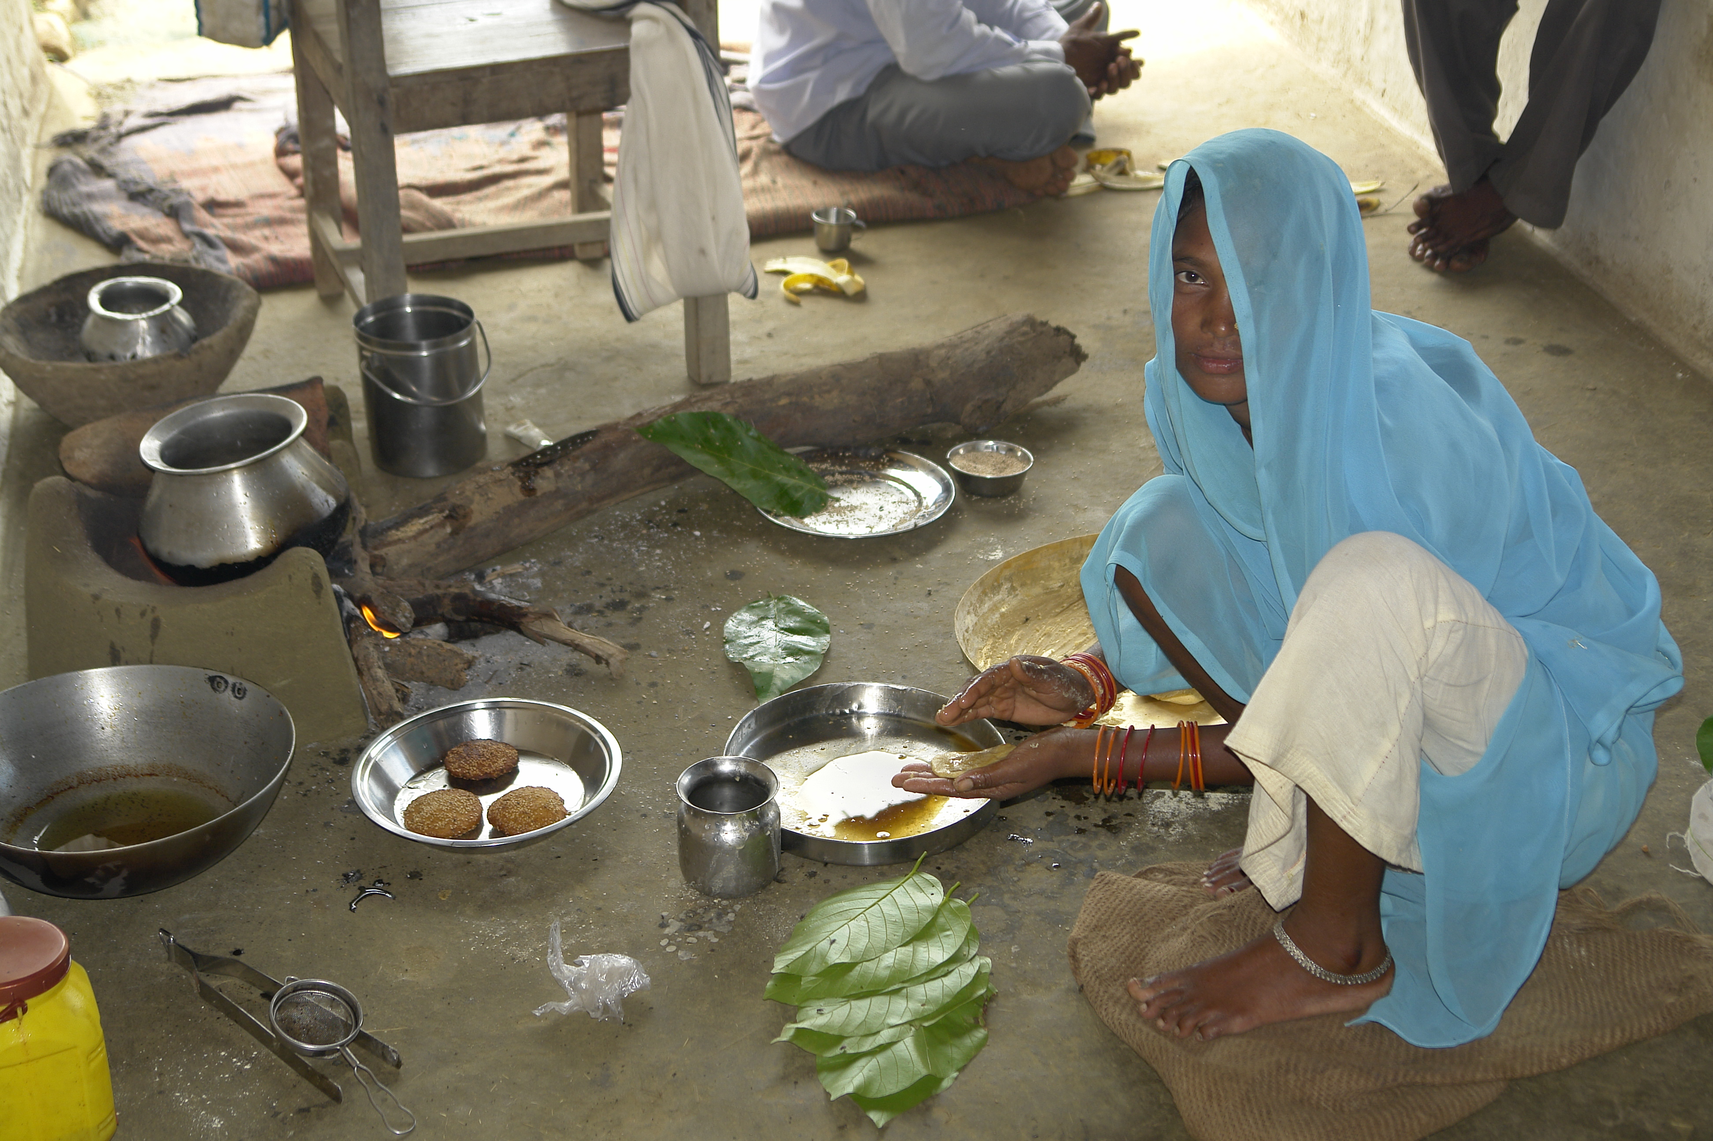
Higher-income nations will need to commit to substantial reductions of all greenhouse gases. Can low or middle-income nations work to reduce black carbon and other short-lived greenhouse gases that they emit in greater proportion?
The common but differentiated responsibility (CBDR) principle supports mitigation sharing among nations. Is it fair to expect developing nations to bear this burden ?

Slide 32
Photos from the New York Times article and Wikipedia Commons.
References are included in the PowerPoint slides. Additional references
are given on the Instructor’s Notes at the SERC website (will be updated).
http://serc.carleton.edu/NAGTWorkshops/energy/activities/32421.html
Anne Larson Hall
ahall04@emory.edu

