Slide 1


Slide 2
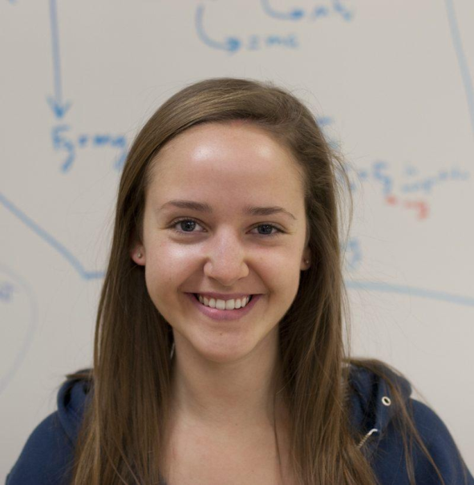
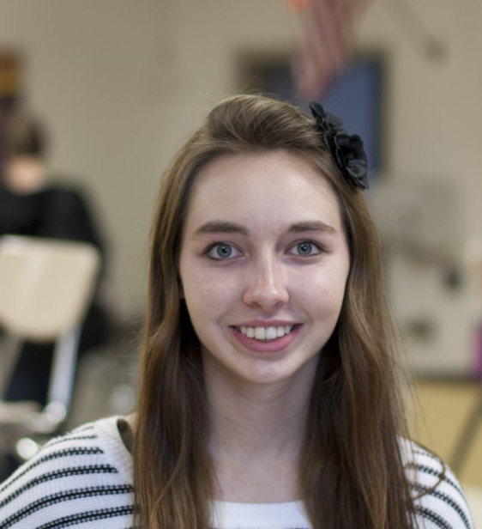
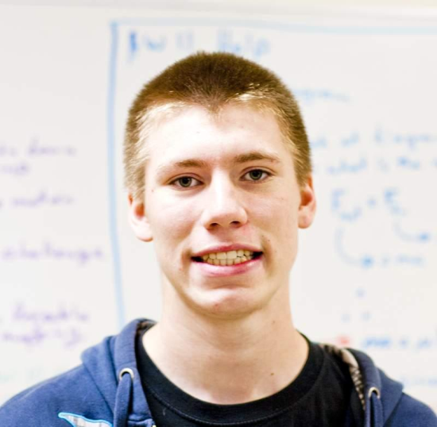
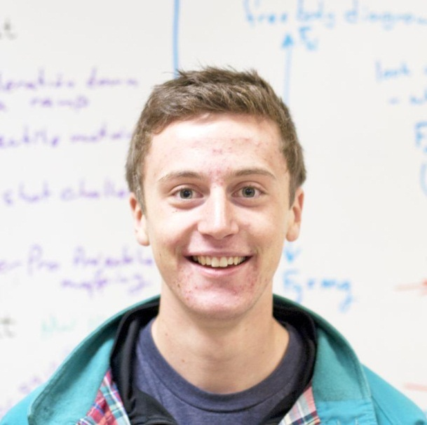
Georgia Schmitt
Cassie Severson
Cale Cook
Michael Stockton

Slide 3


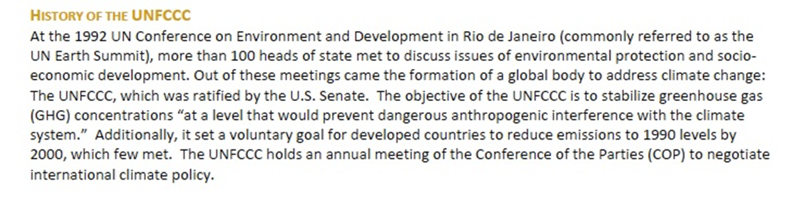
UNFCCC
SBSTA
Subsidiary Body for Science and Technology Advice
COP
SBI
Conference of the Parties
Subsidiary Body for Implementation

Slide 4









Slide 5
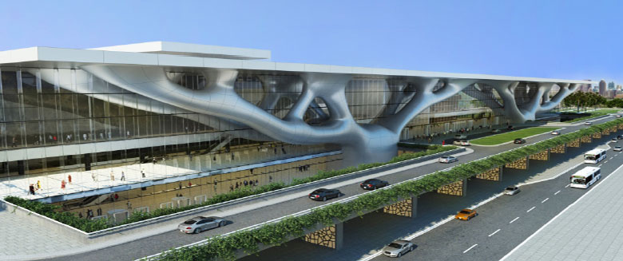
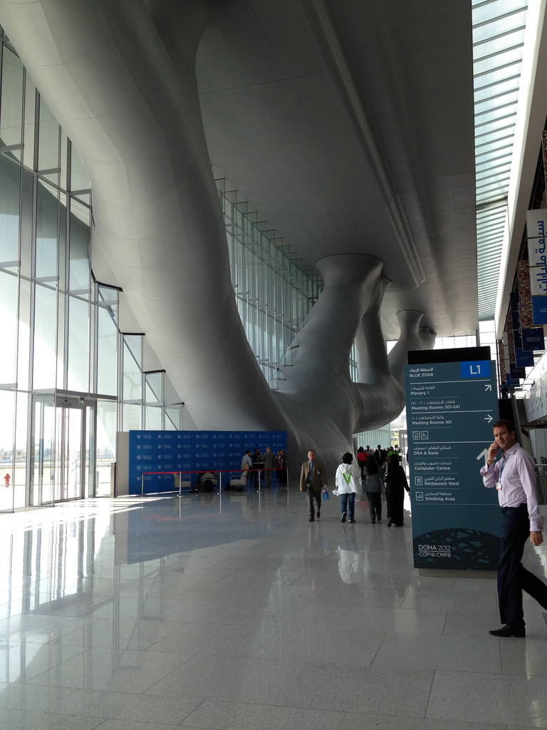
Qatar National Conference Centre

Slide 6
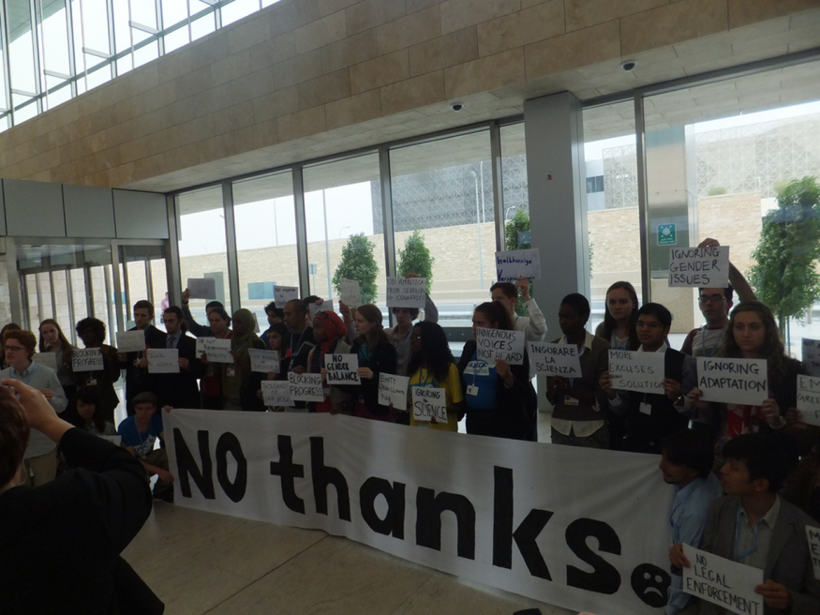
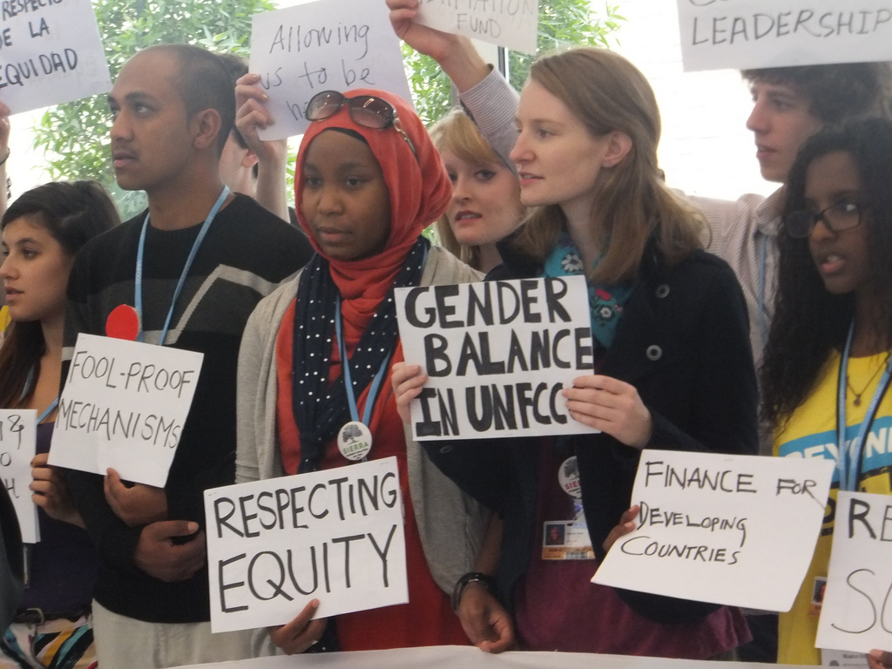
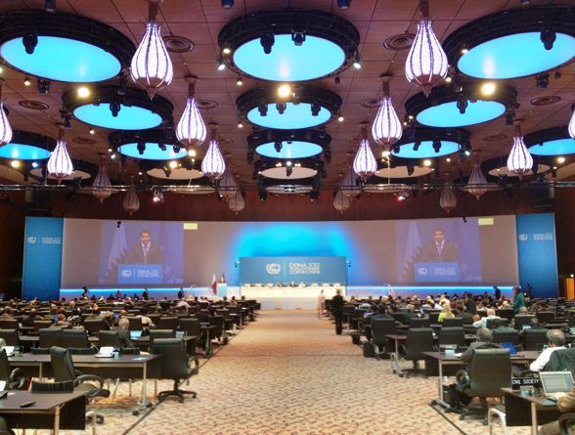
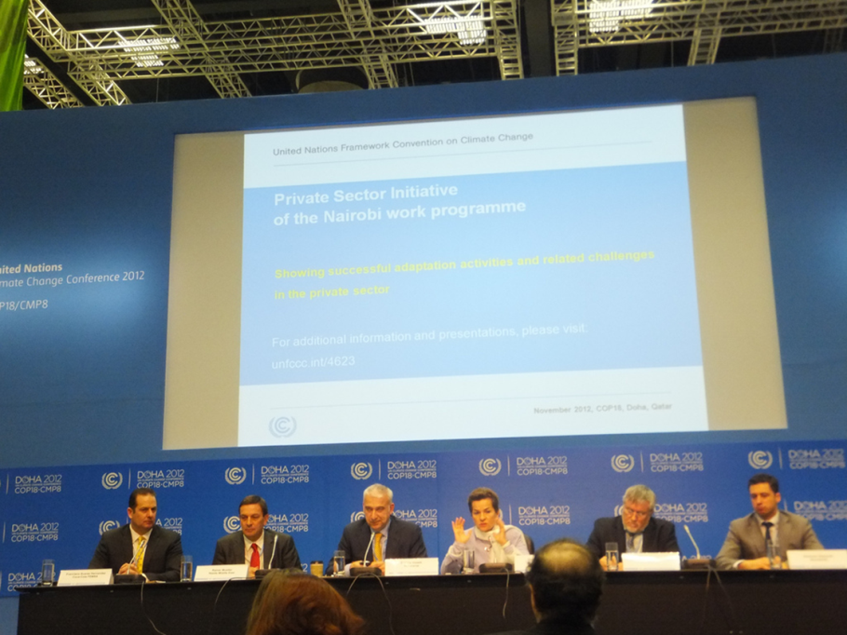

Slide 7
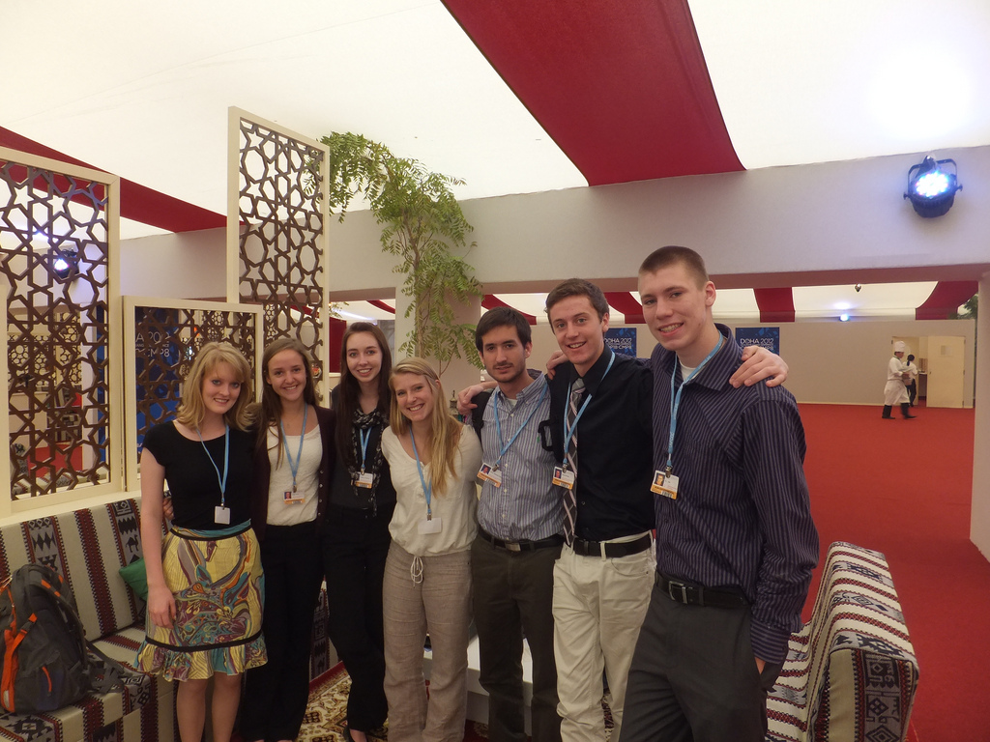
Our Partners – The American School of Doha
and the Will Steger Foundation

Slide 8
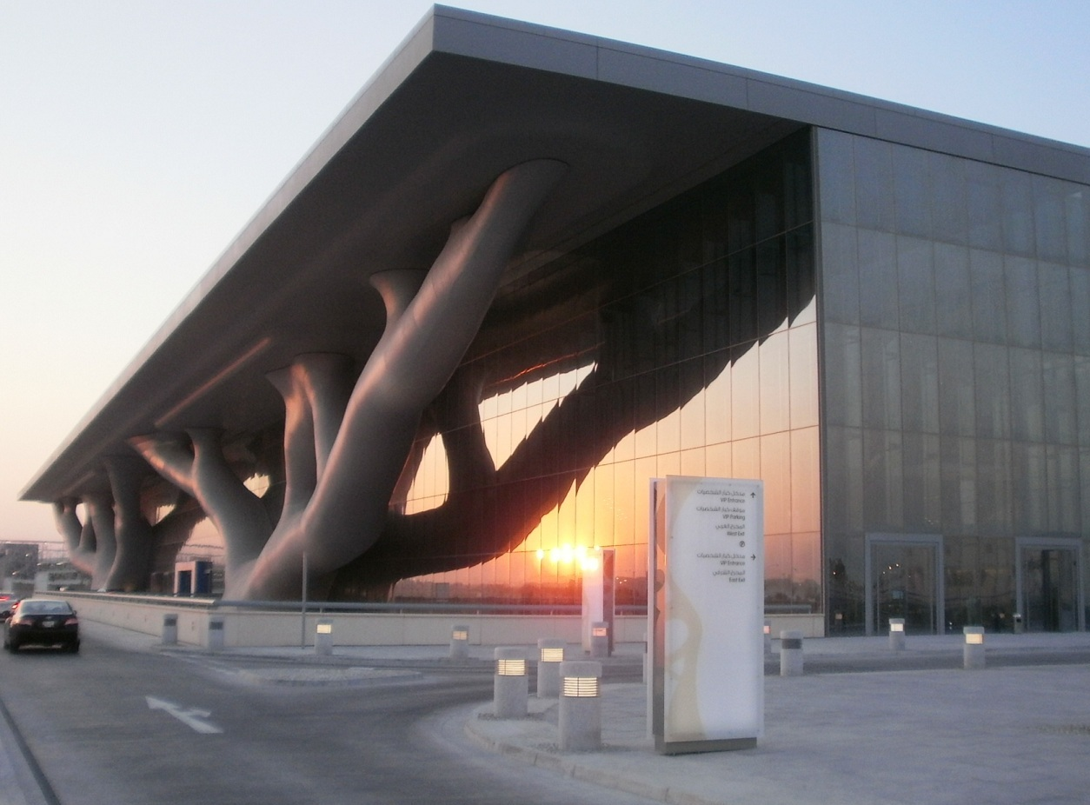

Schedule
Plenary
Side events
NGO booths

Slide 9
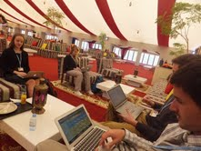
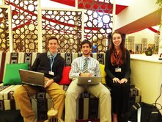
Blogging

Slide 10
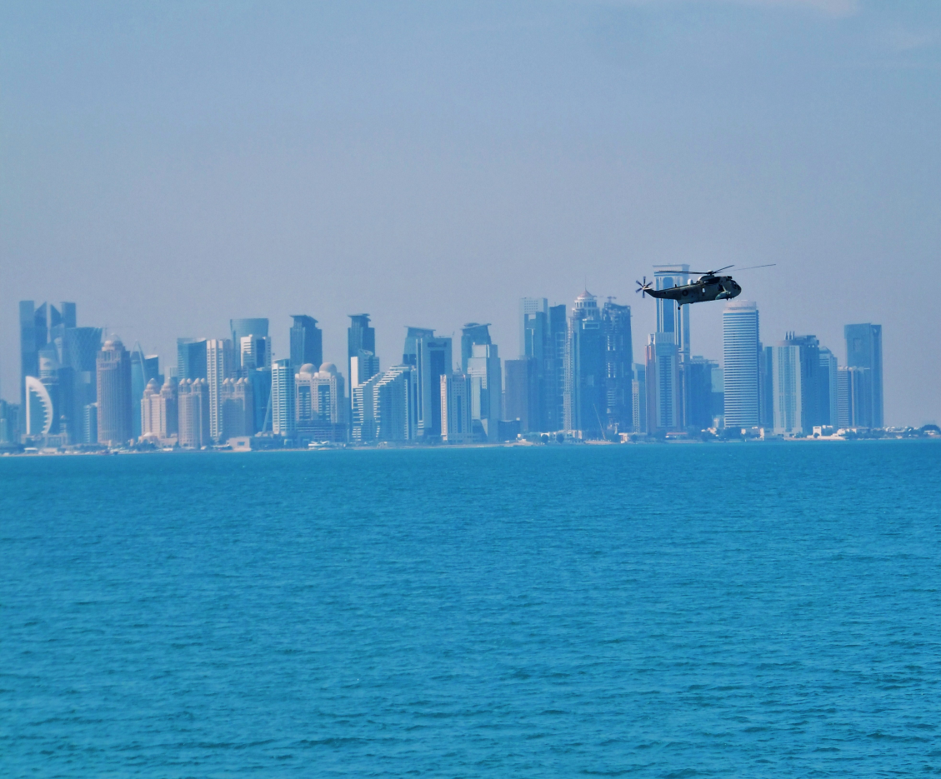
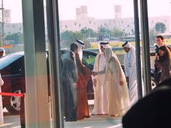
COP 18 Host – Doha, Qatar

Slide 11
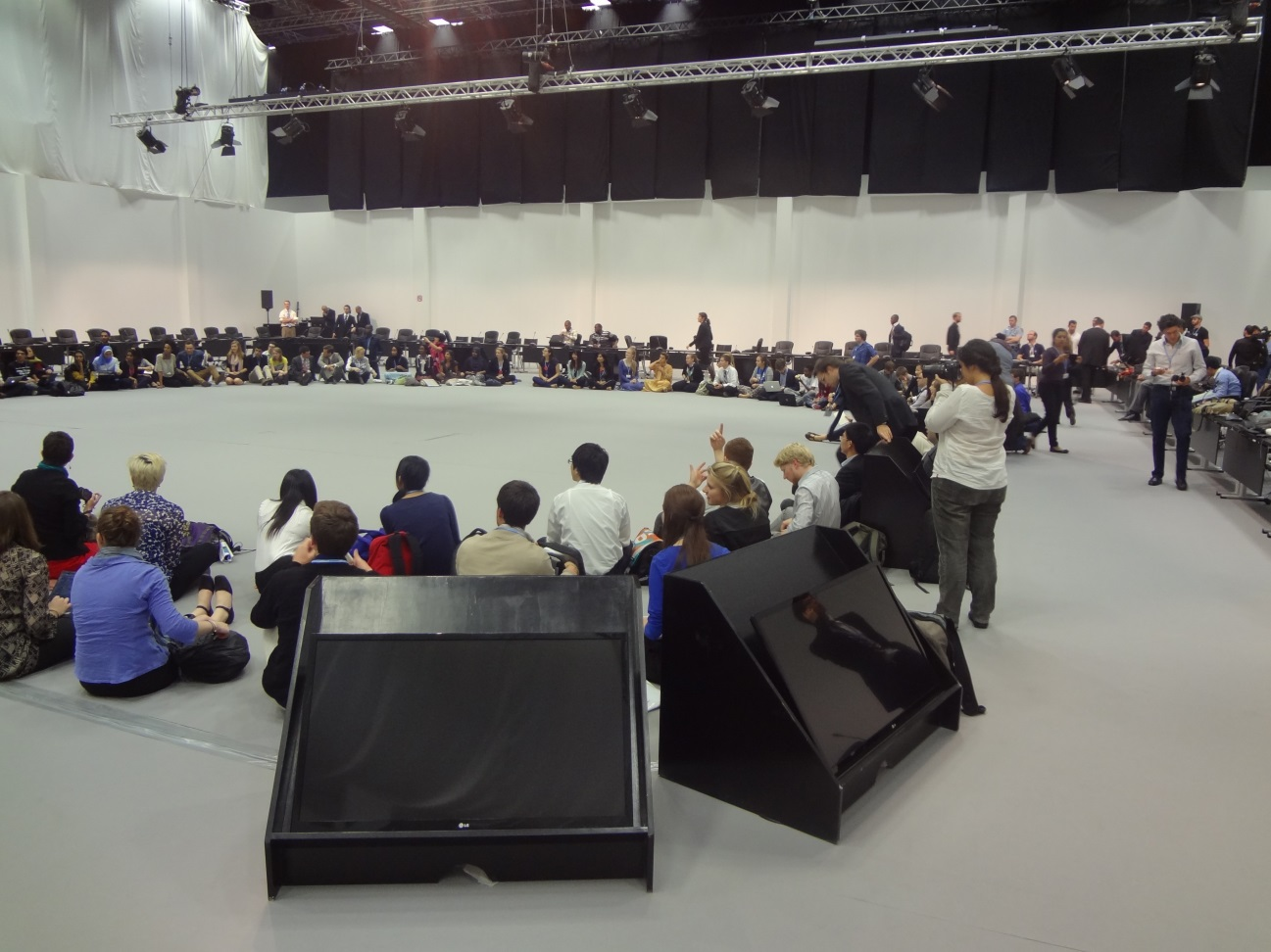
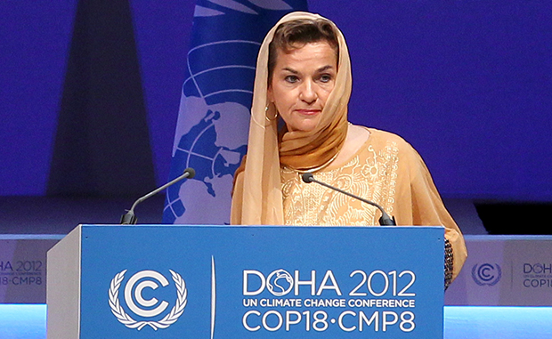
Cassie Severson

Slide 12


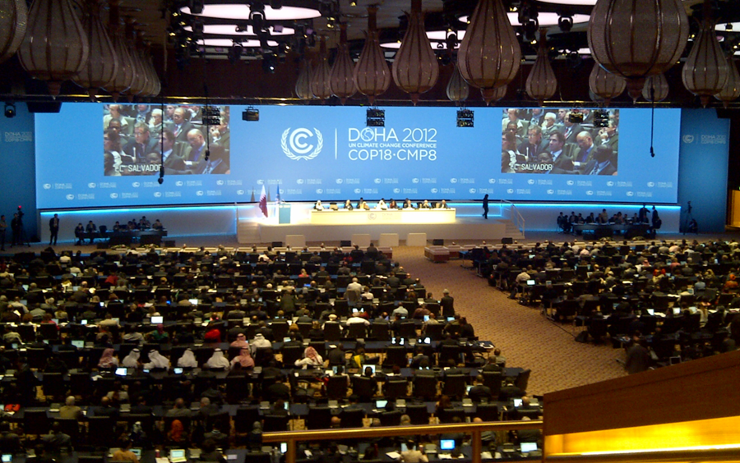

Slide 13
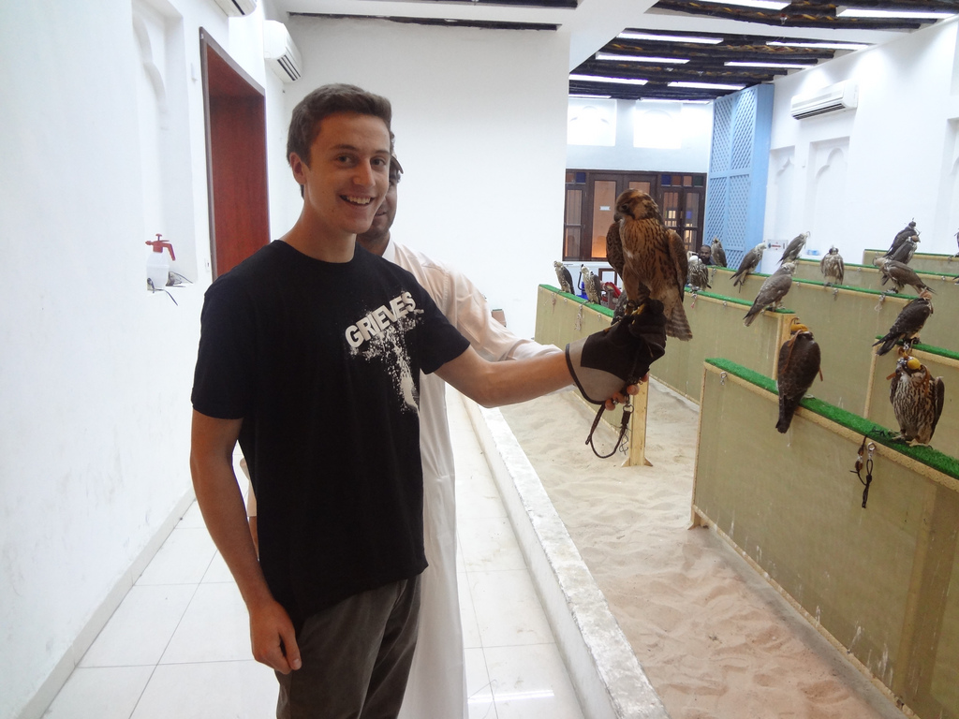
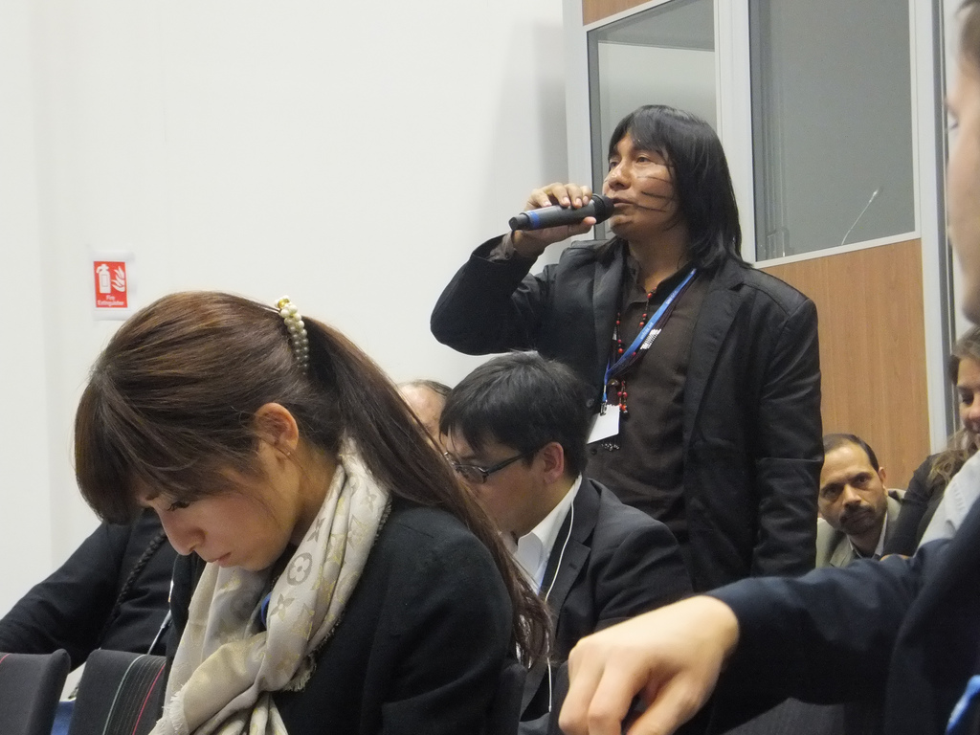
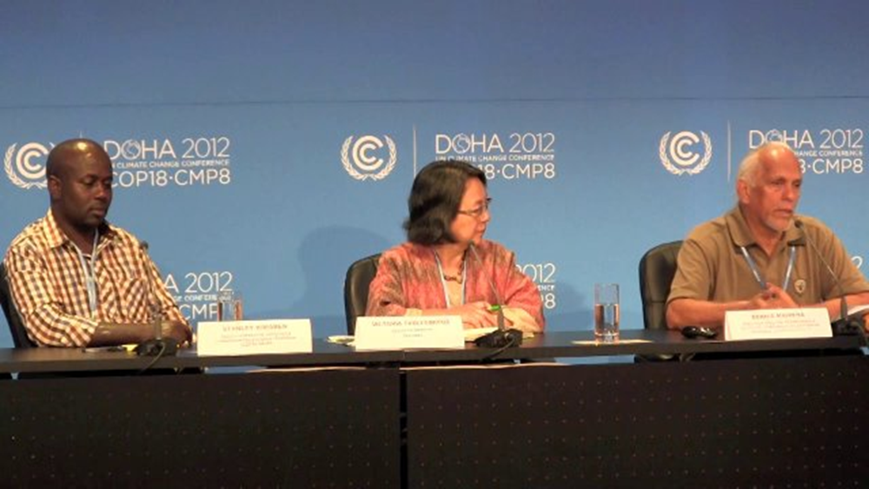
Michael
Stockton

Slide 14
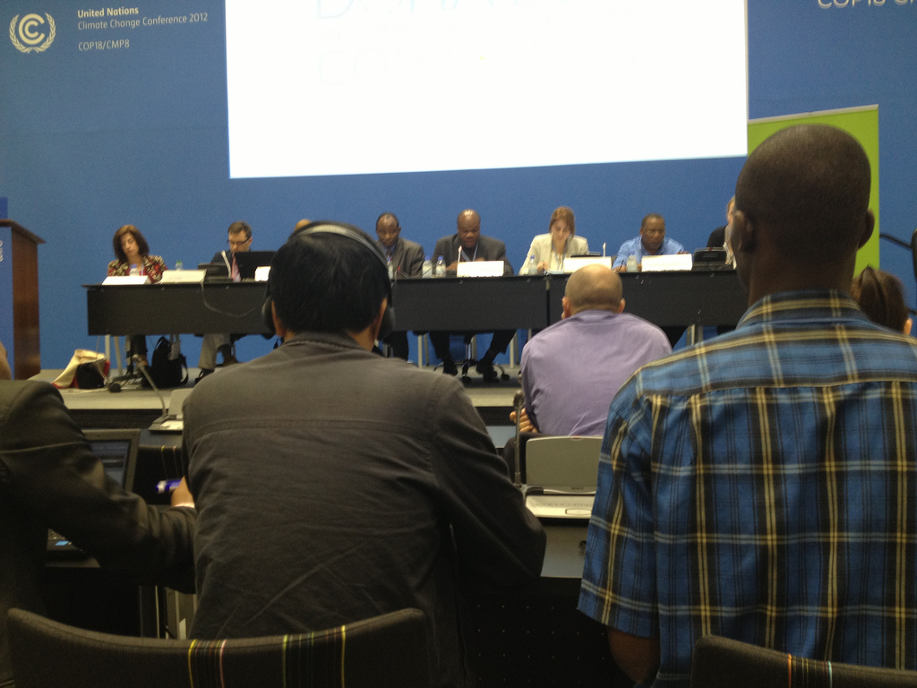

http://www.environmentmagazine.org/Archives/Back%20Issues/2011/May-June%202011/green-climate-fund-full.html

Slide 15
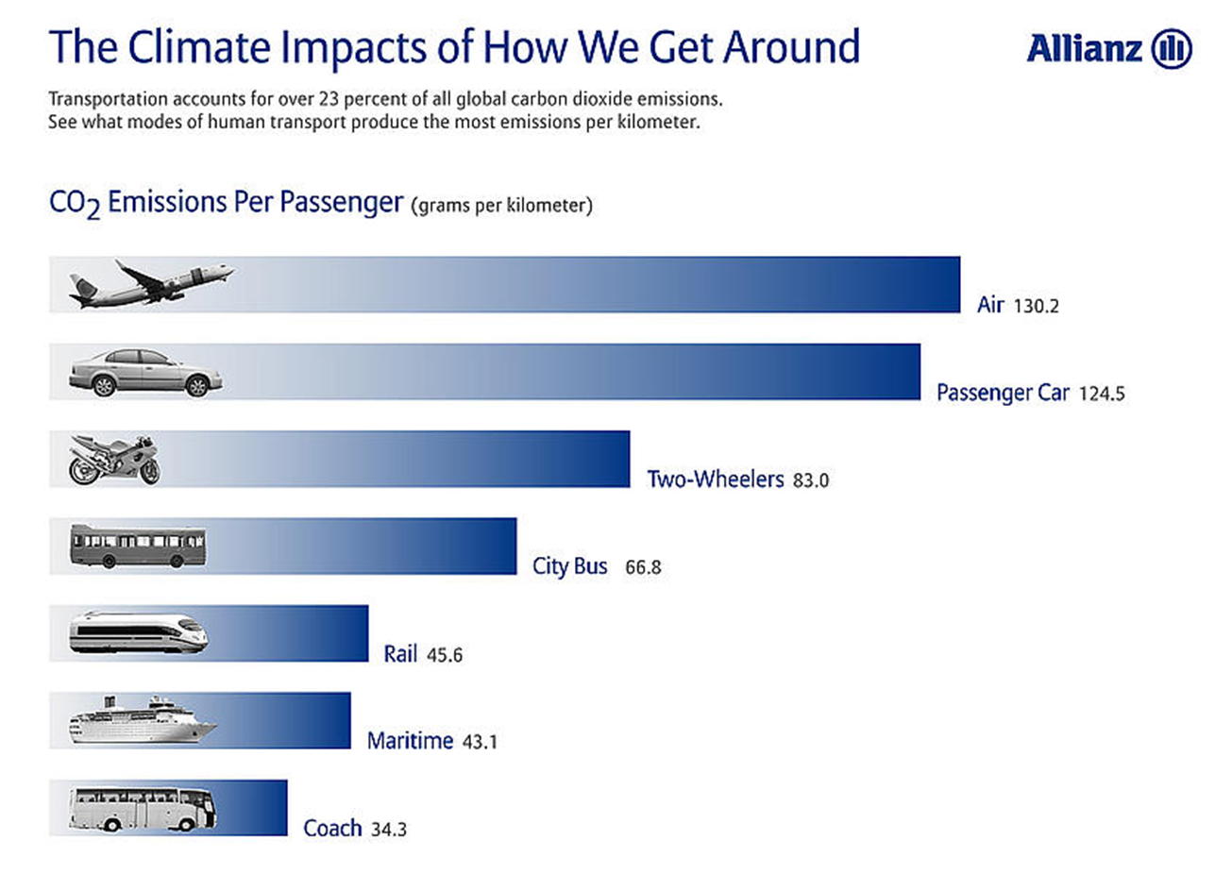

Cale Cook

Slide 16
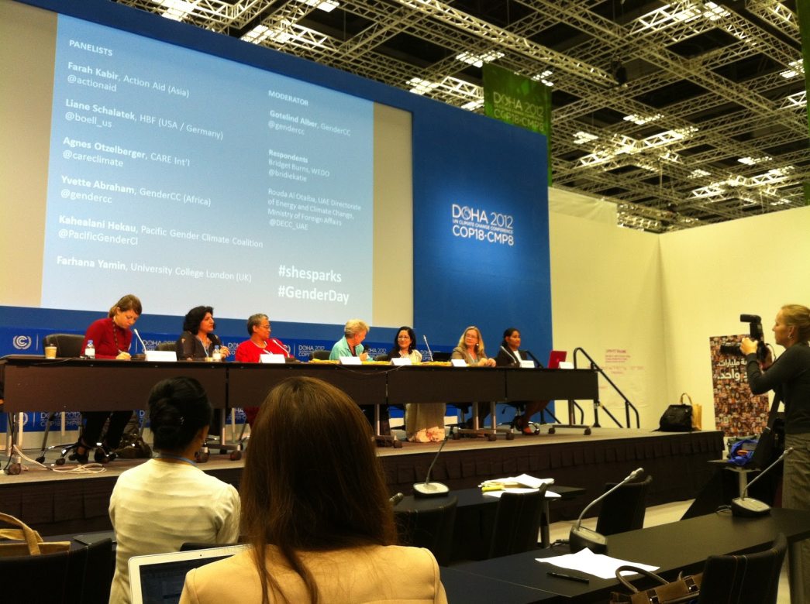
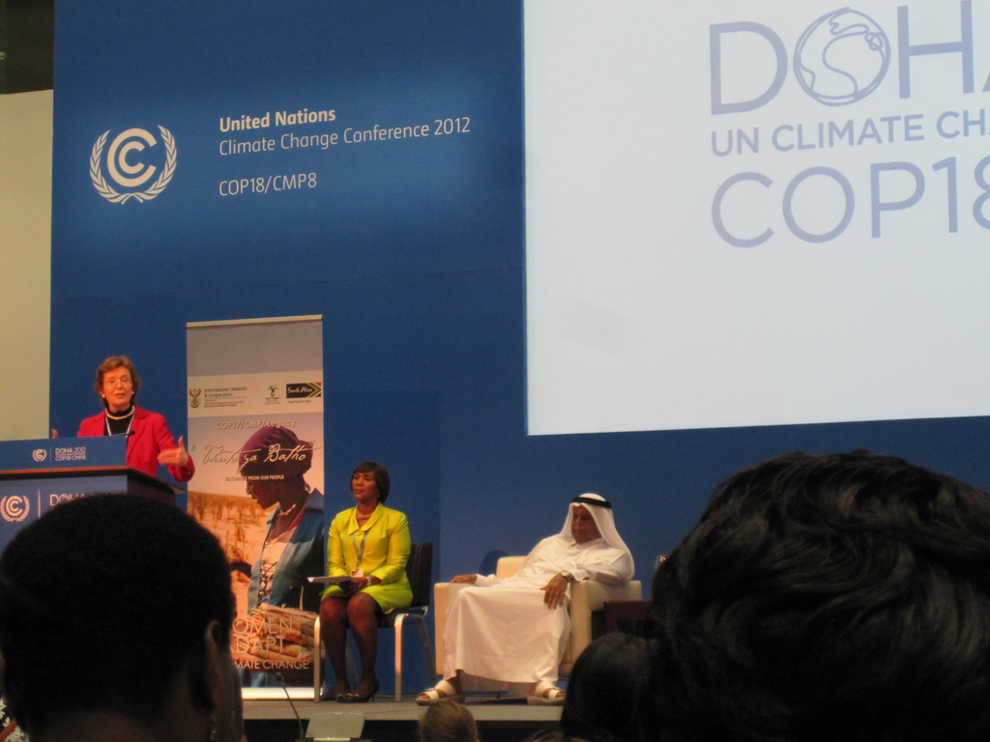
Georgia Schmitt
- Gender Day & UNFCCC women panel
U.S. Center Side Event
Former President of Ireland Mary Robinson: "It's about people"

Slide 17
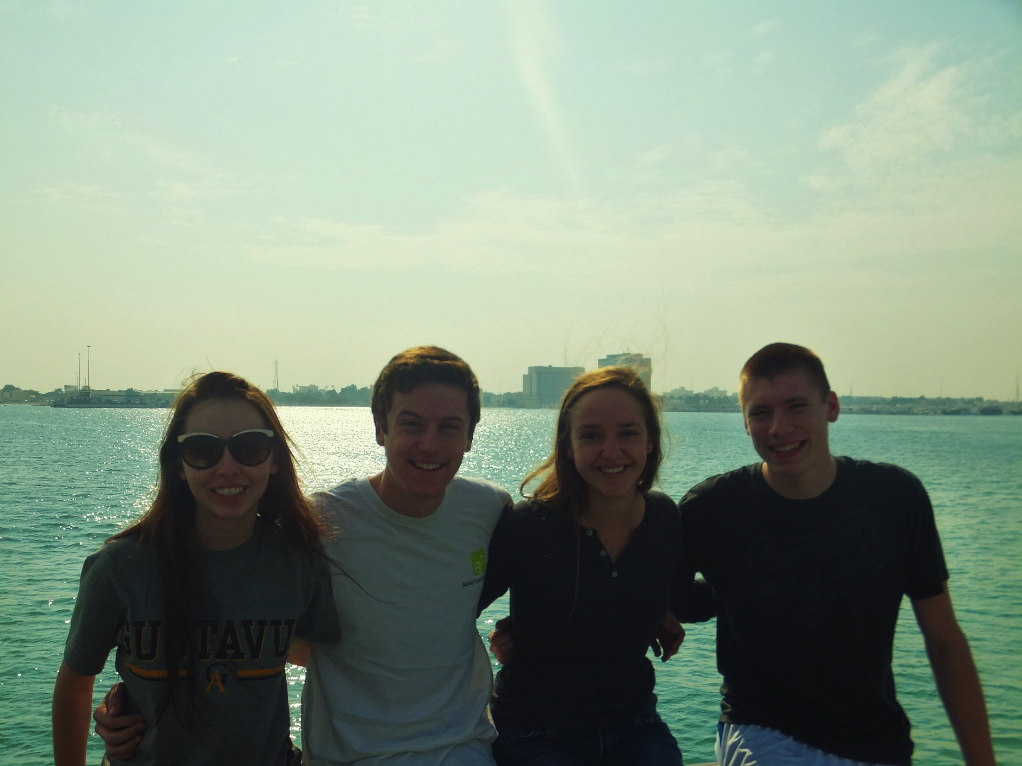
Thanks for Listening!
Questions?

