Slide 1
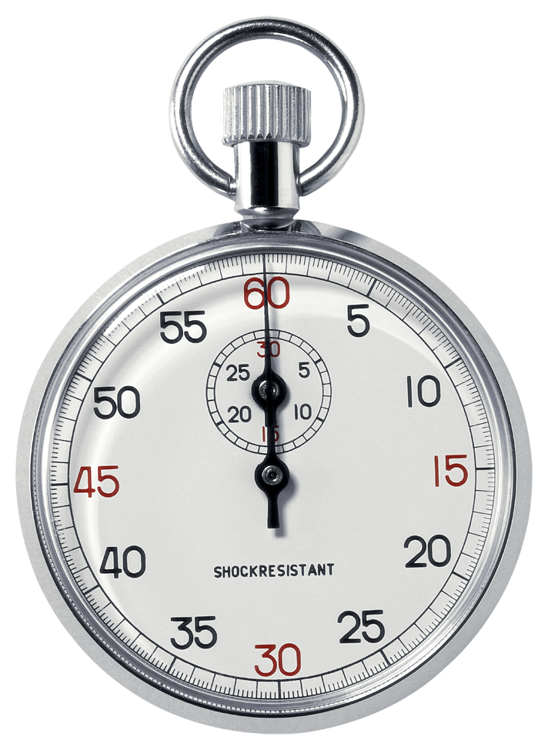
COUNT TO
TEN
(are you counting?)
Now, NEXT PAGE…

Slide 2
IN :10, WHAT WOULD YOU SAY TO SOMEONE TO CONVINCE HIM/HER ABOUT CLIMATE CHANGE?

Slide 3
TALK INTO YOUR
MEMO RECORDER
FOR 10 seconds

Slide 4
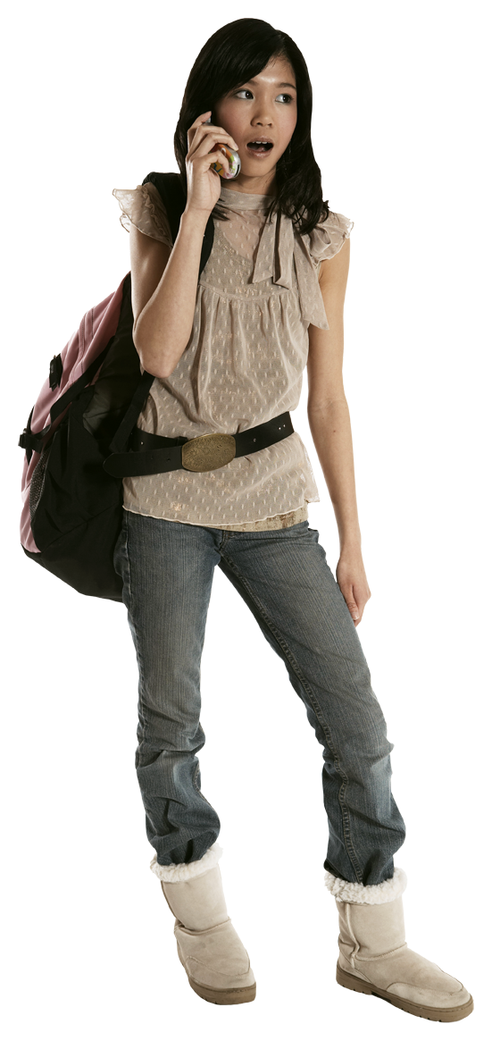
TALK TO HER

Slide 5
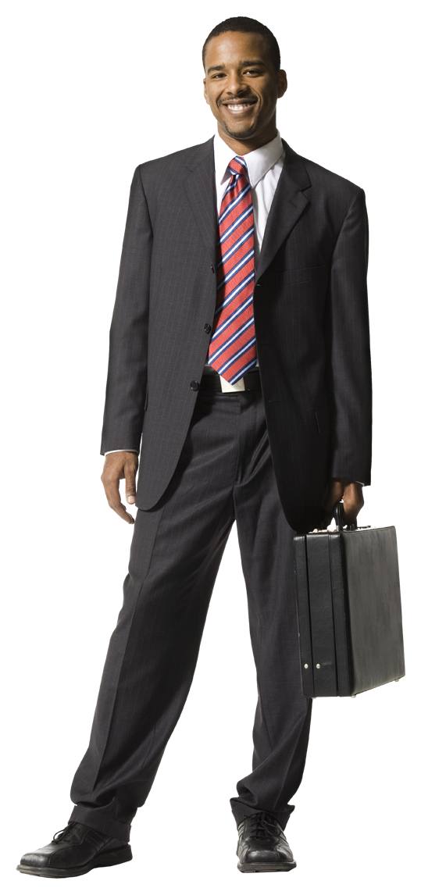
OR HIM

Slide 6
READY, SET, GO….

Slide 7
THAT’S MORE THAN THE ATTENTION SPAN
OF MOST PEOPLE
FOR EXTRANEOUS
INFORMATION

Slide 8
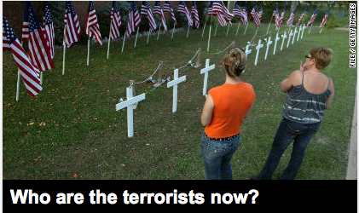

AND WHY MASS MEDIA
RESORTS TO
“SENSATIONALISM”

Slide 9

AND WHY MAJOR BRANDS SPEND MILLIONS TO DEVELOP
MESSAGING

Slide 10
…BEFORE THEY SPEND
$$$$ ON TV, RADIO, PRINT, INTERNET, PACKAGING, POINT OF SALE, MEDIA, SPONSORSHIPS, COUPONS, SIGNAGE, GAMES…

Slide 11

THEY START WITH “THE
CREATIVE BRIEF”

Slide 12
LET’S USE SOMETHING AS SIMPLE AS CHEERIOS TO EXPLORE THE
“CREATIVE BRIEF”
APPROACH TO MESSAGING

Slide 13
#1. WHAT IS THE SINGLE MOST IMPORTANT
OBJECTIVE OF OUR
COMMUNICATIONS?

Slide 14
(A SIMPLE “CHEERIOS” EXAMPLE)
#1. Single most important objective:
SELL MORE
CHEERIOS

Slide 15
#2. WHO IS YOUR
MOST IMPORTANT AUDIENCE?

Slide 16
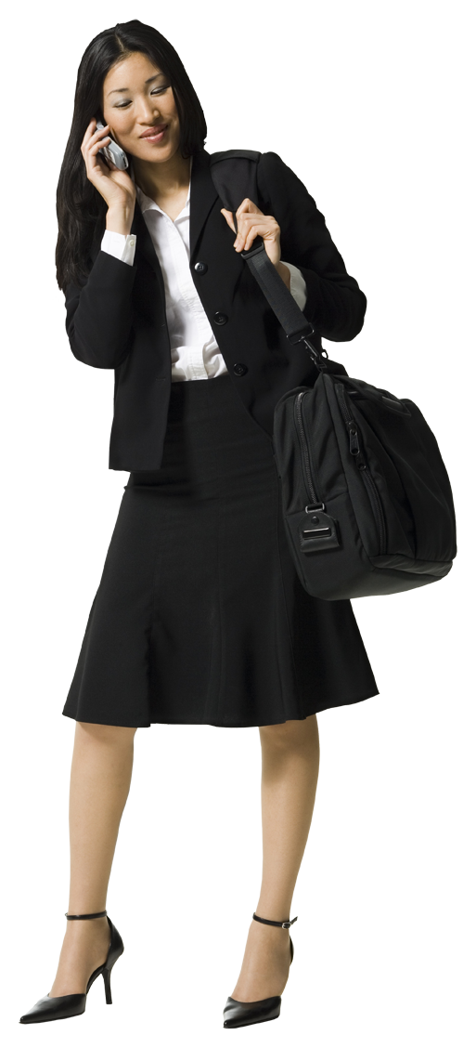
#2. Single most important audience:
YOUNG MOMS*
*Moms (25-40) hold more purchasing power than any demographic.

Slide 17
#3. WHAT IS THE MOST IMPORTANT AUDIENCE BENEFIT?

Slide 18
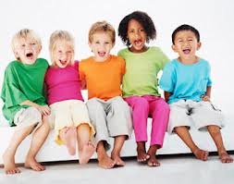
#3. Most important audience benefit
THEIR CHILDREN’S
HEALTH AND WELLNESS

Slide 19
#4. WHY SHOULD THEY BELIEVE THIS?

Slide 20
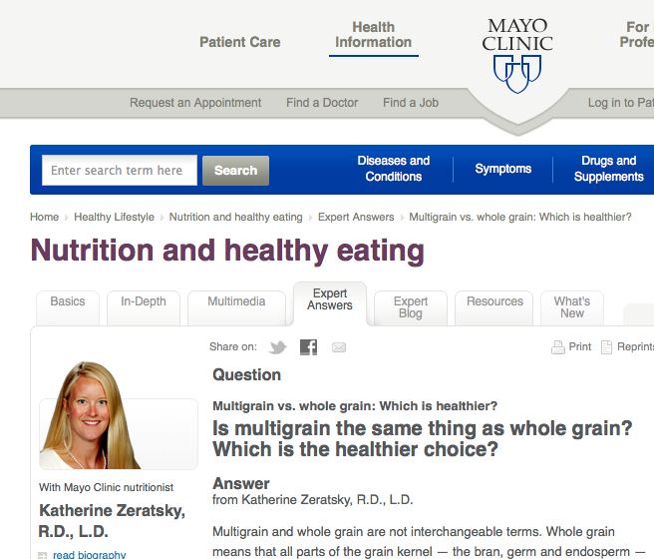
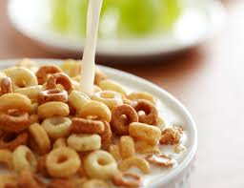
#4. Why should they believe this?
DOCTORS PREFER MULTI-GRAIN

Slide 21
#5. WHAT IS THE BIGGEST OBSTACLE?

Slide 22
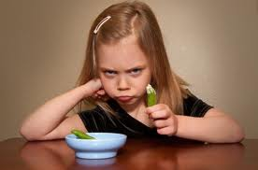
THE KIDS
#5. What is the biggest obstacle?

Slide 23
#5. THE MOST IMPORTANT MESSAGE?

Slide 24

#5.The most important message?
KIDS CHEERIOS

Slide 25
#6. WHAT DO WE WANT THE AUDIENCE TO DO?

Slide 26

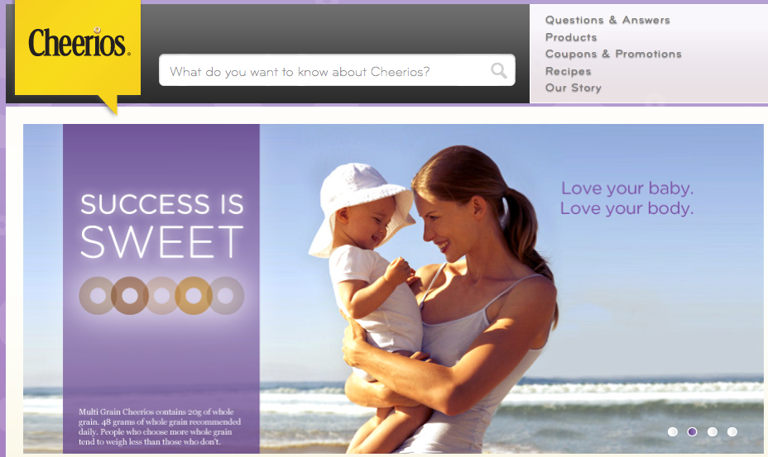

EMOTIONALLY
ATTACH TO CHEERIOS
#6. What do we want the audience to do?

Slide 27
#7.HOW WILL WE KNOW IF OUR MESSAGE WORKED?

Slide 28
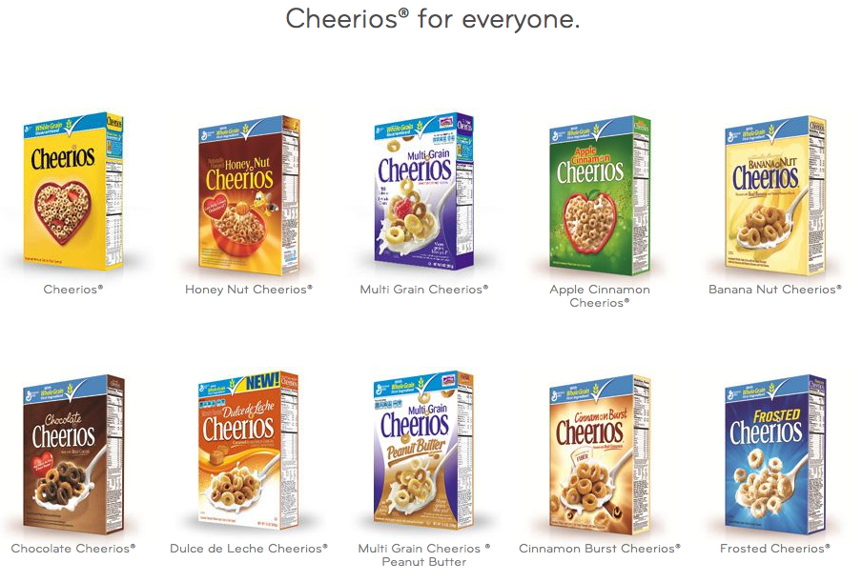
SALES FIGURES AND BRAND LOYALTY
#7. How will we know if our message worked?

Slide 29
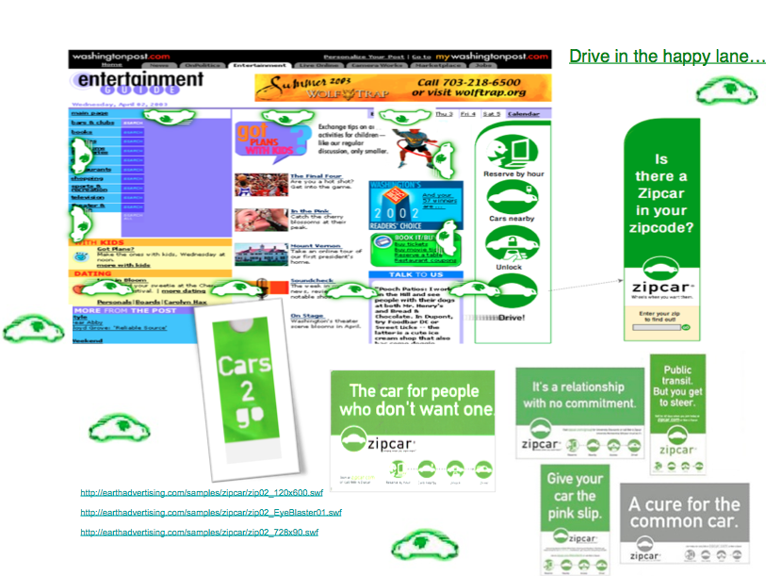
EXAMPLES OF “EXECUTIONS” BASED ON A CREATIVE BRIEF
ZIPCAR CREATIVE BRIEF:
#1 What is the single most important objective of our communications?
Get people to think they might not need to own their own car
#2 Who is our most important audience?
City people with cars who walk to work
#3 What is the most important audience benefit?
No hassle and expense of a car.
#4 Why should they believe this?
You can rent nearby by the hour
#5 What is the biggest obstacle?
New concept
#6 The most important message?
Wheels when you want them
#7 What do we want the audience to do?
Get people to check to see if there is one in their neighborhood.
#8 How will we know if we are successful?
Memberships

Slide 30

STONYFIELD ORGANIC CREATIVE BRIEF:
#1 What is the single most important objective of our communications?
Organic is healthier for people and planet
#2 Who is our most important audience?
Moms - shoppers
#3 What is the most important audience benefit?
Health
#4 Why should they believe this?
Healthy cows make healthy milk
#5 What is the biggest obstacle?
Confidence in our food system
#6 The most important message?
No hormones, antibiotics and pesticides
#7 What do we want the audience to do?
Try it
#8 How will we know if we are successful?
Sales

Slide 31

LET’S DO A
CREATIVE BRIEF

Slide 32
#1. WHAT IS THE SINGLE MOST IMPORTANT
OBJECTIVE OF OUR
COMMUNICATIONS?

Slide 33

For example….
AGREE THAT WE ARE AFFECTING
OUR CLIMATE NEGATIVELY

Slide 34
#2. WHO IS OUR
MOST IMPORTANT AUDIENCE?

Slide 35
Audience choices
Intellectuals, thought leaders, press, who will spread the message to “apathies” to convert them to action, and build momentum (ignoring the non-believers.)
a.
b.
People who are:
•uneducated
•non-believers
•creationists
See” Conscious Consumers in a Nutshell, by Martha Shaw

Slide 36
b. Let’s choose B
• Uneducated
• Non-believers
• Creationists/ anti-scientists

Slide 37
#3. WHAT IS THE MOST IMPORTANT AUDIENCE BENEFIT?

Slide 38
how about…
“Be smarter than your friends”

Slide 39
#4. WHY SHOULD THEY BELIEVE THIS?

Slide 40
WE CAN NOW TRACE POLLUTANTS TO THEIR SOURCE

Slide 41
#5. WHAT IS THE BIGGEST OBSTACLE?

Slide 42
MEDIA $ POWER SAYING OTHERWISE
b. GUILT AND NEGATIVITY
c. CHANGE OF LIFESTYLE
d. GOD has the answer

Slide 43
#5. THE MOST IMPORTANT MESSAGE?

Slide 44
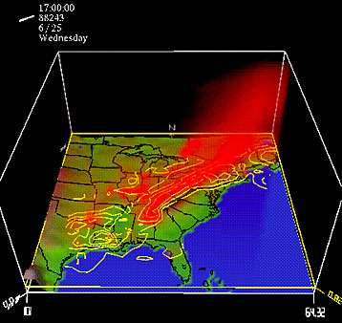
WHO DUNNIT?

Slide 45
#6. WHAT DO WE WANT THE AUDIENCE TO DO?

Slide 46
CHOOSE ONE:
a. FIGHT AGAINST FOSSIL FUEL SUBSIDIES
b. SPREAD THE WORD
c. REDUCE THEIR EMISSIONS
d. CONSCIOUSLY CONSUME
e. WHISTLE BLOW

Slide 47
#7.HOW WILL WE KNOW IF OUR MESSAGE WORKED?

Slide 48
Discussion.

Slide 49

Thank you.
CLN is considering the idea of developing a media campaign. Please contact Tamara if you are interested in working on the Creative Brief, the first and most important phase.
Martha Shaw
martha@earthadvertising.com
212-933-1391
http://www.earthadvertising.com/EAabout.html

