Slide 1

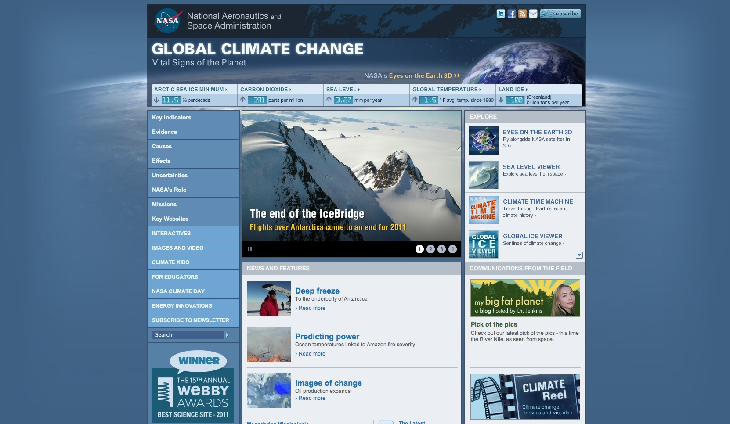

Laura’s Greatest Hits Part 2:
The Latest and Most Amazing
New Resources at NASA's Global Climate Change Website
Laura Faye Tenenbaum
Science Communicator
laura.f.tenenbaum@jpl.nasa.gov
NASA’s Jet Propulsion Laboratory
http://climate.nasa.gov/

Slide 2
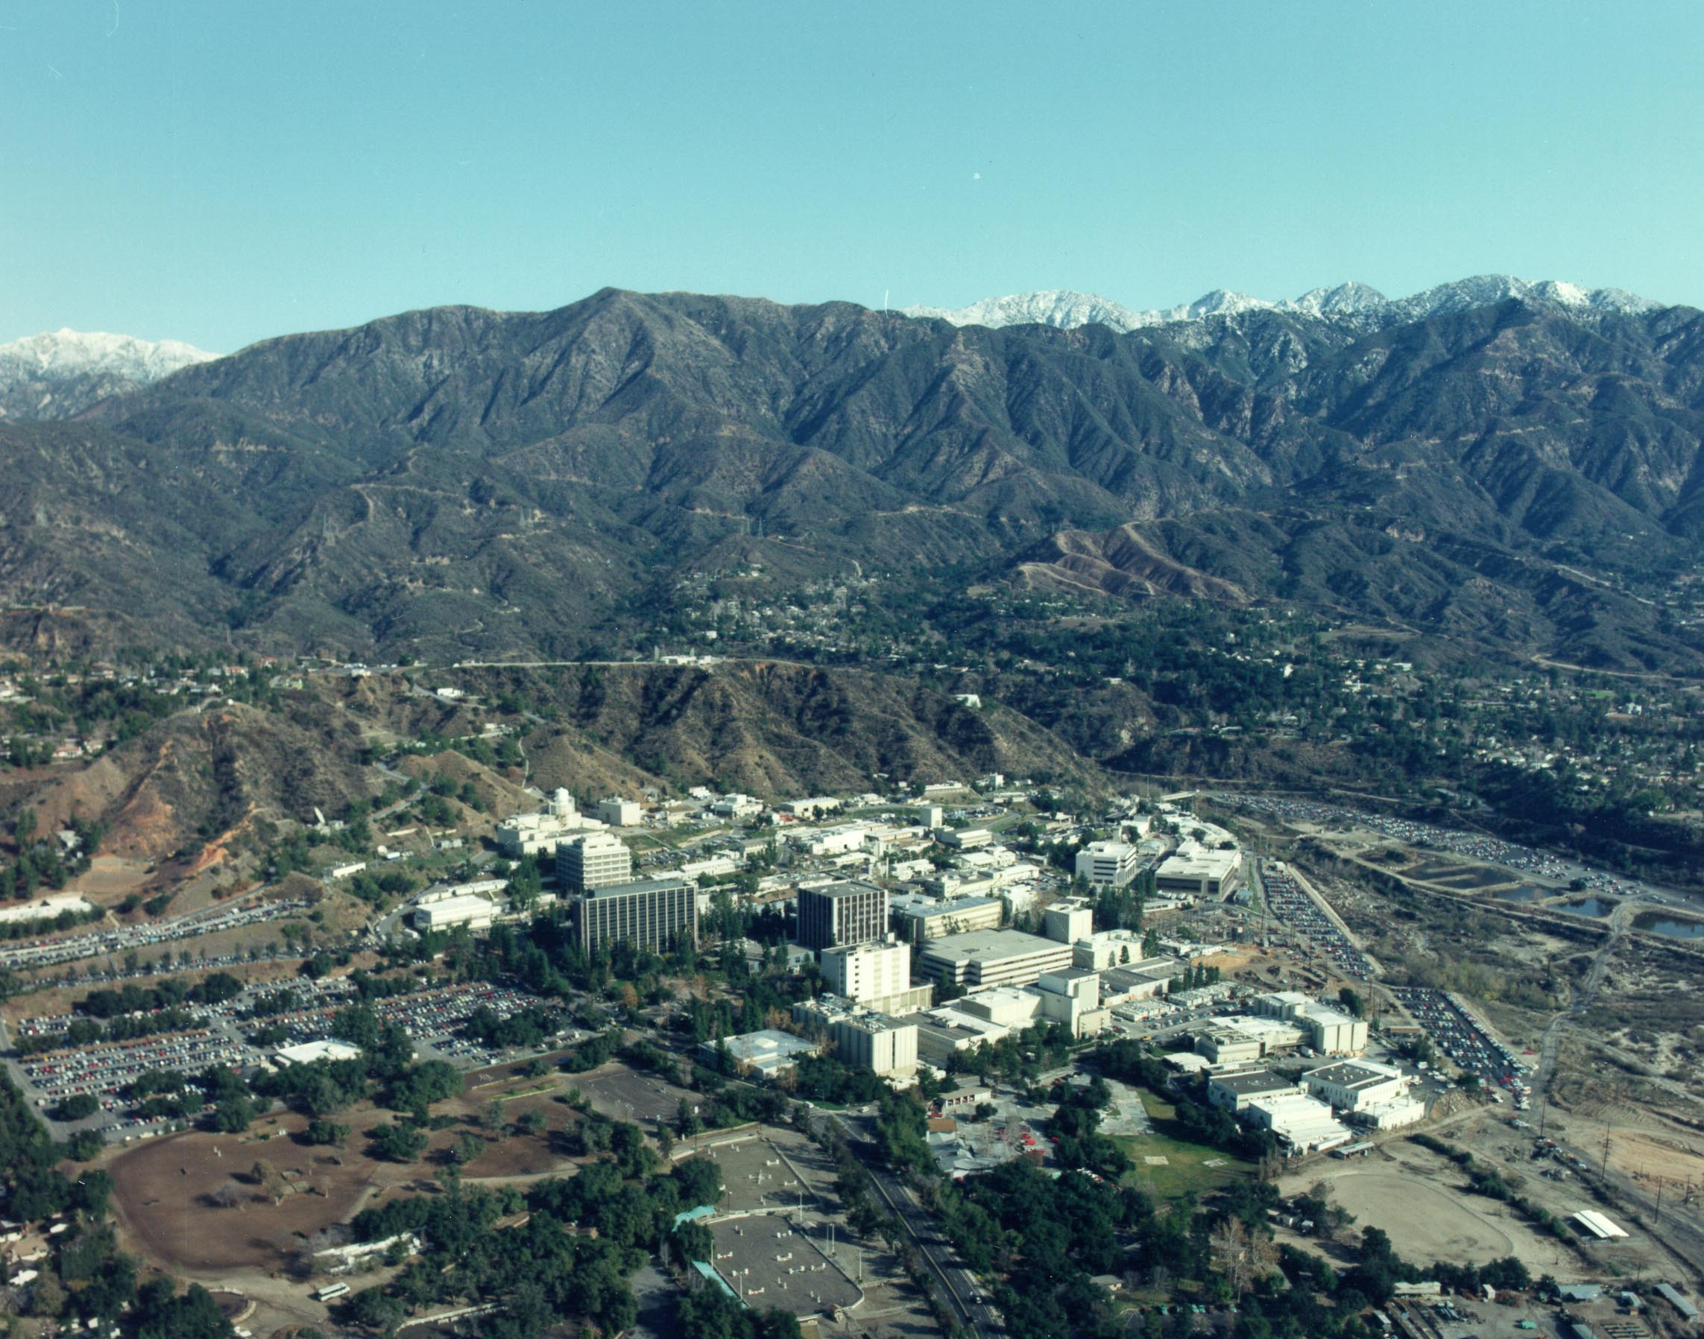
NASA's Global Climate Change Website
Managed at the Jet Propulsion Laboratory in Pasadena
http://climate.nasa.gov/

Slide 3
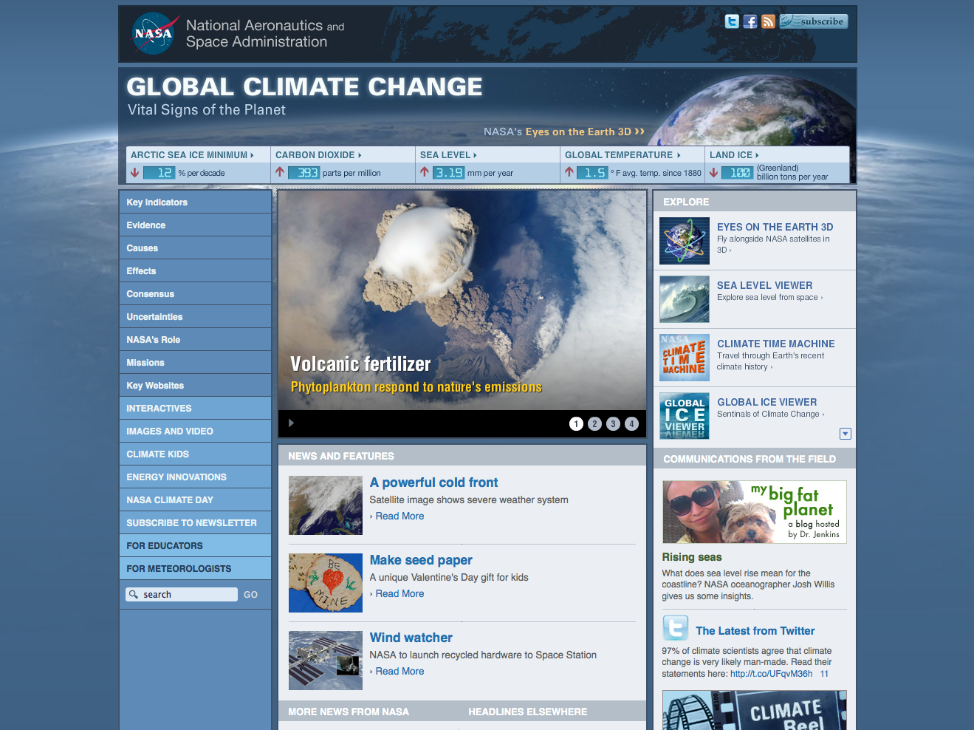
Meteorologist Center
http://climate.nasa.gov/meteorologists

Slide 4
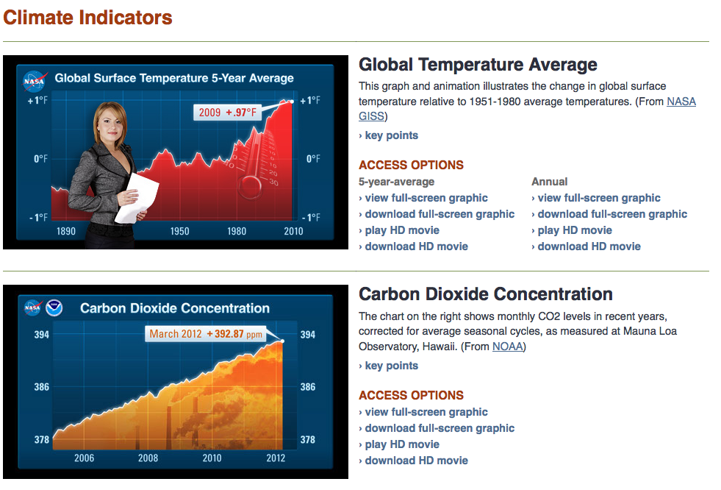
Meteorologist Center
http://climate.nasa.gov/meteorologists

Slide 5
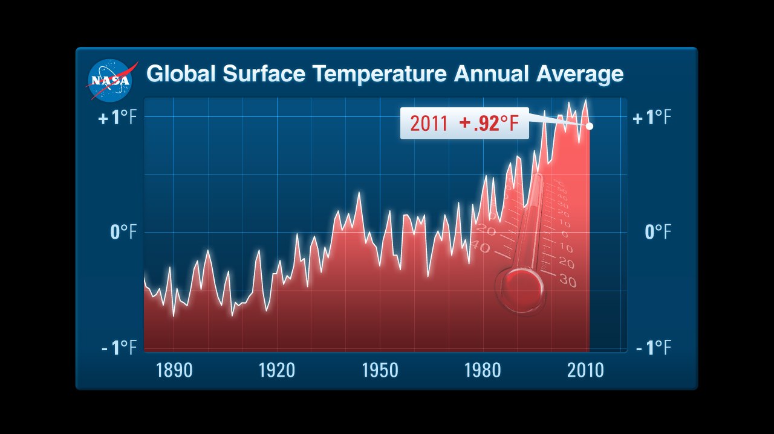
Global Average Temperature
http://climate.nasa.gov/meteorologists/graph-globalTemp-annual-full-090512.tif

Slide 6
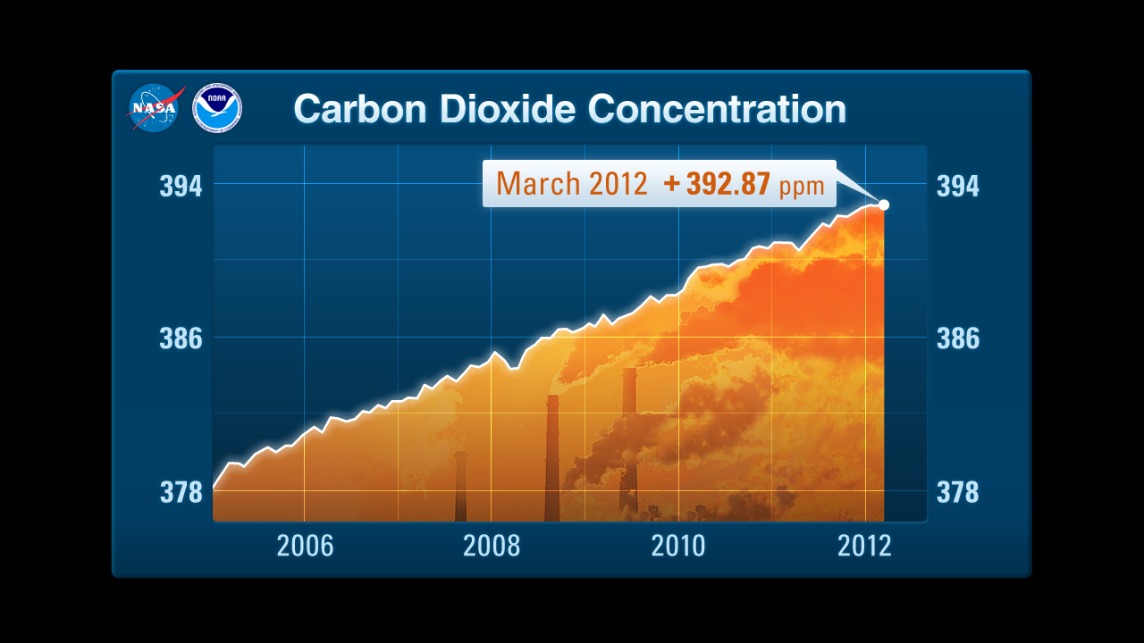
Carbon Dioxide Concentration
http://climate.nasa.gov/meteorologists/graph-co2-full.tif

Slide 7
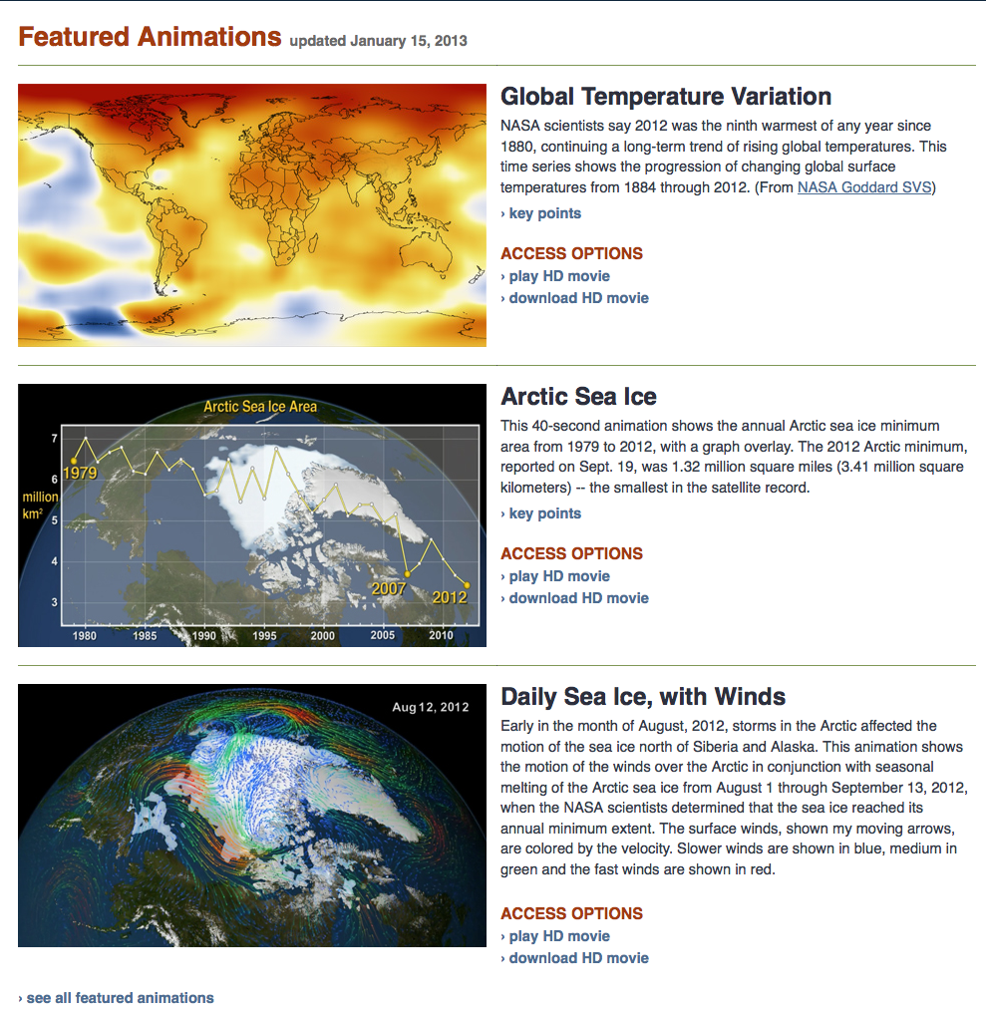
Meteorologist Center
http://climate.nasa.gov/meteorologists

Slide 8
Tips For Educators
http://climate.nasa.gov/education/tips

Slide 9
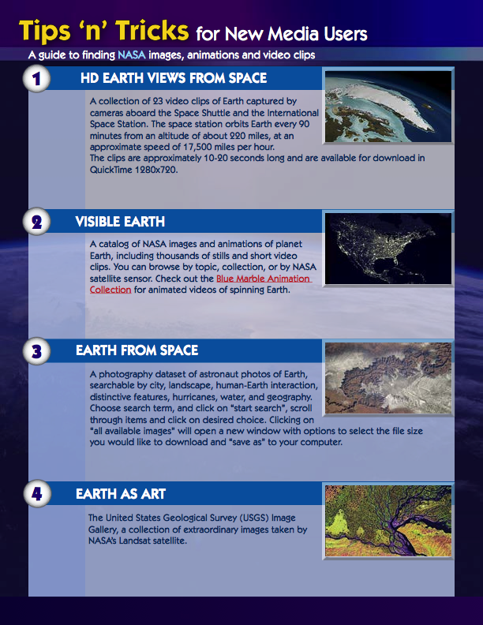
Tips For Educators
http://climate.nasa.gov/education/tips

Slide 10
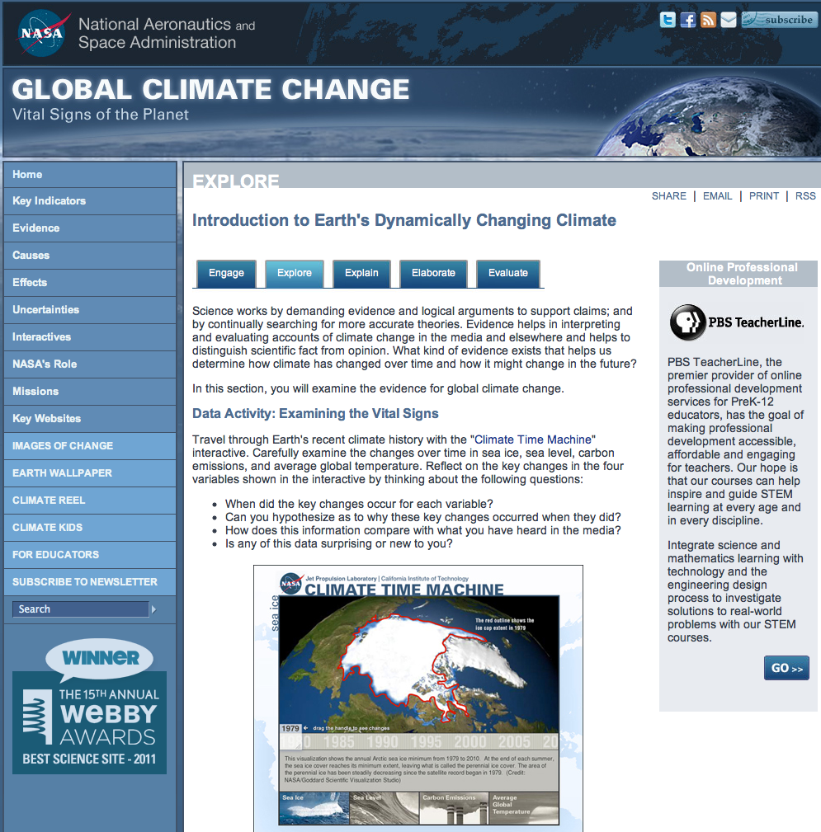
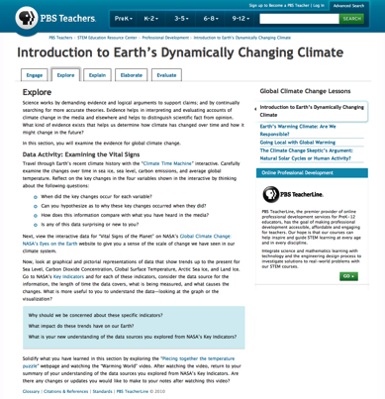
New PD from PBS and NASA
http://climate.nasa.gov/education/pbs_modules
Notes:
which supports a science literate society

Slide 11
Eyes on the Earth 3D
http://eyes.nasa.gov/earth/

Slide 12
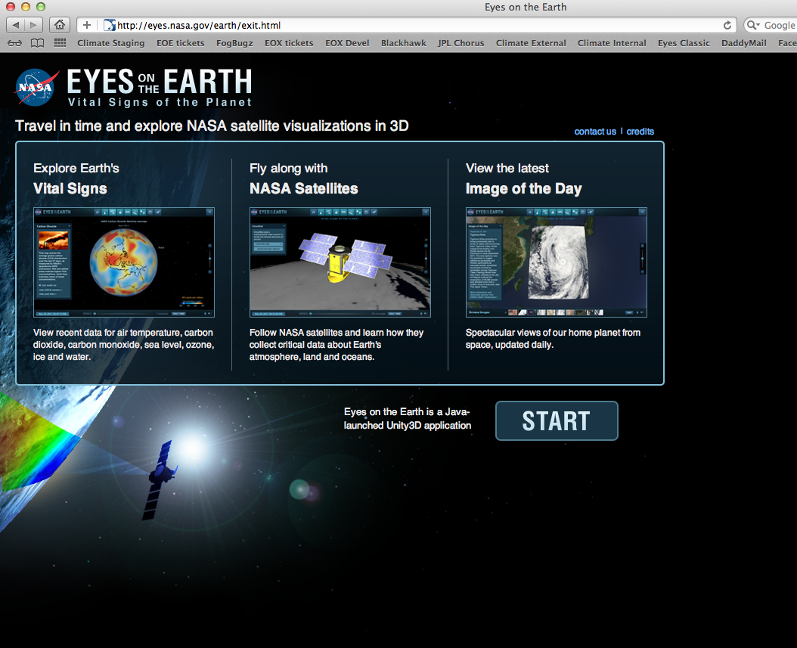
Headlines: Planet Earth
2. Click “START”
1. Go to http://eyes.nasa.gov/earth

Slide 13
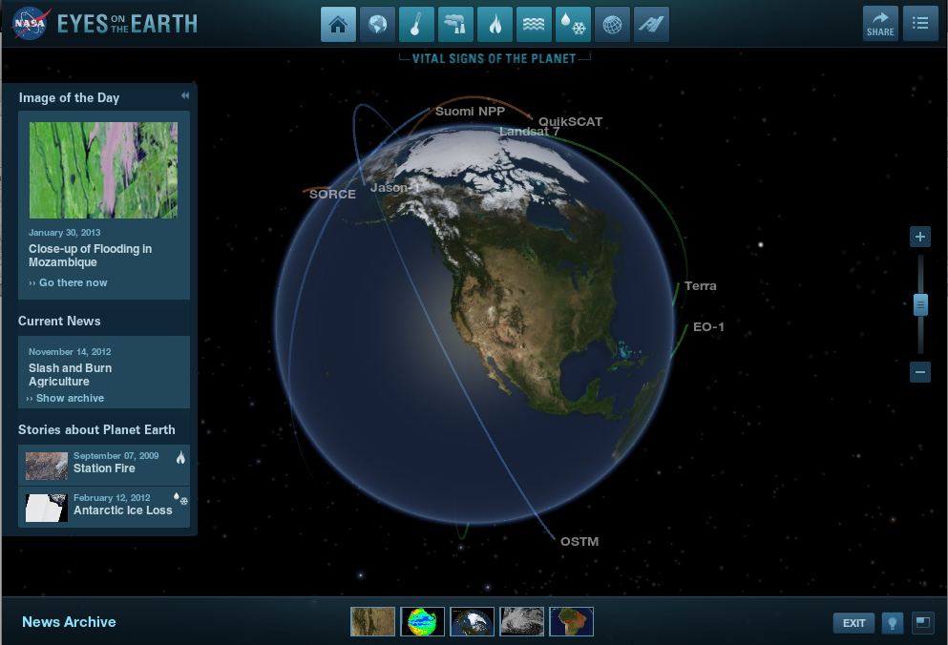
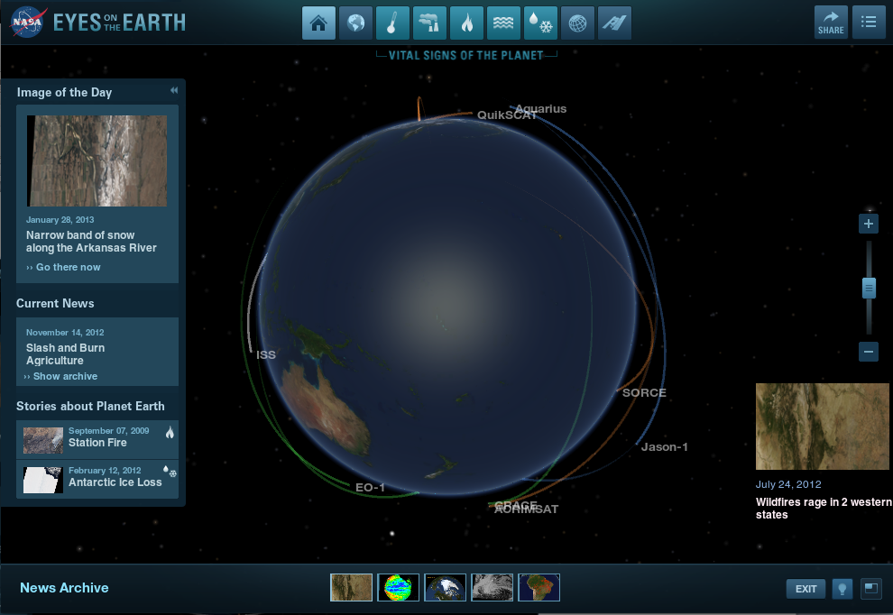
3. Click “News archive”
4. Select a thumbnail
from the news archive

Slide 14
Image of the Day

Slide 15
Visible Earth

Slide 16
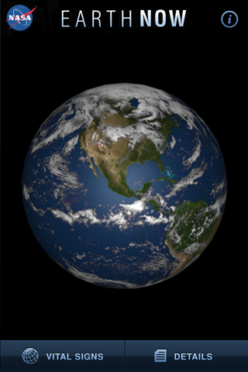
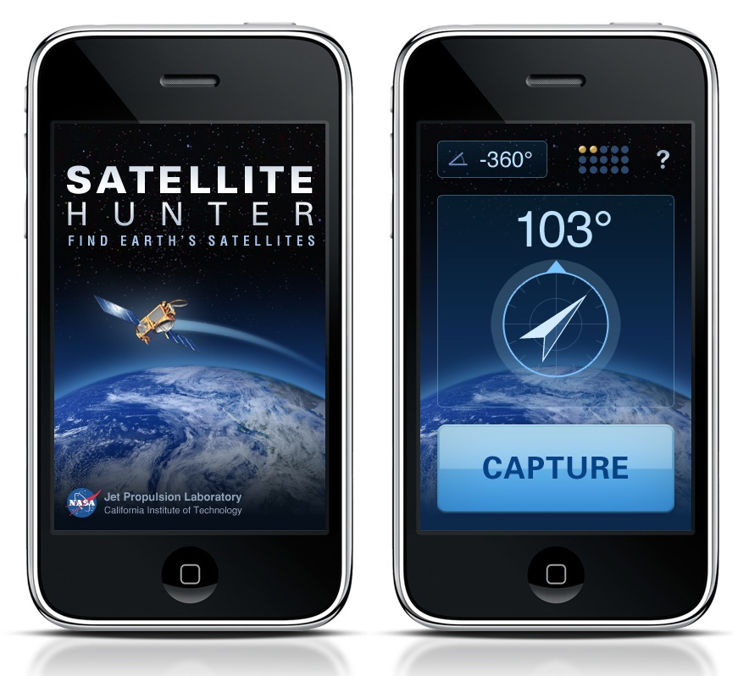
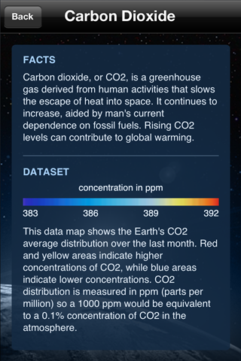
Expanded to mobile

Slide 17
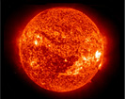
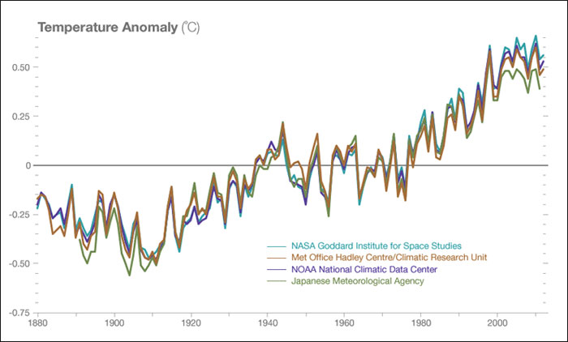
What else is new?
Facebook Share buttons
Eyes on Earth Data
The Sun: A Virtual Tool
Consensus Page
http://climate.nasa.gov/scientific-consensus

Slide 18
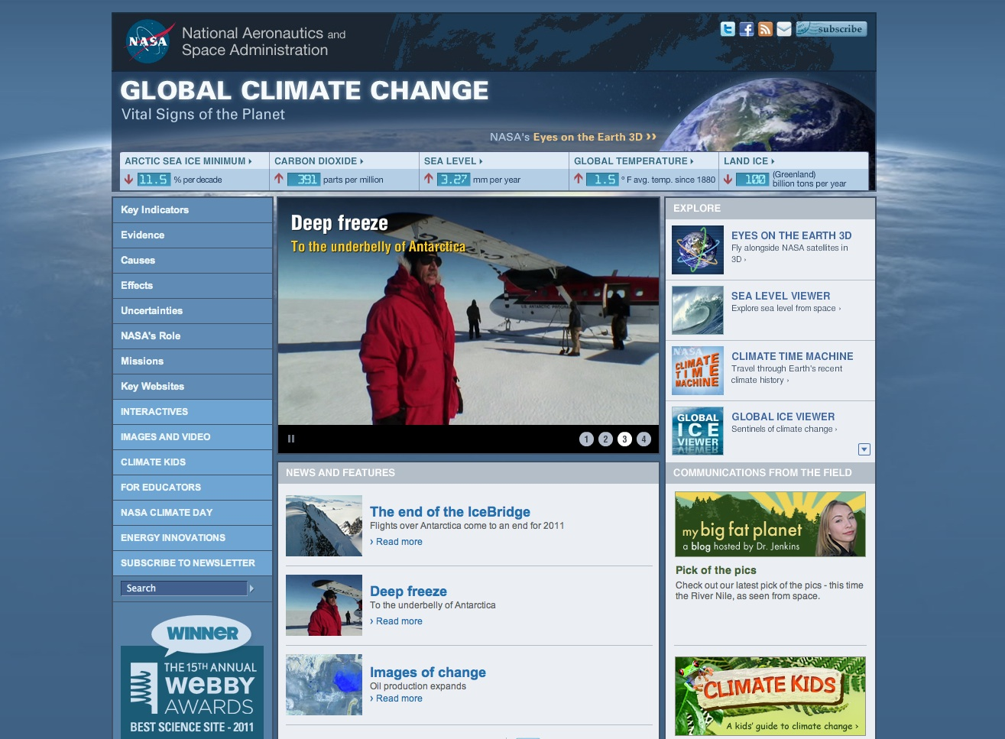
A reason to stay connected
Latest news and information
Notes:
which supports a science literate society

Slide 19
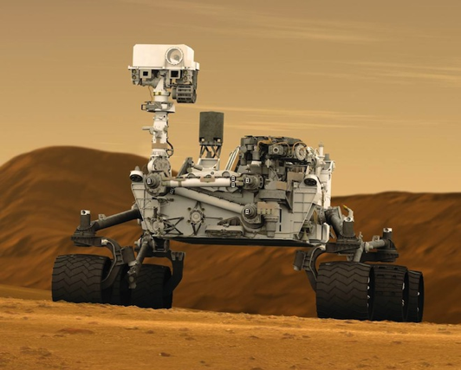
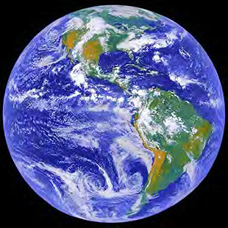
Going back to Earth
…to going ‘Back to Earth’
Six NASA missions, 18 months beginning April 2014

Slide 20
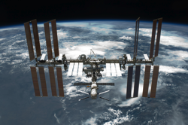
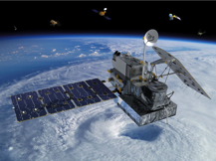
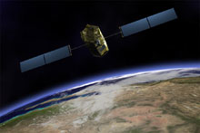
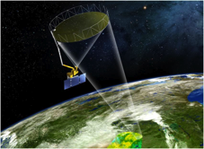
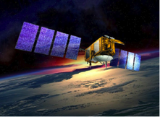
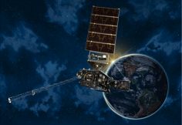
Six NASA Missions, Eighteen Months
Six NASA Missions, Eighteen Months
 | Mission | Launch | What it will do for the planet
1 | Rapid SCAT | April 2014 | Measure winds over the ocean: hurricanes, storms, climate change
2 | GPM | June 2014 | Measure rain and snow every 3 hours: understand water and energy cycles and forecast extreme events
3 | OCO-2 | July 2014 | Measure atmospheric CO2: understand where the carbon is going (sources and sinks)
4 | SMAP | October 2014 | Measure global soil moisture & freeze/thaw every 3 days: support agri productivity and flood & drought prediction
5 | Jason-3 | March 2015 | Global view of sea-level changes: reveal where the heat is stored and how currents affect weather & climate
6 | GOES-R | October 2015 | Provide atmospheric and surface measurements of Western Hemisphere: weather forecasting, severe storm tracking, and meteorological research

Slide 21
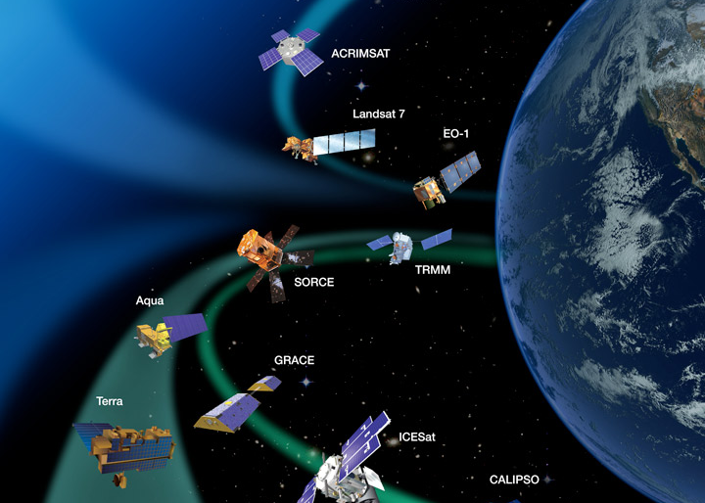
Develop key messages and thematic story
Notes:
Global observation and data collection, more than half federal dollars on Climate change
Inspiration, public engagement, promote science literacy stricking, visual palatable
Foster collaboration

Slide 22
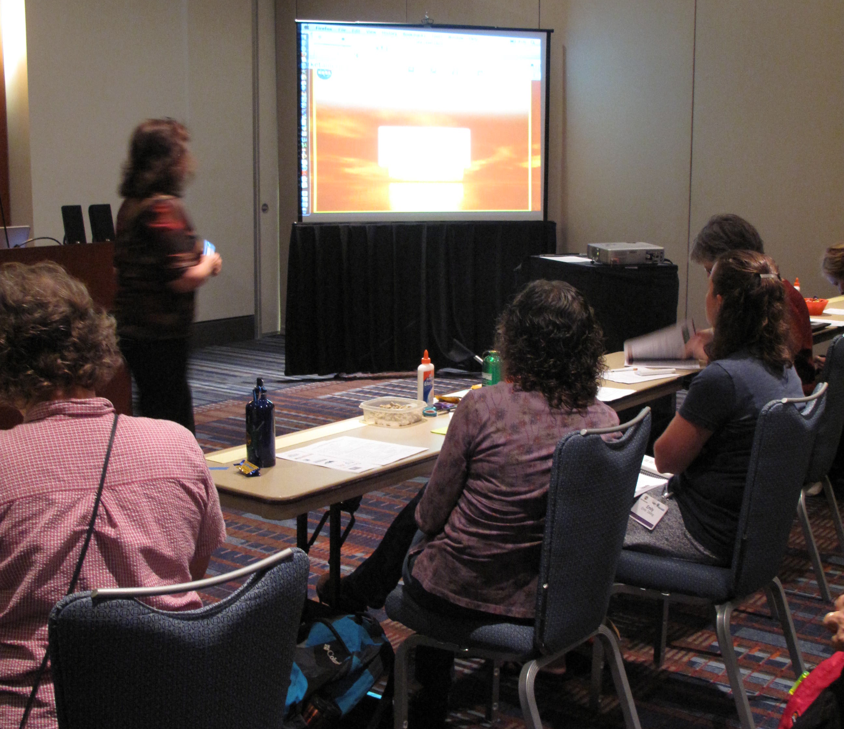
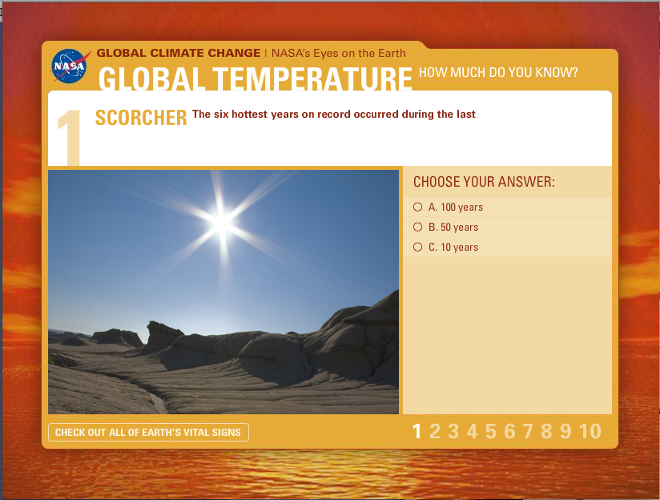
Feedback and dissemination from CLN
What else can we do to help you?
* At “Climate Change Education: Science, Solutions, Inspiration and Empowerment” at the North American Association of Environmental Education in Raleigh, NC.
Notes:
which supports a science literate society

Slide 23
What works
Make scientific concepts engaging, useful, and relevant
Build immersive and interactive experiences
Use images and video to tell a story
Partner with trusted sources
Give users a reason to stay connected and come back
Notes:
which supports a science literate society

Slide 24
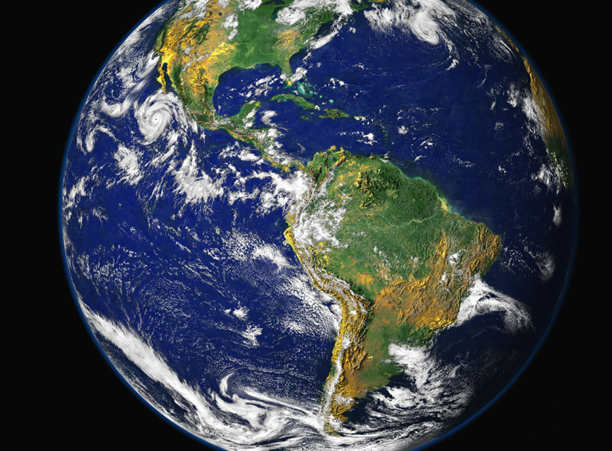
Laura Faye Tenenbaum
Education Specialist
NASA Jet Propulsion Laboratory
California Institute of Technology
4800 Oak Grove Drive
Pasadena, CA 91109
Email: Laura.F.Tenenbaum@jpl.nasa.gov
Office: 818.354.1226

