Slide 1
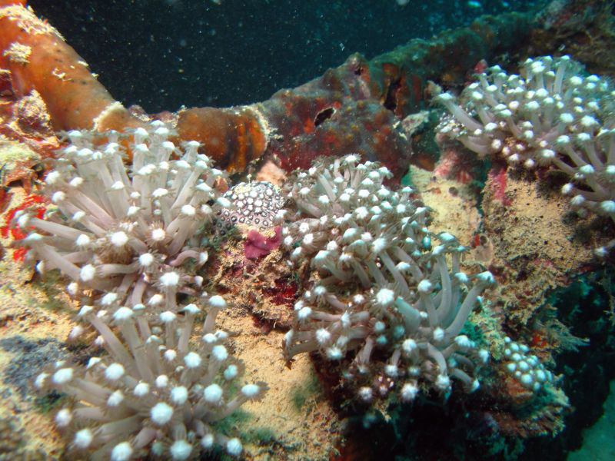
The Pacific Islands Climate Education Partnership (PCEP)
A 5-year Phase II CCE project funded by the National Science Foundation (NSF)
Photo by Susan Burger

Slide 2
PCEP Principal Investigators:
Dr. Sharon Nelson-Barber, PREL
Dr. Art Sussman, WestEd
Dr. Chip Fletcher, University of Hawai‘I
Mr. Don Hess, College of the Marshall Islands
  The PCEP serves the U.S. Affiliated Pacific Islands (USAPI). The PCEP vision is to educate the region’s students and citizens in ways that exemplify modern science and indigenous environmental knowledge, address the urgency of climate change impacts, and honor indigenous cultures.

Slide 3
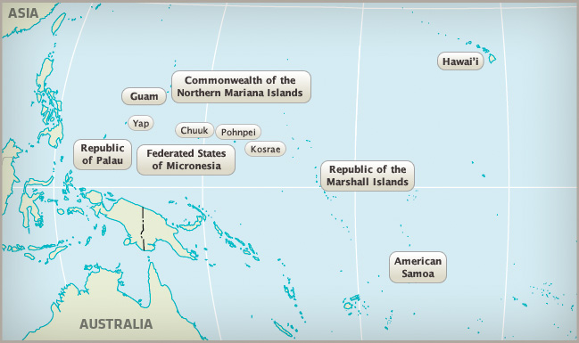
U.S. Affiliated Pacific Islands (USAPI)

Slide 4
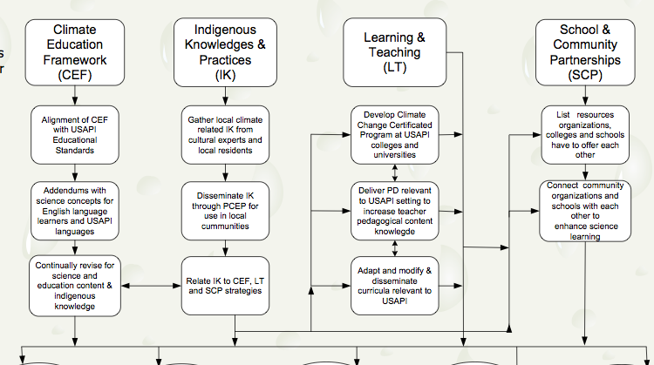
PCEP Theory of Action

Slide 5
PCEP Climate Education Framework
Draws from Climate Literacy Principles and Framework for K-12 Science Education
Contextualized for Pacific Island climate, impacts, cultures, education realities
K-2, 3-5, 6-8, and 9-12 Grade Bands
Updated annually re IK, NGSS, new info
Guides PCEP Teaching/Learning and Community School Partnership strands

Slide 6
Organization of PCEP CEF
Earth’s Matter
The Biosphere
Energy and the Earth System
Earth System Science
Weather and Climate
Climate Change Impacts on Human Societies
Engineering Climate Mitigation and Adaptation
Scientific and Engineering Practices (grade span descriptions from NGSS draft)
Crosscutting Concepts (emphasis on systems)

Slide 7
Earth’s Matter (6-8)
What key science concepts about matter help us understand climate and its impacts in the Pacific Islands and globally?
Molecular Nature of Matter
Four concept statements
Earth’s Biogeochemical Cycles
Three concept statements
Properties of Matter that Directly Relate to Understanding Climate
Four concept statements (two re density; one re properties of substances; one re acid-base balance)

Slide 8
6-8Matter.C Properties of Matter that Directly Relate to Understanding Climate
6-8Matter.C.1a Dissolving salt in water increases its density. A less dense fluid (liquid or gas) floats on top of a more dense fluid. Due to differences in density, freshwater floats on top of salt water.
6-8Matter.C.1b Heating a volume of gas or liquid causes it to expand and become less dense. Warmer air is less dense than colder air and floats above it. Warmer water is less dense than colder water and floats on top of it.
6-8Matter.C.2a Every substance has unique properties. These properties arise from the kinds of atoms that make up the substance and how those atoms are connected to each other.
6-8Matter.C.2b The pH (acid-base balance) is a property of liquid solutions that is particularly important for life. Dissolving of carbon dioxide in water causes the water to become more acidic (lower pH).
Notes:
A generally accepted K-14 climate science education framework that builds a deep understanding of climate change
Grade-span progressions that will guide climate education and is strongly based on context and the latest research in learning science and climate change understandings – from both science and indigenous experiential knowledge

Slide 9
The Biosphere (6-8)
What key science concepts about life help us understand climate and its impacts in the Pacific Islands and globally?
Earth’s Organisms
Seven concept statements
Pacific Island Ecosystems
Four concept statements
Biodiversity
Three concept statements

Slide 10
Energy and the Earth System (6-8)
What key science concepts about energy help us understand climate and its impacts in the Pacific Islands and globally?
Nature of Energy
Six concept statements
6-8Energy.A.1a Every system has a measurable property that is called its energy. Energy is a number that describes how much change can happen in a system.
Flows of Energy Into, Within and Out of the Earth System
Four concept statements
6-8Energy.B.4 The functioning of planet Earth relies on a constant input of energy from the Sun. The absorbed solar energy circulates within the Earth system and eventually leaves it as heat radiating to outer space. From a systems point of view, Earth is an open system with respect to energy.

Slide 11
Earth System Science (6-8)
How does Earth System Science help us understand climate and its impacts in the Pacific Islands and globally?
Systems
Four concept statements
Earth System Science
Six concept statements

Slide 12
Weather and Climate(6-8)
What major science concepts help us understand weather and climate in the Pacific Islands and globally?
Local Weather and Regional Climate
Four concept statements
Regional and Global Climate Change
Six concept statements

Slide 13
Climate Change Impacts on Human Societies (6-8)
How will climate change impact human societies in the Pacific Islands?
Regional Perspectives on Climate Change Impacts
Seven concept statements
6-8Impacts.A.1b Underground sources of freshwater on Pacific islands float on top of seawater. These freshwater lenses can be shrunken and contaminated by salt as sea level rises or the ocean surges over the land.

Slide 14
Engineering Climate Adaptation and Mitigation (6-8)
What can Pacific Island nations and communities do to reduce the damage caused by climate change?
Climate Adaptation
Two concept statements
Engineering Climate Adaptations
Six concept statements
6-8Adapt.B.2b There are many types of models, ranging from simple physical models to computer models. They can be used to investigate how a design might work, communicate the design to others, and compare different designs. (NRC 5).

Slide 15
Exploring Further
The CEF and many other PCEP Resources can be accessed from our web-based information platform:
http://pcep.dsp.wested.org
http://pcep.dsp.wested.org/content_items/1524587
Happy to discuss and collaborate with others about organizing K-12 climate education, professional development, climate adaptation, etc.
Art Sussman
asussma@wested.org
415-531-3110

