Slide 1


Introduction to Using Climate Models in Class
June 2011
Cindy Shellito
University of Northern Colorado

Slide 2
Global Climate Modeling: A very brief overview
What is a climate model?
Mathematical representation of climate system and system interaction – Based on our understanding of physics, chemistry, biology
Provide us with an independent way of testing whether a particular hypothesis can explain the data we have collected

Slide 3
The physics in the heart of every model…
Δ heat = energy absorbed – energy emitted
Outgoing longwave radiation
from Earth = σT_{earth}⁴
σ = Stefan-Boltzmann constant
σ = 5.67 x 10⁻⁸ W/m²K⁴
The Sun
Incoming shortwave at
top of atmosphere:
S_{o} = 1367 W/m²
Earth

Slide 4
Development and use of a model
Model Development
(driven by observations)
Laws of physics, principles of chemistry, biology, parameterizations
Analyze Results
Test model validity against observations
Make climate projections, Develop/test hypotheses
Simulation
Model => Results
Forcings
Boundary Conditions
Notes:
http://stratus.astr.ucl.ac.be/textbook/chapter3_node3.html

Slide 5
Range of complexity:
Energy Balance Models: simple models of Earth’s radiative balance (1-D & 2-D)
EMICs: Earth Models of Intermediate Complexity (2-D & 3-D)
3-D Global Climate Models
Regional Climate Models
Geochemical Models

Slide 6
Which model to use?
EBMs
EMiCs
GCMs:
Includes Atmosphere, Ocean, Earth System Models
Depends on:
Assumptions we choose to make
Knowledge of external forcing factors, response and interactions of Earth System Components
Which questions we would like to answer
Notes:
Also: Computing Power!

Slide 7
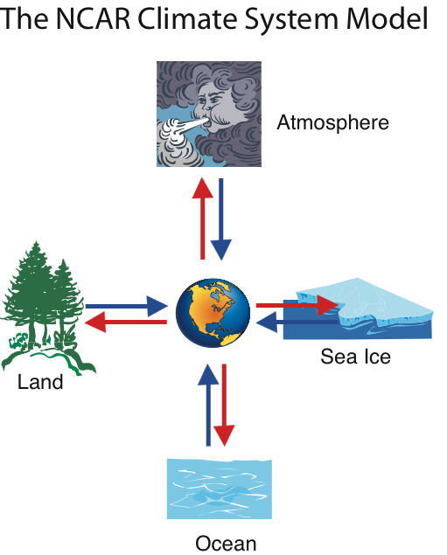
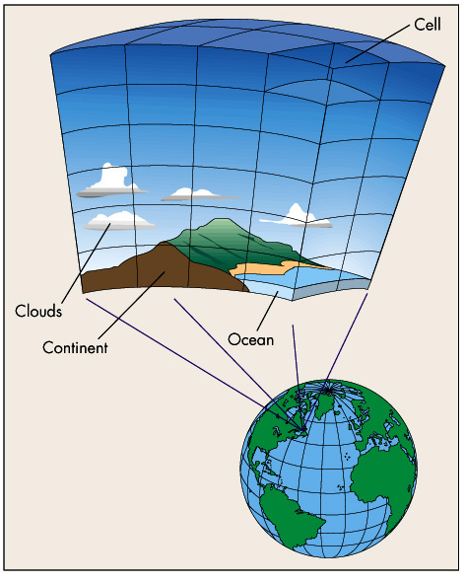
GCM Resolution:
Depends on size of grid cells

Slide 8
Advantages of using GCMs in the classroom
Allows students to use authentic ‘research’ tool
Promotes inquiry
Students consider climate system complexity
Visualization may enhance understanding of system dynamics

Slide 9
Challenges of using GCMs in the classroom
Most models are NOT USER-FRIENDLY! (Require extensive setup and advanced computing skills – for instructor AND students)
User-friendly models tend to cost more than many departments can afford.

