Slide 1
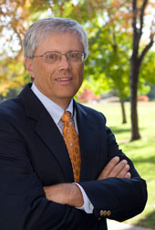

Free modules and resources for climate education
Tim Spangler
Director
The COMET Program
Boulder, CO

Slide 2
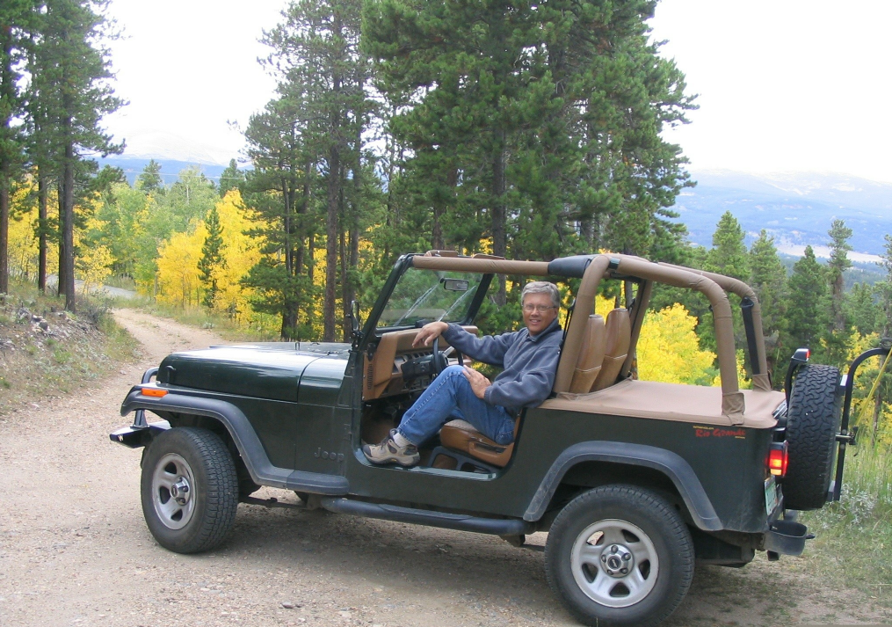
Notes:
A less formal picture of Tim in his natural habitat.

Slide 3
Who We Are
Federally funded education and training program for working meteorologists
Part of the University Corporation for Atmospheric Research in Boulder, CO
Over 600 hours of free, online training at www.meted.ucar.edu
Notes:
The COMET Program was established to provide education and training for meteorologists, primarily in the National Weather Service, Navy, and Air Force.
UCAR is a consortium of 75 universities created to promote atmospheric research
COMET online learning modules include interactive and print versions
About 1/3 of the modules are available in Spanish

Slide 4
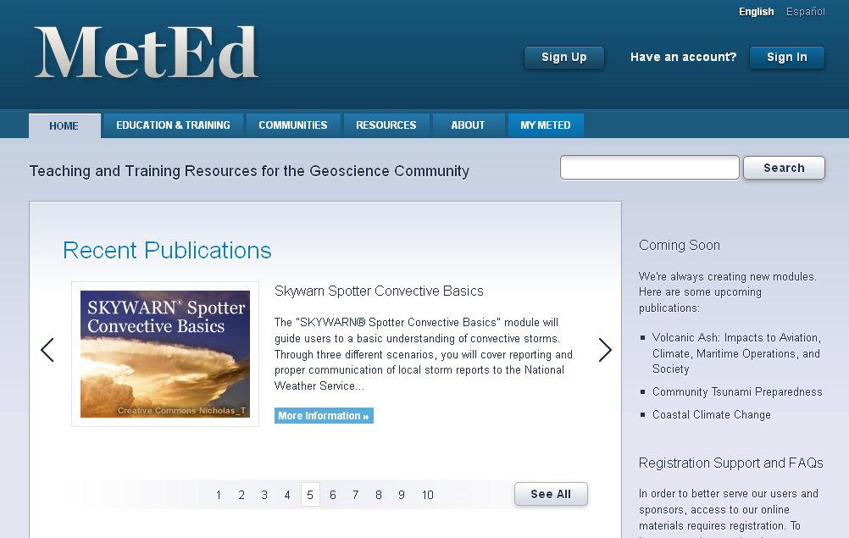
Our MetEd Website
Notes:
Most of the content was designed primarily for working meteorologists, so not all of it is appropriate for students or the general public.
However, we have over 200,000 registered users, the majority of whom are educators and students
The website offers complete courses, individual modules, and access to graphical images and animations used in our materials

Slide 5
WWW.METED.UCAR.EDU
Notes:
To access modules on the website, you’ll need to register in the system, which is free. In addition to viewing the modules, registrants can take quizzes, keep track of their scores, and have their scores forwarded to a teacher or supervisor.

Slide 6
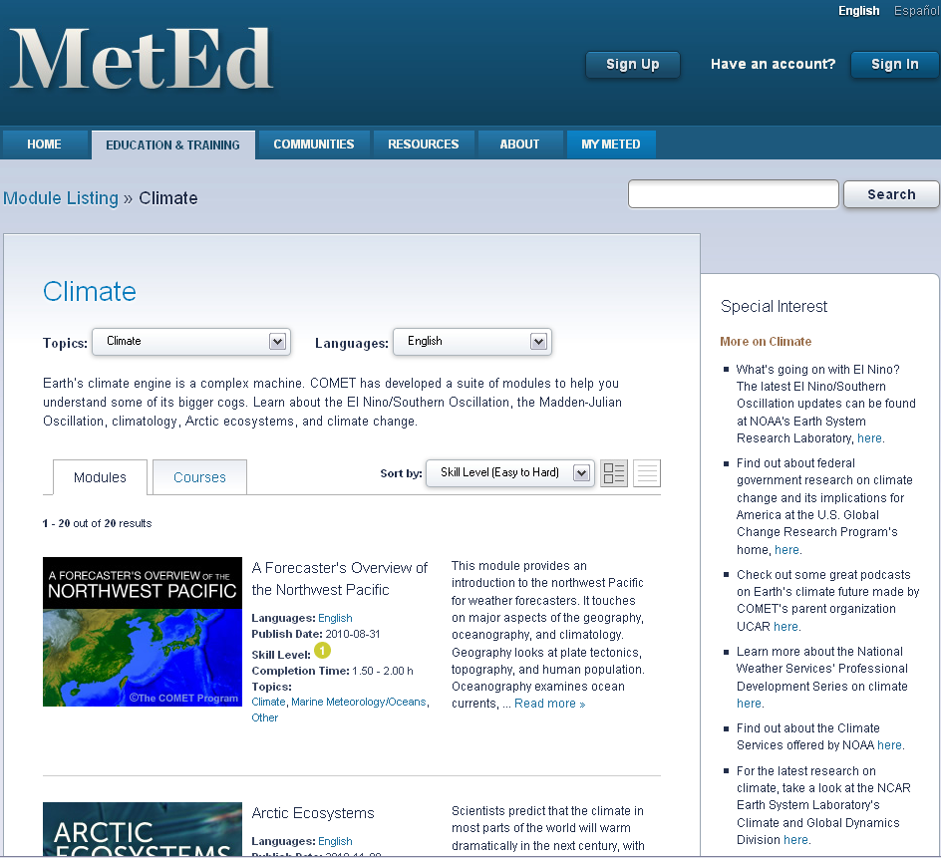
Climate Resources
Notes:
Navigation to the modules is through the Education & Training tab. In this example, we’ve selected the Climate topic. All the modules in that topic area will be displayed on the screen, with a description, information about the skill level, estimated completion time, and the languages the module is available in.

Slide 7
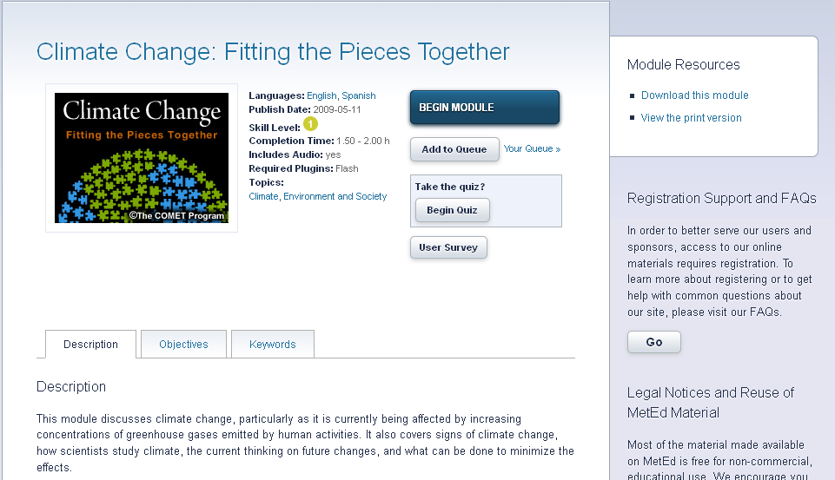
Notes:
This is the information for our module that provides the most comprehensive view of climate change. If you are registered, you would click “Begin Module” to start taking the instruction.

Slide 8
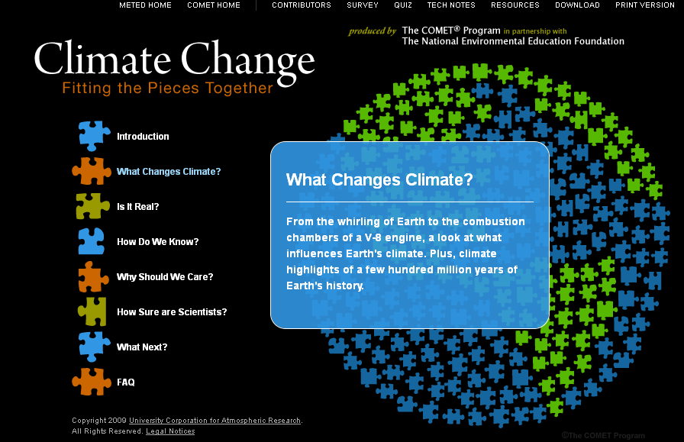
Notes:
Here’s an example of one of our modules—this one happens to have been designed for the general public
If you roll over the sections names, you’ll see some information about what’s in it
As are many of our modules, this module is a multimedia one—it has audio, graphics, interactions, and animations. As we’ll see later, images from our modules are generally available as individual objects for you to download and reuse in your own educational presentations.

Slide 9
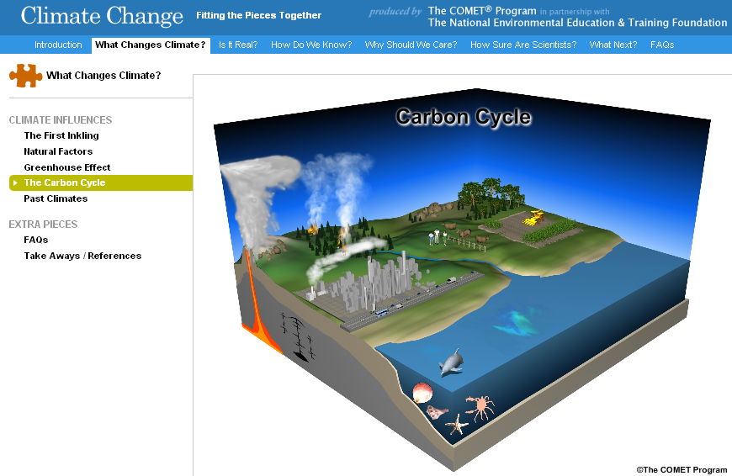
Notes:
In the section “What Changes Climate?” this graphic shows the carbon cycle. In the live module, audio plays and describes the various components of the carbon cycle as the “camera” zooms in.

Slide 10
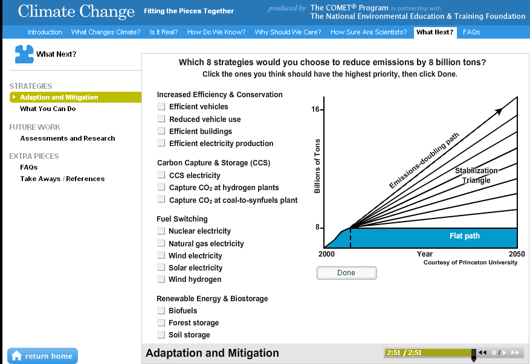
Notes:
This interaction in the “What Next?” section of the module has the student pick 8 strategies to reduce emissions to keep us on a path of no growth in CO2 emissions. Of course, there is no right answer. Once the student clicks “Done”, the interaction reveals information—both advantages and limitations—about each strategy.

Slide 11
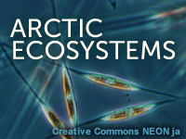
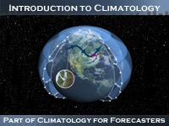

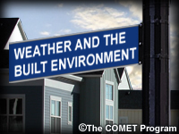
Notes:
Just to give an idea of the variety of topics, here are some of the other modules in the climate section. Some of these may be designed primarily for meteorologists. However, you may be able to use materials (content or images) from the modules for your own educational needs. Note also that you may find useful content in other topic areas besides climate—feel free to explore!
Arctic Ecosystems: This module explores the Arctic Ocean ecosystem through interaction with a model that simulates how phytoplankton and zooplankton interact and respond to changes in season, sea ice, and nutrients.
Introduction to Climatology: an overview of the study of climate.
Understanding Drought: presents the measures and scales of drought, how drought is monitored and predicted, the impacts of drought, and information about drought-related resources
Weather and the Built Environment: overview of the evolution of our modern urban environment with a focus on impacts on the urban watershed, air quality, and climate.

Slide 12
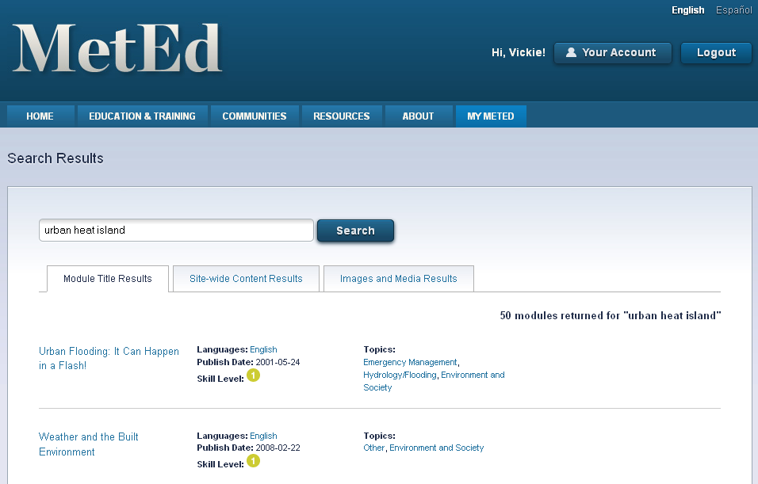
Notes:
Let’s say you want to find an image to illustrate something in a presentation you’re giving. Using the search function, let’s do a search on “urban heat island”. This tab shows modules that have something related to those words. Then if you click the Images and Media Results tab you get…

Slide 13
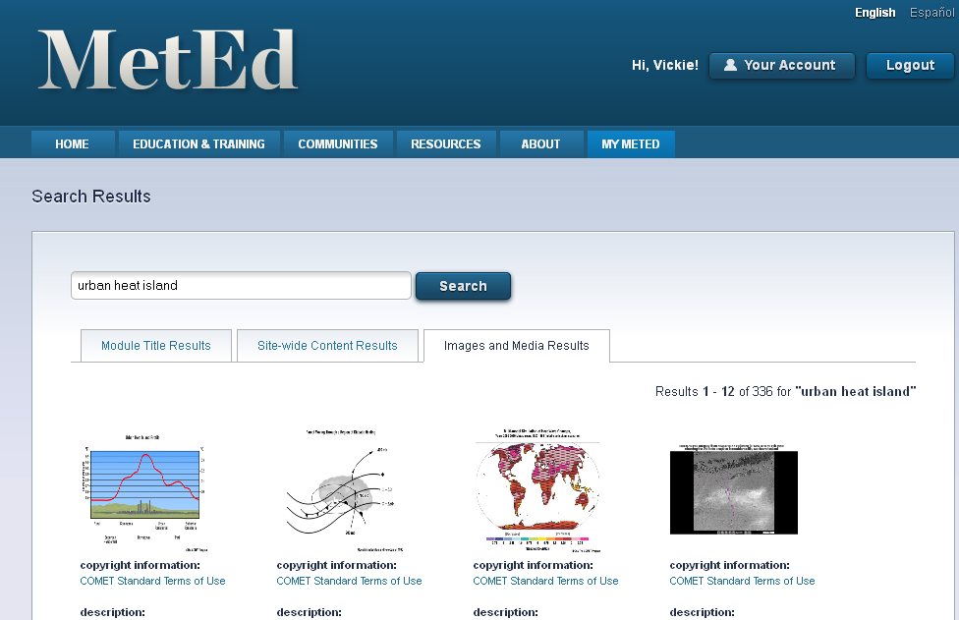
Notes:
Images and animations from the search. Like a Google search, not all of these may be exactly what you’re looking for. If you put the phrase in quotes, the search will be more exact. If you were to click on the first image…

Slide 14
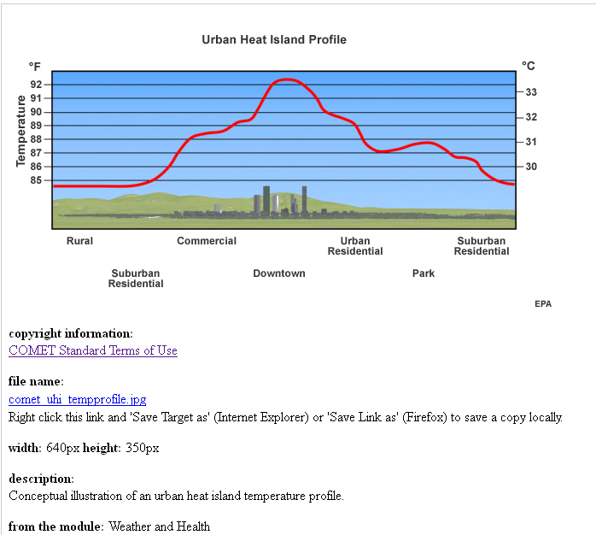
Notes:
You would go to the image or animation that you can save to your computer for use in your work. Copyright information is provided below the image. In general, COMET Standard Terms of Use allow the image to be used for non-commercial purposes.

Slide 15
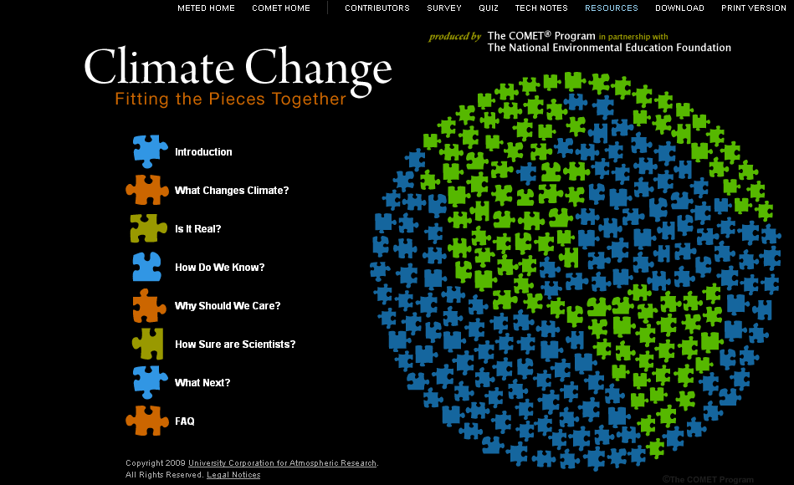
Notes:
Another way (easier) to find resources is via a direct link to images that many of our modules have. In the case of this module, you would click the Resources link in the top menu.

Slide 16
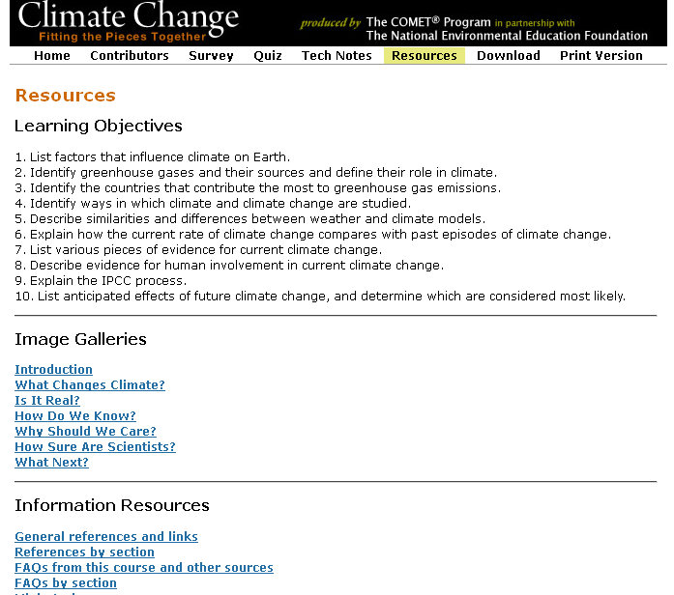
Notes:
The “Image Galleries” section is a compilation of all the images used in the module. If you clicked on the link to “Is it Real?”, you would go to the following…

Slide 17
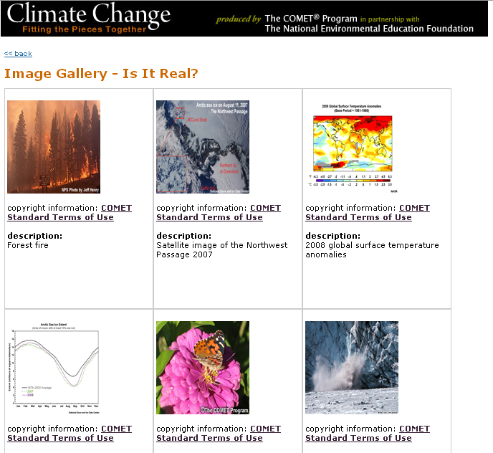
Notes:
This has all the images for this section and again, all you have to do is right click to download the image or animation.

