Slide 1


In-Class CO₂ Activity:
Randy Richardson
Department of Geosciences
University of Arizona
Online Workshop
About Teaching
Climate Science
8 June 2011
See also: http://serc.carleton.edu/introgeo/interactive/examples/co2.html

Slide 2
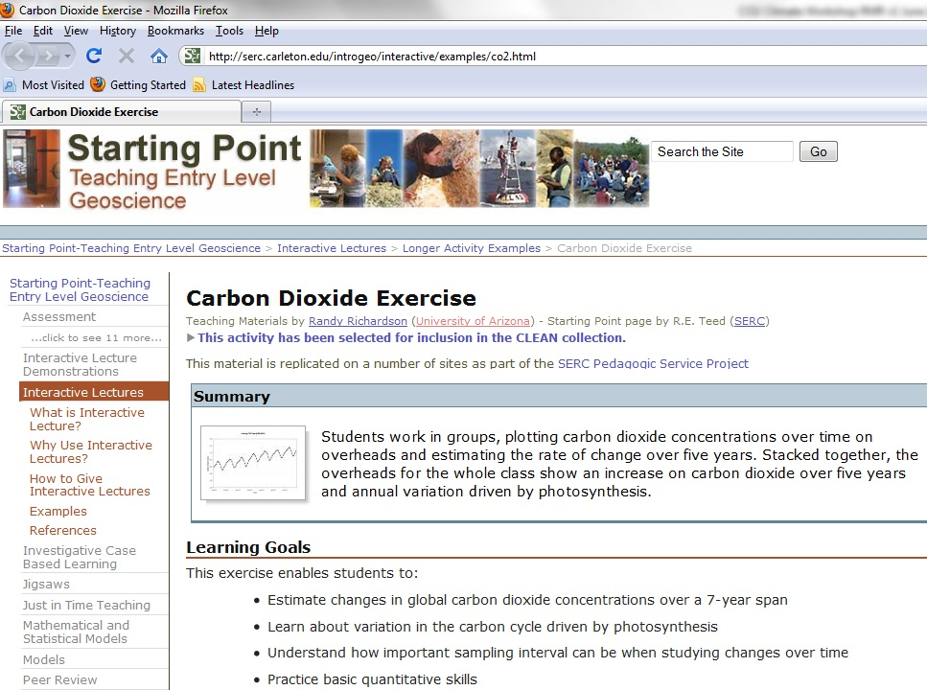

Slide 3
Objective of Activity:
Students will be able to use real CO₂ data to measure rates of CO₂ increase over time.
Background Information:
CO₂ (Carbon Dioxide) is a trace greenhouse gas that is strongly correlated with global temperatures … the more CO₂ in the atmosphere, the warmer Earth’s atmosphere and surface become because of the ability of CO₂ to absorb Earth’s outgoing infrared radiation.
The slope of a line in a graph is the ratio of the rise (the Y-axis) over the run (the X-axis), and has units of the rise axis over the run axis. For example, if a graph has time (hours) as the X-axis and distance (miles) as the Y-axis, then a line will have slope of miles/hour.

Slide 4
Overview of the Activity:
In my class student groups plot 8 CO₂ concentrations from Mauna Loa, HI, taken between 2003 and 2009 on a graph provided, using randomly selected data on next slide.
Today you will each plot one of 31 randomly selected data points from the 84-point 2003-2009 data set.
As a group we will estimate the slope of the best line through our 31 data points.
(Students estimate how many years it will take for CO₂ concentrations to double at the rate they’ve found.)
(Students learn about problems associated with incomplete data)

Slide 5
Use the day of the month (1-31) of your birthday for Group G; Plot the 8 data points on the graph.

Slide 6
8 Data
Points
Group # ______
Line
392
391
390
389
388
387
386
385
384
383
382
381
CO₂ Concentration (ppm)
380
379
378
377
376
375
374
Slope = ______ ppm
373
372
2003
July
2004
July
2005
July
2006
July
2007
July
2008
July
2009
July
2010

Slide 7
Group # __29__
392
391
390
389
388
387
386
385
384
383
382
381
CO₂ Concentration (ppm)
380
379
378
377
376
375
374
Slope = _2.1__ ppm
373
372
2003
July
2004
July
2005
July
2006
July
2007
July
2008
July
2009
July
2010

Slide 8
Sharing your results:
Hopefully you were able to plot your data points …. ☺
Did the data set we plotted look very noisy?
  Any ideas why?
    (Incomplete data …)
Let’s look at the data sets a little more closely …

Slide 13
http://bluemoon.ucsd.edu/pub/cdrg/continuous/monthly_mlo.csv

Slide 14
In-Class Activity:
What are your reactions?
Have you done anything similar?
What do you think works well?
What do you think doesn’t work?
How might you modify the exercise for you setting?
Other comments?

