Slide 1
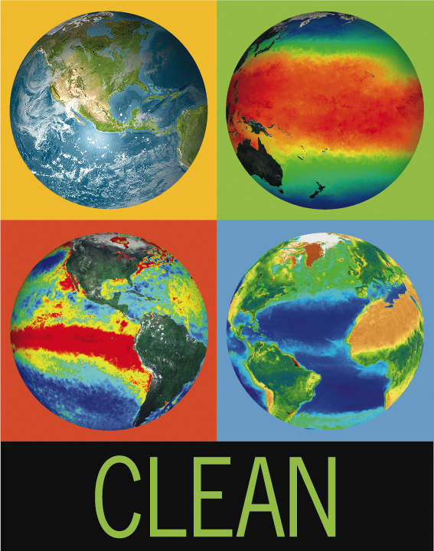
The Climate Literacy Network: Leveraging a Diverse Community to Broaden the Reach of Your
Climate Literacy Efforts
Tamara Shapiro Ledley, TERC
Scott Carley, College of Exploration
Frank Niepold, NOAA Climate Program Office
Don Duggan-Haas, Museum of the Earth
Karen Hollweg, NAAEE
Mark McCaffrey, NCSE

Slide 2
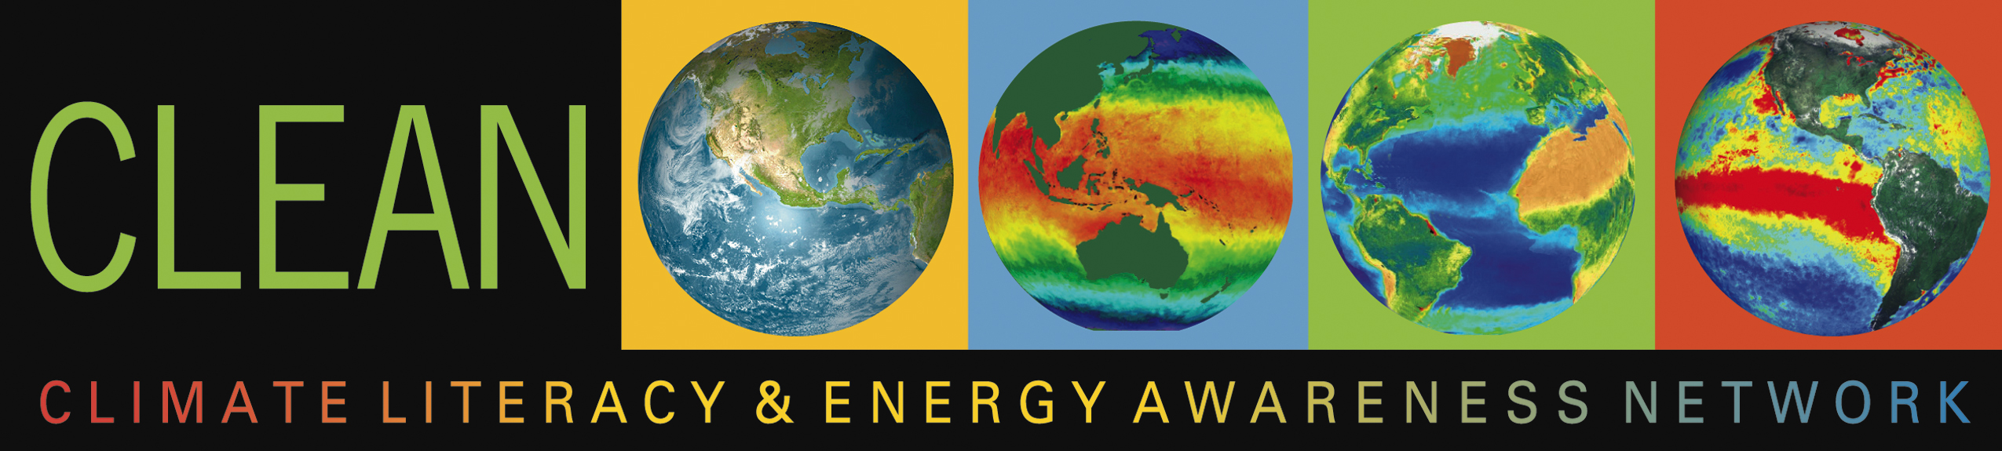
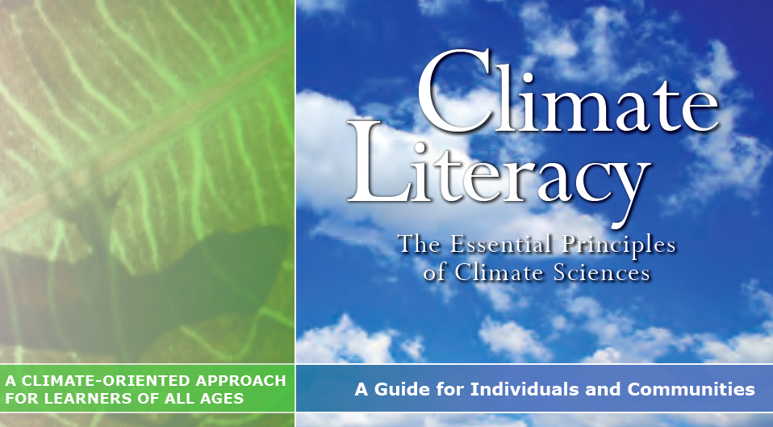

Formed January 2008
  20 members
  Pressing need to infuse climate literacy into educational contexts to prepare society and future workforce to address the environmental issues and challenges of the future.
December 2012
  379 members
2008
2010
2012

Slide 3
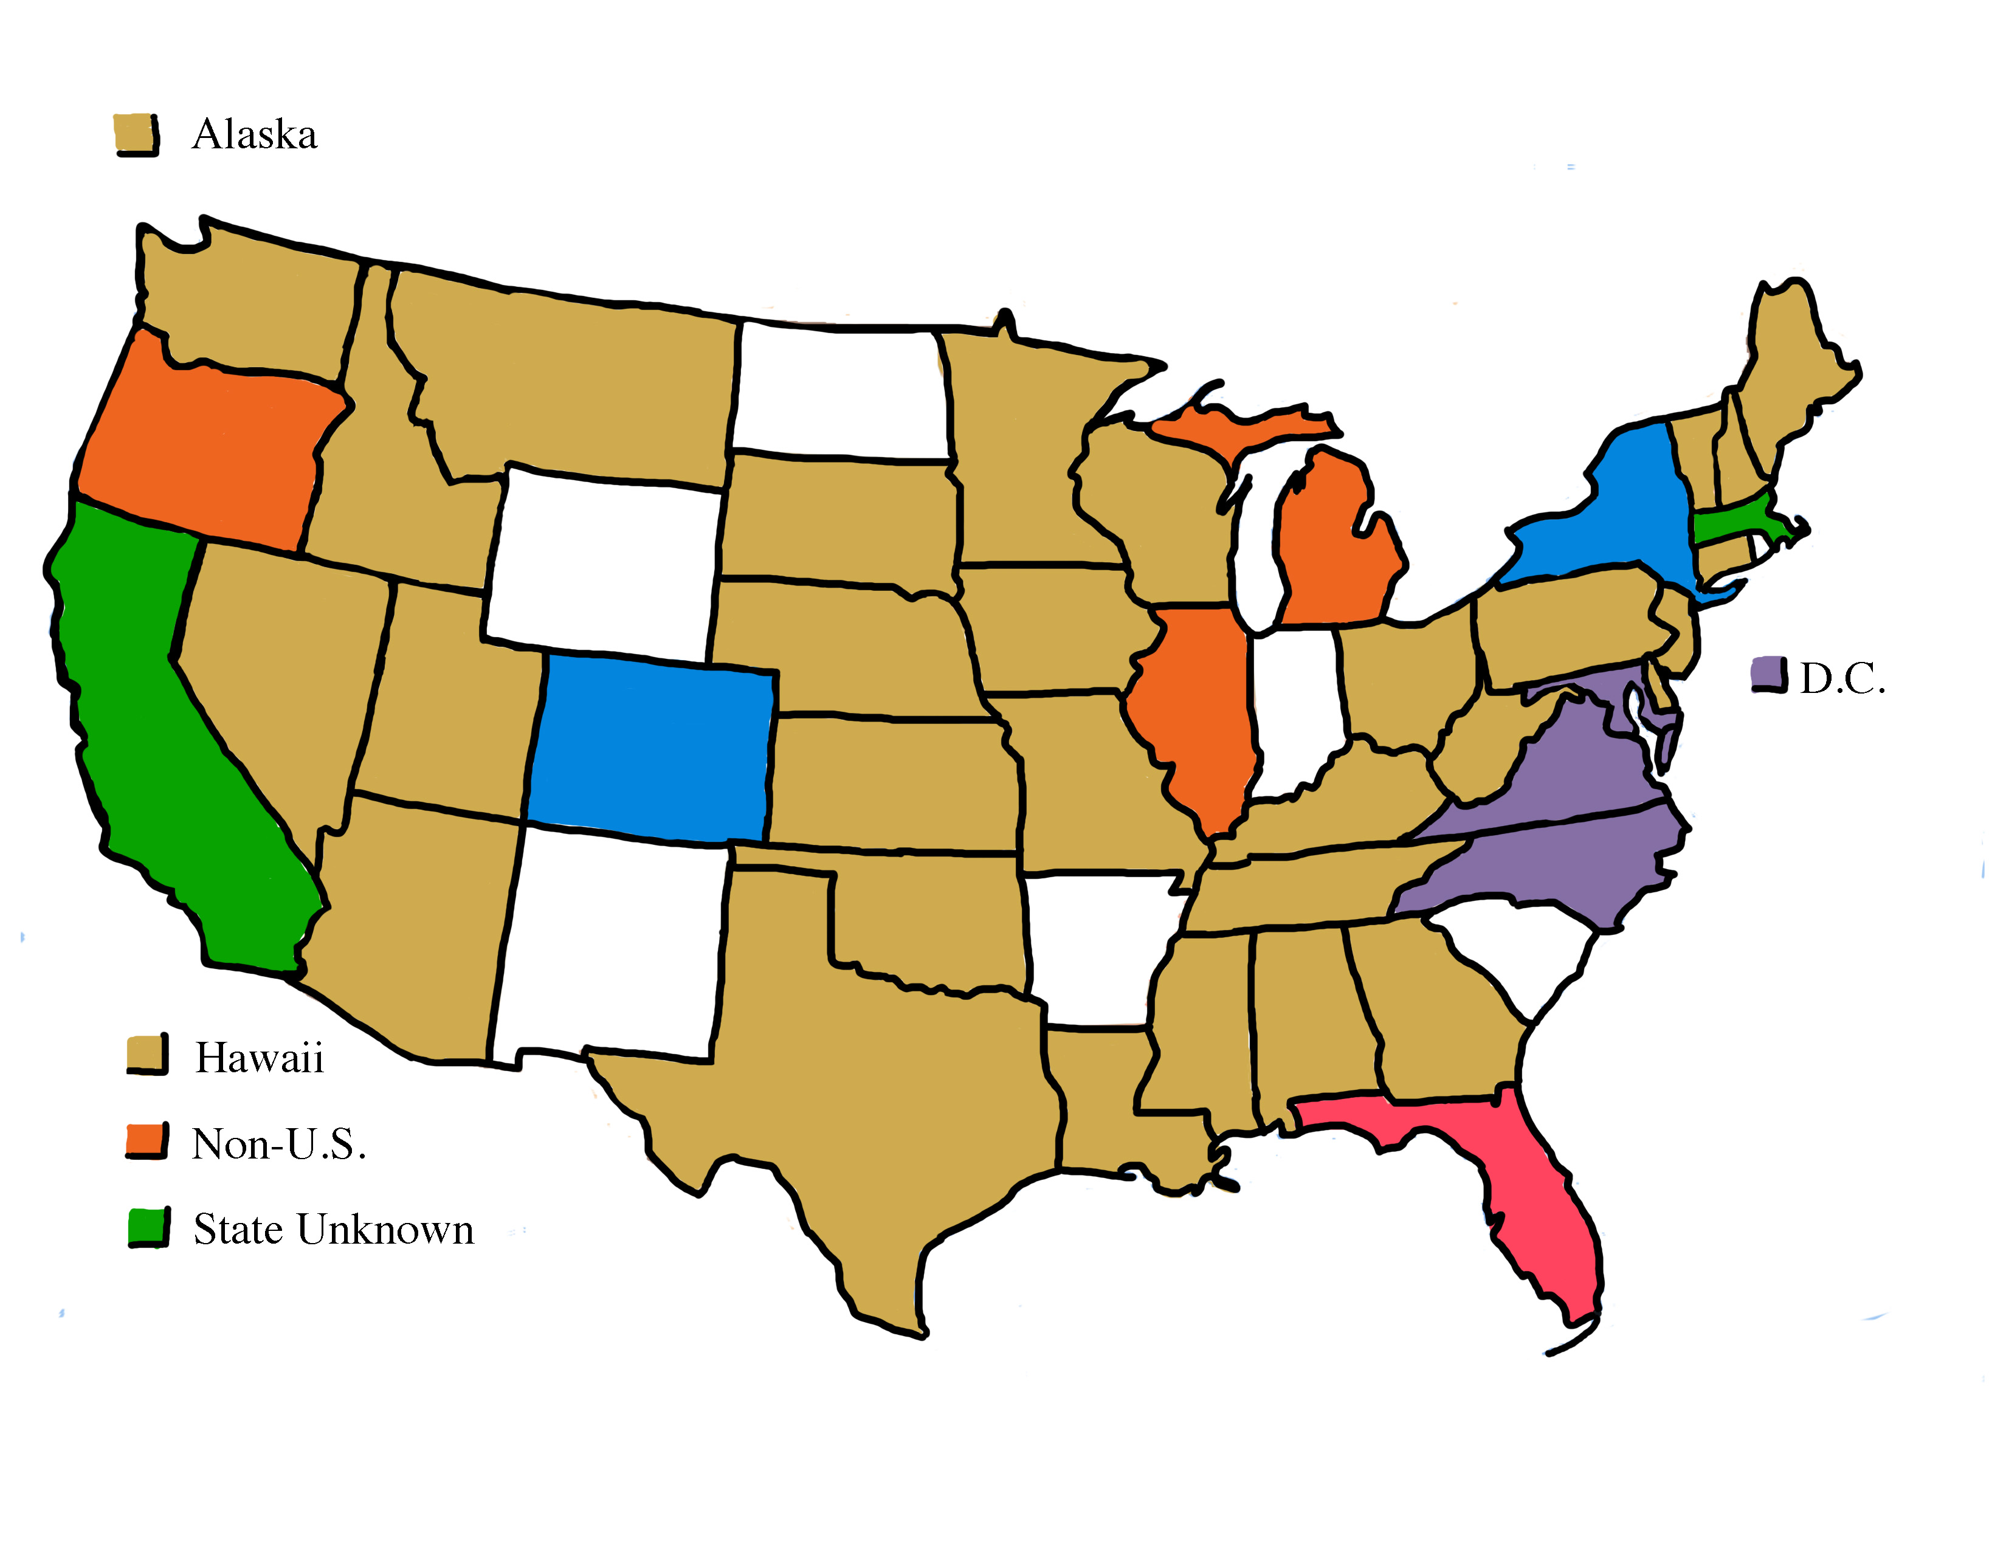
Distribution of CLN Members
# of Members
0 = white
1 - 5 = beige
6-10 = orange
11-15 = rose
16-20 = violet
21-25 = blue
>25 = green
October 2012

Slide 4
Activities of the CLN
Weekly Teleconferences & Active Listserv
  Discussions around the complex issues involved in making climate literacy accessible for all citizens
  Members leverage the expertise in the CLN to gain guidance for their individual efforts, share cutting edge news, ideas, opportunities, and more.
Organize sessions and presentations at professional meetings – AGU, GSA, NAAEE, NSTA
Provided input documents relevant to climate literacy
  E.g. Next Generation Science Standards
Partnerships and CLEAN

Slide 5
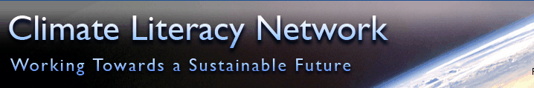

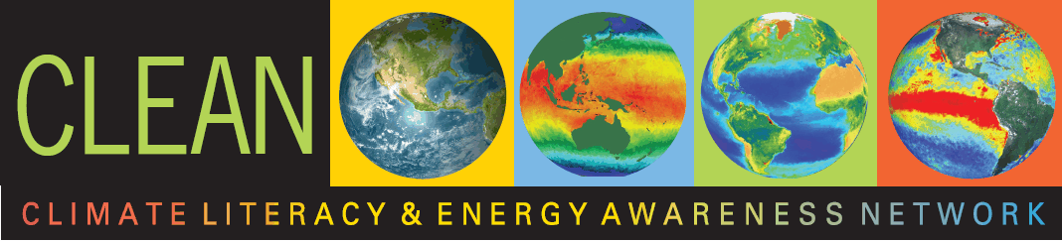





CLN – Climate Literacy Network
National Science Digital Library’s
Climate Literacy and Energy Awareness Network

Slide 6
Organize Sessions/Presentations at Professional Meetings
Organized sessions at Fall AGU Meetings
  2011 – 5 sessions ~100 papers
  2012 – 6 sessions (8 oral, 6 poster), ~170 papers
Organized sessions at GSA Annual Meeting
  2012 – 2 sessions
NAAEE
  CLN Roundtable & coordinated suite of presentations – 2010, 2011 & 2012
Active in the Tri-Agency Climate Change Education Community

Slide 7
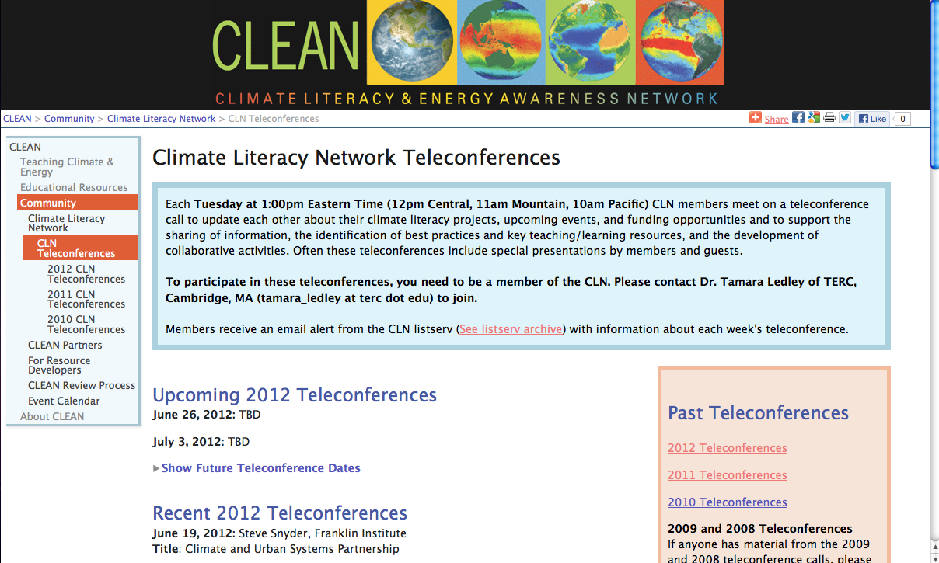
http://cleanet.org/clean/community/cln/telecon_schedule.html

Slide 8
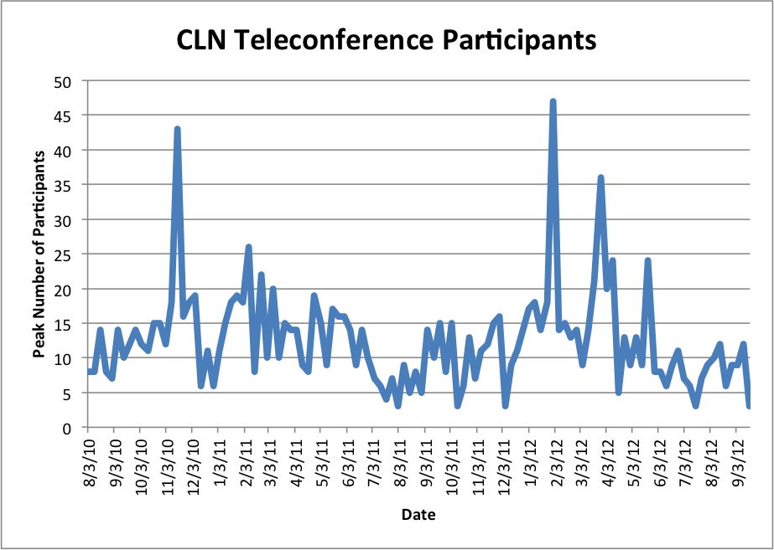
Teleconferences
Tuesdays 1pm ET
Nov 16, 2010 – Council of Environmental Deans and Directors
Feb 8, 2011 – NASAs Global Climate Change Website
Jan 31, 2012 – CLEAN Review Services
March 27, 2012 – Earth The Operators Manual
April 10, 2012 – Lessons Learned from the Evolution Trenches
May 22 & 29, 2012 – CLN Community provides response to Draft NGSS
Members can also received feedback from this diverse community
Aug 13, 2010 - Sept 18, 2012
Total Number of Teleconferences = 111
Total Number of Presentations = 52
Average number of participants = 13
Slides and Recorded Teleconference Posted

Slide 9
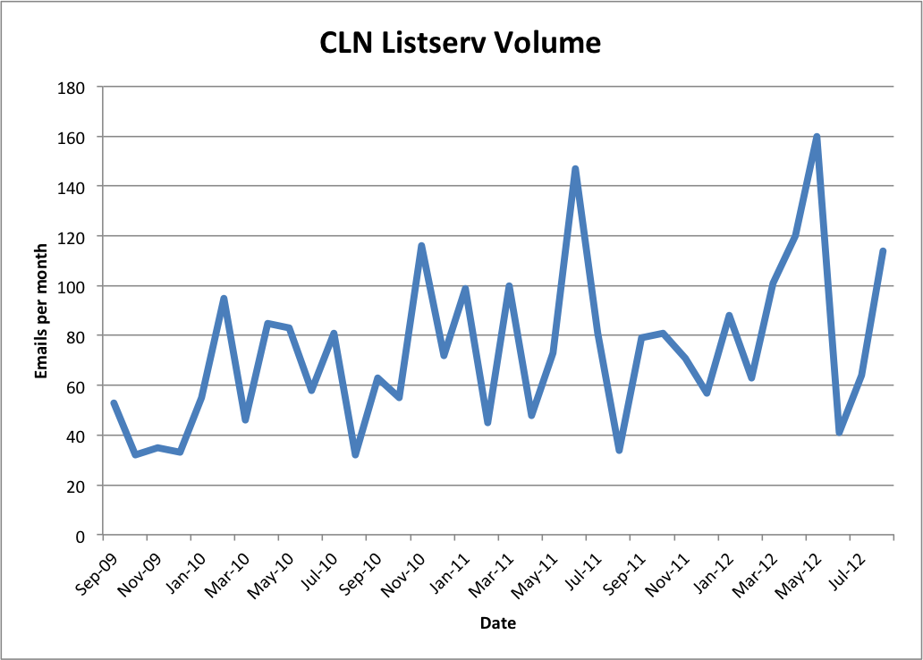
Listserv
Example Topics of Listserv Discussion
June 2011
Climate of Denial
Global Warming/Climate Change…the truth
Extreme weather and climate change
April 2012
Capturing interest of disinterested students
Energy Consumption/greenhouse gas Inventory Tools
Debate on how to teach Evolution and Climate Change
Panel Discussions on future CLN calls
September 2009 – August 2012
Average volume per month: 74
2009: 38 (4 months)
2010: 74
2011: 76
2012: 94 (8 months)

Slide 10
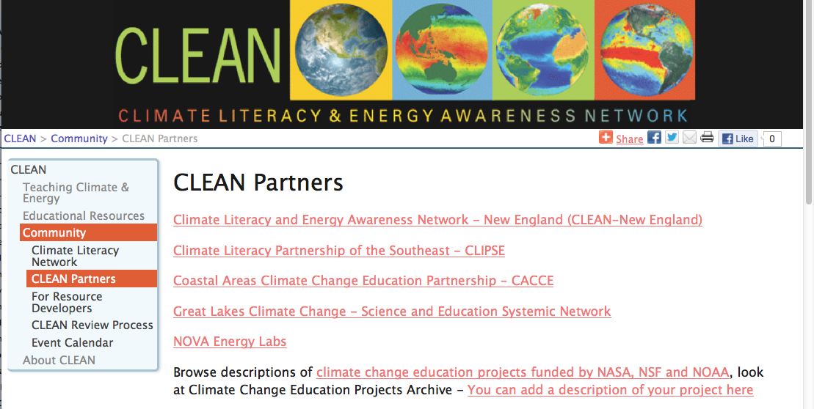
http://cleanet.org/clean/community/partners.html

Slide 11
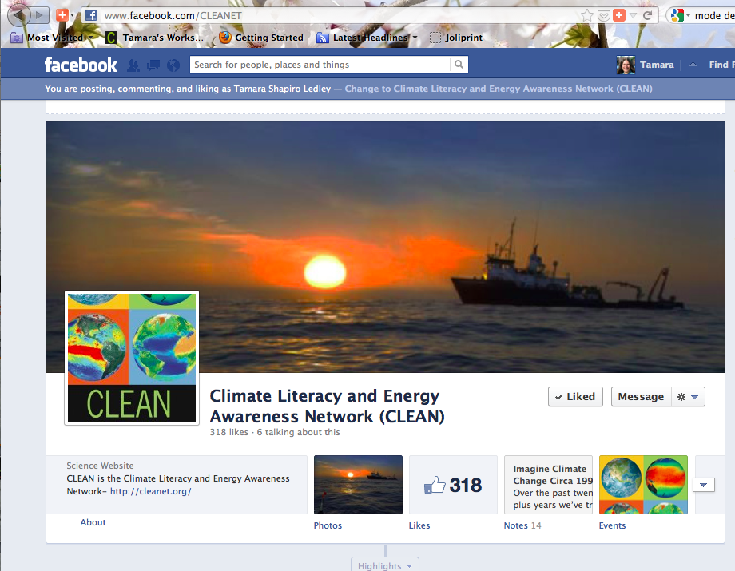
CLEAN Facebook Page
http://www.facebook.com/CLEANET

Slide 12
Climate Literacy Network
  http://cleanet.org/cln
  Listserv: climateliteracynetwork@list.terc.edu
  Teleconference Tuesdays 1pm ET
CLEAN Pathway Portal – http://cleanet.org
Contact: Tamara Ledley
  Tamara_Ledley@terc.edu, 617-873-9658

Slide 14
AGU 2012 Climate Literacy Sessions
Climate Literacy: Barriers, Misconceptions and Progress in Improving Climate Literacy: ED11E, ED12A, ED13B
Climate Literacy: Evidence from Research and Evaluation on Effectiveness of Interdisciplinary Programs: ED12B, ED13C
Climate Literacy: Great Lakes Climate Change Education Initiatives: ED13D
Climate Literacy: Preparing K-12 Students to Address Next Generation Challenges: ED21D, ED22B, ED23A
Climate Literacy: Reaching Diverse Audiences Through Informal Education Experiences, Public Outreach, and Community Programs: ED31C, ED32A, ED33B
Climate Literacy: Higher Education Efforts in Climate Change Education: ED33A, ED42A

Slide 15
GSA 2012 Climate Literacy Session
Climate Literacy: Educational Research and Evidence of Progress in Improving Climate Literacy
Climate Literacy: Formal and Informal Educational Activities and Community Outreach to Support an Informed Society
Uncertainty in Earth and Climate Science: Communicating Uncertainty to the Public

