Slide 1
Social Media for Organizations and High-Profile Individuals
Maureen Moses | Ellen Klicka
American Meteorological Society
Notes:
We hope you’ve had a chance to do some of the homework items Emily presented on May 7.
This presentation will not be a tutorial format or contain a lot of nuts-and-bolts “how-to” type of tips. We are aiming to go over some examples of how organizations and high-profile individuals have leveraged social networks as strategic tools to accomplish their communications goals. We also will present concepts and ideas that will help you get more out of your experiences consuming social media content and maybe inspire you to apply some concepts in your organizations. For how-to questions, please feel free to follow up with us offline after this call.

Slide 2
American Meteorological Society
Member society that represents over 14,000 weather, ocean, climate and hydrologic scientists
Founded in 1919
Publishes 10 major peer-reviewed journals
501c3 non-profit
Main office in Boston
Satellite DC office: Education and Policy departments
Notes:
Quick facts about AMS (for those who don’t know)
Highlight that Ellen and Mo are not in the Boston office

Slide 3
Organizations: Social Media GOALS
Connect with others in your field or others who share your views
Steady stream of ideas, content, resources focused on your interests
Monitor what’s being said about your organization
Monitor what’s being said about your partners
Extend the reach of your thought leadership
Promote your products and services directly to a target audience
Start with #1 and work your way down
Notes:
Connect with people you know offline – this can be a way to help you keep in touch. I did that with AGU, WRI and NOAA Communications staff. Following the right organizations and people is an art. The part about sharing your views can be tricky when it comes to climate change. You don’t want to be dismissed for only making company with a small portion of the community.
This can help keep your content feed alive during dead spots. It’s generally good practice to mix original and shared content. Your audience will like the variety. Sharing the content of others shows that you value others’ ideas and that you give credit where it’s due.
3. You can find out instantly. This can be helpful if damage control is needed.
4. I use the term partner in a very broad sense. Any person or organization that touches yours and has a stake in your success and vice versa. This can help them protect their brands.
5. For example, blog posts and other content
6. This goal is last for a reason. Don’t go shouting how great your organization is until you have a network of connections who believe in your brand.

Slide 4
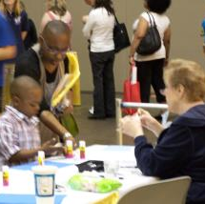
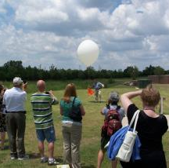
AMS Education Program
Audience
  Educators
  Scientists
  Students
Research News (f,t)
  (f) longer description
Opportunities for educators and students (f,t)
News about the organization (f,t)
Photos (f,t)
Ask questions (t)
Notes:
Audience based on Ed Pgm work + concerns from members and leadership.
GOALS: have members understand what we do (and think highly of it), share other opportunities with educators, and share exciting information/news. Product of me being an excited individual.
Photos: events relevant to Ed Program Mission, or REALLY cool science pictures
Outcomes: have found new members (typically studnets) for AMS, have increased visibility, have developed relationships with scientific groups (partially because I know people at those organizations) but also because I share their exciting news too.
Continued Work: transition to intern (AGU, typical of other organizations); how to successfully market our products via social media.

Slide 5
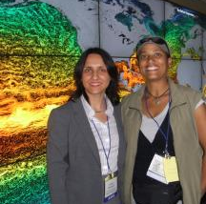
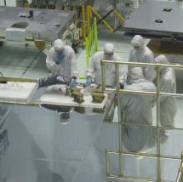
AMS Climate Studies Diversity Program
Currently Happening!
Live-tweeting is a great way to generate interest; momentum
#AMSDiversity13
@-tweeting funders/partners
Demonstrate to membership what AMS does to promote diversity in the Earth sciences
Gratuitous use of #tags.

Slide 6
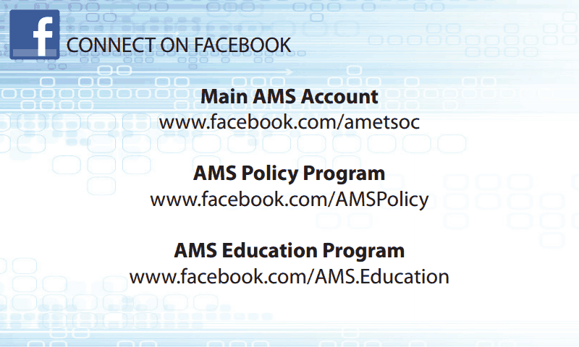
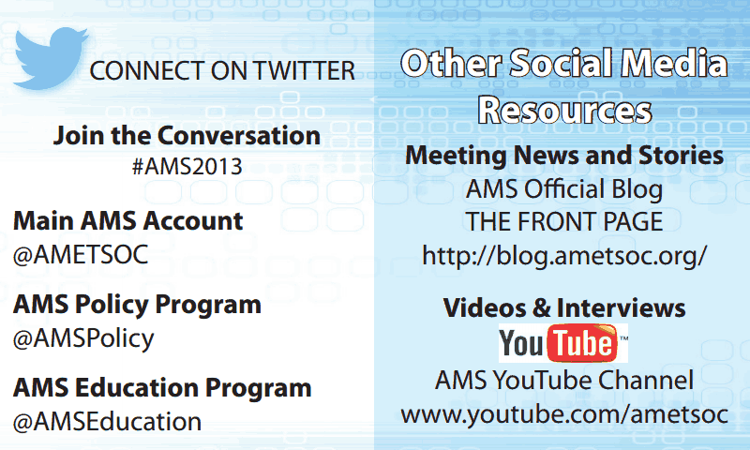
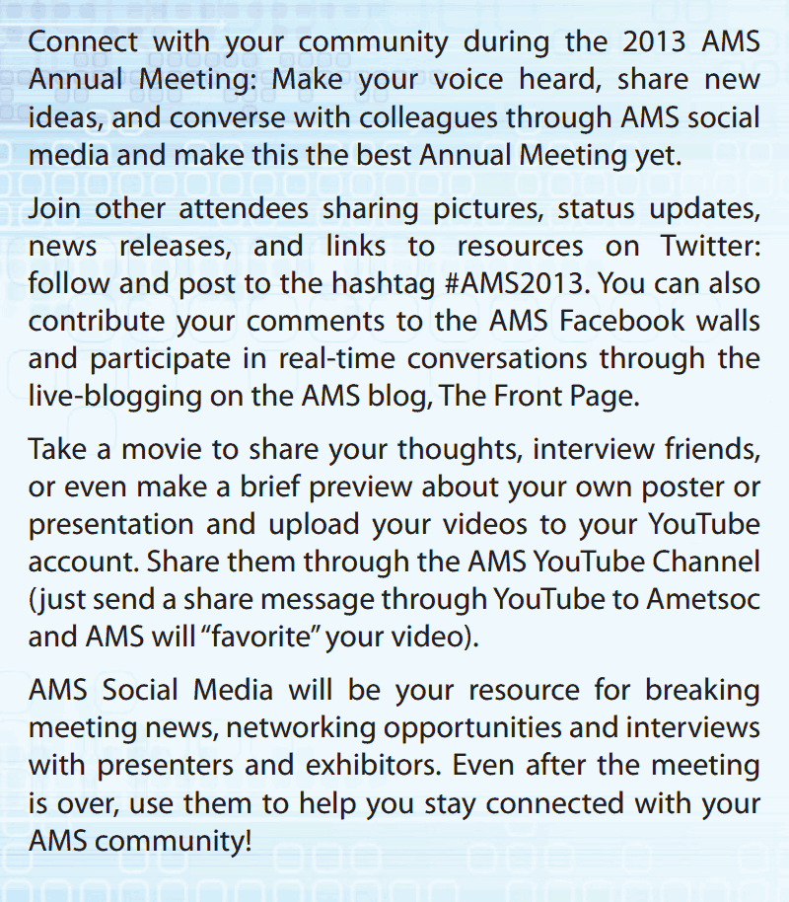
Case Study: Annual Meeting 2013
Similar goals
  Policy Program, Education Program, Membership Committee, eager members
Created unique identifiers for the event
  #Tags (t)
Created a “business card” with relevant information (~$100)
  who to look for on f/t
  How to use Social Media
  Why to use social media
Pulse of the event
Form new relationships within AMS
Notes:
Formed by common interests of different groups at AMS
As a group, we decided what #tags should be, and formed a meeting strategy (including Social Media “leadership”)
Created a “business card” to promote this at the annual meeting, Follow people travelling to the meeting, what research they found important and which events resonated
New relationships which lead to AMS Public Relations team

Slide 7
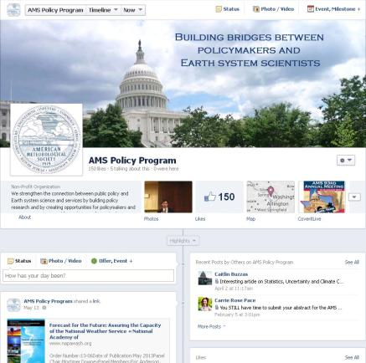
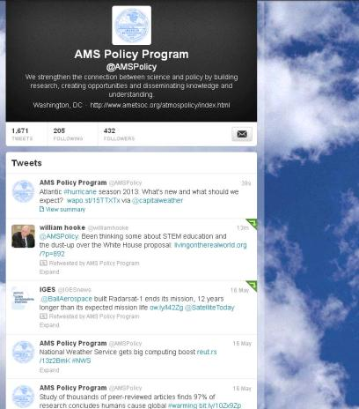
AMS Policy on Social Media
Twitter, Facebook, YouTube and LinkedIn

Slide 8
2013 AMS
Washington Forum
The AMS Washington Forum: 120 attendees
Comments not for attribution
Twitter hashtag: #AMSWF
LinkedIn group for attendees
AMS blog posts
No new accounts
Both AMS staff and attendees were very active
  Promoted social media plan
  Got buy-in from heavy social media hitters
Press plan included social media:
Twitter
LinkedIn
Facebook
Blogs
Notes:
Activity during the event included live tweeting and posting photos to Facebook

Slide 9
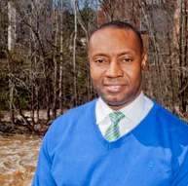
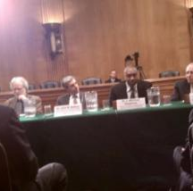
Marshall Shepherd:
High-Profile Individual Case Study
Follows the right sources
Networks online and offline
Shows his passion for science
Captures the “so what?” succinctly
Takes time to reflect and write thought-provoking content
Professor and Research Meteorologist, University of Georgia
Director, UGA Atmospheric Sciences Program
President, AMS
Frequently quoted in media
Testifies before Congress

Slide 10
Social Media Resources
Social Media Examiner
  www.socialmediaexaminer.com
Influential Marketing Blog
  http://www.rohitbhargava.com/integrated-marketing

Slide 11
Contact
Maureen Moses, AMS Education
  mmoses@ametsoc.org
Ellen Klicka, AMS Policy Program
  eklicka@ametsoc.org

