Slide 1


Slide 2
Outline
5 minutes: overview and history
10 minutes: quick demo
5 minutes: ways to get involved
Discussion and questions.

Slide 3
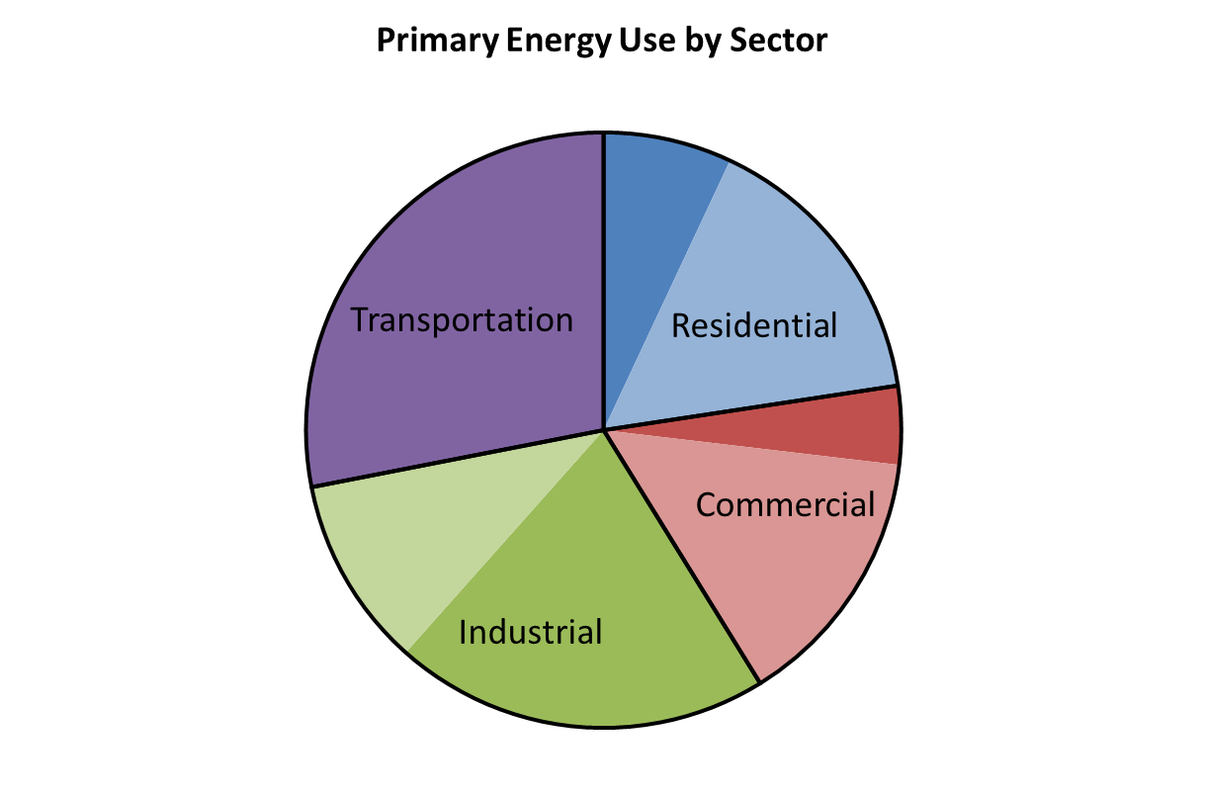
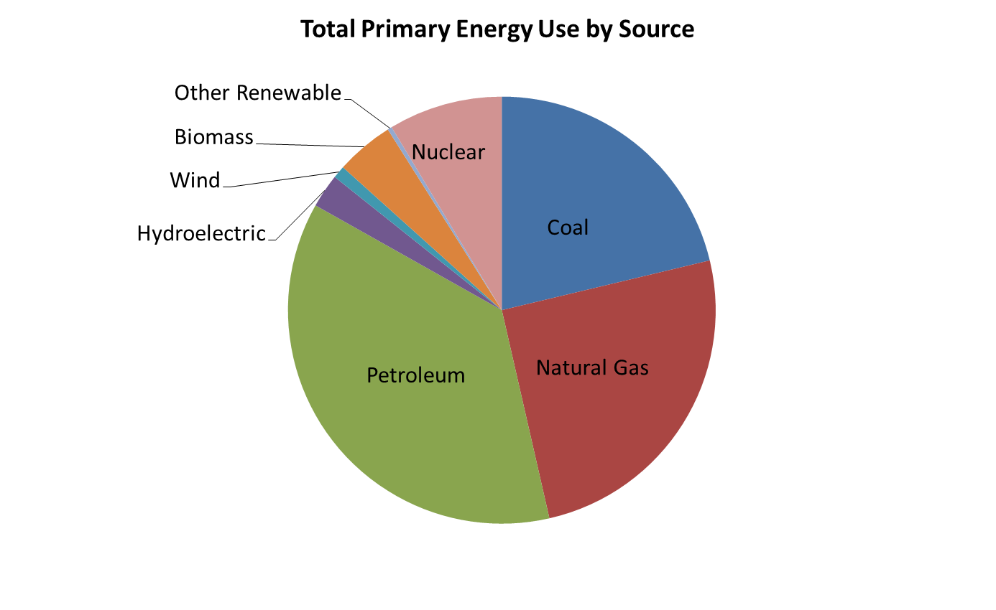
Energy Use in the United States
Total Energy Use = 98 quadrillion Btu
(in left chart, lighter shade is energy for electricity used in that sector)

Slide 4
Background
Energy use is intrinsic to the whole economy
We use a wide variety of different sources of energy for different services
The media and other sources are inundated with pros and cons for many energy options
Learning about and comparing the impact of various options is important, but with such a complex system, it is extremely challenging.

Slide 5
The Office of Energy Efficiency and Renewable Energy (EERE): Multiple Goals and a Diverse Portfolio
Electric Generation
Transportation
Efficiency Research
Deployment
Geothermal
Water
Wind
Solar
Vehicles
Biofuels
Hydrogen
~$2 billion
Industry
Buildings
Federal Energy
Weatherization
Blue dots are energy efficiency, Green dots are renewable energy, and orange dots are deployment. Dot size proportional to program budget
Notes:
EERE has a total annual budget for research, development, demonstration, and deployment across ten programs of about $2 billion (varies by year).
Ten Programs, Many Goals – each program supports different technologies with different proximities to market and varying potential benefits.
How do we add up cheaper batteries + higher capacity factor wind + efficient refrigerators?

Slide 6
EERE Goals and Related Tools
EERE has diverse goals (environmental, economic, energy security) and various programs on the supply and demand sides of energy
Strategic Analysis developed tools to combine the impacts of technology development and deployment in all these EERE areas
These tools were instructive for the team, so we developed a version for the web.

Slide 7




Four Sectors in BITES
Building Codes
Retrofits
Appliance Efficiency
Industrial Efficiency
Fuel Switching
Light-duty Vehicle Efficiency
Heavy-duty Vehicle Efficiency
Renewable Fuels
Demand (Miles Driven)
Natural Gas
Renewables
Nuclear
Carbon Capture and Sequestration

Slide 8
Demonstration

Slide 9
Goals for Education
Learn where we get energy and where we use energy in the U.S., as well as the associated emissions
Experiment with options to change the energy future of the U.S.
Explore the trade-offs between sectors and individual technologies
Generate a realistic cross-sector scenario that meets or approaches energy and carbon emission targets
Share learning by discussing, comparing, and justifying selected scenarios

Slide 10
Example Workshop
Developed and piloted a draft curriculum
Workshop timeline (approximately three class time hours, 10 minute break in the middle):
  Introduction (30 minutes): covers U.S. energy use, the prospects for clean energy, and societal context
  BITES demo (10 minutes): run through the features of the tool
  Sector exercises (45 minutes): student groups attempt to meet energy and emissions goals by implementing changes in one sector each (buildings, transportation, industry, electricity)
  Group exercises (45 minutes): redistribute students among different groups so each group has at least one representative from each sector to be an ‘expert’; focus on developing a combined scenario to meet goals
  Presentation, discussion of scenarios, and class consensus scenario (40 minutes): constructive discussion of the plausibility of scenario components.
Optional: pre-lesson readings (45 minutes – 1hour, suggested pages and links provided).

Slide 11
Groups
Buildings
1
2
3
4
Industry
5
6
7
8
1st groups: by sector
Transportation
9
10
11
12
Buildings
13
14
15
16
1
2
3
4
2nd groups: whole system

Slide 12
How to Get Involved
Join our ‘educators’ group
Volunteer to run or host pilot workshops
Use the tool in other ways, and let us know how
Feedback on curriculum
  Big or small changes?
  Continue to develop one version, or split into different lengths and expertise levels?
Feedback on overall site (usability, etc.).

Slide 13
Questions?
Beta version: https://bites.nrel.gov/.
Educational materials: https://bites.nrel.gov/education.php
For more information: austin.brown@nrel.gov.

Slide 14
Appendix
(Some screenshots from the demo just in case)

Slide 15
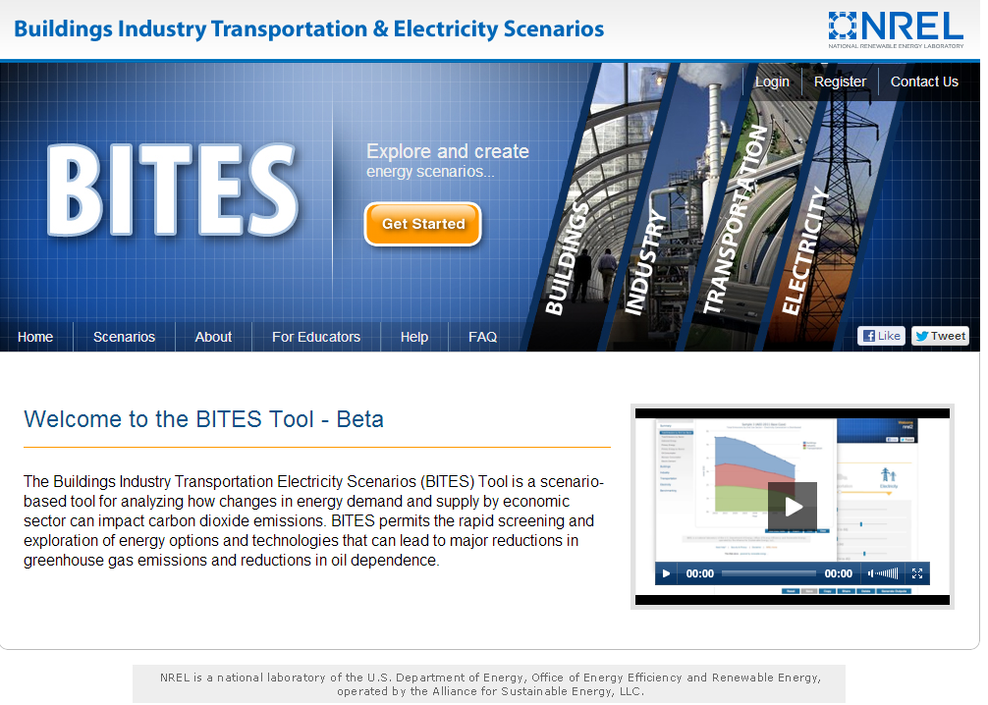

Slide 16
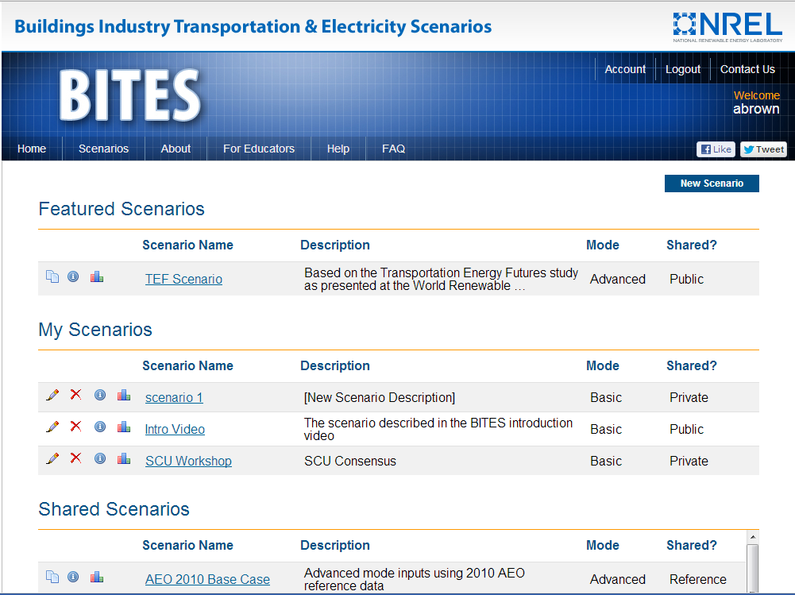

Slide 17
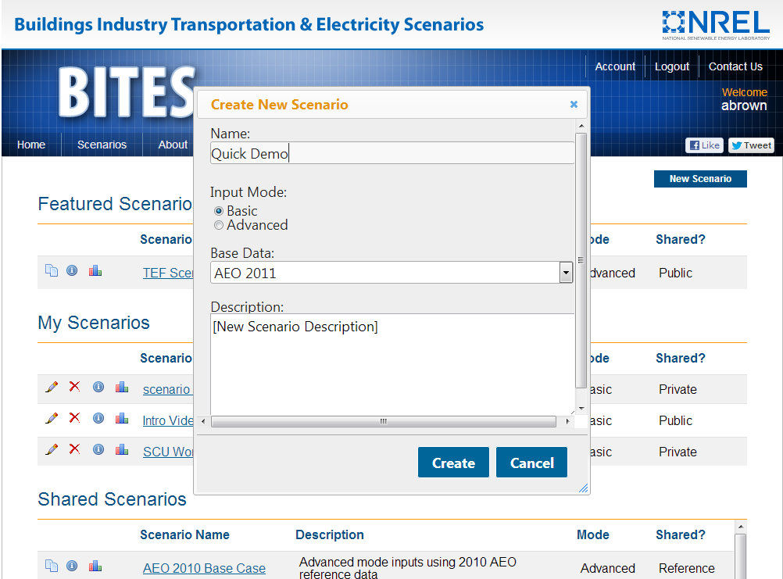

Slide 18
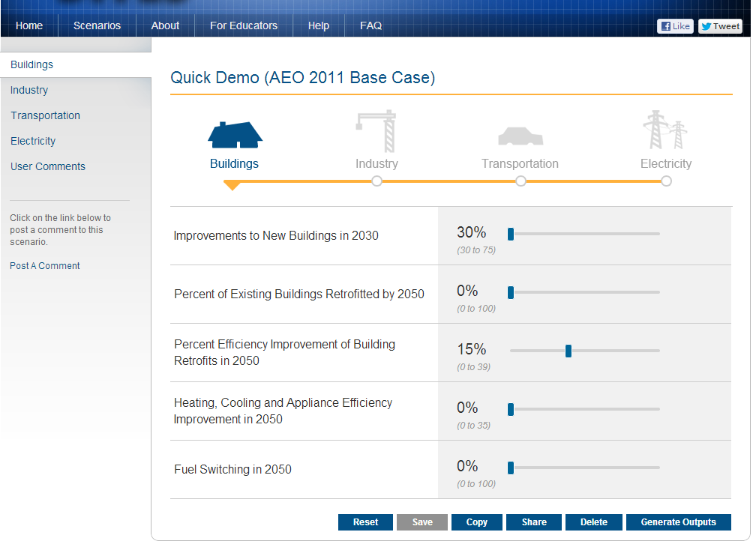

Slide 19
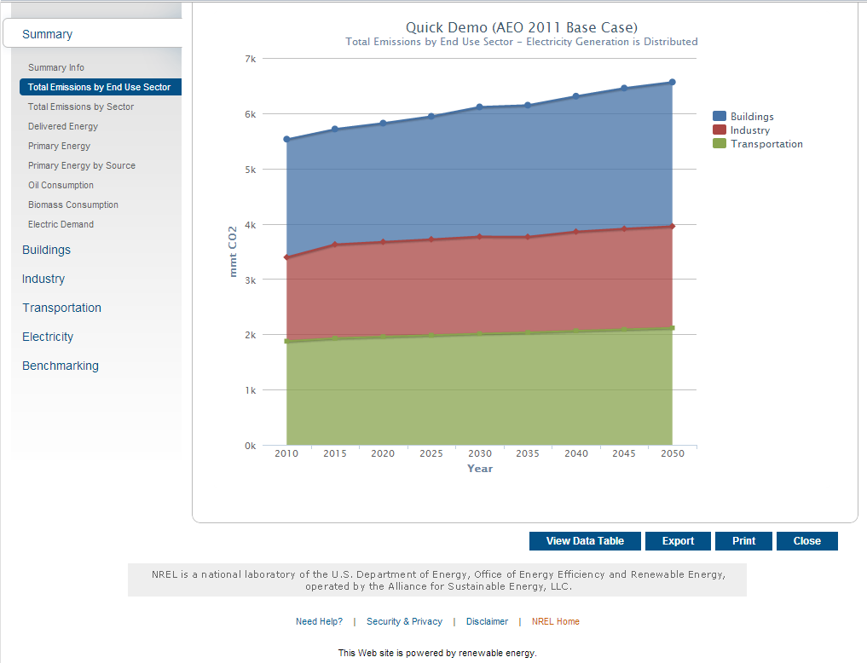

Slide 20
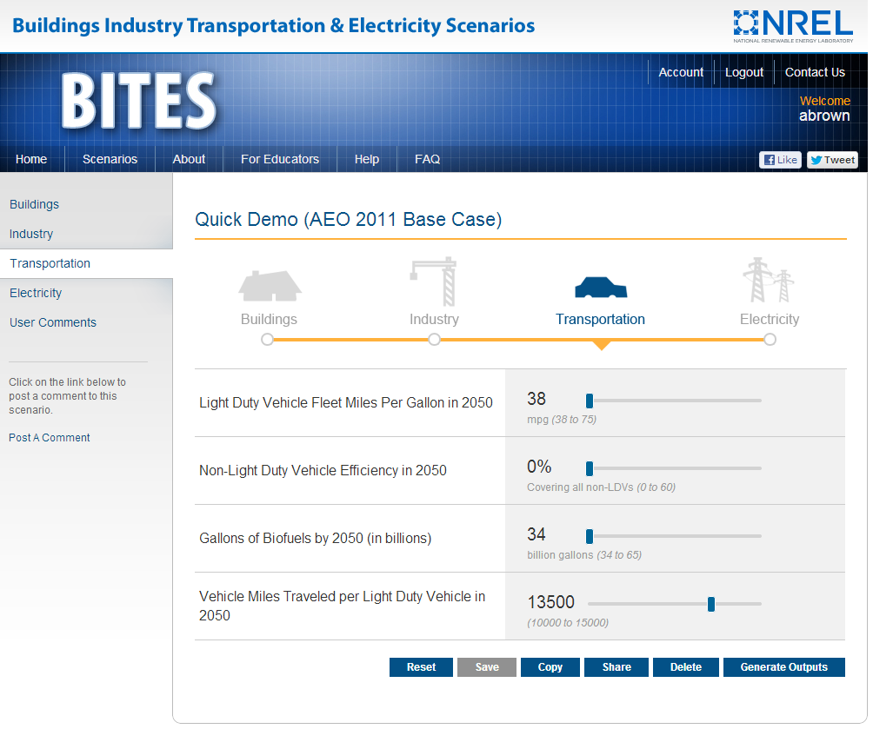

Slide 21
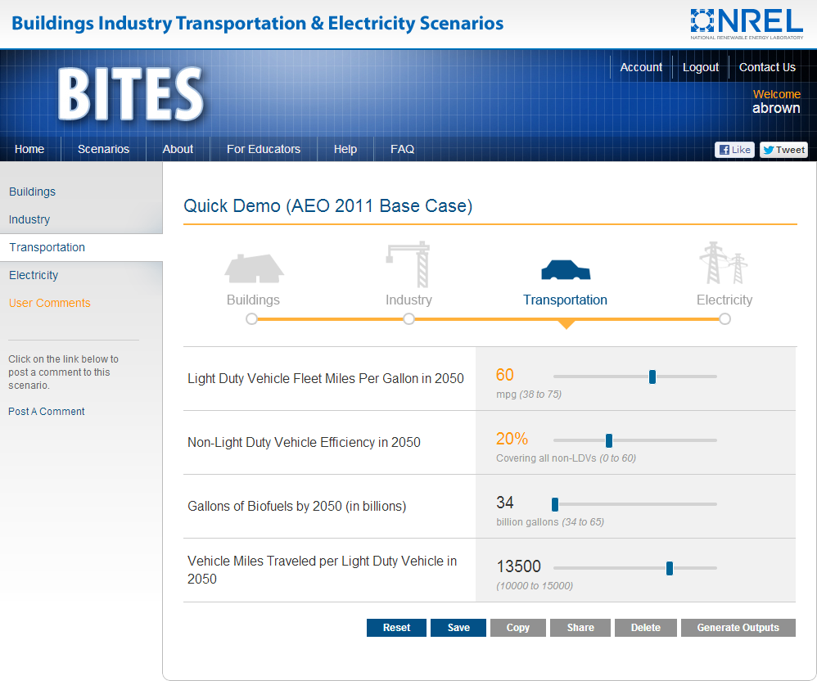

Slide 22
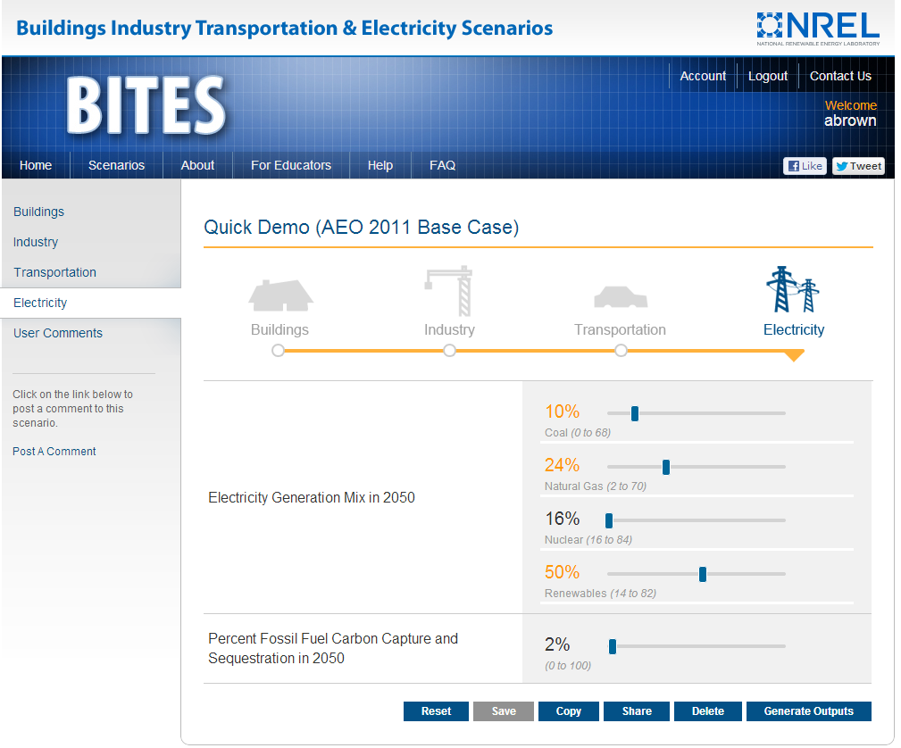

Slide 23
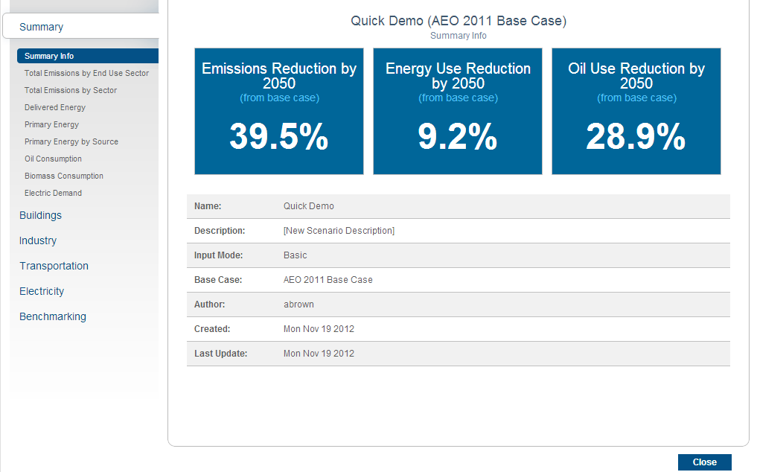

Slide 24
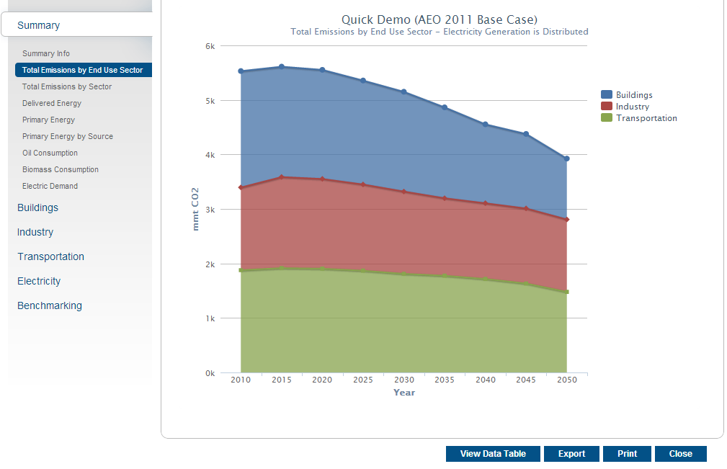

Slide 25
