Slide 1

Déjà vu All Over Again: Comparing Opposition to Evolution and Global Warming
April 23, 2013
CLN Webinar
Eugenie C. Scott, Ph.D.
Executive Director
National Center for Science Education, Inc.
WWW.NCSE.com
Notes:
NCSE is a nonprofit organization founded by scientists and teachers in the early 1980s
A movement called “creation science” was claiming that a Biblical literalist view of creation could be supported by science, and thus should be taught alongside evolution in science classes
Scientists and teachers (and other citizens) united to defeat proposed laws that would require equal time for creation science
NCSE has continued to support teachers, museums, zoos, science centers and even National Park Service personnel who face opposition for the teaching of evolution

Slide 2
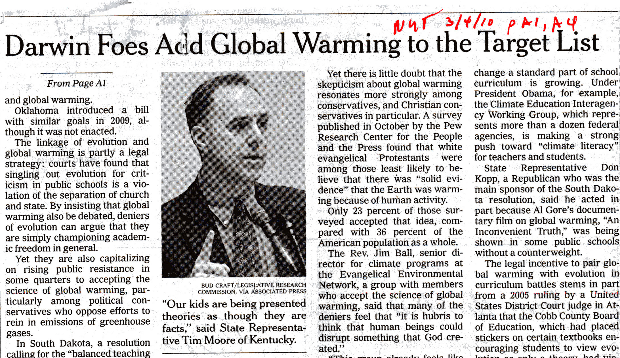
Notes:
A few years ago, NCSE began to notice that in legislation being submitted around the country, evolution was being bundled with GW as topics that teachers should address differently than other subjects in the curriculum
Also often bundled were some other scientific ideas, OOL, stem cells, human cloning
This got us interested in looking at the teaching of Global Warming/Climate change, and we found many parallels to our concerns with the teaching of evolution
Let’s take a quick look at both of these controversies and their general characteristics

Slide 3
Anti-Evolutionism
Creation Science
Notes:
The traditional form of anti-evolutionism is “Creation Science”, a movement that claims not just the truth of a biblical literalist interpretation of Genesis, but scientific support for it
This is a religious view that is not held by the majority of Christians, by the way, but it is a view looked at favorably by conservative Christians, who are a substantial minority of American citizens

Slide 4
Anti-Evolutionism
Creation Science
Intelligent Design
Notes:
The other, somewhat more recent, form of anti-evolutionism is Intelligent Design, which began in the 1980s, rose to some prominence in the late 1990s and early 2000, it has been somewhat on the decline since
However, intelligent design proponents are strongly supporting some of the anti-evolution and anti-global warming legislation that is springing up around the country
Most people at the grassroots to not really distinguish between Creation Science and intelligent design. It is not at all uncommon for someone who believes in a young earth, and that dinosaurs and humans lived together, to identify as a supporter of intelligent design
Leaders of the intelligent design movement, however, try to distinguish their views and their movement from the young earth creationists

Slide 5
  Common Perspectives
It’s not getting warmer
Notes:
Global warming rejection takes several forms [discuss]

Slide 6
  Common Perspectives
It’s not getting warmer
It’s getting warmer, but humans aren’t responsible

Slide 7
  Common Perspectives
It’s not getting warmer
It’s getting warmer, but humans aren’t responsible
It’s getting warmer, we’re responsible, but we can only accommodate rather than prevent disaster
Notes:
Whether GW is anthropogenic is particularly contentious

Slide 8
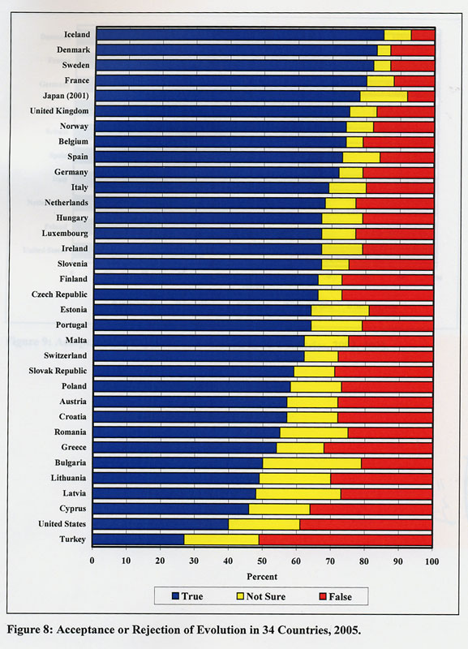
Notes:
Our citizens lag behind those of other nations in both acceptance of evolution and in accepting that that GW is occurring
The US is just above Turkey in a comparison of 34 countries in acceptance of evolution

Slide 9
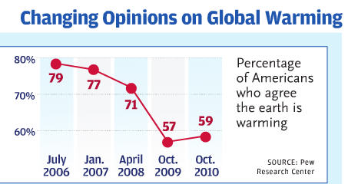
Great Britain, 2012
Planet not warming 7%
Planet warming 87%
Notes:
On the right, British data show 87% accepting global warming, compared to 59% at about the same year (2012 vs 2010)
So clearly something is going on here regarding two sciences: both are accepted by scientists, both have lots of empirical support, both are rejected by a high percentage of Americans – though not rejected by citizens of other countries
So let’s unpack this a bit
The causes of evolution or GW rejection are reflected in the arguments raised against these sciences: 3 pillars, if you will

Slide 10
Pillars of Rejection
Science
Ideology
Culture
Notes:
The first pillar is to challenge the validity of the science – it’s claimed that the science is unsettled or weak,
The second is an ideological pillar – evolution or global warming must be rejected because it is not compatible with some ideological view
And finally, the third pillar reflects cultural values important to American society – fairness and balance, free speech, letting all voices be heard, etc. An application of this in the educational setting is to contend for equal time laws, which was done with creation science in the 1970s and 80s, and is being done today with “Academic Freedom Laws” which promote the teaching of creationism and GW denial in the guise of critical thinking and academic freedom

Slide 11
Pillars of Rejection
Science
Ideology
Culture
Notes:
The cultural pillar reflects similarities in framing and rhetoric used by antievolutionists and GW contrarians to present their views to the public, but also sincere beliefs in the ideological and cultural values being expressed
It is the second and third pillars that provide the motivation for both antievolutionism and GW contrarianism, rather than the allegedly poor science of these fields
Most of the objection springs from what opponents consider negative implications or consequences if the science is correct.
Creationists: if evolution is true (they believe) then there is no God; for GW contrarians, if things are as dire as the other side claims, then we will have to make unacceptable (to them) changes in their way of living, giving up personal freedoms, etc.
Since these positions are unthinkable, the science must be wrong
Let’s start with the first pillar – questioning the science

Slide 12

Questioning the Science
Notes:
Questioning the science is fundamental to denialism, as illustrated by Oreskes and Conway in their book “Merchants of Doubt”
William Jennings Bryan challenged the validity of evolution in the Scopes Trial in 1925
More recently, it was used by the tobacco companies during the decades that public health organizations attempted to demonstrate that smoking caused cancer, addiction, heart disease and other conditions
Tobacco companies claimed that the science is not yet settled on the issue – even well beyond the point where there was a strong scientific consensus that smoking was bad for your health
Their belief was that as long as they could create doubt in the public’s mind about whether or not the science was settled, they could avoid restrictions on their business, such as warning labels, ability to advertise, advertisement to kids, etc.
And of course – in the case of evolution and GW, you are manufacturing a lack of certainty, rather than reflecting one

Slide 13
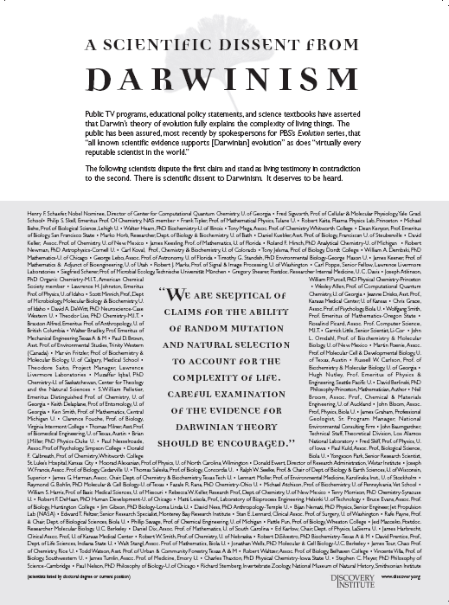
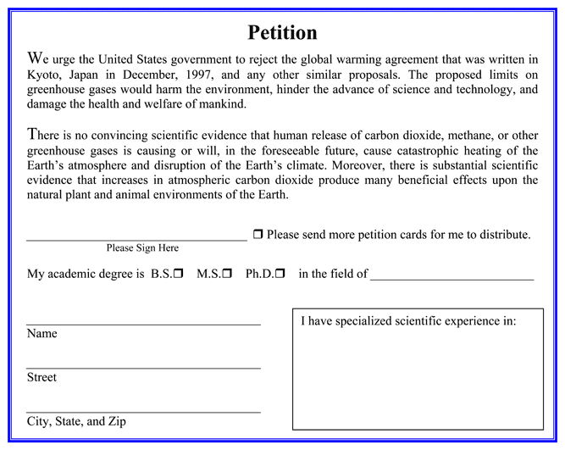
Notes:
One means of challenging the science is to showcase some scientists who deny the consensus
Tobacco companies, creationists, and GW deniers all have used this approach effectively
DI has its list of Scientists doubting Darwinism – somewhat over 800 now
Oregon Institute of Science and Medicine (run by a man named Arthur Robinson and his sons) has an impressive-sounding 30,000 scientists on their equivalent petition
Signatories must have a bachelors degree or higher
However, they are drawn from a fairly random list of sciences including medicine, engineering, veterinary medicine, agriculture, computer science, as well as climate science. About a third, and the largest category (almost 10K) was “general science”. Also are questions as to the validity of many of the signatures
But in any event – even 30,000 scientists is a small fraction of the number of people receiving degrees in science since the 1970s -- .3%

Slide 14
Notes:
And of course the big point to be made to the public about these claims of substantial numbers of scientists doubting either evolution or GW: the number of scientists on the “other side” is miniscule compared to the number accepting either evolution of GW
The public tends to hear the media’s commitment to “balance” – which is presenting all sides of an argument – as meaning both sides have equal weight
Which they don’t, in this case

Slide 15
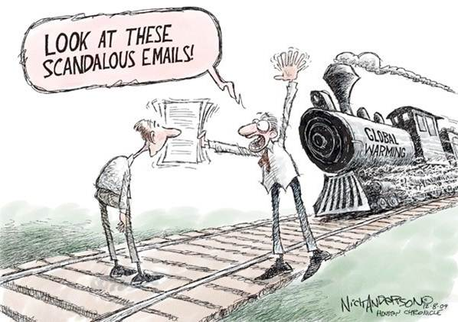
Distraction
Notes:
In addition to suggesting that there are lots of scientists rejecting evolution and GW, these contrarians will also inflate small issues to distract the public from the large amount of data and inference supporting these sciences
Perhaps best example of this for GW is the fuss over leaked University of E. Anglia emails – “climategate”
Scientists talking to one another over a period of several years, using the typical shorthand that people use in email – not realizing that it would be read line by line by opponents
Should climategate arise, it’s useful to note that a half dozen investigative agencies have examined the emails and concluded that there were no fraudulent acts or violations of ethics
Still, this meme continues to poison the public’s view of climate science – and even science as a whole

Slide 16
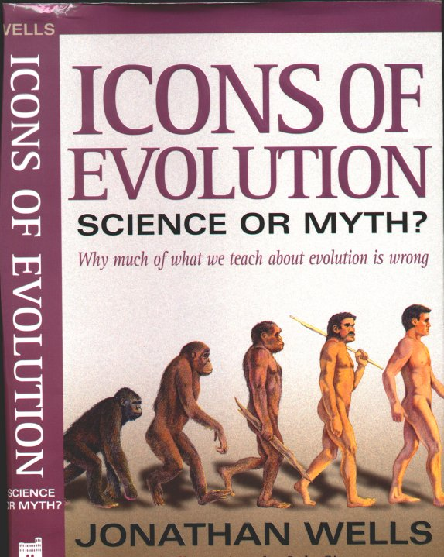
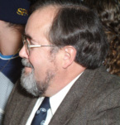
Notes:
For evolution, many good examples of distraction can be found in Jonathan Wells’s “Icons of Evolution”, which attacks the validity of evolution largely by attacking the credibility of scientists, but also the quality of the data

Slide 17
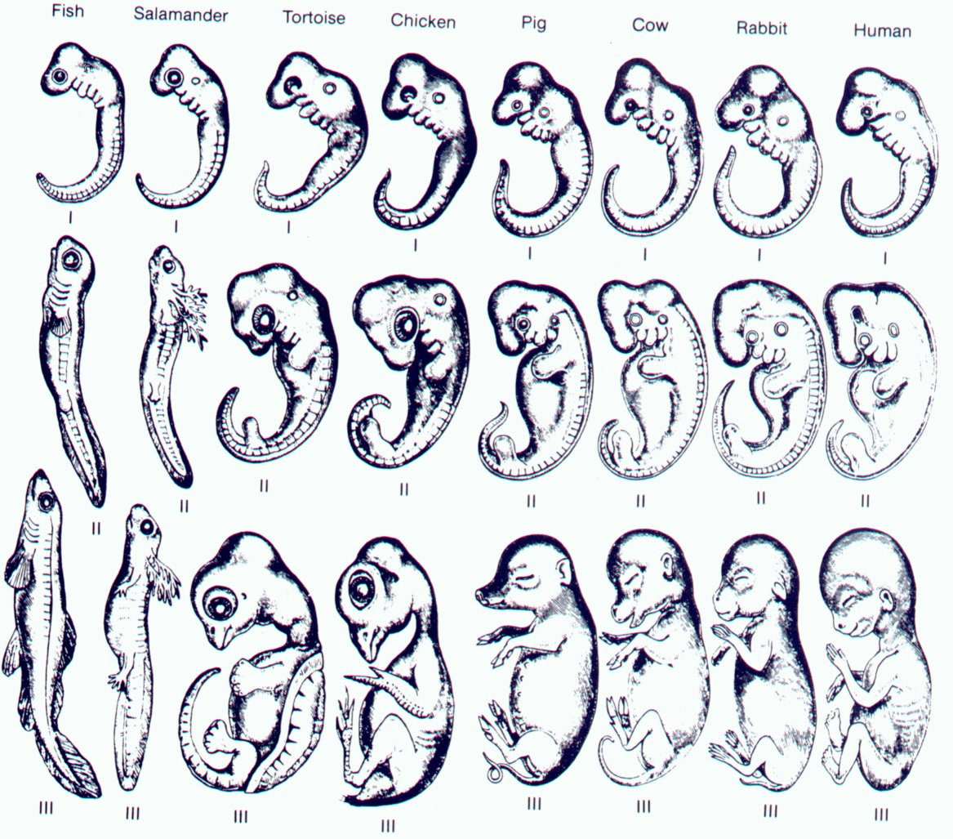
Notes:
One example from Wells is his treatment of the 19th C German embryologist, Ernst Haeckel, whom he accuses of fraudulently mis-drawing his vertebrate embryos to make them accord more to his theories
This isn’t the place to discuss Haeckel, but there is reason to cut him a little slack, given the kind of magnifying equipment available to him in the 19th C
Well’s point is that because Haeckel (allegedly) faked his results, there is no link between developmental biology and evolution – therefore the evidence for evolution is weakened

Slide 18
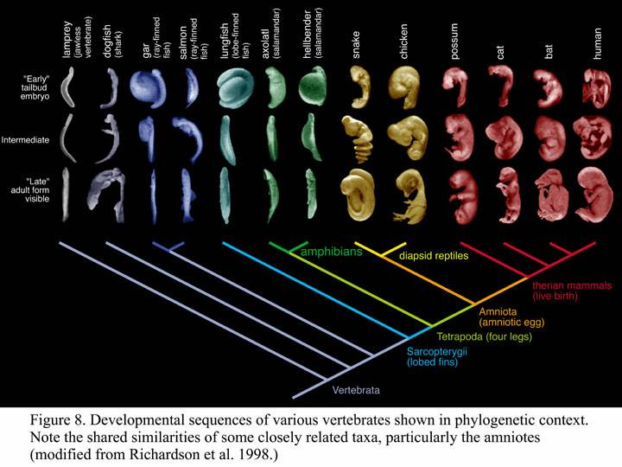
Notes:
Of course, nothing could be farther from the truth: “evo-devo” is the hot biological field these days, and will be for some time to come
And haeckel’s basic point regarding homology of embryos still holds: the more recently two forms shared a common ancestor, the more similar be their embryos

Slide 19
Skeptical Science’s 160+ list of questions and responses
Climate's changed before
It's the sun
It's not bad
There is no consensus
It's cooling
Models are unreliable
Temp record is unreliable
Animals and plants can adapt
It hasn't warmed since 1998
Antarctica is gaining ice
Ice age predicted in the 70s
CO2 lags temperature
We're heading into an ice age
Ocean acidification isn't serious
Hockey stick is broken
Hurricanes aren't linked to global warming
Glaciers are growing
Climate sensitivity is low
Al Gore got it wrong
1934 - hottest year on record
It's cosmic rays
It's freaking cold!....
http://www.skepticalscience.com/
Notes:
Courtesy of Peter Gleick
Of course, climate change contrarians have a long list of what they claim are scientific challenges to especially global warming
And, as with creationism, these claims have been refuted by scientists
A very good place to find thoughtful refutations of the most common of these claims is skepticalscience.com
In any regard, challenging the science is a mainstay of the evolution or CC contrarian arsenal
And a thoughtful response is needed, because too often the enterprise of science is presented as dogmatic and close-minded by these contrarians, and it is a serious matter for this misunderstanding to persist
One way of addressing this misconception, and also helping nonscientists to better understand the enterprise of science, is to remind people that even though scientific conclusions are subject to change, science is still reliable
This is because not everything in science changes the same amount

Slide 20
CORE
Notes:
From physicist James Trefil : A consumer’s Guide to Pseudoscience
The content of science can be viewed as 3 concentric rings
First, there are the core ideas of science – [discuss]

Slide 21
CORE
Frontier
Notes:
Next are the frontier ideas of science….
[discuss]

Slide 22
CORE
Frontier
Fringe
Notes:
Finally, there are the fringe ideas of science
[discuss]
So how does evolution fit into this model?

Slide 23
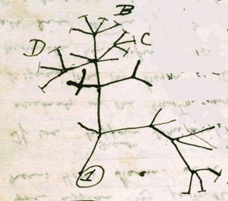
Evolution, Pattern, Process
“Big idea”:
Descent with modification/ common ancestry
Notes:
Biological evolution is a three part idea – big idea, pattern and process
[discuss Big Idea]
Scientists are virtually unanimous that living things have common ancestors

Slide 24
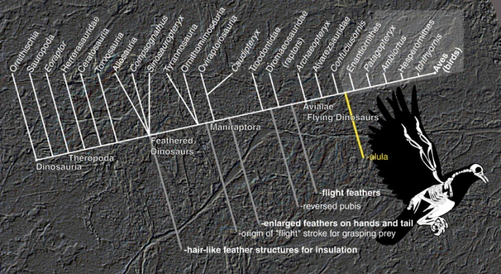
Evolution, Pattern, Process
“Big idea”:
Descent with modification/ common ancestry
Mechanisms or Factors Effecting Evolution:
-natural selection
-non-selective (drift)
-“evo-devo”
Patterns of Evolution:
Notes:
The other parts to the idea of evolution are pattern and process
[discuss]
Where the research is going on and where scientists disagree is over the details of pattern and process
Normal science
Creationists will often seize on the arguments among scientists about the details, and claim that this invalidates the big idea of evolution
In AFA legislation, they often speak of wanting teachers to teach the “S&W” of a topic
The underlying assumption here is that if scientists are debating some detail, then there’s warrant to question the whole enterprise
So if scientists are debating, for example, whether dinosaurs are warm blooded or cold blooded, then the big idea of common ancestry is threatened
This is a category error – scientists aren’t arguing about the big idea, but about the details of pattern and process
So how does this reflect the model of science I am suggesting?

Slide 25
Common
Ancestry
Notes:
Common ancestry is a core idea of science – it is highly unlikely it will change

Slide 26
Common
Ancestry
Pattern & Process
Notes:
The pattern and process components of evolution are the frontier areas – where active research is going on
Some of these ideas will go into the core, some will not

Slide 27
Fringe
Common
Ancestry
Pattern & Process
Notes:
Finally, we have the fringe ideas of evolution (aquatic ape, Raelians) which are rejected because they contradict core ideas of the discipline
Take away here is that debate among scientists about data and theory are not “weaknesses’ of science – it’s normal science
What creationists (and people behind AF bills) want teachers to do is deny the core, attack the frontier, and elevate the fringe to dignity in the classroom
It’s pretty much the same thing with GW

Slide 28
Global Warming
“Big Ideas”:
The planet has been warming
Humans are largely responsible for the current accelerated rate of warming
Notes:
For GW, the big ideas are two: it’s getting warmer, and humans are largely responsible for the current rate changes

Slide 29
Global Warming
“Big Ideas”:
The planet has been warming
Humans are largely responsible for the current accelerated rate of warming
How much will ocean rise, by 2100? 2’ or 6’?
Role of aerosols in cooling?
Role of oceans as heat sink?
How much heating is due to humans?
Etc.
Notes:
*the details of those big ideas are what scientists are debating,
Of course, debate about details is not a “weaknesses” – but normal science
How does this track on the model of science presented here?

Slide 30
It’s warmer.
Rate = humans
Notes:
That the planet is getting warmer is a core idea of science – scientists not debating this, it’s not likely to change; the science is solid
Also are not debating that the current rate of increase of warming since the Industrial Rev is due to human use of fossil fuels and results of increasing warming gasses like CO2 and methane into the atmosphere

Slide 31
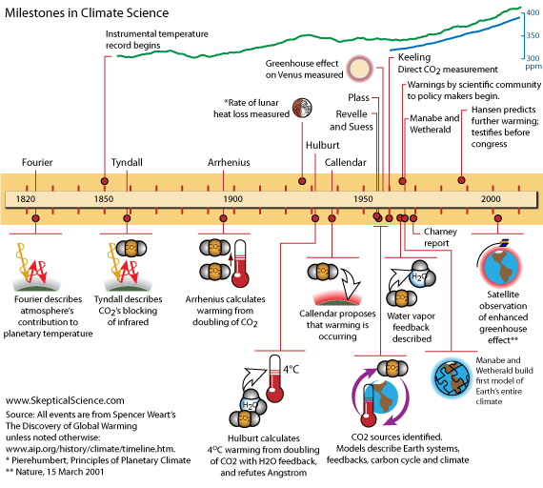
Notes:
That the planet is getting warmer is a science with a long history -- it wasn’t just invented by Al Gore
It’s almost as old as evolution

Slide 32
It’s warmer
Rate = humans
Details (how
much rise )
Notes:
The frontier areas – the details of climate science
where active research is going on – are areas of legitimate debate
Science is not dogmatic – but some parts of science (the core ideas) change very little, and should be recognized as such

Slide 33
“it’s just a socialist/liberal plot”
It’s warmer
Rate = humans
Fringe
Details(how
much rise )
Notes:
Finally, we have the fringe ideas of global warming which we do not encourage teachers to spend much time on, as there is little enough time to spend on teaching real science.
What GW contrarians (and people behind AF bills) want teachers to do is deny the core, attack the frontier, and elevate the fringe to dignity in the classroom
In any case, it is bad science, and bad educational policy

Slide 34
Pillars of Rejection
Science
Ideology
Culture
Notes:
Let’s move on to the ideology pillar, because it is a significant motivation for both anti-GW and anti-evolution movements, and the key to understanding where they are coming from

Slide 35
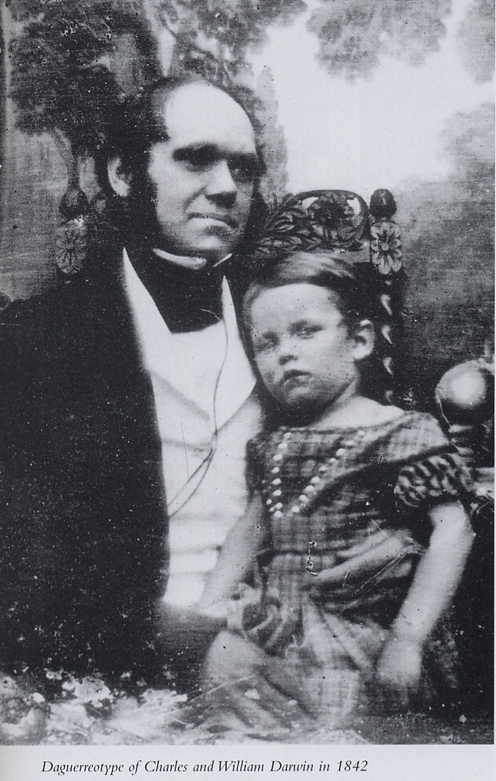
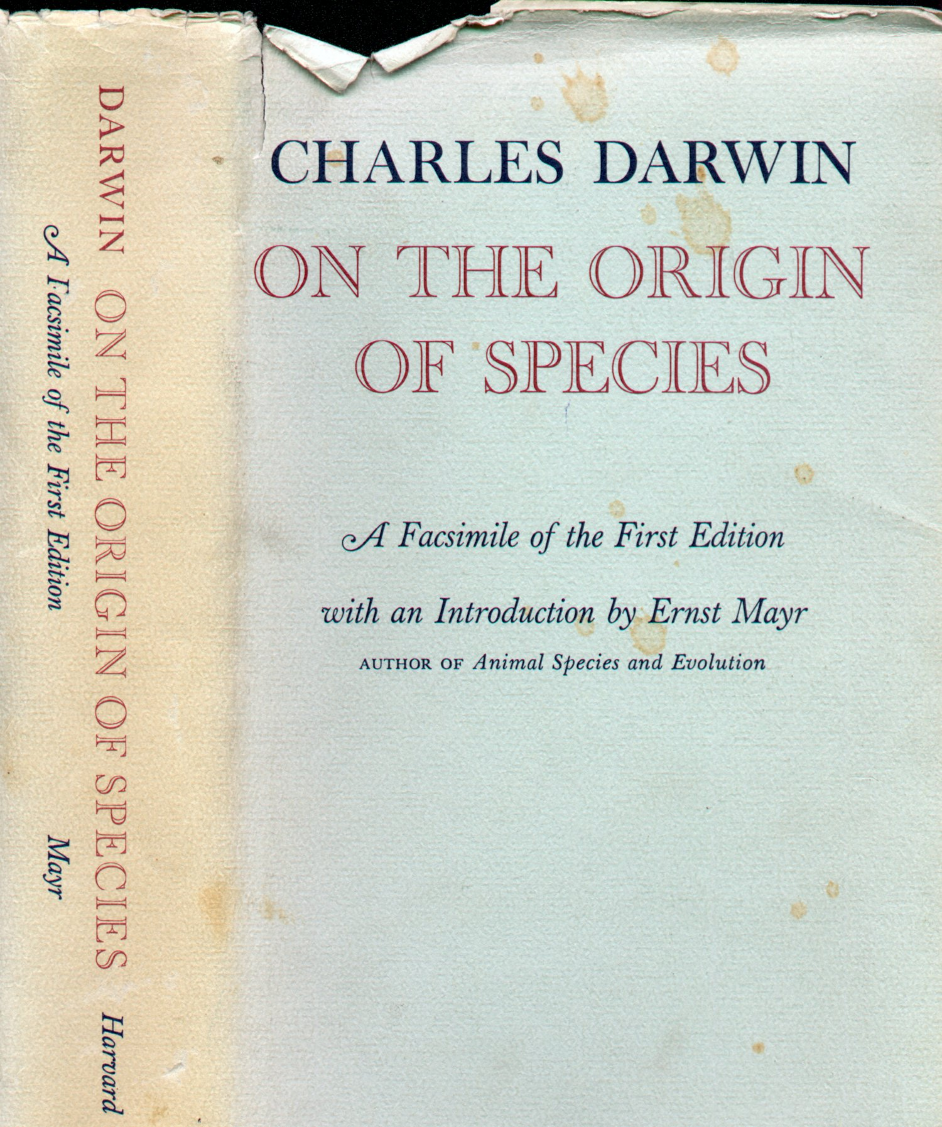
Notes:
Creationists object to evolution for religious reasons – and indeed, evolution has serious implications for some forms of Christian theology
In On the Origin of Species, Darwin made two points (though he said it was “one big idea!”)

Slide 36
Religious Implications of Evolution
Evolution Happened
Challenged Special Creation (literal view of Bible)
Notes:
First, that living things had descended with modification from common ancestors – and he supported it so well that there was almost universal acceptance of it in science within a couple of decades
This inference, however, was a direct challenge to the theological view of Special Creationism, held by many, but not all Christians
Today, of course, is not dominant Christian theology, being rejected by Catholics and mainstream Protestants in favor of TE
But there are many Xians today who reject evolution because it is, indeed, incompatible with special creationism

Slide 37
Religious Implications of Evolution
Evolution Happened
Challenged Special Creation (literal view of Bible)
Natural Selection Explains It
Challenged direct hand of God as Creator (God less personal)
Notes:
Darwin’s second point was the natural selection mechanism, and this had a couple of additional problems for Christians
It was a natural law that explained design, which suggested that God worked through natural law not just in making the planets go around the Sun, which Newton had proposed when he proposed that God created gravitation
-but that God worked through natural law when it came to living things, and humans
To many Christians in Darwin’s day and today, this is a bridge too far: God is pushed back from being the direct actor in creation, and therefore is less active in the world, and less personal
There is also the problem of theodicy, or the existence of evil – natural selection didn’t invent the problem of evil, but it exacerbated it
Why would a benevolent God create diversity of life through such a wasteful, painful process? So it was the implications of evolution by natural selection that turned off many Christians more than the science itself
And it is the implications of evolution and its incompatability with certain versions of Christianity that motivate the creationist movement

Slide 38
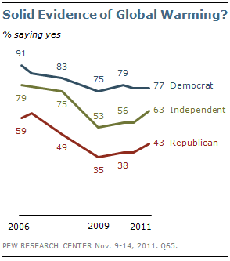
Notes:
What about climate change? Here we have a strong indication that political ideology is a strong motivator
These data are from the Pew foundation, and they show sharp contracts among adherents to different political ideologies
But where does religion come in? Or does it?

Slide 39
Religious
Right
Political
Conservatives
Religious
Conservatives
Notes:
Let’s clear up some confusion between political and religious conservatism
Religious conservatives hold certain religious views.
-- inerrancy of the Bible and a personal relationship with Jesus for salvation
They are evangelicals, fundamentalists, charismatics, other terms – they prefer “conservative Christians”
Political conservatives: confidence in capitalism as an economic system, opposition to taxation, belief in minimal government, elevate individuality and personal liberty to a high state, combined with confidence in the American myth of the potential for everyone to succeed based on their own efforts,
Not all religious conservatives are political conservatives: some of most energetic workers for the poor and disadvantaged are evangelicals
Not all political conservatives are religious conservatives, obviously
Intersection is known as the religious right
This diagram is relevant to both of the controversies I’m talking about today

Slide 40
Anti-Evolutionists
Religious
Right
Political
Conservatives
Religious
Conservatives
Notes:
Antievolutionists reliably include the RR, but not all religious conservatives are antievolutionists – we have some powerful allies among evangelicals in promoting acceptance of evolution
Not all political conservatives are antievolutionists – many political conservatives readily accept evolution because they belong to denominations that are not biblically literalist
But the reason for antievolutionism among members of the RR is because they ALSO are religious conservatives
With antievolutionism, we’re picking up those political conservatives who also are religious conservatives,
Rather than picking up political conservatives per se
What’s the situation with GW? Here also there is an ideological foundation, although not primarily a religious one

Slide 41
Global Warming Contrarians
Religious
Right
Religious
Conservatives
Political
Conservatives
Notes:
With GW, the RR again are reliably GW contrarians
And most political conservatives are usually anti-GW as well
But there is not necessarily a close association betw religious conservatism and anti-GW
There is a substantial group of “green Christians” who are environmentalists
They favor Creation Care, or Stewardship Theology, rather than Dominion theology
And they are outside of the anti-GW movement
So ideologically, GW contrarians are politically conservative, rather than religiously conservative, per se
There is, however, a small slice of the GW contrarians who believe the way they do for religious reasons: they believe that God will not let anything bad happen to His creation,
and/or they believe efforts of humans are so puny next to the might of God (who sent the Flood of Noah, after all) that to think that anthropogenic GW would produce problems for the Earth is overweening hubris
But the primary motivation for those who object to GW is political conservatism

Slide 42
Global Warming Contrarians -2
Political
Liberals
Libertarians
Political
Conservatives
Notes:
There is one additional component to the composition of GW contrarians, and this is an economic ideology: Libertarian economics
Libertarians are a somewhat odd group politically, as they share some interests with political liberals and some with political conservatives
Like conservatives, they are strongly anti-Big Government (there’s a strong libertarian streak in the Tea Party) and strongly support individual self-reliance
Among the Ayn Rand Objectivism group of libertarians, this latter tendency almost borders on social Darwinism -- the idea of a governmental safety net is anathema: social services of all kinds, schools, roads – everything but police and the military – should be privatized
But like political liberals, they value personal autonomy, and so support such things as legalization of marijuana, abortion rights, gay marriage, and the like
The key characteristic of libertarianism, however, is what George Soros has called, “free market fundamentalism”, where there is great confidence in the power of the free market – laissez faire capitalism, essentially – to solve all economic and social issues
Many libertarians object to GW because they believe it to be a socialist attack on capitalism
As do political conservatives, they strongly object to cap and trade or carbon tax policies, or any restraints (economic, tax, etc) on the carbon-producing industries, oil, coal, and gas, in the interest of letting the free market do its thing
So there are indeed many ideological motivations for rejecting the idea of climate change – religious, political, and economic, with the religiously-motivated the smallest part of this movement
None of these communities are monolithic: not the religion, political, or economic ideological communities

Slide 43
Source: Pew Religious Landscape Survey, 2008
Notes:
Looking at religion: overwhelmingly, most of Americans are religious, and most of them are Christians
But not all Christians agree on the same theology

Slide 44
Source: data from Pew Religious Landscape Survey, 2008
Notes:
Look at the blue in this chart
Conservative Christians comprise about 40% of American Christians
With the caveat that it is difficult to estimate the subdivisions of American Christianity – terms like “evangelical”, “fundamentalist”, “born again” are not used consistently among Christians and certainly not among nonChristians
-but it is among conservative Christians where you will find antievolutionism, with much less of it being found in the other 46%

Slide 45

Statements from Religious Organizations
American Jewish Congress
American Scientific Affiliation
Center For Theology And The Natural Sciences
Central Conference Of American Rabbis
Episcopal Bishop Of Atlanta, Pastoral Letter
General Assembly of the Presbyterian Church (USA) (2002) *
The General Convention Of The Episcopal Church
Lexington Alliance Of Religious Leaders
The Lutheran World Federation
Roman Catholic Church (1981)
Roman Catholic Church (1996) *
Unitarian Universalist Association (1977)
Unitarian Universalist Association (1982)
United Church Board For Homeland Ministries
United Methodist Church
United Presbyterian Church In The U.S.A. (1982)
United Presbyterian Church In The U.S.A. (1983)
Notes:
{discuss}
So there is variation within the Christian community regarding evolution
Similarly, there is variation within the conservative political community regarding global warming

Slide 46
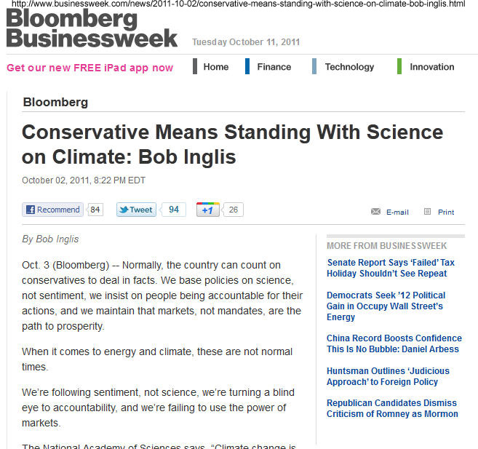
Political Conservatism:
Not Monolithic!
When it comes to energy and climate… [w]e’re following sentiment, not science, we’re turning a blind eye to accountability, and we’re failing to use the power of markets.
Notes:
There are Republicans who believe in following the science, as former South Carolina Republican Bob Englis noted in an October 2011 Businessweek article
“When it comes to energy and climate… [w]e’re following sentiment, not science, we’re turning a blind eye to accountability, and we’re failing to use the power of markets.”

Slide 47
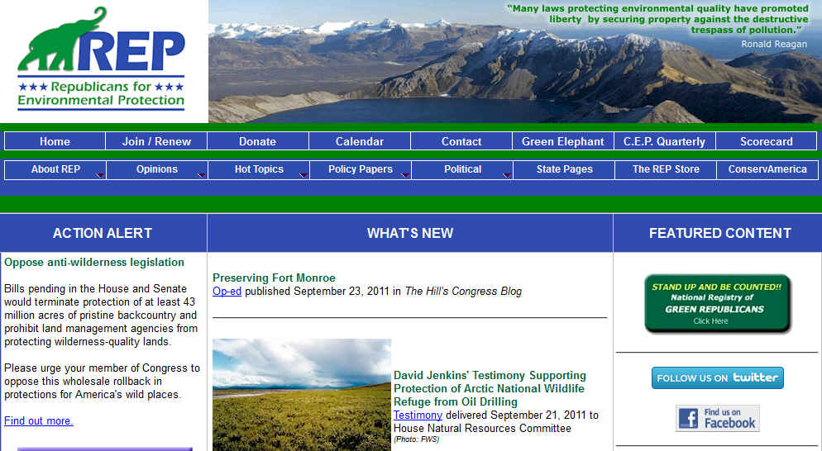
Political Conservatism:
Not Monolithic!
Notes:
Republicans for Environmental Protection
Quoting George Schultz, Ronald Reagan, other prominent Republicans
Note the “National Registry of Green Republicans” – may their tribe increase!
Point here is that it is dangerous to indulge in dichotomous thinking: that all Christians reject evolution
Or that all Republicans and libertarians reject climate change
There is variation in each of these motivating camps, and it can be utilized by those of us who want to encourage acceptance of these sciences

Slide 48

Notes:
Our goal is to get people to listen to the science, and they can’t, if they have their fingers jammed in their ears
What keeps the fingers jammed in the ears is the belief that something very important is going to be lost if the other guy is right
For creationists: they have to give up their belief in God, and in salvation, and in the truth of the Bible
For GW contrarians: GW “alarmists” will weaken the economy, harm national security, and require compromises in individual liberty
If those concerns aren’t assuaged, all the science in the world won’t be convincing

Slide 49

Notes:
But if you can demonstrate that there are ways to retain some of those important ideological positions, THEN you have a chance of getting the science listened to
And that’s pretty important
Most of us believe that education is important, and that people should know and understand science
Ideological positions can get in the way of even the most persuasive scientific evidence

Slide 50
Pillars of Rejection
Science
Ideology
Culture
Notes:
Finally, I want to talk a bit about the cultural pillar
Arguably, it is the most effective pillar the creationists and the GW contrarians have
The cultural pillar relies on values that are shared with the people the creationists and the contrarians are trying to reach
Some of them differ, such as the creationists’ emphasis on biblical literalism and the contrarians’ emphasis on free market solutions
But I want to talk about the ones used in an educational context – how creationists and GW contrarians frame their position when they are trying to influence educational policy
In this context, the most popular of the cultural arguments are the ones stressing fairness, academic freedom, and critical thinking
This brings us to the recent spate of “Academic Freedom Act” legislation

Slide 51
“Academic Freedom” Legislation
Alabama 2004, 2005, 2006, 2008, 2009
Florida 2008, 2011 New Mexico 2009, 2011
Louisiana 2008 Maryland 2006
Michigan 2006, 2008 Texas 2009, 2011
S. Carolina 2008, 2010 Kentucky 2010, 2011
Missouri 2007, 2008, 2009, 2010, 2011, 2012, 2013
Oklahoma 2006, 2009, 2011, 2012, 2013
Iowa 2009 Indiana 2013
Tennessee 2011, 2012 Arizona 2013
Colorado 2013
Montana 2013
www.ncse.com
Notes:
These AF laws began in 2004 as creationist enthusiasm, but by the end of the decade we began to see evolution bundled with other “controversial” scientific views
In these laws, teachers are directed to compromise the teaching of evolution, GW, origin of life, human cloning, and/or embryonic stem cells
This slide shows only a sample: there have been at least 50 of these proposed

Slide 52
Pillar 3: Fairness & Critical Thinking
“full range of views”
“critically evaluate” the “strengths and weaknesses”
“arguments for or against”
“all relevant scientific information”
“understand, critique and review”
Notes:
Bills all sound very reasonable to most people, since they are calling for students to work harder, become critical thinkers, etc
And why not present information for and against a scientific theory? Isn’t that exactly what scientists do?
Yes – that’s what SCIENTISTS do; it isn’t what 10th graders do
Antievolutionists and anti GW proponents blur this important distinction between the role of a student and the role of a scientist
10th graders aren’t scientists – the goal of a secondary school education is rather different from that of a research scientist
A student is getting the basics of the scientific discipline –optics, not string theory
Students get the core ideas of science, and carefully selected frontier ideas, when there is time
They should not be taught the fringe ideas as if they were acceptable science
So the lines are blurred, but in ways that reflect American cultural values of freedom of thought and freedom of expression

Slide 53
Pillar 3: Fairness & Critical Thinking
The goal should be to get politics out of the classroom, not protect it by banning debate and censoring objective sources of research.
Joe Bast, http://blog.heartland.org/2011/08/heartland-replies-to-science/, Aug. 10, 2011
Notes:
Mr. Bast from the Heartland Institute has weighed in on this, though a bit polemically
Note the implication that teaching only GW and not contrarian positions is censoring, banning debate, infringing on the academic freedom of teachers, etc – all very negative images
A common meme in both creationism and GW contrarianism is persecution of the person who stands against the scientific establishment
Such views also do not communicate an important fact about the content of science – those explanations come out of a process of peer review and constant evaluation – which does not take place in the science classroom, but in the laboratories, scientific conferences, and journals
Science has an important criterion that goes beyond free speech: you explanation has to work, not merely be expressed

Slide 54

From AFA site: www.academicfreedomact.org/
Notes:
These bills are couched in terms that most Americans would find very attractive – I do!
Sure you want kids to be critical thinkers! We want them to be able to take information, evaluate it, and come to a conclusion!
But we also want them taught the basics, and to miseducate them, to give them a lot of wrong, fringe information in the guise of teaching them critical thinking does them no favors

Slide 55
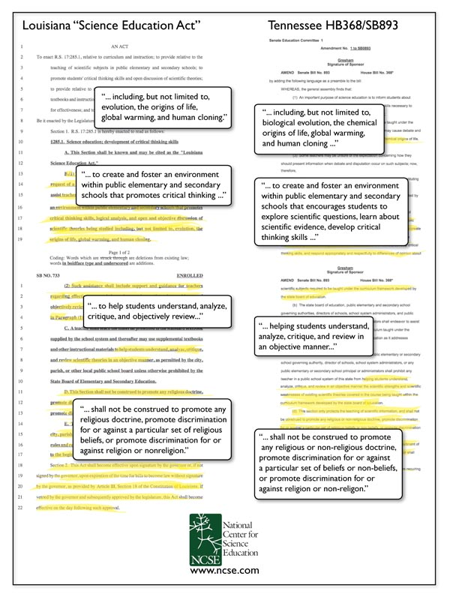
Notes:
Two of these AFA bills have passed, unfortunately – in Louisiana and Tennessee
And they are quite similar, reflecting a similar origin
Both bundle evol, OOL, GW, cloning
Both are couched in terms of critical thinking
Both encourage teachers to critique evolution and the other subjects
Both have an obligatory statement that they are not intended to promote religion (to try to duck the first amendment)
TN bill in addition is protective – brought over from the descendants of the Alabama bill, as influenced by the Discovery institute
Lot easier to stop these bills in committee than to deal with them after they have passed

Slide 56
Summary: AFA
Avoid religion (Establishment Clause)
Stress free speech (academic freedom)
Stress critical thinking
Protective bills – teacher license to teach “alternatives/EAE”
Permissive bills – as applied vs facial challenges
Notes:
[critical thinking – everyone is in favor

Slide 57
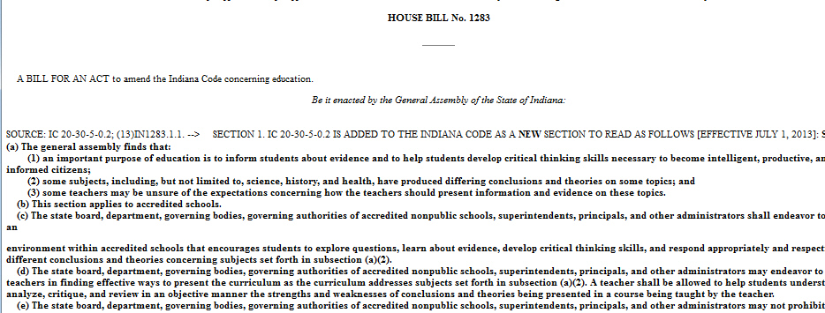
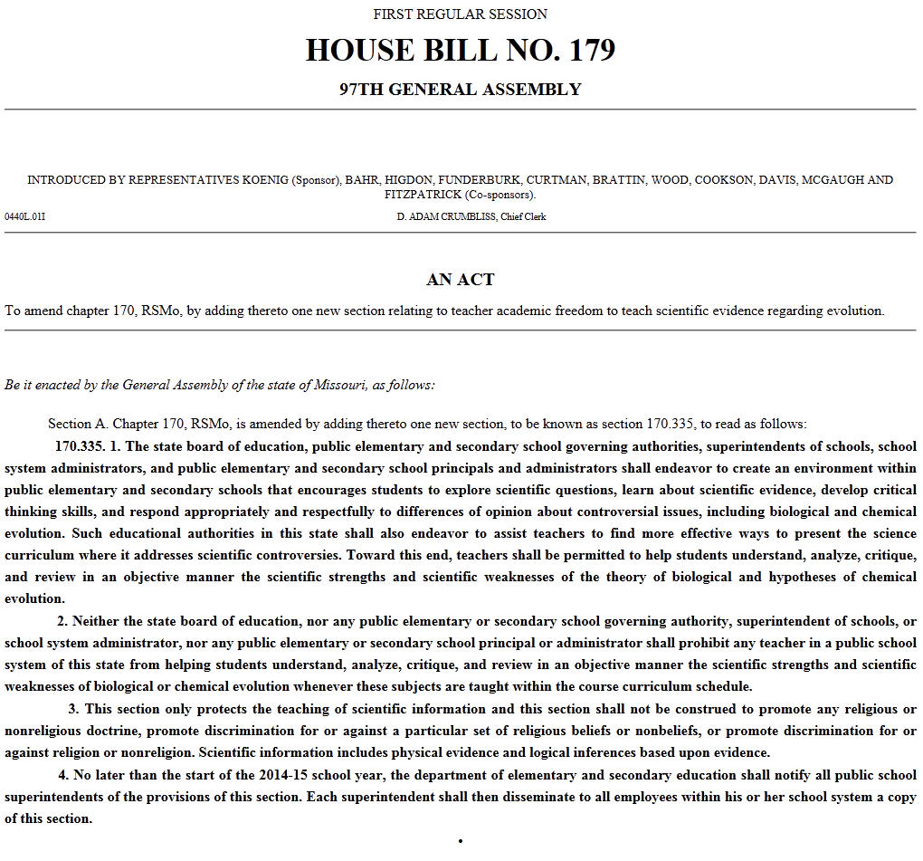
Anti-Science legislation in 2013
www.NCSE.com
MO HB 179*
MO HB 291
CO 13-1089*
MT HB 183*
OK SB 758
OK HB 1674*
IN HB 1283*
TX HB 285
AZ SB1213*
Notes:
This year there have been 9 bills in 7 states that were either antievolution, anti—GW, or both
Asterisks indicate AFA bills
We suspect now that LA and TN have shown the way, there will be more attempts to get such bills passed – the DI is industriously working to persuade conservative legislators to pass AFA bills
Changes are, you’ll be seeing more anti-GW sentiment generated as a result of these bills, whether they pass or not
It’s important that the CC community address this issue, which is not just a CC issue, but one of science literacy.

Slide 58
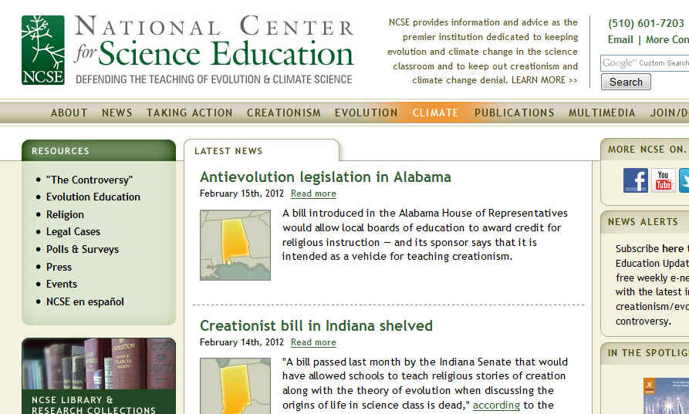
www.ncse.com

Slide 59
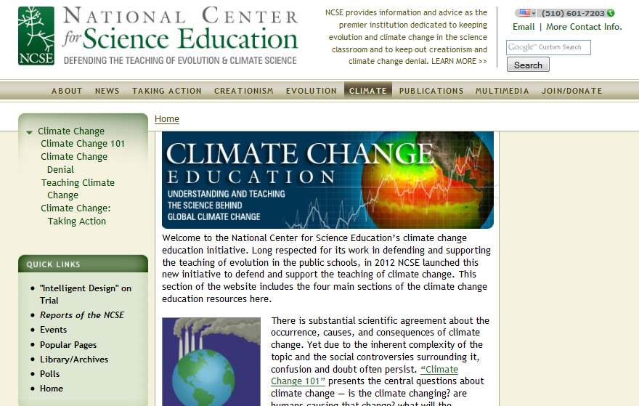
www.ncse.com

Slide 60
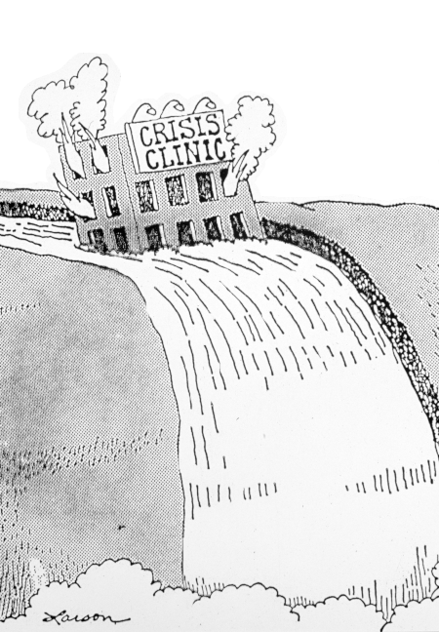




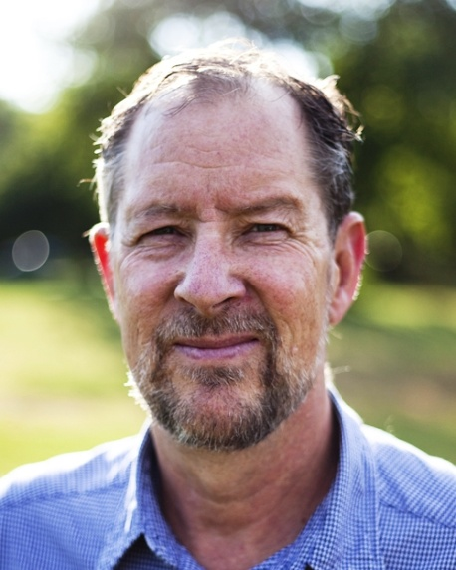

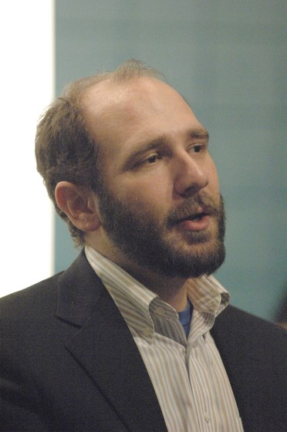
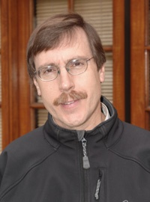


www.NCSE.com
Crisis center
Notes:
Glenn Branch, Deputy Director, Robert Luhn (Comm); Peter Hess (religious community Outreach),
Flareups wranglers: Josh Rosenau, Steve Newton, education director Eric Meikle – and our two new climate change specialists, Mark McCaffrey, and Minda Berbeco

Slide 61
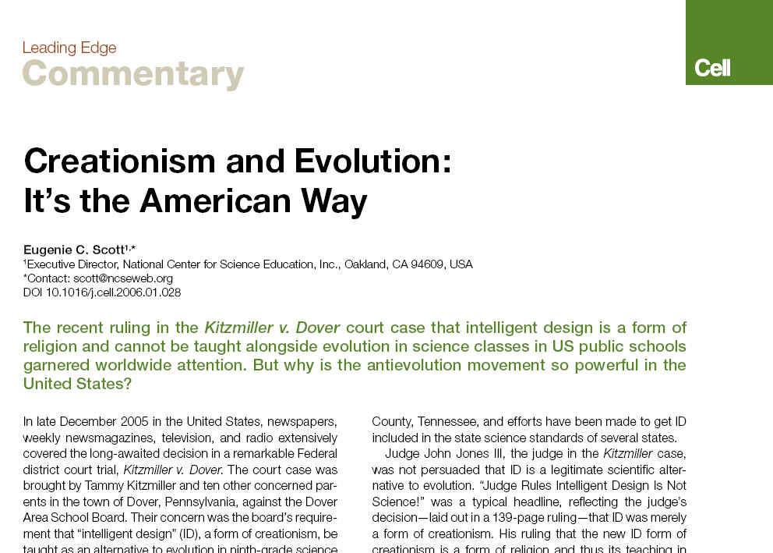
Cell 124:449-451. (Feb 10, 2006)

Slide 62
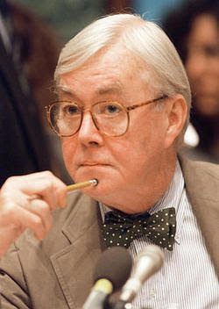
“Everyone is entitled to his own opinion, but not his own facts”.
Daniel Patrick Moynihan
Notes:
Daniel patrick Moynihan’s adage is good to remember – opinions and facts are different
Your visitors are free to hold their own opinions of climate change of evolution, but the science of both is strong
And it is the science and other valid scholarship that you are responsible for teaching

